Slide 1
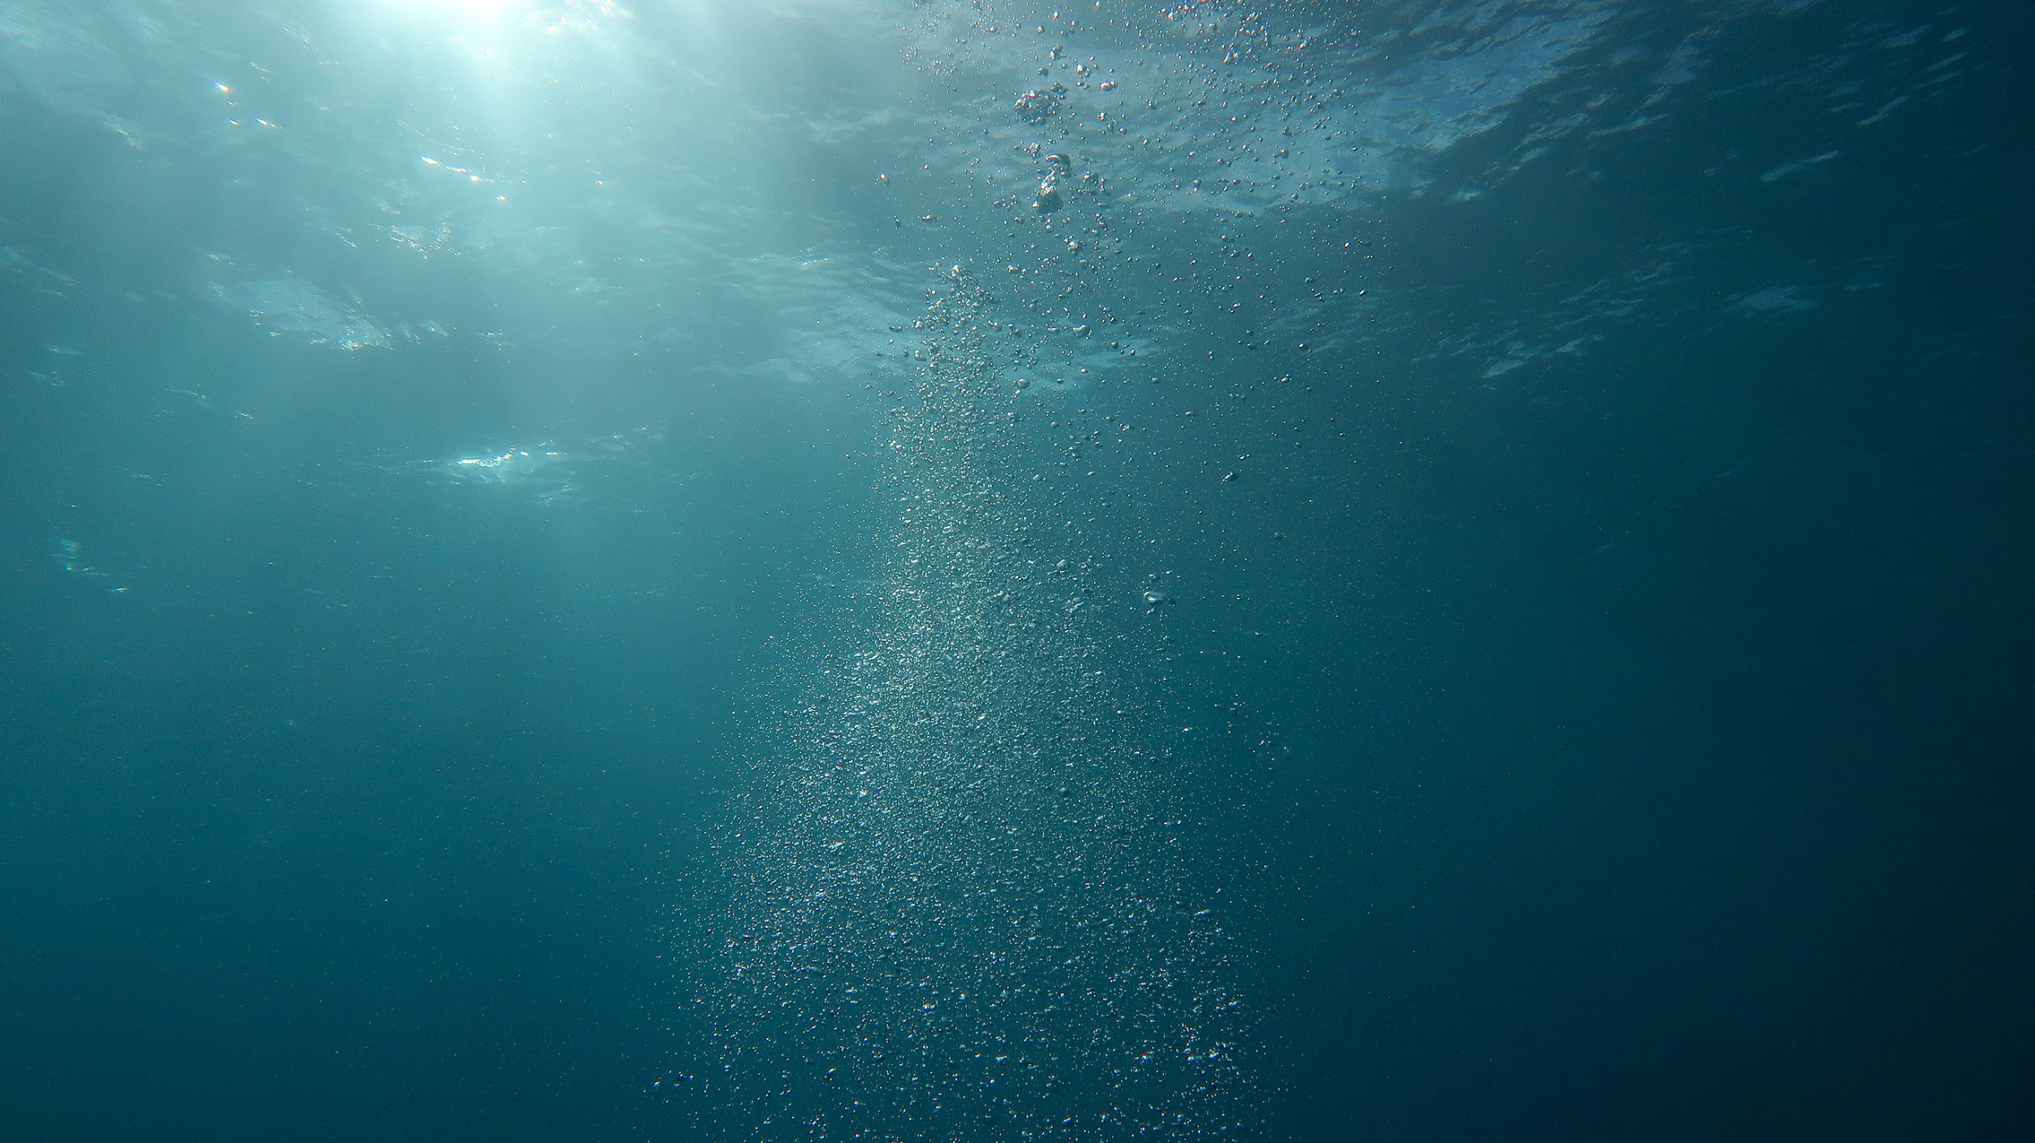

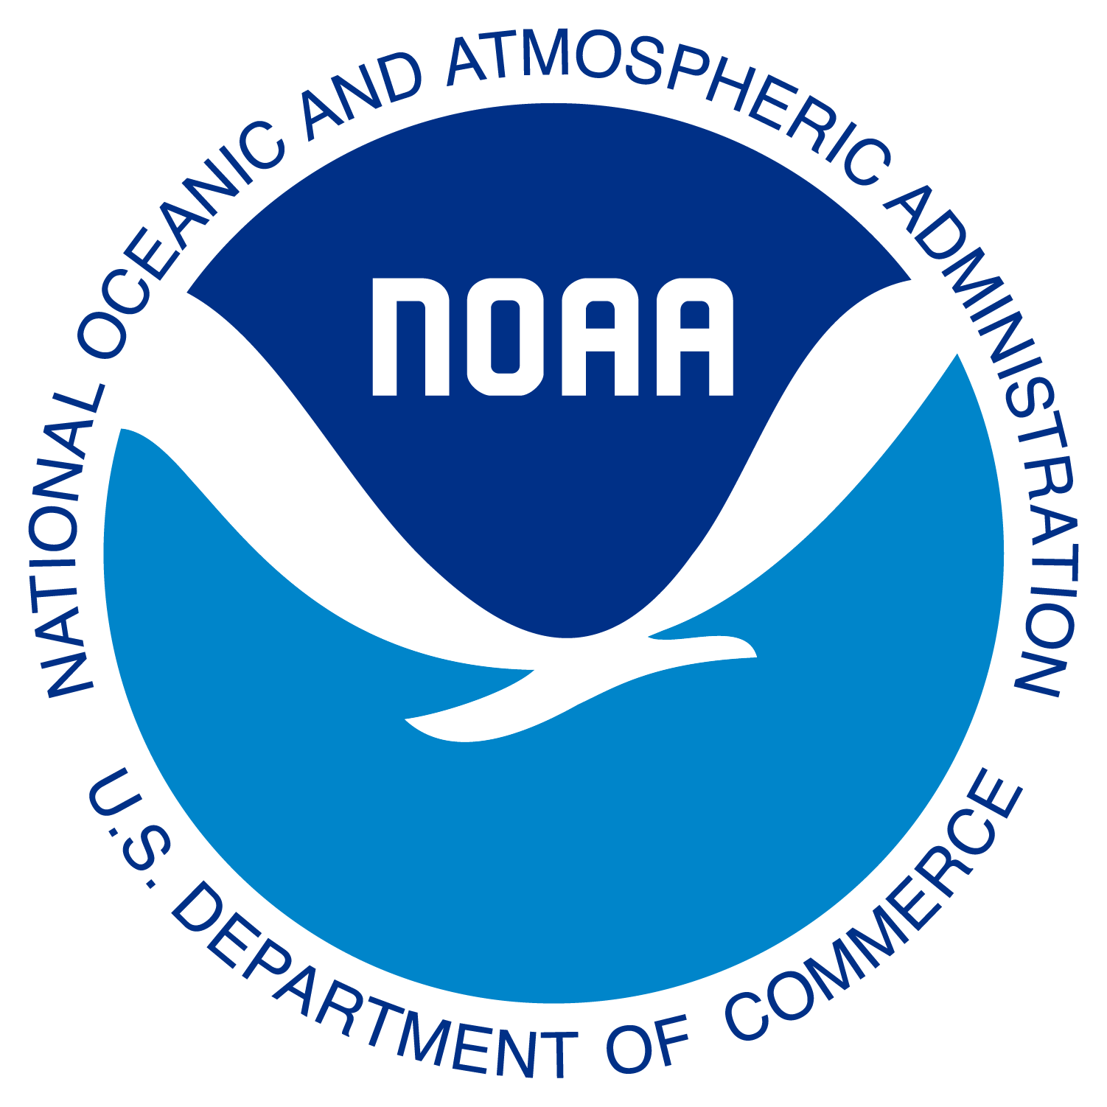
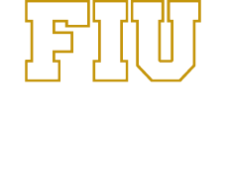

Microplastics
Microplastics
What they are and why they matter

Slide 2
Workshop Goals
Microplastics
  What microplastics are and why they are in the environment.
  How they affect ecosystem and human health.
By the end of the workshop participants will understand:

Slide 3
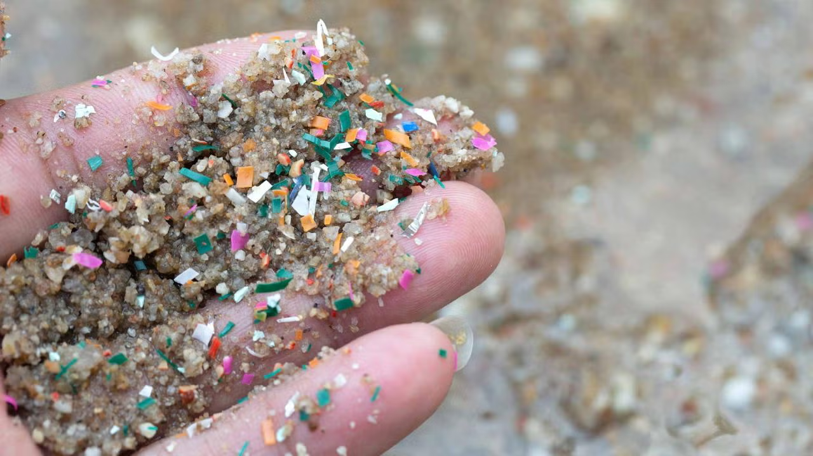
Agenda
Microplastics
Agenda
  Introduction of Presenters & Group Norms
  Introduction to Microplastics
  Sources and Impacts of Microplastics
  Interactive Activity
Chrobak 2024

Slide 4
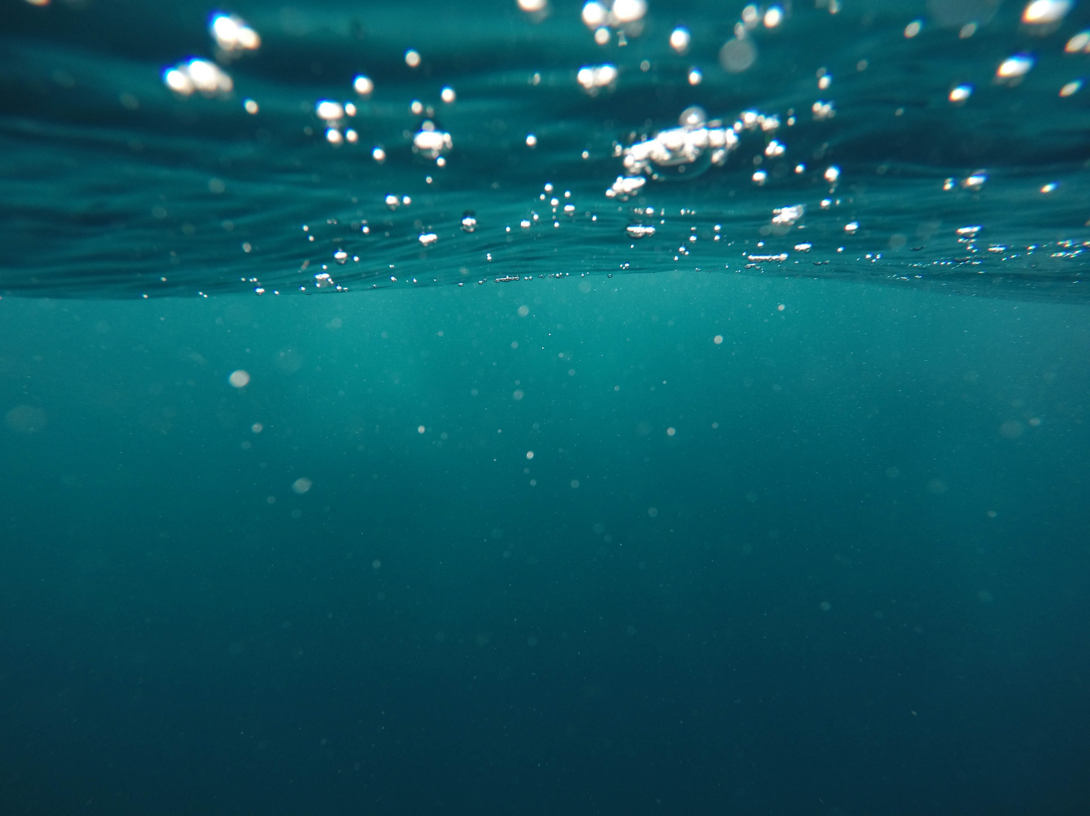
Group Norms
Microplastics
Group Norms
  We are respectful of each other and our ideas
  Asking questions is encouraged
  All ideas are good ideas, and each contributor has value
  Any other group norms?

Slide 5
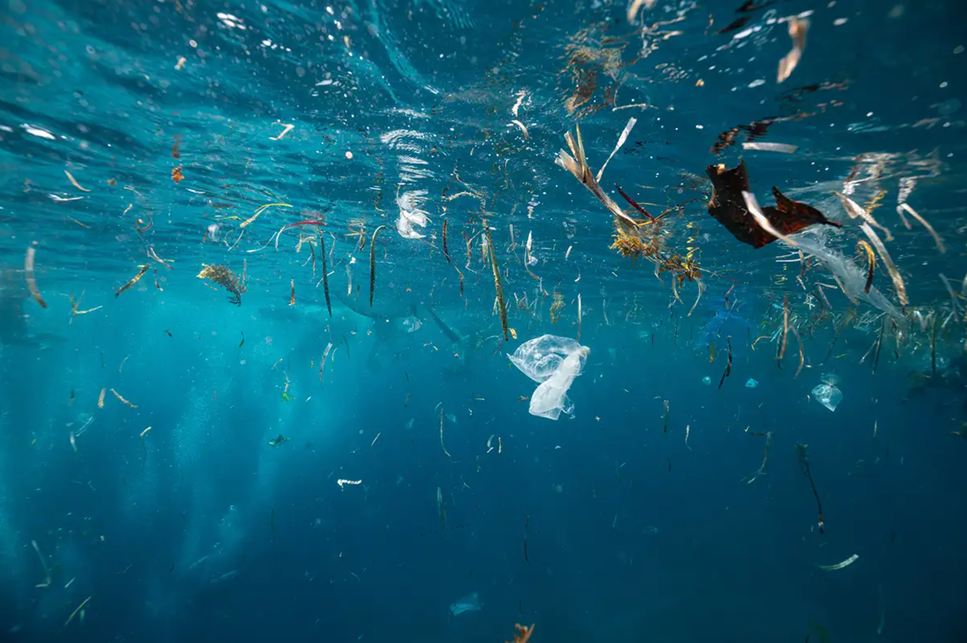
What Do You Think Microplastics Are?
Microplastics

Slide 6
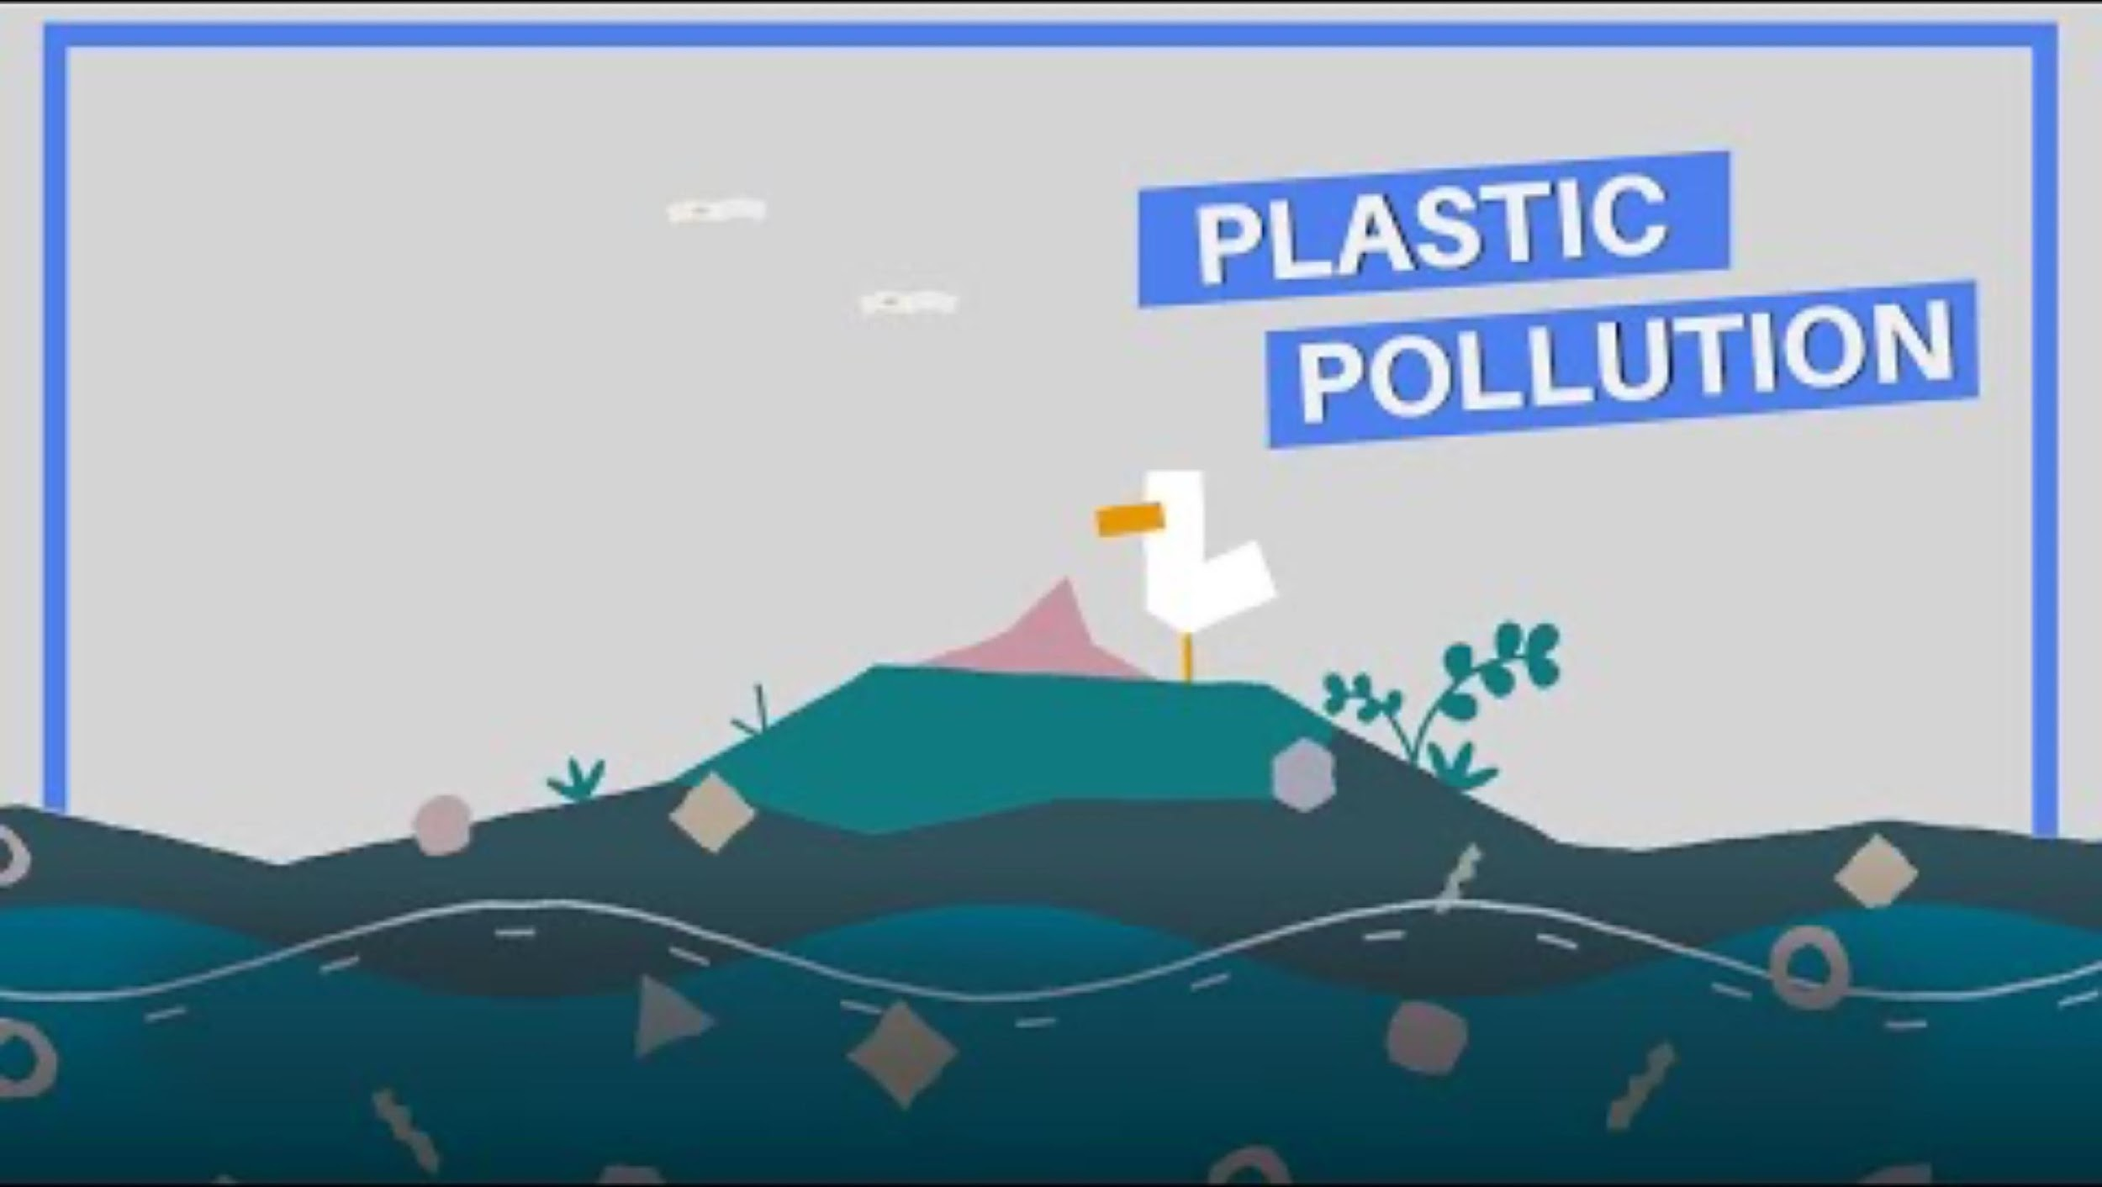
Overview
Microplastics
Notes:
https://youtu.be/npHUp_oQ-08?si=IiJCQ9cV_aMr55eA

Slide 7
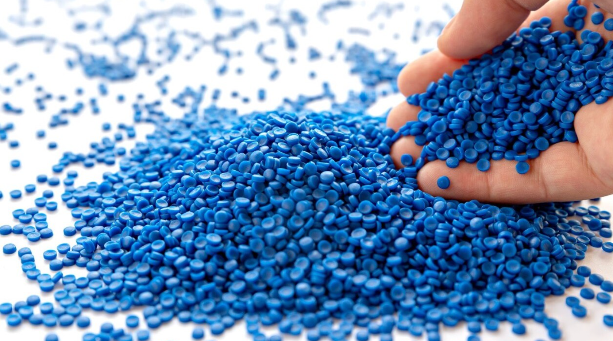
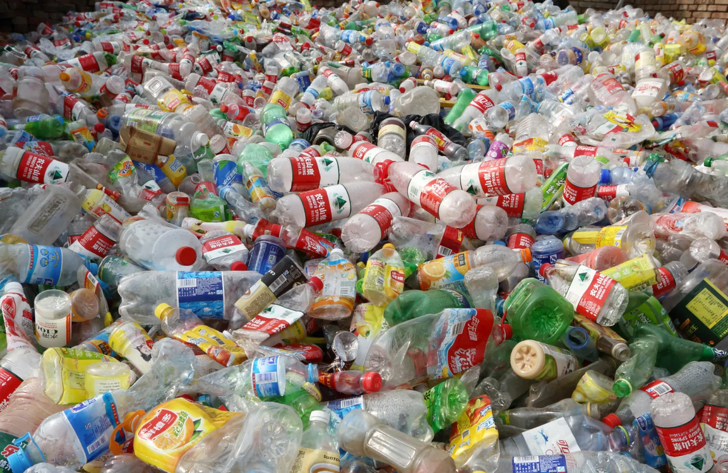
Microplastics: What They Are
Microplastics
Plastics are man-made materials that come from things like polyethylene, nylon, fossil fuels (crude oil or coal), and recycled plastics
Plastic granules: what they are, applications, our grinding systems
Microplastics are specifically plastics that have an upper size limit of 5mm
Whiting 2022
McGuire et al., 2019
Notes:
Plastics are man-made materials that come from things like polyethylene, nylon, and fossil fuels (crude oil or coal), and recycled plastics. They start off being soft and easy to shape, then harden into sturdy or slightly bendy forms that we use every day.
Polyethylene is a thermoplastic that is made from linking together small ethylene molecules to form a longer chain. Ethylene is a gas that occurs in natural gas, coal gas, or crude oil.
Nylon is a lightweight synthetic polymer. These are typically made from fossil fuels such as petroleum.
Microplastics are specifically ones that have an upper size limit of 5mm, which to put in perspective is a little larger than a sesame seed or a small bead. They are often hard to see, but everywhere around you

Slide 8
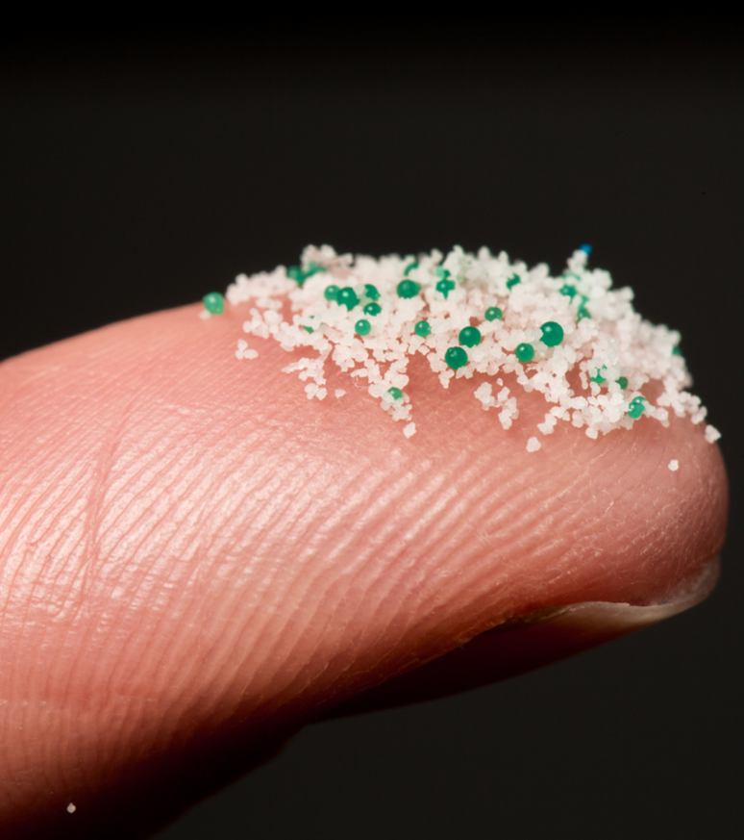
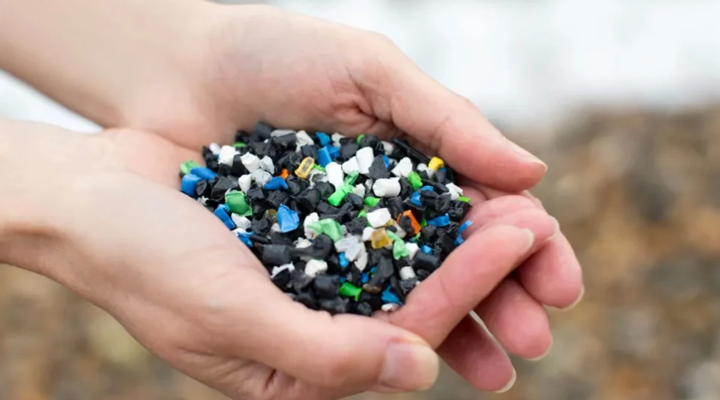
Primary Microplastics
Microplastics: What They Are
These plastics are intentionally produced at a small size for multiple uses. This includes nurdles, a common raw material in the manufacturing of plastic products.
Raubenheimer, 2024
Betham, 2023
McGuire et al., 2019
Notes:
The left is a picture of microbeads. Microbeads are typically the same size as other microplastics, 5 millimeters or less, and these are typically used in cosmetic products such as exfoliants or body washes. This will be discussed more at the end of the presentation.
The picture on the right is a picture of nurdles.

Slide 9
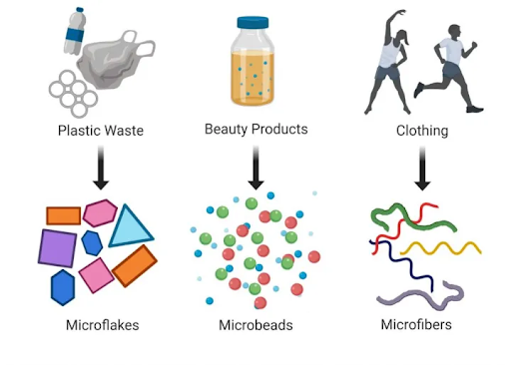
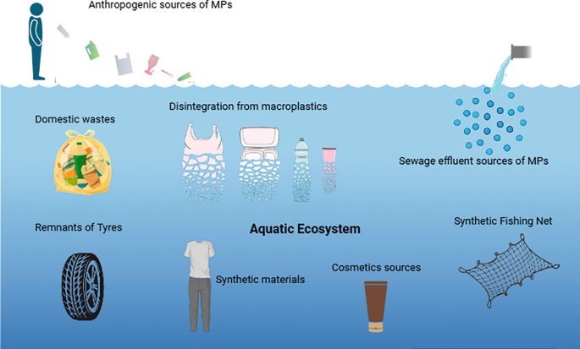
Secondary Microplastics
Microplastics: What They Are
All types of microplastics you should know
Roy et al. 2025
Plastics that are not manufactured as small particles and turn into small pieces of plastic through chemical, physical, and/or microbial degradation
McGuire et al., 2019
Notes:
The picture on the left shows ways that microplastics are able to form from common products. The plastic waste breaks down in natural conditions, beauty products can contain small microbeads that cannot be filtered out, and washing clothing can release microfibers into waterways.
The picture on the right portrays certain sources of microplastics such as anthropogenic sources, sewage effluent, fishing nets, and much more. It includes the production of secondary microplastics that are disintegrating from macroplastics.

Slide 10
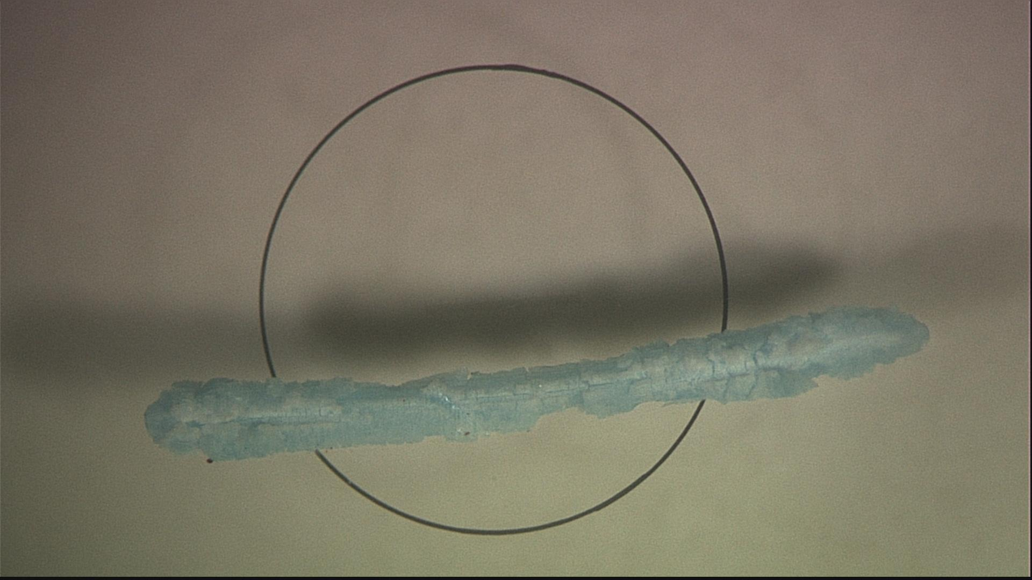
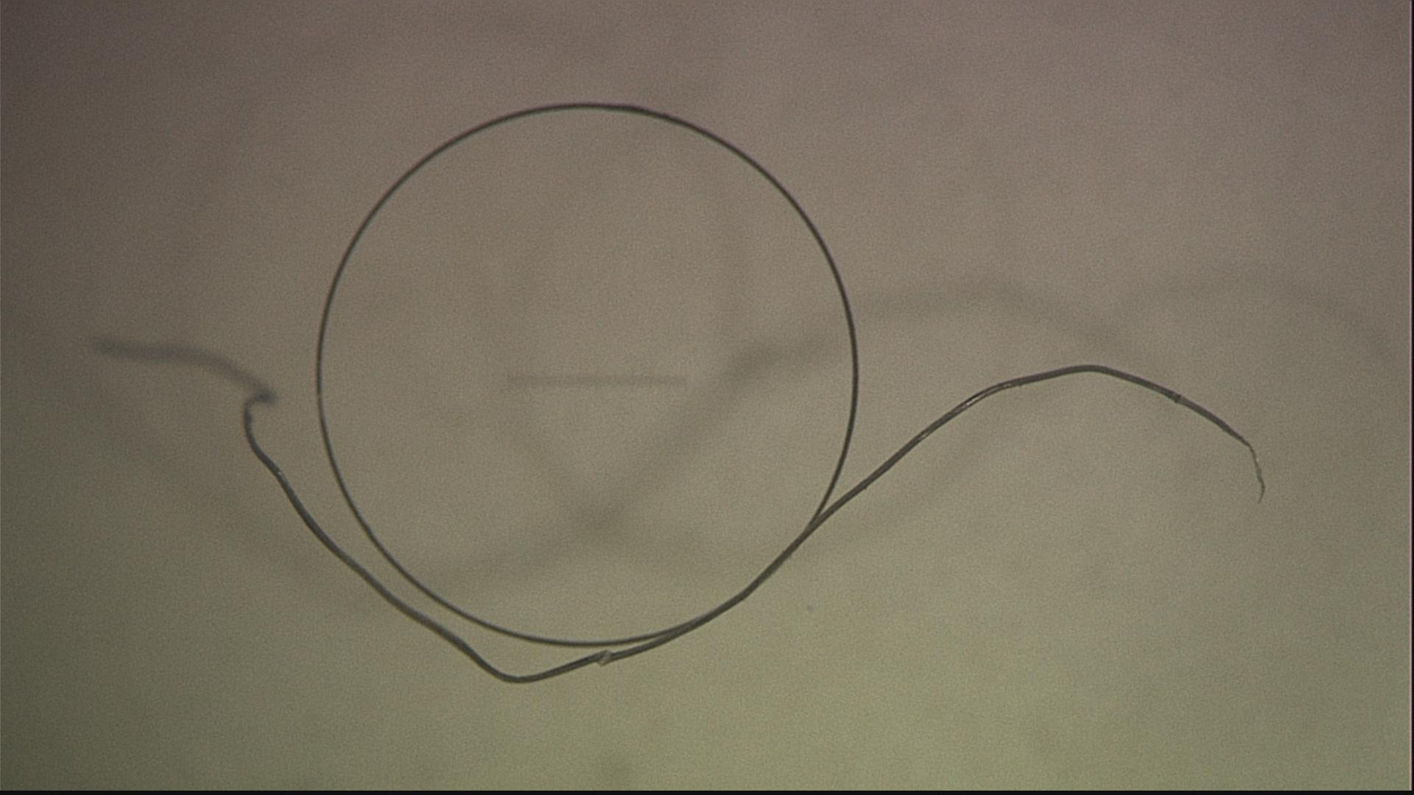
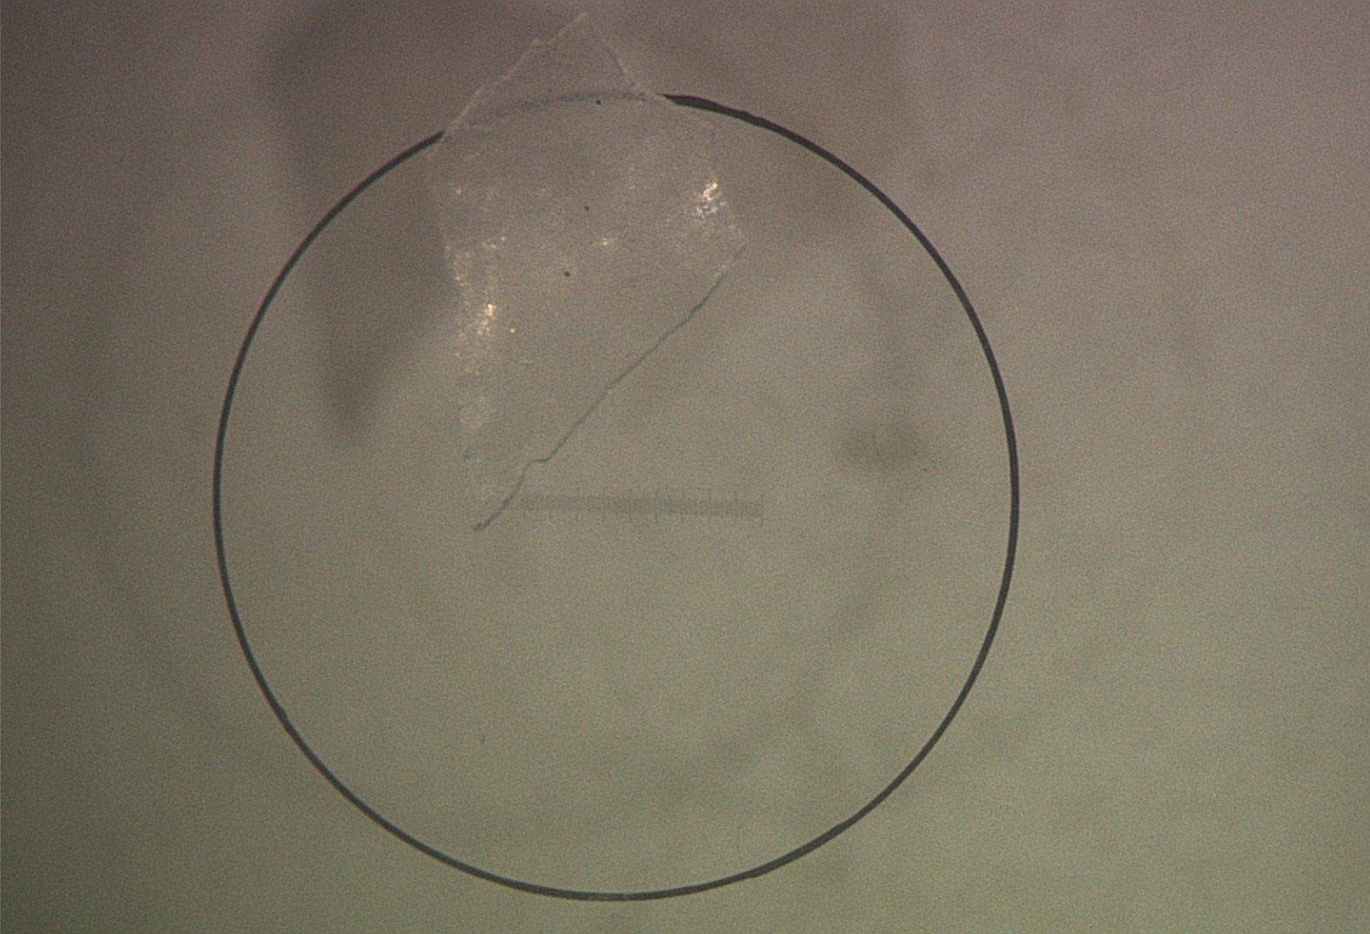
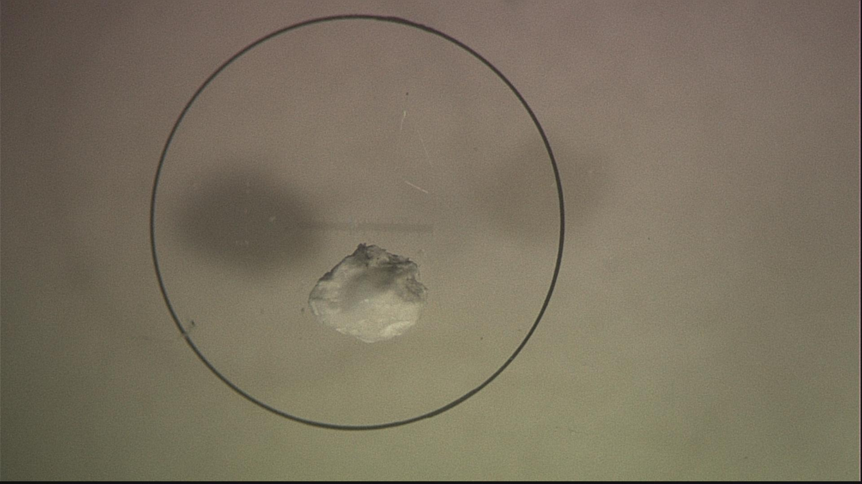
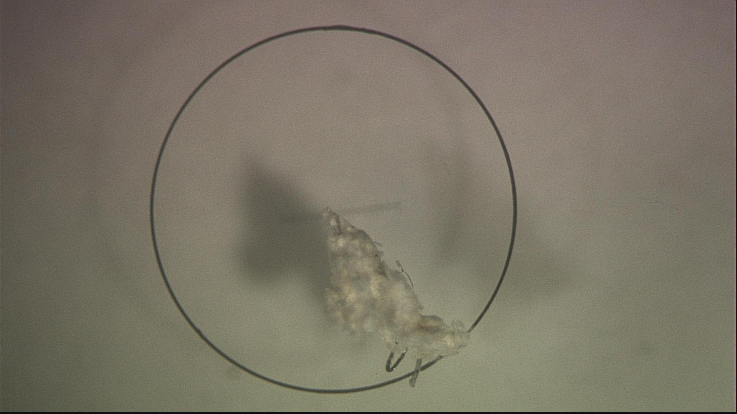
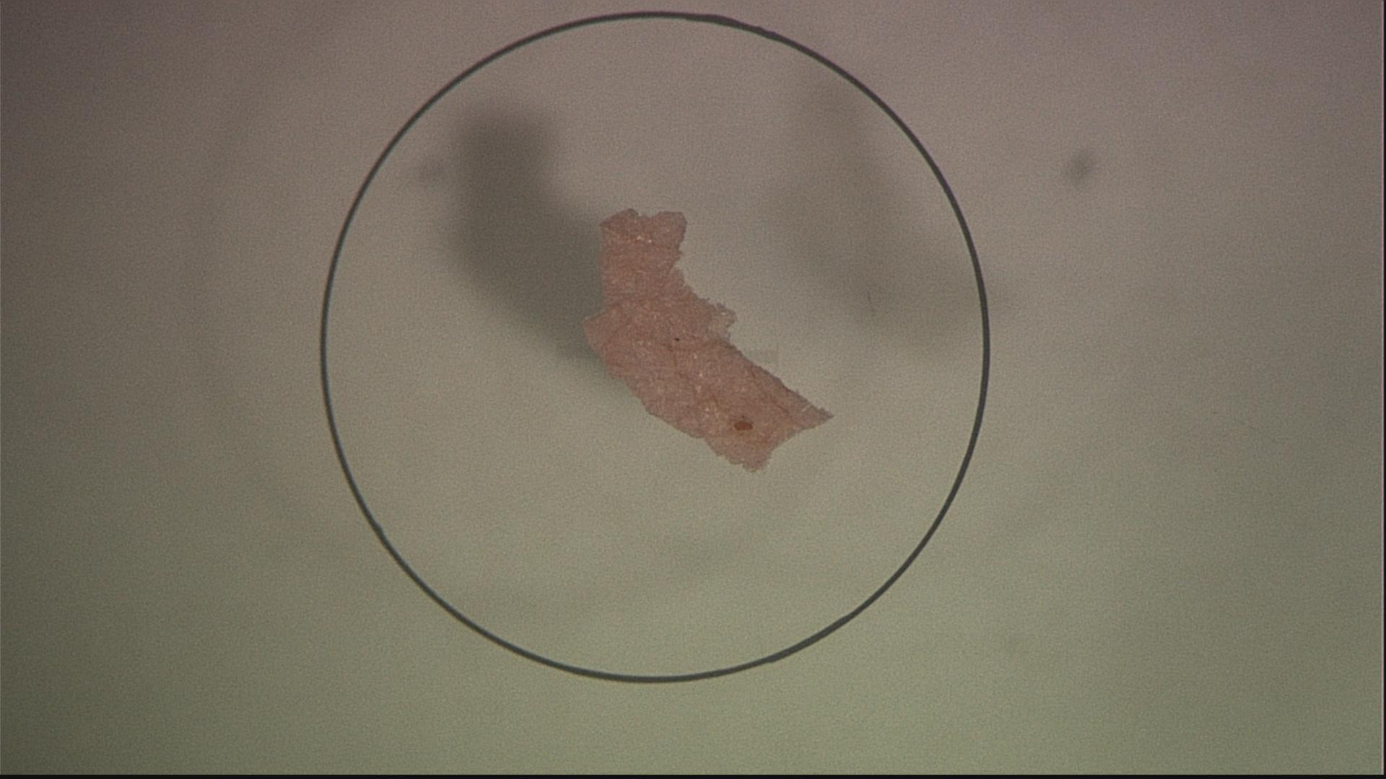
Microplastics: Pictures
Notes:
Here are pictures from Marcellinus Ogudo who is a PhD Student at Florida International University of actual microplastics that range from fragments, fibers, films, and foams. The scale of these pictures its 100 microns, which is about the size of a grain of salt. These pictures show the range of what microplastics can look like and how difficult some of these would be to see in the environment.

Slide 11
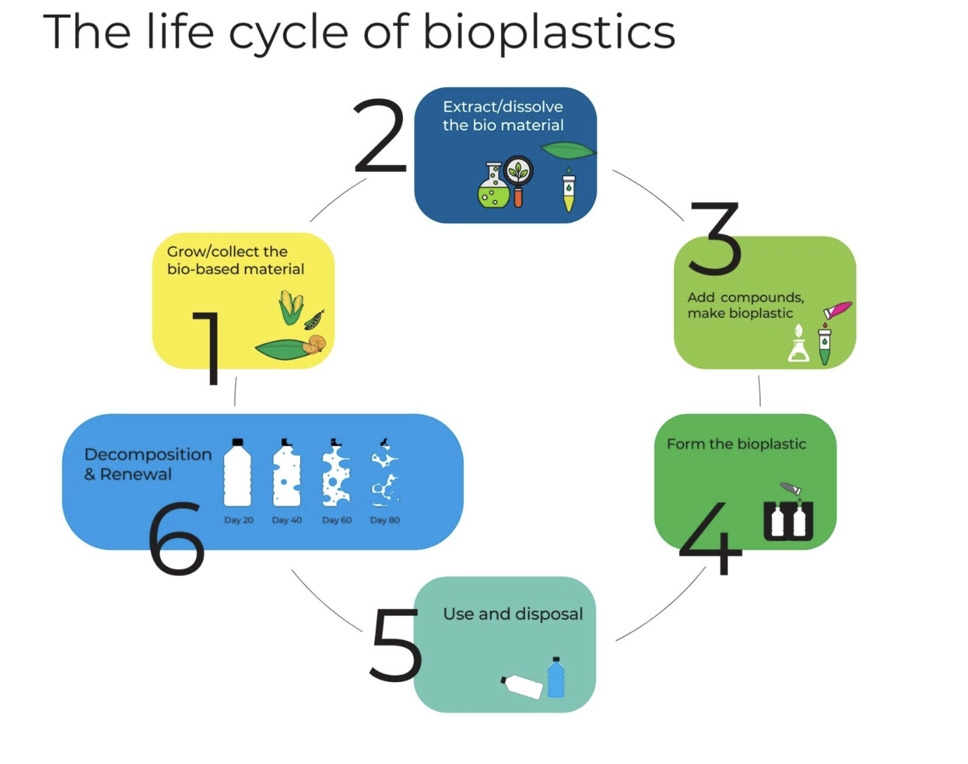
How Plastics are Produced
Microplastics: What They Are
  Common Plastics
  Extracting natural gas, coal, and crude oil from the earth
  Chemically break these down to ethylene and propylene
  Mixed with other chemicals and put under high temperature and pressure conditions to create the actual plastic
  Cooled and shaped
  Bioplastics:
  Use natural sources to create plastics
  Bacteria break them down or chemical synthesis
  Polymerization and cooled to shape
Biodegradable Plastic Manufacturing Process, 2023
Impact of How Plastic is Made, 2025; Biodegradable Plastic Manufacturing Process, 2023
Notes:
The most common way to produce plastic is through extracting natural gas, coal, and crude oil from the earth. Then plants process these fossil fuels break them down into ethane and propane. Then they chemically break these down to ethylene and propylene. They are then mixed with other chemicals and put under high temperature and pressure conditions to create the actual plastic. Once they have formed long chains, the entire process has gone through polymerization and then are cooled to form their shape.
Bioplastics, which will be discussed more later, are produced by using natural substances (corn, potatoes, or wood chips) and extracting the sugars and lipids from them. Bacteria or yeast can ferment them or they can be combined with other chemicals to produced them. Just like regular plastics they go through polymerization to make long chains and are cooled to form shape.

Slide 12
What Are Common Sources of Microplastics?
Microplastics
Notes:
Asks as a discussion

Slide 13
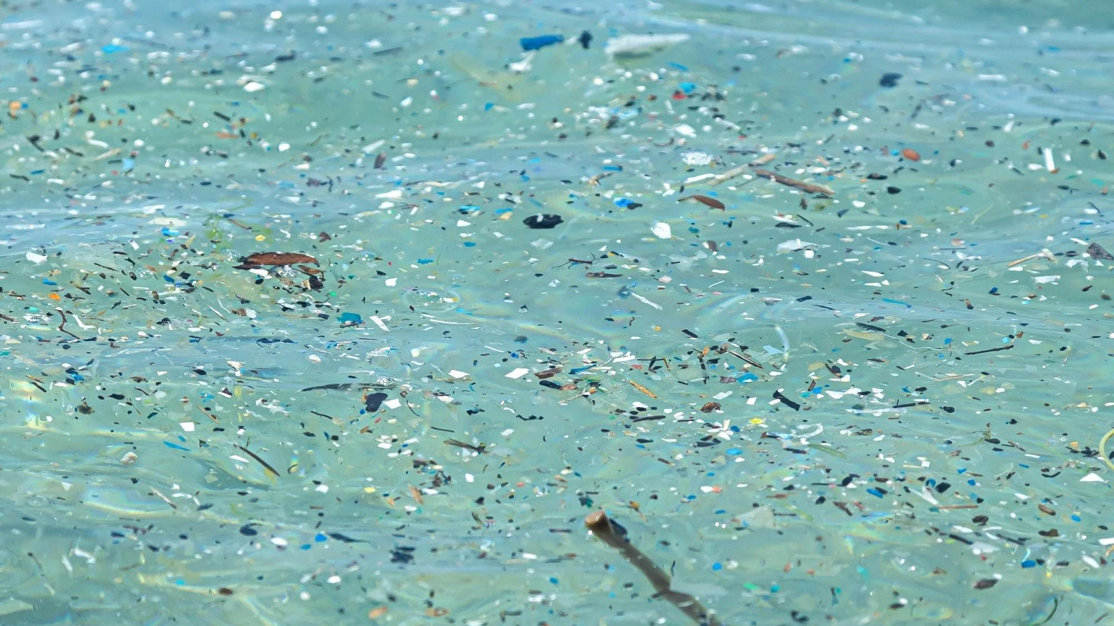
Common Sources of Microplastics
Microplastics
Singh, 2025
Notes:
Starts the next section

Slide 14
Textiles
Microplastics: Common Sources
What they are
What they do
Effect
  Textiles is a broad term to encompass various fiber-based materials. This includes clothes, towels, ropes, safety equipment, and more.
  They can either be natural or synthetic
Shed microfibers through:
  Travel
  Washing
  Manufacturing
  Wearing
  Disposal
  35% of microplastics in the ocean after from washing synthetic materials
  Release 0.2-0.5 million tons per year of microplastics into the ocean
Microplastics from textiles: towards a circular economy for textiles in Europe, 2022
Notes:
These textiles can be seen in storm water, wastewater, rivers, lakes, and ponds. Wherever water can travel to, you can typically find these microfibers from textiles within them.

Slide 15
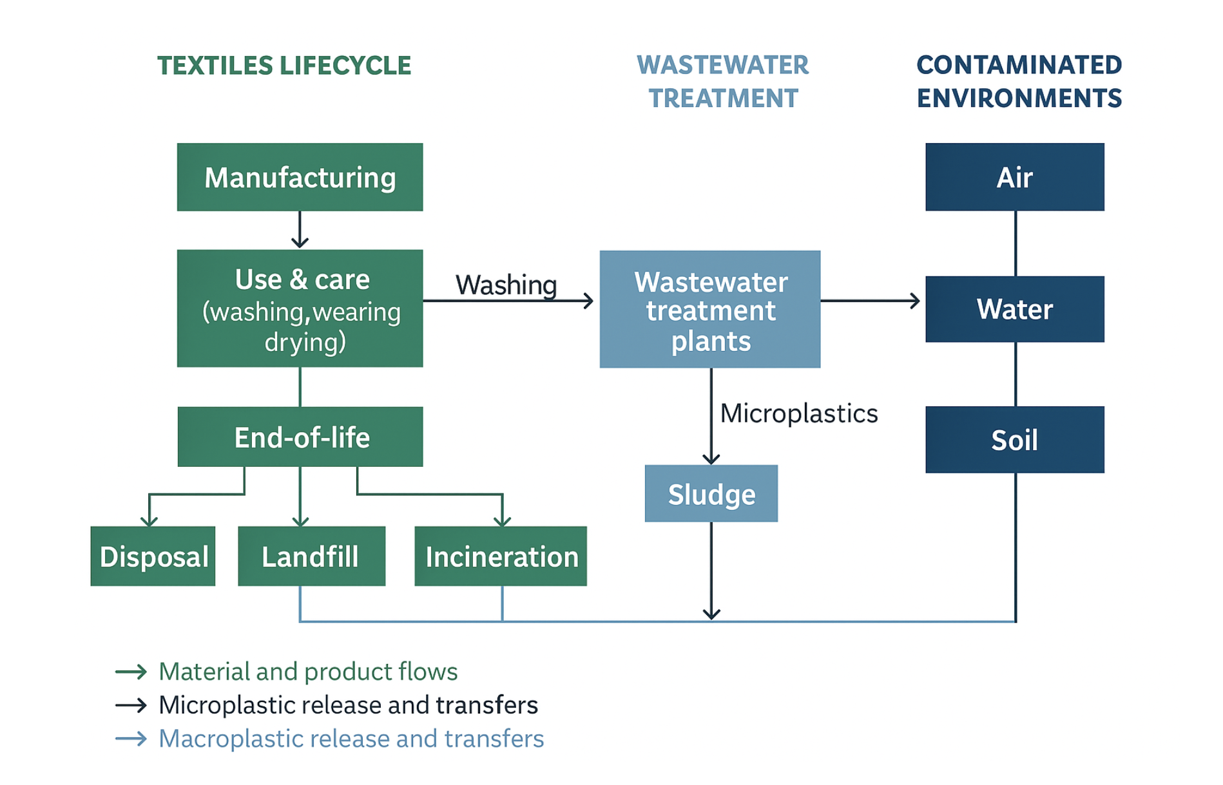
Textiles lifecycle
Adapted from Microplastics from textiles: towards a circular economy for textiles in Europe, 2022
Notes:
The flow of this chart begins with textile fiber and product manufacturing. Once manufacturing and given to the general public, they are typically used and washed and cared for until they are disposed of. Once they are disposed it is typically through the recycling of these products, incineration, or they are taken to a landfill. There are a number of consequences for this cycle such as creating dust, litter, or releasing microfibers into textiles. Once the water reaches wastewater treatment plants they can be turned into sewage sludge which is used in fertilizers or the microfibers are not caught within the filters and are released as effluents. Through all of this, the environments that now contain textile pollution are air, ocean, freshwater, and soil.
Air is affected by the dust released during manufacturing, oceans are affected by the release of effluents and litter falling into it. Freshwater is affected by the release of effluents, and the runoff of soil treated by the sewage sludge from wastewater treatment plants. Soil is affected by littering and the sewage sludge mentioned before.
WITH NEW ONE: Textiles, like our clothes, go through a life cycle that starts with manufacturing, continues through everyday use, and ends with disposal in landfills, incineration, or recycling. Along the way, small plastic fibers, called microplastics, are released — especially during washing. Some of these fibers are caught in wastewater treatment plants, but many escape into rivers and oceans. Even when captured, the sludge from treatment plants is often spread on land, adding more microplastics to soil. Beyond water and soil, textiles also release fibers into the air through wear and drying. Together, this means textiles contribute to plastic pollution in air, water, and soil throughout their entire life cycle.

Slide 16
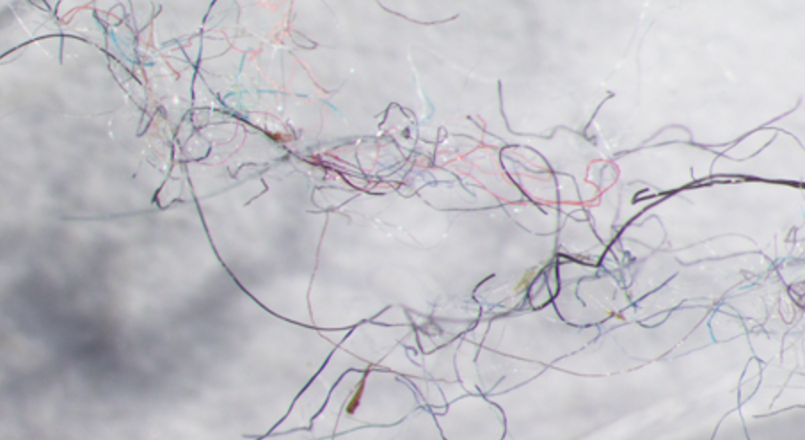
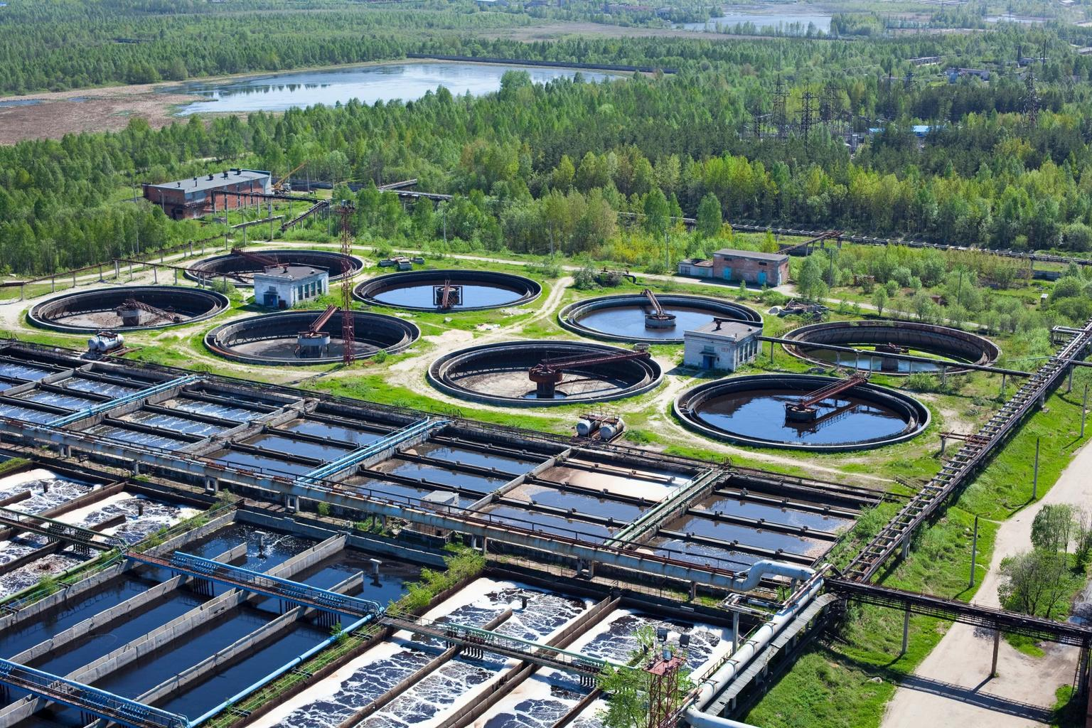
Wastewater Effluent
Microplastics: Common Sources
O’Connor
Wastewater treatment plants have sources coming from:
  Domestic Watewater
  Commercial Sources
  Industrial Discharges
  Urban Runoff
Enabling Control Over a Wastewater Treatment Plant
With large volumes of water being processed, the smallest of microplastics and fibers are not filtered out
Iyare et al., 2020
Notes:
Examples of each: domestic (toilets, sinks, showers, laundry, dishwashers); commercial (hotels, restaurants, car washes, manufacturing facilities); industrial (manufacturing, chemical processing, and power plants); urban runoff (construction sites, lawns, litter, rain coming off roads and parking lots)
- important to give general public examples of things they know
While the treatment plants do take a large majority of microplastics out, large volumes of water are being processed and the smallest of microplastics typically are not filtered out. These become trapped in sewage sludge which can be reused as fertilizers, or in bodies of water
Info from: DOI: 10.1039/d0ew00397b

Slide 17
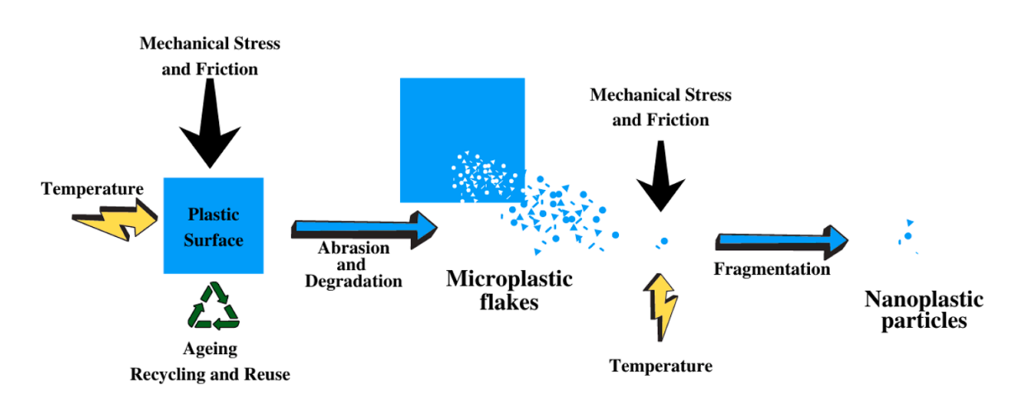
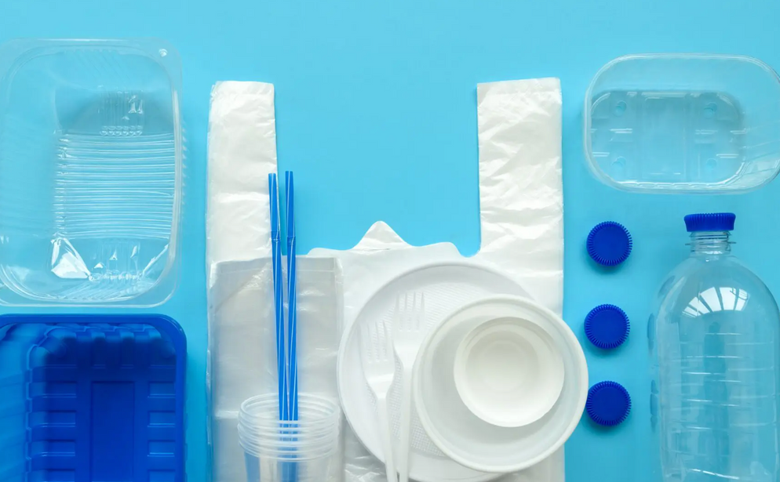
Packaging
Microplastics: Common Sources
Plastic packaging includes:
  Water bottles
  Containers
  Cutlery
  Food Wrappers
  Straws
Jadhav et al. 2021
This packaging can become degraded through means of reusing, cutting, tearing, opening, and warming up.
The Different Types of Plastic Packaging and Their Uses, 2024
Jadhav et al. 2021
Notes:
The more that plastic packaging is reused, the more microplastics come off over time. Also basic processes such as cutting, opening, closing, or tearing this packaging will release microplastics. Seen at about 0.46-250 microplastics per cm. Many people experience the effects of warming up a plastic container and it warping into a different shape. This is because high temperatures are able to change its shape, and these temperatures also give off more microplastics (Jadhav).
Tearing plastics can cause 0.46-250 microplastics per cm to be produced.

Slide 18
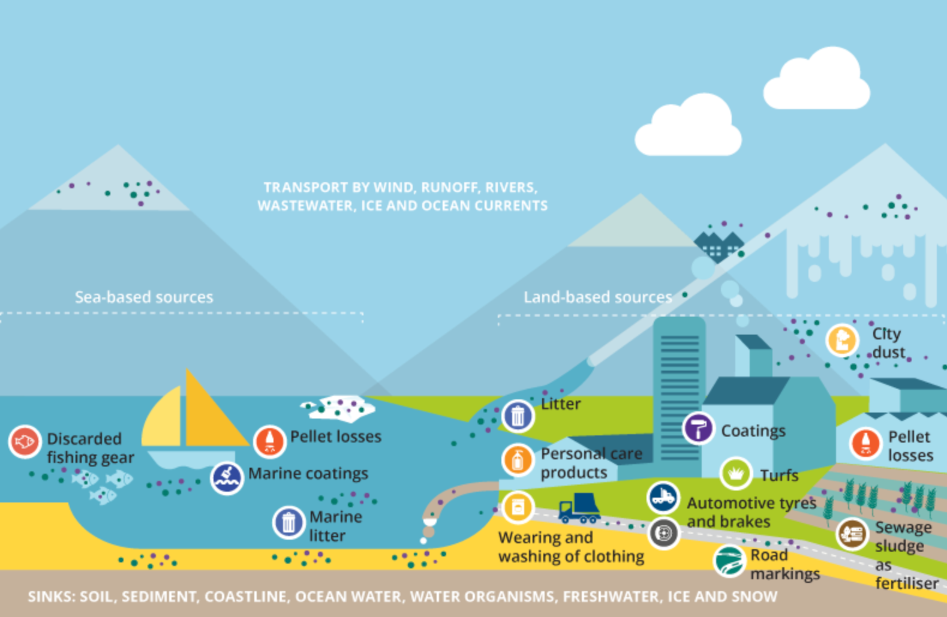
Microplastic Release Routes
Microplastics from textiles: towards a circular economy for textiles in Europe, 2022
Notes:
This slide portrays the many ways in which microplastics are released. While we have gone over most of them previously, I want focus on a few more that we have no discussed yet.

Slide 19
Microplastic Release Routes 2
Microplastic Release Routes
Microplastics from textiles: towards a circular economy for textiles in Europe, 2022
Notes:
Discarded fishing gear enters the oceans through in either large amounts such as gear in the fishing industry or in small amounts with individual fishermen. This gear turns into secondary microplastics as they degrade in the environment. Some of this fishing gear can also already be attached to organisms, so they are in the direct line of fire when these plastics become smaller and smaller.

Slide 20
Microplastic Release Routes 3
Microplastic Release Routes
Microplastics from textiles: towards a circular economy for textiles in Europe, 2022
Notes:
Pellet losses are specifically talking about nurdles. When nurdles are being transported to other places to create plastics, they are subject to falling off of the large shipping boats and falling into the ocean. These are now primary microplastics that are in the environment and can harm the organisms around it.

Slide 21
Microplastic Release Routes 4
Microplastic Release Routes
Microplastics from textiles: towards a circular economy for textiles in Europe, 2022
Notes:
Marine coatings and coatings are paint that contains microplastics within them. Acrylic latex paint tends to have the highest amount of microplastics. These microplastics enter the water from the leaching of paint surfaces, maintenance on the ships or houses, and the disposal of paint as many times going down the drain or into a wastewater facility.

Slide 22
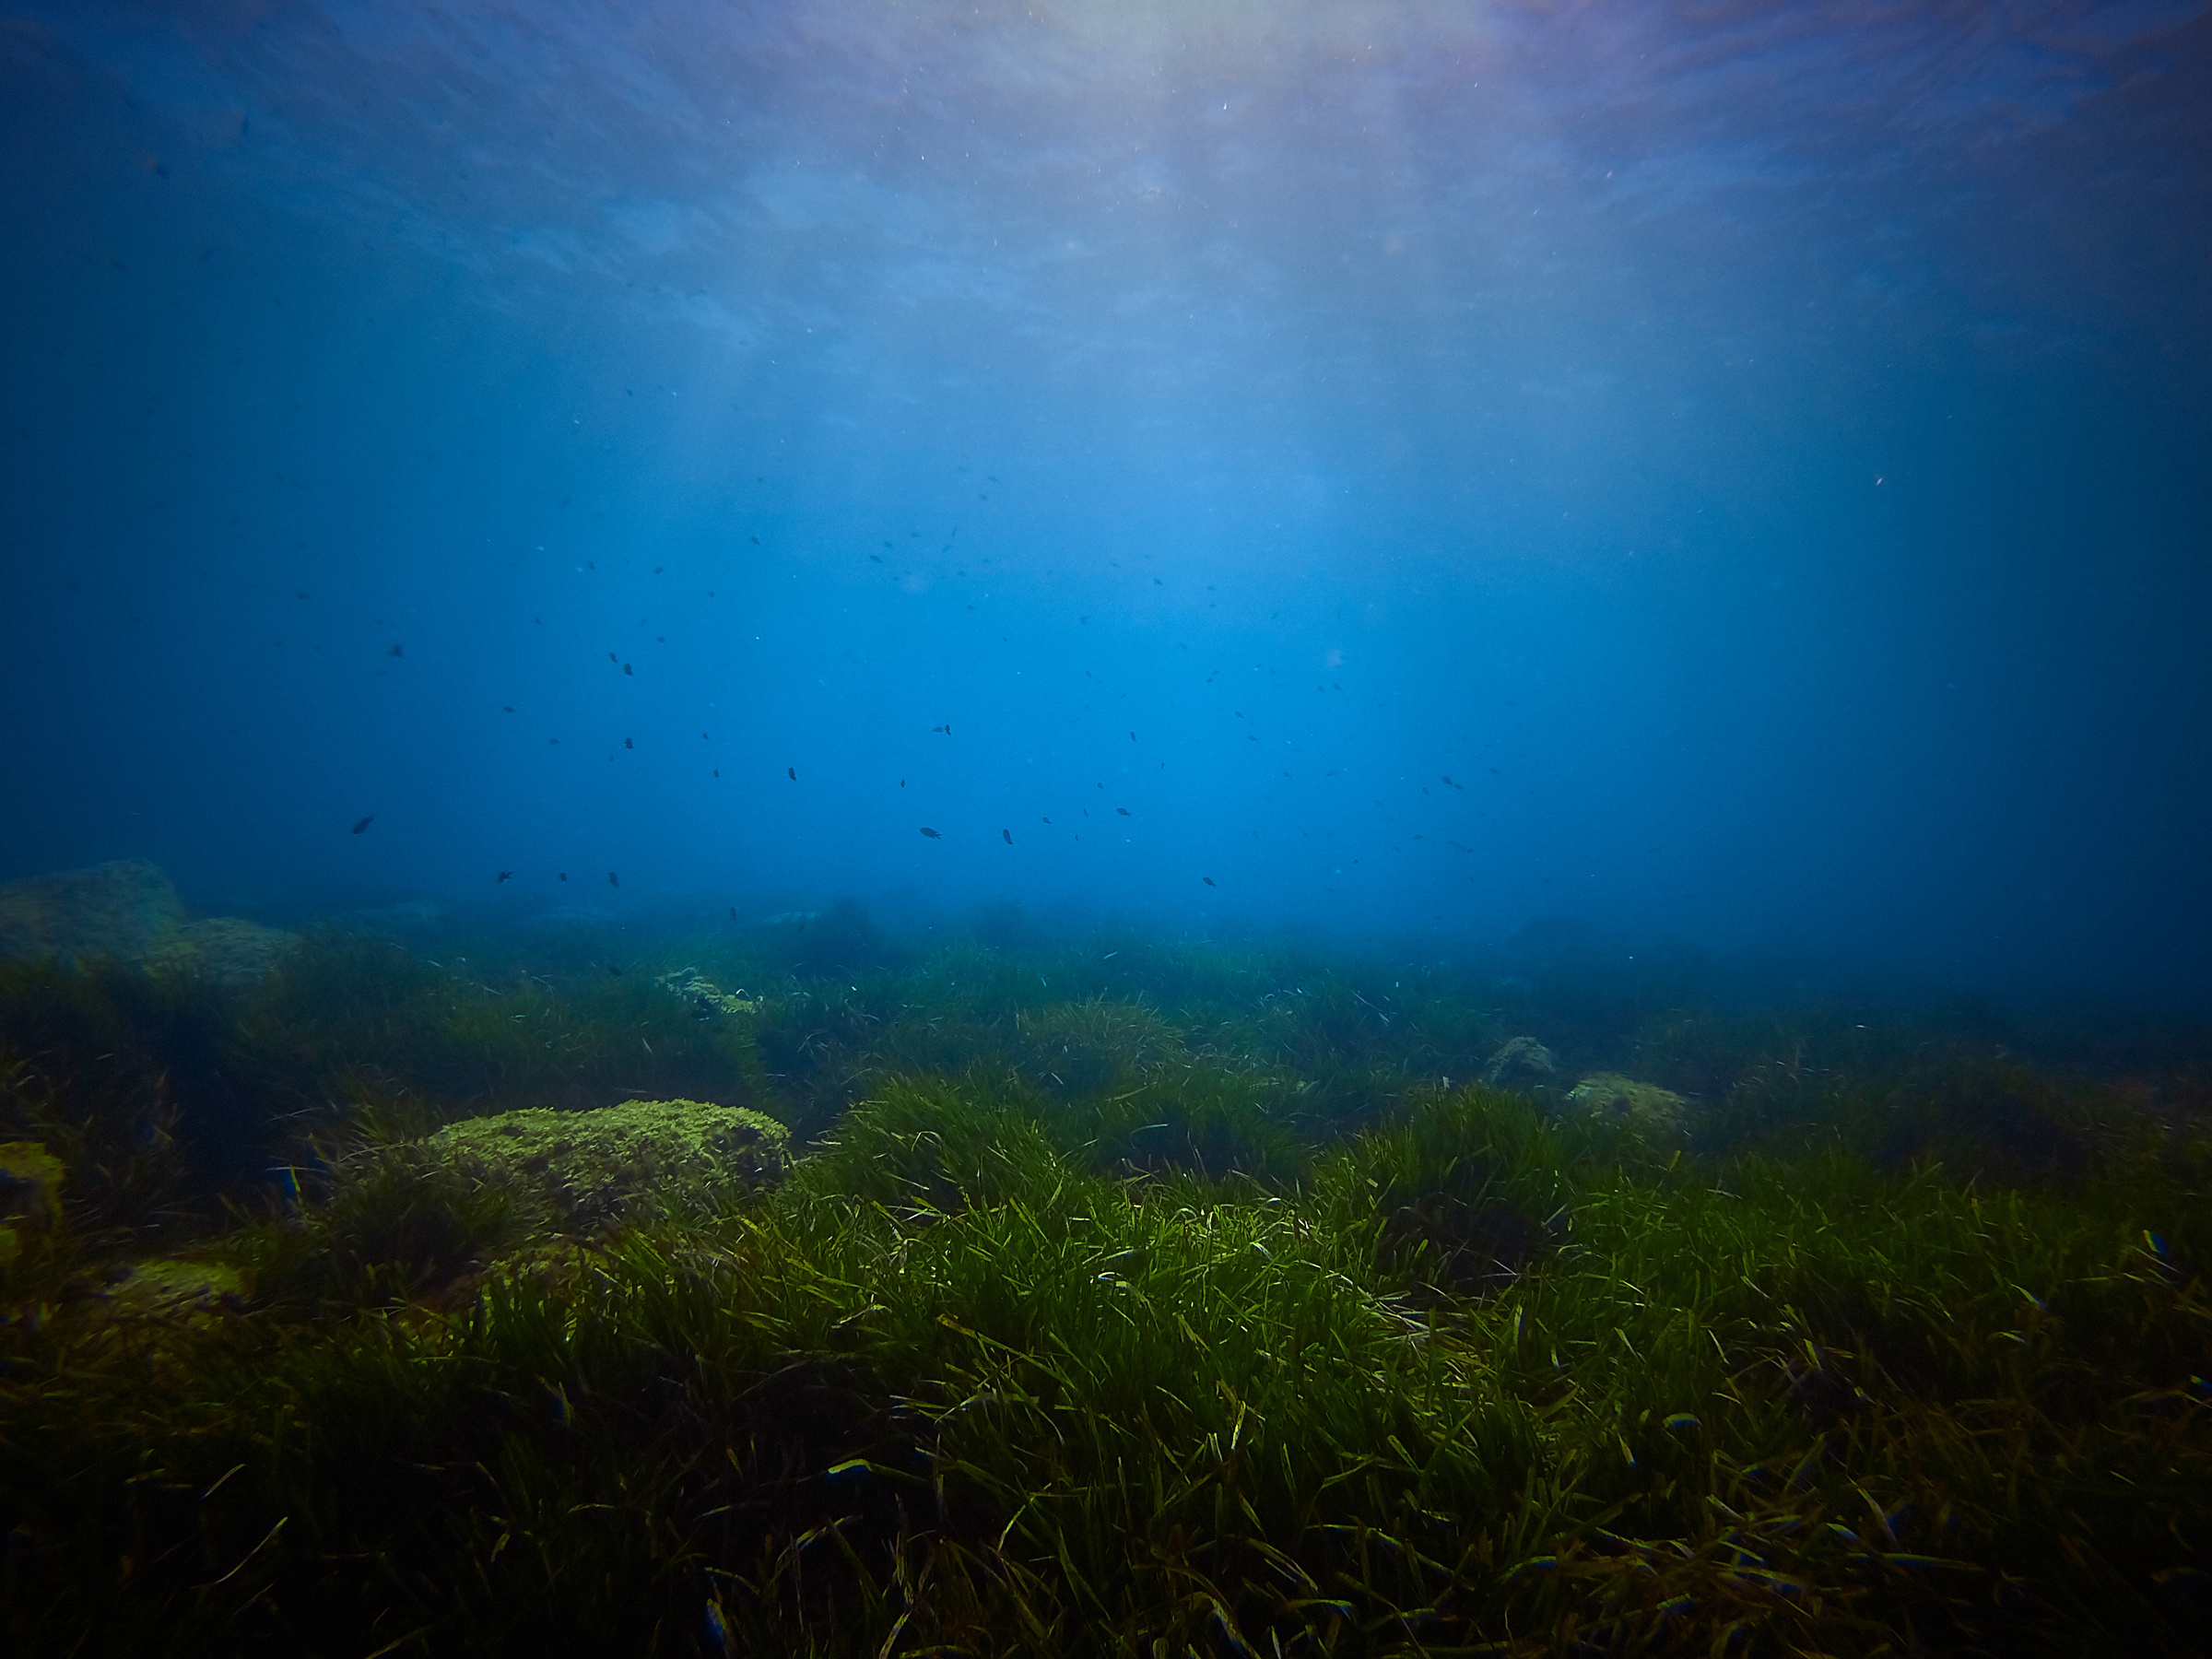
Impacts
Microplastics
Plastic Bi-Products (PFAS)
Ecosystems
Marine Life
Humans

Slide 23
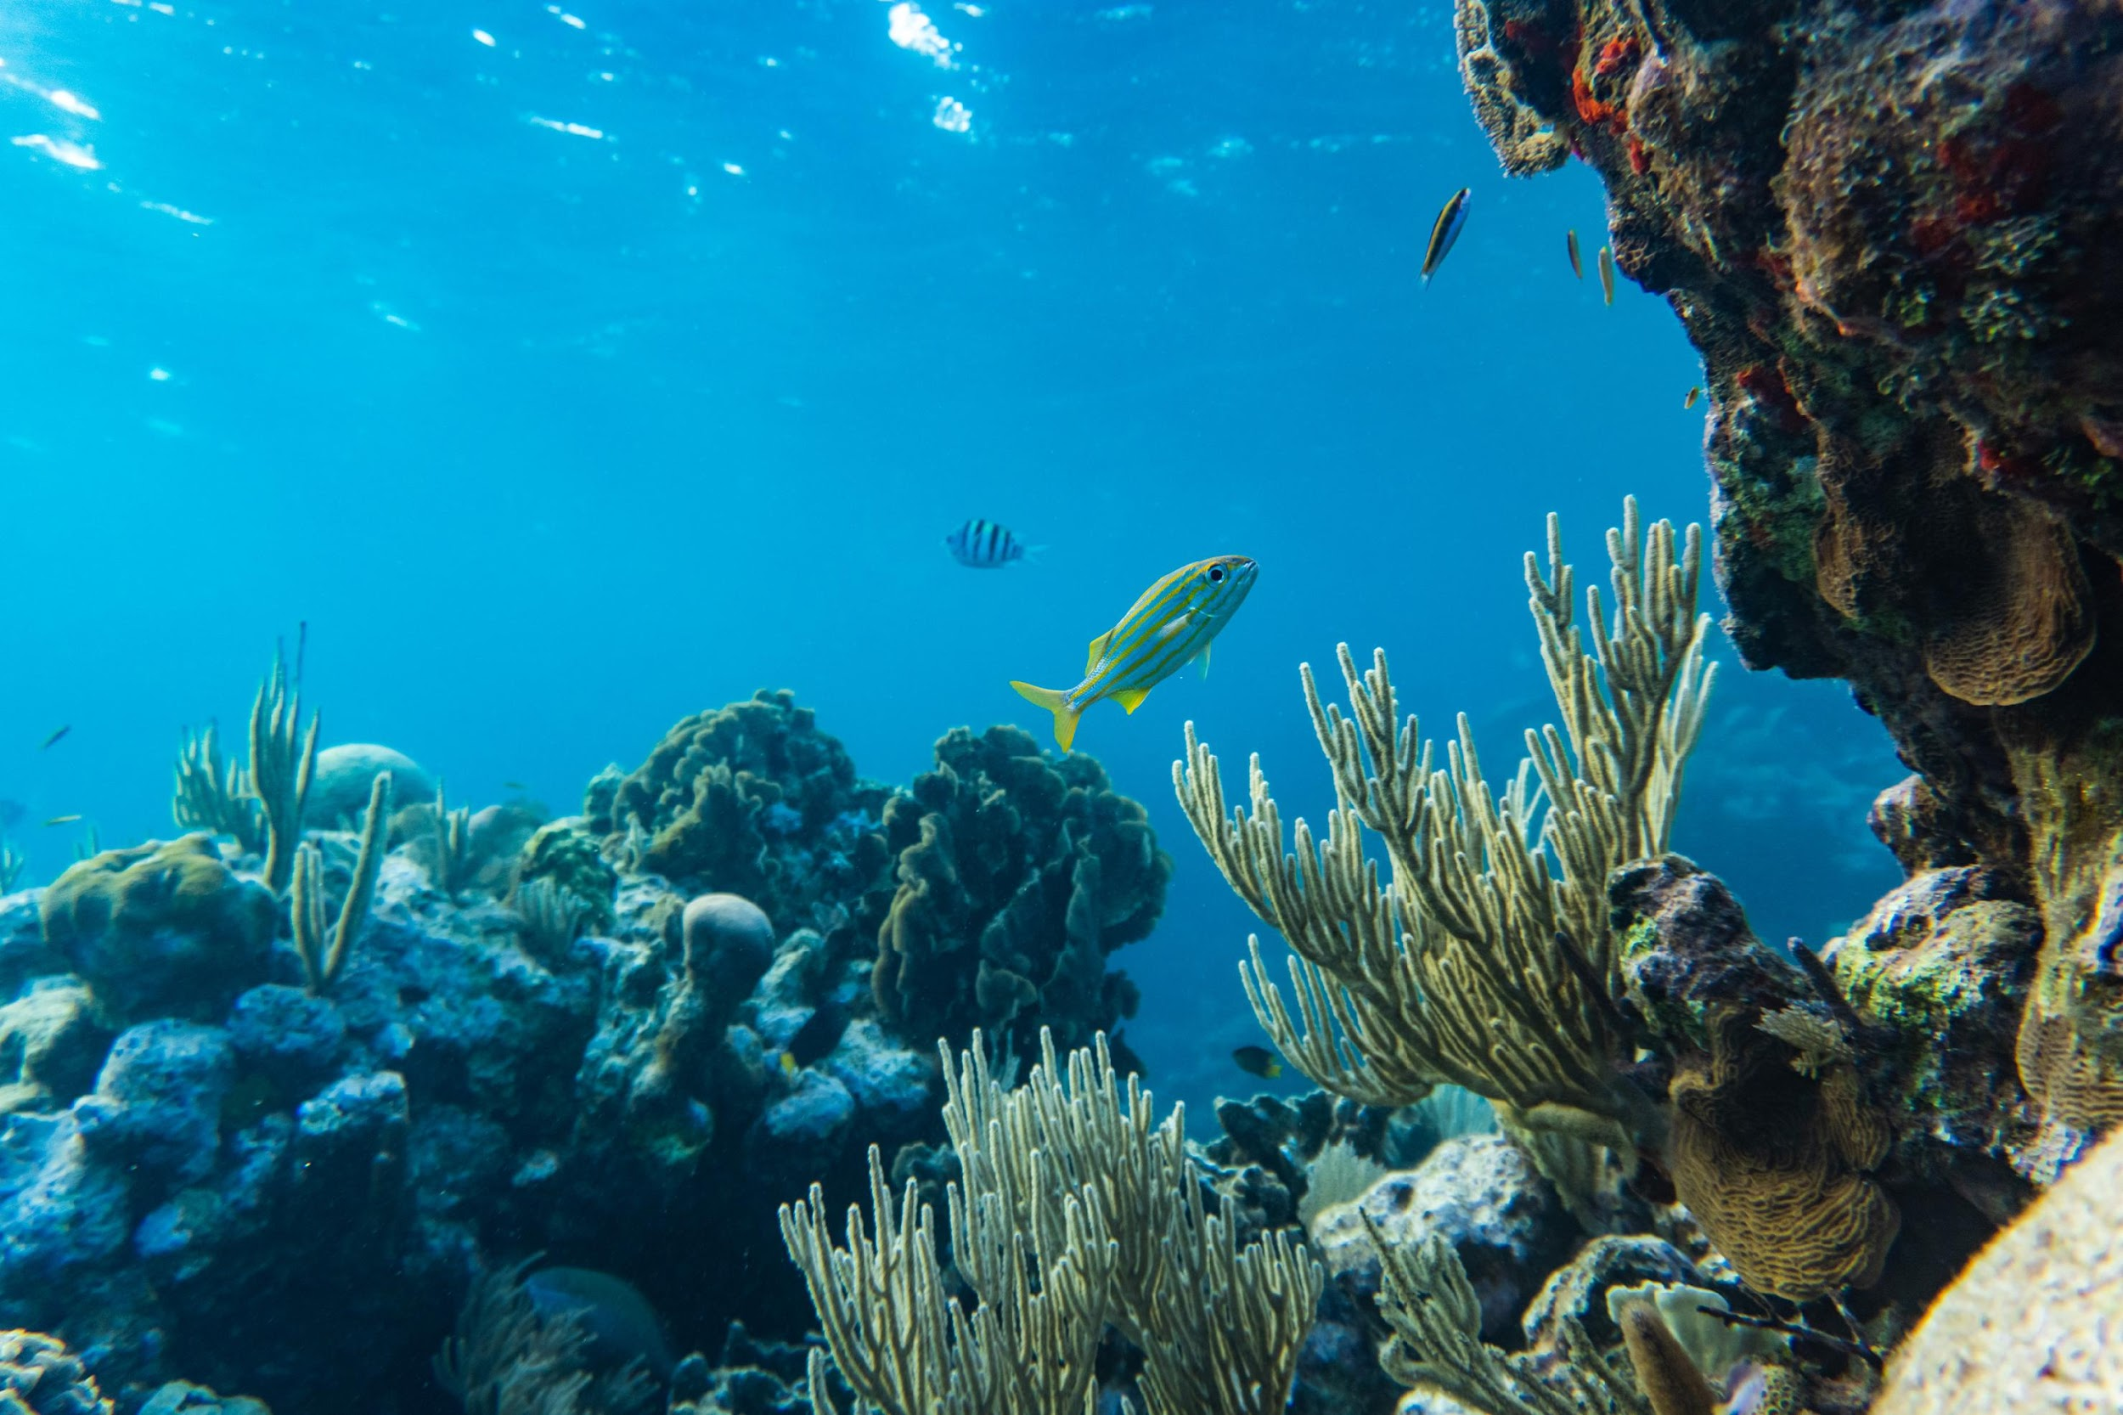
Impacts on Ecosystems
Microplastics: Impacts
Alters microbial communities
Pollutes Air
Contaminates Soil
Bioaccumulation
Habitat Degradation
Yu et al., 2020; Sajjad et al., 2022
Notes:
The chemical and physical properties of microplastics make it easy for pollutants to stick to them. With more microplastics in an environment, this causes the bioaccumulation of these toxins and pollutants. These begin to alter microbial communities as the toxins reach them first. These pollutants can either hurt microbes or cause others to grow rapidly, which in turns alters the predator-prey relationships in these communities. These can cause big problems for the ecosystems as the basis of the food webs are altered and the soil is contaminated.
Air is also polluted with microplastics being in dust, clothes, and rubbing off tires. This is done at manufacturing plants that release these particles into the air. While the effects of inhaling microplastics is unknown, they are able to spread all throughout the body and into different systems. Either through methods of evaporation and precipitation or just wind blowing the microplastics around, they are easily spread this way. Manufacturing plants also release microplastics into the water through their wastewater systems. Microplastics that enter the soil through wastewater systems, typically spread as fertilizer created from wastewater sludge, contaminates it and just like in water can attract pollutants. This affects organisms that are living there as they can ingest these pollutants and harm their well being.
The accumulation of microplastics on shores and throughout environments can alter its normal processes such as waves, currents, and wind. If it is the case of secondary microplastics, it takes time for these bigger pieces to degrade. If they are out in the environment, they are taking up space and getting in the way of these normal waves and currents. The cycle begins all over with these pieces becoming smaller, pollutants becoming chemically attached, and harming organisms until the habitat is completely degraded.

Slide 24
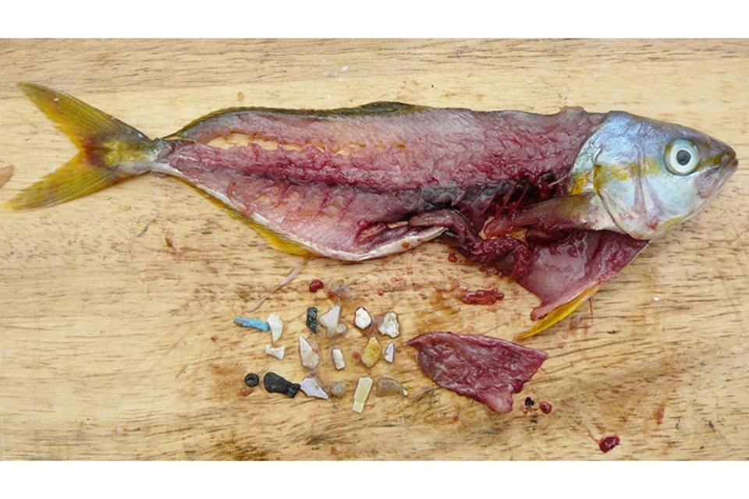
Impacts on Marine Life
Microplastics: Impacts
Effects
  Degrading plastics potentially entangle animals
  Cut or block their digestive tract
  Spread toxins throughout their body
  Spread throughout food web
Thompson 2018
McGuire et al., 2019
Notes:
Larger plastics that are degrading can entangle animals which injures them or causes them to drown. Swallowing harder plastics with sharp edges injures the digestive tract. As talked before, toxins are chemically bonded to microplastics, and these can spread and leach into animals bodies. The effects of these toxins can affect reproduction, avoiding predators properly, feeding, skin damage, and ulcers. Microplastics can also be taken up by smaller organisms such as plankton. These animals are the basis of the food webs causing these plastics and toxins to move spread throughout the food chain. (contaminants in the urban environment)

Slide 25
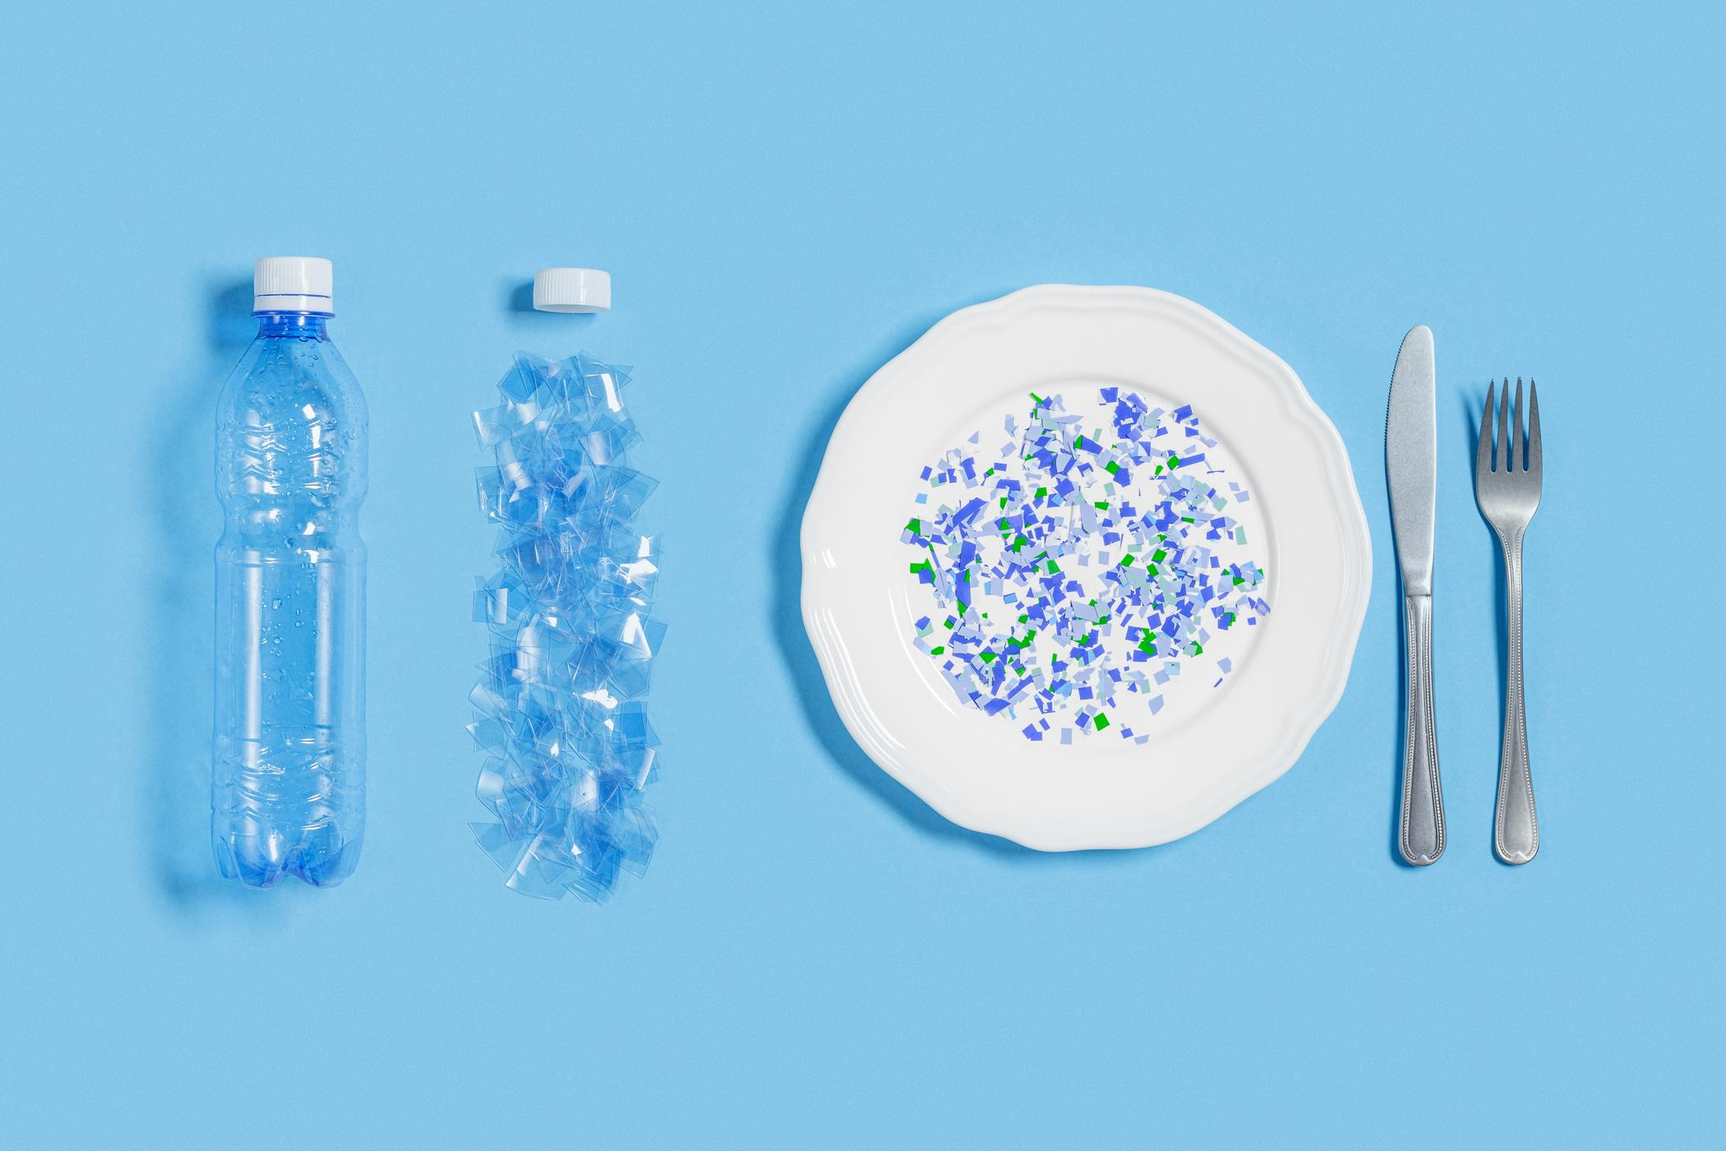
Impacts on Humans
Microplastics: Impacts
Microplastics have been found in:
  Tap water
  Bottled water
  Beer
  Sea salt
  Seafood
  Fish
  Honey
  Sugar
  Milk
  Teas*
  Baby Formula*
The effects on microplastics on humans are still mostly unknown, but potentially have the same effects as other vertebrates.
How to Avoid Microplastics in Water Bottles: The Harms & Fix
*once heated to certain temperatures
McGuire et al., 2019; Jadhav et al., 2021
Notes:
Before showing where microplastics have been found, ask people to brainstorm where they think they have been found.

Slide 26
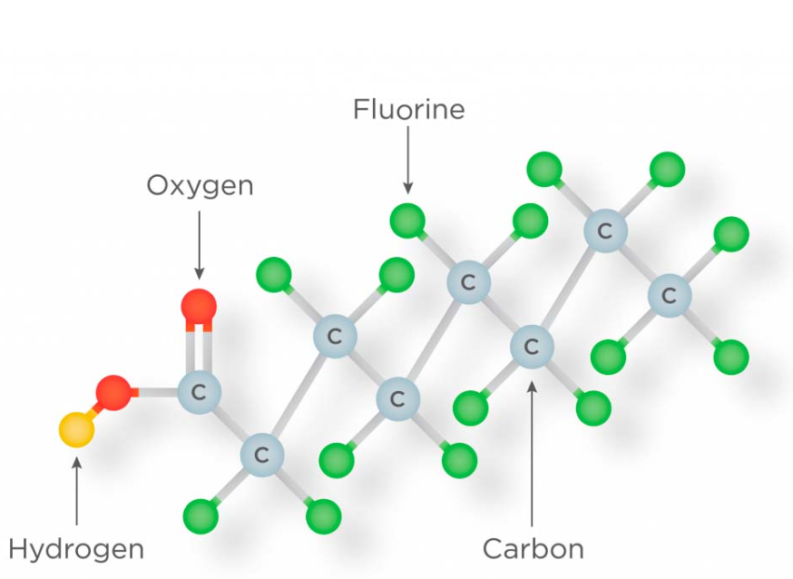
PFAS: What are they?
Microplastics: Impacts
  Per- and poly-fluoroalkyl (PFAS) are a common chemical pollutant that easily become attached to microplastics
  Have been referred to as “forever chemicals”
  Two categories of PFAS
    Short-chained
    Long-chained
PFAS
Glüge et al., 2020; Johnson, 2020
Notes:
PFAS are chemicals that began producing in the 1940s and there are now thousands of them being produced (Gluge: DOI: 10.1039/d0em00291g)
Forever chemicals because they are durable and persistent in the environment
There are two categories of PFAS which include short chained molecules and long chained molecules. Long-chained molecules have more carbon bonds which make them especially difficult to break down in the environment and have more of a negative effect on animals and people (Johnson https://heinonline.org/HOL/Page?collection=journals&handle=hein.journals/pittjtlp21&id=138&men_tab=srchresults).

Slide 27
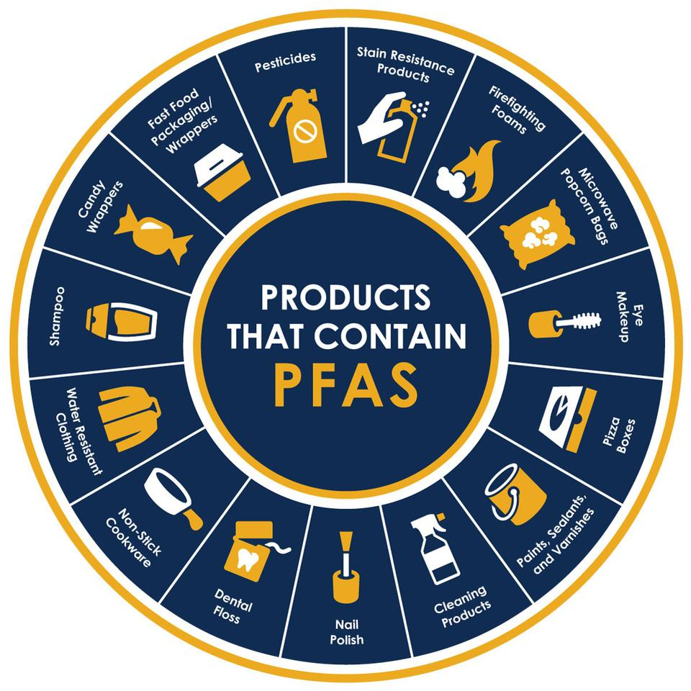
Products that contain PFAS
Microplastics: Impacts
  Carpet
  Cleaning Products
  Construction Materials
  Cookware
  Furniture
  Hand Soaps
  PPE
  Paints, Primers, and Coatings
  Refrigerators, Freezers, and Ice Makers
  Clothing
Understanding PFAS,2020
A Slick New Guide to Avoiding PFAS (Forever Chemicals) in Products Using Massachusetts Statewide Contracts (2025)
Notes:
Avoiding PFAS Guide Massachusetts Guide
Items such as carpet tile, carped padding, cleaning products for all parts of the house, insulation, ceiling tiles, non-stick pans, baking sheets, chairs, couches, foam products, lotion products, PPE such as face masks and gowns, paints and waterproofing sealants, and all types of clothing and textiles. As you can see, there are PFAS molecules in almost everything you can think of.

Slide 28
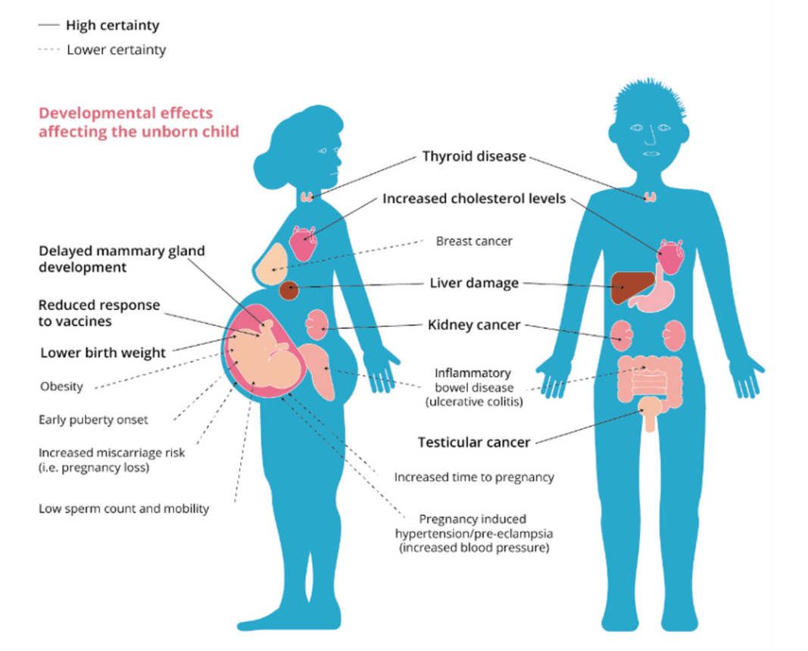
PFAS Effects
Microplastics: Impacts
  Potentially cause effects for:
    Endocrine system
    Reproductive Issues
    Birth & Developmental issues
    Cancer
    Immune system damage
Health Impacts- PFAS Contamination in Agriculture
Johnson, 2020; Ghosh, 2021
Notes:
While the effects of PFAS are still quite unknown, they are theorized to have similar effects as many other harmful chemicals such as the ones listed on the screen.
Speaker may also go through and discuss the specific effects on the picture.

Slide 29
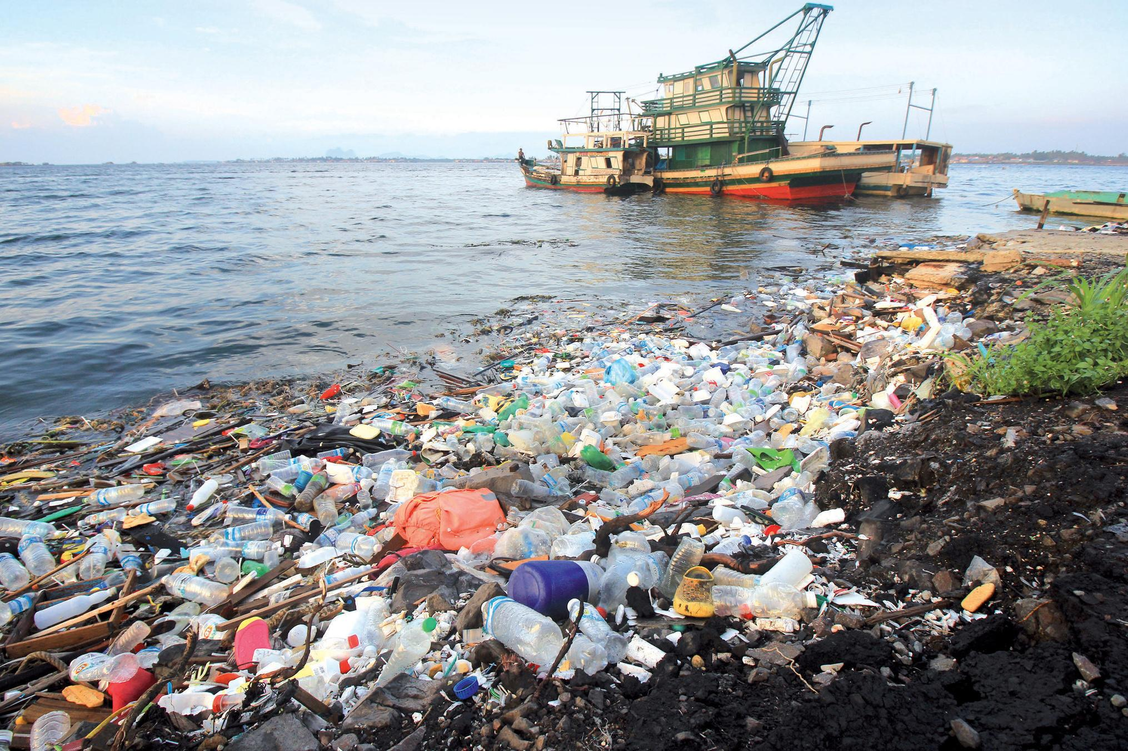
Next Step
Microplastics
Discussion
Chatterjee & Sharma, 2019

Slide 30
How to stop them
Microplastics
Microplastics

Slide 31
Workshop Goals 2
Microplastics
Workshop Goals
  How individuals can take practical steps to reduce microplastic pollution
  2. How municipalities can take charge
By the end of the workshop participants will understand:

Slide 32
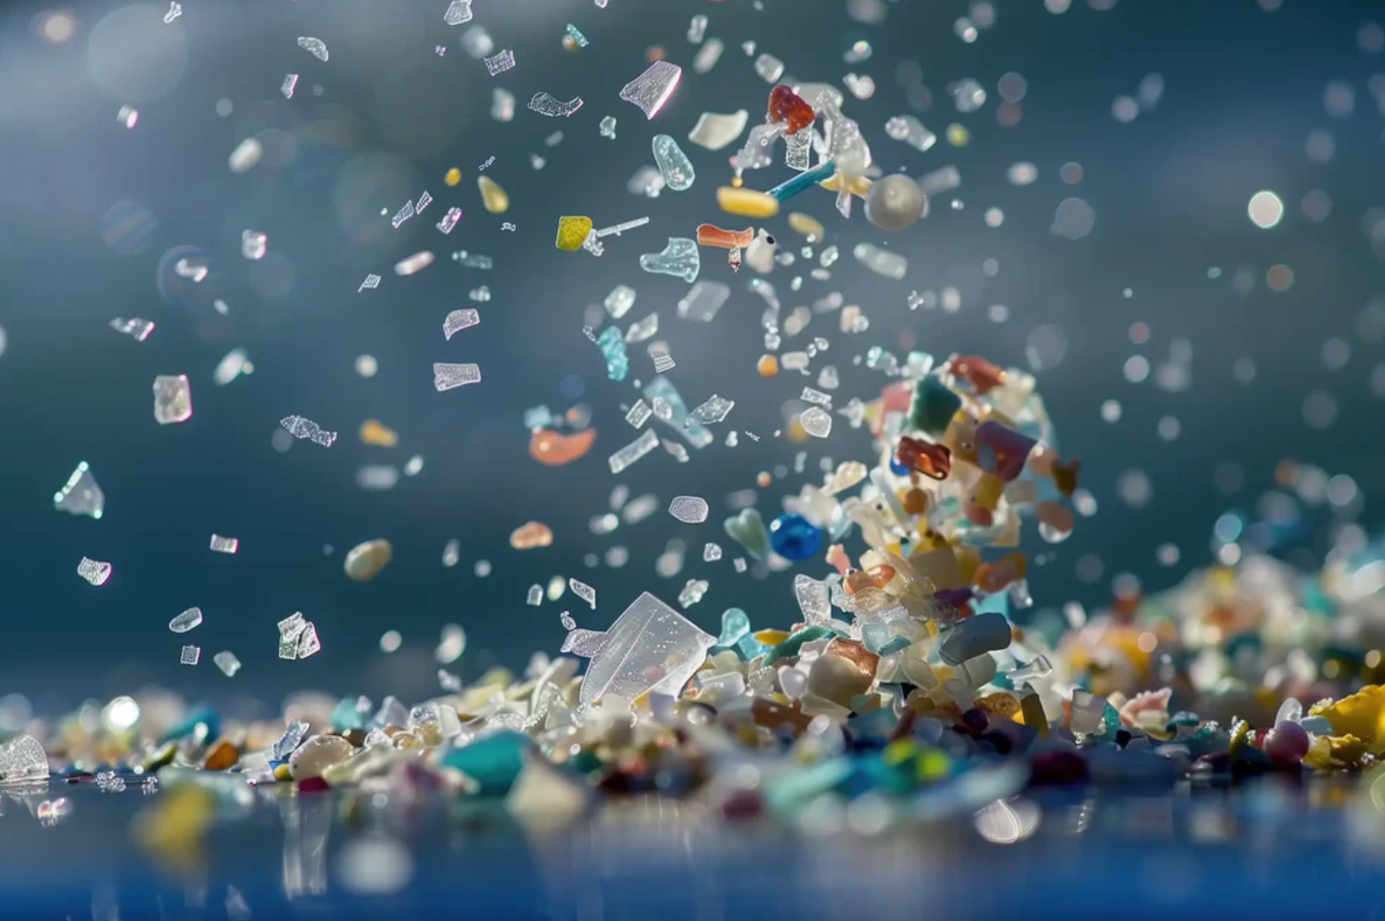
Workshop Agenda
Microplastics
Agenda
  Short Summary
  2. Discuss individual, community, and policy changes
  3. Wrap-Up
Flanagan, 2025

Slide 33
Review
Microplastics: Review
Primary vs. Secondary Microplastics
Common Sources
Impacts
Now: What You Can Do
Singh, 2025
Notes:
As discussed before primary microplastics are ones that are produced to that size and secondary microplastics are ones that become that way after weathering, ripping, etc. The most common sources of microplastics are urban runoff, textiles, wastewater effluent, and packaging. These microplastics have an impact on the ecosystem, marine life, and humans. Research into PFAS could be helpful to look into to understand the effects on humans from these forever chemicals. Now we are going to discuss what individuals and communities can do to avoid putting these out into the environment.

Slide 34
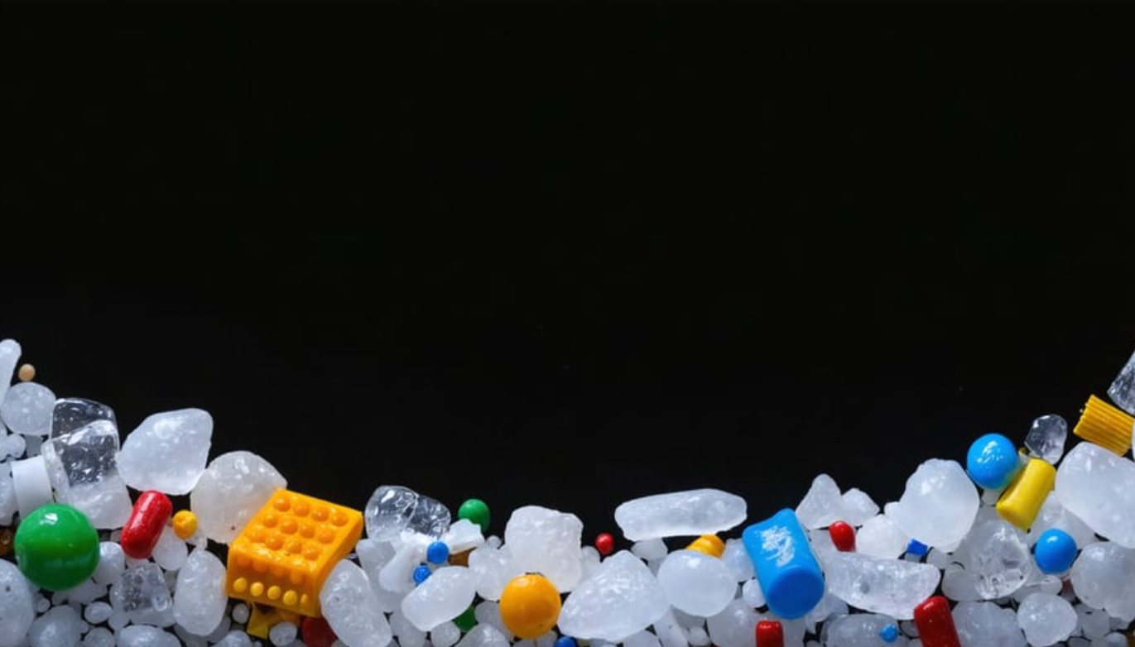
Individual
Microplastics: Actions
The Invisible Threat: How Microplastics Are Devastating Marine Ecosystems

Slide 35
Remember: Sources of Single Use Plastic?
Microplastics
Notes:
Have the group name as many single use plastics they can remember from the presentation before or more

Slide 36
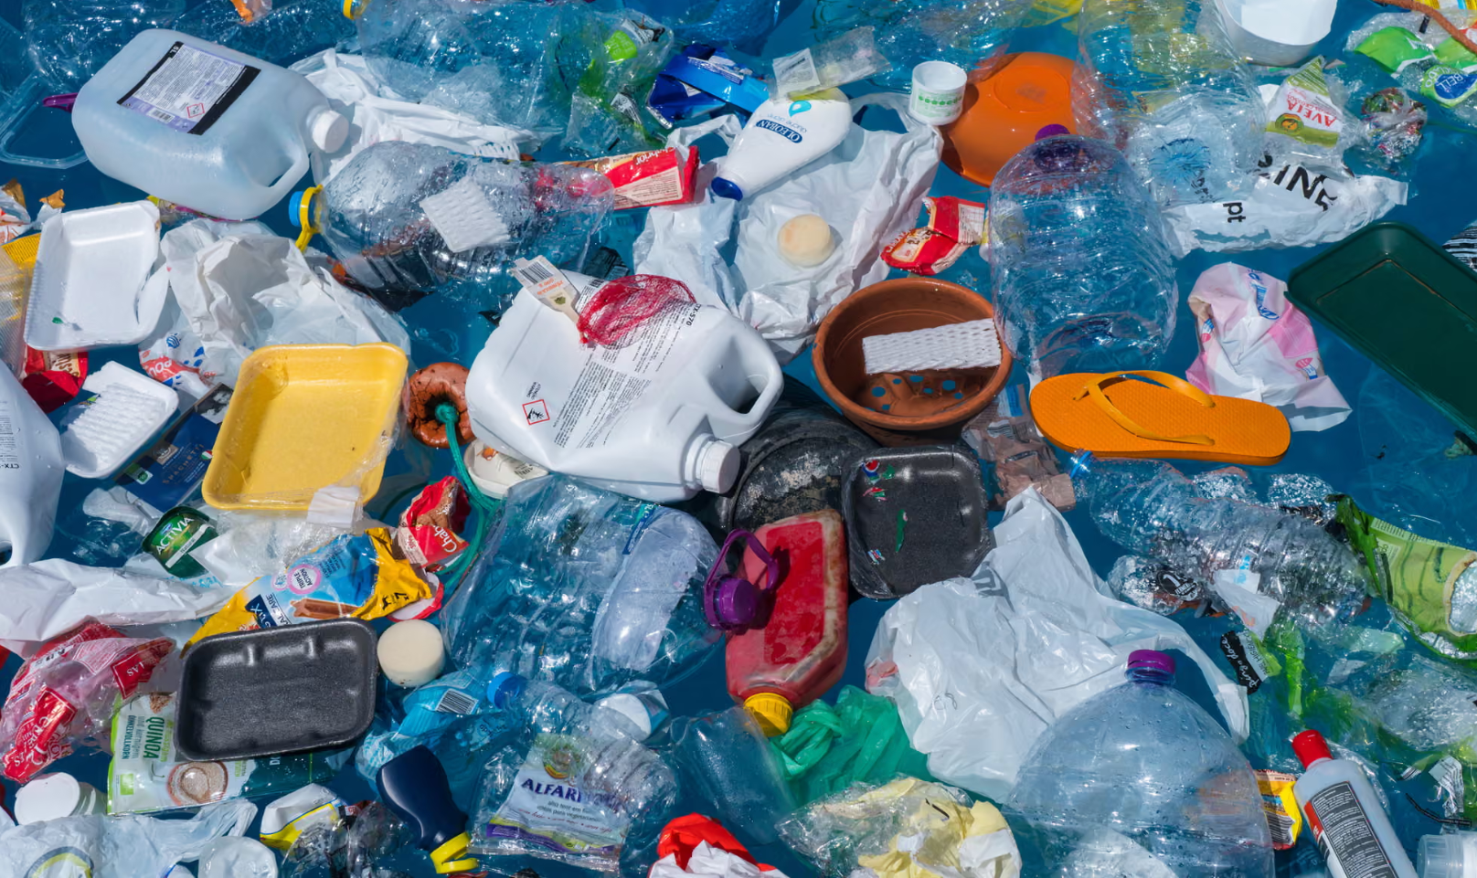
Avoid Single-Use Plastics
Microplastics: Individual Actions
By avoiding single-use plastics you are creating more sustainable choices for not only yourself, but the environment
Singh, 2019
Notes:
Avoiding using single use plastics is important because it positively affects your health since you are limiting access to the harmful chemicals that are attached to microplastics. Also limiting the amount of plastic that ends up as pollution and harms wildlife.
Concrete examples of ways to do this (dishwasher pods, toothpaste bars, detergent bars)

Slide 37
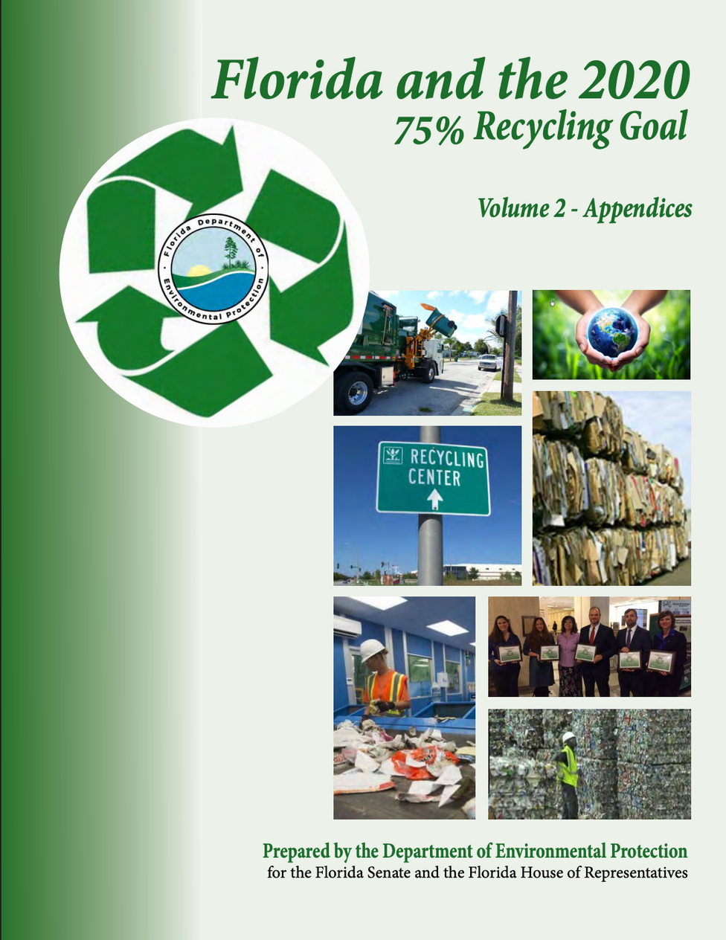
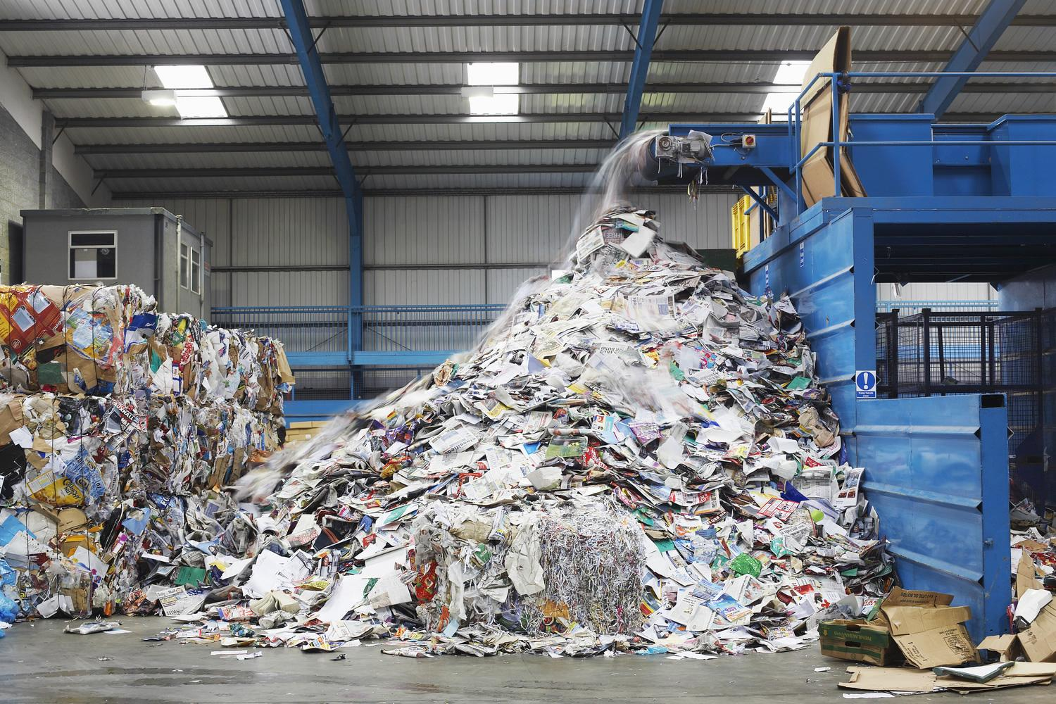
Disposal and Recycling
Microplastics: Individual Actions
Recycling Center
Important that citizens recycle, but also imperative that they are doing so properly
Viscusi et al., 2018; Florida and the 2020 75% Recycling Goal
Notes:
The intensity of recycling in the US is dependent on the state laws that make it possible and easy for the general public to do so. For example, in other states it is mandatory that residents must recycle, but in Florida residents have the opportunity to recycle (Viscusi, Huber, & Bell 2018). Proper disposal and recycling of plastics is very important to ensure that it can happen properly. While in Florida each county has differences in their recycling techniques, overall Florida has a 75% recycling goal. This goal was to recycle 75% of municipal solid waste by 2020. While a few counties were able to reach this goal, overall the state fell short at 50% instead of 75% (FDEP). While new programs have been implemented to increase the amount of recycling happening, it is also important that people know how to recycle properly.

Slide 38
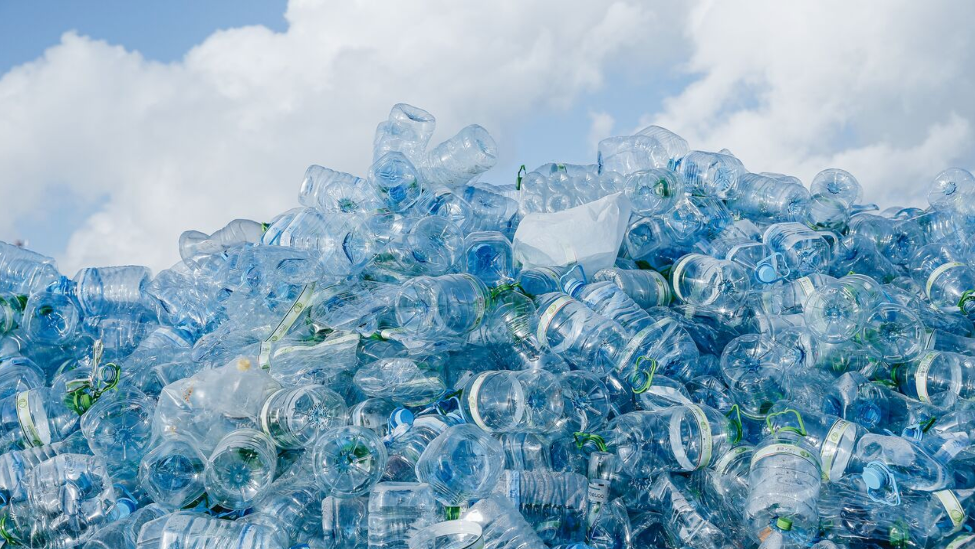
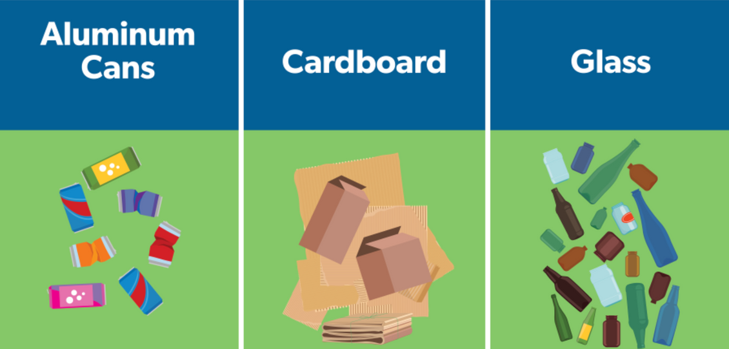
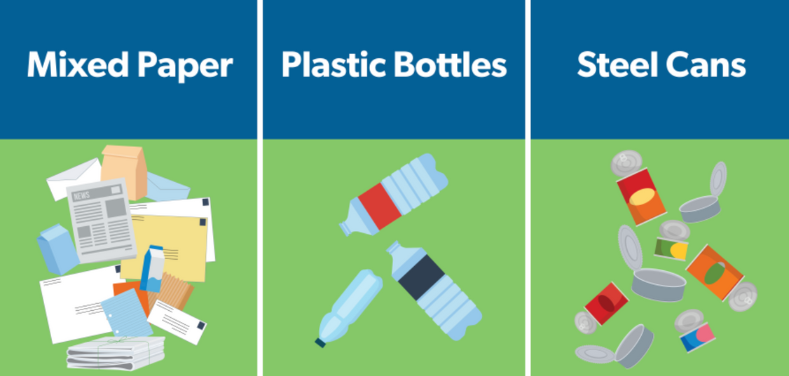
How to Recycle These Common Items?
Microplastics: Individual Actions
FloridaRecycles- Rethink. Reset. Recycle.
Notes:
Have the audience go through and describe how they believe they can recycle each of these items. Then briefly go through each one, leaving the plastic one for the next slide:
When it comes to recycling aluminum cans it is important to rinse, drain, and completely dry them to avoid residue attract insects. Crushing them to save room will ensure that you can fit more recyclable items in the recycling bin. Not reusing the cans is important because different things in the cans may cause contamination preventing it from being recycled.
For recycling cardboard, it is important to make sure that the cardboard is clean and dry. For example the greasy tops of pizza boxes are not able to be recycled. Also taking plastics out of cardboard and flattening the boxes is important for creating enough room.
To recycle glass its important to look up your county's regulations for recycling glass, but typically in Alachua county, you can only recycle jars and bottles
Mixed paper includes books, magazines, mail, paper, and newspaper. It can go in curbside bins as long as its clean and dry.
For steel cans, some come with a paper lab on the outside, which you do not need to remove. All you need to do is rinse the cans and then take off the libs and put them inside the cans.
We will talk about how to properly recycle plastics now.
https://floridarecycles.org/

Slide 39
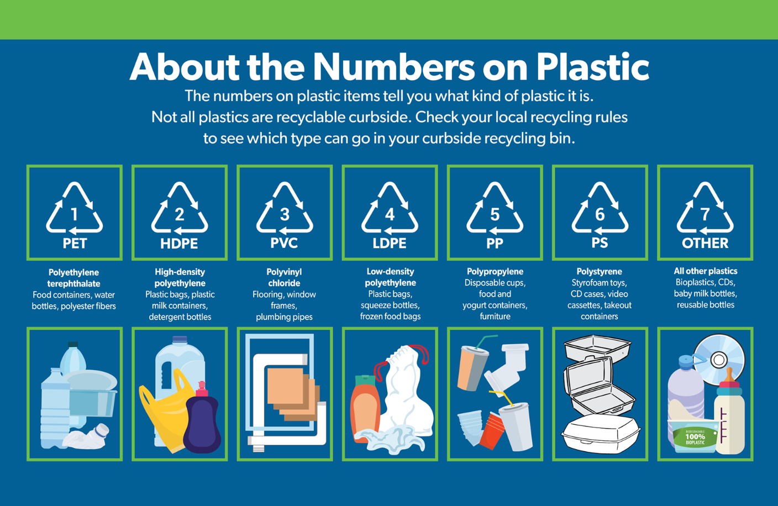
Recycling Plastics
Microplastics: Individual Actions
  Try not to purchase single use plastics in the first place
  If you must purchase them, look at the labels to make sure they can be recycled
  Rinse the bottles and take off the labels if they are able to go in curbside bin
  If not, must go to recycling centers to properly dispose of them
FloridaRecycles- Rethink. Reset. Recycle.
Notes:
When it comes to recycling plastic bottles, trying not to purchase them is the first step. The less consumers buy them, the less likely they are to go out into the environment to become secondary microplastics. If buying them, look at the number on the bottom of the container to make sure that it can be recycled, as some plastics cannot be. If they can be, the numbers will tell whether they can be recycled with other plastics in the curbside bin or if you have to go to a recycling bin.
PET and HDPE are the easiest plastics to recycle. PET are your typical soda and water bottles, while HDPE are more of detergent and milk jugs.

Slide 40
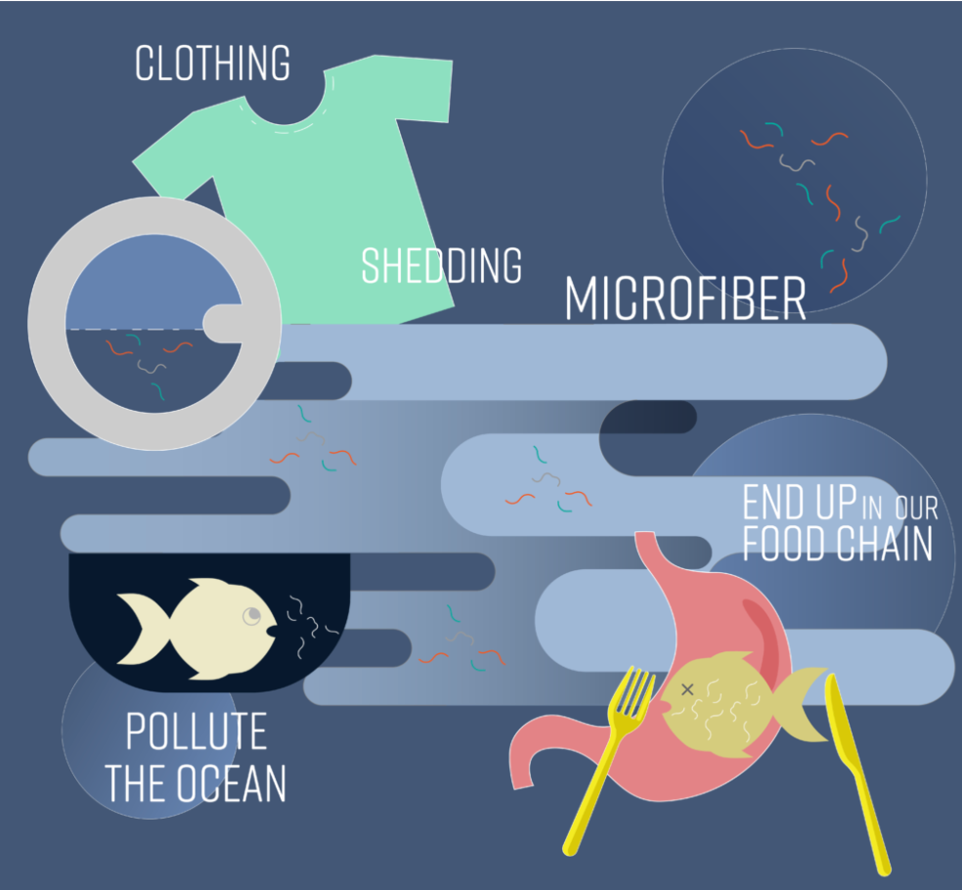
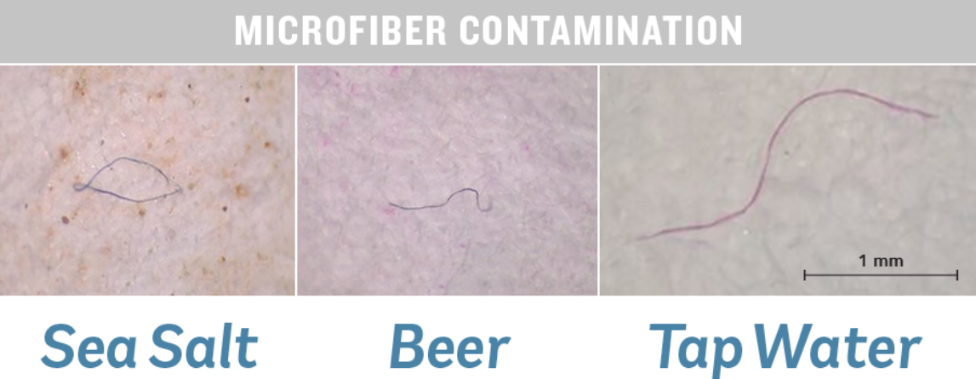
Limit Synthetic Fibers
Microplastics: Individual Actions
O’Connor 2018
Limit the release of microfibers in the environment by:
  Purchasing Natural Fibers
  Avoiding Fast Fashion
  Investing in Long-Lasting Pieces
  Using Mild/Liquid Detergent
  Short and Cold Wash Cycles
O’Shea 2023
Microplastics from textiles: towards a circular economy for textiles in Europe, 2022
Notes:
There are many things to do in order to limit the amount of synthetic fibers that you purchase and how to prevent your textiles in general from shedding microfibers into the environment. Purchasing fabrics and textiles with natural fibers is helpful because while they still do shed, it is a lot less than synthetic ones. Avoiding buying from fast fashion companies also prevents the sale of synthetic fibers and items that will have little use. Investing in long-lasting good quality clothing instead will not only be helpful for you, but also for the environment. Using mild/liquid laundry detergent is helpful because using powdered ones are more abrasive on the fabric and cause more microfibers to come off. Using short cycles can prevent the length of time that clothing is being tugged for and using cold water is helpful in preventing more tears as well.

Slide 41
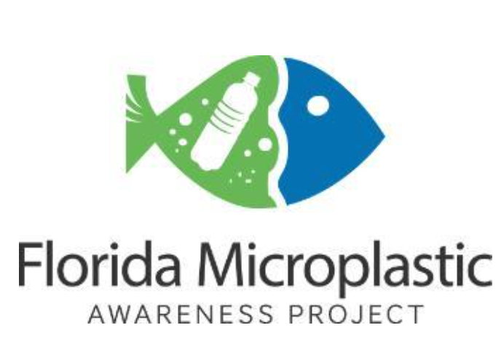
The Pledge
Microplastics: Individual Actions
Singh, 2025
Notes:
picture link: https://www.azom.com/article.aspx?ArticleID=24308

Slide 42
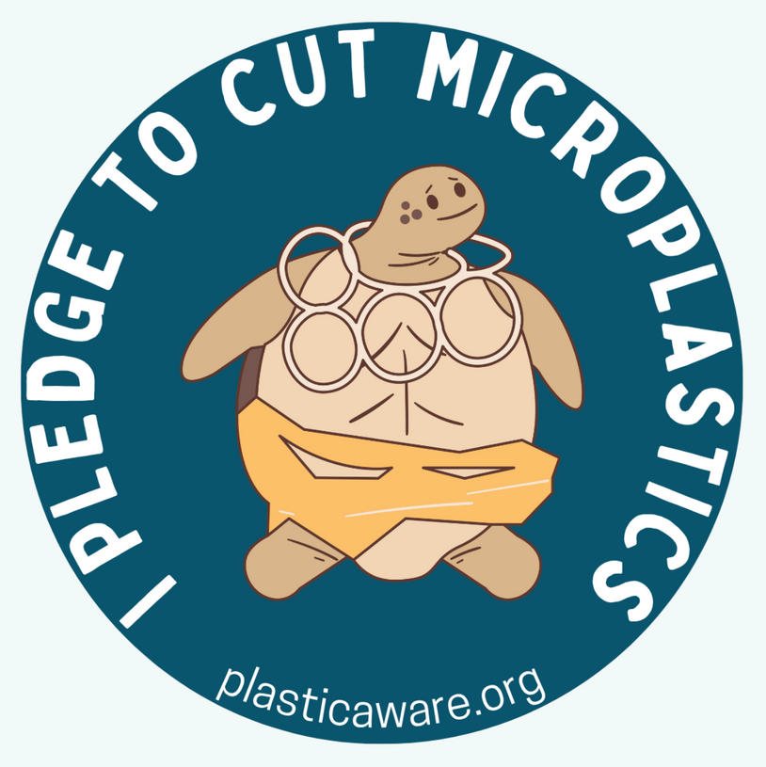
Actions in Pledge
Microplastics: Individual Actions
  Read labels on personal care products and avoid products containing polyethylene
  Use paper or reusable shopping bags instead of single use plastic ones
  Avoid using plastic straws
  Bring reusable water bottle/cup instead of single-use
  Bring washable coffee/hot drink cup instead of using a disposable one
  Bring foil or washable to container for leftovers or lunch
  Recycle as many plastic items as possible
  Choose more natural fabrics rather than microfiber or synthetic ones
Notes:
The pledge is a part of the Florida Microplastics Awareness Project and is a way to keep yourself responsible for keeping microplastics out of the environment. Consists of a small survey of different actions that you may already take or will take to reduce your microplastic contribution.

Slide 43

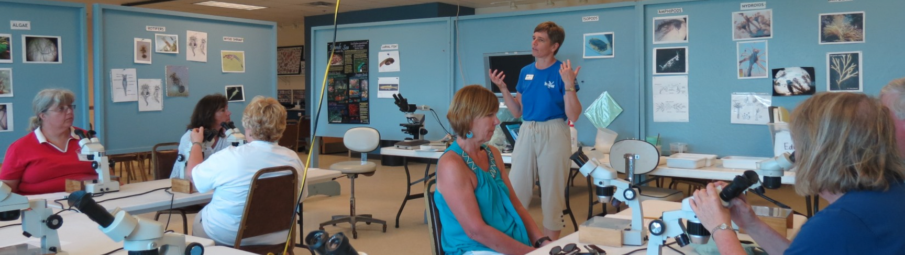
Volunteering
Microplastics: Individual Actions
Take the Pledge!
Citizens can volunteer to help with two aspects of the Florida Microplastics Awareness Project:
  Collecting Data
  Educational Outreach
Notes:
Taking the pledge is very simple and can be done on your phone! If you are interested, you can scan the QR code on the screen.
Another aspect of the citizen science project with the Florida Microplastic Awareness Project is volunteers that are able to help with two aspects of the project. One is more hands on where volunteers are able to collect water samples, filter them, and see if you are able to find microplastics. The other aspect of the project is educating the people around you, the community, or stakeholders about microplastics. Both are incredibly useful and to find more information you can look up Florida Microplastic Awareness Project to find educational videos, outreach materials, and more information on how to get involved.
https://flseagrant.ifas.ufl.edu/microplastics/

Slide 44
Municipalities & Nations
Microplastics
The Invisible Threat: How Microplastics Are Devastating Marine Ecosystems
Notes:
Now we are going to discuss what municipalities and nations are able to change to reduce microplastics

Slide 45
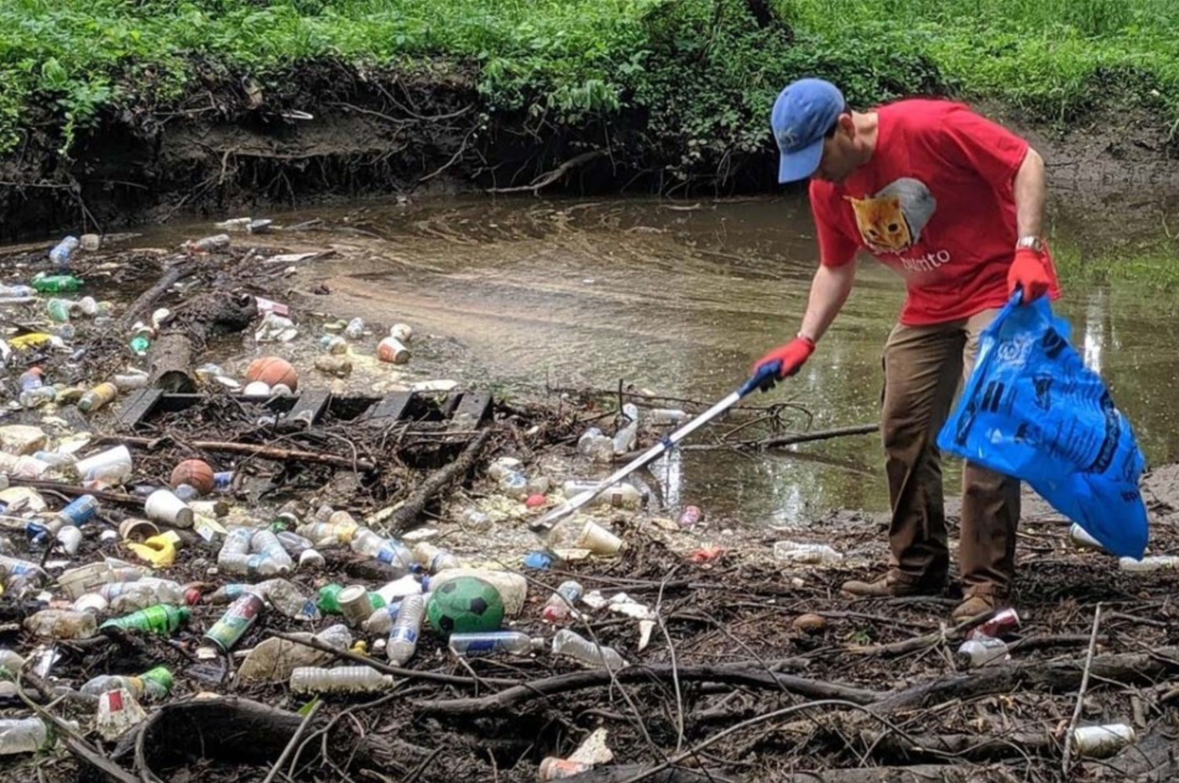
Community Cleanups
Microplastics: Municipalities & Nations
  Prevents the creation of secondary microplastics
  Raises public awareness of plastics in local environment
  Citizens can with local cleanup businesses
Crider 2024
Notes:
Community cleanups in different environments such as parks, creeks, next to roadways, and more would benefit the environment by getting rid of larger pieces of plastic that can degrade and become secondary microplastics. Doing this in public spaces can also raise awareness of these plastics and encourage others to volunteer to preserve their local environments. People can do this by researching their local cleanup business and working with them or joining clubs that host volunteering workshops.

Slide 46


Green Infrastructure
Microplastics: Municipalities & Nations
Bioretention systems 2020
Infrastructure such as:
  Bioretention Systems
  Stormwater Ponds
  Permeable Pavements
  Constructed Wetlands
Garcia-Haba et al. 2024
Filters out about 28-99% of large plastics before it reaches other bodies of water
Garcia-Haba et al. 2024; Ahmad et al., 2025
Notes:
Green infrastructure is typically use for stormwater management and can be useful in filtering out microplastics before it reaches large bodies of water and can provide other environmental benefits in the process.
Different green infrastructures like bioretention systems, stormwater ponds, permeable pavements, and constructed wetlands have the potential to remove microplastics from 28%-99% with large particles. Smaller particles are harder to remove (Ahmad, T, et al.). Permeable pavements are better at absorbing microplastics that are less than 0.1mm in size (Garcia-Haba).

Slide 47

Improving Education
Microplastics: Municipalities & Nations
Microplastics
Actions to Improve Education:
  Providing alternatives to single-use plastic available in public spaces
  Uploading infographics and videos on social media
  Hosting workshops
  Putting posters up in public spaces
  Creating new educational materials on reducing microplastics
  Educating local schools
Notes:
A few ideas that could improve education throughout a community could be providing alternatives to single use plastics, hosting workshops such as this one, educating local schools or including it in the curriculum and much more.
When it comes to alternatives in public spaces, especially in Gainesville, UF would have a big impact on doing that. The product stewardship institute put out a paper about Marine Debris & Plastic Source Reduction Toolkit on how to specifically do that on college campuses. This could be a great starting point for public areas, especially ones that contain universities and colleges.
Advocating for local ordinances that limit plastic use is also an important way to improve education of not only citizens in your area, but local officials of issues that they might not have been paying attention to before. Doing this pushes legislation forward and creates a community of individuals advocating to improve societies future. Going to public meetings, connecting with local officials, and creating/joining groups that have the same beliefs all bring awareness to a problem we are collectively facing.

Slide 48

Bioplastics
Microplastics: Municipalities & Nations
  Bioplastics are biodegradable plastics created from bacteria
  Has its own pros and cons
  Polyhydroxyalkanoates (PHAs) are one of the most studied and most similar to everyday plastics
Yildiz 2023
Plastic, 2025; Tyagi et al., 2021
Notes:
Bioplastics are plastics made of biodegradable polymers that are created from bacteria and mimic the properties of plastics. The difference is that since they are biodegradable and biocompatible, which give them the potential to take less time to decompose, making them better for the environment. That is still being studied and are still subject to staying in bodies of water for an indefinite time. Also more expensive to produce.
Polyhydroxyalkanoates are one of the most popular substitutes for regular plastics, but again the cost to produce them is quite high.

Slide 49

Increase Filtration Systems
Microplastics: Municipalities & Nations
More extensive filtration systems in industrial processing sites and thermal treatment for leftover sludge will prevent microplastics from moving into the environment
de Oliverira et al. 2023
Microplastics from textiles: towards a circular economy for textiles in Europe, 2022
Notes:
During sewage treatments, small microplastics tend to go through the filtering systems already set up, so incineration/thermal treatment can be useful for the sludge that is accumulated and used in the future for fertilizer.
Industrial processing of synthetic fibers is another major way that microfibers are getting into waterways. Having better treatment plans on the waste water would prevent more of it from going out into the environment. Also since for synthetic fabrics most of the microfibers are released during the first 5-10 washes, pre-washing at industrial sites with increasing waste water filtration would be helpful
(https://www.eea.europa.eu/publications/microplastics-from-textiles-towards-a)

Slide 50

Successes So Far
Microplastics
How Microplastic Filtration in Wastewater Treatment Tackles Overlooked Pollution 2024
Notes:
Lastly lets talk about a couple of successes in the world of preventing microplastics so far

Slide 51


Microbead-Free Waters Act
Microplastics: Successes
Products that contained microbeads:
  Body Scrubs
  Toothpaste
  Body Washes
  Lip Sticks
  Eyeliner
  Sunscreen
  Deodorant
  Cleaning Products
Amended the Federal Food, Drug, and Cosmetic Act to ban rinse off cosmetics containing microplastics
The Hidden Microplastics in our Homes: Microbeads, 2024
What are microbeads and why are they ruining the environment
McDevitt et al., 2017
Notes:
Passed in 2015, it amended the Federal Food, Drug, and Cosmetic Act to ban rinse off cosmetics that contain intentionally-added plastic microbeads in 2018 and the manufacturing of them in 2017.
While the ban was in general helpful in preventing microbeads from getting into the environment, it still overlooked a few things. It only reduces one source of microplastics in the environment and arguably does not target the greatest hazard. It also groups all plastics the same, including ones that are bioplastics and are not effecting the environment as much (McDevitt).

Slide 52

France’s Anti-Waste Law for a Circular Economy
Microplastics: Successes
Includes changes such as:
  Zero Disposable Plastic by 2040
  Reusable Tableware at Fast Food Restaurants
  Ban of Plastic Bags
  Plastic Microfiber Filter on Washing Machines
  Water Fountains Available
  No Plastic Packaging around Produce
  & Much More
Ministère de la Transition Ecologique 2020
Microplastics from textiles: towards a circular economy for textiles in Europe, 2022
Notes:
In January of 2020, France passed the Anti-Waste Law for a circular economy which is made up of 5 parts including phasing out of disposable plastic, better informing consumers, fighting against waste and for solidarity reuse, acting against planned obsolescence, and better production. The actions listed on the screen are a part of the phasing out of disposable plastic parts, but this is only a small amount of the changes that have already been made since 2020. There are fifty measures that France is taking to create new obligations, prohibitions, and tools for controlling what is entering the environment (european union document)

Slide 53

Recap
Microplastics
Notes:
https://www.youtube.com/watch?v=kDgIg4uIEJk

Slide 54
Further Questions?
Microplastics
Resources:
  Anna Braswell (a.braswell@ufl.edu)
  Local Extension Office
  Florida Microplastics Awareness Project Website
Actions to take:
  Reflect on your plastic use habits
  Research local cleanups
  Be the change!

Slide 55
Thank you!
Microplastics

Slide 56
References: Information
References: Information
Ahmad, T., Gul, S., Peng, L., Mehmood, T., Huang, Q., Ahmad, A., Ali, H., Ali, W., Souissi, S., & Zinck, P. (2025). Microplastic mitigation in urban stormwater using green infrastructure: a review. Environmental Chemistry Letters, 1-26.
A Slick New Guide to Avoiding PFAS (Forever Chemicals) in Products Using Massachusetts Statewide Contracts. (2025). Responsible Purchasing Network for MA Operational Services Division.
Biodegradable Plastic Manufacturing Process. (2023). Indpro Engineering Systems. indpro.com/blog/biodegradable-plastic-manufacturing-process/#:~:text=Extrusion%20and%20Molding:%20The%20uniformly,pneumatically%20to%20the%20next%20step.
Florida and the 2020 75% Recycling Goal. Florida Department of Enviornmental Protection (Volume 2). floridadep.gov/sites/default/files/FinalRecyclingReportVolume2forweb.pdf
García-Haba, E., Benito-Kaesbach, A., Hernández-Crespo, C., Sanz-Lazaro, C., Martín, M., & Andrés-Doménech, I. (2024). Removal and fate of microplastics in permeable pavements: An experimental layer-by-layer analysis. Science of the Total Environment, 929, 172627. https://doi.org/10.1016/j.scitotenv.2024.172627
Ghosh, S. (2021). Tiny Microbeads-Threat to Human Life, Threat to Environment. Intl. J. Eng. Res. Tech, 10(1).
Glüge, J., Scheringer, M., Cousins, I. T., DeWitt, J. C., Goldenman, G., Herzke, D., ... & Wang, Z. (2020). An overview of the uses of per-and polyfluoroalkyl substances (PFAS). Environmental Science: Processes & Impacts, 22(12), 2345-2373. 10.1039/d0em00291g
Impact of How Plastic is Made. (2025). Conservation Law Foundation. https://www.clf.org/blog/how-plastic-is-made/
Iyare, P. U., Ouki, S. K., & Bond, T. (2020). Microplastics removal in wastewater treatment plants: a critical review. Environmental Science: Water Research & Technology, 6(10), 2664-2675. DOI: 10.1039/d0ew00397b
Jadhav, E. B., Sankhla, M. S., Bhat, R. A., & Bhagat, D. S. (2021). Microplastics from food packaging: An overview of human consumption, health threats, and alternative solutions. Environmental Nanotechnology, Monitoring & Management, 16, 100608.https://doi.org/10.1016/j.enmm.2021.100608
Johnson, N. M. (2020). Me-fas, you-fas, we all eat pfas: what to do about the forever chemical. Pittsburgh Journal of Technology Law and Policy, 21(1), 134-[ii]. 10.5195/tlp.2021.247
McDevitt, J. P., Criddle, C. S., Morse, M., Hale, R. C., Bott, C. B., & Rochman, C. M. (2017). Addressing the Issue of Microplastics in the Wake of the Microbead-Free Waters Act A New Standard Can Facilitate Improved Policy. Environmental Science & Technology, 51(12), 6611-6617.
McGuire, M., Yang, Y.Y., Rodriguez-Jorquera I.A., Toor G.S., Reisinger, A.J. (2019). Contaminants in the Urban Environment: Microplastics. Department of Soil, Water, and Ecosystem Services UF/IFAS Extension. https://doi.org/10.32473/edis-ss649-2015
Microplastics from textiles: towards a circular economy for textiles in Europe. (2022). European Environment Agency. https://www.eea.europa.eu/en/analysis/publications/microplastics-from-textiles-towards-a-circular-economy-for-textiles-in-europe
Plastic. (2025). Marine Debris Program. marinedebris.noaa.gov/what-marine-debris/plastic
Sajjad, M., Huang, Q., Khan, S., Khan, M. A., Liu, Y., Wang, J., ... & Guo, G. (2022). Microplastics in the soil environment: A critical review. Environmental Technology & Innovation, 27, 102408. https://doi.org/10.1016/j.eti.2022.102408
Tyagi, V. K., Kumar, M., An, A. K., & Cetecioglu, Z. (Eds.). (2021). Clean Energy and Resource Recovery: Wastewater Treatment Plants as Biorefineries, Volume 2. Elsevier.
Viscusi, W. K., Huber, J., & Bell, J. (2018). Lessons from ten years of household recycling in the united states. Environmental Law Reporter News & Analysis, 48(5), 10377-10380
Yu, Q., Hu, X., Yang, B., Zhang, G., Wang, J., & Ling, W. (2020). Distribution, abundance and risks of microplastics in the environment. Chemosphere, 249, 126059. https://doi.org/10.1016/j.chemosphere.2020.126059

Slide 57
References: Pictures
References: Pictures
All types of microplastics you should know. (n.d.). EuroPlas. https://europlas.com.vn/en-US/blog-1/all-types-of-microplastics-you-should-know
Betham, C. (2023). Tiny Nurdles are Causing Big Damage - Aston. Neumann University. https://learn.neumann.edu/neupress/tiny-nurdles-are-causing-big-damage
Bioretention systems | The different types & benefits. (2020). River Sands. https://www.riversands.com.au/understanding-bioretention-systems/
Chatterjee, S., & Sharma, S. (2019). Microplastics in our oceans and marine health. Field Actions Science Reports- The journal of field actions. http://journals.openedition.org/factsreports/5257
Chrobak, U. (2024). The Problems with Microplastics. UC Davis. www.ucdavis.edu/magazine/problem-microplastics
Crider, G. (2024). Annual Creek Cleanup. Friends of Little Hunting Creek. https://friendsoflittlehuntingcreek.org/annual-creek-cleanup/
de Oliveira, C. R. S., da Silva Júnior, A. H., Mulinari, J., Ferreira, A. J. S., & da Silva, A. (2023). Fibrous microplastics released from textiles: Occurrence, fate, and remediation strategies. Journal of Contaminant Hydrology, 256. https://doi.org/10.1016/j.jconhyd.2023.104169
Enabling Control Over a Wastewater Treatment Plant. (n.d.). Teltonika Networks. https://teltonika-networks.com/use-cases/industrial-automation/enabling-control-over-a-wastewater-treatment-plan
Flanagan, K. (2025). Should We Be Worried About Microplastics In Drinking Water? The Water Professor. The Water Professor
Florida and the 2020 75% Recycling Goal. Florida Department of Enviornmental Protection (Volume 2). floridadep.gov/sites/default/files/FinalRecyclingReportVolume2forweb.pdf
FloridaRecycles – Rethink. Reset. Recycle. (n.d.). Florida Department of Environmental Protection. https://floridarecycles.org/
García-Haba, E., Benito-Kaesbach, A., Hernández-Crespo, C., Sanz-Lazaro, C., Martín, M., & Andrés-Doménech, I. (2024). Removal and fate of microplastics in permeable pavements: An experimental layer-by-layer analysis. Science of the Total Environment, 929, 172627. https://doi.org/10.1016/j.scitotenv.2024.172627
Health Impacts - PFAS Contamination in Agriculture. (n.d.). MSU College of Agriculture and Natural Resources. https://www.canr.msu.edu/pfas/health-impacts-of-pfas
How Microplastic Filtration in Wastewater Treatment Tackles Overlooked Pollution. (2024). Lakeside Equipment Corporation. https://www.lakeside-equipment.com/microplastic-filtration-in-wastewater-treatment/
How to Avoid Microplastics in Water Bottles: The Harms & Fix. (n.d.). Carbon8. carbon8water.com/blogs/news/how-to-avoid-microplastics-in-water-bottles?srsltid=AfmBOoofnorv4yJeY-LIWNLllWb1i2yfz9BlAaK6CUbE_QC0lS1asWf7
Jadhav, E. B., Sankhla, M. S., Bhat, R. A., & Bhagat, D. S. (2021). Microplastics from food packaging: An overview of human consumption, health threats, and alternative solutions. Environmental Nanotechnology, Monitoring & Management, 16, 100608.https://doi.org/10.1016/j.enmm.2021.100608
Marine Debris & Plastic Source Reduction Toolkit For Colleges & Universities. (2015). Product Stewardship Institute. flseagrant.ifas.ufl.edu/media/flseagrantifasufledu/sea-grant/pdf-files/microplastics/marine-debris-plastic-reduction-toolkit-for-colleges-and-universities.pdf
Marshall, M. (2020, May 15). We may have missed half the microplastics in the ocean. New Scientist. https://www.newscientist.com/article/2243731-we-may-have-missed-half-the-microplastics-in-the-ocean/
Ministère de la Transition Ecologique. (2020). The Anti Waste Law in the daily lives of the French people: What does that mean in practice?. circulareconomy.europa.eu/platform/sites/default/files/anti-waste_law_in_the_daily_lives_of_french_people.pdf
Microplastics from textiles: towards a circular economy for textiles in Europe. (2022, February 9). European Environment Agency. https://www.eea.europa.eu/en/analysis/publications/microplastics-from-textiles-towards-a-circular-economy-for-textiles-in-europe
O'Connor, M. C. (2018). Humans, fish and other organisms are consuming microfibers. Ensia. https://ensia.com/features/microfiber-impacts/
O’Connor, M.C. (n.d.). Our clothes are contaminating our planet with tiny plastic threads. Ensia. ensia.com/features/microfibers/
O’Shea, A. (2023). Impact of Microfibers on the Environment. Presso. https://getpresso.com/the-impact-of-microfibers-on-the-environment-understanding-the-issue-and-taking-action/
PFAS. (n.d.). American Water Works Association. https://www.awwa.org/resource/pfas/
Plastic granules: what are they, applications, our grinding systems. (n.d.). Vismec. https://www.vismec.com/en/news/plastic-granules-applications/
Raubenheimer, K. (2024). Scientists reviewed 7,000 studies on microplastics. Their alarming conclusion puts humanity on notice. Greenpeace. https://www.greenpeace.org/aotearoa/story/scientists-reviewed-7000-studies-on-microplastics-their-alarming-conclusion-puts-humanity-on-notice/
Recycling Center. (n.d.). Orlando Recycling Inc. https://www.orlando-recycling.com/recycling-center.html
Roy, S., Sarkar, D.J., Mondal, K., Das, B.K. (2025). Introduction to Microplastics: A Global Perspective of an Alarming Contaminant in the Aquatic Ecosystem. In: Das, B.K., Kumar, V. (eds) Laboratory Techniques for Fish Disease Diagnosis. Springer, Singapore. https://doi.org/10.1007/978-981-96-4620-3_23
Singh, A. (2025). What Happens to Microplastics in the Ocean? AZoCleantech. www.azocleantech.com/article.aspx?ArticleID=1984
Singh, M. (2019, September 13). Most ambitious US law to tackle single-use plastics faces make-or-break moment. The Guardian. https://www.theguardian.com/us-news/2019/sep/13/california-plastics-legislation-single-use
The Different Types of Plastic Packaging and Their Uses. (2024). FlexiPack. https://www.flexipack.com/en/the-different-types-of-plastic-packaging/
The Hidden Microplastics in our Homes: Microbeads. (2024). 5 Gyres Institute. https://www.5gyres.org/newsroom/microbeads-ab823
The Invisible Threat: How Microplastics Are Devastating Marine Ecosystems. (n.d.). Marine Biodiversity Science Center. https://www.marinebiodiversity.ca/the-invisible-threat-how-microplastics-are-devastating-marine-ecosystems/
Thompson, A. (2018, September 4). From Fish to Humans, A Microplastic Invasion May Be Taking a Toll. Scientific American. https://www.scientificamerican.com/article/from-fish-to-humans-a-microplastic-invasion-may-be-taking-a-toll/
Understanding PFAS | riversideca.gov. (2020, December 7). City of Riverside. https://riversideca.gov/press/understanding-pfas
Wang, C., O'Connor, D., Wang, L., Wu, W. M., Luo, J., & Hou, D. (2022). Microplastics in urban runoff: Global occurrence and fate. Water research, 225, 119129.https://doi.org/10.1016/j.watres.2022.119129
What are microbeads and why are they ruining the environment? (n.d.). EcoSource. https://ecosourcejanitorial.com/2018/05/23/what-are-microbeads-and-why-are-they-ruining-the-environment/
Whiting, A. (2022). How to Solve the Problem of Plastic Packaging. WIRED. https://www.wired.com/story/plastic-waste-packaging/
Yildiz. (2023). The Rise of Bioplastics: A Greener Future for Packaging. Yelkenciler. www.yelkenciler.com/the-rise-of-bioplastics-a-greener-future-for-packaging/

