Slide 1
Seafood HACCP Alliance Segment Two Course
Course Number:
Course Location:
Course Date:
AFDO Region:
Instructor:

Slide 2
AGENDA (SHA Segment 2 Course)
PART 1: Lecture and Discussion
      FDA Seafood HACCP Regulation
      Using the Seafood Safety Hazards Guide
      Guidance for developing a HACCP Plans
PART 2: HACCP Group Exercise
      Practical group exercise to develop a model HACCP Plan
      Present HACCP Plan developed

Slide 3
Purpose of this Training
Individuals who complete this course will meet the training requirement of the FDA Seafood HACCP regulation and can do the following:
  Conduct a Hazard Analysis
  Develop a HACCP Plan for seafood products as required by the FDA regulation
  Reassess or modify a HACCP Plan as necessary and/or required by the FDA regulation
  Review HACCP Plan records as required by the FDA regulation

Slide 4
Expectations for Training
Seafood HACCP Alliance courses provide:
A basic introduction to the HACCP regulatory requirements for the processing of fish and fishery products.
Instructions and exercises to help learn how to use the seafood HACCP Guidance manual (FDA Guide) to conduct a Hazard Analysis and develop a HACCP Plan.
Receive explanations and examples for how to monitor the required Sanitation Control Procedures (SCP’s).

Slide 5
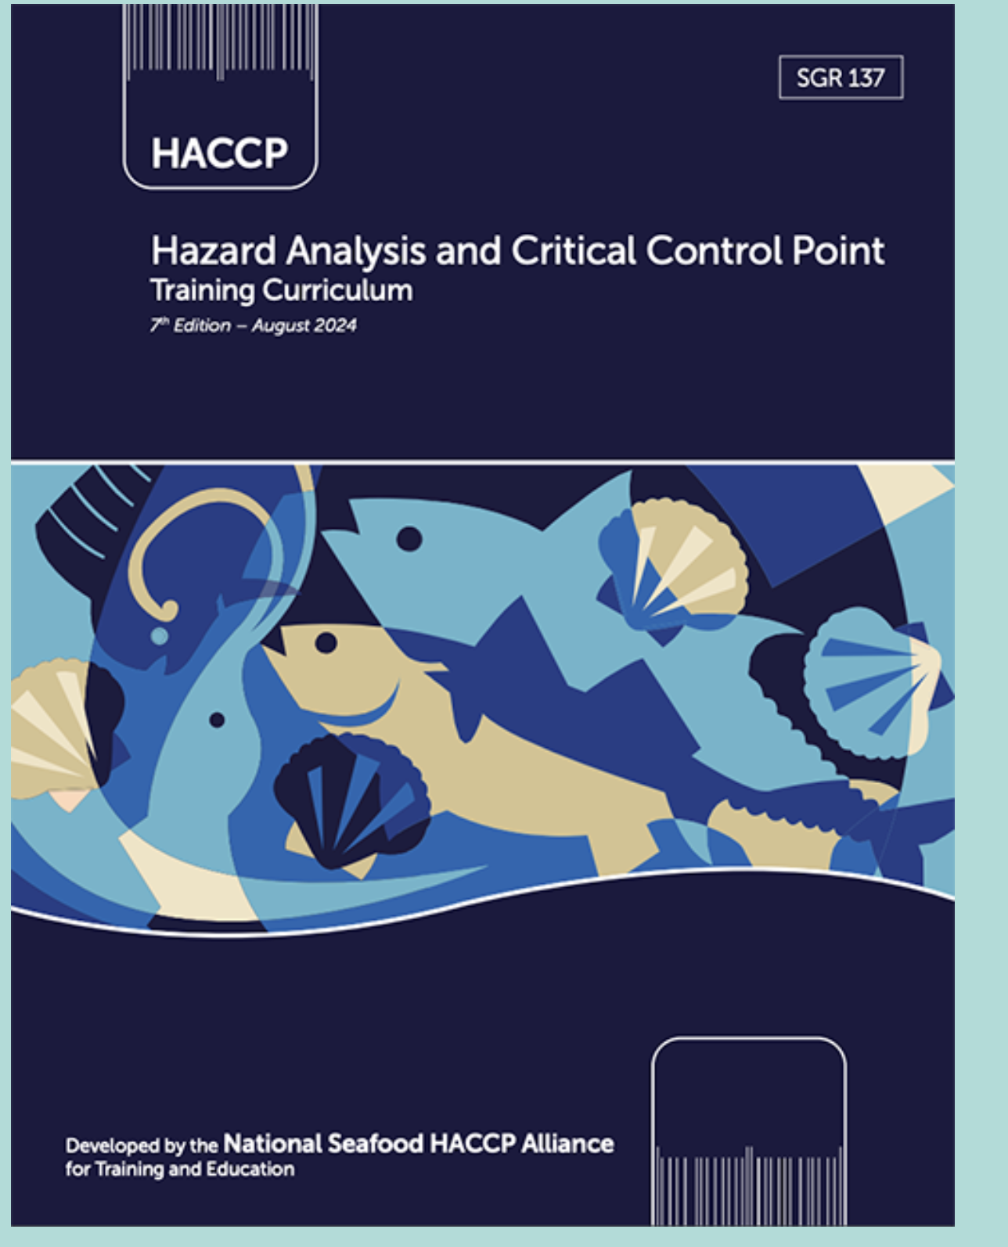
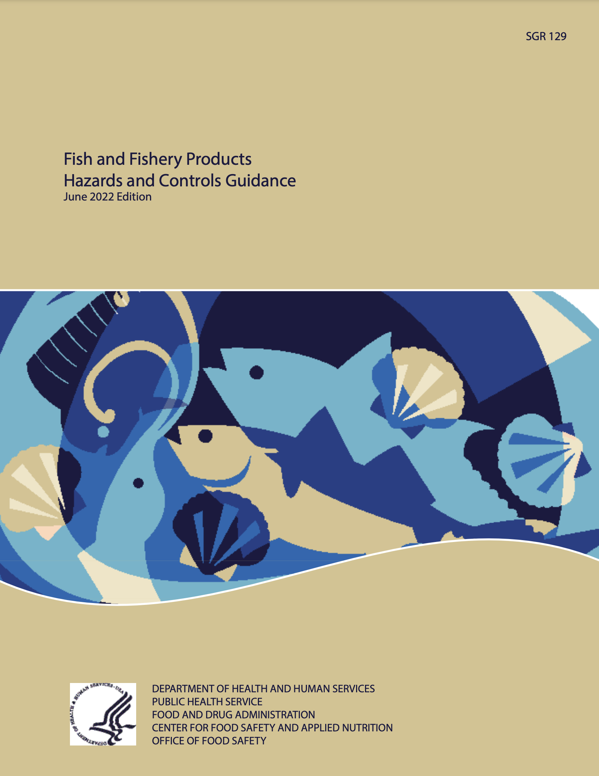
SHA Training Materials
SHA Curriculum
FDA GUIDE
BLUE BOOK
GOLD BOOK
5
5
Notes:
The blue box in the presentation slides indicates information sourced from the Blue Book, while the yellow box signifies information from the Gold Book.

Slide 6

FDA Seafood HACCP Regulation
21 CFR Part 123
Fish and Fishery Products
Seafood HACCP
  https://www.fda.gov/food/hazard-analysis-critical-control-point-haccp/seafood-haccp
Fish and Fishery Products Hazards and Controls
  https://www.fda.gov/food/seafood-guidance-documents-regulatory-information/fish-and-fishery-products-hazards-and-controls

Slide 7
FDA Seafood HACCP Regulation
21 CFR Part 123
Any fish or fishery products processed or imported in violation of this regulation can be considered adulterated and subject to regulatory action.
A processor is any person engaged in commercial, custom or institutional processing of fish or fishery products either in the U.S. or in a foreign country.
An importer is the U.S. owner/consignee or the U.S. agent/representative of the foreign owner/consignee at the time of the product entry into the United States.
CHP 12: 197
CHP 12: 192
CHP 12: 191
AD1 - 1

Slide 8
What Does Processing Include?
Processing means:
Handling, storing, preparing, heading, eviscerating, shucking, freezing, changing into different market forms, manufacturing, preserving, packing, labeling, dockside unloading, or holding fish or fishery products.
The regulation does not apply to:
  The harvest or transport of fish or fishery products
    Including aquaculture farms unless processing
  Practices such as heading, eviscerating or freezing intended solely to prepare a fish for holding on a harvest vessel
  The operation of a retail establishment
AD1 - 2
CHP 12: 192

Slide 9
What are fish or fishery products?
Fish means freshwater or saltwater finfish, crustaceans, aquatic animal life (including alligators, frogs, aquatic turtles, jellyfish, sea cucumbers, sea urchins and roe) other than birds or mammals, and all mollusks, where such animal life is intended for human consumption.
  Note: it is important to carefully read the definition of fish and note that mollusks (molluscan shellfish) are considered fish for purposes of this regulation.
Molluscan shellfish means any edible species of fresh or frozen oysters, clams, mussels, or scallops, or edible portions of such species, except when the product consists entirely of the shucked adductor muscle.
Fishery product means any human food product where fish is a characterizing ingredient, such as clam chowder or fish sauce.
All products intended for human consumption are covered.
AD1 - 2
CHP 12: 191

Slide 10
What MUST all seafood processors do?
Every processor shall conduct, or have conducted , a Hazard Analysis.
  Complete a Hazard Analysis to determine if there are any significant hazards associated with your products(species) or process.
Every processor shall have and implement a written HACCP Plan whenever a hazard analysis reveals one or more food-safety hazards that are reasonably likely to occur.
Monitor and keep records of monitoring results and corrections taken for 8 specified areas of sanitation.
The HACCP plan shall be signed and dated:
  By the most responsible individual at the processing facility or a higher level official.
    Signed and dated:
      Upon initial acceptance.
      Upon any modification.*
      At least annually.
      *This is a verification requirement.
CHP 12

Slide 11
What MUST all seafood processors do?
Processors are required to develop
and maintain a HACCP program, HACCP must be built upon current food safety programs such as:
Sanitation Control Procedures (SCPs—21 CFR 123.11)
Current Good Manufacturing Practices (cGMPs—21 CFR 117)
  These programs are known as “prerequisites” that provide a foundation for the HACCP program
HACCP
SCPs
cGMPs
CHP 1: 7
AD1 - 3
AD1 - 7

Slide 12
Sanitation Control Procedures (SCPs)
Seafood processors are required to comply with cGMPs, monitor SCPs, correct problems, and keep records of their monitoring results and the corrections made during all processing operations
As of 2016, the SCPs must be based on the most current Good Manufacturing Practices Part 117 that replaced GMPs Part 110
SCPs are not featured in this Segment Two HACCP course, but they are the essential and required foundation for all HACCP Programs
HACCP
SCPs
cGMPs 117
CHP 2: 15-21

Slide 13
Sanitation Control Procedures (SCPs)
Processors must monitor and keep records of monitoring results
and corrections for 8 key areas of sanitation:
Safety of water
Condition and cleanliness of food contact surfaces
Prevention of cross contamination
Maintenance of hand washing, hand sanitizing, and toilet facilities
Protection from adulterants
Labeling, storage, and use of toxic compounds
Employee health
Exclusion of pests
CHP 2: 17-21
AD1 - 8

Slide 14
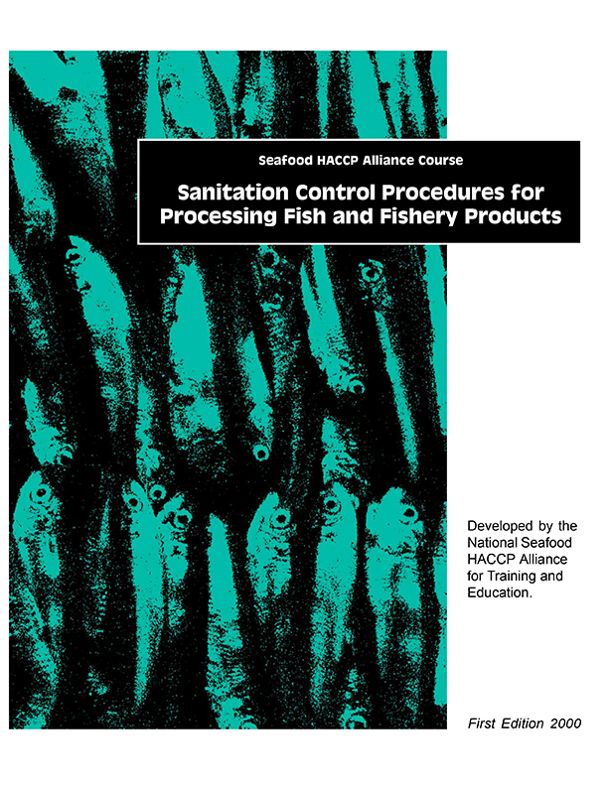
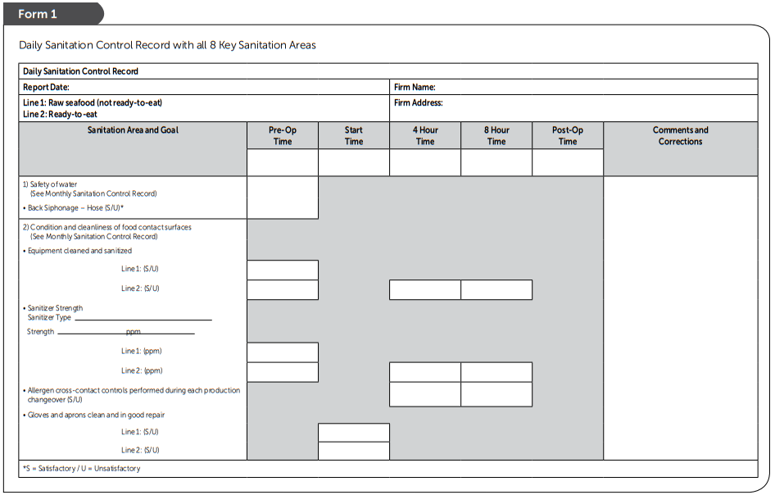
Sanitation Control Procedures (SCPs)
Example of Written Sanitation Standard Operating Procedures (SSOPs) and Records
SCP
Curriculum
SHA Curriculum
GREEN BOOK
BLUE BOOK
SSOP-4 to SSOP-16
CHP 2: 29-39
Source: Florida Sea Grant https://www.flseagrant.org/seafood/haccp/
14

Slide 15
Current Good Manufacturing Practices (cGMPs)
The new current GMPs (21 CFR Part 117 Subpart B) introduced additional requirements for all seafood processors:
Seafood processors are required to assess and record any necessary
SCPs controls to prevent cross-contact resulting in ‘unintended allergen presence’
HACCP
SCPs
Appendix 3: 233
cGMPs 117

Slide 16
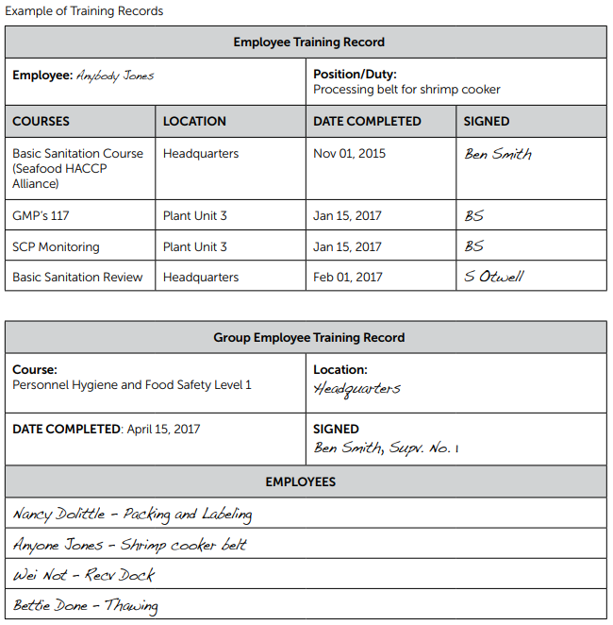
21 CFR Part 117 Subpart A: General Provisions
CHP 2: 13
Employee Training Records
Facilities are required to keep records that document the training on the principles of food hygiene and food safety for those who supervise or perform manufacturing, processing, packing, or holding activities for food.
Processors must maintain records of this training for 2 years.
There are no prescribed courses and performance remains the primary measure for effective training, but training records are mandatory

Slide 17
Required Parts of a HACCP Program
Every processor shall conduct, or have conducted for it, a hazard analysis to determine whether there are food safety hazards that are reasonably likely to occur for each kind of fish and fishery product processed by that processor and to identify the preventive measures that the processor can apply to control those hazards.
Every processor shall have and implement a written HACCP plan whenever a hazard analysis reveals one or more food safety hazards that are reasonably likely to occur…
AD1 - 3

Slide 18
HACCP Plan Requirements
Each of the 7 Principles of HACCP has a section in the FDA regulation with specific requirements related to that principle.
HACCP Plans must be specific for:
  Each kind of fishery product
    Products can be grouped if hazards, processing steps & controls are the same
  Each processing location
HACCP Plans must list all the required components for each identified food safety hazard (CCP, CL, monitoring, corrective actions, verification, recordkeeping).
HACCP Plans must be signed, dated & routinely implemented.
AD1 - 4

Slide 19
Review of 7 HACCP Principles

Slide 20
Review of 7 HACCP Principles
Conduct a Hazard Analysis:
Principle 1 – Conduct a Hazard Analysis (HA)
Principle 2 – Identify Critical Control Points (CCPs)
Build a HACCP Plan
Principle 3 – Establish Critical Limits (CL)
Principle 4 – Establish CCP Monitoring Procedures
Principle 5 – Establish Corrective Action Procedures (CA)
Principle 6 – Establish Verification Procedures
Principle 7 – Establish a Recordkeeping System

Slide 21
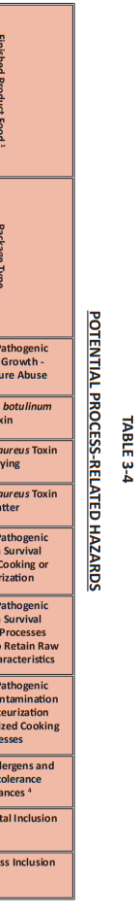
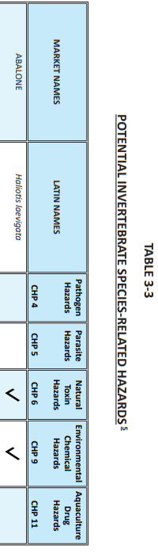
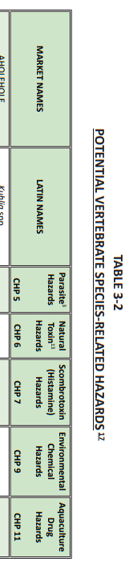
Principle 1: Conduct a Hazard Analysis
Identify and list ALL potential food safety hazards associated with the product and process.
Species Hazards
Process Hazards
CHP 5: 77
CHP 5: 81
CHP 3: 3-2
CHP 3: 3-4
CHP 3: 3-3
Notes:
Provide some example of process and species related hazards to your students
Pathogens from Harvest Area
Parasites
Natural Toxins
Scombrotoxin (Histamine)
Other Decomposition-related Hazards (Biogenic amines)
Environmental Chemicals
Methyl Mercury\
Aquaculture Drugs
12. Pathogen Growth & Toxin Formation
13. C. botulinum Growth & Toxin Formation
14. Pathogen Growth & Toxin Formation inadequate
drying.
15. S. aureus Toxin Formation in hydrated batters
16. Pathogen Growth & Survival through cooking
17. Pathogen Survival through process designed to retain
raw characteristics
18. Intro. of Pathogens after pasteurization and specialized cooking
19. Allergens & Food Intolerance Substances
20. Additives
21. Metal or Glass Inclusion

Slide 22
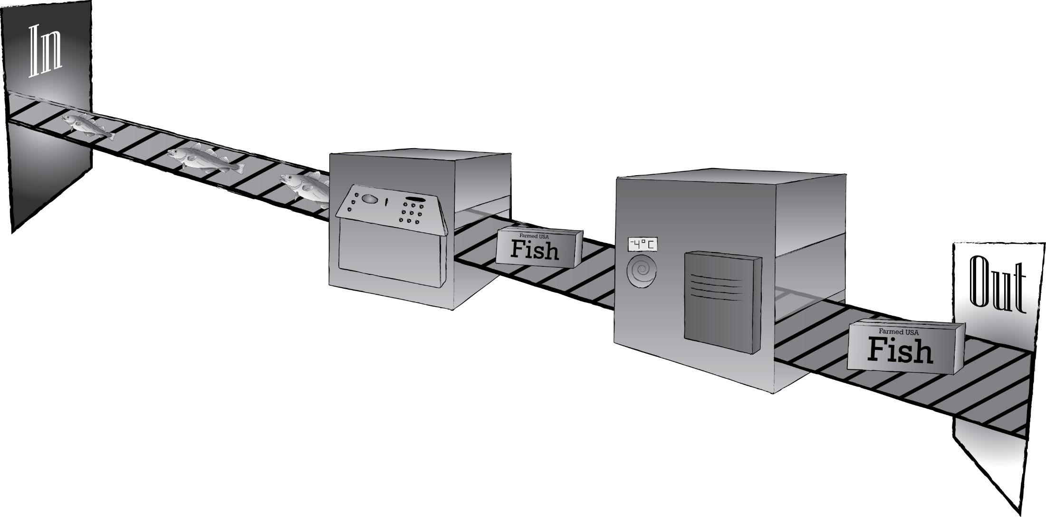

Principle 2: Identify Critical Control Points (CCPs)
Identify what processing steps can be used to control the significant hazards.
CHP 6: 99
Receiving
Refrigerated Storage
CHP 2: 25
Packaging
Processing

Slide 23
Principle 3: Establish Critical Limits
Critical limits specify the maximum and/or minimum value to which a parameter (temperature, time) must be controlled at a CCP.
Received from approved supplier with documentation to control aquaculture drugs
Label with species name must be present to control allergens
Temperature not to exceed 40°F to prevent pathogen growth
CHP 7: 109
CHP 2: 26
Not to exceed 1 hour to prevent pathogen growth

Slide 24

Principle 4: Establish CCP Monitoring Procedures
Determine what will be monitored, how it will be monitored, when it will be monitored and by who.
CHP 8:119
When: Continuously by logger and initialed 1x daily
What: Temperature
CHP 2: 26
How: Temperature Logger
Who:
QA Manager or other designated employee

Slide 25

Principle 5: Establish Corrective Actions
Determine what you will do if your critical limits are not met.
CHP 9: 129
If: Temperature exceeds 40°F.
Then: Move product to a working refrigerator and hold for testing
AND
Fix the broken refrigerator
CHP 2: 27

Slide 26
Principle 6: Establish Verification Procedures
Implement procedures for validating that your HACCP plan is working properly.
CHP 10: 141
HACCP Plan Assessment
CHP 2: 28
Process Validation
Equipment Calibration
Equipment Accuracy Checks
Targeted Sampling and Testing for Product Safety
Review of Calibration, Monitoring, Corrective Actions Records

Slide 27
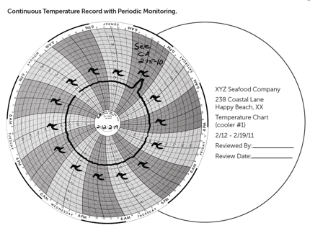
Principle 7: Establish Recordkeeping Procedures
Tracks all monitoring procedures, corrective actions, and verifications of your system to ensure standards are met and facility is in compliance.
CHP 11: 159
Form Title: Refrigerator Temperature Log (Monitoring Record)
Firm Name: |  |  |  | Firm Location:
Production Identification:
Critical Limits: |  |  | Monitoring Activities:
Date | Time | Storage Unit # | Refrigerator Temperature |  | Critical Limit Met (Yes/No) | Line Operator (Initials)
Reviewer Signature: |  |  |  |  | Date of Review:
CHP 2: 27

Slide 28
Potential Seafood Safety Hazards

Slide 29
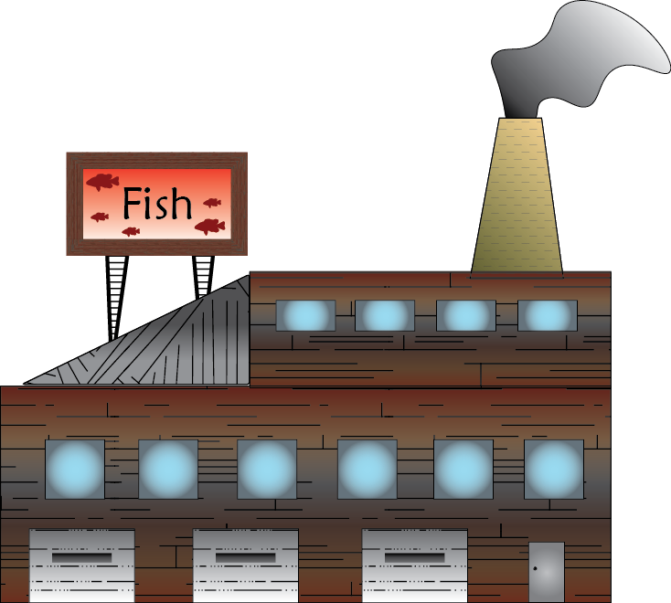
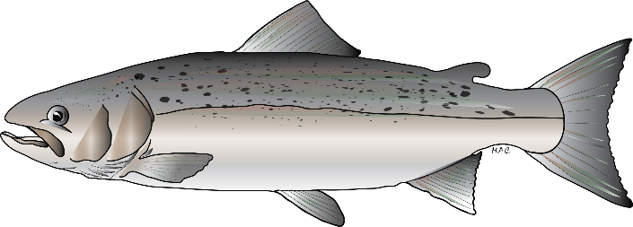
Potential Seafood Safety Hazards
Seafood
Species-Related Hazards
Process-Related Hazards

Slide 30
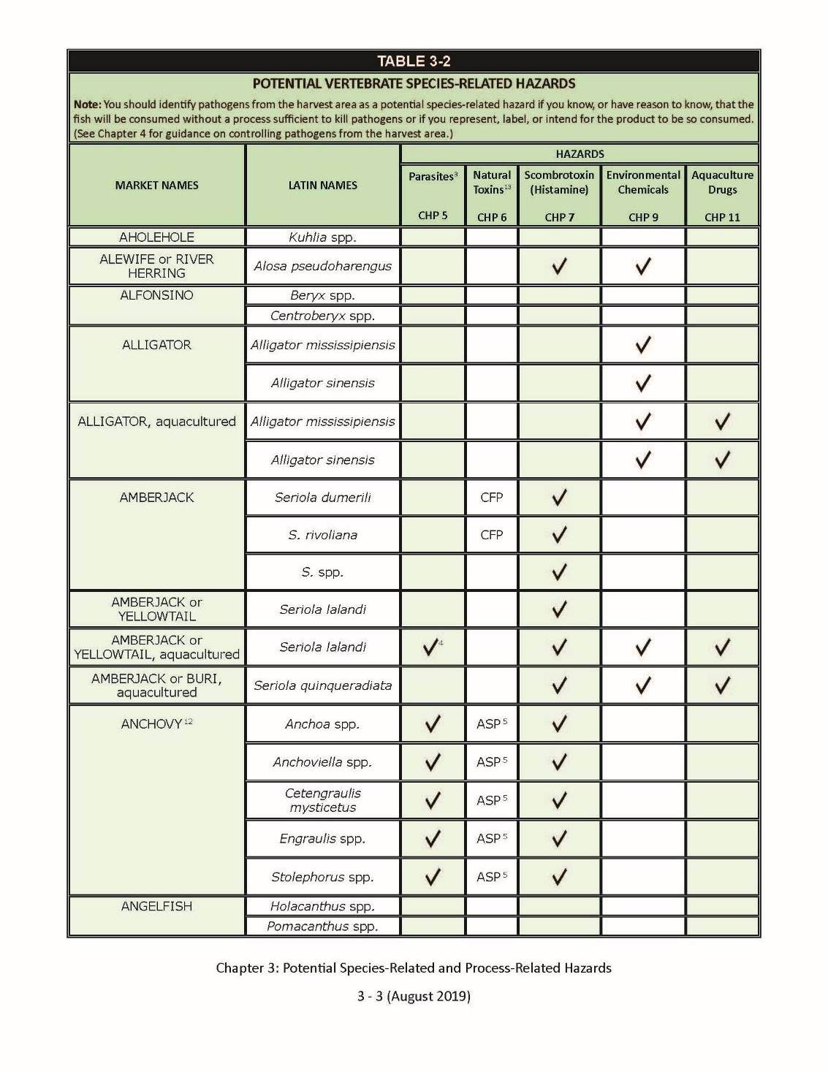
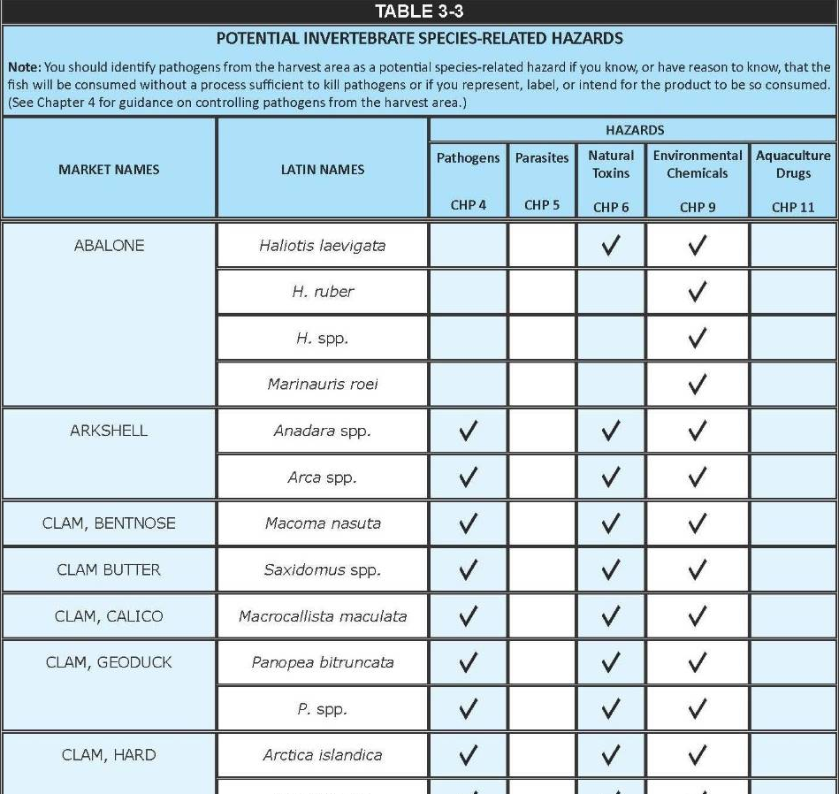
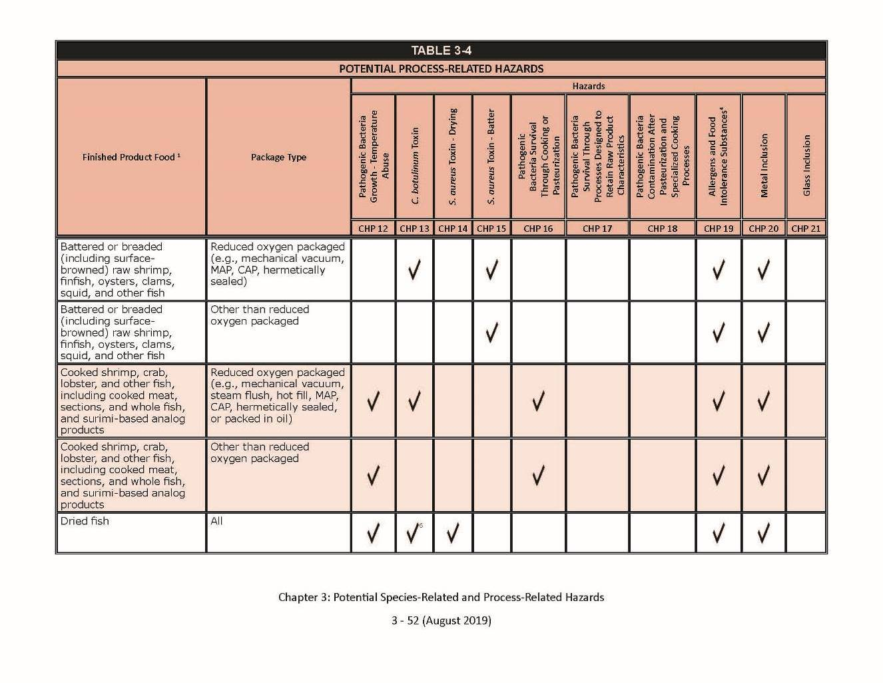
Seafood Safety Hazards & Controls
Vertebrate Table 3-2
Invertebrates Table 3-3
Process Hazards Table 3-4
Key Concepts:
Species Hazards
Process Hazards
P 41
Notes:
General Pathogen Growth caused by time/temperature abuse: Applies to which types of finished seafood products?
What Control Measures can be used?
When/where are controls applied?
Staph. aureus toxin production:
Applies to which fish or shellfish species?
What Control Measures can be used?
When/where are controls applied?

Slide 31
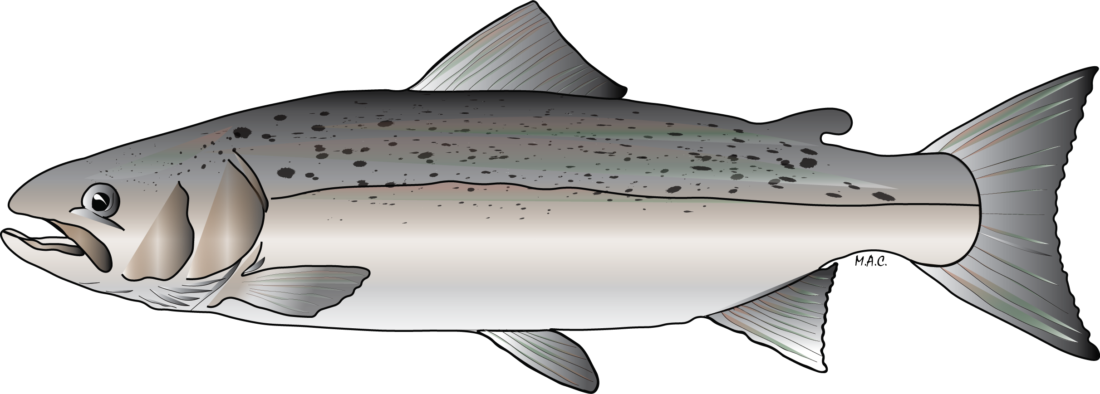
Seafood Safety Hazards
Species Hazards – Hazards associated with specific types (species) of fish or shellfish and/or where they are harvested
CHP 3: 3-25
Environmental Chemicals
Parasites
Aquaculture Drugs
Salmon(Farmed Salmo salar)

Slide 32
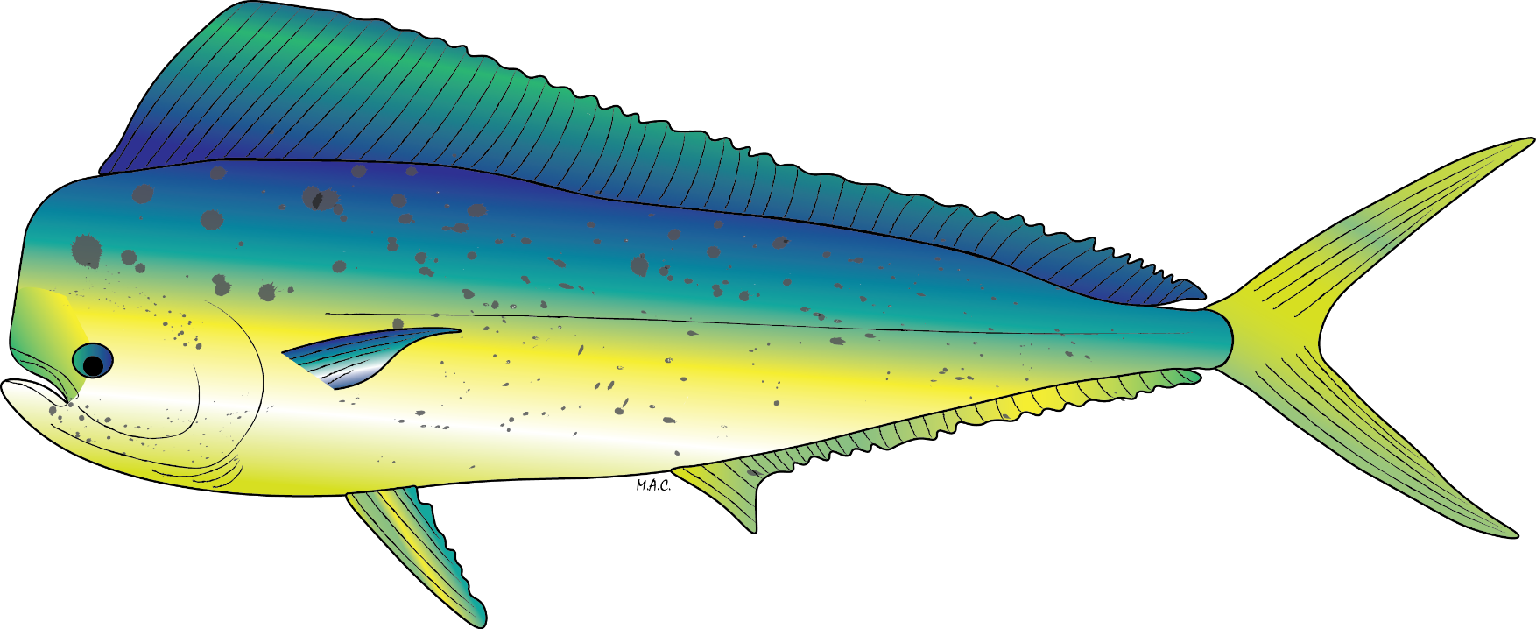
Seafood Safety Hazards
Species Hazards – Hazards associated with specific types (species) of fish or shellfish and/or where they are harvested
CHP 3: 3-21
Histamine
Wild Coryphaena spp.

Slide 33
Potential Seafood Hazards, SPECIES-Related Hazards
Vertebrate Table 3-2 P 3-3
Pathogens (harvest)
Parasites
Natural Toxins
Histamine (elevated)
Environmental Chemicals
Aquaculture Drugs
Invertebrate Table 3-3
P 3-40

Slide 34
Seafood Safety Hazards
Process Hazards – Hazards associated with different products and product forms & how they are processed, packaged, stored or distributed
CHP3: 3-52
Pathogen Growth Temperature Abuse
Additives
S. Aureus Toxin
Batter
Allergens
Metal Inclusion

Slide 35
Potential Seafood Hazards, Process-Related Hazards
Pathogenic Bacteria Growth – Temperature Abuse
C. botulinum toxin
S. aureus Toxin – Drying
S. aureus Toxin – Batter
Pathogenic Bacteria Survival through Cooking and Pasteurization
Pathogenic Bacteria Survival through Processes Designed to Retain Raw Product Characteristics
Pathogenic Bacteria Contamination After Pasteurization and Specialized Cooking Processes
Allergens and Food Intolerance Substances
Metal Inclusion
Glass Inclusion
Table 3-4
P 3-52

Slide 36
Potential Seafood Safety Hazards and Their Controls

Slide 37
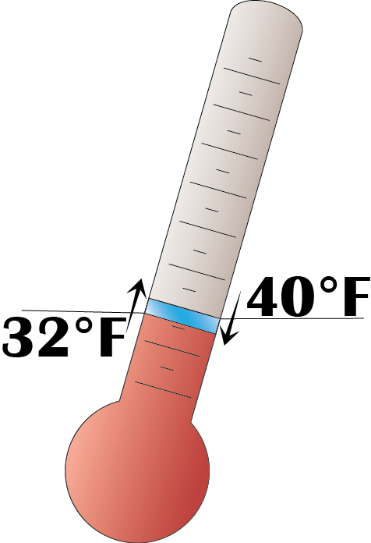
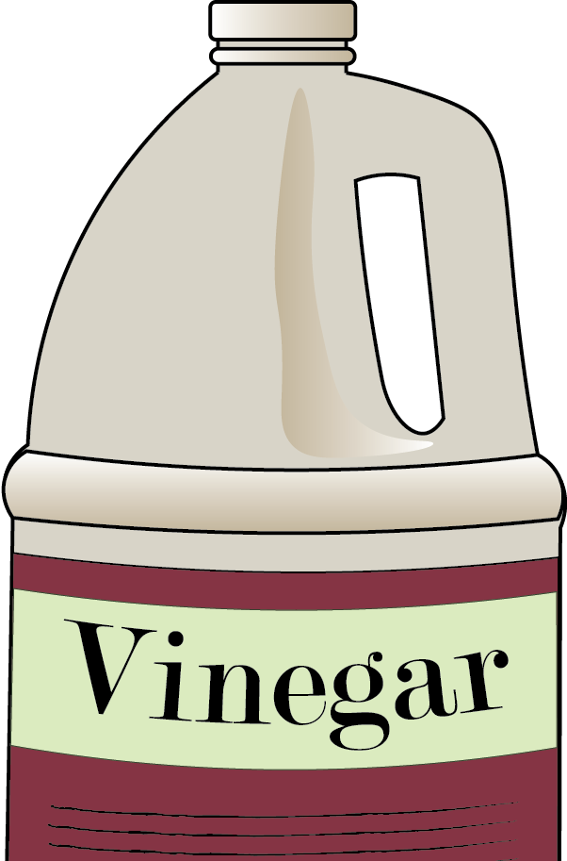
Controls
Once a processor identifies a hazard – species or process-related, they must implement a control strategy to control the hazard

Slide 38
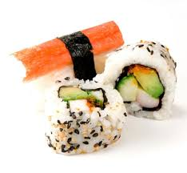
Species-Related Food Safety Hazards
Parasites:
Hazard: Living parasites in certain fish or shellfish species that can infect humans.
Controls: Cooking or proper freezing.
HACCP Controls: A processor must properly freeze products that are likely to contain parasites if they will be consumed raw or partially cooked (e.g., sushi, sashimi, cold smoked, pickled, etc.).
CHP5:91

Slide 39
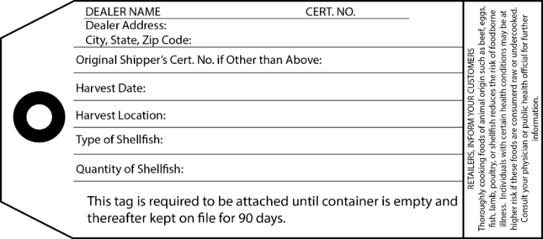
Species-Related Food Safety Hazards
Harvest Pathogens:
Hazard: Harvest waters can have high pathogen levels that contaminate shellfish or some fish.
Controls: Cooking or restricting harvesting to approved waters with safe pathogen levels.
HACCP Controls: Bivalve molluscan shellfish are only harvested from approved waters and all processors ensure products are properly tagged or labeled to ensure traceability.
CHP4:75
Notes:
Instructors should reference NSSP Guide as shellfish hazards and controls are not specifically covered in the Hazards Guide.
Instructor’s note should add that cooking will not eliminate toxins or environmental chemicals.

Slide 40

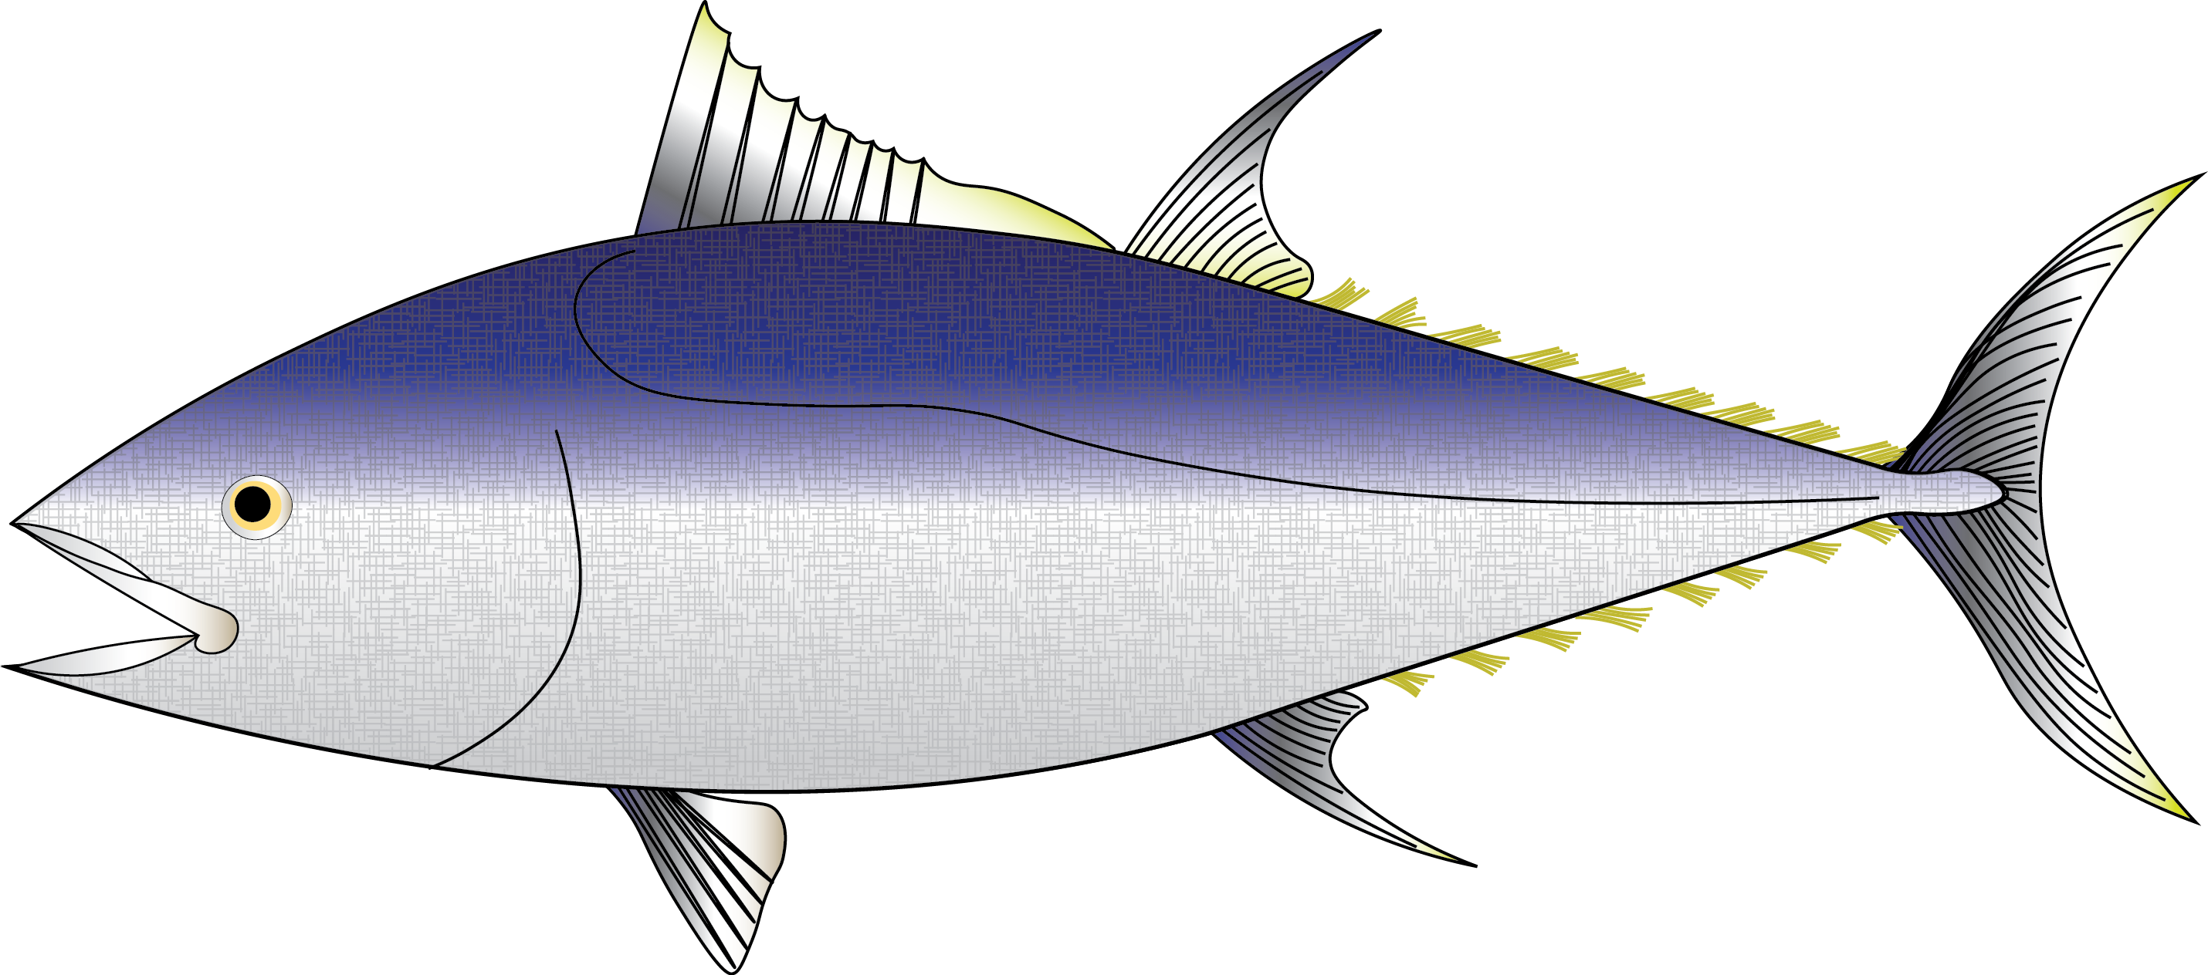
Species-Related Food Safety Hazards
Histamine or Scombrotoxin:
Hazard: Elevated histamine levels can develop in certain fish species exposed to time and temperature abuse.
Controls: Prevent time and temperature abuse in fish species likely to develop scombrotoxin.
HACCP Controls: All processors must keep fish chilled and limit exposure times to unrefrigerated temperatures.
CHP4:113

Slide 41
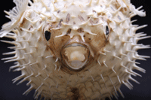
Species-Related Food Safety Hazards
Natural Toxins:
Hazard: Naturally occurring toxins can accumulate in shellfish and finfish harvested from contaminated waters.
Controls: Prohibit harvesting from contaminated waters.
HACCP Controls: Primary processors must confirm that the products they receive were not harvested from contaminated waters.
CHP6: 6-1

Slide 42

Species-Related Food Safety Hazards
Environmental Chemical Pollutants/Contaminants:
Hazard: Environmental or industrial chemicals can accumulate in finfish or shellfish harvested from polluted waters.
Controls: Prohibit harvesting from contaminated waters.
HACCP Controls: Primary processors must confirm that the products they receive were not harvested from waters that have a health advisory because of pollution.
CHP9: 9-1

Slide 43
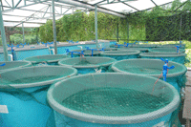
Species-Related Food Safety Hazards
Aquaculture Drugs:
Hazard: Drugs used in aquaculture facilities must be approved by FDA and properly used.
Controls: Prohibit use of unapproved drugs and follow expert advice on proper use of approved drugs.
HACCP Controls: Primary processors must confirm that the products they receive from aquaculture suppliers are following Good Aquaculture Practices, including following the drug usage instructions and FDA requirements.
CHP11: 11 - 1

Slide 44
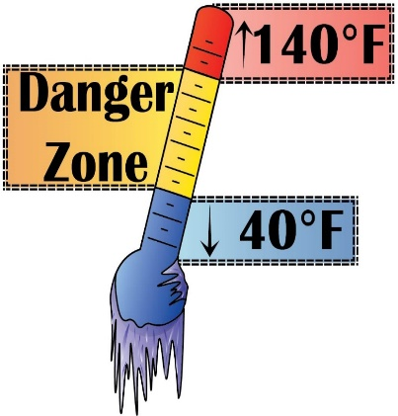
Process-Related Food Safety Hazards
Pathogen Growth caused by time/temperature abuse:
Hazard: Pathogen growth in products that will not be cooked before they are consumed could cause consumer illness.
Controls: Prevent time and temperature abuse of ready-to-eat products (e.g., smoked products, cooked or pasteurized products, salads, sushi).
HACCP Controls: All processors must keep ready-to-eat products adequately chilled and strictly limit exposure times to unrefrigerated conditions.
CHP12: 209

Slide 45
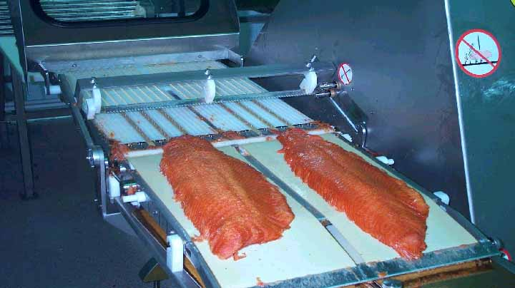
Process-Related Food Safety Hazards
CHP13: 245
Clostridium botulinum toxin production:
Hazard: C. bot can grow in smoked, salted, & pickled products and products packed in reduced oxygen packages (ROP) that are subjected to time and temperature abuse.
Controls: Ensure that adequate secondary barriers (e.g., pH, water activity) are in place and prevent exposures to unsafe times and temperatures.
HACCP Controls: All processors must use validated smoking, drying, salting, pasteurization and pickling procedures that are supported by scientific studies and that are adequately implemented; prevent time and temperature abuse; and use Time Temperature Indicators(TTI) when adequate secondary barriers are not in place or when products require more stringent storage controls.

Slide 46
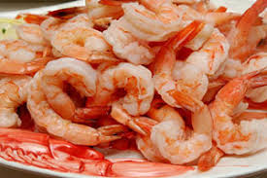
Process-Related Food Safety Hazards
CHP15: 309
Staph. aureus toxin production:
Hazard: S. aureus can grow in products where competing bacteria have been reduced or eliminated, such as cooked, battered, and salted products that are subjected to time and temperature abuse.
Controls: Prevent time and temperature abuse.
HACCP Controls: Processors must keep batters refrigerated and products chilled during and after processing steps where competing bacteria have been eliminated, strictly limiting exposure times to unsafe temperatures.

Slide 47
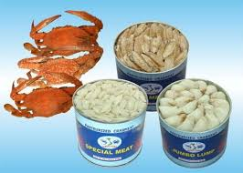
Process-Related Food Safety Hazards
Cooking, Pasteurization and Non-thermal Processes:
Hazard: Improperly cooked, pasteurized, or non-thermally processed foods can contain pathogens and cause consumer illness.
Controls: Scientifically validated cooking, pasteurization, or non-thermal processes must be used to kill all pathogens.
HACCP Controls: Processors must continuously monitor their cooking, pasteurization, or non-thermal processes to ensure that pre-determined validated limits have been met.
CHP16: 315
CHP 17: 331
CHP 18: 345

Slide 48
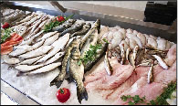
Process-Related Food Safety Hazards
CHP 19: 19 -1
Undeclared Food Allergens:
Hazard: All finfish and crustaceans are considered a major food allergen. Additional ingredients can introduce allergens.
Controls: Finfish and crustacean products and seafood products that contain allergens must be labeled with their correct market name for the species in addition to any other allergenic ingredients in accordance with FALCPA requirements.
HACCP Controls: Processors must ensure that all containers or packages that contain fish, crustaceans, or other allergenic ingredients declare the presence of all allergens.

Slide 49
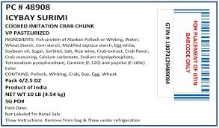
Process-Related Food Safety Hazards
Food Intolerance Substances:
Hazard: Sulfites and some coloring agents can cause a food intolerance reaction in sensitive consumers.
Controls: Products that contain food intolerance substances must be properly labeled to alert consumers.
HACCP Controls: Processors must ensure that products that contain food intolerance substances are properly labeled.
CHP 19: 19 -3

Slide 50
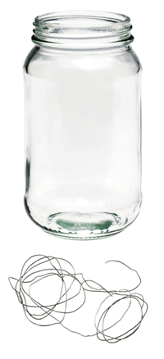
Process-Related Food Safety Hazards
Metal inclusion in finished products:
Hazard: Undetected metal fragments in food can cause injury to consumers.
Controls: Metal detection when it is likely that manufacturing could introduce metal fragments into the food or equipment checks to identify when metal fragments may have been introduced.
HACCP Controls: Processors either implement controls to detect metal fragments or identify when breakage of equipment may have introduced metal fragments into the food.
CHP 20: 385

Slide 51
Process-Related Food Safety Hazards
Glass inclusion in finished products:
Hazard: Undetected glass fragments in food can cause physical injury to consumers.
Controls: Glass containers are inspected and cleaned to prevent glass contaminating the food. Or work areas are inspected to identify when glass breakage has occurred.
HACCP Controls: Processors must inspect glass containers to detect breaking, cracking or other types of glass contamination to ensure that contaminated products are not sold. Or inspect the processing area around lines for broken glass to identify when contamination may have occurred.
CHP 21: 395

Slide 52
Seafood Hazards & Controls
Each ‘potential’ seafood safety hazard and recommendations for respective control options are briefly explained in the FDA Guide:
How processors can determine which ‘potential’ hazards should be considered for their species and products.
How the hazards and controls can vary for primary and secondary processors
FDA GUIDE
GOLD BOOK

Slide 53
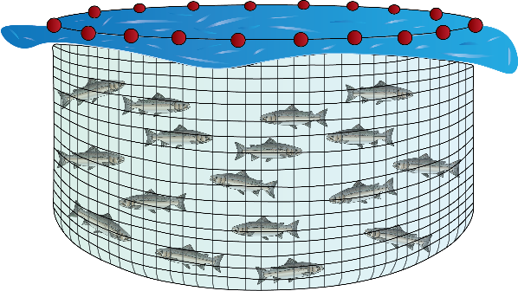
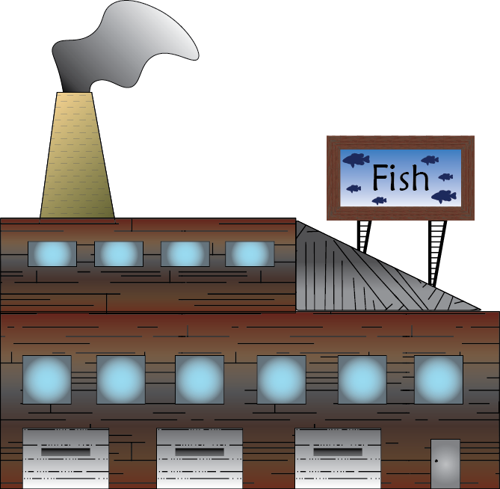
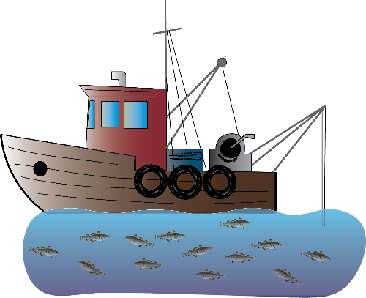
In HACCP regulations processors are responsible for Hazard Controls, so it is important to understand the difference between primary and secondary processing
NOTE
CHP 7: 125
Seafood
Seafood
FARMED
Primary Processor: first receiver from the fisherman or fish farm
Secondary Processor: receives products from other processors
WILD

Slide 54
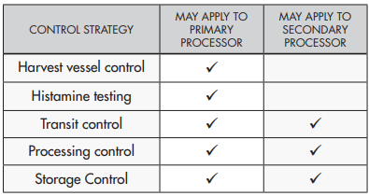
Controlling Hazards
Once a processor identifies a hazard – species or process-related, they must implement a control strategy to control the hazard
CHP 7: 125

Slide 55

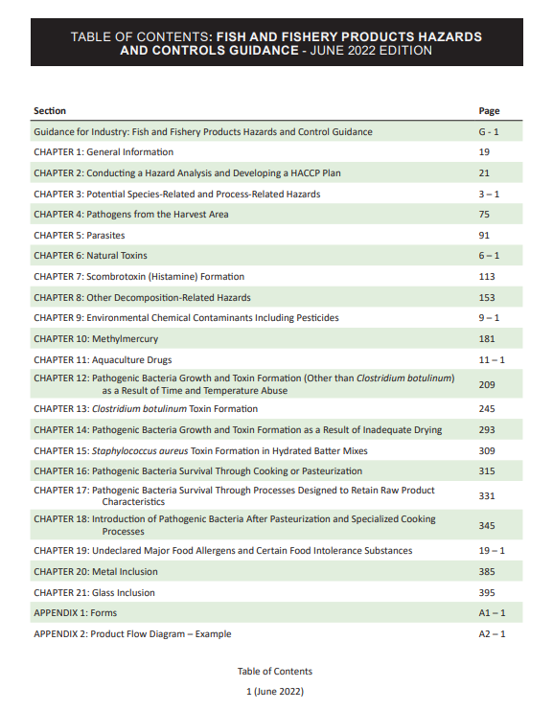

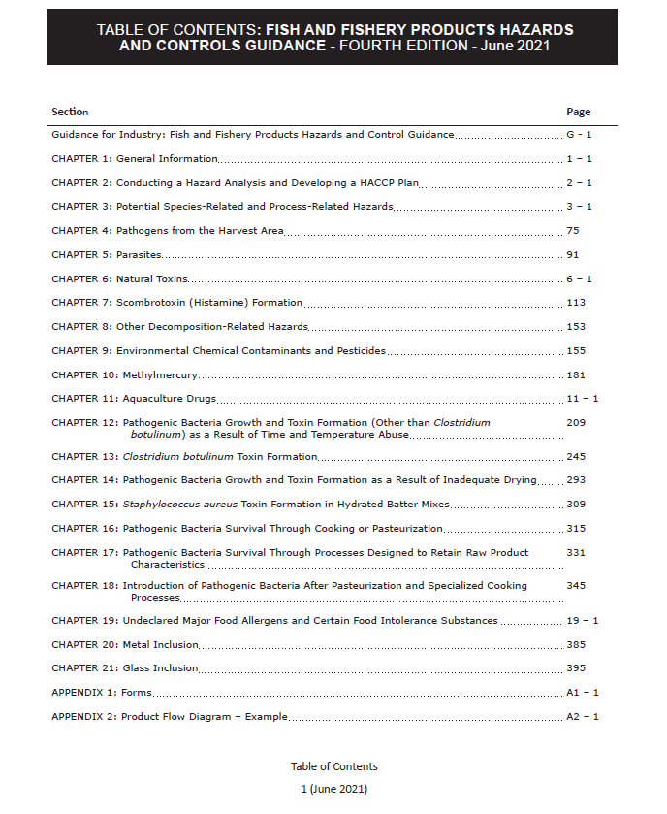
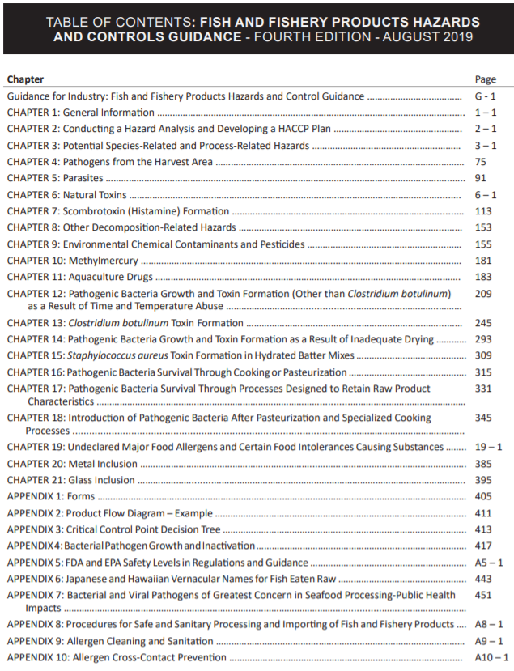
Chapter Structure and Content
Understand the Potential Hazard
Determine whether the hazard is significant
Identifying CCPs
Develop a Control Strategy
  Set Critical Limits
  Establish Monitoring Procedures
  Corrective Actions
  Establish a Recordkeeping System
  Establish Verification Procedures
  Example HACCP Plan(s)
  Bibliography

Slide 56
Format of Chapters
General Background P 315
Hazard Analysis
Determine if Hazard is Significant P 320
Identify Critical Control Points P 320
HACCP Plan
Develop Control Strategies
  Set Critical Limits P 321
  Establish Monitoring Procedures P 321
  Establish Corrective Actions P 323
  Establish a Recordkeeping System P 323
  Establish Verification Procedures P 324
Example Plan
CHAPTER DISSECTION
Gold Book
Example
Chapter 16 Pathogenic bacteria survival through cooking or pasteurization
P 315

Slide 57

Developing A HACCP Program
Hazard Analysis =
CCPs
HACCP Plan =

Slide 58
Building the HACCP Plan
The Blue Book provides an example for how to develop a HACCP Plan and its preliminary steps
SHA Curriculum
Slide 2
CHP4:69 Mahi-mahi Fillets
Preliminary steps:
Assemble HACCP team
Describe the product, intended use and consumers
Develop a Process Flow Chart
Develop a Process Description
BLUE BOOK

Slide 59
Building the HACCP Plan
The Segment 2 course will explain how the HACCP plan was developed using the recommendations in the
FDA Guide
SHA Curriculum
FDA GUIDE
GOLD BOOK

Slide 60
Preliminary Steps

Slide 61
Preliminary Step 1. Assemble the HACCP Team
Managers
Sanitation
Processing
CHP4: 74

Slide 62
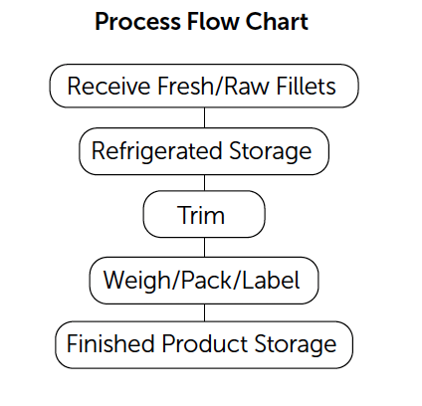
Preliminary Step 2. Process Flow Chart
Develop a Process Flow Diagram and understand or describe what happens at each step (Process Narrative)
Example: Fresh Mahi-mahi fillets
CHP4: 75

Slide 63
A brief processing narrative can be used to help explain the Processing Flow Chart (1 of 2)
Receive Fresh/Raw Fish – Fresh/Raw wild-caught mahi-mahi (Coryphaena species, not aquacultured) fillets are received from several domestic suppliers (processors). Delivery truck transit times range from 2 to 8 hours. Tubs or other containers of mahi-mahi fillets are received along with other fresh seafood products packed in ice and delivered by refrigerated truck. After receipt, products are re-iced if necessary and moved into refrigerated storage.
Refrigerated Storage – Individual mahi-mahi fillets are completely buried in ice and stored in a refrigerated cooler until needed.
Trim – Individual tubs or containers of mahi-mahi fillets are removed from the cooler as needed to pack customers’ orders. Fillets are trimmed by hand with knives if necessary to meet customer specifications. Trimming is completed in 30 minutes or less.
CHP4: 75-76
Fresh/Raw mahi-mahi fillets process flow chart

Slide 64
A brief processing narrative can be used to help explain the Processing Flow Chart (2 of 2)
Weigh/Pack/Label – Per customer order, mahi-mahi fillets are weighed, packed into containers, and each container is labeled with a handwritten or printed label that contains the market name of the species of fish that it contains. Individual containers are completely surrounded by ice and assembled into master cartons for each customer order. The weigh/pack/label steps are completed in 30 minutes or less.
Finished Product Storage – Containers of iced mahi-mahi fillets are placed in master cartons that contain each customer’s order and are placed back into refrigerated storage until it is moved directly to refrigerated trucks for delivery to retail or restaurant customers
CHP4: 75-76
Fresh/Raw mahi-mahi fillets process flow chart

Slide 65
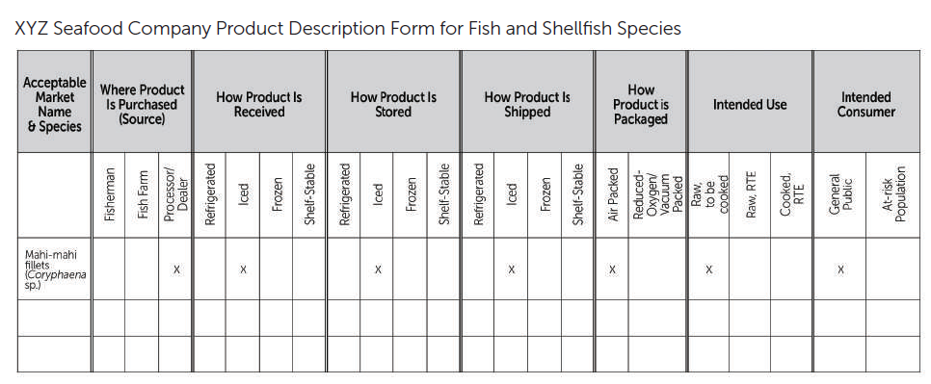

Preliminary Step 3. Describe Product
CHP4: 74
x
x
Blue Book provides a useful form for preliminary information
Appendix 2: 226
65

Slide 66
Hazard Analysis

Slide 67
Required Hazard Analysis
Use the preliminary information
  Process Description
  Processing Flow Chart
  Accompanying process narrative
  with recommendations from the FDA Guide beginning with a Hazard Analysis Worksheet
FDA GUIDE
GOLD BOOK
Appendix 2: 227-228

Slide 68
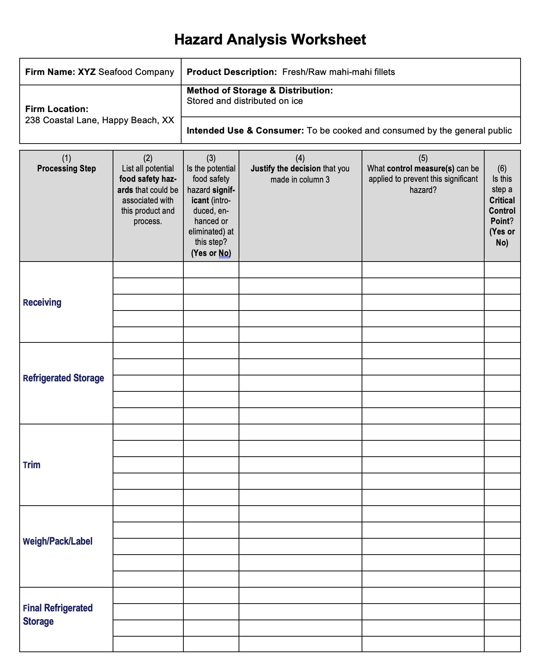
Hazard Analysis
Worksheet
Fresh/Raw mahi-mahi fillets process flow chart
Column 1: List all of the processing steps from the Process Flow Chart

Slide 69
Use the FDA Hazard Guide to help identify the potential hazards for analysis
“… guidance describes the Agency’s current thinking on a topic and should be viewed only as recommendations …”
Recommendations lead to
successful compliance
AD1-3
FDA GUIDE
GOLD BOOK

Slide 70
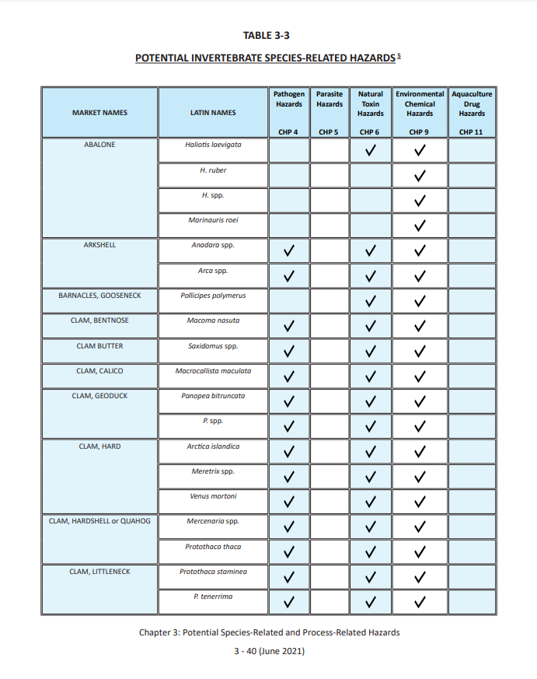
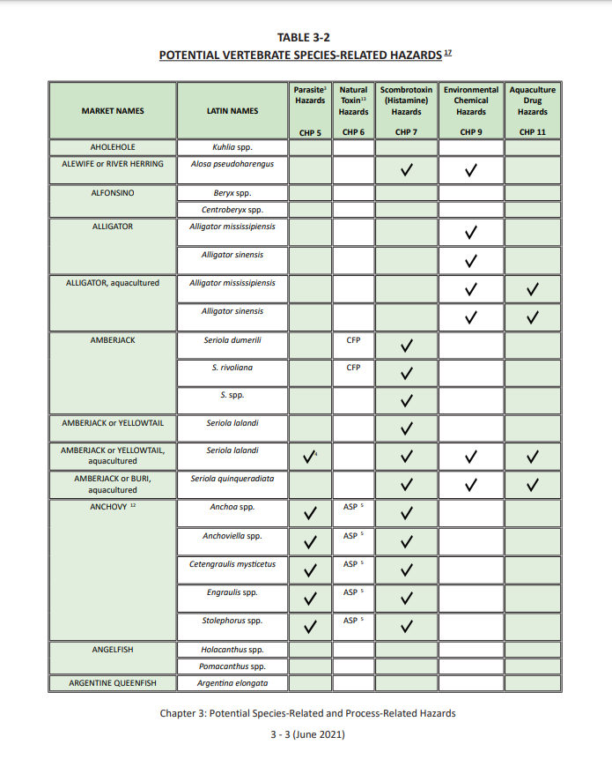
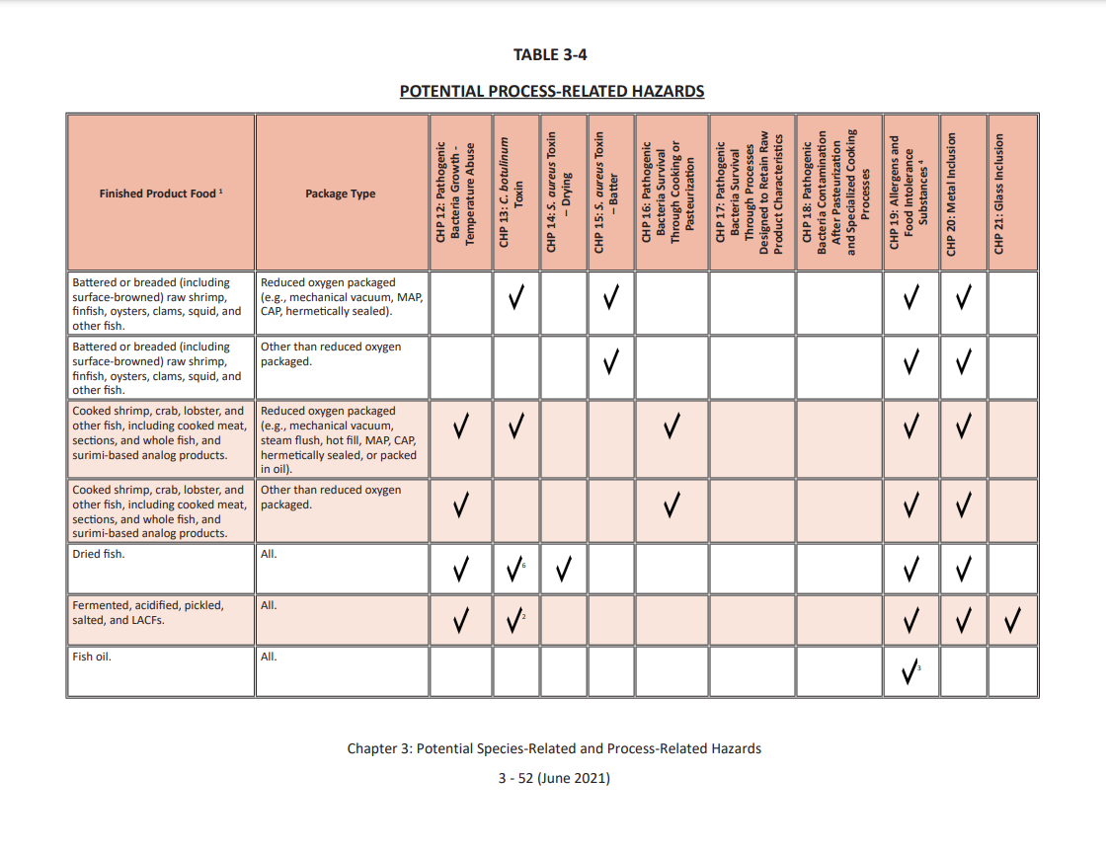
Search for the potential hazards for the Fresh/Raw ‘Wild’ Mahi-mahi Fillets (XYZ Seafood Company)
Tables 3-2 and 3-3 Species-Related Hazards
Table 3-4
Process-Related Hazards
CHP3:
3-3: Vertebrates
3-40: Invertebrates
CHP3: 3-52
70

Slide 71
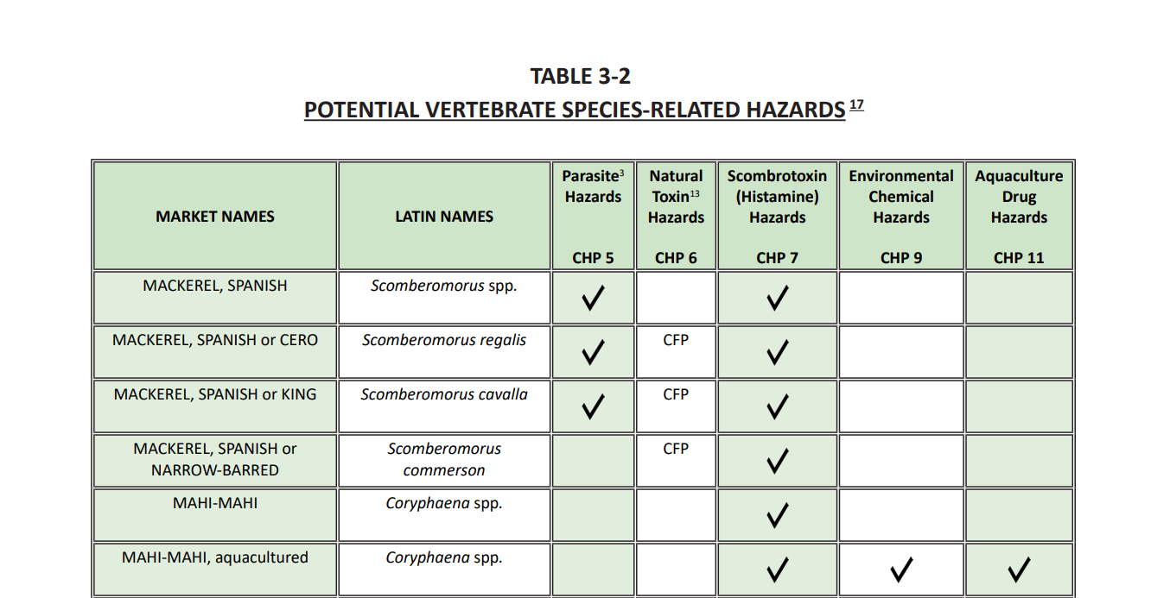
One Species-related hazard
Table 3-2
Page 3-21

Slide 72
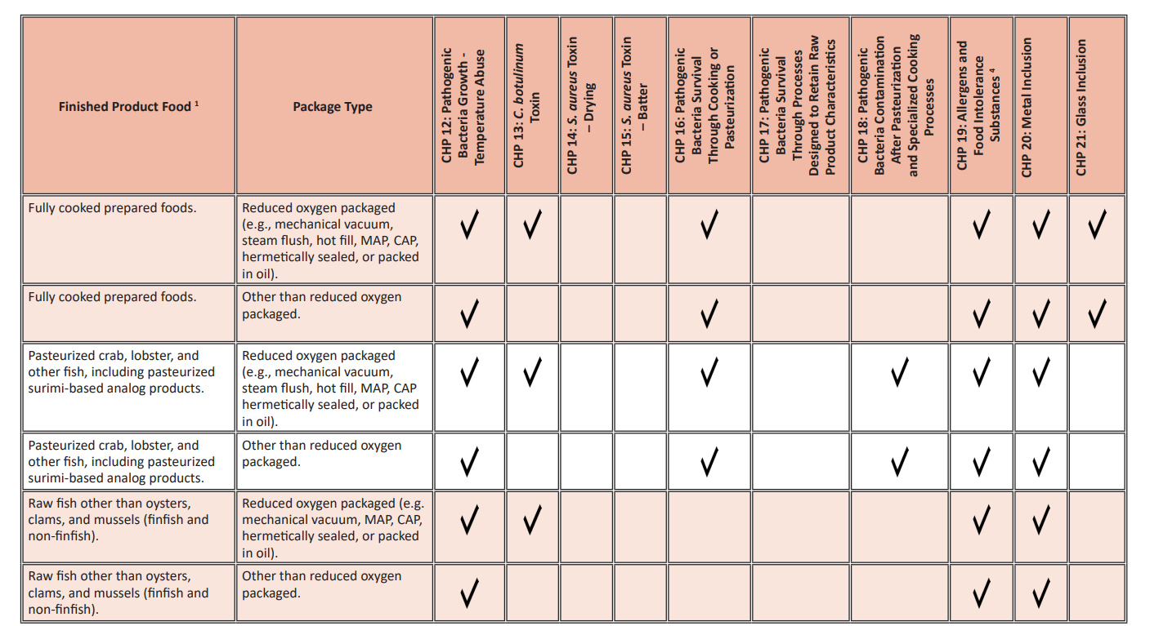
Four Process-related Hazards
Notice two hazards in Chapter 19
Table 3-4
72

Slide 73
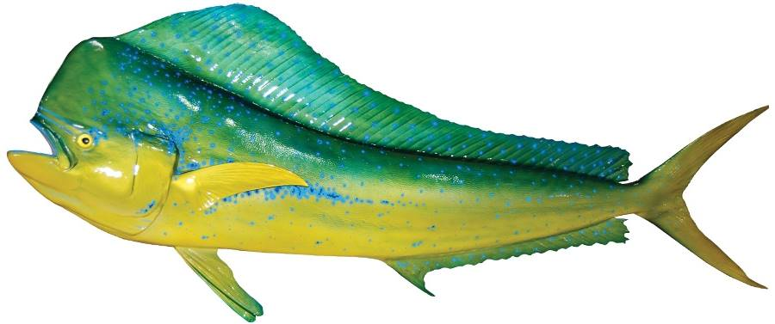
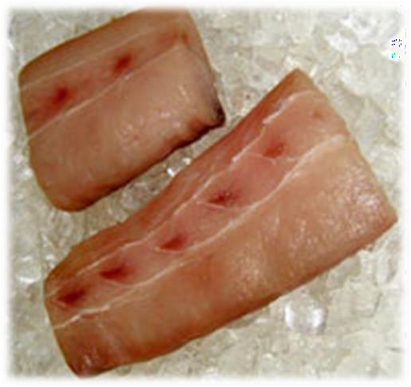
Hazard Analysis for the XYZ Seafood Company should include 5 potential hazards:
Species-related Hazards (Table 3-2)
Histamine formation
Process-related Hazards (Table 3-4)
Pathogenic bacterial growth-temperature abuse
Allergens
Food Intolerance Substances
Metal inclusion
CHP 7
CHP 12
CHP 19
CHP 19
CHP 20

Slide 74
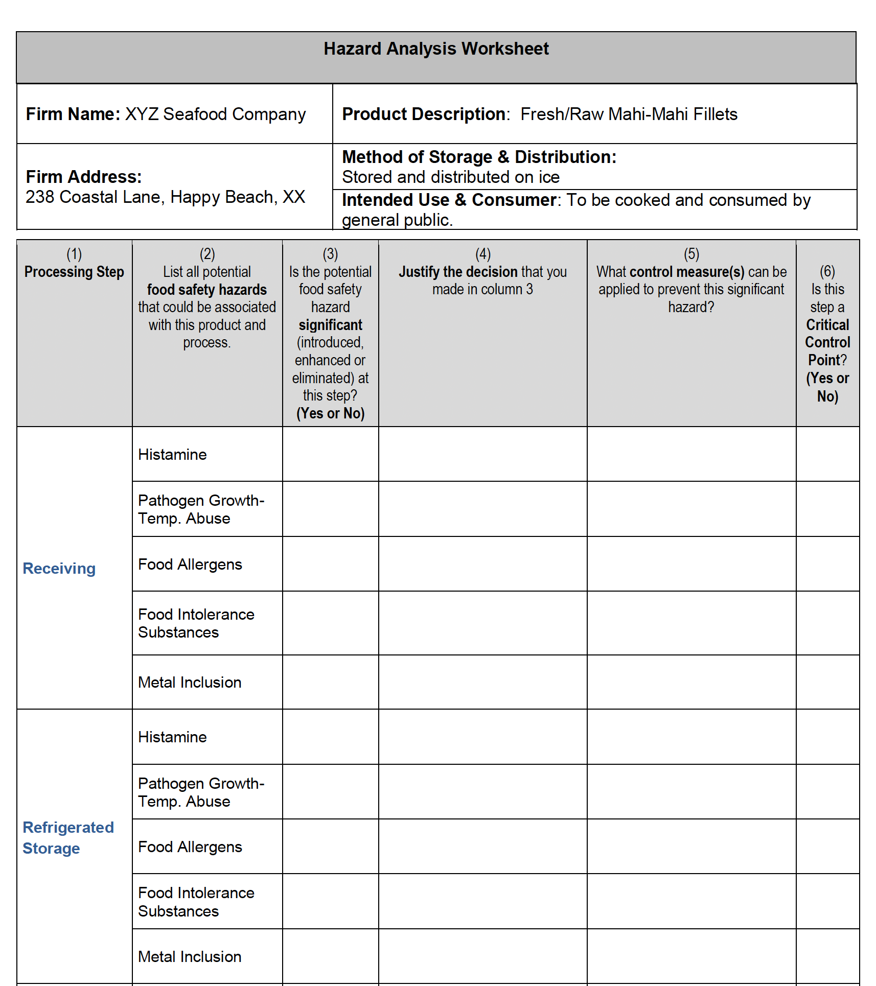

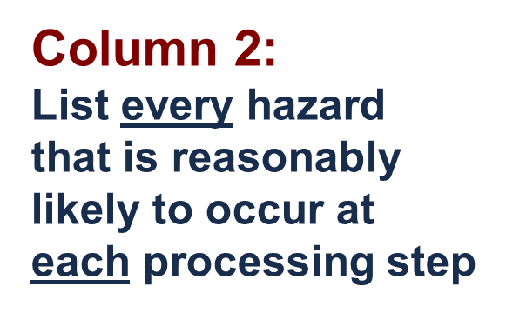
Inclusive
Method
List every potential hazard at each processing step

Slide 75

Exercise - Complete the Hazard Analysis Worksheet
Answer the questions, in order, for each listed potential hazard at each processing step using the appropriate chapter of the FDA Guide.
The FDA Guide provides information in the respective hazard chapters to help determine if the hazard is reasonably likely to occur and recommendations for control strategies.

Slide 76
BRIEF SUMMARY based on the FDA Guide that provides more recommended
Hazard Analysis Worksheet
(1) Processing Steps | (2) List all potential food safety hazards that could be associated with this product and process. | (3) Is the potential food safety hazard significant (introduced, enhanced or eliminated) at this step? (Yes or No) | (4) Justify the decision that you made in column 3 | (5) What control measure(s) can be applied to prevent this significant hazard?
Receive Fresh/Raw Fillets | Histamine | Yes CHP7: 121 | If the product does not remain sufficiently chilled, histamine could form | Mahi-mahi fillets are shipped in tubs or containers completely surrounded by ice (Proper Icing) CHP7: 123
 | Pathogen Growth due to Temperature Abuse | No CHP12: 214 | Product will be cooked prior to consumption | N/A CHP 12
 | Allergens | Yes CHP19: 19-6 | Fish is one of the top 8 food allergens | Will be controlled at labeling (Proper Labeling) CHP19: 19-7
 | Food Intolerance Substances | No CHP19: 19-6 | No FIS used or added in this processing operation | N/A CHP 19
 | Metal Inclusion | No CHP20: 386 | Not likely to occur at this step | N/A CHP 20

Slide 77
Completed Hazard Analysis Worksheet
Page 1
CCP
Completed
Hazard Analysis
105-107
CCP
NOTE: Every ‘Yes’ in column 3 requires a response in column 6

Slide 78

Completed Hazard Analysis Worksheet
Page 2
Completed
Hazard Analysis
105-107
CCP
CCP
NOTE: Every ‘Yes’ in column 3 requires a response in column 6

Slide 79
Conclusions from the Hazard Analysis
Histamine is a significant food safety hazard and there are three CCPs for this hazard:
CCP 1. Receive fresh fish
CCP 2. Refrigerated storage, and
CCP 3. Finished product refrigerated storage
Food allergens is a significant food safety hazard and there is one CCP for this hazard:
CCP 4. Weigh/Pack/Label

Slide 80
Building HACCP Plan

Slide 81

Building the HACCP Plan
Appendix 2

Slide 82


Optional HACCP Plan Forms
(both must contain same information)
Appendix 2: 101 and 102
Portrait
Landscape

Slide 83



Set up a HACCP Plan Form for each CCP
YES
Column 1 & 2: List all of the identified CCPs

Slide 84

Principle 3: Set Critical Limits using the FDA Hazards Guide
CHP 7: 125
CONTROL STRATEGY
selected from the FDA Guide
CCP – Receiving
Hazard - Histamine
Example 3 CHP 7: 137

Slide 85
Principle 3: Set Critical Limits using the FDA Hazards Guide
TRANSIT CONTROL OPTIONS (Example 3)
Critical limits will depend on how product is received.
Fish delivered refrigerated (not frozen), or
Fish delivered under ice, or
Fish delivered under ice on an open-bed truck, or
Fish delivered under chemical cooling media, or
Fish delivered refrigerated (not frozen) with transit time of 4 hours or less
CHP 7: 137

Slide 86
Principle 3: Set Critical Limits using the FDA Hazards Guide
TRANSIT CONTROL CRITICAL LIMITS
Transit temperature records, or
Completely surrounded by ice on delivery, or
Use of ice; AND internal fish temperature, or
Frozen gel-packs; AND internal fish temperature, or
Transit time (< 4 hours); AND internal fish temperature
CHP 7: 137
Tip
Notice ‘ORs & ANDs ’

Slide 87
Principle 3: Establish CRITICAL LIMITS
CCP | Hazard | Critical Limits for each Control Measure | Monitoring |  |  |  | Corrective Action | Verification | Records
 |  |  | What | How | When | Who
Receiving | Histamine | Tubs or containers of Mahi-mahi fillets are completely surrounded with ice at receipt.
Refrigerated Storage | Histamine | Tubs or containers of Mahi-mahi fillets are completely surrounded with ice throughout storage time.
Weigh/Pack/Label | Food Allergens | All finished product containers will be labeled with the correct market name
Finished Product Refrigerated Storage | Histamine | Containers of Mahi-mahi fillets are completely surrounded with ice throughout storage time.
CHP7: 109
Receiving - Transit Control Example 3 - CHP 7: 137
Based on recommendations
in the FDA Guide

Slide 88
Principle 4: Establish Monitoring Procedures
Follow the same option selected for Critical Limits
Example: Control Strategy = Transit control
Critical Limit Option: Surrounded by ice
    What will be monitored?
    How will monitoring be done?
    How often will monitoring be done (frequency)?
    Who will do the monitoring?
CHP 7: 137-139

Slide 89
Principle 4: Establish CCP MONITORING
CCP | Hazard | Critical Limits for each Control Measure | Monitoring |  |  |  | Corrective Action | Verification | Records
 |  |  | What | How | When | Who
Receiving | Histamine | Tubs or containers of Mahi-mahi fillets are completely surrounded with ice at receipt. | Adequacy of ice surrounding tubs or containers of mahi-mahi fillets at delivery | Visual check of adequacy of ice in a representative number of containers in each delivery | Every Delivery | Receiving Manager
Refrigerated Storage | Histamine | Tubs or containers of Mahi-mahi fillets are completely surrounded with ice throughout storage time. | Adequacy of ice surrounding tubs or containers of mahi-mahi fillets | Visual check of adequacy of ice in a representative number of containers in cooler storage | At the beginning and end of the work day | Cooler Manager
Weigh/Pack/Label | Food Allergens | All finished product containers will be labeled with the correct market name | The market name on each container of finished product | Visual comparision of the label again the product specification for accuracy | At the start of the production lot AND at least every 2 hours OR when new containers of labels are opened or rolls of labels are changed. | Packing manager
Finished Product Refrigerated Storage | Histamine | Containers of Mahi-mahi fillets are completely surrounded with ice throughout storage time. | Adequacy of ice surrounding containers of mahi-mahi fillets | Visual check of representative number of containers in cooler storage | At the beginning and end of the work day | Cooler manager
CHP8: 119
CHP8: 119
Example 3
CHP 7: 137-139
Based on
FDA Guide

Slide 90
Principle 5: Establish Corrective Actions
Follow the same option selected for Critical Limits
Example: Control Strategy = Transit control
Critical Limit Option: Surrounded by ice
Corrective Actions must cover two parts that include actions to assure safe products and to fix the problem before further processing
CHP 7: 139

Slide 91
Principle 5: CORRECTIVE ACTIONS (Page 1 of 2)
CCP | Hazard | Critical Limits for each Control Measure | Monitoring |  |  |  | Corrective Action | Verification | Records
 |  |  | What | How | When | Who
Receiving | Histamine | Tubs or containers of Mahi-mahi fillets are completely surrounded with ice at receipt. | Adequacy of ice surrounding tubs or containers of mahi-mahi fillets at delivery | Visual check of adequacy of ice in a representative number of containers in each delivery | Every Delivery | Receiving Manager | If: the amount of ice is not adequate Then: reject product, and call supplier to let them know CL was not met and provide product delivery specifications, and discontinue use of supplier until their transport procedures are corrected.
Refrigerated Storage | Histamine | Tubs or containers of Mahi-mahi fillets are completely surrounded with ice throughout storage time. | Adequacy of ice surrounding tubs or containers of mahi-mahi fillets | Visual check of adequacy of ice in a representative number of containers in cooler storage | At the beginning and end of the work day | Cooler Manager | If: the amount of ice is not adequate; Then: chill and hold the product until it can be evaluated based on its total time and temperature exposure, including exposures during prior processing operations, and add ice and make adjustments to the ice application process.
CHP 9: 129
Example 3
CHP 7: 139

Slide 92
Principle 5: CORRECTIVE ACTIONS (Page 2 of 2)
CCP | Hazard | Critical Limits for each Control Measure | Monitoring |  |  |  | Corrective Action | Verification | Records
 |  |  | What | How | When | Who
Weight/Pack/Label | Food Allergens | All finished product containers will be labeled with the correct market name of the fish. | The market name on each container of finished product. | Visual comparison of the label against the product specification for accuracy | At the start of the production lot AND at least every 2 hours OR when new containers of labels are opened or rolls of labels are changed. | Packaging manager | If: A) container is improperly labeled; then: Hold and isolate labeled product since the last acceptable inspection of labels; Inspect 100% of affected product and relabel mislabeled products; Inspect remaining labels staged for use and remove inaccurate labels from processing area; Review a representative sample of labels in storage and hold and isolate inaccurate labels, if appropriate; Discontinue use of label supplier; Modify label procedures as appropriate.
Finished Product Refrigerated Storage | Histamine | Containers of Mahi-mahi fillets are completely surrounded with ice throughout storage time. | Adequacy of ice surrounding tubs or containers of mahi-mahi fillets | Visual check of adequacy of ice in a representative number of containers in cooler storage | At the beginning and end of the workday | Cooler Manager | If: finished product containers do not have adequate ice; Then: chill and hold the product until it can be evaluated based on its total time and temperature exposure, including exposures during prior processing operations, and determine if there is a problem with the cooler and fix it
CHP9: 129

Slide 93
Principle 6: Establish Verifications
Select the Verification options that apply to the critical limit chosen:
    Weekly record review applies to all options
    Periodic check of internal temperature of fish to ensure ice keeps below 40°F
    Thermometers must be checked for accuracy and periodically calibrated
    Annual Review of HACCP Plan
CHP 7: 139 - 140

Slide 94
Principle 6: VERIFICATIONS (Page 1 of 2)
CCP | Hazard | Critical Limits for each Control Measure | Monitoring |  |  |  | Corrective Action | Verification | Records
 |  |  | What | How | When | Who
Receiving | Histamine | Tubs or containers of Mahi-mahi fillets are completely surrounded with ice at receipt. | Adequacy of ice surrounding tubs or containers of mahi-mahi fillets at delivery | Visual check of adequacy of ice in a representative number of containers in each delivery | Every Delivery | Receiving Manager | If: the amount of ice is not adequate Then: reject product, and call supplier to let them know CL was not met and provide product delivery specifications, and discontinue use of supplier until their transport procedures are corrected. | Weekly review of Receiving Log (Monitoring record) and Corrective Action. Review of the Verification records within a reasonable time frame. Check internal temperature of fish at delivery for each new supplier and quarterly thereafter to ensure that ice maintains product temperature Check the accuracy of the thermometer before each use. Annual calibration of thermometer used to check internal temp.
Refrigerated Storage | Histamine | Tubs or containers of Mahi-mahi fillets are completely surrounded with ice throughout storage time. | Adequacy of ice surrounding tubs or containers of mahi-mahi fillets | Visual check of adequacy of ice in a representative number of containers in cooler storage | At the beginning and end of the work day | Cooler Manager | If: the amount of ice is not adequate; Then: chill and hold the product until it can be evaluated based on its total time and temperature exposure, including exposures during prior processing operations, and add ice and make adjustments to the ice application process. | Weekly review of Cooler Ice Log (Monitoring record) and Corrective Action. Review of the Verification records within a reasonable time frame. Check internal temperature of fish quarterly to ensure that ice maintains product temperature Check the accuracy of the thermometer before each use. Annual calibration of thermometer used to check internal temp.
Example 3
CHP 7:
139 -140
CHP10: 141

Slide 95
Principle 6: VERIFICATIONS (Page 2 of 2)
CCP | Hazard | Critical Limits for each Control Measure | Monitoring |  |  |  | Corrective Action | Verification | Records
 |  |  | What | How | When | Who
Weight/Pack/Label | Food Allergens | All finished product containers will be labelled with the correct market name of the fish. | The marketname on each container of finished product. | Visual comparison of the label against the product specification for accuracy. | At the start of the production lot AND at least every 2 hours OR when new containers of labels are opened or rolls of labels are changed. | Packaging manager | If: a container is improperly labelled. Then: Hold and isolate labelled products since the last acceptable inspection of labels; inspect 100% of affected products and relabeled mislabeled products; inspect remaining labels staged for use; and remove inaccurate labels from the processing area. Review a representative sample of labels in storage and hold and isolate inaccurate labels, if appropriate. Discontinue use of label supplier; modify label procedures as appropriate | Weekly review of packing room log (monitoring record) and corrective action. Review of the verification records within a reasonable time frame. Verify the list of allergenic or food intolerance substance ingredients against raw materials ingredients’ label declarations at least annually and when changes to suppliers or formulation occur, if appropriate.
Finished Product Refrigerated Storage | Histamine | Containers of Mahi-mahi fillets are completely surrounded with ice throughout storage time. | Adequacy of ice surrounding tubs or containers of mahi-mahi fillets | Visual check of representative number of containers in cooler storage | At the beginning and end of the work day | Cooler Manager | If: finished product containers do not have adequate ice; Then: chill and hold the product until it can be evaluated based on its total time and temperature exposure, including exposures during prior processing operations, and determine if there is a problem with the cooler and fix it. | Weekly review of Cooler Ice Log (Monitoring record) and Corrective Action. Review of the Verification records within a reasonable time frame. Check internal temperature of fish quarterly to ensure that ice maintains product temperature. Check the accuracy of the thermometer before each use. Annual calibration of thermometer used to check internal temperature.
CHP10: 141

Slide 96
Principle 7: Establish Record Keeping Procedures
Enter the name of the records that will be kept for that CCP on the HACCP Plan Form
Your Records must be designed to meet the requirements of 21 CFR Part 123.9 to document the results of the Monitoring, Corrective Action, and Verification components of the HACCP Plan
CHP 7: 139

Slide 97
Principle 7: RECORDS (Page 1 of 2)
Example 3
CHP 7: 139
CHP11:159
CCP | Hazard | Critical Limits for each Control Measure | Monitoring |  |  |  | Corrective Action | Verification | Records
 |  |  | What | How | When | Who
Receiving | Histamine | Tubs or containers of Mahi-mahi fillets are completely surrounded with ice at receipt. | Adequacy of ice surrounding tubs or containers of mahi-mahi fillets at delivery | Visual check of adequacy of ice in a representative number of containers in each delivery | Every Delivery | Receiving Manager | If: the amount of ice is not adequate Then: reject product, and call supplier to let them know CL was not met and provide product delivery specifications, and discontinue use of supplier until their transport procedures are corrected. | Weekly review of Receiving Log (Monitoring record) and Corrective Action. Review of the Verification records within a reasonable time frame. Check internal temperature of fish at delivery for each new supplier and quarterly thereafter to ensure that ice maintains product temperature. Check the accuracy of the thermometer before each use. Annual calibration of thermometer used to check internal temp. | Receiving Log that documents: the number of containers examined; the number of containers in each delivery; and the results of checks for adequacy of ice. Corrective Action records Verification Record Accuracy Check Log Calibration Log
Refrigerated Storage | Histamine | Tubs or containers of Mahi-mahi fillets are completely surrounded with ice throughout storage time. | Adequacy of ice surrounding tubs or containers of mahi-mahi fillets | Visual check of adequacy of ice in a representative number of containers in cooler storage | At the beginning and end of the workday | Cooler Manager | If: the amount of ice is not adequate; Then: chill and hold the product until it can be evaluated based on its total time and temperature exposure, including exposures during prior processing operations, and add ice and make adjustments to the ice application process. | Weekly review of Cooler Ice Log (Monitoring record) and Corrective Action. Review of the Verification records within a reasonable time frame. Check internal temperature of fish quarterly to ensure that ice maintains product temperature Check the accuracy of the thermometer before each use. Annual calibration of thermometer used to check internal temp. | Cooler Ice Log that documents: the number of containers examined, the approximate number of containers in storage, and the results of checks for adequacy of ice. Corrective Action records Verification Records Accuracy Check Record Annual Calibration Log

Slide 98
Principle 7: RECORDS (Page 2 of 2)
CHP11:159
CCP | Hazard | Critical Limits for each Control Measure | Monitoring |  |  |  | Corrective Action | Verification | Records
 |  |  | What | How | When | Who
Weigh/Pack/Label | Food allergens | All finished product containers will be labeled with the correct market name of the fish. | The market name on each container of finished product | Visual comparison of the label against the product specification for accuracy | At the start of the production lot AND at least every 2 hours OR when new containers of labels are opened or rolls of labels are changed. | Packaging Manager | If: a container is improperly labeled, Then: Hold and isolate labeled product since the last acceptable inspection of labels; Inspect 100% of affected product and relabel mislabeled products; Inspect remaining labels staged for use and remove inaccurate labels from processing area; Review a representative sample of labels in storage, and hold and isolate inaccurate labels, if appropriate; Discontinue use of label supplier; Modify label procedures, as appropriate. | Weekly review of Packing Room Log (Monitoring record) and Corrective Action. Review of the Verification records within a reasonable time frame. Verify the list of allergenic or food intolerance substance ingredients against raw materials ingredients’ label declarations at least annually and when changes to suppliers or formulation occur, if appropriate. | Packing Room Log that documents: the number of containers checked, the number of containers in the order, and the results of the label check. Corrective Action records Verification Records
Refrigerated Storage | Histamine | Tubs or containers of Mahi-mahi fillets are completely surrounded with ice throughout storage time. | Adequacy of ice surrounding tubs or containers of mahi-mahi fillets | Visual check of adequacy of ice in a representative number of containers in cooler storage | At the beginning and end of the work day | Cooler Manager | If: finished product containers do not have adequate ice; Then: chill and hold the product until it can be evaluated based on its total time and temperature exposure, including exposures during prior processing operations, and determine if there is a problem with the cooler and fix it. | Weekly review of Cooler Ice Log (Monitoring record) and Corrective Action. Review of the Verification records within a reasonable time frame. Check internal temperature of fish quarterly to ensure that ice maintains product temperature Check the accuracy of the thermometer before each use. Annual calibration of thermometer used to check internal temp. | Cooler Ice Log that documents: the number of containers examined, the approximate number of containers in storage, and the results of checks for adequacy of ice. Corrective Action records Verification Records Accuracy Check Record Annual Calibration Log

Slide 99





Complete HACCP
CHP11: 181-187

Slide 100
HACCP Plans can be built for any Hazard in the same way using the appropriate chapter in the FDA Hazards Guide
Select the Control Strategy that applies to your situation & CCP
Select one or more Critical Limit options for your situation
Follow the same option(s) to determine Monitoring, Corrective Action, Verification and Record keeping procedures

Slide 101
Other Resources in the FDA Hazards Guide
Appendices 1-3 (A1-1, A2-1, & A3-1) Blank Forms, flow diagram, and CCP decision tree.
Appendix 4 (417) Bacterial Pathogen Growth and Inactivation Tables A-1 to A-4.
Appendix 5 (A5-1) FDA & EPA Safety Levels in Regulations and Guidance.
Appendix 9 & 10 (A9-1 & A10-1) Allergen cleaning, sanitation and cross-contact prevention.
Appendix 11 & 12 (A11-1 & A12-1) Approved and unapproved aquaculture drugs.
Addendums 1 & 2 (AD1-1 & AD2-1) Fish and Fishery Products (21 CFR 123) and Control of Communicable Diseases (21 CFR 1240.60) [Formerly Appendix 8] and cGMP Regulation.

Slide 102
WORK SESSIONS
Each group will:
Get organized: choose a leader, scribe & presenter
Read and review the Preliminary Steps Handout (product description, process narrative, & process flow chart for the model)
Conduct Your Hazard Analysis:
  Set up a Hazard Analysis Worksheet (fill in heading & Column 1 – enter all process steps from Process Flow Diagram)
  Look up all potential Species & Process Hazards in Tables 3-2, 3-3 & 3-4 in the FDA Hazards Guide and enter results in Column 2
  Determine which potential hazards are significant using Chapters 4-21 of the FDA Hazards Guide and enter results in Columns 3 and 4
  For all significant hazards (YES in column 3) identify control measures in Column 5
  Determine if each step is a CCP for the significant hazards that you have identified using Chapters 4-21 of FDA Hazards Guide
  Every ‘Yes’ in Column 3 requires responses in Column 4,5, and 6 (Identified CCPs).

Slide 103
WORK SESSIONS -continued
Each group will:
Develop a HACCP Plan for each significant hazard at each CCP identified in the Hazard Analysis by completing the following:
  Set up a HACCP Plan Form by filling in company & product information and columns 1 and 2 (CCP and Hazard)
  Identify a Control Strategy and the corresponding Critical Limit using Chapters 4-21 in FDA Hazards Guide and enter result in Column 3
  Complete the HACCP Plan Form by identifying the appropriate monitoring, corrective action, verification and records associated with the Control Strategy that was selected from Chapters 4-21. Enter the results in Columns 4-10 of the HACCP Plan Form
Finalize your group’s results for presentation to the rest of the class and determine who from your group will do the presentation.

Slide 104

WORK SESSIONS -continued
Finally, to complete the learning process,
Each group will present results for their Hazard Analysis and HACCP plan for open discussion

Slide 105

Course Closeout
Certificates are sent via email within two weeks of AFDO receiving course closeout paperwork.
Make sure you can receive emails from haccp@afdo.org.
If certificate is not received, first check your junk folder, then contact your instructor.
Confirm certificate information is accurate upon receipt.
NOTE: there is a $15 fee to have certificates re-issued or revised more than 3 months after it was issued.

Slide 106

Training Evaluation
Complete your training evaluation online using the URL or QR code below.
bit.ly/SHAEvaluation

Slide 107

QUESTIONS
Contact Dr. Razieh Farzad with any questions or comments about these slides
Email:rfarzad@ufl.edu
Phone number: (352)-2945-3902

