Slide 1
Seafood HACCP Basic Training
Training Number:
Training Location:
Training Date:
AFDO Region:
Instructor:

Slide 2
Slides prepared to support Seafood HACCP Alliance training courses approved by the Association of Food and Drug Officials (AFDO) which ‘require’ the accompanying training manuals:
Hazard Analysis and Critical Control Point Training Curriculum (SGR 137; Blue Book) 7th edition August 2024
FDA Fish and Fishery Products Hazards and Controls Guidance (Gold Book; SGR 129)
4th edition June 2022
1

Slide 3
Program Introduction
National Seafood HACCP Alliance for Training and Education

Slide 4
Introduction to the Alliance Course and HACCP​
Slide 1
In this chapter, you will learn the:
Objective of the course
Format of the course
Expectations of the participants
Meaning and importance of HACCP

Slide 5
Slide 2
Course Objective:
The FDA HACCP regulation has a training requirement
for individuals who develop or modify a HACCP plan or review records
The Alliance training course can be used to demonstrate that you meet this requirement
Slide 3
Course Format:
HACCP fundamentals using the FDA Hazards Guide
The FDA seafood HACCP regulation and guidance for developing HACCP Plans
Practical group exercise to develop a model HACCP Plan

Slide 6
Audience Role
Slide 4
Participants are encouraged to:
Ask questions and participate in discussions
Actively participate in the practical group exercise to develop a HACCP Plan
Attend all parts of the course

Slide 7
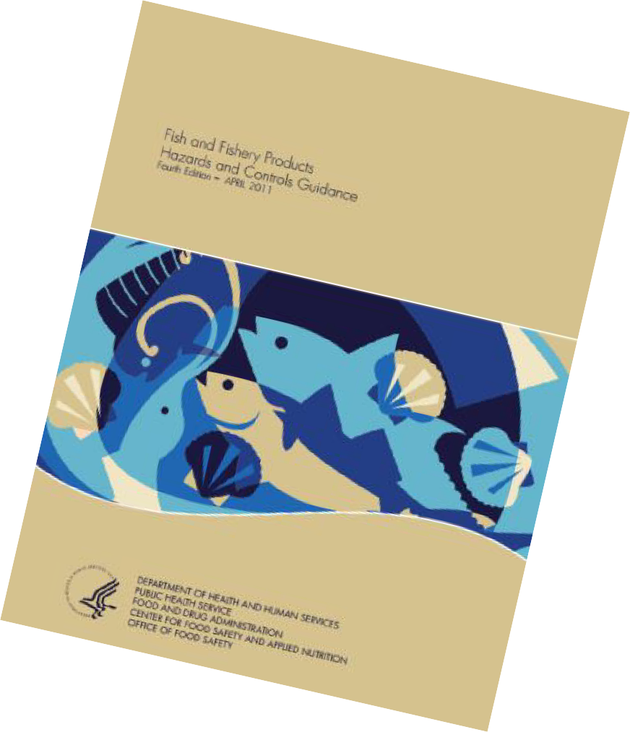
Slide 5
The Seafood HACCP Training Manual (blue book) provides:
•Written content that describes each presentation in the course
•Reference information and forms to help you develop a HACCP Plan
The FDA Hazards Guide provides:
•Guidance for the seafood industry to help them identify hazards for their products and develop effective control strategies
•A tool for regulatory officials to help them evaluate HACCP Plans for seafood products
BLUE
Book
GOLD
Book

Slide 8
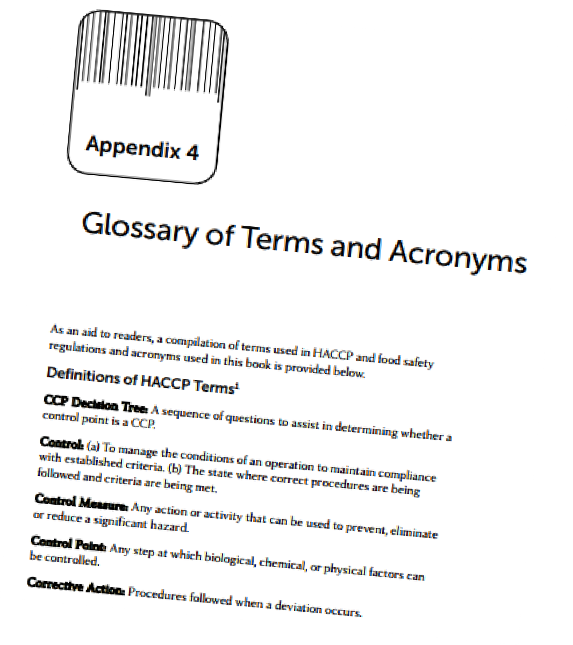
Definitions and Terms
Slide 6
Key Definitions and Terms used in the FDA Seafood HACCP regulation and Hazards Guide are provided for reference in Appendix 4
Appendix 4
page 246

Slide 9
Slide 7
HACCP stands for Hazard Analysis and Critical Control Points
Slide 8
A HACCP system is
•Preventive, not reactive
•A management tool use to protect the food supply
•Designed to minimize the risk of food safety hazards, but is not zero risk

Slide 10
Slide 9
Origin of HACCP:
•Pioneered in the 1960s
•First used when foods were developed for the space program
•Adopted by many food processors
Slide 10
National Academy of Sciences Recommendation:
The HACCP approach should be adopted by all regulatory agencies, and it should be mandatory for food processors

Slide 11
7 Principles of HACCP
Slide 11
Seven principles of HACCP:
1) Conduct a hazard analysis
2) Determine the critical control points (CCPs) in the process
3) Establish the critical limits
4) Establish monitoring procedures
5) Establish corrective actions
6) Establish verification procedures
7) Establish record-keeping procedures

Slide 12
Layers of Controls
Slide 12
HACCP is not a stand-alone system.
HACCP is built on a foundation of Good Manufacturing Practices
HACCP
Sanitation Control Procedures
Good Manufacturing Practices

Slide 13
Prerequisite Programs and Sanitation Control Procedures
Slide 1
In this chapter you will learn:
• The importance of prerequisite programs for HACCP
• Good Manufacturing Practices (GMPs)
• Sanitation Control Procedures (SCPs)
• Examples of SCP monitoring

Slide 14
Prerequisites
Slide 2
Definition:
Prerequisite programs are procedures, including Good Manufacturing Practices (GMPs), that address environmental and operational conditions which provide the foundation for the HACCP system.

Slide 15
Slide 3
Federal, State, or Local Requirements
• Food Defense and Biosecurity Requirements
• Food Safety Modernization Act (FSMA) Requirements
-Sanitary Transport
-Food Traceability (some exemptions)
-Mitigation for intentional adulteration
• Labeling Requirements
-Food Allergen Labeling and Consumer Protection Act (FALCPA)
-Country of Origin Labeling (COOL)
-Nutritional Labeling and Education Act (NLEA)
• State and Local Licenses and Permits

Slide 16
Slide 4
Recommended programs
•Environmental Monitoring
•Transportation Controls
•Recall Programs
•Supplier controls
•Preventive maintenance
Slide 5
Required Prerequisite Programs for Seafood HACCP
•Employee training and training records
•Current Good Manufacturing Practice (GMPs)
•Seafood HACCP Regulation-Sanitation Control Procedures

Slide 17
FSMA addition
Slide 6
Training Requirements - Preventive Controls for Human Food (21 CFR 117)
•Employees must be qualified to perform assigned jobs
•Training in food hygiene and food safety
•Supervisors assure compliance
•Training records maintained

Slide 18
Required Training Records
Page 13

Slide 19
GMP’s 117
Slide 8
Good manufacturing practices (GMPs) are the basis for determining if process methods produce safe foods and whether products have been processed under sanitary conditions.
Slide 9
Good Manufacturing Practices (21 CFR Part 117 Subpart B)
•Describes requirements for food processors to ensure safe and sanitary production of foods.
•First released in 1969 (21 CFR Part 110), GMPs for food manufacturing were revised in 1986 and again in 2015 (21 CFR Part 117).
•The updated GMPs include prevention of allergen cross-contact.

Slide 20
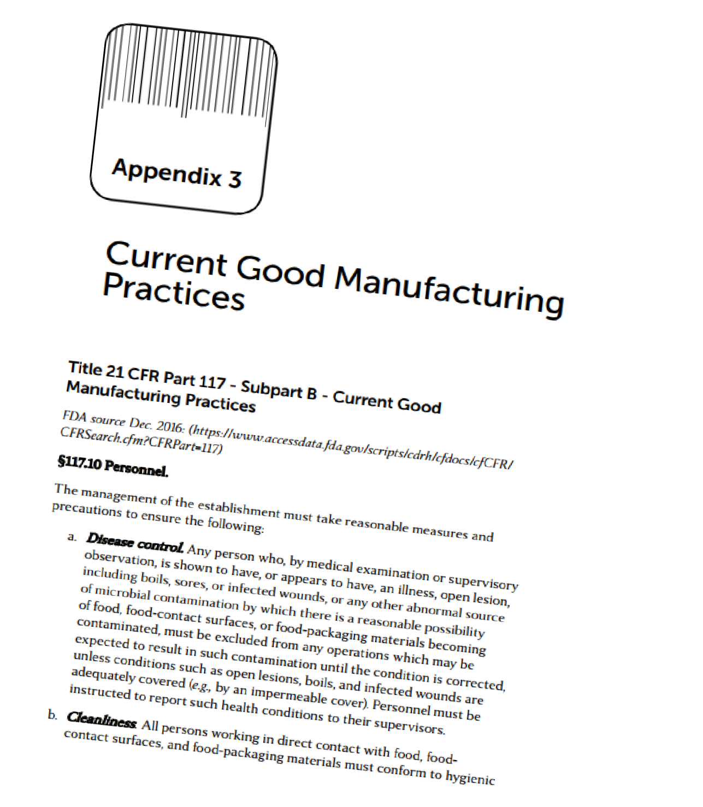
GMP’s 117
Slide 10
Seafood HACCP programs must be based on a solid foundation in compliance with the GMPs and SCPs.
Appendix 3
page 233
20

Slide 21
Sanitation Control Procedures(SCPs)
Slide 11
Sanitation control procedures (SCPs) are used by food processing firms to meet requirements in the GMPs.
SCPs are an effective means to control potential food safety hazards that might be associated with the processing environment and employee practices.

Slide 22
SSOP’s- Written Procedures
Slide 12
Sanitation Control Procedures:
Recommended:
•Written Sanitation Standard Operating Procedures (SSOPs).
Required
•Monitoring
•Corrections
•Recordkeeping

Slide 23
Example of Sanitation Control Procedures
Slide 13
Examples of Sanitation Control Procedures
Control of bacterial cross contamination hazard
•Maintain product flow
•Location of hand washing stations
•Equipment cleaning and Sanitizing
Control of chemical cross contamination and/or allergen cross-contact hazards
•Proper chemical storage
•Proper chemical labeling
•Correct use of chemicals
•Production scheduling to prevent allergen cross-contact.

Slide 24
8 Key Areas of Sanitation
Slide 14
Eight Key areas of sanitation:
1)Safety of water
2)Condition and cleanliness of food contact surfaces
3)Prevention of cross contamination
4)Maintenance of hand washing, hand sanitizing and toilet facilities
5)Protection from adulterants
6)Labeling, storage and use of toxic compounds
7)Employee health
8)Exclusion of pests

Slide 25
Slide 15
1) Safety of water
•Source and treatment of water that comes in contact with food or food contact surfaces
•Water used in the manufacture of ice
•Cross-connections between potable and non-potable
water supplies
Slide 16
2) Condition and cleanliness of food contact surfaces
•Design, workmanship, maintenance, and materials used for food contact surfaces
•Routine scheduled cleaning and sanitizing of food contact
surfaces including gloves and outer garments

Slide 26
Slide 17
3) Prevention of cross-contamination
•Employee hygiene practices
•Employee food handling practices
•Plant design and layout
•Physical separation of raw and ready-to-eat products
Slide 18
4) Maintenance of hand washing, hand sanitizing, and toilet
facilities:
•Maintenance and location of hand washing, hand sanitizing, and toilet facilities
•Maintenance of adequate sewage disposal system

Slide 27
Slide 19
5) Protection from adulterants
•Protect food, food contact surfaces, and food packaging material from contaminants.
Slide 20
6) Labeling, storage and use of toxic compounds

Slide 28
Slide 21
7) Employee health conditions:
•Controls are necessary to ensure that employee health
conditions do not cause food contamination.
Slide 22
6) Exclusion of pests:
• Pests must not be present in the food processing facility.

Slide 29
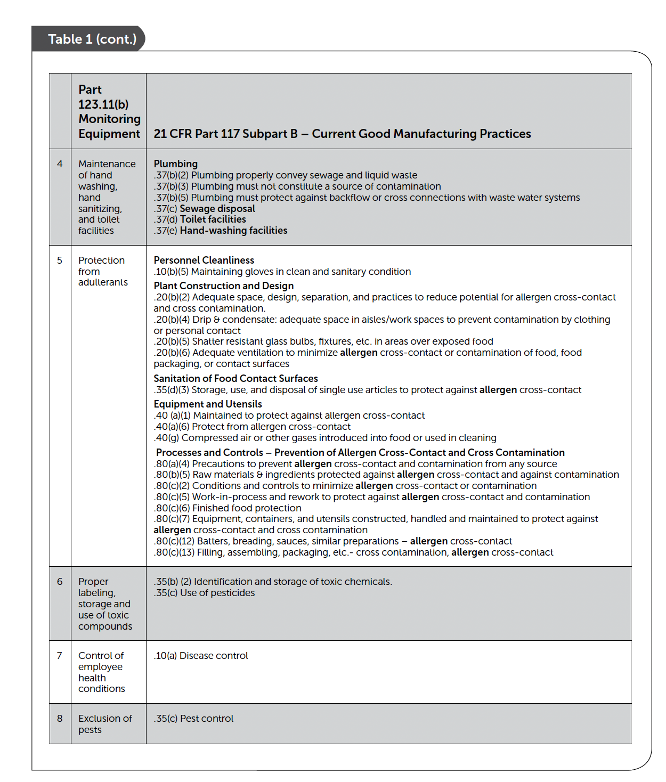
SCPs in GMPs 117
Pages 21-22

Slide 30
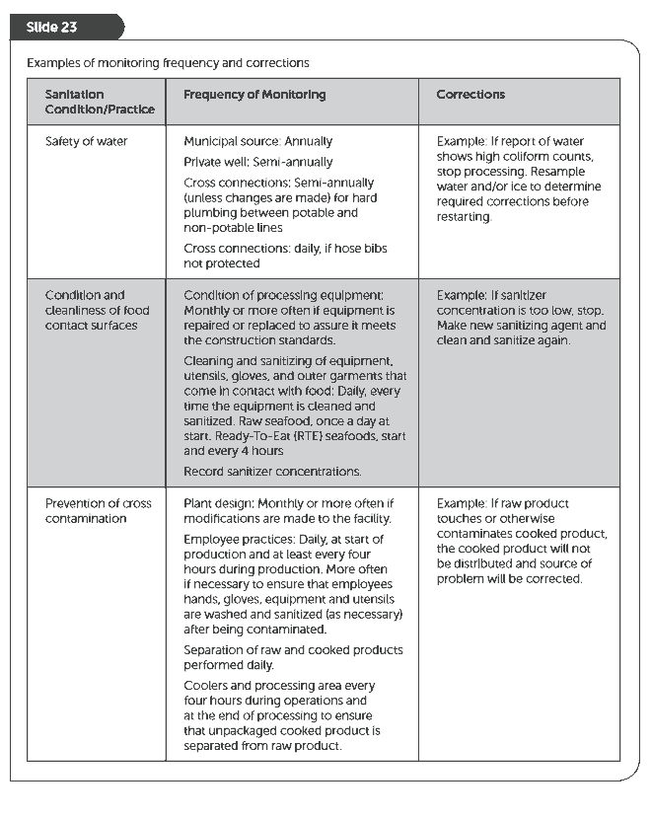
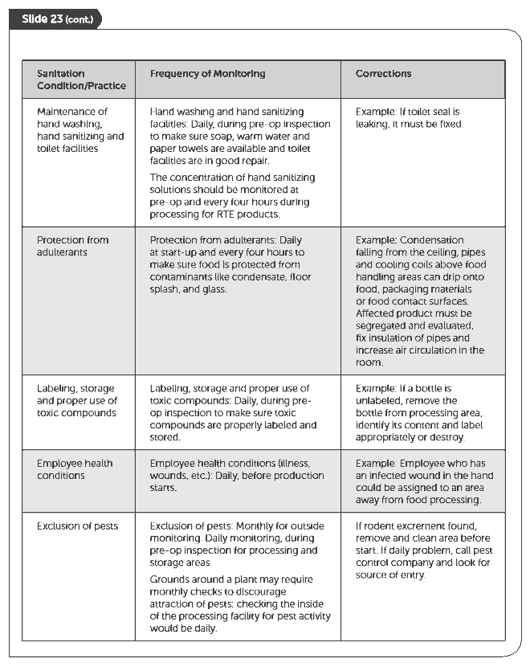
Monitoring SCPs
Pages 24-25

Slide 31
Monitoring SCPs
Slide 24
Required Elements of SCP Monitoring Records
•Name and address of the firm
•Date and time of the recorded activity
•Include all of the eight key sanitary concerns pertinent to the operation
•Monitoring procedure and appropriate frequency
•Monitoring results
•Corrections taken
•Signature or initials of person conducting the monitoring

Slide 32
Slide 25
A facility processes only chilled Atlantic Salmon and Pacific Cod fillets
•Does SCP concerning safety of water apply? How?
•Does SCP concerning protection from adulterants apply? How?
Page 27

Slide 33
SCP Requirements
Slide 26
Sanitation in the Seafood HACCP Regulations:
SCPs are required and written SSOPs are recommended,
Monitoring for the eight key areas of sanitation is required,
Recording monitoring results is required,
Making corrections and documenting them is required.

Slide 34
HACCP vs. SCP’s
Slide 27
Hazard | Control | Type of Control | Control Program
Histamine | Time and temperature controls for fish | Product specific | HACCP
Pathogen survival | Time and temperature controls for smoking fish | Processing step | HACCP
Contamination with pathogens | Wash hands before touching product | Employee | Sanitation or SCP
Contamination with pathogens | Limit employee movement between raw and cooked areas | Employee | Sanitation or SCP
Contamination with pathogens | Clean and sanitize food contact surfaces | Plant environment | Sanitation or SCP
Chemical contamination | Use only food-grade grease | Plant environment | Sanitation or SCP

Slide 35
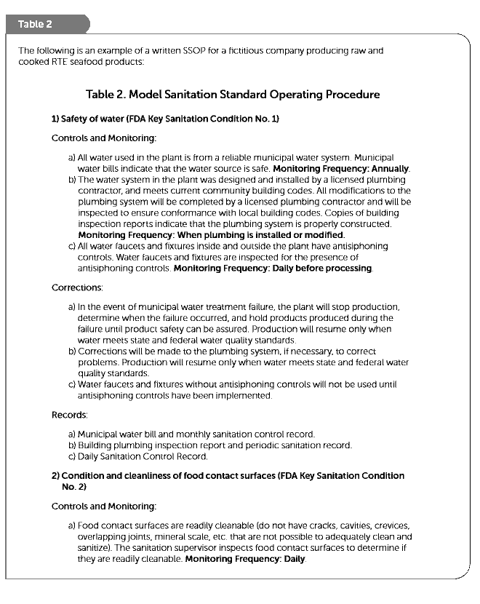
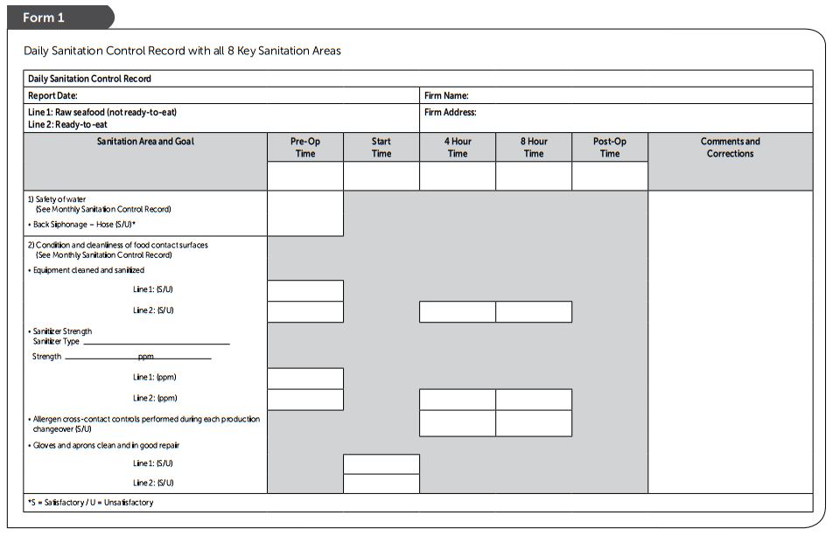
Example SSOP ‘written program’
and accompanying records
Pages 30-39

Slide 36
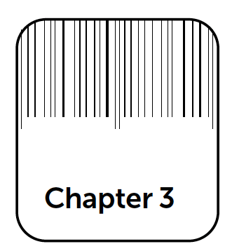
Seafood Safety Hazards
Slide 1
In this chapter you will learn:
• Food Safety Hazards that have been associated with seafood and are considered “reasonably likely to occur” if not subject to appropriate controls

Slide 37
Slide 2
Hazards: a biological, chemical or physical agent that is reasonably likely to cause illness or injury in the absence of appropriate controls
Undesirable conditions may not impose a particular food safety hazard, but they are subject to other regulatory controls and pre-requisite requirements (i.e., GMPS and Sanitation Control Procedures (SCPs). Examples include:
Insects
Hair
Filth
Spoilage
Economic Fraud
Violations of regulatory food safety standards not directly related to safety

Slide 38
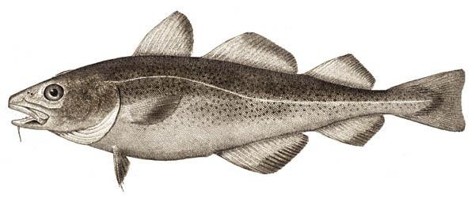
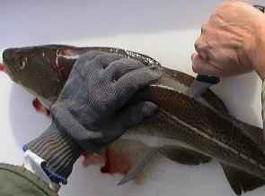
Categories for Seafood Safety Hazards
Slide 3
Potential seafood safety hazards can be grouped into two categories:
Species-related hazards
Process-related hazards

Slide 39
Species- and Process-Related Hazards
Slide 4
Species-Related Hazards
Pathogens from the Harvest Area (molluscan shellfish only)
Parasites
Natural Toxins
Scombrotoxin or Histamine Formation (certain species of finfish only)
Environmental Chemical Contaminants Including Pesticides Methylmercury
Aquaculture Drugs (farm raised)
Process-Related Hazards
Pathogenic Bacteria Growth and Toxin Formation (Other than Clostridium botulinum) as a Result of Time and Temperature Abuse
Clostridium botulinum Toxin Formation
Pathogenic Bacteria Growth and Toxin Formation as a Result of Inadequate Drying
Staphylococcus aureus Toxin Formation in Hydrated Batter Mixes
Pathogenic Bacteria Survival Through Cooking or Pasteurization
Introduction of Pathogenic Bacteria After Pasteurization and Specialized Cooking Processes
Undeclared Major Food Allergens and Certain Food Intolerance Substances
Metal and glass inclusion

Slide 40
Pathogens in Seafood
Slide 5
Microorganisms that can be pathogenic and cause seafoodborne illnesses:
Bacteria
Viruses
Protozoa
Microscopic parasites
Slide 6
Bacterial Hazards:
Foodborne infection
Foodborne intoxication

Slide 41
Pathogen Controls
Slide 7
Control strategies for pathogens in seafood:
Source controls for high risk products like raw molluscan shellfish require that they only be harvested from waters that do not have elevated levels of pathogens
Prevent or reduce pathogen growth to an acceptable level by: freezing, refrigeration (minimizing exposure to temperatures above 40°F), drying, acidifying, fermenting, or salting
Eliminate or kill pathogens by cooking, pasteurizing, or using lethal non-thermal treatments

Slide 42
Pathogens Growth
Slide 8
Slide 9
What bacteria need for favorable growth:
Food (nutrients from the seafood)
Water (moisture in the seafood)
Proper temperature
Air, minimal air or no air (reduced-oxygen)

Slide 43
Primary Microbial Pathogens
Slide 10
Pathogens of Concern for Seafood Products:
Sporeforming bacteria
Clostridium botulinum
Bacillus cereus
Clostridium perfringens
Non-Sporeforming bacteria
Listeria monocytogenes
Salmonella spp. (e.g., S. typhimurium, S. enteriditis)
Shigella spp. (e.g., S. dysenteriae)
Pathogenic Staphylococcus aureus
Vibrio spp. (e.g., V. cholerae, V. parahaemolyticus, V. vulnificus)
Others (Campylobacter jejuni, Yersina enterocolitica, Shigella spp. and Escherichia coli)

Slide 44
Specific Pathogen Controls
Slide 11
Some controls for Clostridium botulinum in seafood:
•Destroy spores during processing (e.g., thermal processing
[canning] or proper cooking to destroy the spores).
•Prevent potential growth by proper salting, drying, or pickling (acidification).
•Proper refrigeration, particularly for raw, non-frozen seafood packaged in anaerobic conditions (limited oxygen).
•Packaging refrigerated fishery products in permeable film that allows enough oxygen exposure to prevent anaerobic growth.

Slide 45
Specific Pathogen Controls
Slide 12
Some controls for Bacillus cereus in seafood:
Proper sanitation to prevent product contamination (product source, process facilities and personnel)
Proper chilling rates for warm prepared food
Proper refrigeration for prepared, ready-to-eat (RTE) food with extended shelf lives

Slide 46
Specific Pathogen Controls
Slide 13
Some controls for Listeria monocytogenes in seafood:
Proper sanitation to prevent product contamination (product source, process facilities, and personnel)
Proper refrigeration to prevent growth
Proper cooking
Prevent cross-contamination after cooking

Slide 47
Specific Pathogen Controls
Slide 14
Some controls for Salmonella spp. in seafood:
Proper sanitation to prevent product contamination (product source, process facilities and personnel)
Proper refrigeration to prevent growth
Proper cooking
Prevent cross-contamination after cooking

Slide 48
Specific Pathogen Controls
Slide 15
Some controls for Staphylococcus aureus in seafood:
Proper sanitation to prevent product contamination (product source, process facilities and personnel)
Proper refrigeration to prevent growth
Proper cooking
Prevent cross-contamination after cooking

Slide 49
Specific Pathogen Controls
Slide 16
Some controls for Vibrio cholerae, Vibrio parahaemolyticus and Vibrio vulnificus in seafood:
Product harvested from approved sources
Proper refrigeration from harvest through processing
Proper cooking
Consumption advisories for more susceptible consumers

Slide 50
Viruses
Slide 17
Hazards from viruses in foods
Not truly "alive“
Exist everywhere
Do not grow in food
Do not spoil food
Transmitted by people, food and contaminated water
Cause illness by infection

Slide 51
Viruses
Slide 18
Hazards from viruses in foods
Not truly "alive“
Exist everywhere
Do not grow in food
Do not spoil food
Transmitted by people, food and contaminated water
Cause illness by infection
Viruses:
Hepatitis A virus causes fever and abdominal discomfort, followed by jaundice
Norovirus group (formerly Norwalk Virus) causes nausea, vomiting, diarrhea, and abdominal pain (gastroenteritis); headache and low-grade fever may also occur
Slide 19
Some controls for viruses in seafood:
Product from approved sources
Thorough cooking

Slide 52
Parasites
Slide 20
Parasites are organisms that need a host to survive.
Thousands of kinds exist worldwide but less than 100 types are known to infect people through food consumption
Types of concerns for seafood or water:
Parasitic worms (e.g., roundworms/nematodes, tapeworms/ cestodes, and flukes/trematodes)
Hazards from viruses in foods
Not truly "alive“
Exist everywhere
Do not grow in food
Do not spoil food
Slide 21
Methods of preventing transmission of parasites to foods by fecal contamination include:
Good personal hygiene practices by food handlers
Proper disposal of human feces
Elimination of insufficiently treated sewage to fertilize crops
Proper sewage treatment

Slide 53
Parasites
Slide 22
Parasitic Worms:
Cryptosporidium parvum
Nematodes and roundworms (Anasakis simplex, Pseudoterranova dicepiens, Eustrongylides spp. and Gnathostoma spp.)
Cestodes or tapeworms (Diphyllobothrium latum)
Trematodes or flukes (Chlonorchis sinensis, Heterophyes spp., Metagonimus spp., and others)
Hazards from viruses in foods
Not truly "alive“
Exist everywhere
Do not grow in food
Do not spoil food
Slide 23
Some controls for Anisakis simplex, P. decipiens and D. latum parasites in seafood:
Proper freezing
Proper cooking

Slide 54
Species-Related Hazards from Harvest/Growing Waters
Slide 24
Species-Related Hazards Associated with the Harvest/Growing Area
Natural Toxins
Environmental Chemical Contaminants
Aquaculture Drugs

Slide 55
Natural Toxins
Slide 25
Biotoxins – naturally occurring hazards:
Shellfish Biotoxins- Amnesic Shellfish Poisoning (ASP; domoic acid)
Diarrhetic Shellfish Poisoning (DSP; okadaic acid)
Neurotoxic Shellfish Poisoning (NSP)
Paralytic Shellfish Poisoning (PSP; saxitoxins)
Ciguatera Fish Poisoning (CFP)
Tetrodotoxins (puffer fish poisoning)

Slide 56
Natural Toxins Controls
Slide 26
Control for shellfish biotoxins in seafood:
Only harvest approved shellfish products from approved waters
Slide 27
Control for ciguatera in seafood:
Do not process certain fish harvested from waters that have been designated as potentially ciguatoxic

Slide 57
Natural Toxins Controls
Slide 28
Control for tetrodotoxin in seafood:
Do not process certain fish (puffer fish) that have been designated as potentially tetrodotoxic
Slide 29
Control for gempyltoxin in seafood:
Do not process certain potentially gempylotoxic fish

Slide 58
Environmental Chemical Contaminants
Slide 30
Controls for Environmental Chemical Contaminants (Pollutants)
Do not harvest or sell fish or shellfish from waters that have been closed by federal, state, or local authorities due to environmental pollution
Properly locate and monitor aquaculture farming operations to prevent pond contamination from runoff, and previous or new human activities. Testing for chemical contaminants of concern

Slide 59
Aquaculture Drugs: Illegal or Improper Use
Slide 31
Some controls for use of aquaculture drugs:
When necessary, only use certain controlled drugs in the manner prescribed by a recognized veterinary expert
Test for any excessive residuals in final products

Slide 60
Scombrotoxin(histamine poisoning)
Slide 32
Control for potential scombrotoxin in seafood:
Temperature controls from the moment of harvest through processing, storage, and product distribution

Slide 61
Process-Related Hazards
Slide 33
Other Process-Related Food Safety Hazards
Food Intolerance Substances (FIS)
Food Allergens
Metal and Glass Inclusion

Slide 62
Process-Related Hazards
Slide 34
Examples of Food and Color Additives
Preservatives (e.g. nitrite, sulfites)
Nutritional additives (e.g. vitamins)
Color Additives (FD&C Yellow No. 5)
Slide 35
Controls for intentionally added ingredients in seafood:
Use proper type and amount of ingredients
Label product to inform consumers (e.g., sulfites and yellow #5)

Slide 63
Food Allergens
Slide 36
Control for shellfish biotoxins in seafood:
Only harvest approved shellfish products from approved waters
Slide 37
Control for ciguatera in seafood:
Do not process certain fish harvested from waters that have been designated as potentially ciguatoxic

Slide 64
Process-Related Hazards
Slide 33
Other Process-Related Food Safety Hazards
Food Intolerance Substances (FIS)
Food Allergens
Metal and Glass Inclusion

Slide 65
Physical Hazards
Slide 38
Physical Hazard:​
Any extraneous matter not normally found in food that could cause physical injury
Example:​ The following are examples of materials that may be physical hazards:​ ​
Material​ | Why a hazard?​
Glass​ | Cuts, bleeding; may require surgery to find or remove​
Metal​ | Cuts, broken teeth; may require surgery to remove​

Slide 66
Physical Hazards Controls
Slide 39
Control for potential glass inclusion in seafood:
Examination of glass containers for breakage​
Slide 40
Controls for potential metal inclusion in seafood: ​
Monitoring equipment for wear and breakage ​
Screening products with metal detectors

Slide 67
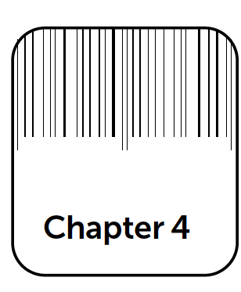
Preliminary Steps in Developing HACCP Plan
Slide 1
In this chapter you will learn:
• The importance of preliminary steps in developing the HACCP plan

Slide 68
Get Ready!
Slide 2
Preliminary steps:​
• Assemble HACCP team​
• Describe the product, intended use and consumers​
• Develop a Process Flow Chart​
• Develop a Process Description​

Slide 69
HACCP TEAM…Who is involved?
Managers Sanitation​ Processing​

Slide 70
Get Ready!
Slide 2
Preliminary steps:​
• Assemble HACCP team​
• Describe the product, intended use and consumers​
• Develop a Process Flow Chart​
• Develop a Process Description​

Slide 71
What is involved?
Slide 3
Product Description should include:​
• Type of seafood product (species and finished product form)​
• Where product is purchased​
• How product is received, stored, and shipped​
• How product is packaged​
• Intended use

Slide 72
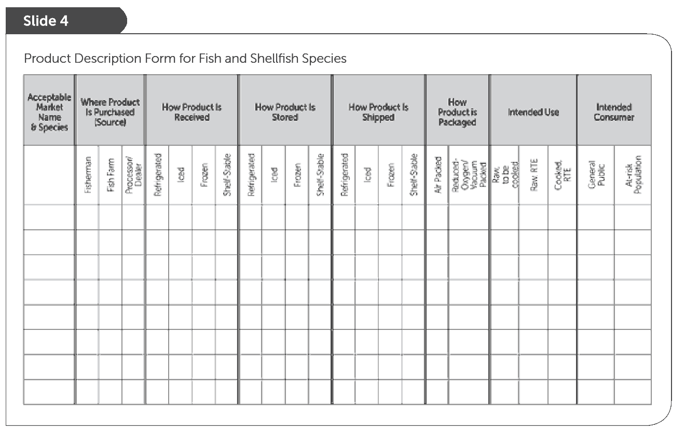
What is involved?
Useful Product Description Chart​
Page 73

Slide 73
Processing steps involved?
Slide 5
Page 73

Slide 74
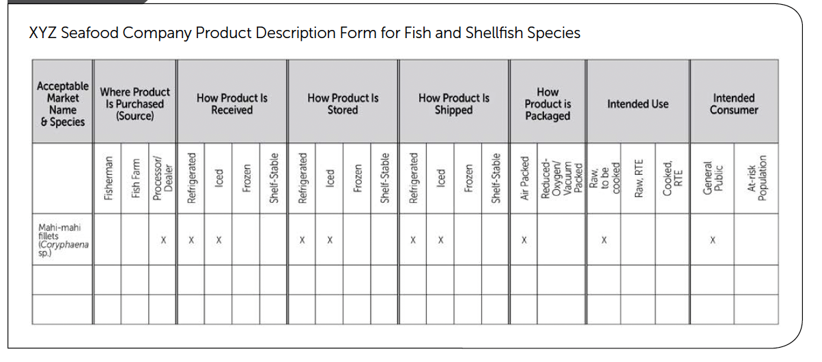
Introduce XYZ Seafood Company (See pages 74-76)
Slide 6
Page 73

Slide 75
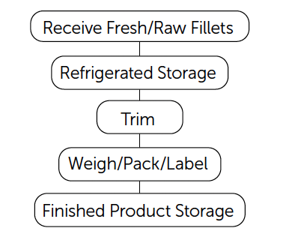
XYZ Processing Steps
Slide7
Example process flow diagram for production of fresh mahi-mahi fillets for XYZ Seafood Company
Process Flow Chart

Slide 76
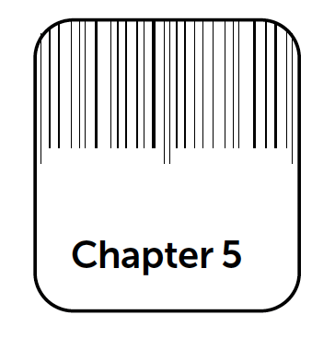
Principle 1: Hazard Analysis
Slide 1
In this chapter you will learn how to:​
• Conduct a hazard analysis​
• Identify significant hazards​
• Identify control measures

Slide 77
Key Definitions
Slide 2
Definition: A hazard is any biological, chemical or physical agent that is reasonably likely to cause illness or injury in the absence of control(s).
Biological​
Chemical​
Physical​
Food Safety Hazards

Slide 78
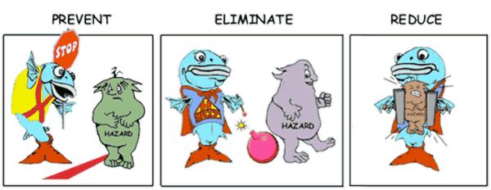
Why conduct a Hazard Analysis?
Slide 3
The hazard analysis is conducted to identify:​
• All potential food safety hazards,​
• Which of these hazards are significant, and​
• Measures to control the significant hazards.​

Slide 79
How to conduct a Hazard Analysis?
Slide 4
There are five steps in a hazard analysis:​
1) List process steps​
2) Identify potential food safety hazards​
3) Determine if the hazard is significant​
4) Justify the decision​
5) Identify control measure(s)
5 Steps​

Slide 80
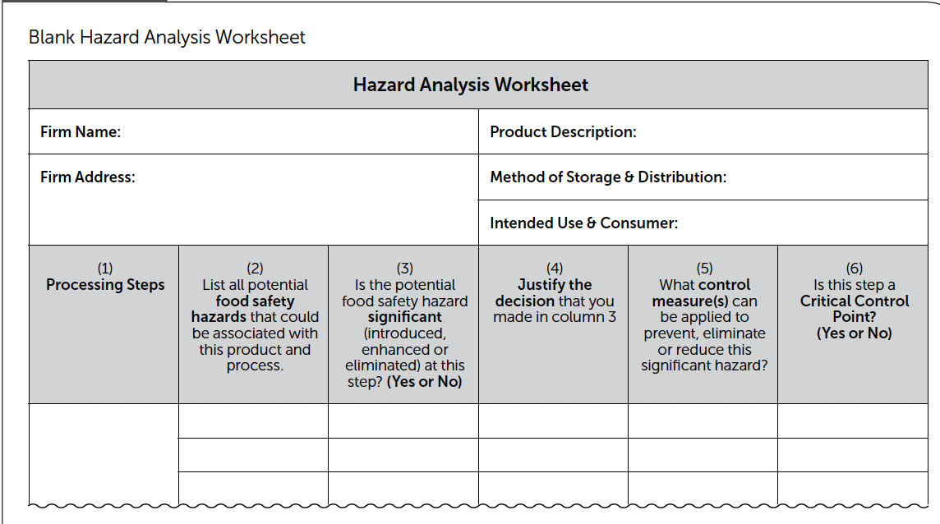
Use the Hazard Analysis Worksheet
Slide 5

Slide 81
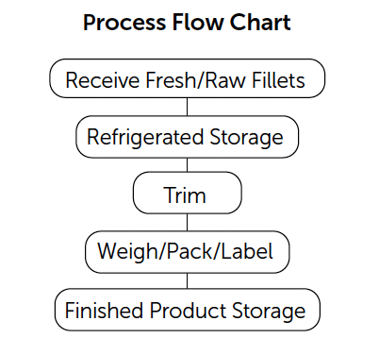
STEP 1– Enter Processing Steps​
Slide 6
Step 1: Enter each of the processing steps from the process flow chart in Column 1 of the hazard analysis worksheet. Each step will have its own block on the worksheet and should be listed in the same order as on the process flow chart.
“Fresh Mahi-mahi Fillets”​
Processing Steps​
Flow Diagram from​
Chapter 4, Page 75​
5 Steps​
Chapter 4, Page 75

Slide 82
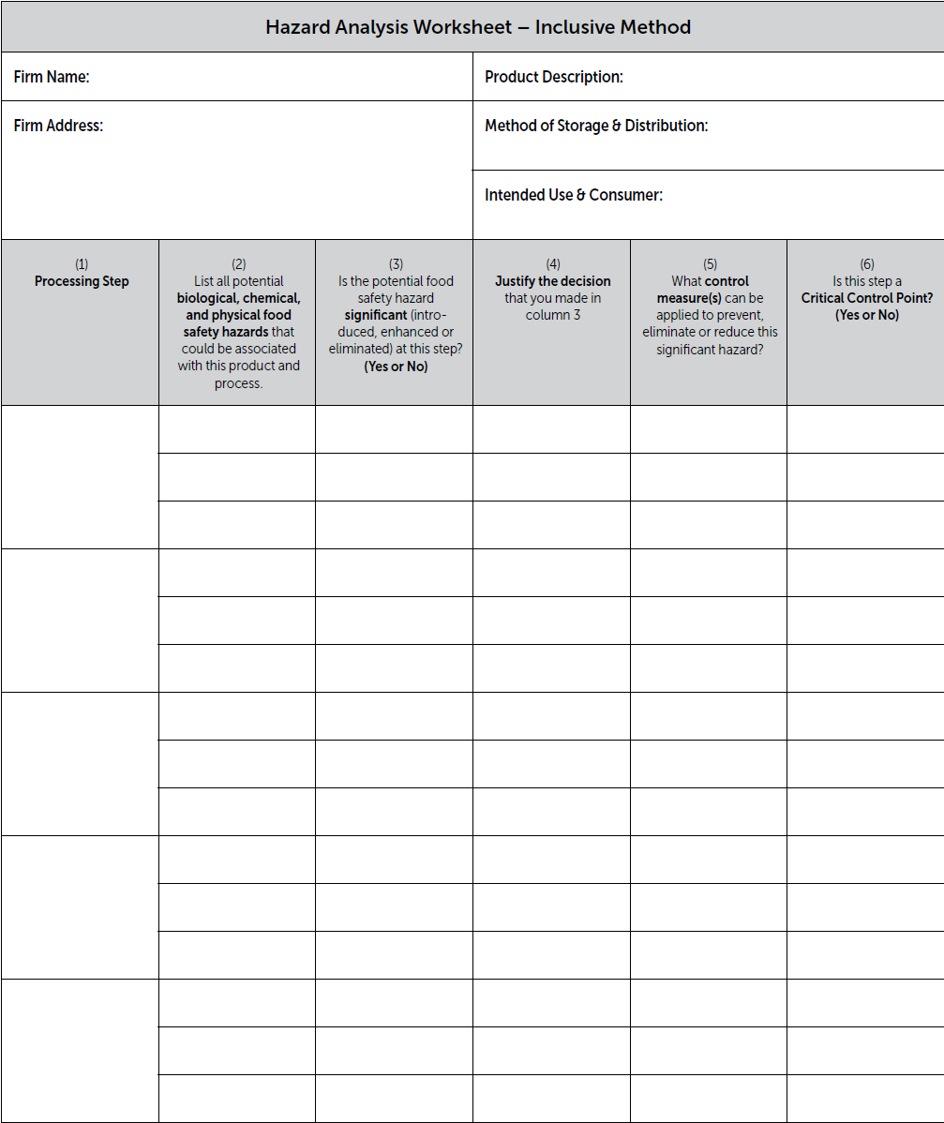
List all Processing Steps
Receiving Fresh/Raw Fillets
Column 1: List all of the processing steps from the Process Flow Chart
Refrigerated Storage
Trim
Weigh/ Pack/Label
Finish Product Refrig. Storage

Slide 83
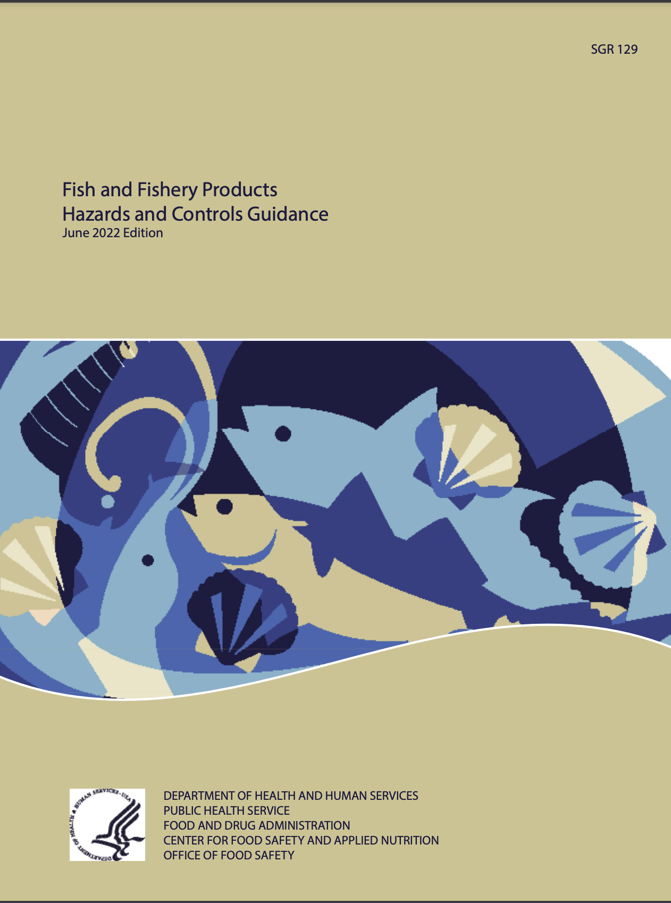
STEP 2– List Potential Food Safety Hazards
Slide 7
Step 2. List potential food safety hazards. It is important to list every identified hazard at each listed processing step.
Slide 8
Use the Hazards Guide as a tool to identify potential hazards.​
5 Steps​

Slide 84
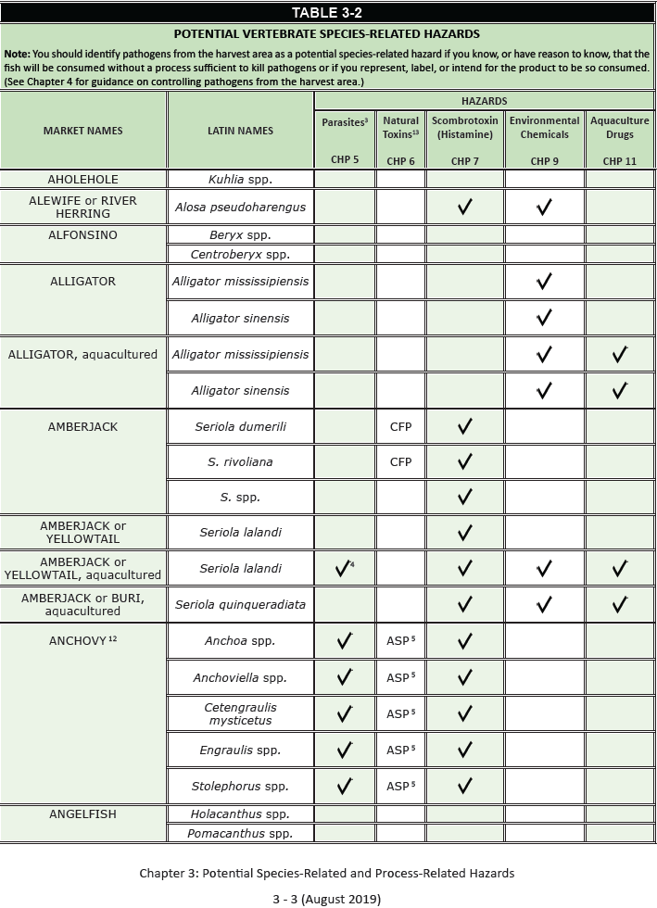
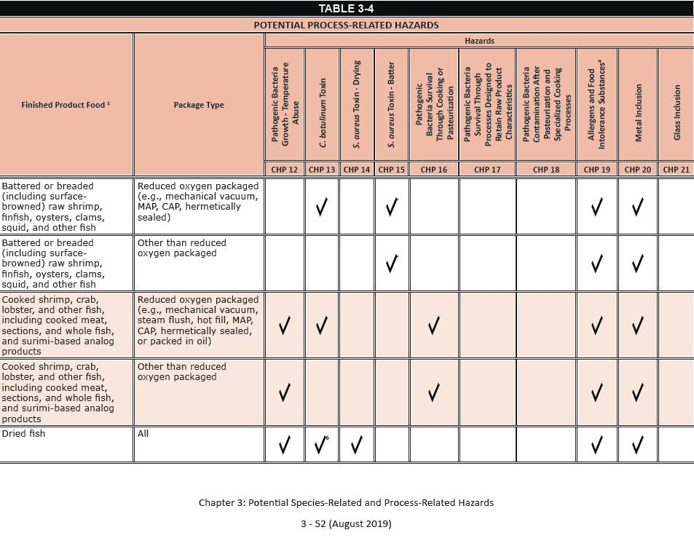
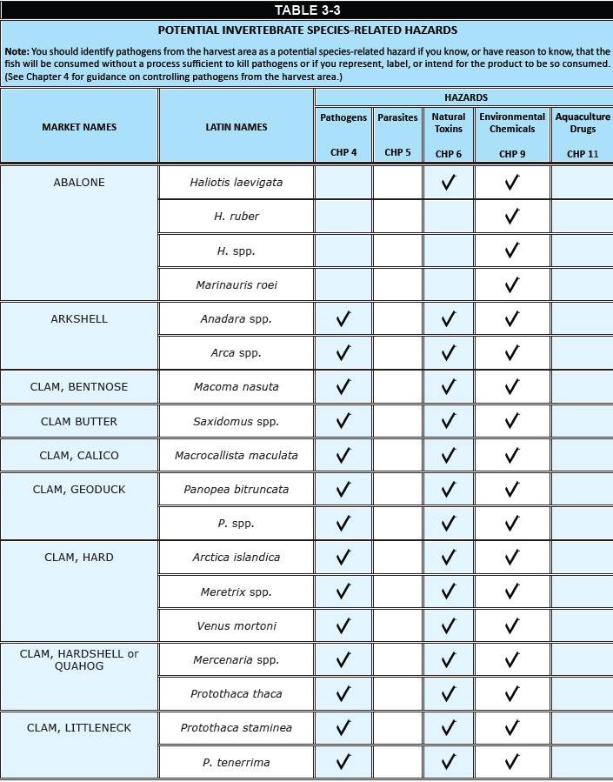
Search for the potential hazards for the Fresh ‘Wild’ Mahi-mahi Fillets
Table 3-4
Process-Related Hazards
Tables 3-2 and 3-3
Species-Related Hazards

Slide 85
One Species-related hazard
Table 3-2

Slide 86
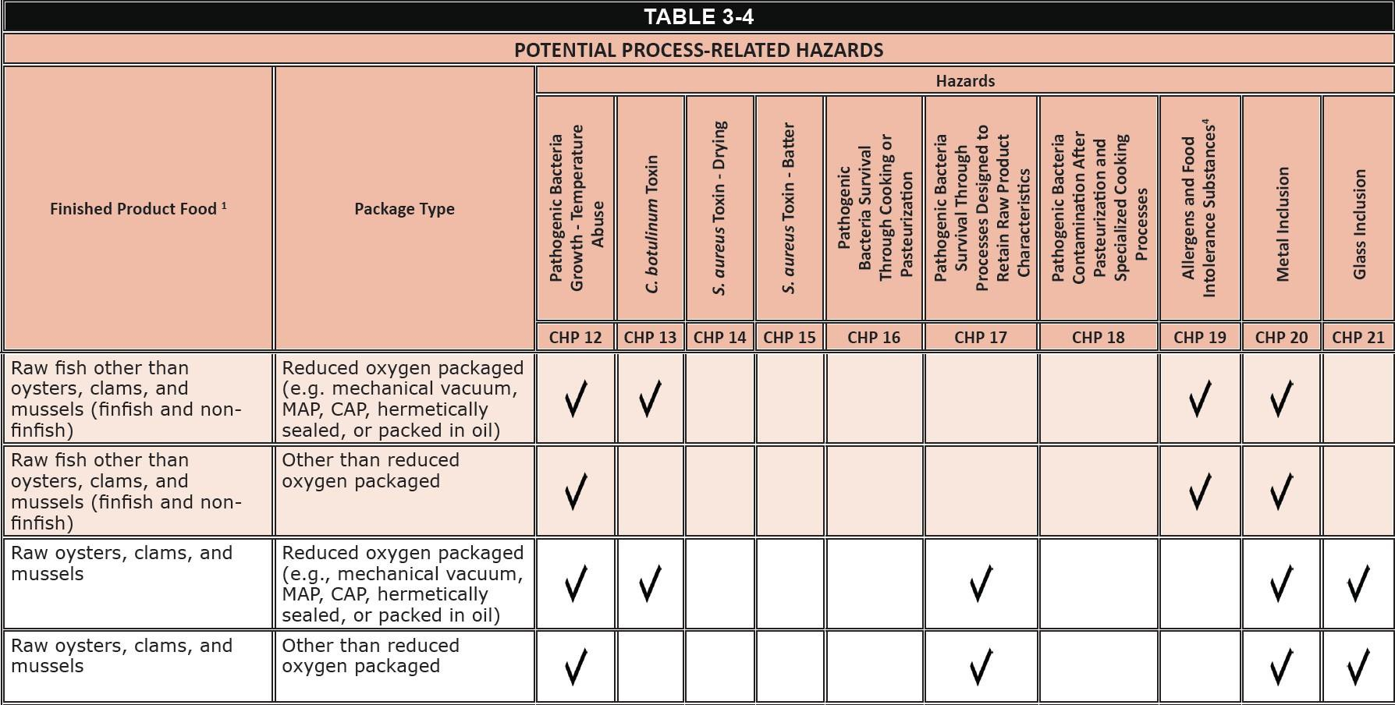
Four Process-related hazard
Notice two hazards in Chapter 19
Table 3-4

Slide 87
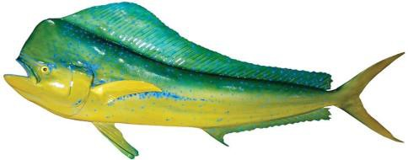
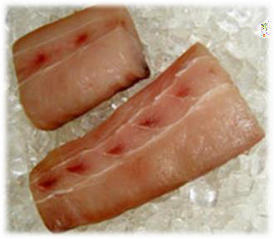
Hazard Analysis for the XYZ Seafood Company should include 5 potential hazards:
Species-related Hazards
Table 3-2
1. Histamine formation (Chapter 7)
Process-related Hazards
Table 3-4
Pathogenic bacterial growth-temperature abuse (Chapter 12)
Allergens (Chapter 19)
Food Intolerance Substances (Chapter 19)
Metal inclusion (Chapter 20)

Slide 88
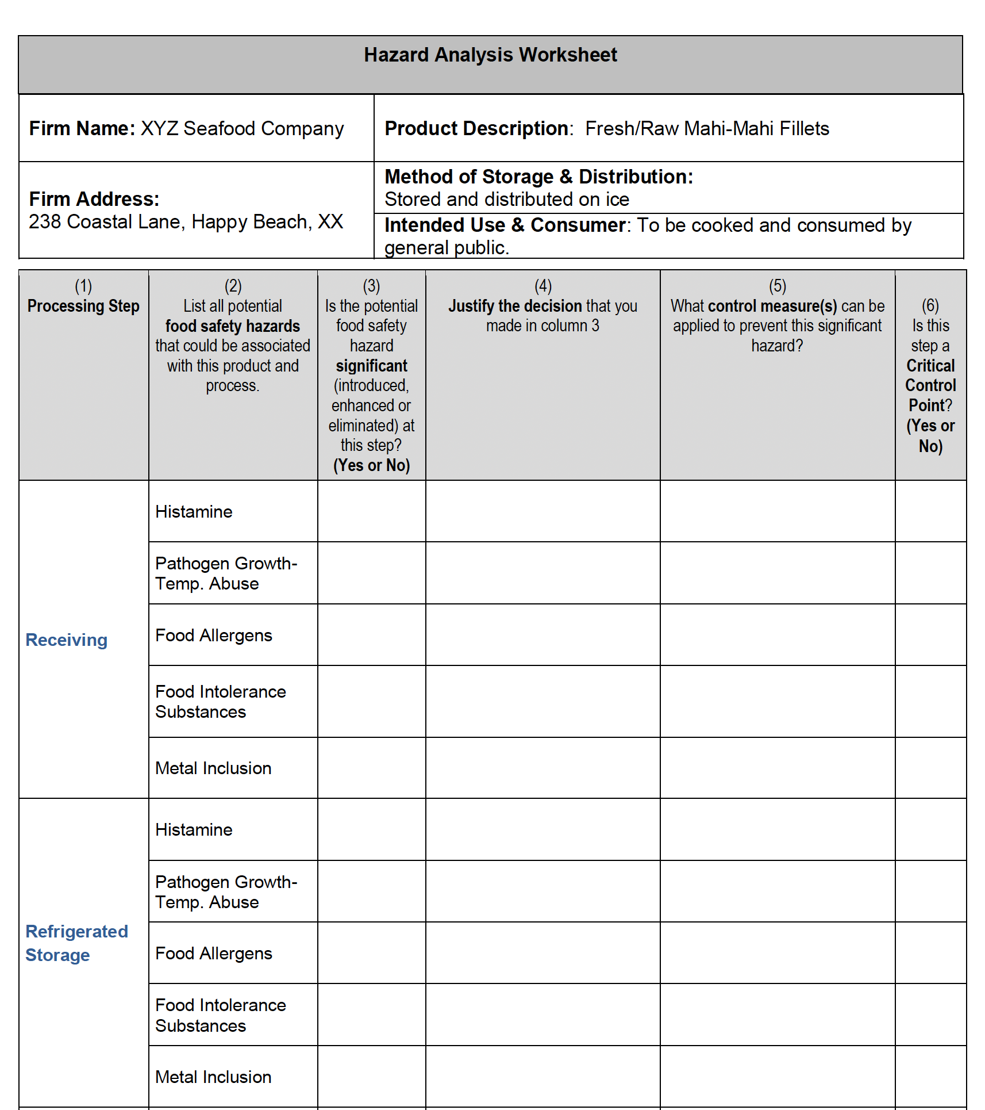
Inclusive Method

Slide 89
STEPS 3 & 4 – Hazard Evaluation & Justification
Slide 12
Steps 3 and 4: Hazard Evaluation and Justification. Determine​which hazards are significant and explain why.​
Simply answer the questions in the Hazard Analysis
5 Steps​

Slide 90
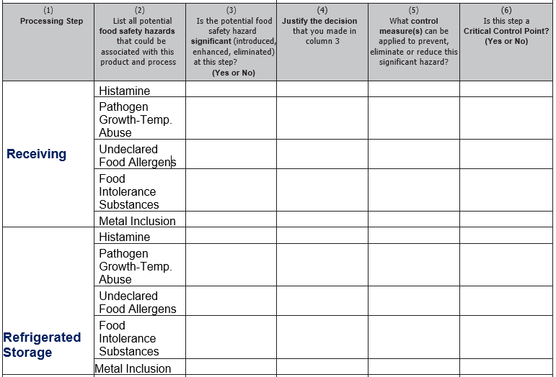
Exercise: Complete the Hazard Analysis Worksheet
Simply answer the questions in order for each listed potential hazard at each processing step
FDA Hazards Guide provides some recommendations in the respective hazard chapters

Slide 91
Slide 13
To determine if a hazard is significant, consider two questions:​
1) Is the hazard reasonably likely to occur in the finished product in the absence of control?​
2) Is the hazard likely to cause consumer illness?
Slide 14
Example – Fresh/Raw Mahi-Mahi ​
Which Hazards are Significant at the first process step, Receiving? ​
Histamine (Yes or No?) ​
Pathogen Growth - Temperature Abuse (Yes or No?) ​
Allergens (Yes or No?) ​
Food Intolerance Substances (Yes or No?) ​
Metal Inclusion (Yes or No?) ​

Slide 92
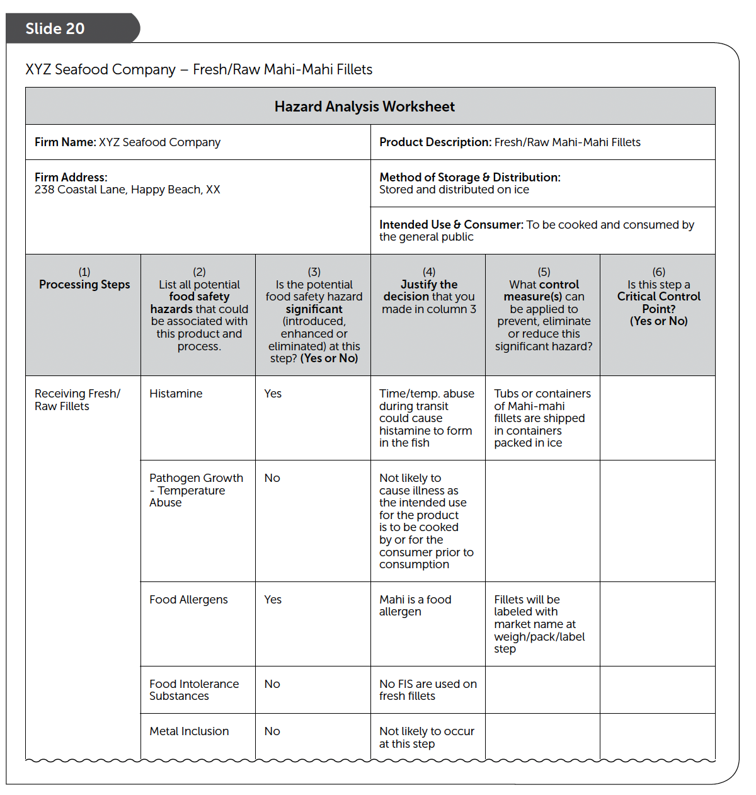
Justify your ‘Yes or No’ decisions
see page 93

Slide 93
BRIEF SUMMARY based on the FDA Guide that provides more recommended details
Column 2 Potential Hazards (Likely to Occur) | Columns 3 & 4 Is the hazard significant in this processing operation
Histamine | YES | Mahi is potential scombrotoxic fish species subject to temperature abuse
Pathogen Growth -Temp. Abuse | NO | Mahi intended to be cooked before consumption
Undeclared Food Allergens | YES | Fish are food allergens
Food Intolerance Substances (FIS) | NO | No FIS or food additives used or added in this processing operation
Metal Inclusion | NO | Not likely to occur in processing steps

Slide 94
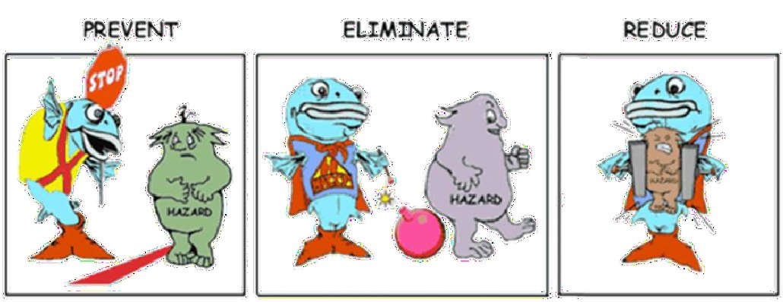
STEPS 5 – Identify control Measures (Column 5)
Slide 16
Step 5: Identify Control Measures for each significant hazard.
Slide 17
Control measures can be used to:​
• Prevent a food safety hazard,​
• Eliminate a food safety hazard, or​
• Reduce a food safety hazard to an acceptable level.​
5 Steps​

Slide 95
Control Measures
Slide 18
Control Measures for Pathogenic Bacteria, Viruses, Parasites​
Bacteria​
1) Time/temperature controls​
2) Heating and cooking​
3) Freezing​
4) Fermentation and/or pH controls​
5) Salt or other preservatives​
6) Drying​
7) Source controls​
18) Other processes (e.g. high hydrostatic pressure and irradiation)​
​
Viruses​
1) Cooking​
2) Source controls​
​
Parasites​
1) Cooking​
2) Freezing​

Slide 96
Control Measures
Slide 19
Control Measures for Chemical and Physical Hazards Chemical Hazards (Natural toxins, pesticides, drug residues, unapproved food and color additives, histamine
1)Source controls
2)Time/temperature controls
3)Production controls
4)Labeling controls
Physical Hazards (Metal, glass, etc.)
1)Source controls
2)Production controls

Slide 97
BRIEF SUMMARY based on the FDA Guide that provides more recommended details
Column 2 Potential Hazards (Likely to Occur) | Columns 3 & 4 Is the hazard significant in this processing operation |  | Column 5 Necessary Controls
Histamine | YES | Mahi is potential scombrotoxic fish species subject to temperature abuse | Time and Temperature controls (Chapter 7)
Pathogen Growth -Temp. Abuse | NO | Mahi intended to be cooked before consumption | Chapter 12
Undeclared Food Allergens | YES | Fish are food allergens | Proper product labeling (Chapter 19)
Food Intolerance Substances (FIS) | NO | No FIS or food additives used or added in this processing operation
Metal Inclusion | NO | Not likely to occur in processing steps | Chapter 20 (page 386)

Slide 98
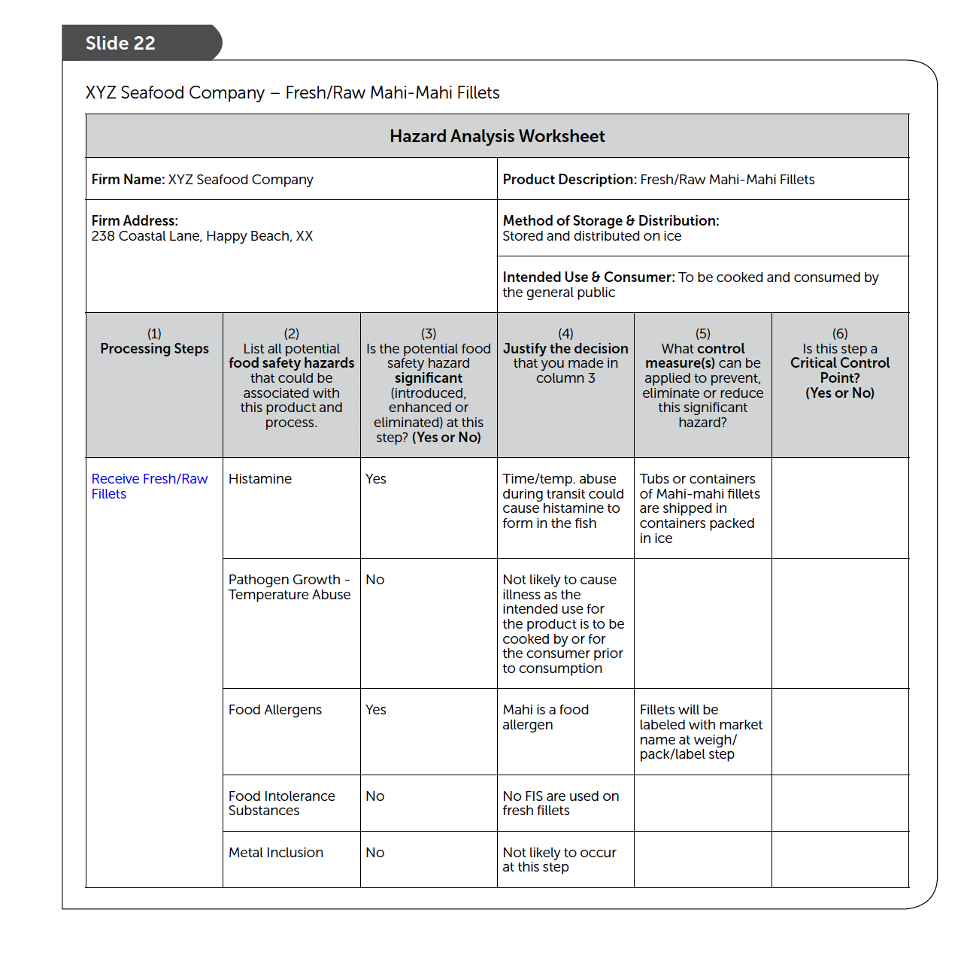
Hazard Analysis Worksheet
Pages 95-97
Every ‘Yes’ in column 3
requires a response in column 5 and 6

Slide 99
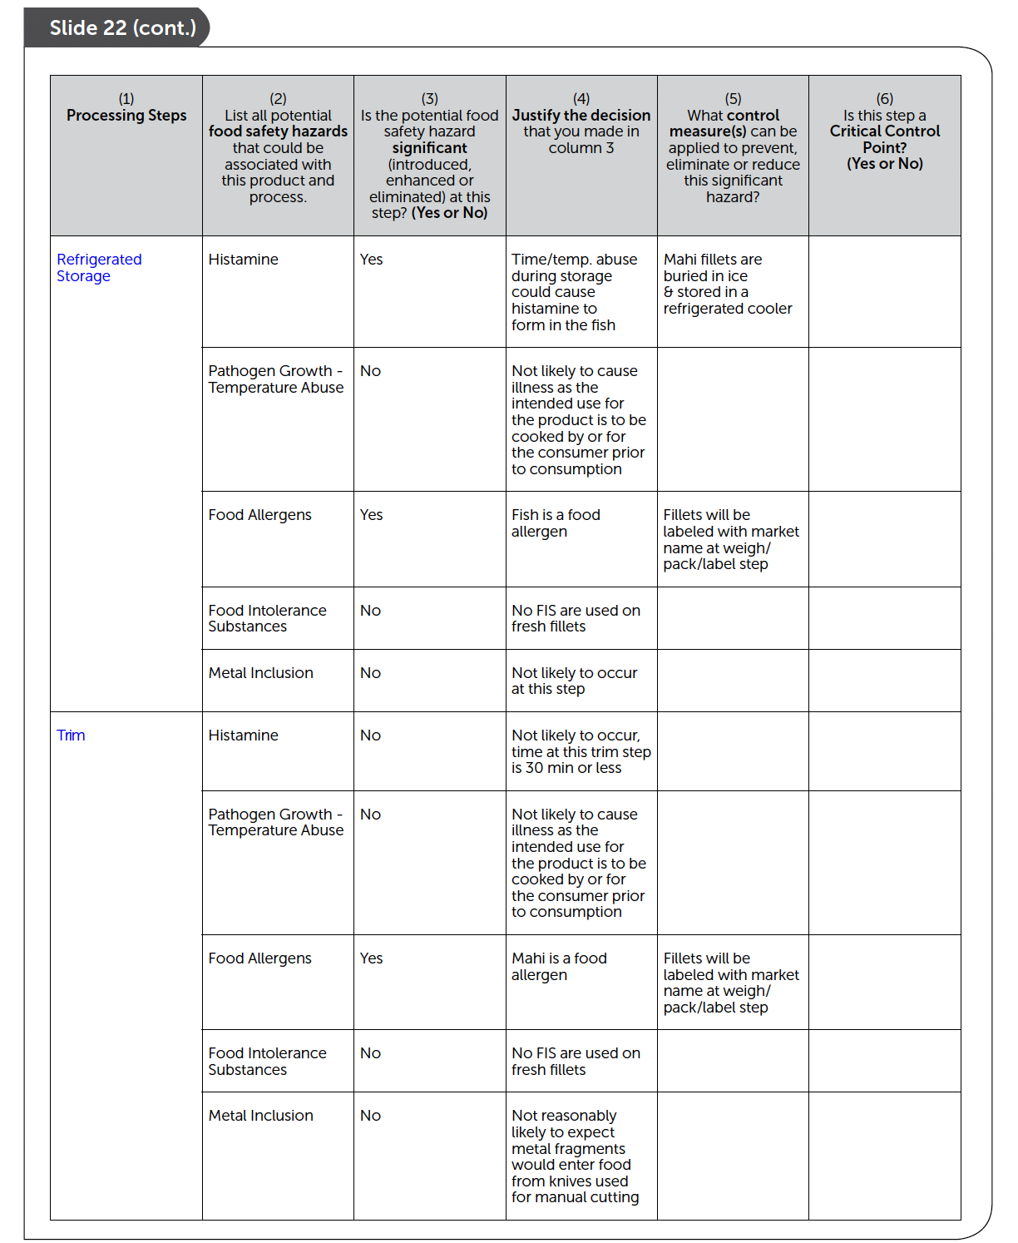
Hazard Analysis Worksheet
Pages 95-97
Every ‘Yes’ in column 3
requires a response in column 5 and 6

Slide 100
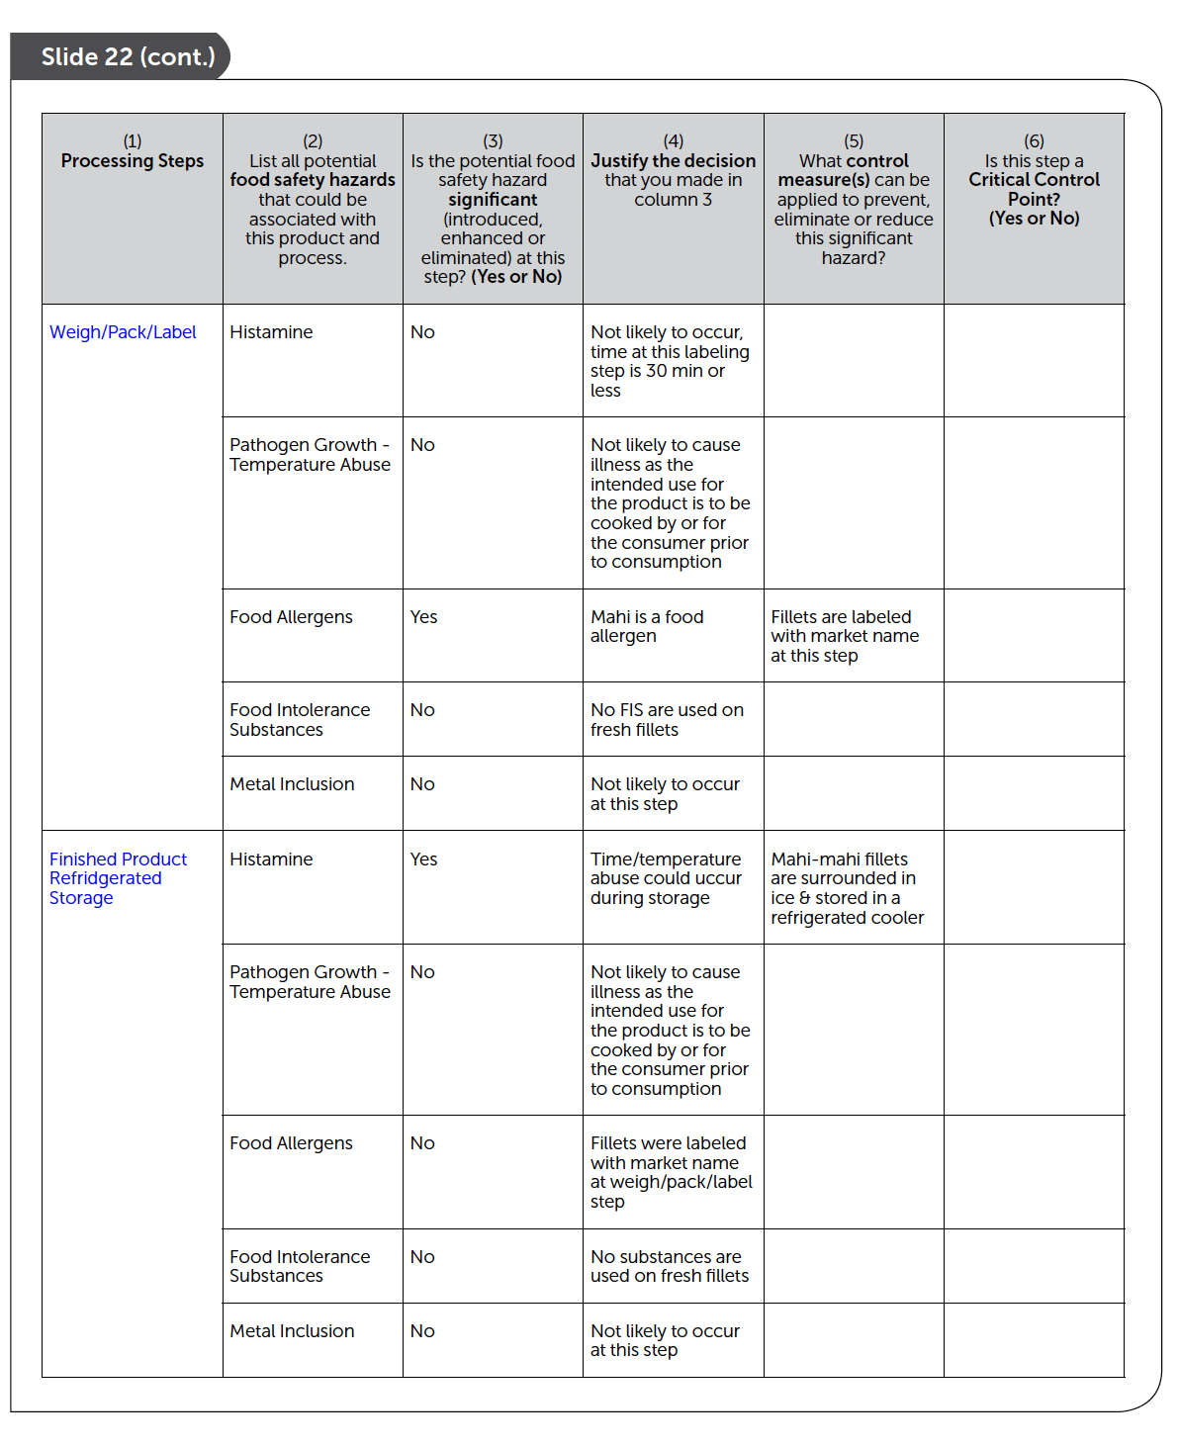
Hazard Analysis Worksheet
Pages 95-97
Every ‘Yes’ in column 3
requires a response in column 5 and 6

Slide 101
Be sure to identify all potential FOOD SAFETY Hazards
Slide 21
All food safety hazards must be considered in the Hazard Analysis, but it is not necessary to distinguish the hazards as biological, chemical or physical hazards.

Slide 102
End Chapter 5: Principle 1
Hazard Analysis

Slide 103
Principle 2: Determine Critical Control Points
Slide 1
In this chapter you will learn:
•The definition of a Critical Control Point (CCP).
•The relationship between significant hazards, control measures, and CCPs.
•How CCPs may be different for different products and processes.
•Tools to help you determine which steps are CCPs.
•Examples of CCPs for various food safety hazards.

Slide 104
What’s a Critical Control Points
Slide 2
Definition: A Critical Control Point is a step at which control can be applied to prevent, eliminate a food safety hazard, or reduce it to an acceptable level.
Slide 3
CCP placement must be at the processing step or steps that adequately control the significant hazard.

Slide 105
Hazard Prevention
Slide 4
CCPs can be steps where hazards can be prevented.
Control Measures Formulation Time/Temp Control Supplier Certificates
CCPs
Mixing Step
Refrigerated Storage Step Receiving Step

Slide 106
Hazard Elimination
Slide 5
CCPs can be steps where hazards can be eliminated.
Control Measures Cooking
Use of Metal Detection Freezing Procedures
CCPs
Cook Step
Metal Detector Step Freeze Step

Slide 107
Hazard Reduction
Slide 6
CCPs can be steps where hazards can be reduced to acceptable level.
Control Measure Source Controls Time/Temp Control
CCP
Receiving Step Cook Step

Slide 108
More than one …
Slide 7
Multiple Hazards and Single CCP
Product = Live oysters (shellstock)
Hazards = Harvest site pathogens + Natural Toxins + Chemical
Contaminants
Single CCP = Receiving
Single Hazard and Multiple CCPs
Product = Fresh Tuna loins
Hazard = Histamine
Multiple CCPs = Receiving + Refrigerated Storage

Slide 109
Product & Process Specific …
Slide 8
CCP are product- and process-specific and impacted by:
•Layout of the plant or processing line,
•Finished product formulation,
•Process flow or sequence of processing steps,
•Processing equipment,
•Ingredients,
•Sanitation or other support programs.

Slide 110
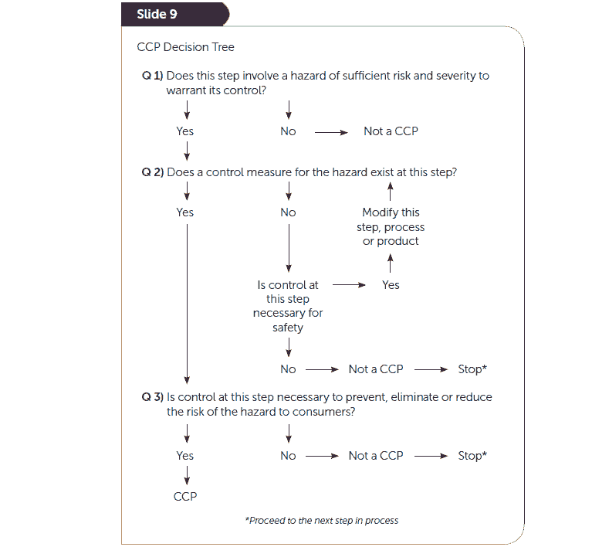
CCP Decision Tree
(optional tool)
Page 103

Slide 111
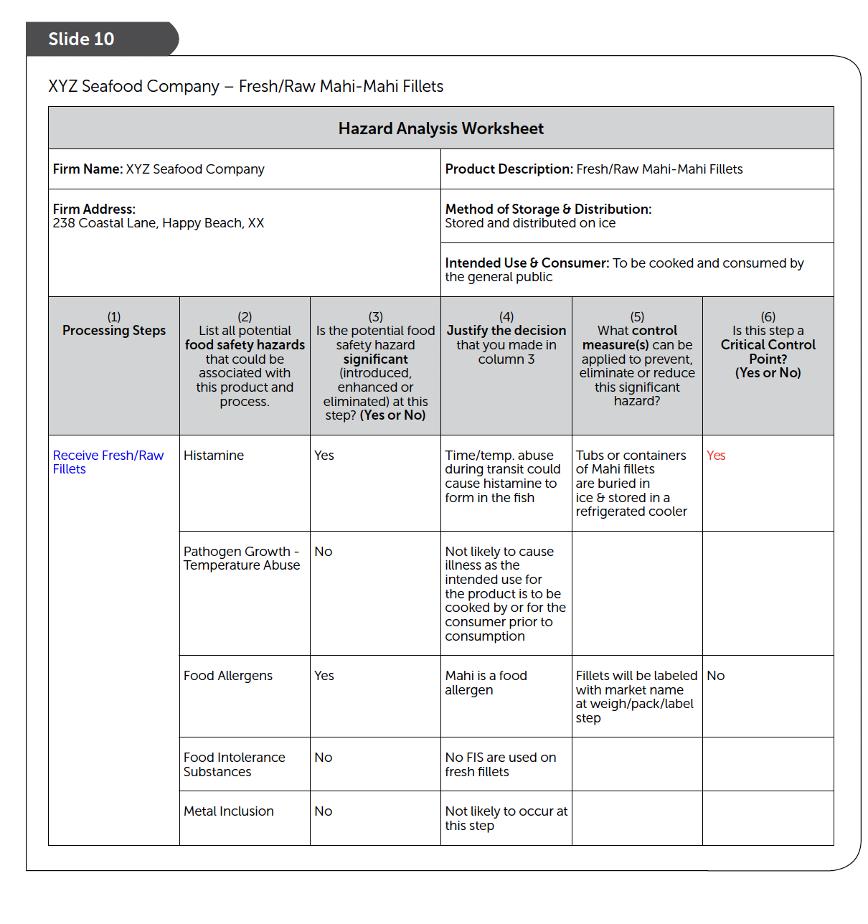
Completed Hazard Analysis 105 - 107
CCP
CCP
Every ‘Yes’ in column 3 requires a response in column 6

Slide 112
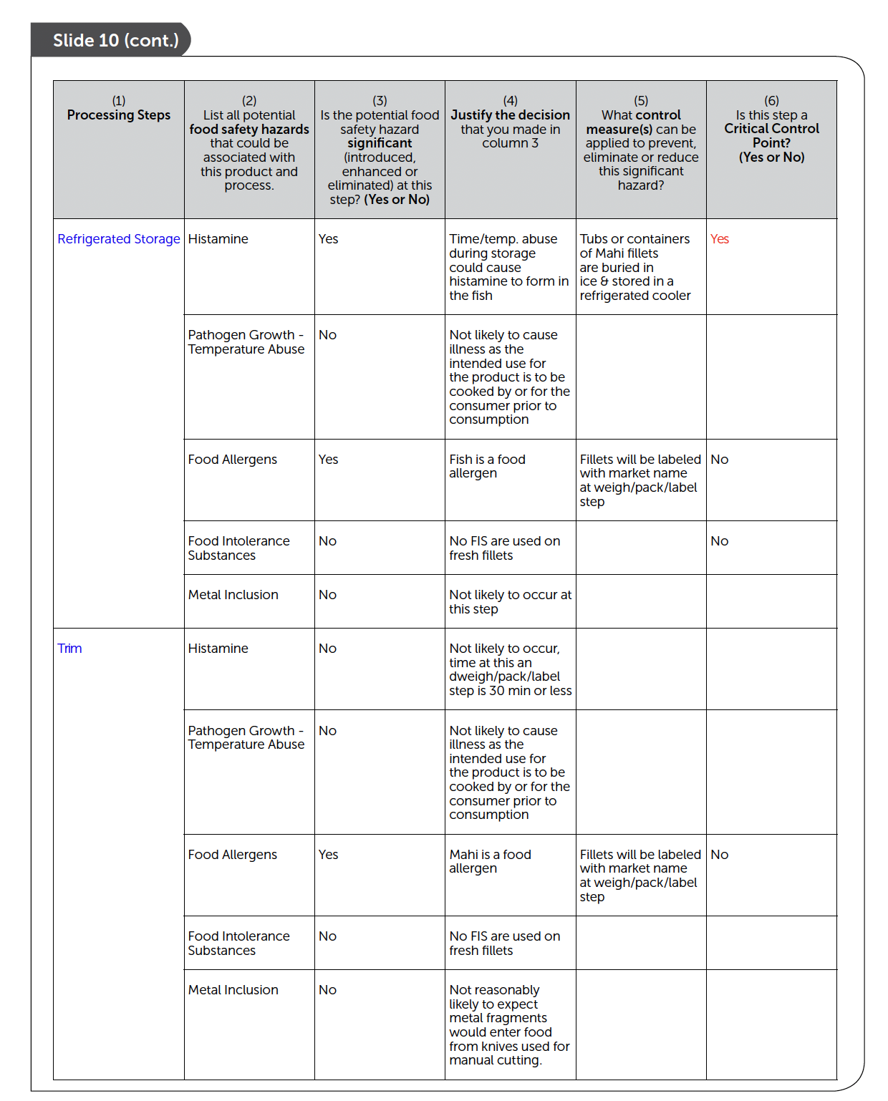
Completed Hazard Analysis 105 - 107
CCP
Completed Hazard Analysis 105 - 107
Every ‘Yes’ in column 3 requires a response in column 6
CCP

Slide 113
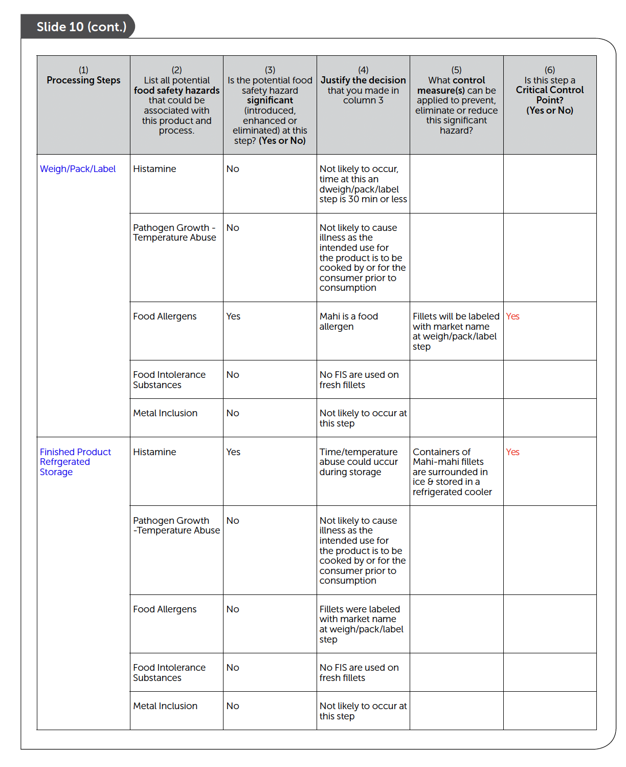
Completed Hazard Analysis 105 - 107
Completed Hazard Analysis 105 - 107
CCP
Every ‘Yes’ in column 3 requires a response in column 6
CCP
CCP

Slide 114
Conclusions from the Hazard Analysis
Histamine is a significant food safety hazard and there are three CCPs for this hazard:
CCP 1. Receive fresh fish
CCP 2. Refrigerated storage, and
CCP 3. Finished product refrigerated storage
Undeclared food allergen is a significant food safety hazard and there is one CCP for this hazard:
CCP 4. Weigh/Pack/Label

Slide 115
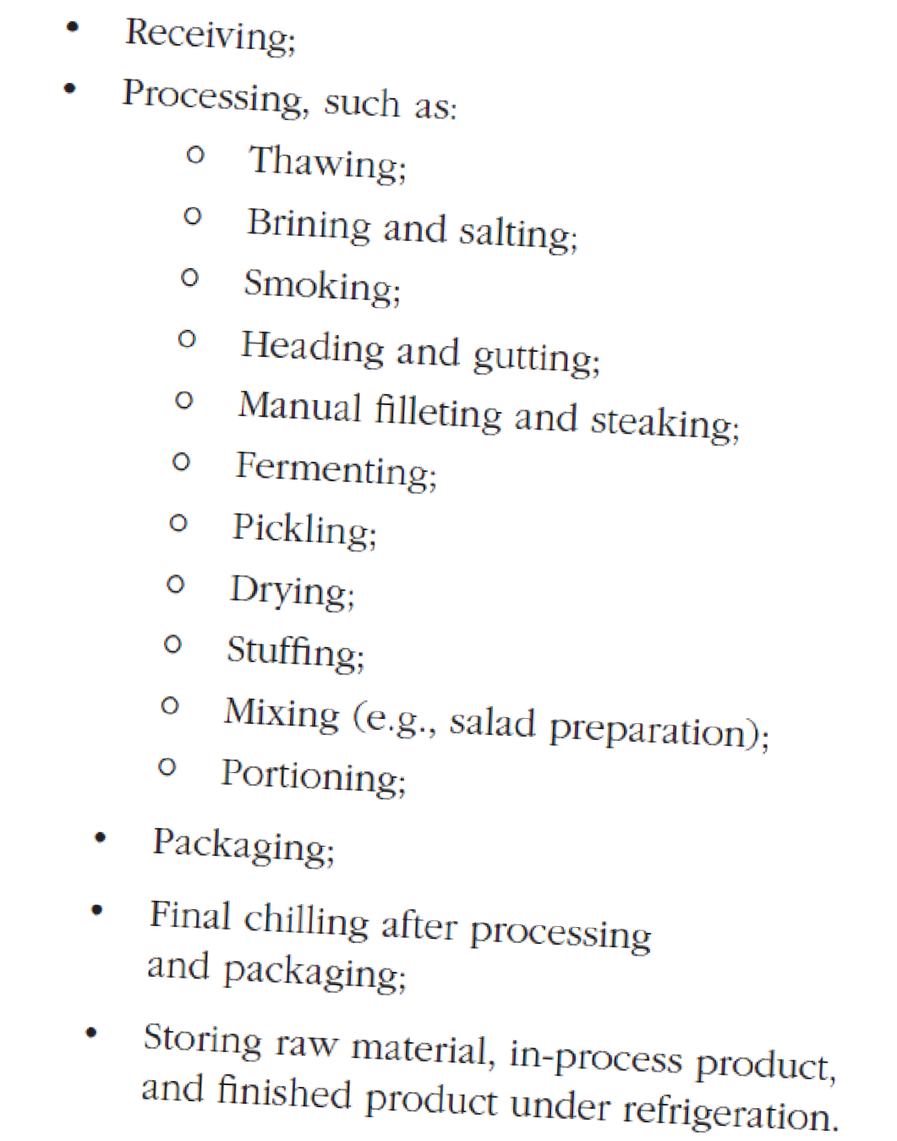
Remember to use the recommendations in the FDA Guide
Tip
For example, ‘Likely CCPs’ for histamine formation (FDA Guide, Chapter 7)
and food allergens
(FDA Guide, Chapter 19)

Slide 116
“CCP either here or later”
Tip
Every ‘Yes’ in column 3
requires a response in column 6
Hazard here
CCP later

Slide 117
End Chapter 6: Principle 2
Determine Critical Control Points
Got it ?

Slide 118
Principle 3: Establish Critical Limits
Slide 1
In this chapter you will learn:
•Definition of critical limit.
•How to determine critical limits for a CCP.
•The relationship between critical limits and operating limits.
•Use of the HACCP plan form.

Slide 119
What’s is a Critical Limit?
Slide 2
Definition:
Critical Limit: A maximum and/or minimum value to which a biological, chemical or physical parameter must be controlled at a CCP to prevent, eliminate or reduce the occurrence of a food safety hazard to an acceptable level.

Slide 120
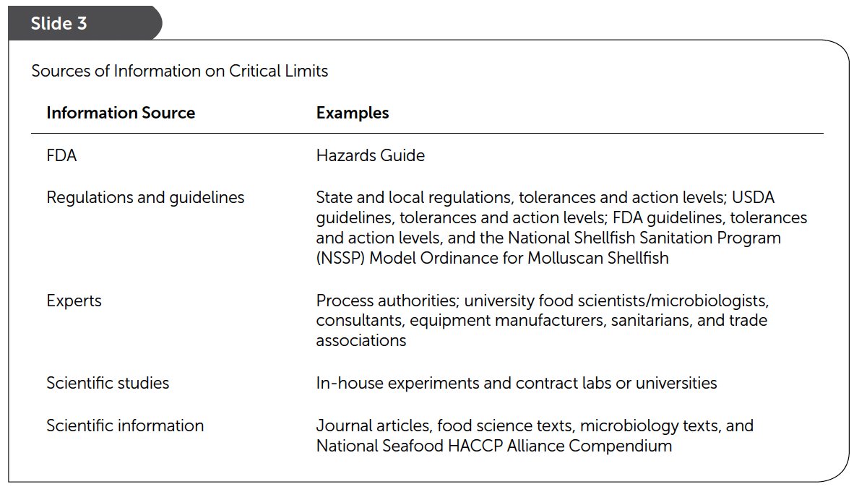
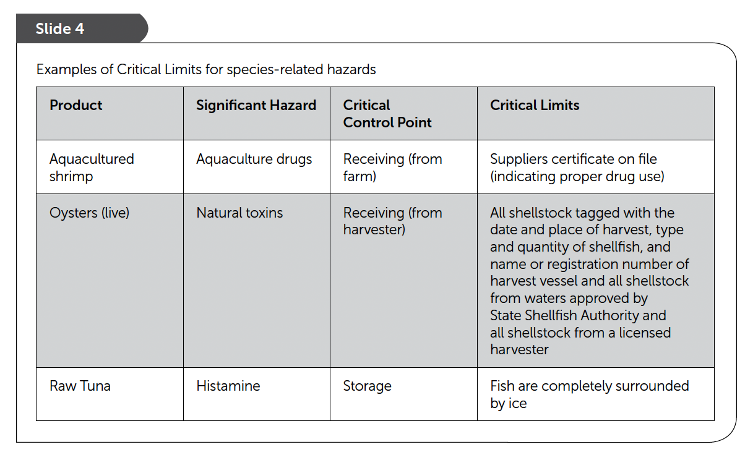
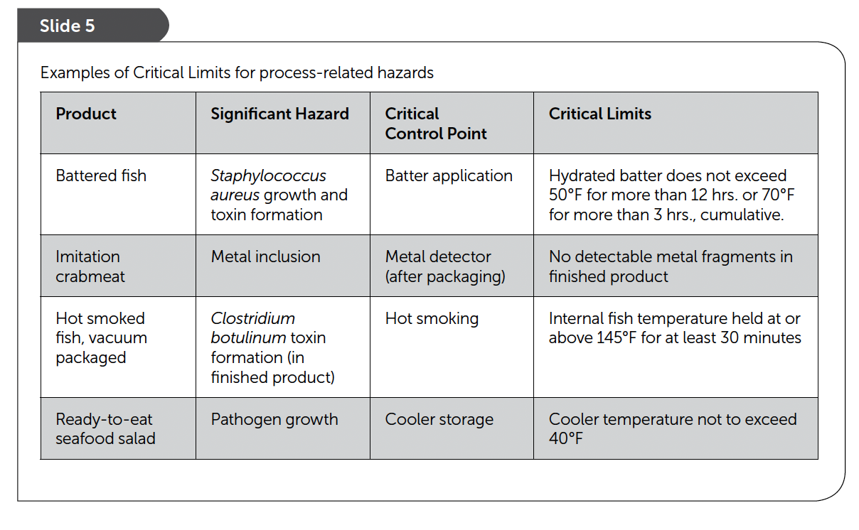
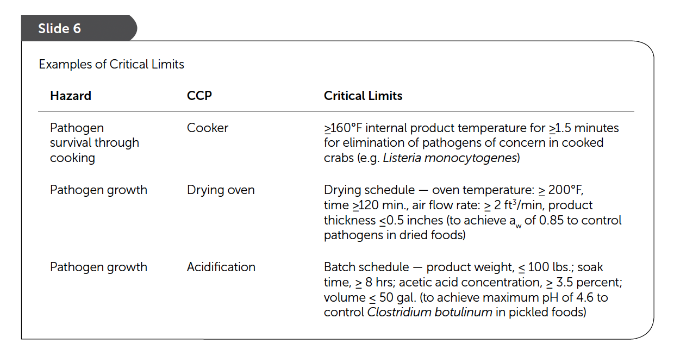
Sources & Examples …

Slide 121
Options and details…
Slide 7
Option No. 1
Product: Fish cakes
Hazard — pathogen survival through cooking CCP — fryer
Critical limit — no pathogens detected
see pages 112-113
Slide 8
Option No. 2
Product: Fish cakes
Hazard — pathogen survival through cooking
CCP — fryer
Critical limit — minimum internal temperature of 165°F for 36 seconds

Slide 122
Options and details…
Slide 7
Option No. 3
Product: Fish cakes
Hazard —pathogen survival
CCP — fryer
Critical limit — minimum fryer oil temperature of 350°F Critical limit — maximum fish cake thickness of ¾ inch Critical limit — minimum cook time in the oil of two minutes
see pages 112-113

Slide 123
Using Operating Limits
Slide 10
Definition:
Operating Limits: Criteria that are more stringent than critical limits and that are used by an operator to reduce the risk of a deviation.

Slide 124
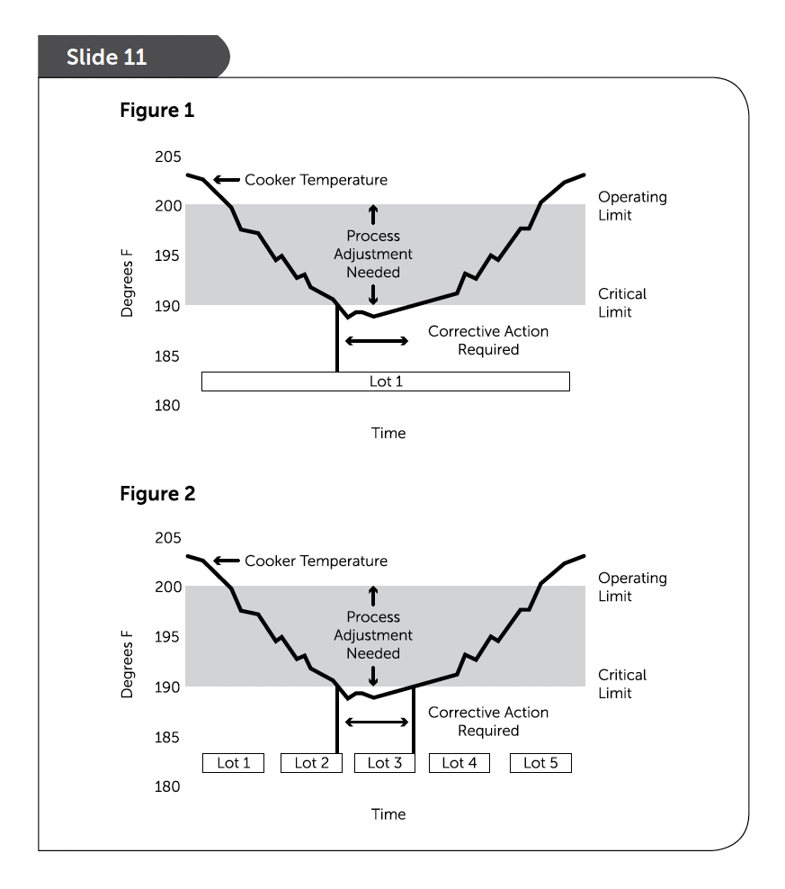
Using ‘Lot’
Designations
Page 115

Slide 125
Critical Limits should be specified in the written HACCP Plan
Slide 12
Blank HACCP Form

Slide 126
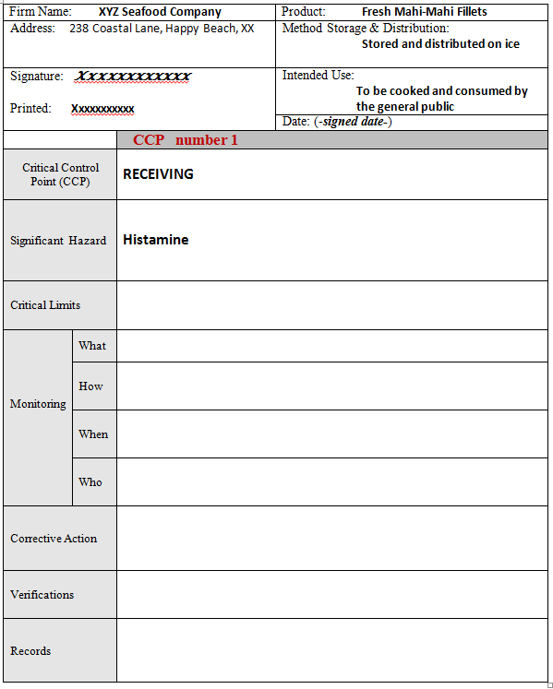
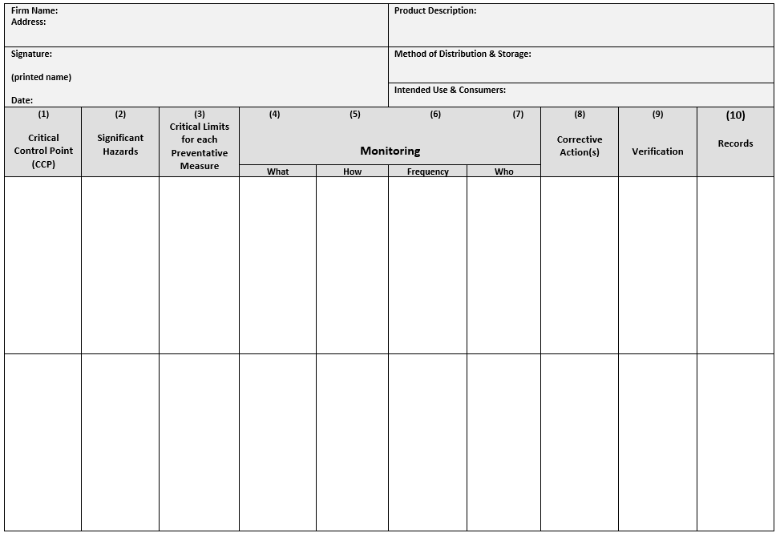
Optional HACCP Plan Forms
(both must contain same information)
Portrait
Landscape

Slide 127
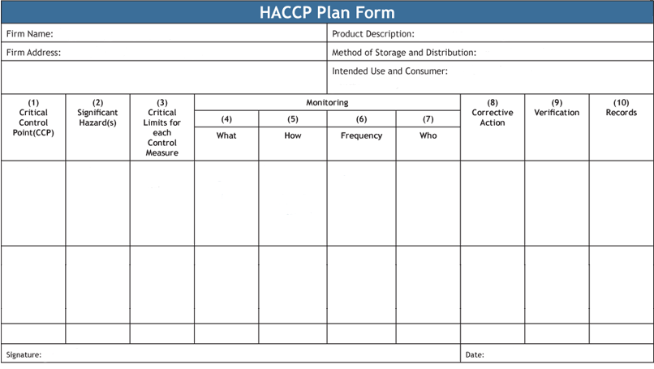
Expected Information in all HACCP Plans

Slide 128
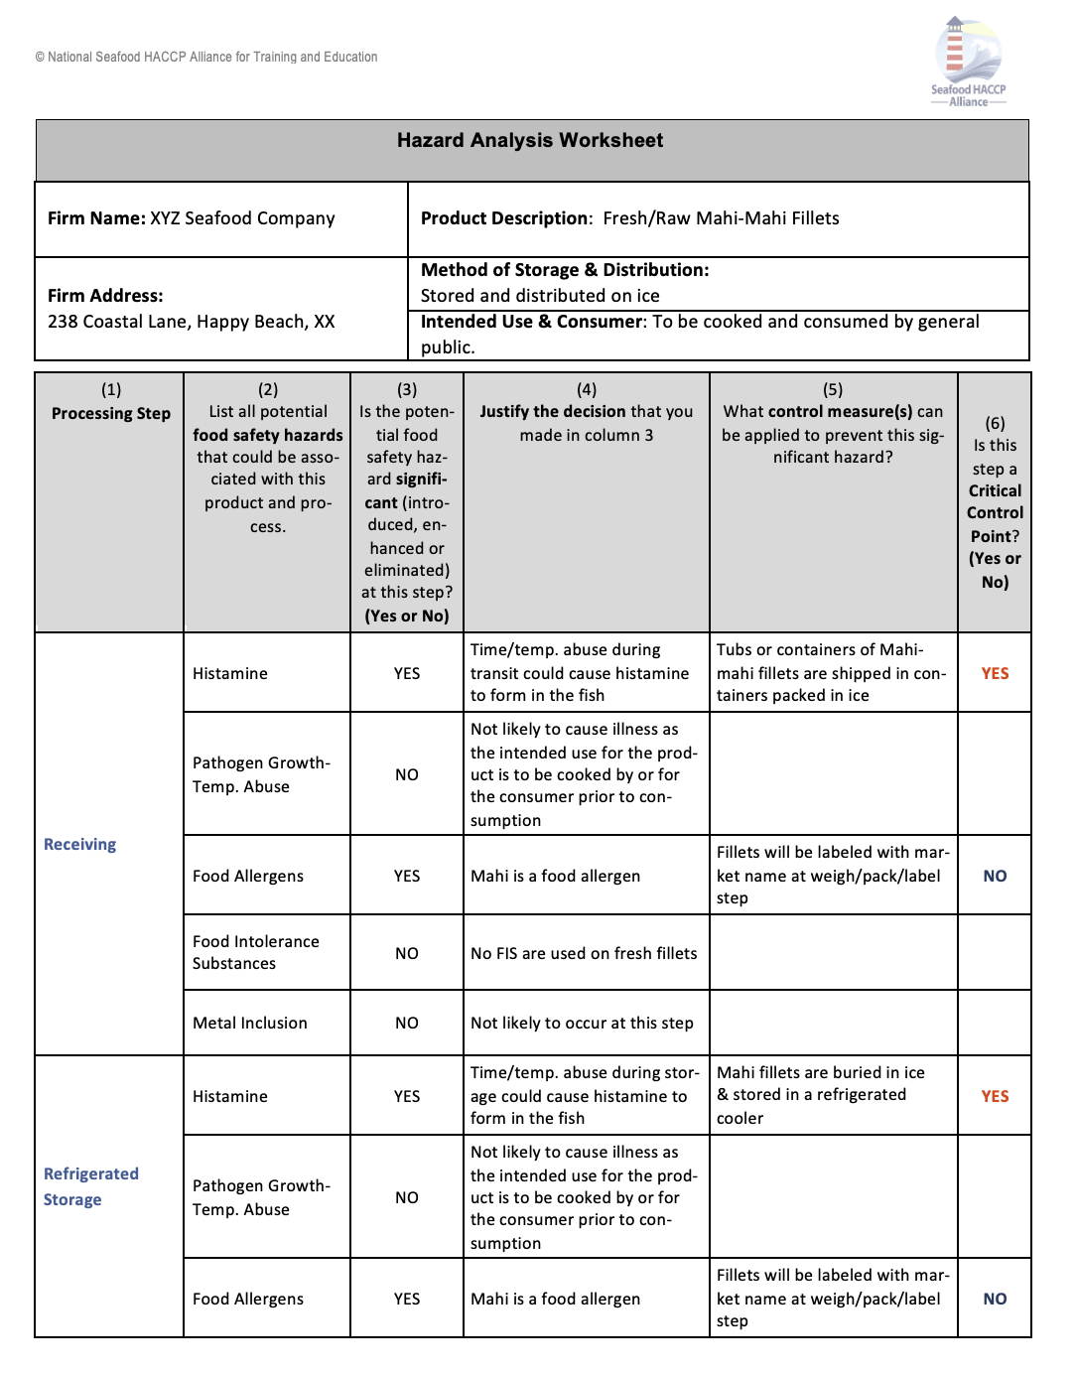
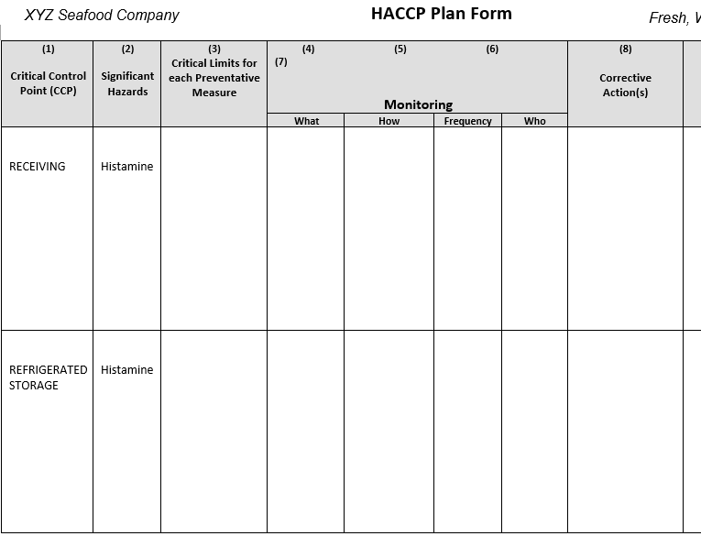
Building a HACCP Plan Form for each CCP
Hazard Analysis Worksheet
HACCP Plan From
Column 1 & 2: List all of the identified CCPs and identified hazards

Slide 129
Recommended Critical Limits
REMINDER: The FDA Guide contains control strategies with recommended CL’s
Processors may select alternative CL’s ‘however’ equivalent effectiveness MUST be demonstrated and documented

Slide 130
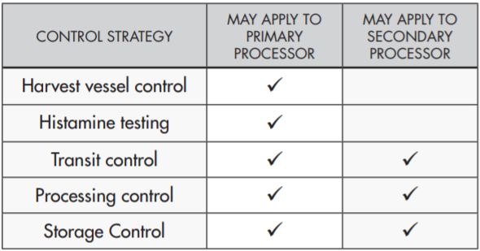
Select a Control Strategy
CONTROL STRATEGY selected from the FDA Guide
CCP – Receiving
Hazard - Histamine
CHP 7

Slide 131
Proceed through the selected Control Strategies
Note all listed options to suit different situations
When applicable, there can be different strategies for
primary vs. secondary processors
Note the details associated with OR’s and AND’s

Slide 132
Select the best control to situation and assure effective control for the potential hazard
TRANSIT CONTROL CRITICAL LIMITS
Transit temperature records, or
Completely surrounded by ice on delivery, or
Use of ice; AND internal fish temperature, or
Frozen gel-packs; AND internal fish temperature, or
Transit time (< 4 hours); AND internal fish temperature
Notice ‘ORs & ANDs ’
Tip

Slide 133
HACCP Plan for XYZ Seafood Company
FDA Guide, Chapter 7

Slide 134
HACCP Plan for XYZ Seafood Company
Critical Limits based on recommendations in the FDA Hazards Guide

Slide 135
Want some more ?
End Chapter 7:Principle 3
Establish Critical Limits

Slide 136
Principle 4: Critical Control Point Monitoring
Slide 1
In this chapter you will learn:
•Definition of monitoring,
•Purpose of monitoring,
•Design of a monitoring system,
•Methods and equipment for monitoring critical limits.

Slide 137
What is a Monitoring?
Slide 2
Definition:
Monitoring: A planned sequence of observations or measurements to assess whether a CCP is under control and to produce an accurate record to demonstrate that critical limits have been met.
Slide 3
Purpose of Monitoring
•To ensure that a critical limit is met,
•To provide documentation that critical limits have been met,
•To identify when there is loss of control (a deviation occurs at a CCP).

Slide 138
4 required parts for proper MONITORING
Slide 4
Elements of Monitoring
•What will be monitored?
•How will monitoring be performed?
•What is the frequency of monitoring?
•Who will conduct the monitoring?
How ?
Who ?
When ? (frequency)
What ?

Slide 139
What ?
What?
Slide 5
What will be monitored?
A measurement or observation to assess if the CCP is operating within the critical limit.

Slide 140
How ?
How?
Slide6
How will monitoring be performed?
•Measurements (quantitative critical limits) or observations (qualitative critical limits).
•Needs to be real-time and accurate.

Slide 141
What? (frequency)
When?(frequency)
Slide 7
What is the frequency of monitoring?
•Monitoring frequency should be sufficient to ensure that the critical limit is met.
•Monitoring frequency can be non-continuous or continuous.

Slide 142
What? (frequency)
Who?
Slide 8
Who will monitor?
Person(s) trained to perform the specific monitoring activity and/or a continuous monitoring device.

Slide 143
Monitoring requires training
Slide 9
Those responsible for monitoring a CCP should
•Be trained in the CCP monitoring techniques.
•Fully understand the importance of CCP monitoring.
•Have ready access to the monitoring activity.
•Accurately report each monitoring activity.
•Immediately report critical limit deviations.

Slide 144
Monitoring examples
Slide 10
Monitoring Example:
• Time and temperature of process
• Time and internal temperature combinations
• Water activity (aw)
• pH
• Internal product temperature
• Salt concentration in brine
• Metal inclusion screening

Slide 145
Monitoring equipment examples
Slide 11
Examples of monitoring equipment
•thermometers
•recorder charts
•clocks
•pH meters
•water activity meters
•data loggers
•metal detectors
•salometer

Slide 146
Monitoring for XYZ Seafood Company

Slide 147
End Chapter 8:Principle 4
Monitoring

Slide 148
Principle 5: Corrective Actions
Slide 1
In this chapter you will learn:
•The definition of corrective actions,
•Procedures for corrective actions, and
•Record-keeping requirements for corrective actions.

Slide 149
What are Corrective Actions
Slide 2
Definition:
Corrective Action: Procedures to be followed when a deviation occurs.
Slide 3
Predetermined corrective actions are recommended.

Slide 150
Corrective action components
Slide 4
Corrective action components:
1)identify the product that was produced during the process deviation, evaluate its safety and determine its disposition.
2)Correct and eliminate the cause of the deviation and restore process control.
Identify involved product
Assess safety and product disposition
Correct the problem
Restore control

Slide 151
Is the involved product safe?
Slide 5
Tools to help evaluate product safety:
•Food Safety Experts
•Production monitoring data/records
•NSSP Shellfish Model Ordinance
•Hazards Guide
-Appendix 4: Pathogen Tables
-Appendix 5: Guidance Levels
•Laboratory testing
Helpful Sources:
FDA Guide-Appendix 4

Slide 152
Is the involved product safe?
Slide 6
Steps to determine the disposition of the product:
Step 1: Determine if the product presents a safety hazard.
Step 2: If no hazard exists, the product may be released.
Step 3: If a potential hazard exists, determine if the product can be:
c)Reworked/reprocessed, or
d)Diverted for a safe use.
Step 4: If a food safety hazard does exist, the product must be rejected or destroyed
Slide 7
Corrective actions must identify the cause of the deviation and restore process control.

Slide 153
Using the FDA Guide for CA’s
Optional CA’s
In some cases, the final option to reject or destroy product is more logical than trying to produce evidence for other options
FDA Guide Example Chapter 7, page 143

Slide 154
Information for documenting Corrective Actions
Slide 8
Corrective actions must be documented to indicate the safety status and consequences for the products and process involved.
Page 133

Slide 155
Example Corrective Actions See pages 134 & 135

Slide 156
Corrective Actions for XYZ Seafood Company
see page 138-139

Slide 157
Corrective Actions for XYZ Seafood Company
see page 138-139

Slide 158
End Chapter 9:Principle 5
Corrective Actions

Slide 159
Principle 6: Establish Verification Procedure
Slide 1
In this chapter you will learn:
•The definition of verification
•Validation is part of verification
•Verification procedures

Slide 160
What is Verifications
Slide 2
Definition:
Verification: Those activities, other than monitoring, that determine the validity of the HACCP plan and that verify the system is operating according to the plan.
Slide 3
“Trust what you can verify.”

Slide 161
Various Types of s
Slide 4
Types of Verification Procedures:
1)Validation (before the HACCP plan is implemented)
2)CCP verification (regularly scheduled activities):
•Calibration of process-monitoring devices,
•Record review,
•Targeted sampling and testing.
3)HACCP system verification (periodic activity):
•HACCP plan reassessment
•Microbiological end-product testing and third party audits
4)Regulatory verification (periodic activity)

Slide 162
Validation ‘before’ operations
Slide5
Definition:
Validation: The element of verification focused on collecting and evaluating scientific and technical information to determine if the HACCP plan, when properly implemented, will effectively control the hazards.
‘Will it work’

Slide 163
Before operations…‘Validate the HACCP controls and plan will work’
Slide 6
Validation involves establishing the scientific basis for the HACCP plan.
Strategies that can be used to validate the HACCP plan include:
• using scientific principles and data,
• relying on expert opinion, or
• conducting in-plant observations or tests

Slide 164
When to Validate
Slide 7
Validation frequency:
Before the HACCP plan is implemented
When factors warrant, such as:
changes in raw materials and/or suppliers
changes in product or process
adverse review findings
recurring deviations
new scientific information on hazards or control measures
on-line observations
new distribution or consumer handling practices

Slide 165
Verification ‘during’ operations
Slide 8
CCP verification activities:
Calibration of process-monitoring devices
Calibration record review
Targeted sampling and testing
CCP record review
‘Is it working’
Slide 9
Accuracy checks and calibrations are performed:
On equipment and instruments used in the HACCP plan
At a frequency that ensures accuracy of measurements

Slide 166
‘Is it working’ … see page 146

Slide 167
Record Accuracy and Calibration
Slide 11
Frequency of accuracy checks and calibration can depend on:
Design of the monitoring device
Reliability and sensitivity of the device
The environment or conditions in which the device is used
Slide 12
Accuracy checks and calibration records must:
Document results of accuracy checks and calibration procedures
Provide a reference to the standard
Be reviewed by qualified, trained personnel

Slide 168
Verify through periodic testing
Slide 13
Periodic verification may also include targeted sampling and
laboratory tests of in-process or finished products.

Slide 169
Must Review Monitoring and Corrective Action Records
Slide 14
Verification through Record Reviews:
All monitoring and correction action records
Records must be reviewed within one week from time they were made by an individual who meets the training requirements of the FDA seafood HACCP regulation.

Slide 170
Total HACCP Program Verification
Slide 15
HACCP system verification or reassessment frequency:
Annually,
Occurrence of a system failure or significant change in product or process.
Requires a signature
Slide 16
System-wide HACCP plan verification reviews include:
Verifying that the hazard analysis and HACCP plan are still accurate, and
Reviewing records to determine trends and verify that the plan is being followed.

Slide 171
Total HACCP Program Verification
Slide 17
Other system-wide verification strategies
Finished product testing for microbiological, chemical or physical hazards
Third-party audits
Slide 18
Situations that may trigger a HACCP plan reassessment:
A change in products or the process
A change in the critical limit at a CCP
Relocation of your plant
Installation of a new piece of equipment
A HACCP system failure
Adverse findings from a regulatory inspection or third party audit

Slide 172
Ultimate Verification
Slide 19
Regulatory agencies conduct inspection to verify that a processor:
Has developed a HACCP plan that controls all significant food safety hazards;
Has implemented the HACCP plan and it is consistently being used; and
Is in compliance with HACCP and other regulations.

Slide 173
Verification Summary…
Pages 152-153

Slide 174
Verifications for XYZ Seafood Company
pages
155

Slide 175
Verifications for XYZ Seafood Company
pages
156

Slide 176
Verifications for XYZ Seafood Company
pages
157

Slide 177
End Chapter 10:Principle 6
VERIFICATIONS

Slide 178
Principle 7: Record Keeping Procedures
Slide 1
In this chapter you will learn:
What records are needed
How to develop appropriate records
How to conduct a record review
How computerized records may be used

Slide 179
Records Support the HACCP Program
Slide 2
Six types of records are needed in a HACCP system:
1) The HACCP plan and supporting documentation
2) CCP Monitoring records
3) Corrective Action records
4) Verification records
5) Sanitation Control records
6) Importer Verification records
Required Records
Slide 3
1) The HACCP plan and its supporting documentation

Slide 180
Recommended and Required Records
Hazard Analysis
HACCP Plan
RECOMMENDED
REQUIRED

Slide 181
Additional Record Support for HACCP
Slide 4
Examples of HACCP Plan Support Documents:
Data from published scientific studies
Data from in-plant studies conducted by processing authorities
Data from equipment manufacturers or other authorities
Data gathered in the Preliminary Steps
Pre-requisite programs including sanitation control procedures
Written hazard analysis worksheets

Slide 182
Records support the HACCP Program
Slide 5
CCP monitoring records are used to document that food safety
hazards have been controlled at each CCP.
Required information on required records
Slide 6
Information required on CCP monitoring records:
Title of record (e.g. Shellfish Receiving Log)
Firm name and location
Product identification (if applicable)
Date and time of monitoring observation
Actual measurement or observation taken
Signature or initials of the person performing the monitoring activity
Signature of the trained person reviewing the monitoring record and the date of review

Slide 183
Example Monitoring Records

Slide 184
Example Monitoring Records …
Pages 163-165

Slide 185
Slide 11
Slide 11
3) Corrective action records
Slide 12
Information for CA records
…
Pages 165-166

Slide 186
Slide 13
4) Verification records
Slide 14
Verification records document the results of
Accuracy and checks and calibration of process-monitoring instruments
Record Reviews
Laboratory test results
In-plant studies or challenge test
Audits and inspections

Slide 187
Additional Record Examples …
Pages 168-171

Slide 188
Do Not Forget Records for required SCP monitoring
Remember SCP records for the 8 Key Sanitation Conditions
Chapter 2
pages 29-39

Slide 189
Do Not Forget Employee Training Records in GMP’s 117
Page 173

Slide 190
Slide 23
Electronic or computerized monitoring records must be equivalent to paper records and and written signature
Computer Recordkeeping allowed… IF
Slide 24
An effective electronic record-keeping system must:
Be authentic, accurate and protected;
Provide accurate and complete copies of records;
Protect records for later retrieval;
Limit Access to authorized individuals;
Provide a secure record audit train ; and
Be reviewed by HACCP trained individual.

Slide 191
Records for XYZ Seafood Company
See pages 180-181

Slide 192
Records for XYZ Seafood Company
See pages 180-181

Slide 193
Records for XYZ Seafood Company
See pages 180-181

Slide 194
SPECIAL NOTE
Slide 32
The HACCP Plan form can be used in portrait format which can be more convenient
XYZ Seafood Company
Pages 184-187
Blank forms are in Appendix 2

Slide 195
End Chapter11: Principle 7
Record-Keeping
Are ya done !

Slide 196
The Seafood HACCP Regulation
Slide 1
In this module, you will learn
•The requirements of the regulation
•How to reference the specific requirements

Slide 197
Copies of the Official Published Regulation 21 CFR Part 123 Seafood HACCP Regulation
SHA Training Manual
Appendix 1 (p. 205)
FDA Guide
Addendum 1
Stay aware for periodic additions and updates
Tip

Slide 198
Regulation Outlined in Parts
Slide 2
Regulation Format
Subpart A — General provision
•123.3 Definitions
•123.5 Current GMPs
•123.6 HACCP plan
•123.7 Corrective actions
•123.8 Verification
•123.9 Records
•123.10 Training
•123.11 Sanitation control procedures
•123.12 Special requirements for imported products
Subpart B — Smoked and smoke-flavored fishery products
•123.15 General
•123.16 Process control
Subpart C — Raw molluscan shellfish
•123.20 General
•123.28 Source controls

Slide 199
Key Definition in the Regulation
Slide 3
•certification number
•critical control point
•critical limit
•fish
•fishery product
•hazard
•importer
•molluscan shellfish
•preventive measure instrument
•processing
•processor
•scombroid toxin-forming species
•shall
•shellfish-control authority
•shellstock
•should
•shucked shellfish
•smoked or
smoke-flavored fishery
•process-monitoring products
•tag

Slide 200
Key Definitions in the Regulation
Every processor shall verify:
•That the HACCP plan is adequate to control the food-safety hazards that are reasonably likely to occur; and
•That the HACCP plan is implemented effectively.
Slide 4
Regulatory terms ”shall” and ”should”
Slide 5
Ongoing verification:
•Review of consumer complaints
•Calibration of process-monitoring instruments
•Periodic end-product and in-process testing (processor’s option)

Slide 201
Who must comply?
Slide 6
Products that are subject to regulation:
• Importer 123.3 (g)
• Processor 123.3 (k) — domestic and foreign

Slide 202
Define Processing
Slide 7
What constitutes processing:
Processing 123.1(l)

Slide 203
Regulation does not apply to:
Every processor shall verify:
•That the HACCP plan is adequate to control the food-safety hazards that are reasonably likely to occur; and
•That the HACCP plan is implemented effectively.
Slide 8
This Regulation doe not apply to
The harvest or transport of fish or fishery products
Practices such as heading, eviscerating or freezing intended solely to prepare a fish for holding on a harvest vessel
The operation of a retail establishment

Slide 204
Foundation for the Regulation
Every processor shall verify:
•That the HACCP plan is adequate to control the food-safety hazards that are reasonably likely to occur; and
•That the HACCP plan is implemented effectively.
Slide 9
Current Good Manufacturing Practices:
Regulations found in Title 21, Part 117 of the Code of Federal Regulations
Proper practices for the safe and sanitary handling of all foods
Copy of the current GMP’s Part 117
Appendix 3, Page 233

Slide 205
Determine hazards likely to occur…
Every processor shall verify:
•That the HACCP plan is adequate to control the food-safety hazards that are reasonably likely to occur; and
•That the HACCP plan is implemented effectively.
Slide 10
Hazard Analysis 123.6(a)
Every processor shall conduct, or have conducted for it, a hazard analysis.
Slide 11
Determining those hazards that are “reasonably likely to occur:” Those “for which a prudent processor would establish controls.”

Slide 206
Witten HACCP Plans….
Every processor shall verify:
•That the HACCP plan is adequate to control the food-safety hazards that are reasonably likely to occur; and
•
Slide 12
HACCP Plan 123.6(b)
Every processor shall have and implement a written HACCP plan whenever a hazard analysis reveals one or more food-safety hazards that are reasonably likely to occur.
The plan shall be specific to:
•Each processing location.
•Each species of fish and type of fishery product

Slide 207
HACCP plans ‘shall’ contain …
Every processor shall verify:
•That the HACCP plan is adequate to control the food-safety hazards that are reasonably likely to occur; and
•
Slide 13
The HACCP plan shall list:
•the food-safety hazards that are reasonably likely to occur.
•the CCPs.
•the critical limits.
•the monitoring procedures.
•predetermined corrective action plans.*
•the verification measures.
•records that will be maintained

Slide 208
HACCP plans ‘shall’ be signed and dated …
Every processor shall verify:
•That the HACCP plan is adequate to control the food-safety hazards that are reasonably likely to occur; and
•
Slide 14
The HACCP plan shall be signed and dated
•By the most responsible individual at the processing facility or a higher level official.
-Signed and dated:
Upon initial acceptance.
Upon any modification.*
At least annually.*
*This is a verification

Slide 209
Special considerations for seafood canning operations
Every processor shall verify:
•That the HACCP plan is adequate to control the food-safety hazards that are reasonably likely to occur; and
•
Slide 15
Processors of acidified or low acid canned foods do not need to include controls for C. botulinum in their HACCP plan.

Slide 210
Sanitation or HACCP Controls?
Every processor shall verify:
•That the HACCP plan is adequate to control the food-safety hazards that are reasonably likely to occur; and
•That the HACCP plan is implemented effectively.
Slide 16
Sanitation controls may be difficult to manage in a HACCP plan.

Slide 211
Slide 17
It is unlawful to process food under conditions that may render it injurious to health.

Slide 212
Processors ‘shall’ take ‘corrective actions’
Slide 18
Corrective Action 123.7
Whenever a deviation from a critical limit occurs, a processor shall take corrective action.
Slide 19
Corrective Actions — Two Choices:
3)Predetermined
4)Alternate Procedure – outlined in the regulation
-Segregate and hold product
-Determine product acceptability
-Apply corrective action to product and process
-Reassess the HACCP plan

Slide 213
Verifications are required…
Every processor shall verify:
•That the HACCP plan is adequate to control the food-safety hazards that are reasonably likely to occur; and
•That the HACCP plan is implemented effectively.
Slide 20
Every processor shall verify:
•That the HACCP plan is adequate to control the food-safety hazards that are reasonably likely to occur; and
•That the HACCP plan is implemented effectively.
Slide 21
Ongoing verification:
•Review of consumer complaints
•Calibration of process-monitoring instruments
•Periodic end-product and in-process testing (processor’s option)

Slide 214
Information required on each record …
Slide 23
Required information on each record:
•Name and location of the processor or importer
•Date and time of the activity being recorded
•Signature or initials of the person making the record
•Identity of the product and the production code where appropriate

Slide 215
Required record…
Slide 23
Records required by the regulation:
•HACCP plan(s)
•Monitoring records
•Corrective action records
•Verification records
•Sanitation control records
•Importer verification records

Slide 216
Record Reviews and Retention …
Slide 24
Review of records:
•CCP monitoring and corrective action records – within one week
•Calibration and in-process or end-product testing records –timely manner
Slide 25
Record Retention
•One year for refrigerated products
•Two years for frozen or preserved products

Slide 217
HACCP training to …
Slide 26
Trained
The HACCP-trained individual shall:
•Develop the HACCP plan.
•Reassess and modify the HACCP plan and hazard analysis.
•Review HACCP records.

Slide 218
SCP’s – Sanitation Control Procedures
Slide 27
• Processors should have written SCPs.
•Processor shall monitor and document sanitation control procedures.
•Processors shall correct sanitation deficiencies in a timely manner.

Slide 219
8 Key Sanitation Control Areas
Slide 28
Eight key sanitation areas:
1)Safety of water,
2)Condition and cleanliness of food-contact surfaces,
3)Prevention of cross-contamination,
4)Maintenance of hand-washing, hand-sanitizing and toilet facilities,
5)Protection from adulterants,
6)Labeling, storage and use of toxic compounds,
7)Employee health conditions,
8)Exclusion of pests.

Slide 220
HACCP with Imported Seafood
Slide 29
Importer Verification:
•Import from countries with a memorandum of understanding (MOU) or
•Implement verification procedures.
Slide 30
Importer Verification Procedures
Importers must have:
1)Written verification procedures
2)Product specifications
3)Affirmative steps

Slide 221
HACCP with Imported Seafood
Slide 31
Affirmative steps may include any of the following:
•Obtain foreign processor’s HACCP and sanitation monitoring records for the lot being entered
•Obtain continuing or lot-by-lot certificate from competent third party
•Regularly inspect foreign processor
•Obtain foreign processor’s HACCP plan and written guarantee that regulation is being met
•Test the product and obtain written guarantee that regulation is being met
•Perform other verification procedures that provide the equivalent level of assurance

Slide 222
HACCP with Smoked Seafood
Slide 32
Smoked and Smoke-Flavored Fishery Products
•HACCP plan must include controls for Clostridium botulinum toxin formation for the shelf life of the product under normal and moderate abuse conditions.
• Where product is subject to 21 CFR 113 or 114, the HACCP plan need not include such controls.

Slide 223
HACCP with Imported Seafood
Slide 32
Smoked and Smoke-Flavored Fishery Products
•HACCP plan must include controls for Clostridium botulinum toxin formation for the shelf life of the product under normal and moderate abuse conditions.
• Where product is subject to 21 CFR 113 or 114, the HACCP plan need not include such controls.

Slide 224
HACCP with Raw Molluscan Shellfish
Slide 33
Raw Molluscan Shellfish 123.20
•HACCP plans must include a means for controlling the origin of the raw molluscan shellfish.
•Where processing includes a treatment that ensures the destruction of vegetative cells of microorganisms of public health concern, the HACCP plan need not include controls on sources of origin.

Slide 225
HACCP with Raw Molluscan Shellfish
Slide 34
Raw Molluscan Shellfish 123.28
Processors shall only process molluscan shellfish from:
•Growing waters approved by a shellfish-control authority
•Federal growing waters not closed by an agency of the federal government
Slide 35
Raw Molluscan Shellfish 123.28
Shellstock Receiving:
•If source is a harvester, harvester must be in compliance with any license requirement.
•If source is another processor, processor must be certified by a shellfish-control authority.
•Containers of shellstock must be properly tagged.

Slide 226
Slide 36
Raw Molluscan Shellfish 1240.60 (b)
Required information on tag:
•Date and place shellfish were harvested (state and site)
•Type and quantity of shellfish
•Harvester identification number, name of harvester or name or registration number of harvester’s vessel
Slide 37
Raw Molluscan Shellfish 123.28
Records for shellstock receiving must document:
Date of harvest
•Location of harvest by state and site
•Quantity and type of shellfish
•Date of receipt by the processor
•Name of harvester, name or registration number of the harvester’s vessel or harvester’s identification number

Slide 227
Slide 38
Raw Molluscan Shellfish 123.28
Shucked molluscan shellfish containers must bear a label that contains:
•Name of packer or repacker
•Address of packer or repacker
•Certification number of packer or repacker
Slide 39
Raw Molluscan Shellfish 1240.60 (c)
Records for shucked product must document:
•Date of receipt
•Quantity and type of shellfish
•Name and certification number of the packer or repacker

Slide 228
Resources for Preparing Seafood HACCP Plans
Resources are available through FL Sea Grant Website:
https://www.flseagrant.org/wp-content/uploads/2024/10/Seafood-and-HACCP-Resources-For-Insturctors_Updated-9-2024-2.pdf

Slide 229
Course Closeout
Certificates are sent via email within two weeks of AFDO receiving course closeout paperwork.
Make sure you can receive emails from haccp@afdo.org.
If certificate is not received, first check your junk folder, then contact your instructor.
Confirm certificate information is accurate upon receipt.
NOTE: there is a $15 fee to have certificates re-issued or revised more than 3 months after it was issued.

Slide 230
Training Evaluation
Complete your training evaluation online using the url or QR code below.
bit.ly/SHAEvaluation

Slide 231
Contact Dr. Razieh Farzad with any questions or comments about these slides.
Email:rfarzad@ufl.edu
Phone number: (352)-2945-3902

