Slide 1
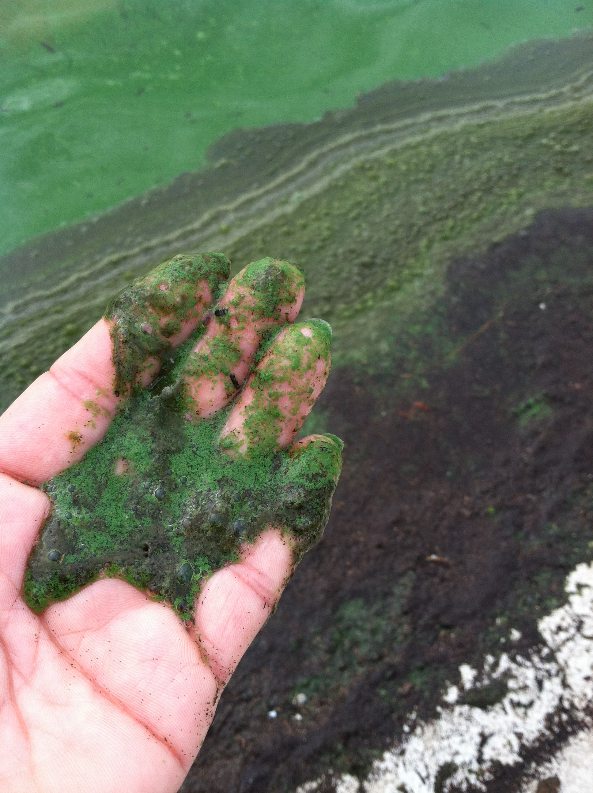
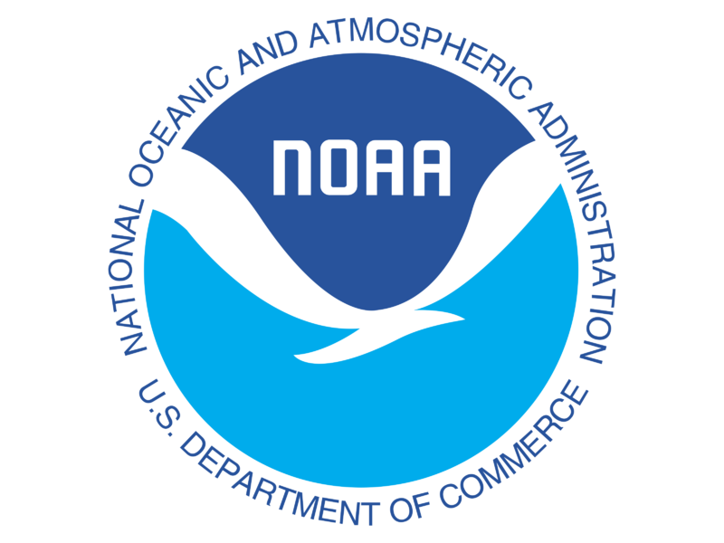
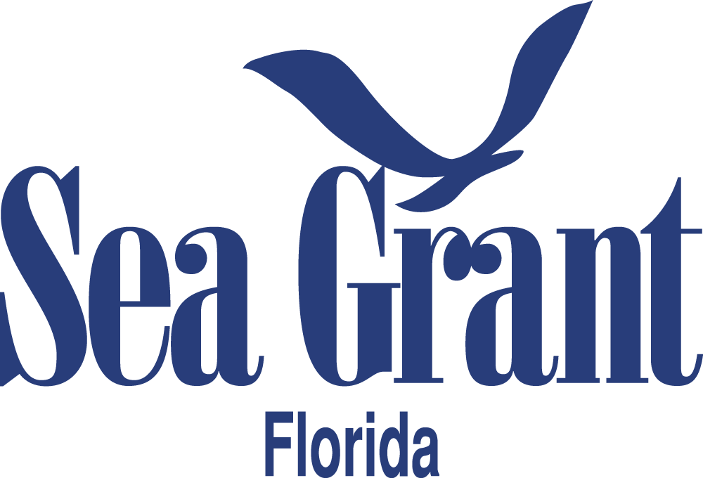
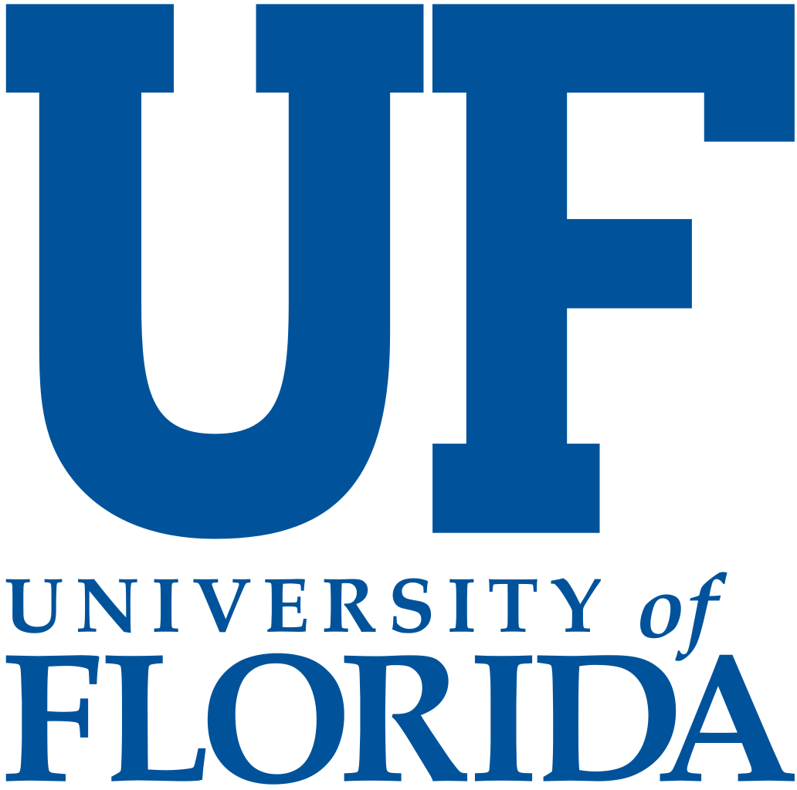
Sea Grant’s Investment in Harmful Algal Blooms
For: HABHRCA Interagency Working Group, April 7, 2022
Betty Staugler, NOAA HAB Liaison, Florida Sea Grant – University of Florida
B. Staugler image

Slide 2
NOAA HAB Liaison Partnership
Notes:
https://www.flseagrant.org/wp-content/uploads/habs_liaison_publication-web_version.pdf

Slide 3
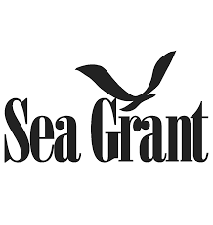
Sea Grant Model
Research
Extension
Education

Slide 4
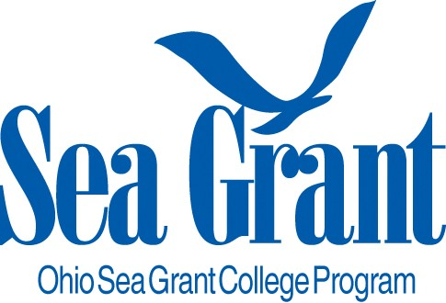
Great Lakes – Ohio
OHSG Supports the State and Region
ODHE - $2M HAB Research
H2OHIO - $200M HAB Mitigation
Recreational impairment criteria for cyano exposure in Lake
Great Lakes WQ Agreement
Outreach
Notes:
Chris Winslow – contact for all winslow.33@osu.edu

Slide 5
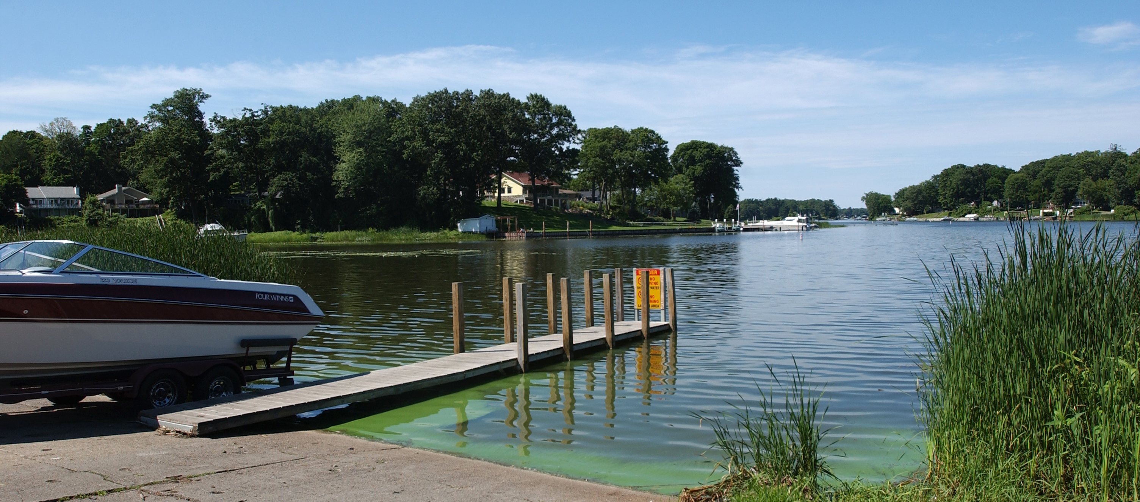
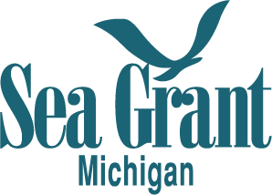
Great Lakes - Michigan
Factors that affect toxicity (2020-P - UMich)
Great Lakes Center for Fresh Water and Human Health – Community Engagement Core (2018-2023)
Credit Todd Marsee, Michigan Sea Grant
Notes:
Identifying factors that affect toxicity in Lake Erie’s harmful algal blooms
• Contact(s) info: Mike Fraker (MISG Research Coordinator, mfraker@umich.edu) or Greg Dick (Project PI, gdick@umich.edu)
Great Lakes Center for Fresh Water and Human Health – Community Engagement Core
Heather Triezenberg, vanden64@msu.edu
Martha Gerig, gerigmar@msu.edu

Slide 6
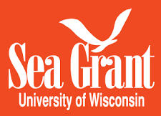
Great Lakes - Wisconsin
Developing models and tools to restore the health of the Green Bay Ecosystem (2020-22 - UW-Green Bay, UW-Milwaukee, UW-Extension)
A New Phosphorus Model for Lake Michigan (2020-22 - UW-Milwaukee)
Assessing and improving policy and practice interventions to reduce nutrient runoff into the Great Lakes (2020-22 - UW-Madison)
Currently employ a HABs postgrad fellow stationed at the Wisconsin Department of Health Services (2021)
Notes:
Kevin Fermanich (PI), J. Val Klump (PI), Hector Bravo (AI), Chad Cook (AI), Paul Baumgart (AI), Michael Zorn (AI), Jerry Kaster (AI)
UW-Green Bay, UW-Milwaukee, UW-Extension
Transitioning Science to Management: Developing models and tools to restore the health of the Green Bay Ecosystem
Key outcomes are the refinement of a set of Management Analysis Tools to help guide resource management and the engagement of those involved in land and water use across all sectors.
Harvey Bootsma (PI), Qian Liao (PI)
UW-Milwaukee
A New Phosphorus Model for Lake Michigan
Rissman, Adena (PI, UW-Madison), Eric Booth (Co-PI, UW-Madison)
UW-Madison
Assessing and improving policy and practice interventions to reduce nutrient runoff into the Great Lakes
Contact: Wisconsin Sea Grant: Jennifer Hauxwell (jennifer.hauxwell@aqua.wisc.edu)

Slide 7
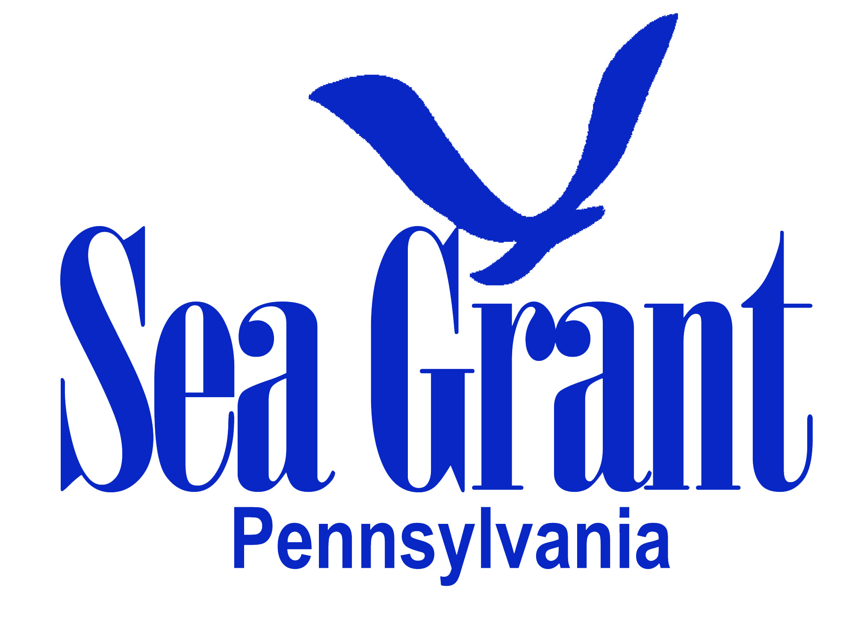
Great Lakes - Pennsylvania
Lake Erie HAB Task Force (since 2013)
Notes:
PA Sea Grant is the new facilitator of this task force (contact Amber Stilwell, ars26@psu.edu)

Slide 8
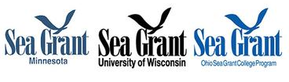
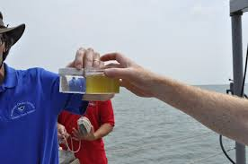
Great Lakes
Ohio, Minnesota & Wisconsin – Joint RFP (2022-24)
Robert Sterner (University of Minnesota Duluth), Todd Miller (University of Wisconsin - Milwaukee), George Bullerjahn (Bowling Green State University) | Stoichiometry meets genomics: assessing limiting factors for diverse CHABs and their associated toxins
Ohio Sea Grant image 2021
Notes:
Ohio, Minnesota and Wisconsin Sea Grant programs are teaming up to launch a joint solicitation for research to advance our understanding of factors leading to the genesis of harmful and nuisance algae blooms, including nutrient source identification using innovative tools
Research is to be conducted in the 2022–24 biennium. Up to $100,000 per year for two years will be available for funding each of the Ohio, Minnesota and Wisconsin portions of a joint research project (this is to include the cost of graduate students) for a grant total of up to $300,000 per year.
For more information:
Wisconsin Sea Grant: Jennifer Hauxwell (jennifer.hauxwell@aqua.wisc.edu)
Ohio Sea Grant: Kristen DeVanna Fussell (fussell.10@osu.edu)
Minnesota Sea Grant: Valerie Brady (vbrady@d.umn.edu)

Slide 9
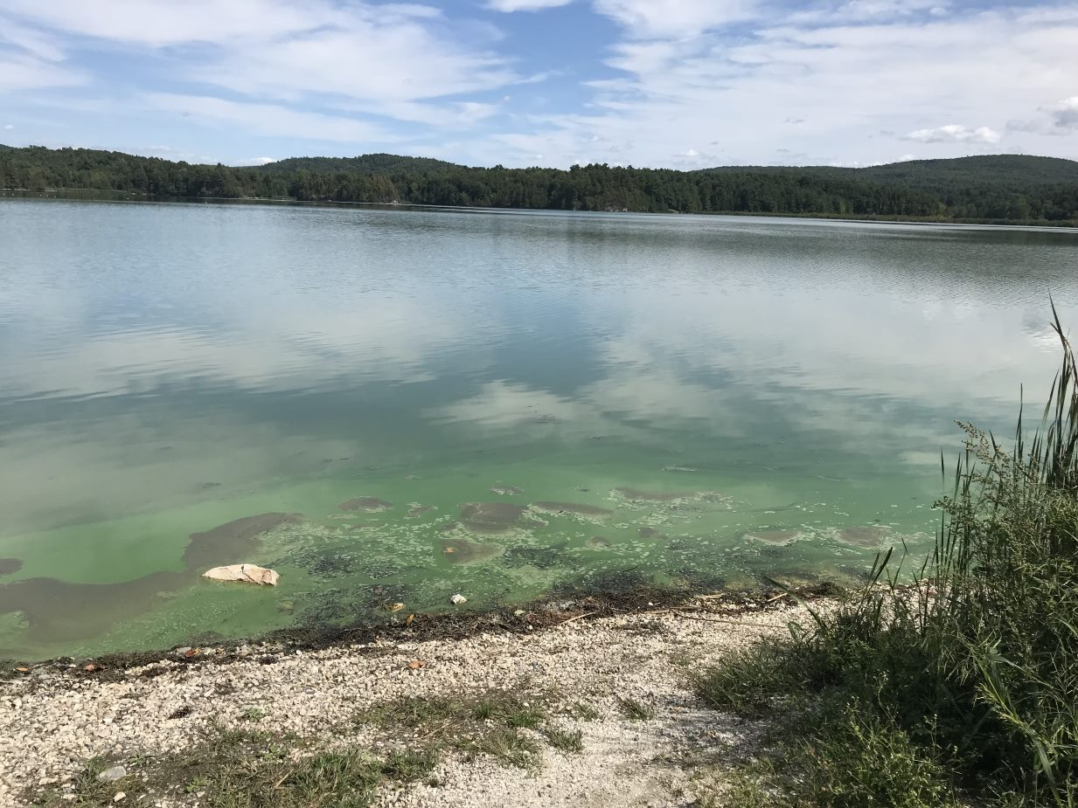
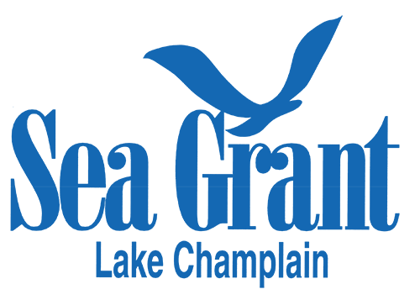
Northeast – Lake Champlain
Lake George Association and the Town of Bolton, NY Image
Ongoing – External funding
HAB ecology & gene activity
Sensor systems for Real-Time WQ
Sensor system for HAB mapping & monitoring
Eval efficacy of woodchip bioreactor (2019-2021 - Lake George Association, Lake George Waterkeeper, and Town of Bolton) Project Website
Outreach, Mitigation & Education Cyanobacteria | Lake Champlain Sea Grant (uvm.edu)
Shelborne Pond image credit J Stockwell
Notes:
A Project to Evaluate the Efficacy of a Woodchip Bioreactor for Denitrification of Tertiary Effluent from the Bolton Wastewater Treatment Plant (Lake George, Warren Country, New York)
Research coordinator: julianna.m.white@uvm.edu
Outreach, mitigation, and education related to cyanobacteria blooms
Extension Leader and Associate Director Kris Stepenuck kstepenu@uvm.edu

Slide 10
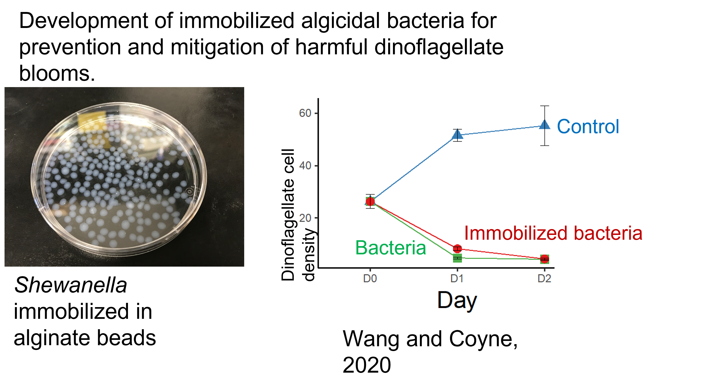
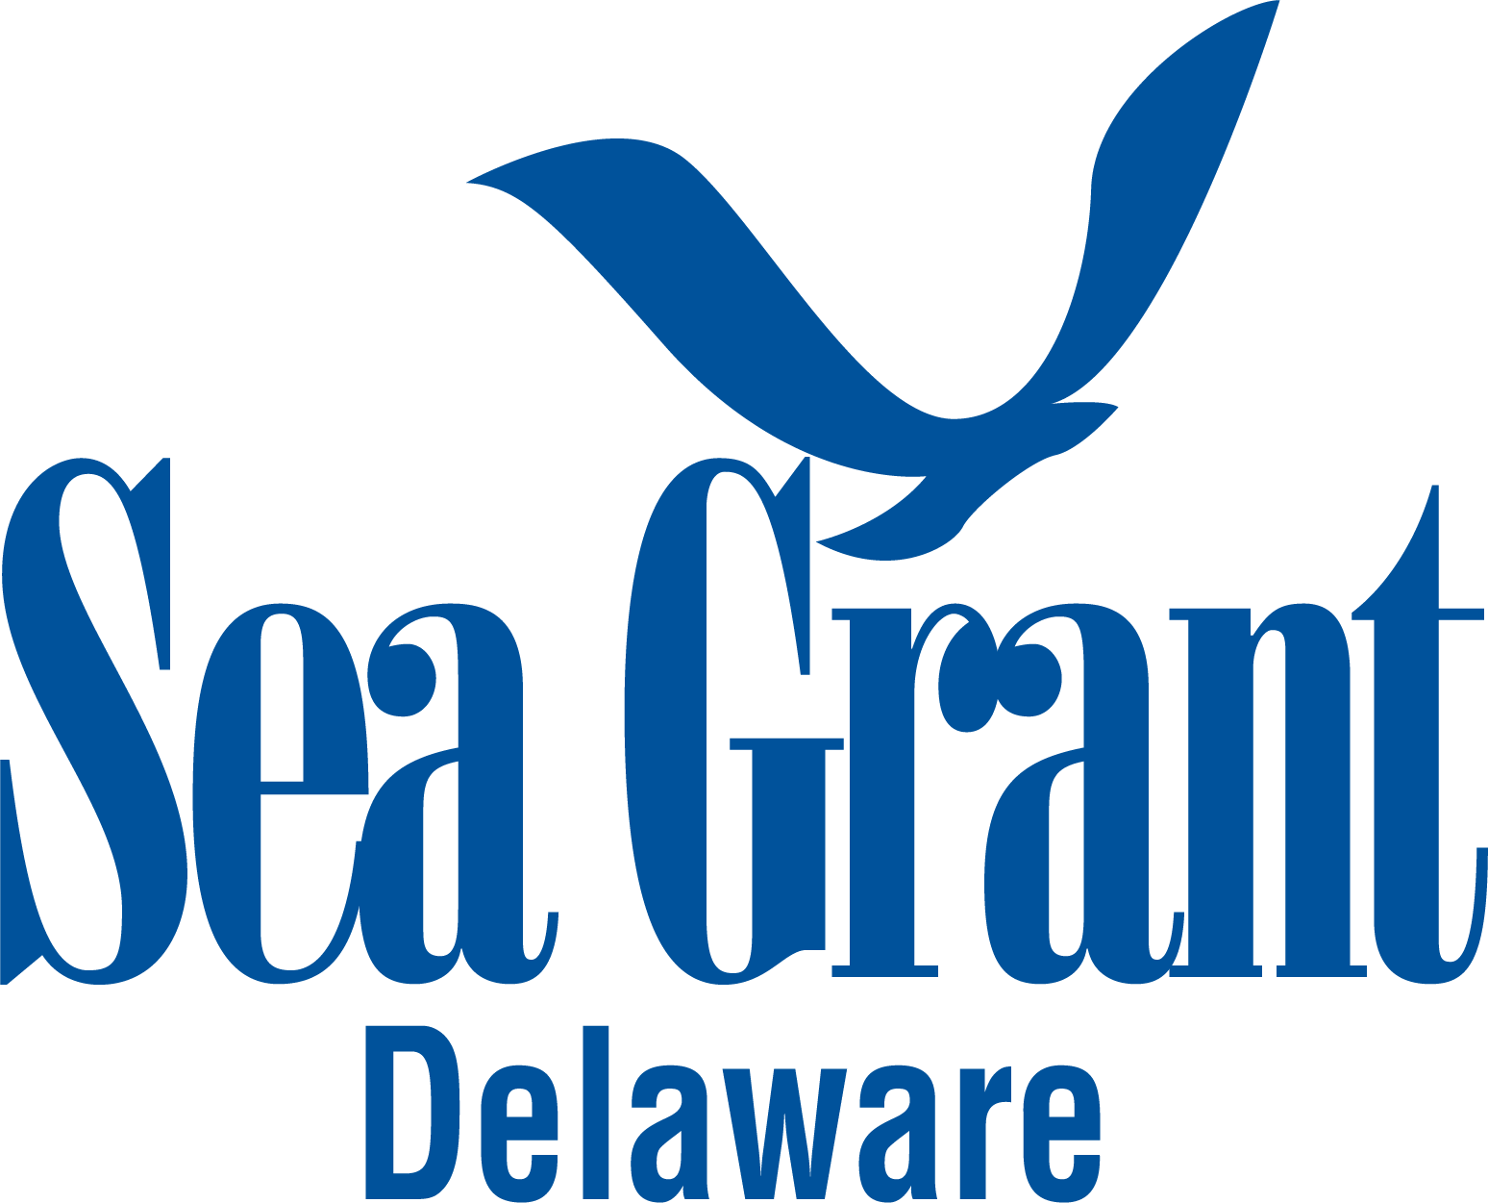
Northeast – Delaware
Development of immobilized algicidal bacteria for prevention & mitigation of dinoflagellate HABs (2yr – complete - UDel)
Dynamics of Heterosigma akashiwo in promoting Dinophysis acuminata (2yr - Complete – Udel)
Heterosigma akashiwo diversity – environmental drivers & strain toxicity (2yr – complete - UDel) https://www1.udel.edu/MERL/Heterosigma_diversity.html
Notes:
Project #1
Development of immobilized algicidal bacteria for prevention and mitigation of harmful dinoflagellate blooms. (Coyne)
Contact(s) info (name & email) – Who in your program should I credit to and refer them to if they want more info.
Kathy Coyne (kcoyne@udel.edu)
Project #2
Phytoplankton dynamics and the role of Heterosigma akashiwo in promoting blooms of the toxic dinoflagellate, Dinophysis acuminata (Pettay and Coyne)
Contact(s) info (name & email) – Who in your program should I credit to and refer them to if they want more info.
Kathy Coyne (kcoyne@udel.edu)
Project #3
Diversity within the harmful alga Heterosigma akashiwo: environmental drivers and strain toxicity (Pettay and Coyne)
Contact(s) info (name & email) – Who in your program should I credit to and refer them to if they want more info.
Kathy Coyne (kcoyne@udel.edu)

Slide 11
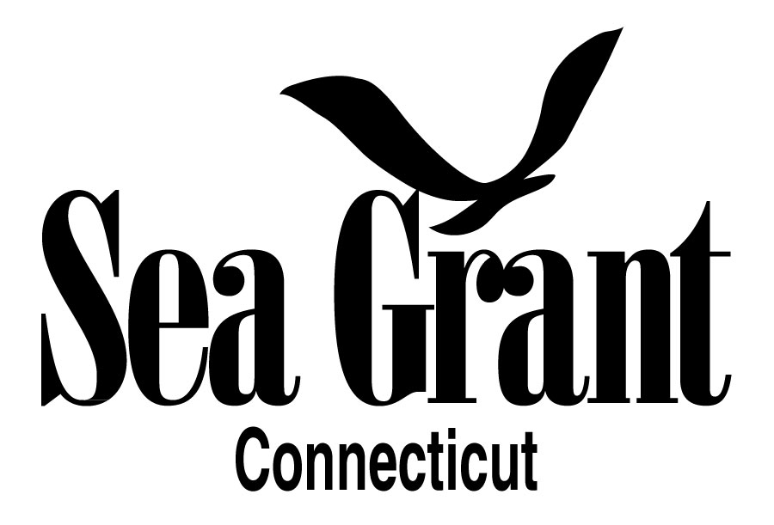
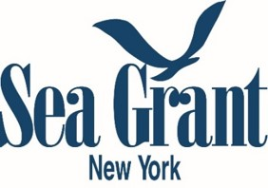
Northeast – Connecticut & New York
Refined Integration of Remote Sensing with Biological parameters for improved management of Long Island Sound Water Quality (CT & NY SG - 2019-21 CUNY )
Use of Macroalgae to expand aquaculture and prevent, control and mitigate HABs in NY’s coastal zones (2020-22 – Stony Brook)
Suspicious Marine HAB Reporting Tool (NYSG – 2020-ongoing)
Notes:
1) CTSG ALONG with NY Sea Grant ADMINISTERS the Long Island Sound Study research competition and have also supported HAB research with these funds:
Refined Integration of Remote Sensing with Biological parameters for improved management of Long Island Sound Water Quality
This study proposes to develop new remote sensing products to improve our knowledge of LIS ecosystem parameters that are critical for management.
2) The use of macroalgae to expand aquaculture and prevent, control, and mitigate harmful algal blooms in New York’s coastal zones
This project will create an opportunity to both (1) expand the scope of the NY aquaculture industry, and (2) introduce a cost-effective method for mitigating damage to aquacultured seafood from HABs.
3) In 2020, NYSG completed development of an online tool allowing the public to easily share HAB data with the County and archive monitoring results. The Suspicious Marine HAB Reporting Tool was presented at the 2020 HAB Virtual Symposium and piloted in summer 2020. This web-based tool enables users to report marine HAB outbreaks in real-time by pinpointing locations on a map; this capability ultimately helps improve administrative decisions that Suffolk County makes for monitoring team deployment and supports Action Plan goals to coordinate monitoring data and develop a real-time HAB public alerts program.
------
(2019-2021) Refined Integration of Remote Sensing with Biological parameters for improved management of Long Island Sound Water Quality
The Research Foundation CUNY—The City College of New York: Maria Tzortziou,
The Research Foundation CUNY—Advance Science Research Center and Queens College: Dianne Greenfield
Lamont-Doherty Earth Observatory, Columbia University: Joaquim Goes
The use of macroalgae to expand aquaculture and prevent, control, and mitigate harmful algal blooms in New York’s coastal zones, PI: Chris Gobler and Michael Doall, Stony Brook University.
Sea Grant contact:
Mr. Lane Smith

Slide 12
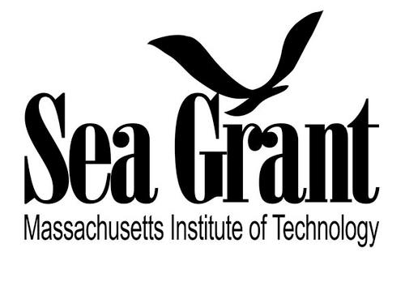
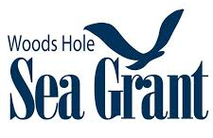
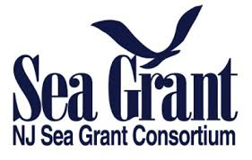
Northeast – MA-MIT, Woods Hole & New Jersey
Floating Wetland Education (MIT – 2020-Present)
Regional Shellfish Aquaculture Hub (Woods Hole, RI & CT - 2020-2023)
HAB and Lakes Management Expert Team - HAB Expert Team (NJSG – 2021- ongoing)
Floating Wetland image - MIT
Notes:
Which SG Program (state(s)): MIT Sea Grant
Project title (if there is one): Floating Wetland Education
Lily Keyes (keyes@mit.edu)
Which SG Program (state(s)): Woods Hole Sea Grant is working in partnership with Rhode Island Sea Grant and Connecticut Sea Grant (lead)
Project title (if there is one): The project is a Regional Shellfish Aquaculture Hub
the lead PI is Tessa Getchis of Conn Sea Grant (tessa.getchis@uconn.edu)
Stephanie Murphy (she/her)
Woods Hole Sea Grant Sr. Communications Specialist
samurphy@whoi.edu | 508.566.3055
--------
HAB and Lakes Management Expert Team - HAB Expert Team (NJSG – 2021- ongoing)
Primary Contact: Michael Danko, NJSGC, 732.610.0015, mdanko@njseagrant.org

Slide 13
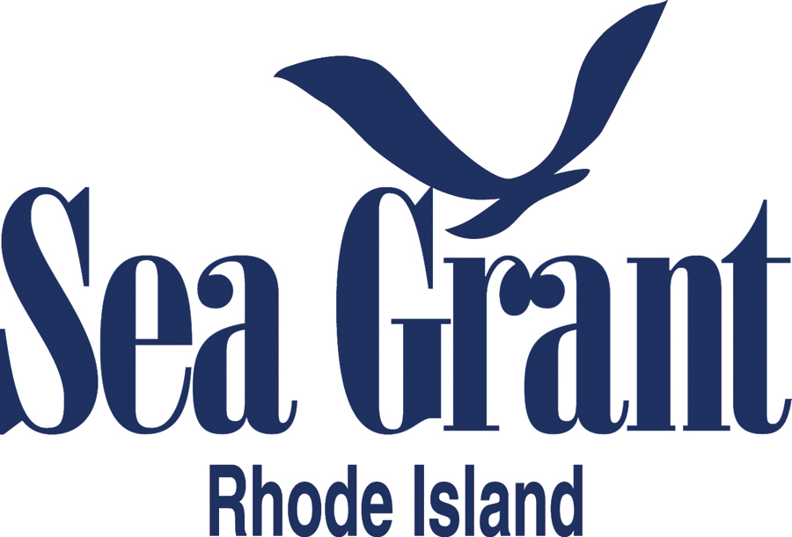
Northeast – Rhode Island
Temporal and spatial dynamics of rust tide caused by Margalefidinium polykrikoides on Rhode Island shellfish farms and resulting impacts on cultured oysters (2022-24 - Roger Williams University)
High-resolution time series for deciphering the Pseudo-nitzschia species and environmental drivers that produce domoic acid in Narragansett Bay (2022-24 – URI)
Environmental triggers of HAB blooms and toxin expression in Narragansett Bay, RI (2022-24 – URI)
Using historical time series data to predict future HAB events in Narragansett Bay, RI (2022-24 – URI)
Harmful Algal Bloom Modeling Using a Lower Trophic Level Ecosystem Model in Narragansett Bay (2022-24 – URI)
https://seagrant.gso.uri.edu/research/
Notes:
Temporal and spatial dynamics of rust tide caused by Margalefidinium polykrikoides on Rhode Island shellfish farms and resulting impacts on cultured oysters (2022-24 - Roger Williams University)
Principal Investigator: Skylar Bayer, Roger Williams University, Other Investigators: Roxanna Smolowitz, Roger Williams University, Gary Wikfors, NOAA Northeast Fisheries Science Center, Tim Scott, Roger Williams University
High-resolution time series for deciphering the Pseudo-nitzschia species and environmental drivers that produce domoic acid in Narragansett Bay (2022-24-URI)
Principal Investigator: Matthew Bertin, University of Rhode Island, Other Investigators: Bethany Jenkins, University of Rhode Island
Environmental triggers of HAB blooms and toxin expression in Narragansett Bay, RI (2022-24 –URI)
Principal Investigator: Colleen Mouw, University of Rhode Island, Other Investigators: Audrey Ciochetto, University of Rhode Island
Using historical time series data to predict future HAB events in Narragansett Bay, RI (2022-24 – URI)
Principal Investigator: Tatiana Rynearson, University of Rhode Island, Other Investigators: Patricia Thibodeau, University of Rhode Island, Gavino Puggioni, University of Rhode Island
Harmful Algal Bloom Modeling Using a Lower Trophic Level Ecosystem Model in Narragansett Bay (2022-24 – URI)
Principal Investigator: David Ullman, University of Rhode Island, Other Investigators: Total Months effort: Jongsun Kim, University of Rhode Island, David Borkman, Rhode Island Dept. Environmental Management, Lewis Rothstein, University of Rhode Island

Slide 14
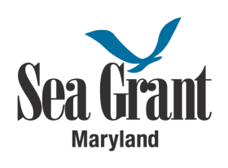
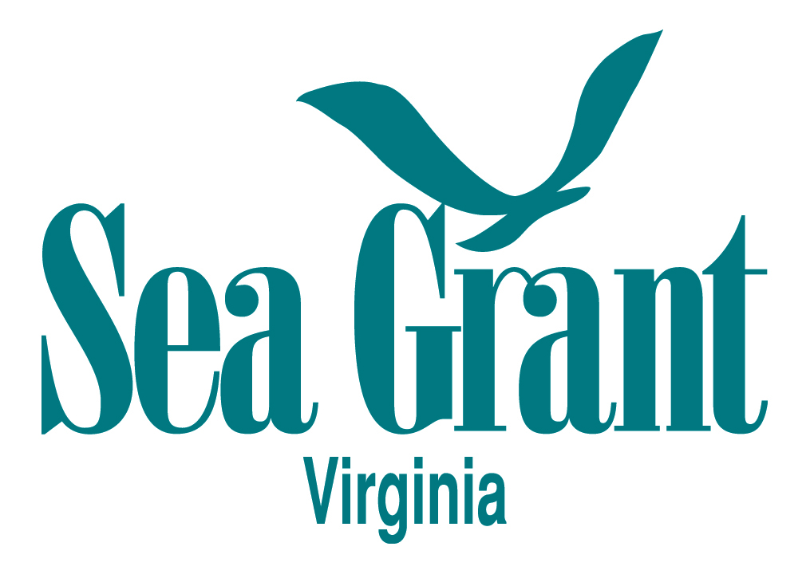
Mid-Atlantic – Maryland & Virginia
Image MD Sea Grant
Natural algaecides: Compounds produced by barley straw (MD – 2019-21 – Grad student grantee)
Causes of benthic cyano overgrowth in SAV beds in Chesapeake (MD – 2022-24 – UMCES)
Pond management issues (MD – ongoing)
Rethinking Tropic Status of Phytoplankton in York River (VA - 1.5 yr current)
Identifying Strategies to Minimize Impacts of HABs on Performance & Survival of Triploid Oysters in Lower Chesapeake (VA - 2-yr project - No cost extension just ended)
Focus Groups (VA) – VASG Partner
Notes:
Natural Algaecides: Compounds Produced by Barley Straw to Reduce Harmful Algal Blooms
Al Place (PI) and Taylor Armstrong (Graduate student grantee). This project was a small two-year graduate research support grant funded in 2019.
In our new omnibus (2022-2024) we are funding a project led by Judy O'Neil at UMCES Horn Point Lab, in collaboration with St. Mary's College of Maryland and Maryland DNR
Causes of benthic cyanobacteria overgrowth in submersed aquatic vegetation (SAV) beds in Chesapeake Bay: Potential consequences for ecosystem resilience
We also have a couple folks from Sea Grant extension that work on pond management issues. Here's a link to their information: https://www.mdsg.umd.edu/topics/stormwater-pond-management/pond-management
------
Currently, we are only supporting a few projects which are related to HABs. I’ve included a PD award that is most relevant, as well as one recent NSGO aquaculture project that have links to HABs.
R/72152L - Rethinking the Trophic Status of Phytoplankton in the York River, VA: Experimental and Historical Analyses (current project; 1.5 years of support)
R/721001 - Identifying Strategies to Minimize Impacts of Harmful Algal Blooms on Performance and Survival of Triploid Oysters Cultured in Lower Chesapeake Bay (2 years of support; no cost extension period just ended)
Samuel J. Lake, Ph.D.
Fellowship & Research Program Coordinator
Virginia Sea Grant College
Email: sjlake@vaseagrant.org
PROJECT SUMMARY Chesapeake Bay Environmental Forecasting System: Accelerating the transition of HAB and pathogen models from research to operations
(b) Primary Contact: Marjorie Friedrichs, Lead Scientific PI Virginia Institute of Marine Science, William & Mary 1375 Greate Road, Gloucester Point, VA 23062-1346 Phone: (804) 684 7695; Email: marjy@vims.edu
(c) Primary Institution: Virginia Institute of Marine Science, William & Mary
(d) Other Principal Investigators: Gerhard Kuska, Transition PI (kuska@maracoos.org) Raleigh Hood, UMCES (rhood@umces.edu) Christopher Brown, NOAA(christopher.w.brown@noaa.gov) John Jacobs, NOAA (john.jacobs@noaa.gov) (e) Brief Project Summary:
The overarching goals of this proposal are to (1) advance the development of forecasts for harmful algal blooms (HABs) and pathogens in the Chesapeake Bay, and (2) accelerate the transition of these forecasts from a research environment to an integrated operational system with MARACOOS (the Mid-Atlantic Regional Association Coastal Ocean Observing System) and their partners within the National Centers for Coastal Ocean Science (NCCOS)….
To ensure end users are inherently involved in the continuing development and design of our operational management tools, we will work in partnership with extension specialists to continue conducting Stakeholder Focus Group meetings to receive feedback on the format and content of the forecasts directly from our end users.
Additional Partners: Dr. Patrick Burke, NOAA/NOS, Chief, Oceanographic Division Dr. Aaron Bever, Anchor QEA, Managing Scientist Dr. Pierre St-Laurent, VIMS, Research Scientist Kelly Knee, RPS North America, Executive Director, Ocean Science Susanna Musick, VIMS, Marine Recreation & Fisheries Extension Specialist Karen Hudson, VIMS, Shellfish Aquaculture Extension Specialist.

Slide 15
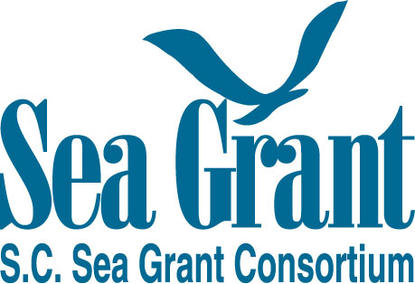
South-Atlantic – South Carolina
HABnet Task Force (2020-ongoing)
Stormwater Pond in the Coastal Zone (2021) https://www.scseagrant.org/stormwater-pond-programming/
Water Chats https://www.scseagrant.org/water-chats/ (2022)
Notes:
2) South Carolina Sea Grant Consortium- HABnet Task Force
• Contact(s) info (name & email) –Brooke Saari, brooke.saari@scseagrant.org
•
W1) South Carolina Sea Grant Consortium-- Stormwater Ponds in the Coastal Zone
• Contact(s) info (name & email) –Brooke Saari, brooke.saari@scseagrant.org
•
3) South Carolina Sea Grant Consortium-- Water Chats
• Contact(s) info (name & email) –. Brooke Saari, brooke.saari@scseagrant.org
•

Slide 16
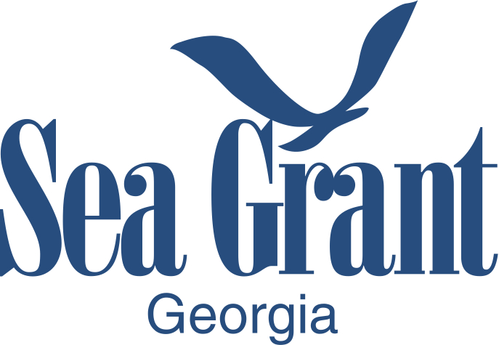
South-Atlantic - Georgia
Image GA Sea Grant
Monitor HABs thru PMN (ongoing)
Factors influencing Akashiwo sanguinea blooms - thesis
UGA’s CAES pond tests (ongoing)
Notes:
Bryan Fluech
Marine Extension and Georgia Sea Grant | Associate Marine Extension Director 715 Bay Street | Brunswick, GA 31520
O: 912-264-7269
C: 239-247-3946 w: gacoast.uga.edu

Slide 17
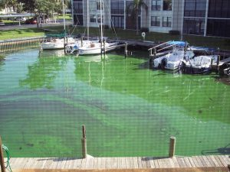
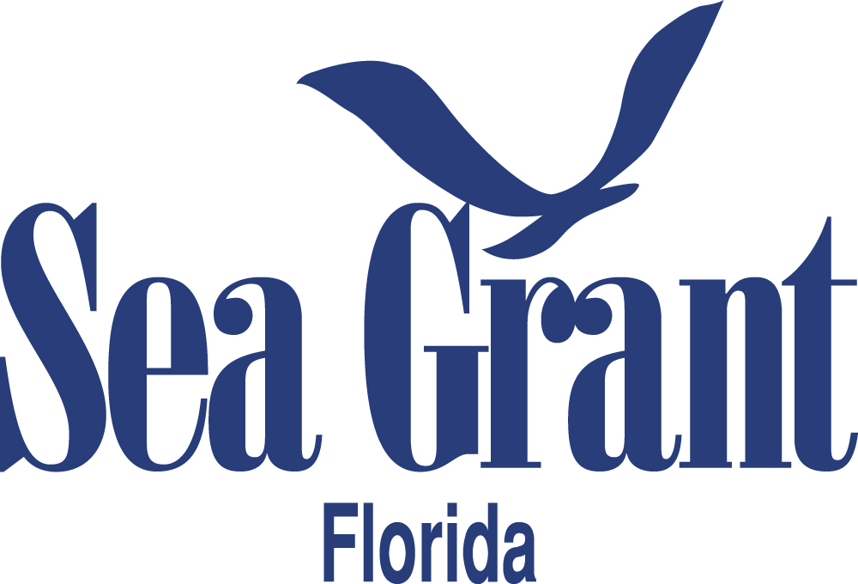
South-Atlantic & Gulf of Mexico - Florida
FSG Image credit Phlips 2004
NOAA HAB Liaison (2021-25)
A promising Florida Red Tide control strategy: combining stakeholder input and benthic surveys to evaluate impacts of clay flocculation (2022-24 – UCF)
Controlling Pyrodinium Outbreaks in the Indian River Lagoon Estuarine System (IRLES) using Low-cost Biochars (2022-24 – UCF)
Use of Chemical Algaecides for the Control of Karenia brevis (1yr – present)
Managing Toxic Cyanobacteria Bloom Biomass Impacting Coastal Ecosystems (1yr – present)
Red tide Communications Plan for Florida (2020-21) - Reports
HABSOS II (Planned 2023)
Community Science – PMN, EOS - Macroalgae & Benthic Cyanos (since 2019 ongoing)
Notes:
A promising Florida Red Tide control strategy: combining stakeholder input and benthic surveys to evaluate impacts of clay flocculation (2022-24 – UCF)
PRINCIPAL INVESTIGATOR(S): Kristy A. Lewis, PhD National Center for Integrated Coastal Research Department of Biology University of Central Florida, CO-PRINCIPAL INVESTIGATOR(S): Salvador Almagro-Moreno, PhD, Burnett School of Biomedical Sciences Chemical and Physical Ecology Program University of Central Florida, Emily R. Hall, PhD, Mote Marine Laboratory, Donald Anderson, PhD Biology Department Woods Hole Oceanographic Institute ASSOCIATE INVESTIGATOR(S): Armando J. Ubeda Florida Sea Grant Agent UF-IFAS Extension
Controlling Pyrodinium Outbreaks in the Indian River Lagoon Estuarine System (IRLES) using Low-cost Biochars (2022-24 – UCF)
PRINCIPAL INVESTIGATOR(S): Toufiq Reza, Ph.D., Assistant Professor of Chemical Engineering, Florida Institute of Technology, Email: treza@fit.edu. CO-PRINCIPAL INVESTIGATOR(S): (1) Spencer Fire, Associate Professor of Biological Sciences, Florida Institute of Technology, Email: sfire@fit.edu. (2) Anwar Sadmani, Assistant Professor, Department of Civil, Environmental and Construction Engineering, University of Central Florida, Email: sadmani@ucf.edu. ASSOCIATE INVESTIGATOR(S): (1) Holly Abeels, Florida Sea Grant Extension Agent, University of Florida IFAS Extension Brevard County, Email: habeels@ufl.edu. (2) Vincent Encomio, Ph.D., Martin and St. Lucie County Extension Agent, 2614 SE Dixie Hwy Stuart, FL, Email: vencomio@ufl.edu
Use of Chemical Algaecides for the Control of Karenia brevis (1yr – present)
PI Information: H. Dail Laughinghouse IV, Assistant Professor of Applied Phycology, hlaughinghouse@ufl.edu
Managing Toxic Cyanobacteria Bloom Biomass Impacting Coastal Ecosystems (1yr – present)
PI – Edward Phlips, Professor, phlips@ufl.edu
Red tide Communications Plan for Florida (2020-21) - Reports
HABSOS II (Planned 2023)
Community Science – PMN, EOS - Macroalgae & Benthic Cyanos (since 2019 ongoing)
Betty Staugler: Staugler@ufl.edu

Slide 18
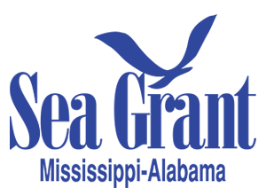
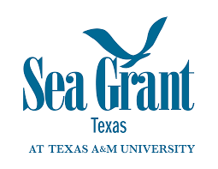
Gulf of Mexico – Mississippi-Alabama & Texas
Image MS-AL SG Consortium
Dueling Blooms (MSAL-SG – 2018)
HABSOS focus groups (2019) – All GOM Programs
Red tide Rangers (TXSG – ongoing)
Notes:
Contact(s) info (name & email) – Who in your program should I credit to and refer them to if they want more info.
Steve Sempier, Outreach and Deputy Director, MASGC (stephen.sempier@usm.edu)
LaDon Swann, Director, MASGC (Ladon.Swann@usm.edu)
Link to more info – if there is one
Red tide publication: faq_red_tide_habs.pdf (masgc.org)
Blue green algae publication: blue-green_algae.faq.pdf (masgc.org)
Red tide Rangers
Texas SG – Tony Reisinger e-reisinger@tamu.edu

Slide 19
Gulf of Mexico - Louisiana
USGS image 2019 approx.
Collaborations with Great Lakes (since 2020)
Source Area-Based Monitoring, Modeling and Mitigation of Harmful Algal Blooms in Lake Pontchartrain (2020-22 - LSU)
Controls of physical drivers on phytoplankton community adaptations in a river diversion influenced estuary (2020-21 - LSU)
Outreach – Website & Webinar (Planned)
Notes:
Source Area-Based Monitoring, Modeling and Mitigation of Harmful Algal Blooms in Lake Pontchartrain
PI: Zhiqiang Deng, LSU, Bert S. Turner Department of Civil and Environmental Engineering Co-PIs: Sibel Bargu (LSU) and Samendra Sherchan (Tulane University)
Controls of Physical Drivers on Phytoplankton Community Adaptations in a River Diversion Influenced Estuary Principal Investigator (PI): Matthew Hiatt, Louisiana State University (LSU), Department of Oceanography and Coastal Sciences Co-PI: Sibel Bargu, LSU
Sea Grant Contacts:
Julie A Lively <julieann@lsu.edu>
Matthew B Bethel <mbethe3@lsu.edu>

Slide 20
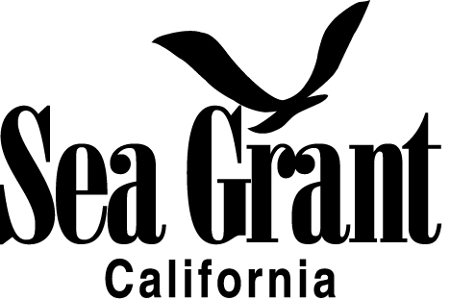
Pacific Coast – California
Identifying missing links in the transfer and retention of domoic acid in commercially important California crab species (2021-23)
Using aquaculture to help mitigate impacts of harmful algal blooms on crustacean fisheries: accelerating depuration to produce safe and marketable seafood products (2020-22)
Strengthening resilience: Mitigating socioeconomic impacts of HAB-related management measures for California commercial crab fisheries and communities (2021-22)
Notes:
California Sea Grant Projects
California Sea Grant extension specialists are leading and/or contributing to three research projects that will increase knowledge about, predictions of, and responses to, the impacts of domoic acid‐producing HABs on California’s crustacean fisheries.
Title: Identifying missing links in the transfer and retention of domoic acid in commercially important California crab species
Contact: Carolynn Culver, cculver@ucsd.edu
Title: Using aquaculture to help mitigate impacts of harmful algal blooms on crustacean fisheries: accelerating depuration to produce safe and marketable seafood products
Contacts: Carolynn Culver, cculver @ucsd.edu
Title: Strengthening resilience: Mitigating socioeconomic impacts of HAB-related management measures for California commercial crab fisheries and communities
Contact: Carolynn Culver, cculver@ucsd.edu
Leah Shore
Communications Manager
University of Southern California Sea Grant Program
lshore@usc.edu | 213-740-1960 | seagrant.usc.edu

Slide 21
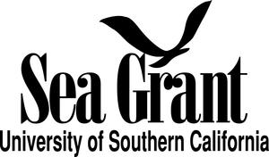
Pacific Coast - USC
USC Sea Grant published a document synthesizing and summarizing results from published USC Sea Grant research on harmful algal blooms funded between 2012-2018. Report
Advancing portable detection capabilities of harmful algal bloom species in California waters (2018-21 - Moss Landing)
Multiple stressors and toxic Pseudo nitzschia blooms in California waters: understanding the complex interactive impacts of nutrients, temperature, and carbonate chemistry (2018-21 - USC)
Design and development of a universal genetic assay to monitor and predict toxic Pseudo nitzschia planktonic blooms (2020-22 – Scripps)
Notes:
Hi Betty,
Hope you are doing well! I’m reaching out in response to your request below for HAB research information. USC Sea Grant published a document synthesizing and summarizing results from published USC Sea Grant research on harmful algal blooms funded between 2012-2018. I’ve attached it to this email.
Within this document, it summarizes the key findings from our 7 funded research projects on HABS over the time period. Information about each of these 7 project titles, description, and years of funding are provided at the end of the document.
Please let me know if you’d like any other information or have any questions about this ahead of your presentation!
Best,
Leah
Leah Shore
Communications Manager
University of Southern California Sea Grant Program
lshore@usc.edu | 213-740-1960 | seagrant.usc.edu
Advancing portable detection capabilities of harmful algal bloom species in California waters 2018-21, OPC Prop 84 Funding, PIs: Holly Bowers and Jason Smith (Moss Landing Marine Laboratories) We now have the ability to vastly improve the efficiency of detecting HAB species through new handheld technology that provides rapid and specific analyses from locations ranging from shore-side to ship deployments. The principal investigators were recently awarded such a device (the Freedom4) through a competitive award from Ubiquitome, New Zealand with the goal of improving HAB detection in the field. The flexibility of established, portable genetic detection technology would greatly enhance sampling efforts on relevant temporal and spatial scales toward overcoming challenges inherent to field monitoring. Moreover, the Freedom4 platform will support future efforts outlined in the OPC recommendations: advancing HAB predictive models, improving the understanding of HAB ecophysiology, and linking HAB events to human health.
Multiple stressors and toxic Pseudo-nitzschia blooms in California waters: understanding the complex interactive impacts of nutrients, temperature, and carbonate chemistry 2018-21, OPC Prop 84 Funding, PIs: David Hutchins and Feixue Fu (USC) Despite our growing knowledge about the impacts of each of these single factors on toxicity, little is known about how projected simultaneous future changes in nutrients, temperature, and carbonate chemistry will together affect domoic acid levels in California coastal food webs. This project will experimentally test the effects of relevant projected levels of these three critical controlling factors using multi-stressor studies with Pseudo-nitzschia cultures isolated from California waters, and with local natural phytoplankton communities containing toxic Pseudo-nitzschia species. The project will be specifically designed to inform a new generation of domoic acid forecasting HAB models incorporating quantitative, mechanistic knowledge of climate change multiple stressor interactions. The aim is to generate a set of informed predictions of how future environmental conditions may influence damaging toxic Pseudo-nitzschia blooms, as our coastal ocean ecosystems continue to respond to ever-increasing human populations and a changing climate.
Design and development of a universal genetic assay to monitor and predict toxic Pseudonitzschia planktonic blooms 2020-22, PIs: Bradley Moore (Scripps Institution of Oceanography) and Andrew Allen ( Scripps Institution of Oceanography and J. Craig Venter Institute) Accurate predictive monitoring tools are lacking for blooms of the globally distributed diatom genus Pseudo-nitzschia that produces the neurotoxin domoic acid (DA). This project aims to develop predictive monitoring approaches by detecting domoic acid biosynthesis genes (dab genes) associated with toxin production in three Pseudo-nitzschia species with varying levels of toxin production. The goal is to develop a universal genetic assay to reliably detect dab genes and apply this knowledge to create a commercial detection kit that can be used for monitoring. This technology presents a predictive, rapid, and low-cost method to identify dab genes of high-toxin producing Pseudo-nitzschia in the environment prior to toxin production. Moreover, this new DA monitoring strategy would complement existing direct detection methodology to better inform and protect coastal communities and economies by predicting the extent of HABs in areas of likely production before they actually begin.

Slide 22
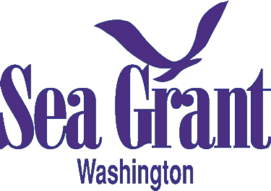
Pacific Coast - Washington
Expanding the Southeast Alaska Tribal Ocean Research Program for Monitoring of Amnesic Shellfish Poisoning and Diarrhetic Shellfish Poisoning (2019-22)
Shellfish killers – an optimized early warning program for the mitigation of HAB impacts on shellfish in the Pacific Northwest (2021-24?) - https://doi.org/10.1016/j.hal.2021.102032
Value of the SoundToxins Partnership: An Early Warning System for HABs in Puget Sound (2020-24)
Notes:
Washington SG
Project title: Expanding the Southeast Alaska Tribal Ocean Research Program for Monitoring of Amnesic Shellfish Poisoning and Diarrhetic Shellfish Poisoning.
Contact(s) info (name & email) – Teri King, guatemal@uw.edu
Project title Shellfish killers – an optimized early warning program for the mitigation of HAB impacts on shellfish in the Pacific Northwest.
Contact(s) info (name & email) – Who in your program should I credit to and refer them to if they want more info. Teri King, guatemal@uw.edu
Project title (if there is one). Value of the SoundToxins Partnership: An Early Warning System for HABs in Puget Sound
Contact(s) info (name & email) – Who in your program should I credit to and refer them to if they want more info. Teri King, guatemal@uw.edu
Which SG Program (state(s)) Washington Sea Grant
Project title (if there is one) SoundToxinsContact(s) info (name & email) – Who in your program should I credit to and refer them to if they want more info. Teri King, guatemal@uw.edu
Link to more info – soundtoxins.org

Slide 23
Thank you!!
Betty Staugler, NOAA HAB Liaison
Staugler@ufl.edu

