Slide 1
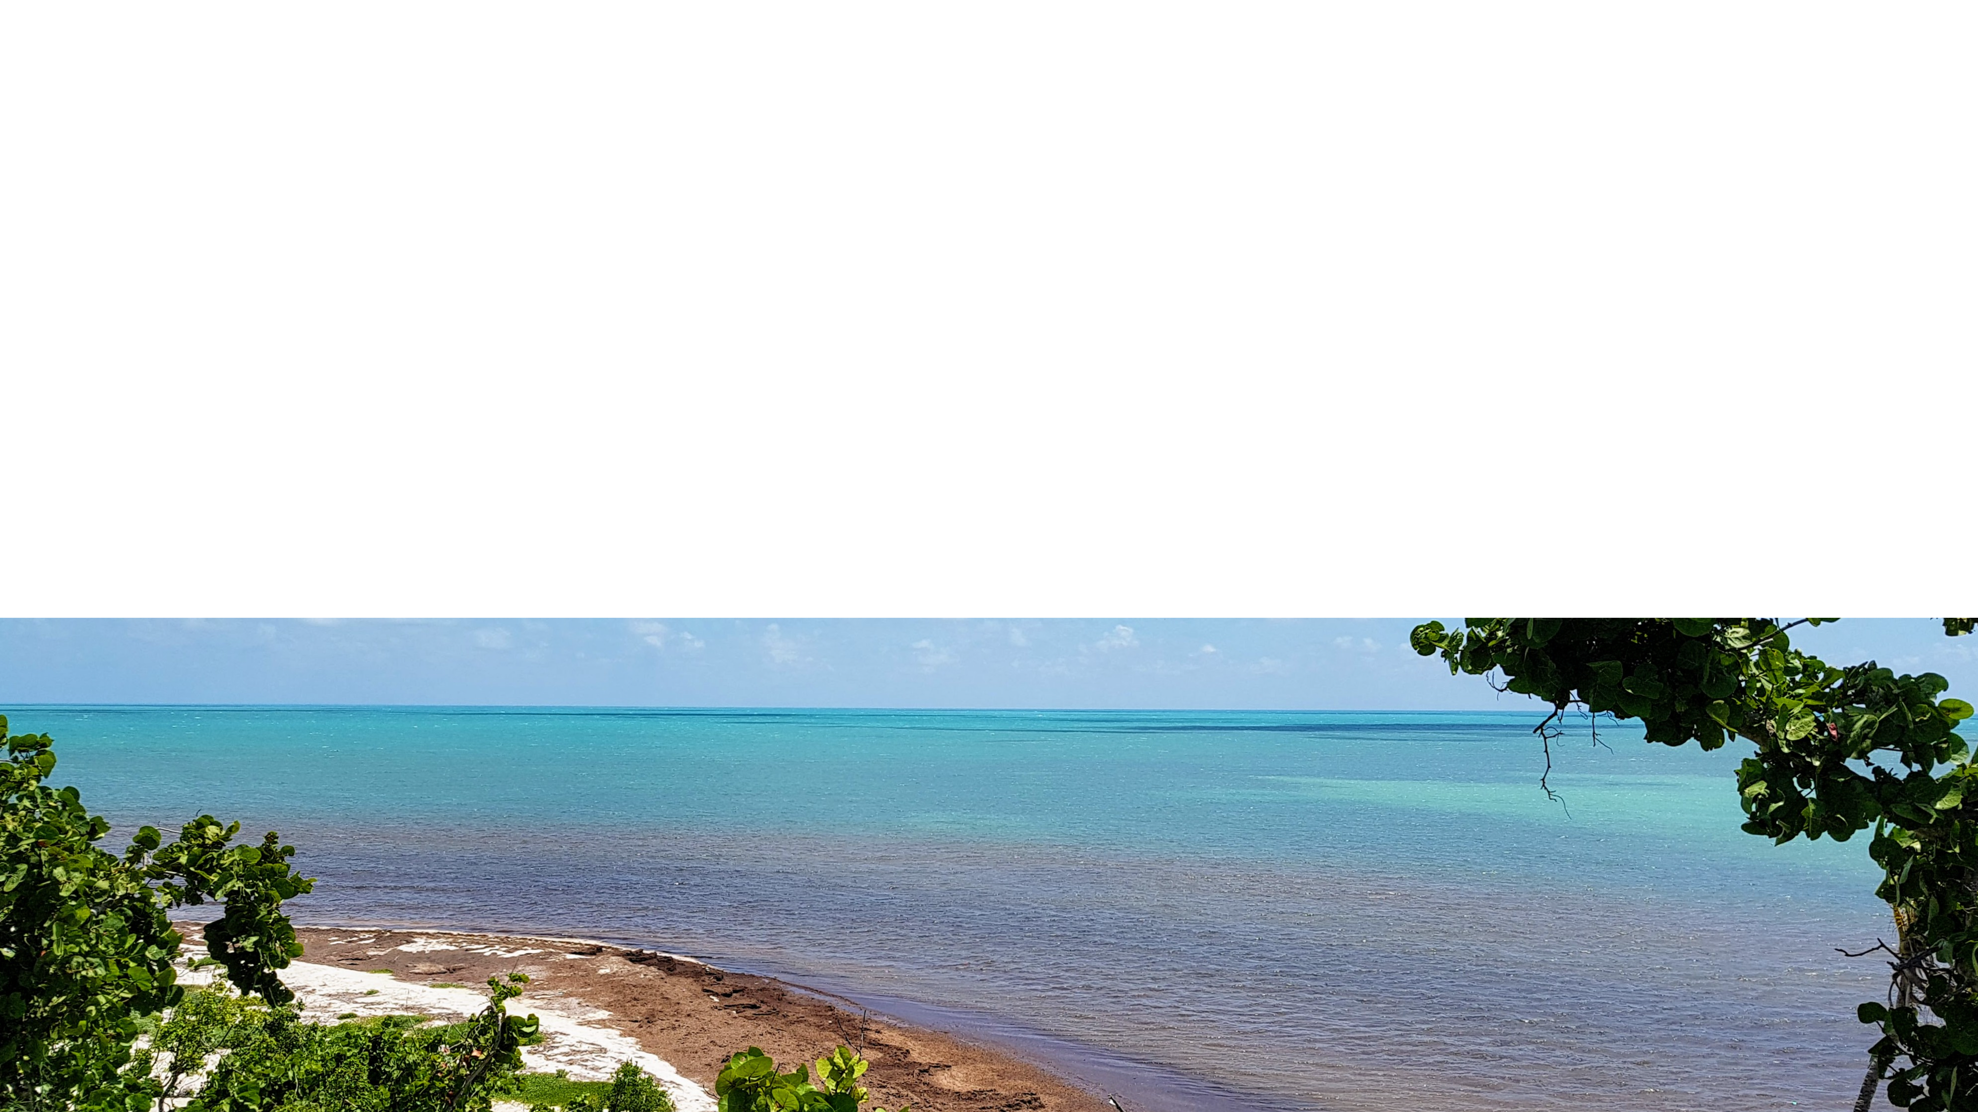
2023 progress
HAB CAST
Collaboration to Advance Stakeholder Tools
November 15, 2023 – Advisory Committee Meeting
NOAA HARMFUL ALGAL BLOOM LIAISON FOR OAR, NOS AND NESDIS

Slide 2
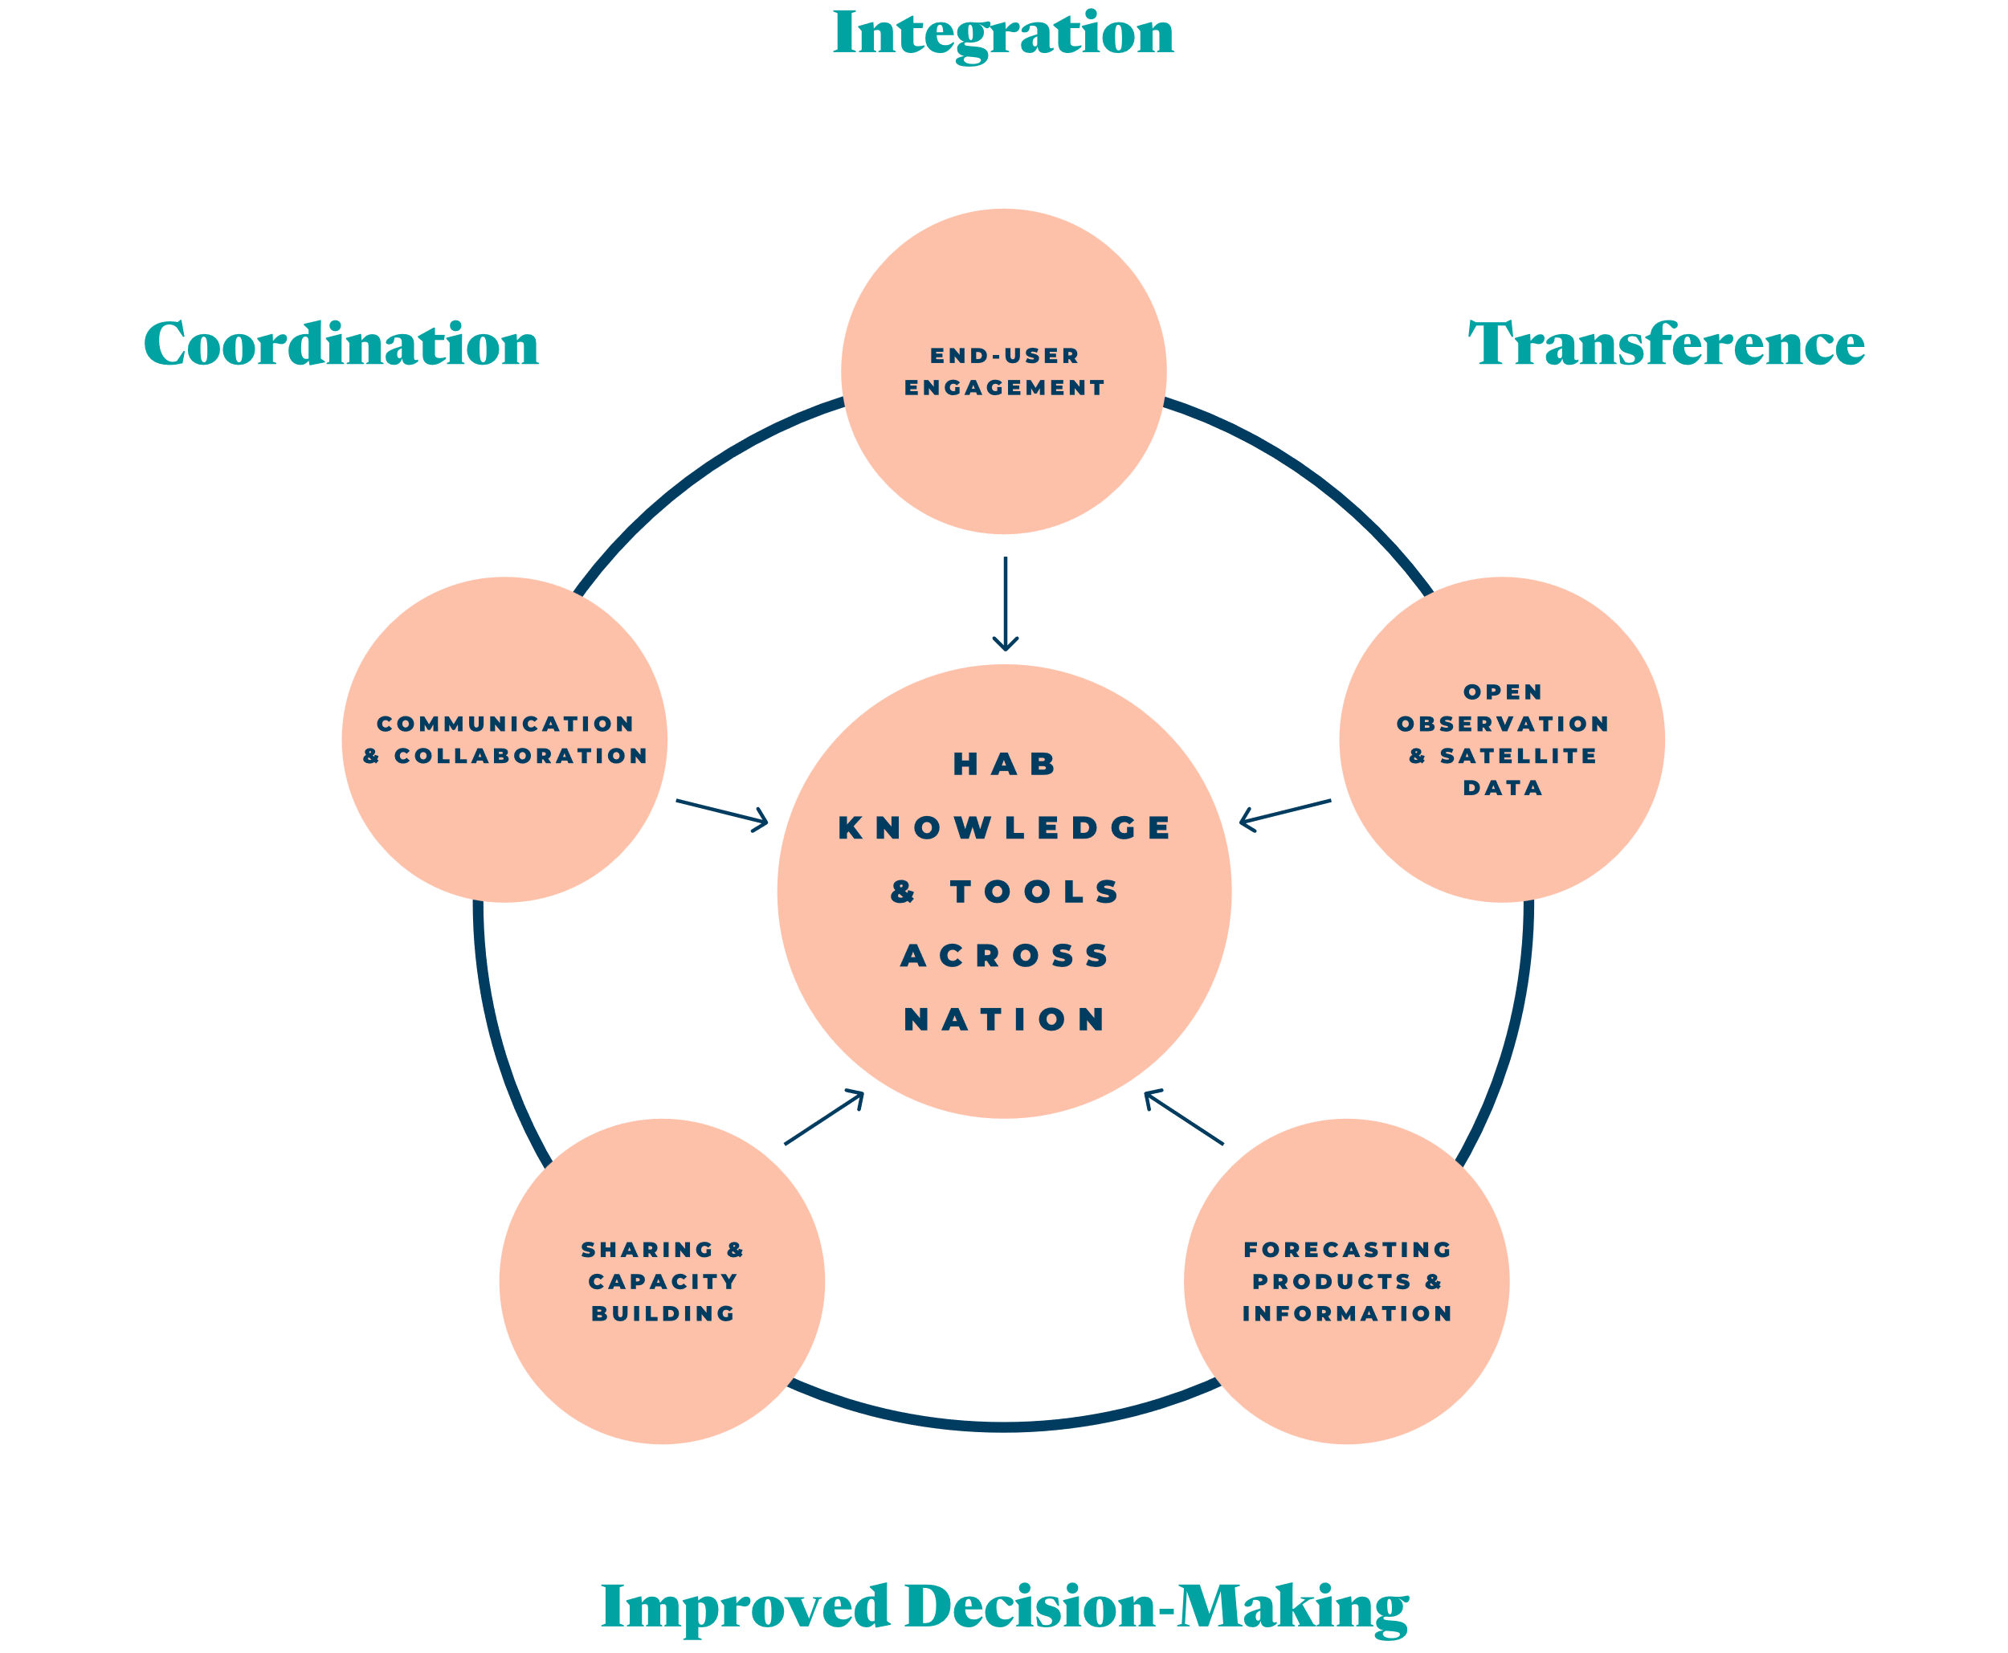
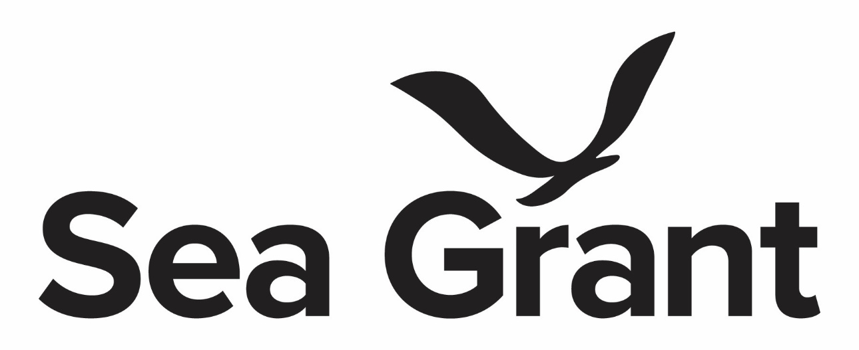


Vision of the hab liaison project
OAR
NESDIS
NOS

Slide 3
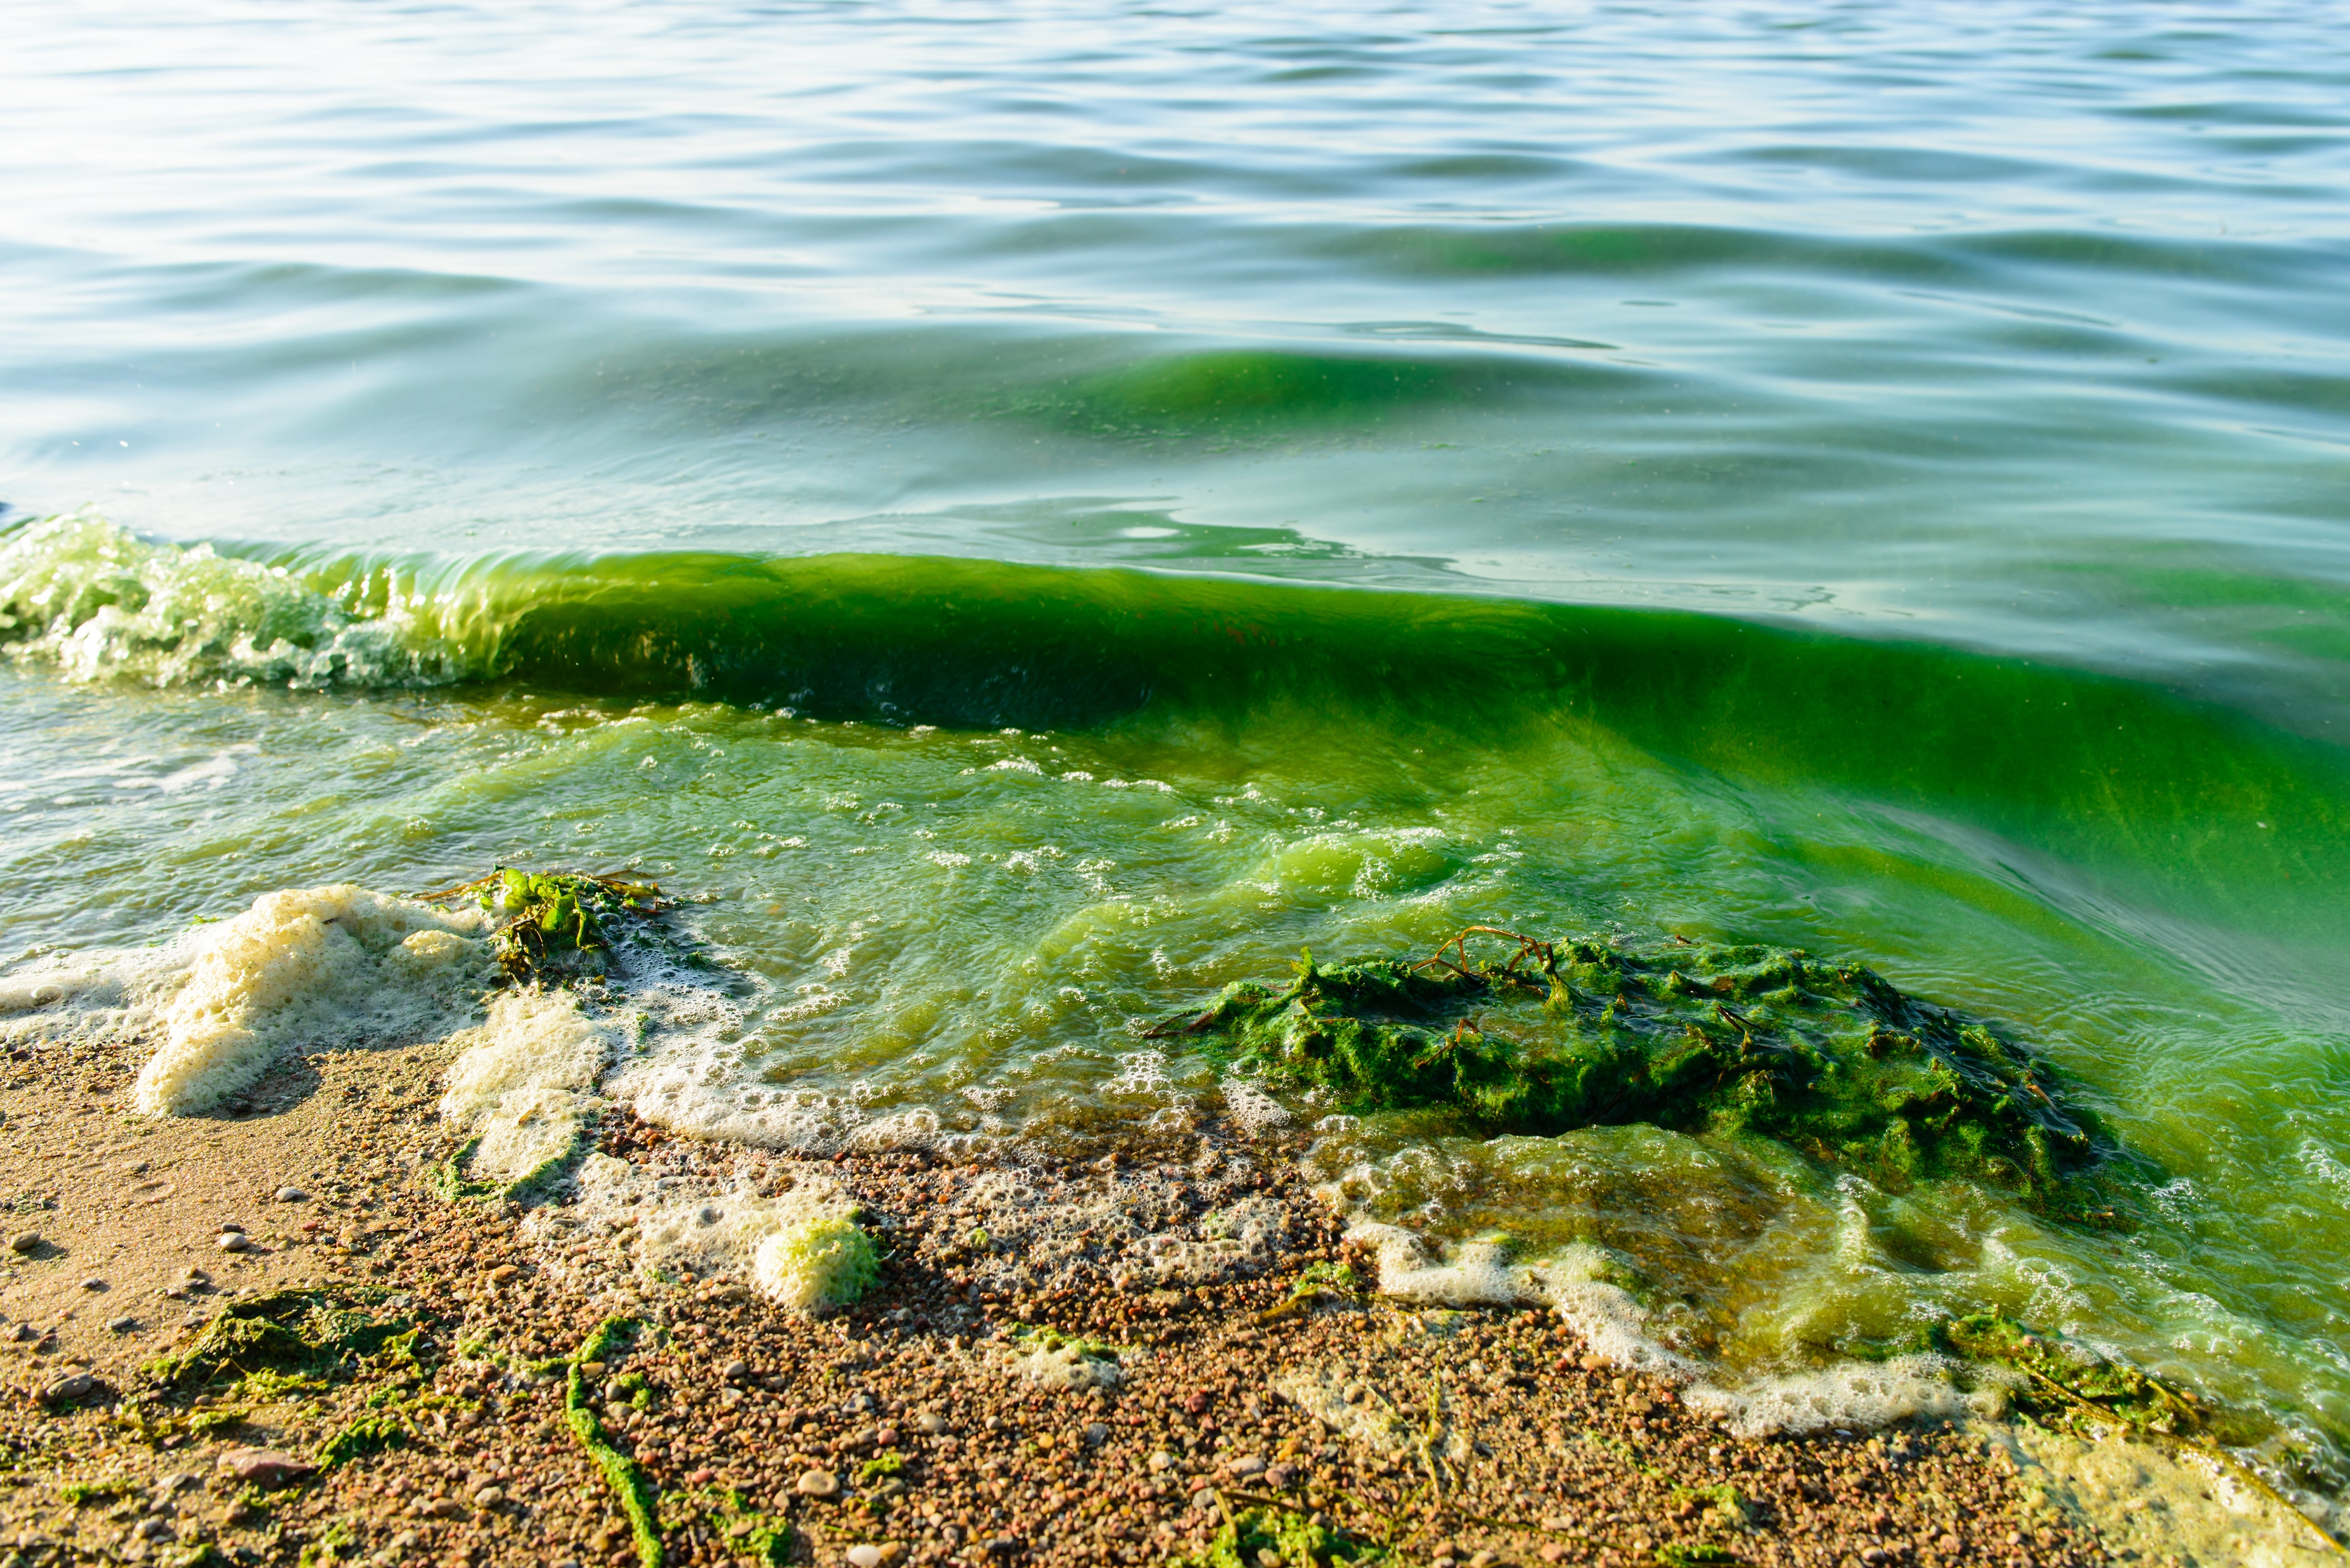

hab liaison project
APPROACHES (to Obtain & Share tools/information)
Stakeholder/end-user Workshops
CoastWatch Training
Informal efforts
CoP

Slide 4
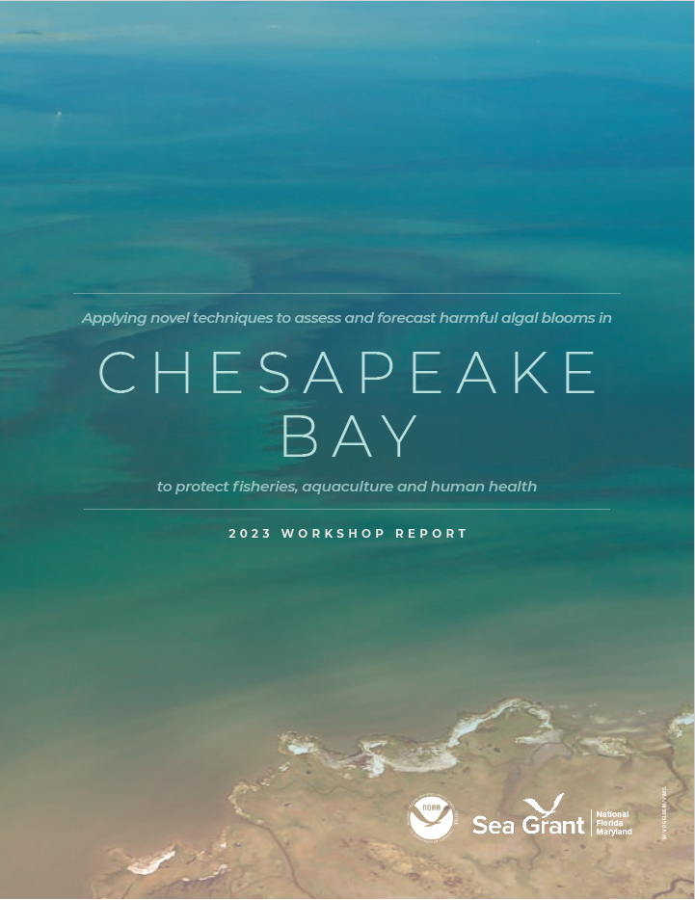
hab liaison project
1
Workshops
Forecasting Workshop – (Jan. 2023)
GOAL: Apply novel techniques to assess and forecast HABs in Chesapeake Bay to protect fisheries, aquaculture and human health
OUTCOMES: 2 Needs assessments & Summary Report, new industry contacts, next steps identified & progress made https://www.flseagrant.org/wpcontent/uploads/2023/05/CB_HABWorkshopReport_Final050423.pdf
FL BGASOSII – (May 2023)
GOAL: Assess progress made towards research priorities since 2019 / identify new research priorities
OUTCOMES: Consensus report, manuscript, progress over 4-yrs assessed (67% priorities addressed), new research priorities identified

Slide 5
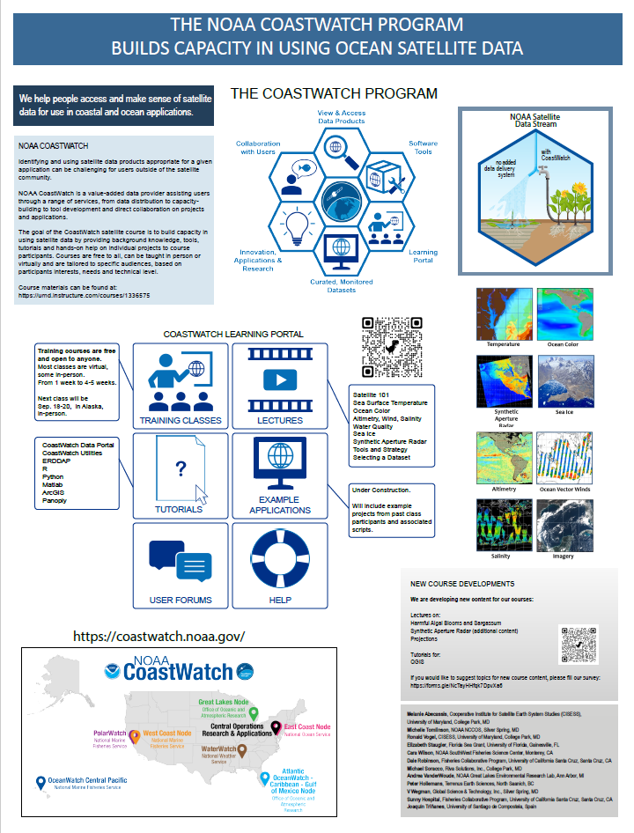
hab liaison project
2
CoastWatch Training expanded
Training Modules – (Ongoing)
Harmful Algal Blooms (2 modules)
Updated tutorials
CoastWatch Training – (Jan.-Feb. 2023)
GOAL: Increase capacity to access and use satellite within Sea Grant and partner organizations
OUTCOMES: Needs assessment / Evaluations
Poster presented at Third International Operational Satellite Oceanography Symposium (OSOS)

Slide 6
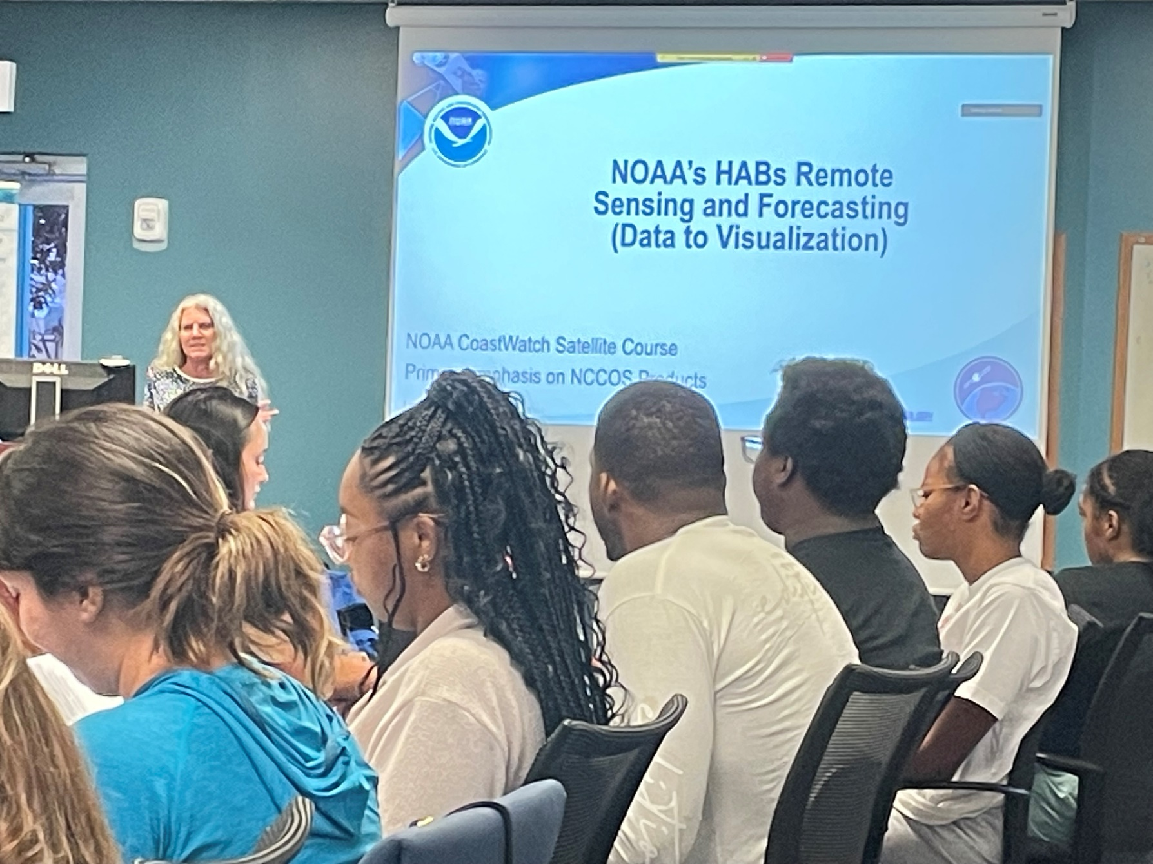
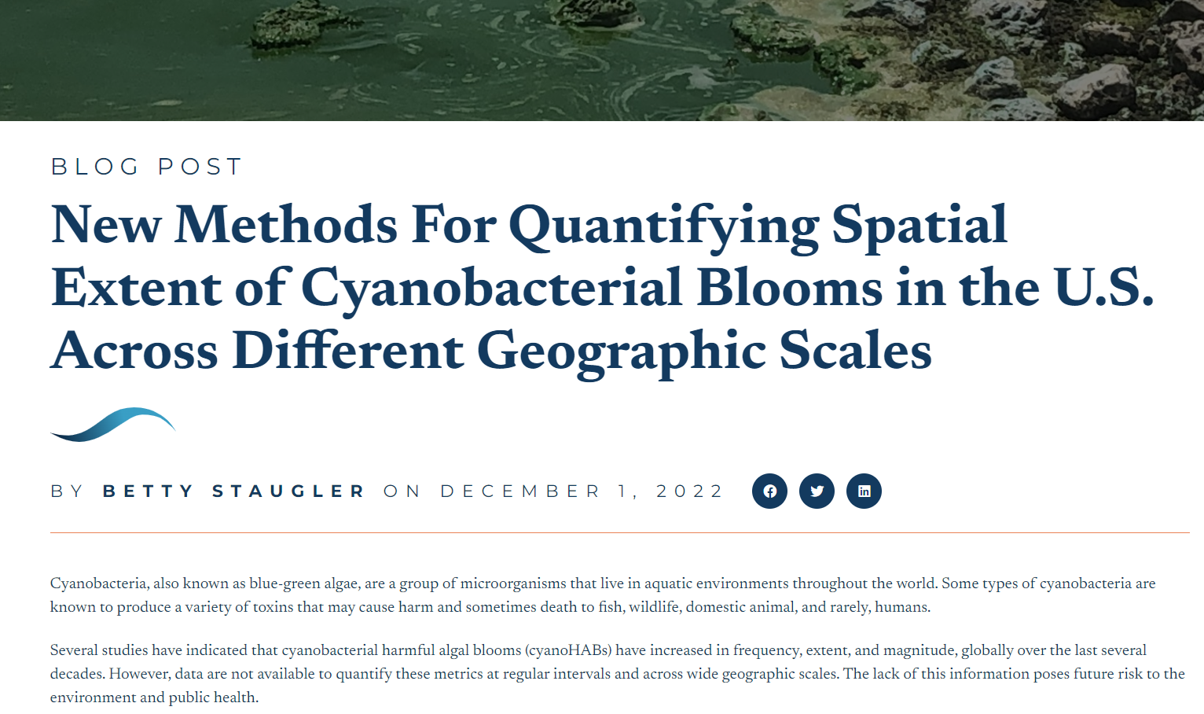
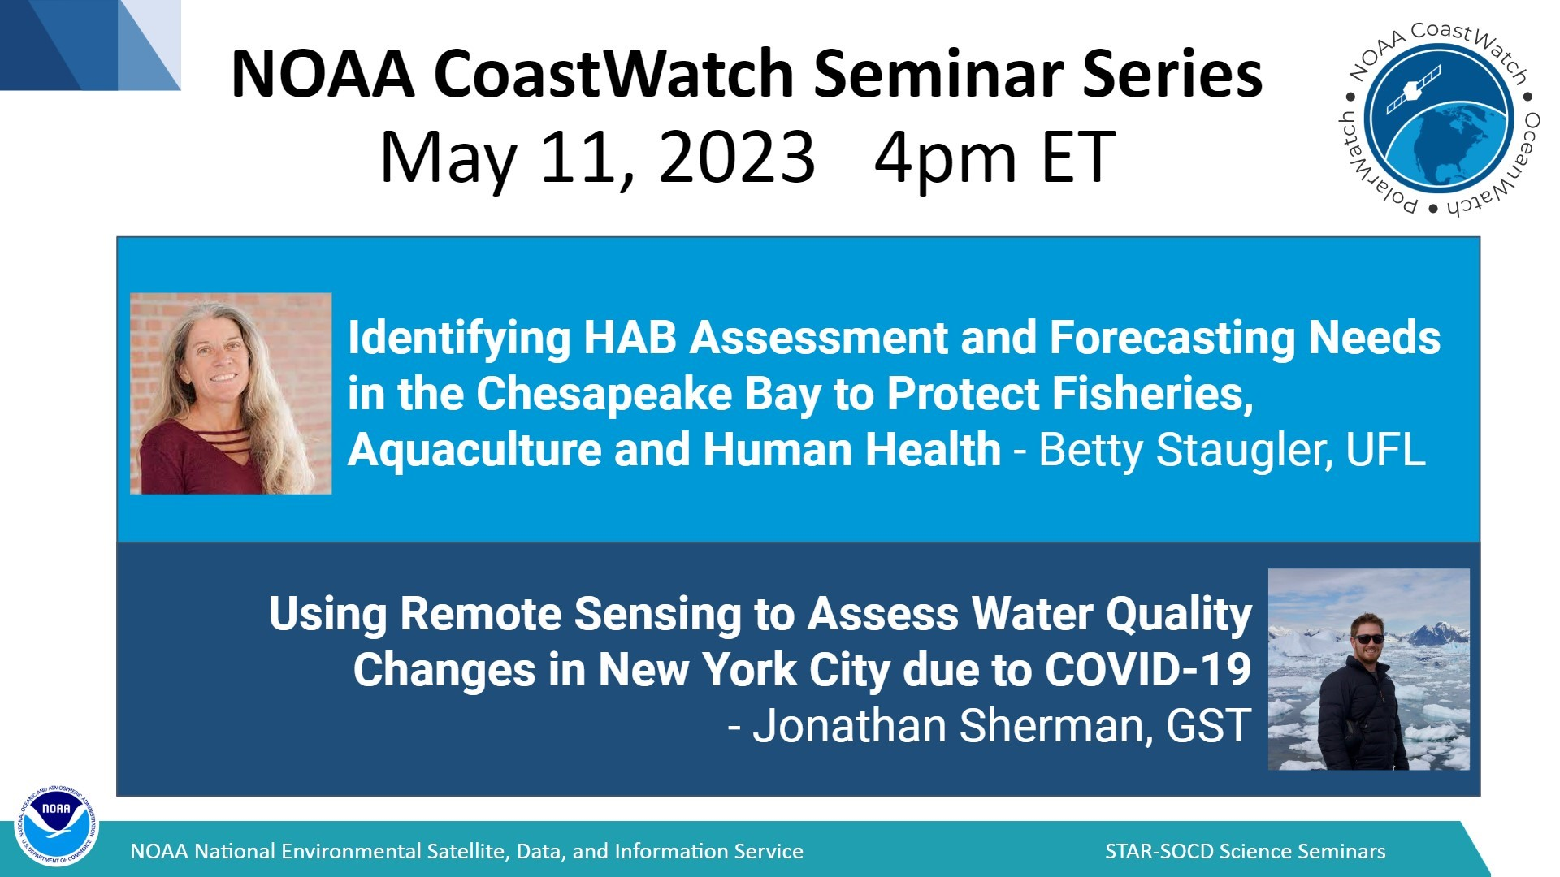
hab liaison project
3
Informal efforts to obtain input / share info
Outreach / Communications (Ongoing)
Presentations, Meeting Participation
Reports, Blogs, Etc.
Requests for information

Slide 7
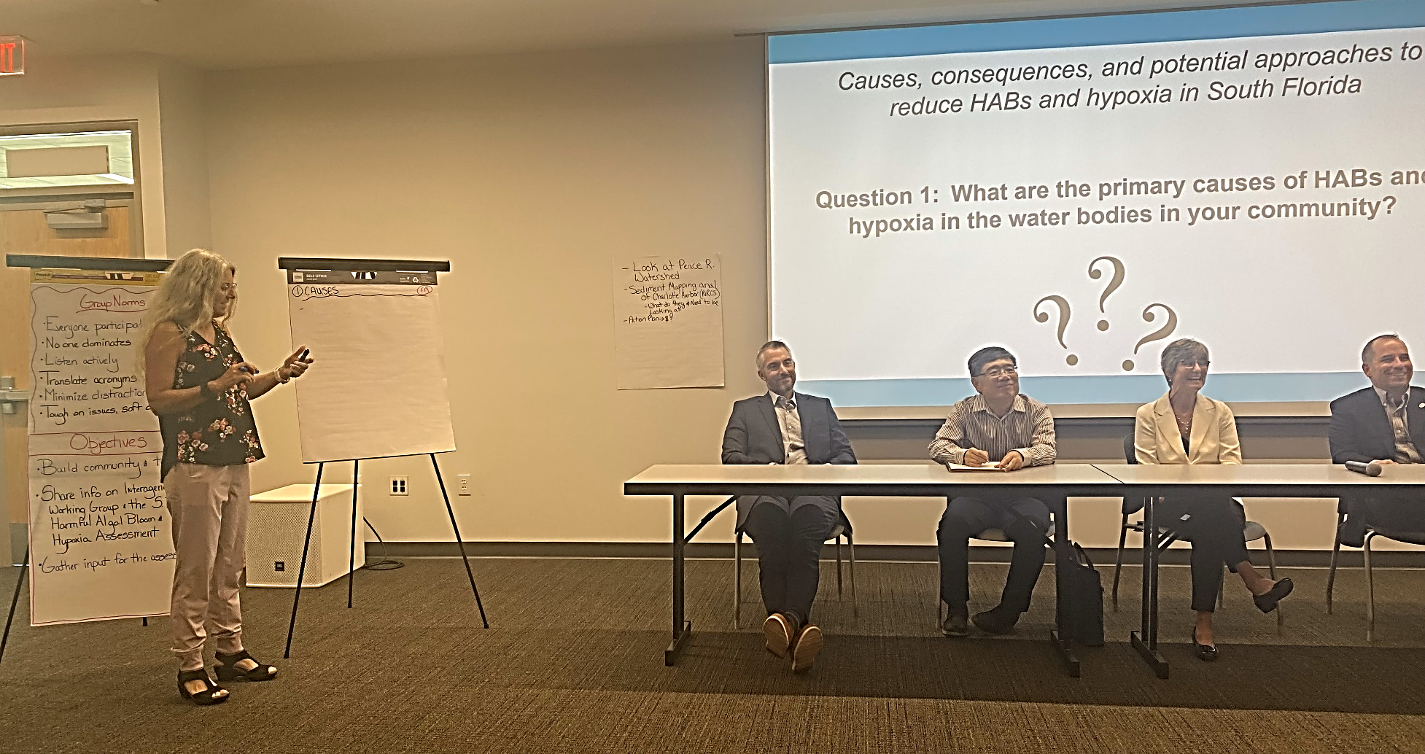
hab liaison project
3
Other Activities
Satellites/Aquaculture Working Group – (Ongoing)
GOAL: Explore satellite application for aquaculture
--
OUTCOME: New products available for NE
IWG HABHRCA – (2023)
GOAL: Sea Grant to be more engaged w/ national HAB efforts
OUTCOME: Liaison appointment to IWG
Sea Grant Aquaculture Chats
S. FL Assessment Listening Sessions – (Jun. 2023)
                GOAL: Receive input on development of plan for reducing, mitigating, and controlling harmful algal blooms and hypoxia in South Florida, and for other purposes
                OUTCOMES: 3 Sessions, 130 participants, 27 organizations, input (science-related, program-related, locations, causes & gaps)

Slide 8
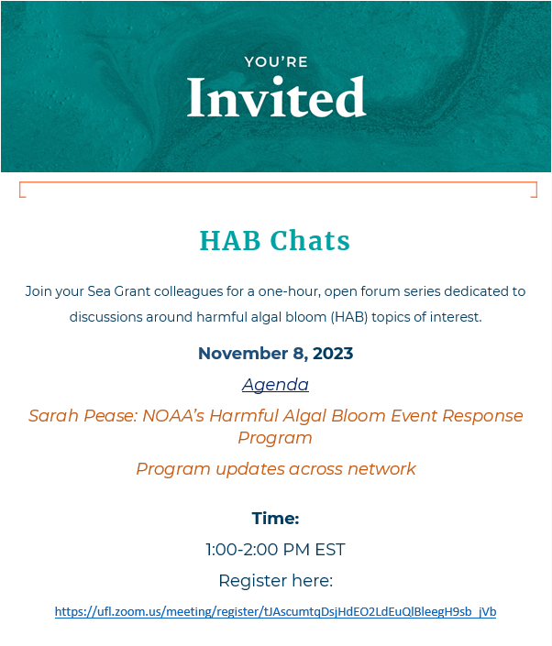
hab liaison project
4
Development of a CoP
HAB Liaison Website – (2022)
GOAL: Share information related to project
OUTCOMES: 2 webpages (about project, CoP)
HAB chats – (2023)
GOAL: Provide a forum for sharing across Sea Grant Network (internal)
OUTCOMES: Bi-Monthly Chats – 18 programs participating in at least one
      -- What HAB related Human Health Challenges are you dealing with?
      -- Tell us about your Extension programs/Activities
      -- What wicked HAB related problems do you foresee facing in the next 1-2 years?
      -- NOAA’s HAB Event Response Program
      → Sea Grant Investment in HABs

Slide 9
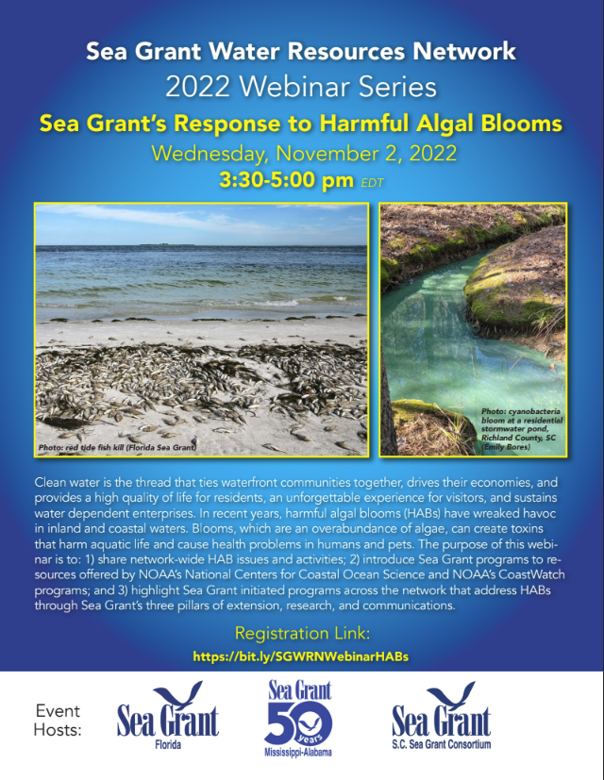
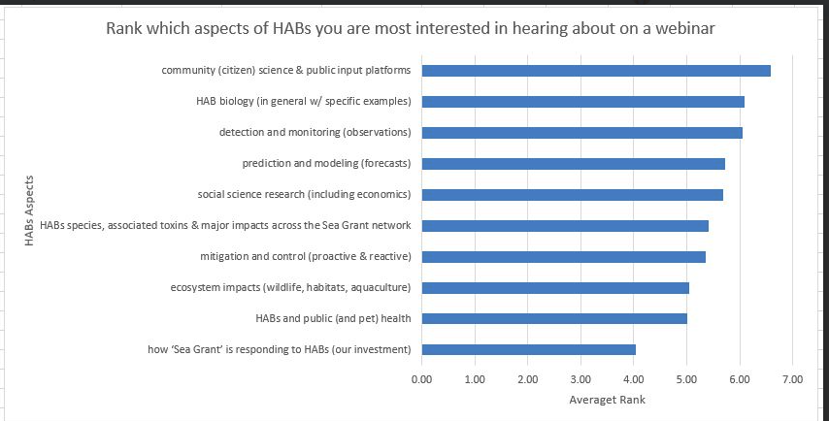
hab liaison project
WRN Survey 2022
Ranked 1-10 with 1 = most interested

Slide 10
Questions?
HAB CAST
Collaboration to Advance Stakeholder Tools
NOAA HARMFUL ALGAL BLOOM LIASON FOR OAR, NOS AND NESDIS

