Slide 1
Lesson 7: Eating Like a Whale…
Notes:
Today we are going to learn how different types of whales and dolphins get their food.

Slide 2
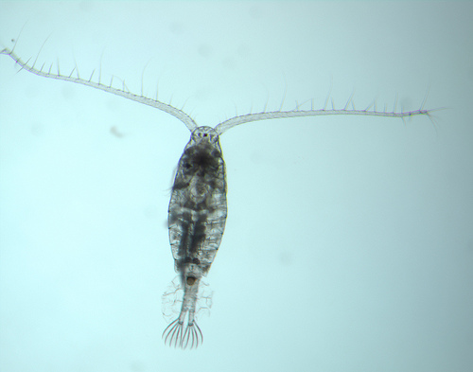
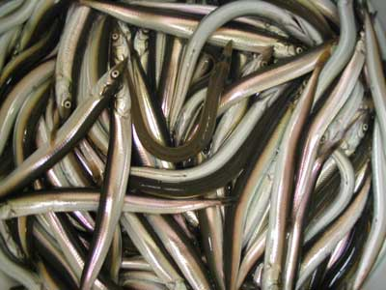
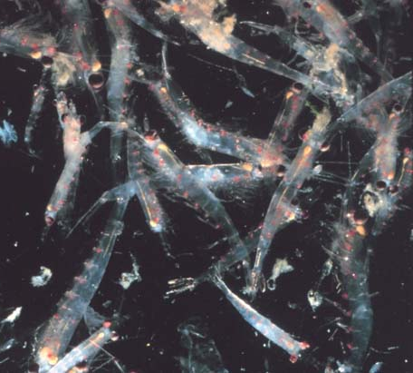
What do baleen whales eat?
Baleen whales eat small prey.
Copepods
Sand lance (small fish)
Krill (shrimp-like)
Photo credit: NOAA
Photo credit: USGS
Photo credit: NOAA
Photo credit: NOAA
Notes:
Baleen whales, or mysticetes (MISS-ti-seats), are some of the largest animals on the planet, but they eat very small food items. Many baleen whales eat plankton. Plankton is made up of very small organisms, many are microscopic, that float in the ocean. Plankton contains animals like copepods and krill that are eaten by baleen whales. Some copepods are smaller than a grain of rice! Baleen whales may also eat small fish, which swim in large schools.

Slide 3
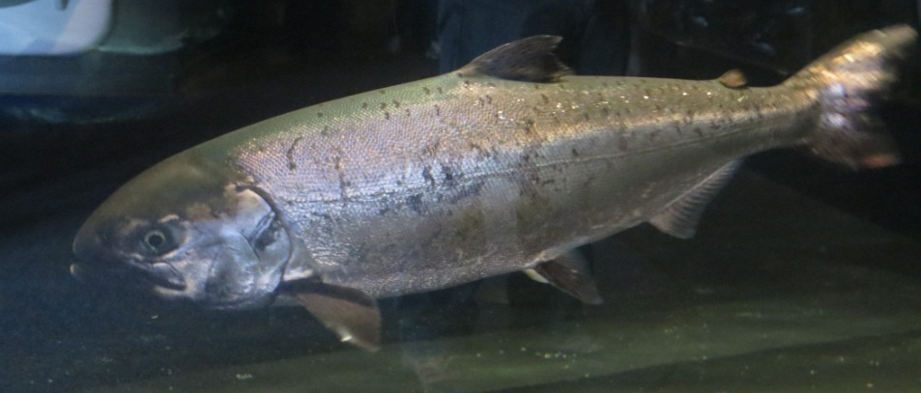
What do toothed whales eat?
Toothed whales eat a variety of fish and larger prey.
Squid
Marine mammals
Photo credits: Maia McGuire
Large fish
Notes:
Toothed whales, or odontocetes (oh-DON-tuh-seats), eat larger prey items—usually fish, but sometimes invertebrates (animals without backbones) like squid. Sometimes they even eat other marine mammals.

Slide 4
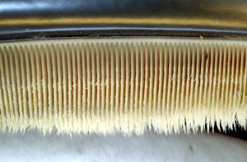
Mysticetes - Baleen Whale Feeding
Baleen whales use their baleen to filter small food items out of the water.
Water containing food flows into the whale’s mouth and out through the baleen plates, which trap food items that can be as small as a grain of rice.
Photo credit: NOAA
Notes:
[Note: if you have already taught Lesson 2, the students will have seen the information on this slide. In this case, use the slide to review previously introduced information.] Since baleen whales feed on fairly small food items, they need a way to filter their prey out of the ocean water. The baleen in their mouths acts as this filter. However, different baleen whales have different feeding behaviors, as we will see in the next few slides.
Baleen photo from http://en.wikipedia.org/wiki/File:Baleen.jpg (NOAA image)

Slide 5
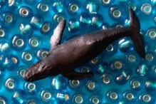
How do baleen whales get their food?
Gulp feeding
blue, humpback, minke, fin, sei, and Bryde’s whales
Skim feeding
bowhead, right whales
Bottom feeding
gray whale
Notes:
There are three major feeding strategies for baleen whales—these are gulp feeding, skim feeding and bottom feeding. Whales that are related to each other use similar feeding strategies.

Slide 6
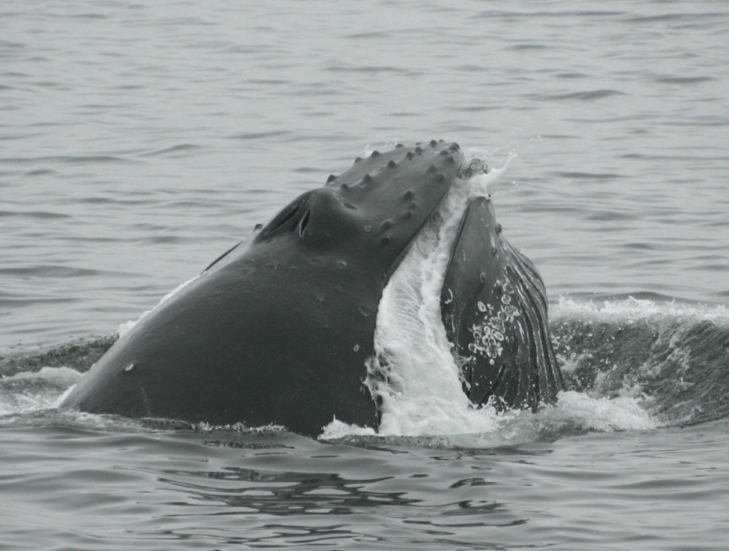
Gulp Feeders
Have throat pleats that expand to allow a large amount of water to be taken into the whale’s mouth.
When the whale closes its mouth, it uses its tongue to force the water out through the baleen.
Photo credit: Robert Pitman, NOAA
Notes:
Gulp feeders, like blue whales and humpback whales, have throat pleats that allow them to take a large amount of water into their mouths. Look for these in the two videos that we are about to see. What you will not be able to see is that the whales use their tongues to push the water through the baleen after they close their mouth. This traps the fish and plankton on the inside of the baleen in the whale’s mouth. We will now see two videos of humpback whales feeding on small fish. In the second video, you will see the humpback using a technique called “bubble net feeding” to concentrate the fish into a small area to make it easier to feed on them.

Slide 7
Lunge Feeding
Humpback whale feeding on fish.
Video Credit: Dan Knaub, www.whalevideo.com http://www.youtube.com/watch?v=Bv2iKaPtqaQ
Notes:
[Click on the video clip to start it—it is narrated, so you will want to have the sound turned on. Clip lasts about 1 minute 17 seconds].
http://www.youtube.com/watch?v=Bv2iKaPtqaQ (permission from Dan Knaub to use any of his DanTheWhaleMan youtube videos)

Slide 8
Bubble Net Feeding
Humpback whales make a bubble net around fish.
Video credit: Gloucester Harbor Walk, MA http://www.youtube.com/watch?v=xutojQbnxfY
Notes:
[Click on the video clip to start it—it is narrated, so you will want to have the sound turned on. Clip lasts 2 minutes 19 seconds.]
Creative commons YouTube video: http://www.youtube.com/watch?v=xutojQbnxfY

Slide 9
Kick Feeding
Humpback whale stuns fish with its tail when kick feeding.
Video credit: Mandy Houston, whalesonfilm.com http://www.youtube.com/watch?v=1e_pswRux4I
Notes:
Kick feeding is another method whales use to group fish together. This video shows a humpback whale named Pinpoint. Pinpoint is using his tail to scare fish so that they group together in a school. When you watch Pinpoint kicking the surface, notice when his body position changes for a deep dive. When he finally comes back to the surface, he has his mouth open exactly where he was “kicking” the surface with his tail! [Click on the video clip to watch it—it has sound, but the audio is not necessary. It runs about 1 minute]
Permission to use video granted by Mandy Houston (Mandy@whalesonfilm.com) on 5-6-12.

Slide 10
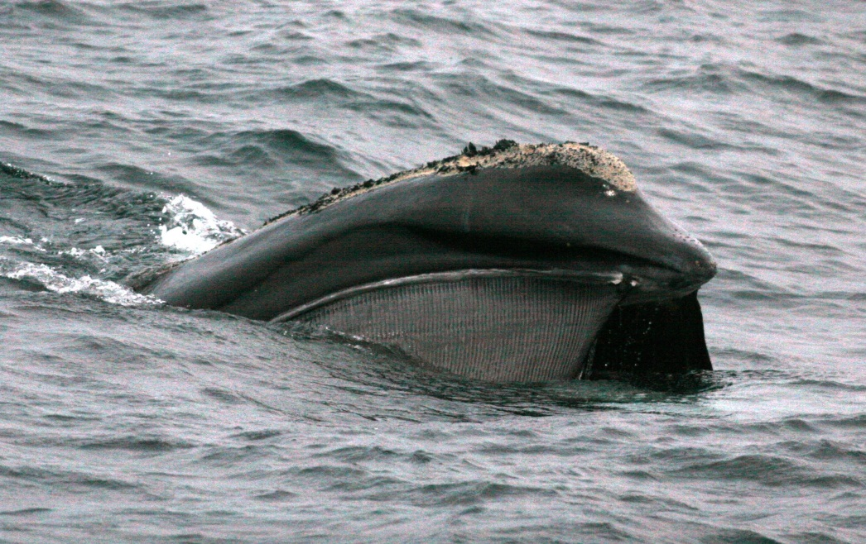
Skim Feeders
Right whales and bowhead whales feed by "skimming.” They swim through a group of prey with their mouths open and their heads partly above water.
Photo credit: Pete Duley, NOAA
When the whale has filtered a mouthful of prey using its baleen plates, it forces the water out of its mouth, dives, and swallows the food.
Notes:
In the next video, we will see a right whale using skim feeding. It is probably eating tiny copepods. A copepod is about the same size as a grain of rice. You will be looking at the tip of the whale’s upper jaw and part of its head. You will see the baleen plates hanging from the top jaw. Right whales and bowhead whales both obtain food by skim feeding at the surface, but they also feed underwater.

Slide 11
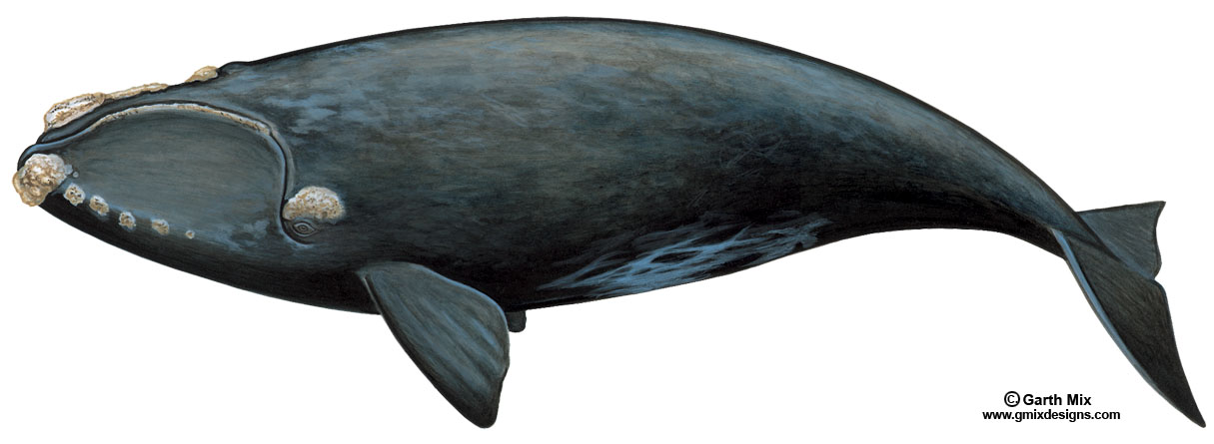
Skim Feeding
Please use the link below to view the video (video will show in your web browser):
http://www.arkive.org/north-atlantic-right-whale/eubalaena-glacialis/video-08.html
Notes:
[You will need to click on the link to access the video from the Arkive website. Video lasts 35 seconds.]

Slide 12
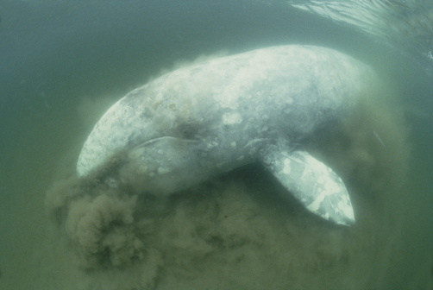
Bottom Feeders
Gray whales are bottom feeders, and suck sediment and their prey from the sea floor.
To do this, they roll on their sides and swim slowly along, filtering their food through baleen plates.
Photo credit: Flip Nicklin
Notes:
The third type of feeding is called bottom feeding. Gray whales will roll on their sides and grab a mouthful of mud, which contains many types of invertebrates. What is an invertebrate? [Answer: An animal that does not have a backbone.]

Slide 13
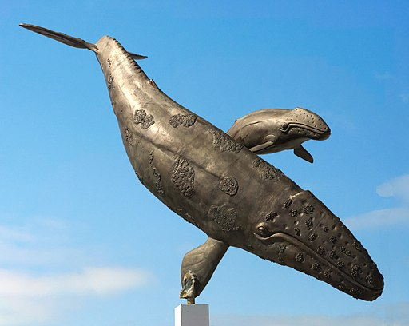
Bottom Feeding
Please use the link below to view the video (video will show in your web browser):
http://www.arkive.org/gray-whale/eschrichtius-robustus/video-08a.html
Notes:
[You will need to click on the link to access the video from the Arkive website. Video lasts 46 seconds.]. The whale is swimming along on its right side—you can see mud streaming out of the back of its mouth. [When, the whale rights itself, the students will be able to see the mud quite clearly].
Image credit: Cvmontuy. Licensed under the Creative Commons Attribution-Share Alike 4.0 International license.

Slide 14
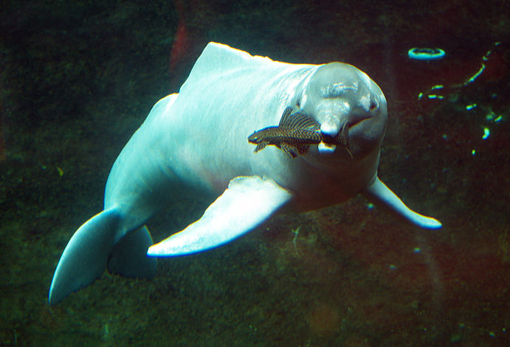
Odontocetes -Toothed Whale Feeding
Toothed whales (odontocetes) use their toothy jaws to catch larger prey items like fish and squid.
Photo credit: Dennis Otten
Notes:
Odontocetes or toothed whales do not have baleen to help them filter food out of the water; instead, they rely on being able to grab larger prey items, like fish and squid. So how do they find their prey? They cannot always rely on being able to see their prey…
Photo from http://commons.wikimedia.org/wiki/File:Inia.jpg. Free to reuse under GNU Free Documentation License.

Slide 15
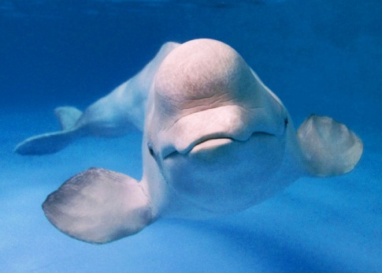
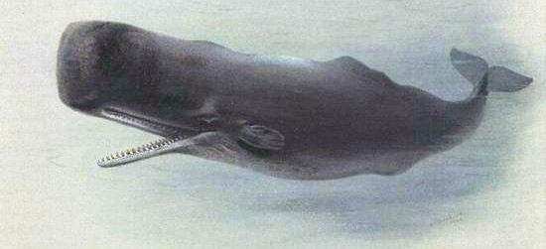
Echolocation
Toothed whales use echolocation to find food (and to navigate).
Echolocation involves creating a sound which reflects off an object, then is received back to the site where it was created.
Different odontocetes produce different sounds
Sperm whale
Beluga whale
Common dolphin
Photo credit: premier.gov.ru
Photo credit: NOAA
Notes:
…so they use a process called echolocation to help them figure out where things are in the water. [This is also explained in Lesson 2]. Odontocetes will produce a sound wave, which hits an object in the water and then bounces back to them. Based on the time taken for the sound to come back, the whale or dolphin can tell how far away the object is. Let’s listen to some of the sounds produced by different toothed whales. [Click on the little speaker symbol next to any of the whales’ pictures to hear the sound. Point out that some of the sounds are like drumbeats, others are squeaks and some are a combination of both.]
Audio files from http://www.junglewalk.com/popup.asp?type=a&AnimalAudioID=13767
Sperm whale sounds from http://www.dosits.org/audio/marinemammals/toothedwhales/spermwhale/
Common dolphin sounds from http://www.dosits.org/audio/marinemammals/toothedwhales/commondolphin/
Beluga sounds from http://www.dosits.org/audio/marinemammals/toothedwhales/belugawhale/
Sperm whale and common dolphin sound courtesy of WhaleAcoustics, LLC. Released under Creative Commons License.
Beluga sounds courtesy of Peter M. Scheifele, Department of Communication Sciences and Disorders and Medical Education, University of Cincinnati Medical Center. Released under Creative Commons License, non-commercial - no derivs
Sperm whale image: United States public domain tag
Beluga whale image from http://en.wikipedia.org/wiki/File:Beluga_premier.gov.ru-3.jpeg.

Slide 16
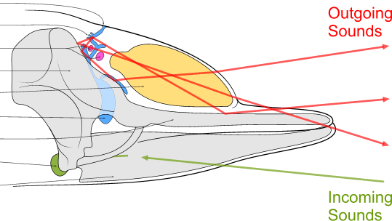
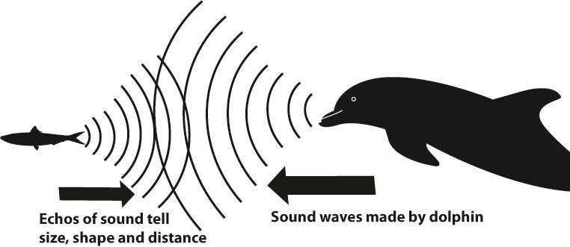
How does echolocation work?
Sound is transmitted into the water by the melon (forehead).
Sound is received by the lower jaw and travels from there to the ear bones.
The further away an object is, the longer it takes for this process.
melon
inner ear
Notes:
Odontocetes’ heads are specially designed for echolocation. They use the forehead region, known as the melon, to produce the sounds and transmit them into the water. The lower jaw detects the returning sounds and carries the vibrations to the ear bones. Odontocetes have ears, but they do not have earlobes to help them trap sounds. This makes it hard to see the ears on whales and dolphins.
Image from http://en.wikipedia.org/wiki/File:Toothed_whale_sound_production.png
This file is licensed under the Creative Commons Attribution-Share Alike 2.5 Generic license

Slide 17
How do toothed whales get their food?
Suction feeding
belugas
Herding/mud ring feeding
dolphins
Strand feeding
dolphins, killer whales (orcas)
Notes:
Toothed whales use many feeding strategies.
Dolphin image: pexels.com

Slide 18
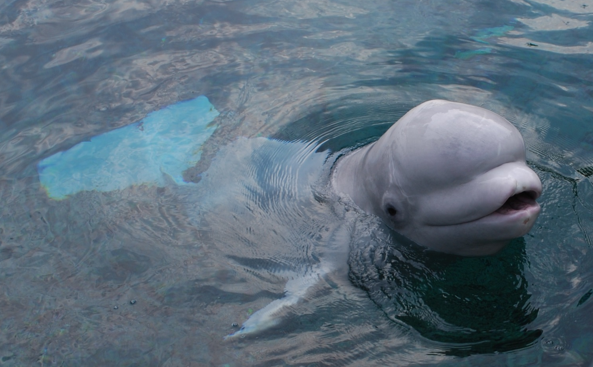
Suction Feeding
Belugas eat many prey items that dwell on the sea floor and use suction to capture their prey.
Photo credit: Cara Hotchkin
Notes:
These include suction feeding, which is commonly observed in beluga whales. Belugas eat many prey items that dwell on the seafloor. They are able to pucker their lips and use suction to capture their food.

Slide 19
Herding
Herding is when a group of dolphins surround a school of fish and take turns swimming through the school and feeding on the fish.
Please use the link below to view the video (video will show in your web browser):
http://www.arkive.org/dusky-dolphin/lagenorhynchus-obscurus/video-08b.html
Notes:
Herding is when a group of dolphins surrounds a school of fish to pack them as tightly as possible. Dolphins then take turns swimming through the school and feeding one at a time. [You will need to click on the link to access the video from the Arkive website. Video lasts 1 minute.]
Dolphin image: pexels.com

Slide 20
Strand Feeding
Dolphins strand feeding along a South Carolina beach.
Video credit: Kiawah Island Community Association https://www.youtube.com/watch?v=W45md7H47KQ
Notes:
Strand feeding is when a toothed whale chases a school of fish or other prey into shallow water. The whale pushes the prey onto the shore and then lunges onto the shore to catch the prey in its mouth. [Click on the video clip to start it—it is narrated, so you will want to have the sound turned on. Clip lasts about 19 seconds].
Permission from Doug Reynolds (doug.reynolds@kica.us) of Kiawah Island Community Association on May 2, 2013.

Slide 21
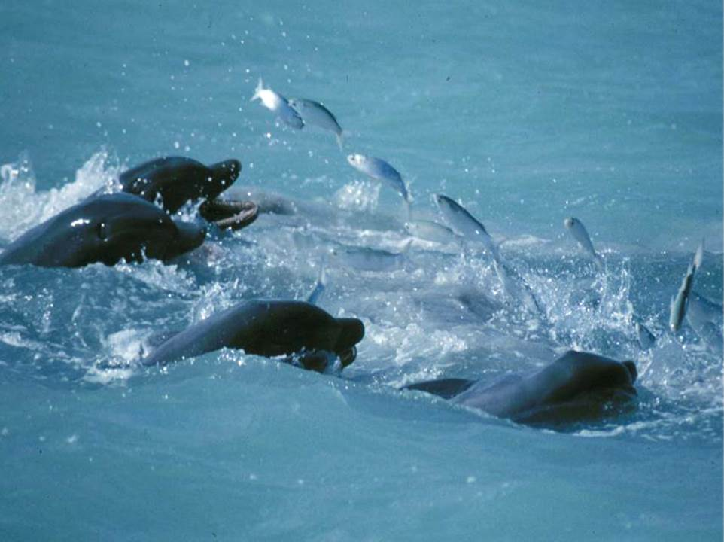
Mud-Ring Feeding
When a group of dolphins use a circle of mud to catch fish it is referred to as mud-ring feeding.
Photo credit: Dolphin Ecology Project
Notes:
Mud-ring feeding is when a group of dolphins uses a circle of mud to catch fish. The action usually begins with one dolphin suddenly swimming off. It then dives below the surface, circling a shoal of fish and stirring up mud along the way. On cue, the other dolphins in the group move into position, forming a barrier to block off any underwater escape routes. As the circle of mud rises to the surface, the fish are trapped. Their only option is to leap clear out of the water and straight into the open mouths of the waiting dolphins.

Slide 22
Illegal Feeding
Toothed whales are commonly fed by humans. It is illegal to feed or attempt to feed marine mammals in the U.S.
Video: Don’t Feed Wild Dolphins https://www.youtube.com/watch?v=T58QaMBOOXA
Notes:
Unfortunately, people often feed toothed whales. This may teach the animals to beg for food from humans. This puts them in danger of being hit by boats or becoming entangled in fishing gear. Swallowing fishing lures or eating foods that are not part of their natural diet may make the animals sick. For these reasons, it is illegal to feed marine mammals in the U.S. [Click on the video clip to start it—it is narrated, so you will want to have the sound turned on. Clip lasts about 30 seconds].

Slide 23
To review….
Baleen whales (mysticetes) use:
Gulp feeding (Iunge, bubble net, kickfeeding)
Skim feeding
Bottom feeding
Toothed whales (odontocetes) use:
Echolocation
Teeth to grab and swallow prey (suction, herding, mud-ring and stranding)
Notes:
To summarize what we’ve learned about whale feeding: Baleen whales feed on relatively small prey items by gulping, skim feeding or bottom feeding. Toothed whales use echolocation to find their larger prey items, grab them with their toothy jaws and swallow them whole. The toothed whales use strategies such as suction, herding, and mud-ring and stranding feeding to catch fish.
Photo credit: This Photo by Unknown Author is licensed under CC BY-ND

