Slide 1
Lesson 6: Cetacean Behaviors
Notes:
Many of you have probably seen dolphins or other toothed whales performing at places like Marineland or Sea World [or insert your local marine mammal park’s name]. The things that these animals do on command in captivity are usually based on behaviors that the animals perform naturally in the wild. Today we are going to learn about some whale and dolphin behaviors.

Slide 2
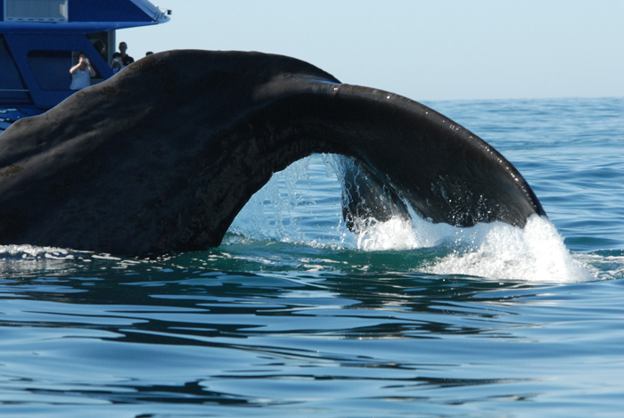
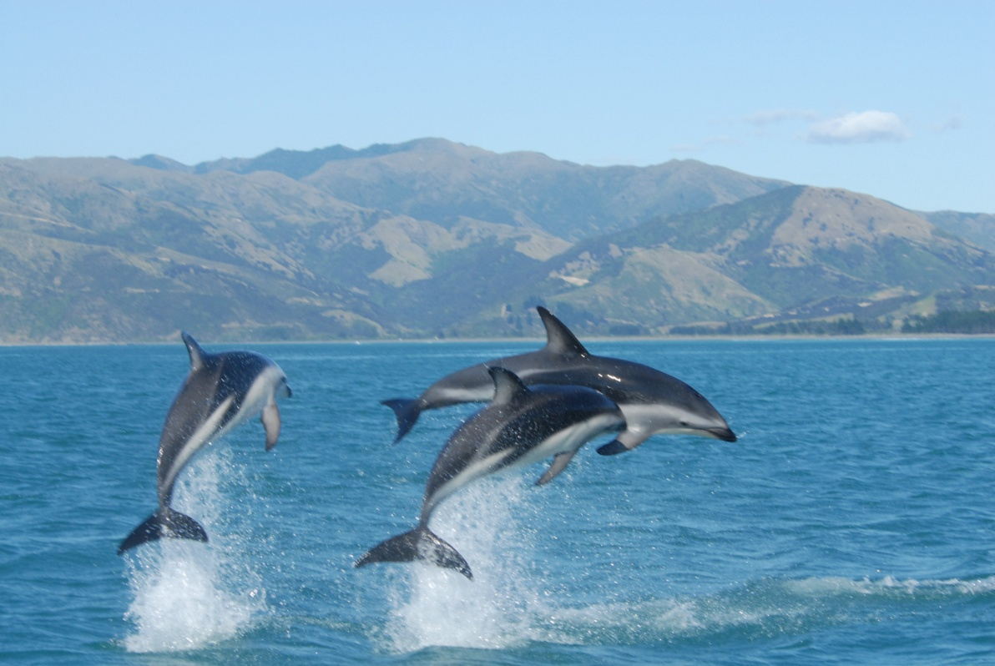
What are they really doing?
Photo credit: NOAA
Carefully observing whales and dolphins can teach us about feeding, reproduction, calf rearing, social interactions, and disturbance.
Notes:
Why do we care about whale behavior? Because whales and dolphins spend so much time underwater, often in very deep water, it is a challenge for biologists to study them. Although whales make sounds, we cannot tell what those sounds mean. [If desired, you can play one or more whale sounds from this website: http://dosits.org/galleries/audio-gallery/marine-mammals/. However, when these animals are at the surface, we can make observations about what they are doing, and can try to learn more about them based on their behaviors.
Photo credits: NOAA (both images)

Slide 3
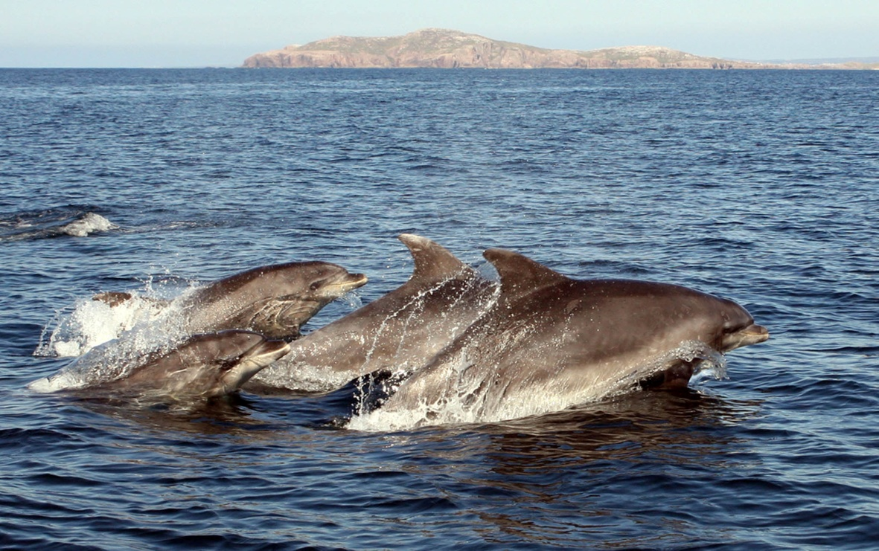
Common Dolphin Behaviors
Feeding/ Begging
Resting
Traveling
Breaching
Bow riding
Socializing
Disturbance
Photo credit: John Rafferty Photography, Marine Photobank
Bottlenose Dolphins traveling in a group
Let’s look at some of these behaviors in a little more detail!!!
Notes:
Let’s read these behaviors together [point to each one in turn and have the class read them out loud with you. It may be helpful to explain to the class that “bow” in “bow riding” is pronounced the same way as the verb, “to bow,” with a long “ow” rather than a shorter “oh” sound]. In this lesson, we will learn more about these common dolphin behaviors.

Slide 4
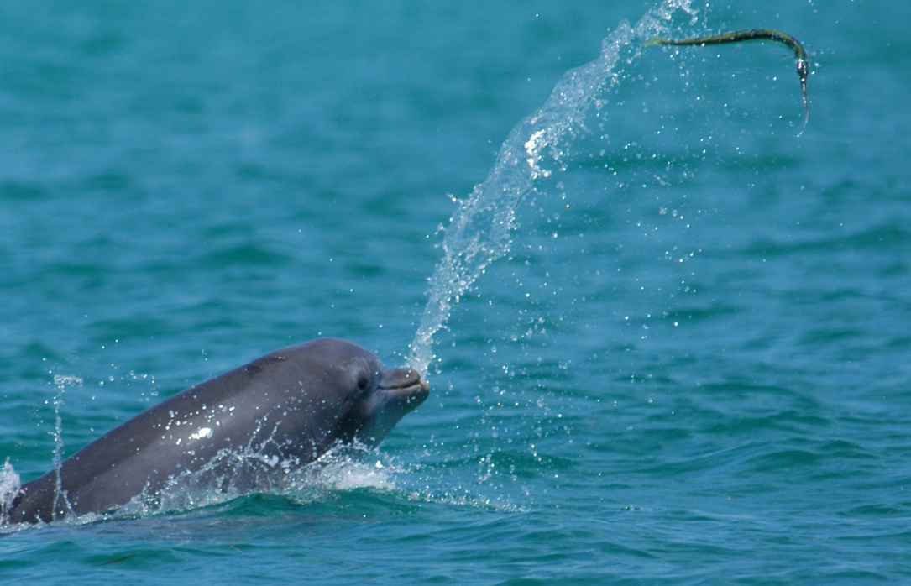
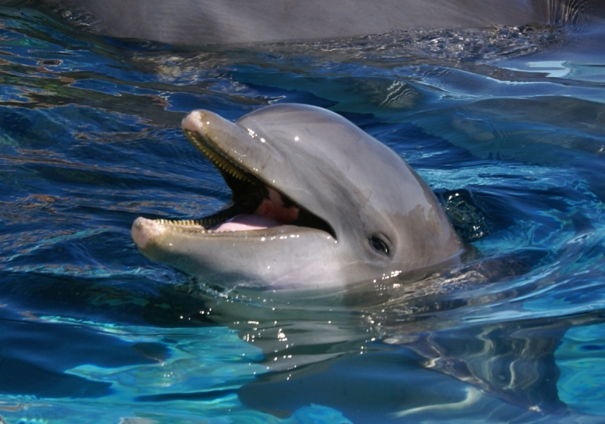
Feeding/ Begging
Photo credit: Dolphin Ecology Project
Photo credit: M. McGuire
Bottlenose dolphin tossing a fish--a natural feeding behavior.
Bottlenose dolphin begging --a behavior learned as a result of illegal feeding by humans.
Notes:
Whales and dolphins also have many different types of feeding behaviors, which will be covered in a different lesson. However, I want to point out this commonly seen behavior called begging. Begging is a learned behavior of dolphins and other marine mammals that have received food from humans. Feeding or attempting to feed a dolphin or other marine mammals is illegal. [see lesson 7]

Slide 5
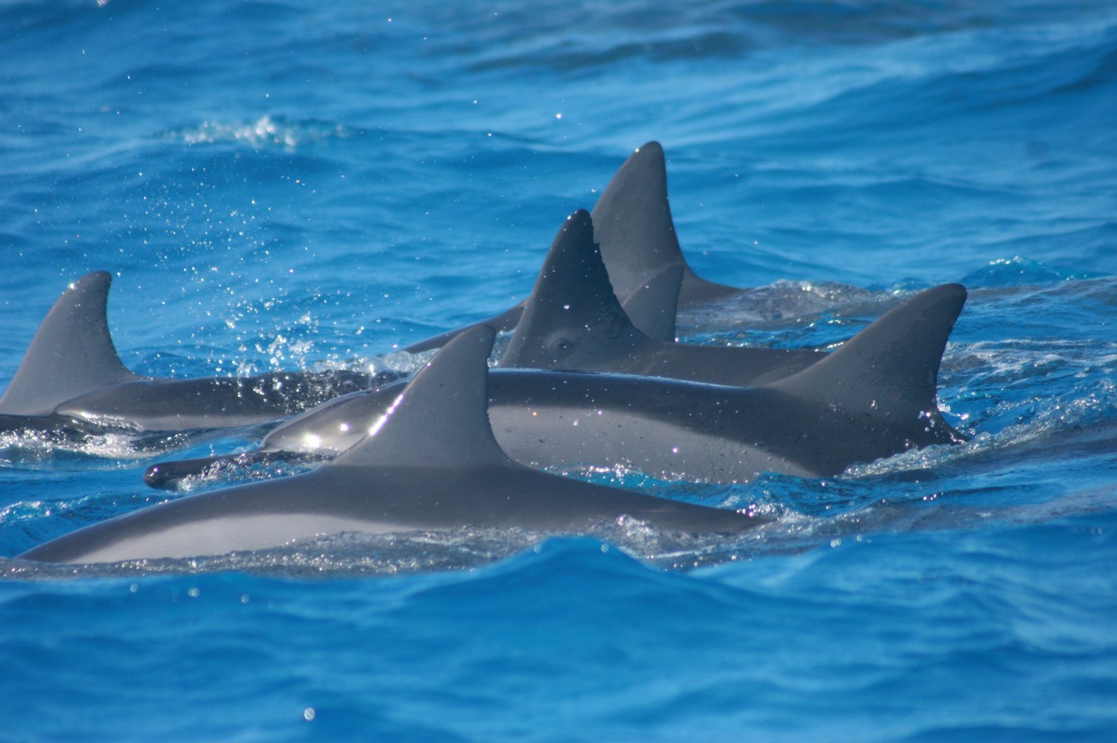
Resting
Spinner dolphins resting during the day.
Photo credit: NOAA PIFSC
Notes:
Dolphin species are often seen moving very slowing at the surface of the water in small groups. This behavior is called resting. It is very important to give these dolphins lots of space, because they need to rest in order to have enough energy to feed, mate and nurse their young. Some dolphin species such as spinner dolphins rest during the day.

Slide 6
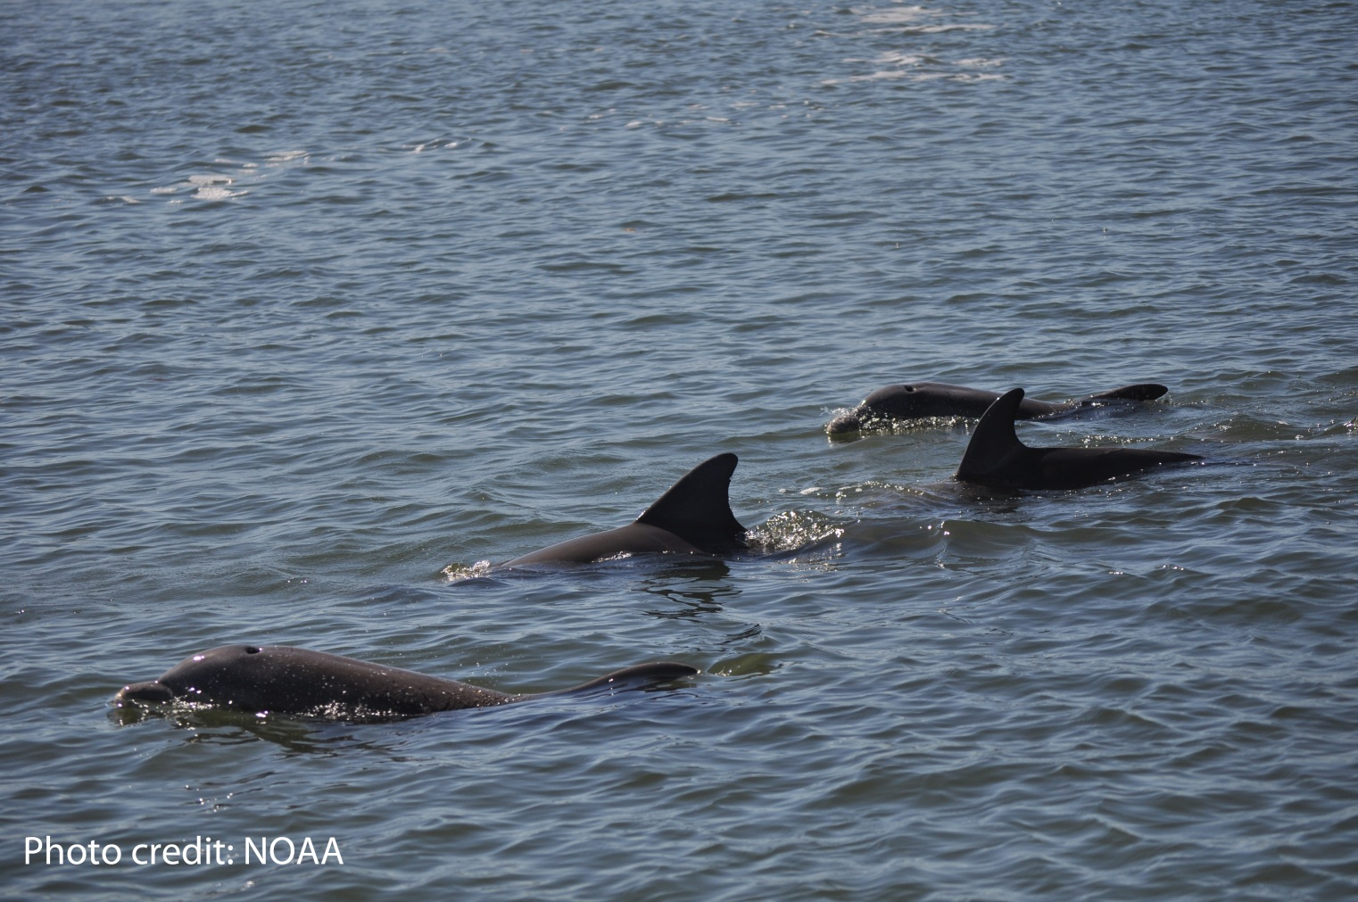
Traveling
Bottlenose dolphins traveling in a group
Notes:
Groups of dolphins are often seen moving quickly in the same direction. This behavior is called traveling.

Slide 7
Breaching
Video credit: American Safari Cruises http://www.youtube.com/watch?v=zUrDgfEBH-A
Notes:
Our next behavior is called breaching. Breaching is a very dramatic behavior. During breaching, a dolphin or whale jumps head first out of the water. While in the air they may rotate their body so they land on their side, creating a HUGE splash!! Both baleen and toothed whales do this. Scientists are not sure why whales and dolphins breach. Possibilities include communicating with other animals, stunning prey so they are easier to catch, or showing that they feel threatened by something. [Click on video to start it. Video is about 60 seconds in length. You might want to be ready to mute the audio for this clip—there are people shrieking quite loudly in it!]. Did you recognize the type of whale in this video? [Correct answer is orca or killer whale.]
Video use permission granted 7-6-12 (credit American Safari Cruises) http://www.youtube.com/watch?v=zUrDgfEBH-A

Slide 8
Bow Riding
Video credit: Sea Star Sport Fishing http://www.youtube.com/watch?v=NKwjcclI-aI
Notes:
Let’s start by talking about bow riding. Many different types of dolphins can be seen bow or wake riding. Note that baleen whales do NOT bow ride. Dolphins ride the waves created in front of or behind boats and may do this for minutes to hours. It may look like the boat will run over the dolphins, but scientists think dolphins do this to save energy. Bow riding may be similar to “body surfing”, which is surfing without a surf board. This is often a fun game for humans to play at the beach. Keep in mind that people should never drive a boat towards dolphins in order to try to get them to bow ride. This can be dangerous to the dolphins. Let’s watch some dolphins bow riding in this clip. (Click on the video to play it. If needed, the direct link is also on the slide, but this will require an Internet connection, and it will open the video in a new window. Video clip is about 1.5 minutes.]
YouTube video posted by Sea Star Sport Fishing. Message sent via Facebook on 5-1-12 to request permission to use this. Permission granted 5-3-12 by Captain Joe.

Slide 9
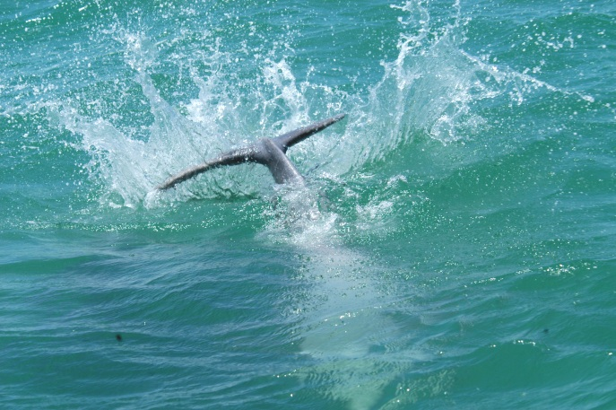
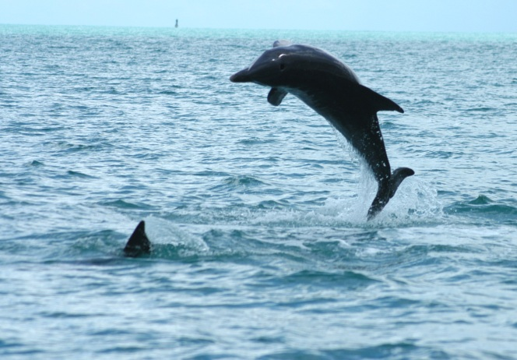
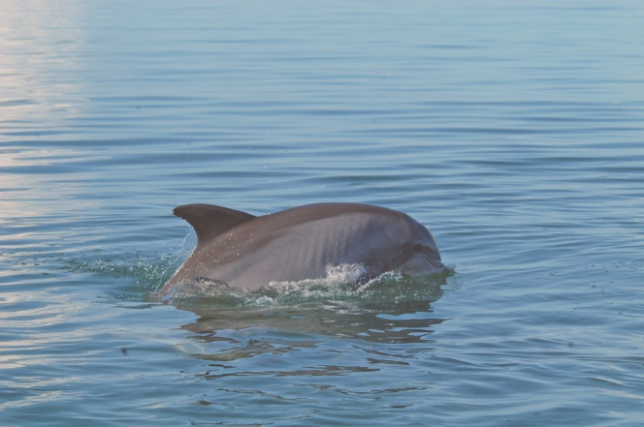
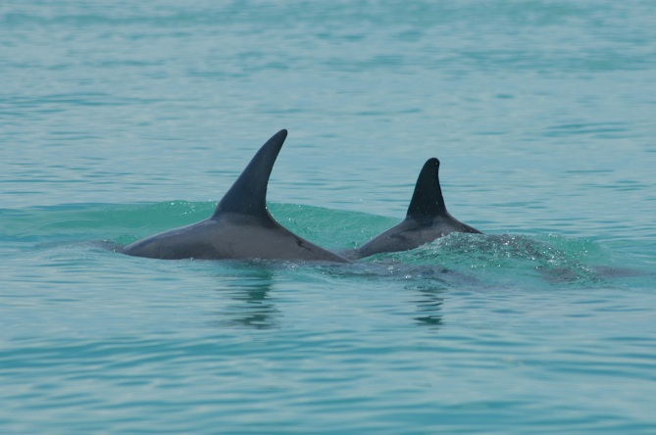
Disturbance Behaviors
Repeated tail slapping
Repeated breaching
Moving away/ swimming quickly
Mother shielding calf
Photo credits: Dolphin Ecology Project
Notes:
Dolphins may display certain behaviors when they feel threatened or when people get too close. These can include tail slapping or breaching, shielding calves from people or vessels, and quick retreats. Scientists call these “disturbance behaviors.”

Slide 10
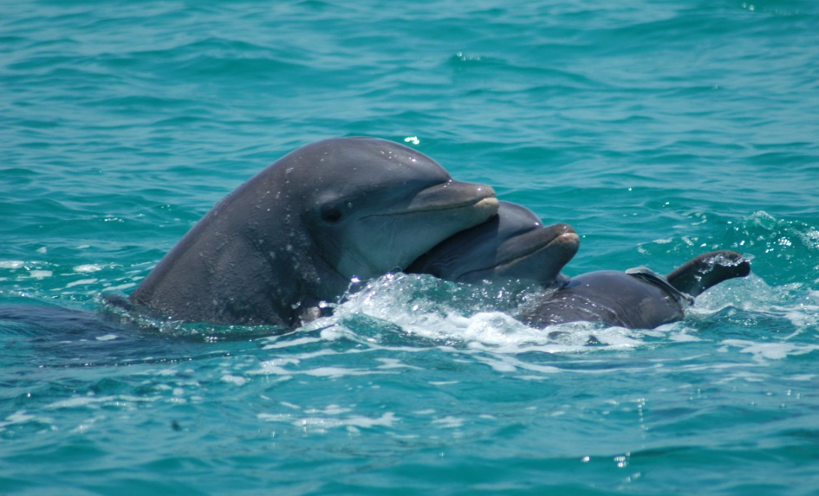
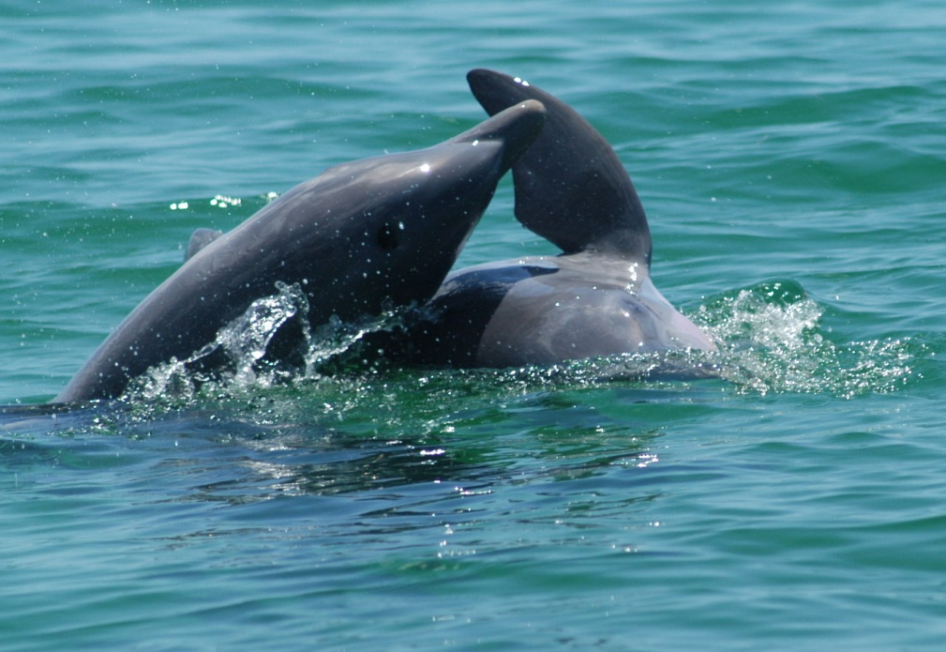
Socializing
Photo credits: Dolphin Ecology Project
Notes:
Dolphins are social animals, but they need lots of space. View them from a distance. It is difficult to tell the difference between social behaviors and disturbance behaviors.

Slide 11
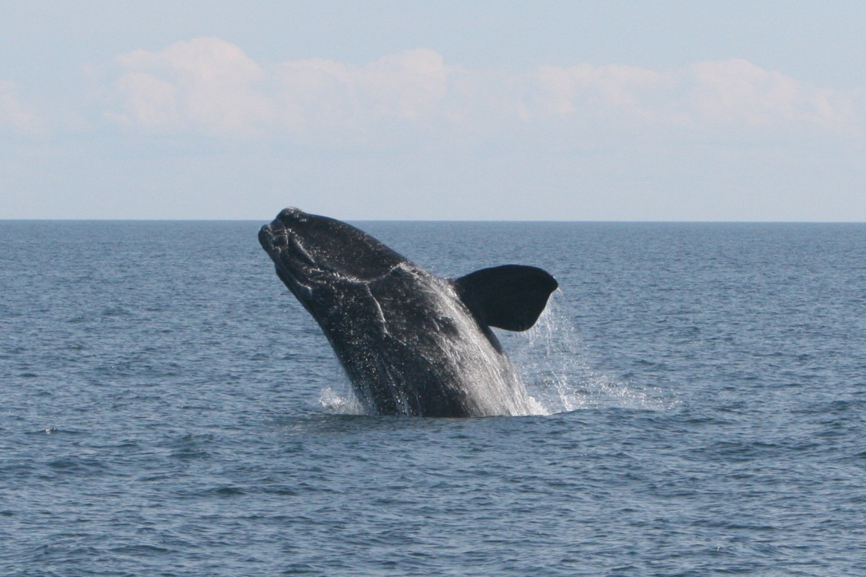
Common Whale Behaviors
Breaching
Flippering
Lobtailing
Logging
Spouting
Spyhopping
Taken Under NOAA Permit
North Atlantic right whale breaching
Let’s look at some of these behaviors in a little more detail!!!
Notes:
Some whale behaviors have funny names. Let’s read these behaviors together [point to each one in turn and have the class read them out loud with you.]

Slide 12
Breaching
Video credit: www.whalevideo.com 2012 http://www.youtube.com/watch?v=8HoZ4q1mkRY
Notes:
Let’s watch a video of whales breaching. Breaching may be a way for whales to scratch their backs. [Click on video to start it; video is 1 minute in length]. Can you tell me anything about this whale? [You might prompt students to see if they can tell if it is a toothed whale or baleen whale…it is a humpback whale, which is a type of baleen whale. Students might be able to identify it because of its long, white flippers.]
Permission from Dan Knaub (danknaub@comcast.net) 5-1-12--credit to state: www.whalevideo.com 2012

Slide 13
It’s very important to view whales from a distance!
Video credit: CBS News http://www.youtube.com/watch?v=ptvpwF9r4mM
Notes:
This next video shows one of the reasons why people should stay far away from whales. Getting too close could be dangerous for both the people and the whale. This is a news report about a young right whale that breached and landed on a sailboat. [Click on video to start it. Video is about 50 seconds in length. Mention that people need to stay 500 yards away from right whales.]
Permission to use video granted 5-10-12 by Maria Montas (MontasM@cbsnews.com)

Slide 14
Flippering
Video credit: Penny Graham, owner/operator Mariner Cruises Whale & Seabird tours; filmed on the Bay of Fundy in Nova Scotia http://www.youtube.com/watch?v=6z7uDZ83Els
Notes:
Our next behavior is called flippering or flipper slapping. Baleen whales do this by rolling on their side and hitting one flipper on the surface of the water. Scientists do not know why whales do this. [Click on video to start it. Video is about 25 seconds in length.]
Permission granted 5-1-12 by whales@novascotiawhalewatching.ca. Credit to read: Penny Graham, Mariner Cruises Whale & Seabird tours; filmed on the Bay of Fundy in Nova Scotia.

Slide 15
Lobtailing
Video credit: Mandy Houston, whalesonfilm.com http://www.youtube.com/watch?v=0XVh7W1UYQ0
Notes:
When lobtailing, a whale positions its body so that its head is down and the tail flukes are above the surface of the water. The whale repeatedly hits the surface of the water with the big flukes. The sound can be very loud and may travel for some distance. Scientists do not know why whales display this behavior. Captive groups of dolphins that are upset or annoyed display a similar behavior called tail slapping. [Click on video to start it. Video is about 4 minutes in length, but the first 20 seconds or so is probably enough to give the students the idea! To stop the video, click on it again.]
If you have visited Marineland, Sea World or other marine parks, you may have seen whales or dolphins trained to “wave goodbye” by standing on their head and waving their tail flukes at the crowd. This is an example of how trainers are able to modify a natural behavior and train whales and dolphins to perform the movement on command.
Permission granted from Mandy Houston (mandy@whalesonfilm.com) 5-6-12. Also Jackie Latham at Capt. Bill’s Whale Watch (same video)—info@captbillandsons.com—5-10-12.

Slide 16
Logging
Video credit: Karen Molina, Pacific Whale Foundation http://www.youtube.com/watch?v=NrAzHRdBQ4Q
Notes:
Logging is different from the behaviors seen so far. The term describes a behavior in which whales stay very still at the water’s surface., moving mainly to take a breath. This behavior may be part of resting after a deep dive. It is possible that whales sleep in this position. [Click on video to start it. Video is about 30 sec in length.] Whales can be very hard to see in this position. Logging whales are at risk of being hit by boats or ships.
Permission granted by Karen Molina from Pacific Whale Foundation (karenmolina@pacificwhalefoundation.org) to use this clip on 5-7-12

Slide 17
Right whale spouting
Video credit: NOAA/NEFSC http://www.youtube.com/watch?v=iQshvSPVFsc
Notes:
Spouting refers to the spray of fine water droplets that forms when a whale exhales, or breathes out. In colder weather, the breath is more visible. The breath is made of warm air and water droplets. The spout of different types of whales looks quite different. Experienced observers can identify a species of whale from the appearance of the spout on the horizon. [Click on video to start it. Video is about 18 seconds in length. Note that the right whale should have a V-shaped spout. In this video clip, it is hard to make that out.]
Video by NOAA/NEFSC (creative commons)]

Slide 18
Blue whale spouting
Video credit: Blue Ocean Whale Watch, Moss Landing
http://www.youtube.com/watch?v=YWAU21nBweU&list=UUJ3knR3qIte9llUYURfw3qA&index=29&feature=plcp
Notes:
Here we have a blue whale spouting. [Click on video to start it. Video is about 1.5 minutes in length. Note that the blue whale spout does not rise as high in the air as the humpback whale spout. The character of the spout is thicker at the bottom. The whale filmed here is traveling, making the character of the spout more difficult to describe.] Imagine if you were a whale biologist and you were trying to identify the type of whale you were seeing based only on its spouting. That might be a bit of a challenge! Remember that some whales can hold their breath for a long time, so you might easily have to wait ten minutes to see a single whale breathe twice, assuming it doesn’t swim too far away for you to see it during that time!
Permission to use this clip granted from blueoceanwhalewatch@gmail.com. 5-3-12. Credit to read: Blue Ocean Whale Watch, Moss Landing.
1.5 minutes.

Slide 19
Spyhopping
Video credit: Dana Wharf Sportfishing and Whale Watching http://www.youtube.com/watch?v=dC440Yf3moo
Notes:
When “spy hopping” a whale pops its head out of the water and looks around. To do this, the whale positions itself in the water column with its head up and tail down. It lifts its body above the surface so it can see what may be happening nearby. In this video, we will see a young gray whale spyhopping off the coast of California. [Click on video to start it. Video is about 30 seconds in length.]
Permission granted by Michelle McCann (michelledws@gmail.com) to use video and credit Dana Wharf. 5-8-12.

Slide 20
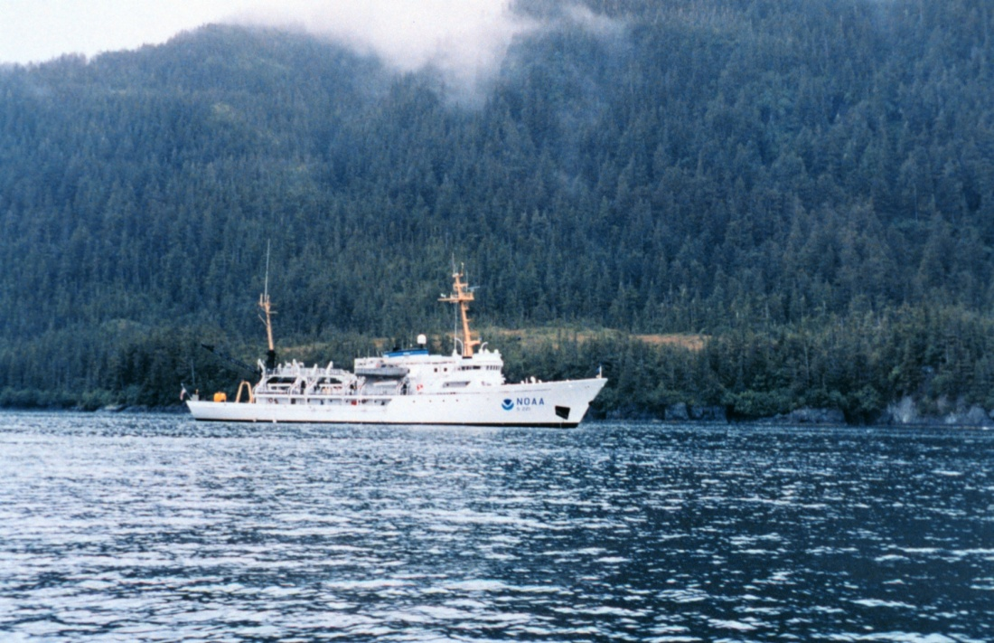
Summary
NOAA Science Ship, Ranier
Photo credit: NOAA
Notes:
Learning about animals that live their entire lives in the ocean can be difficult. Generally, most behaviors that we can see are only those that are visible from the surface. There is much more going on under the water! This lesson has shown you commonly observed whale and dolphin behaviors. Scientists try to interpret these behaviors to learn more about whales.

Slide 21
What behaviors can you see?
Video credit: Blue Ocean Whale Watch, Moss Landing http://www.youtube.com/watch?v=LlVVTtlLOXU
Notes:
As we watch this final video clip of humpback whales, see how many different behaviors you notice. [Click on video to start it. You may want to play it a second time and have the students call out the behaviors that they see. These include breaching, lobtailing, flipper slap, spouting and possibly spyhopping (or a weak breach). Clip is 1 minute 15 seconds.]
Blue Ocean Whale Watching video—1:15. Breaching, lobtail, flipper slap, spouting (humpback). Maybe spyhopping (or weak breach). See slide 14 for permissions info.

