Slide 1
Cetacean BINGO
Call list #2

Slide 2
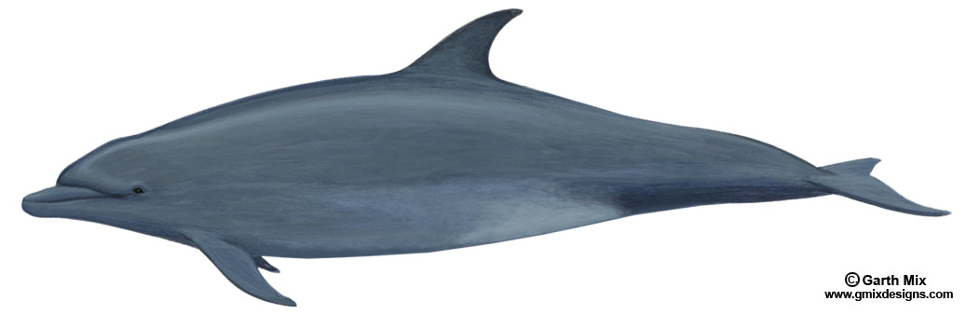
1.
These dolphins are commonly found in zoos and aquaria. One female has lived in an aquarium at Marineland, Florida for more than 58 years.
ANSWER: Bottlenose dolphin

Slide 3
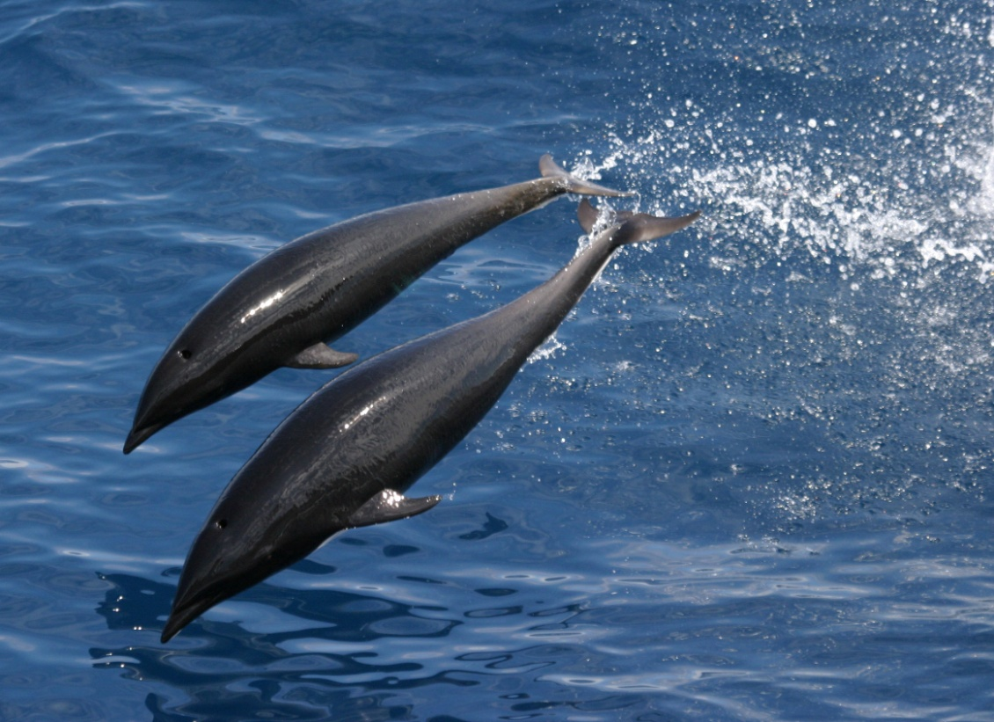
2.
Northern right whale dolphin
Photo credit: NOAA

Slide 4
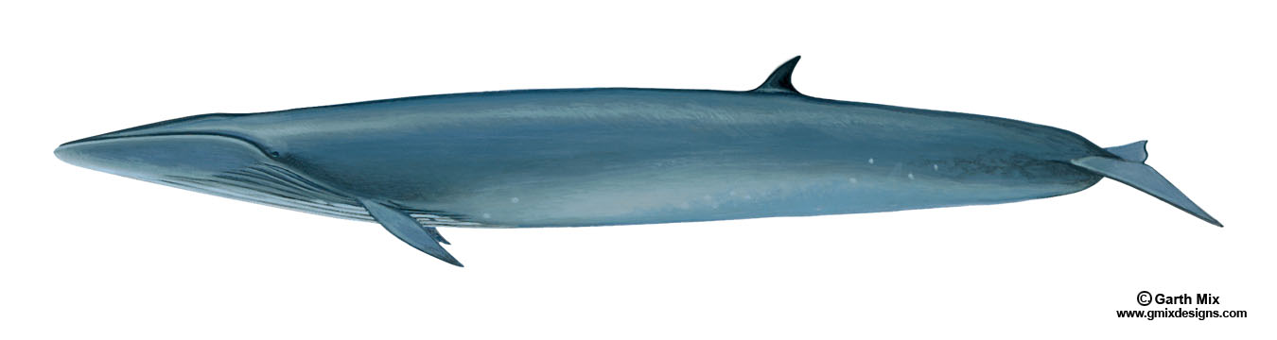
3.
Sei whale

Slide 5
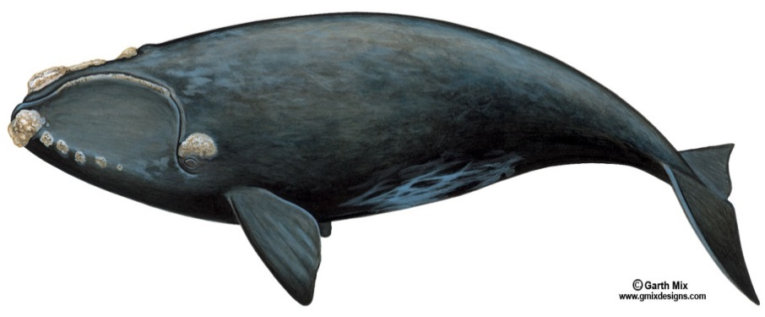
4.
These whales can be recognized by the big white growths (“callosities”) on their heads. Unique patterns of callosities are used to identify individual animals
ANSWER: North Atlantic right whale

Slide 6
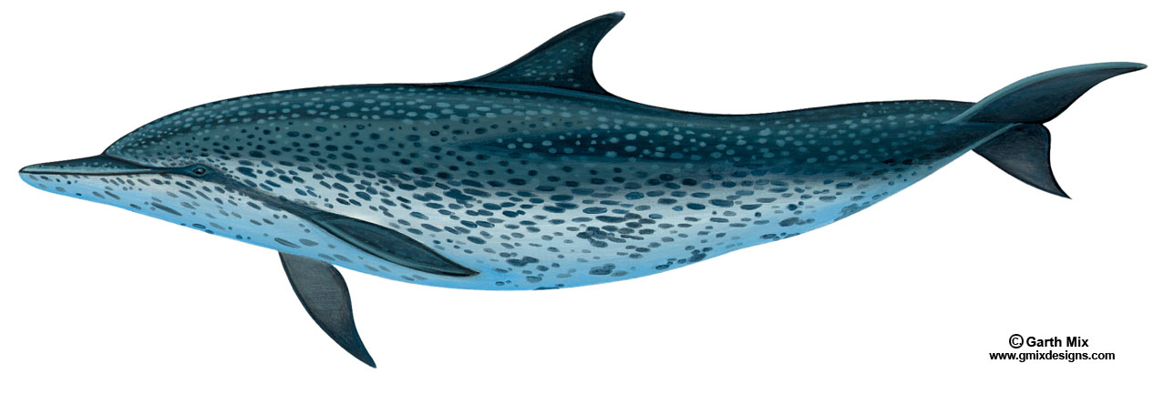
5.
Atlantic spotted dolphin

Slide 7
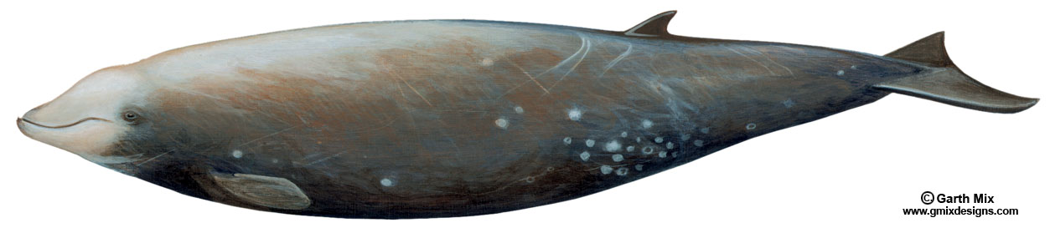
6.
Males of this whale have two small teeth that stick out of the lower jaw, which they use for fighting.
ANSWER: Cuvier’s beaked whale

Slide 8
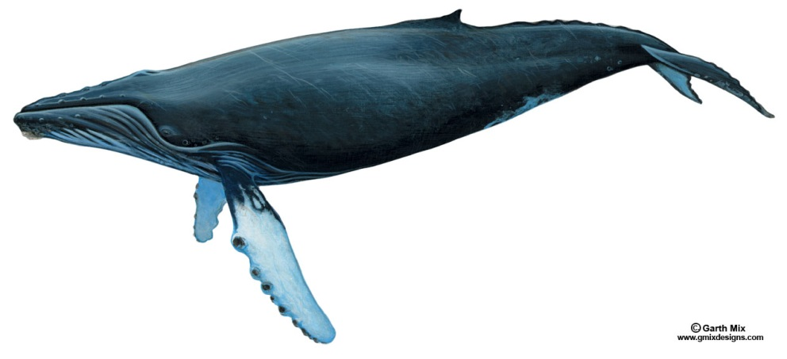
7.
This whale is famous for its songs. Males repeatedly sing songs of 10-20 min each for hours on end. Individual whales can be identified by their unique songs.
ANSWER:
Humpback whale

Slide 9
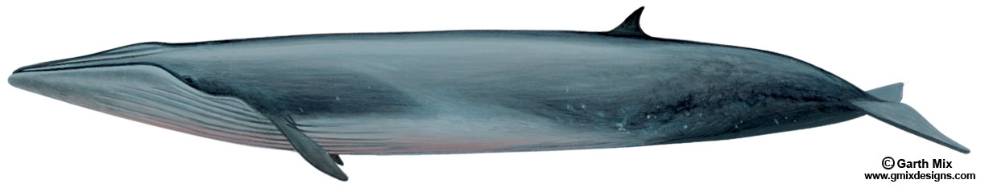
8.
Bryde’s whale

Slide 10
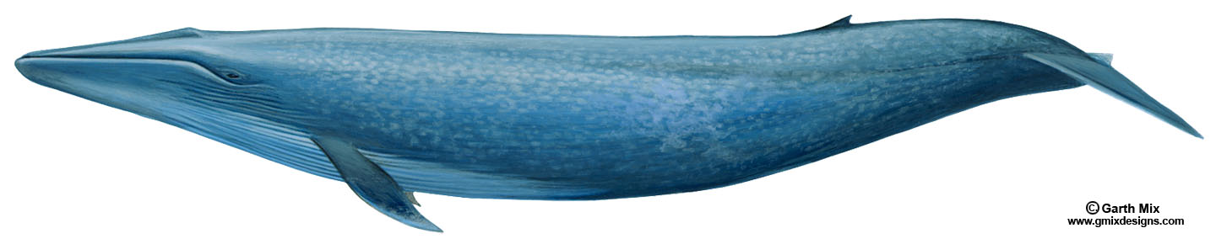
9.
Calves of this whale species can gain weight at a rate of 10 lbs per hour.
ANSWER: Blue whale

Slide 11
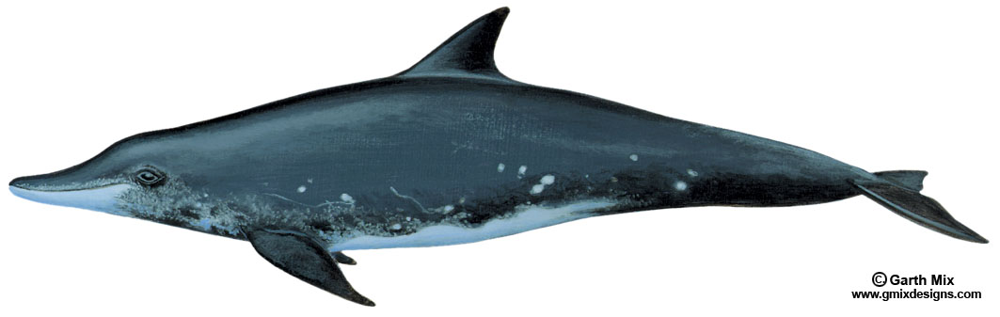
10.
Rough-toothed dolphin

Slide 12
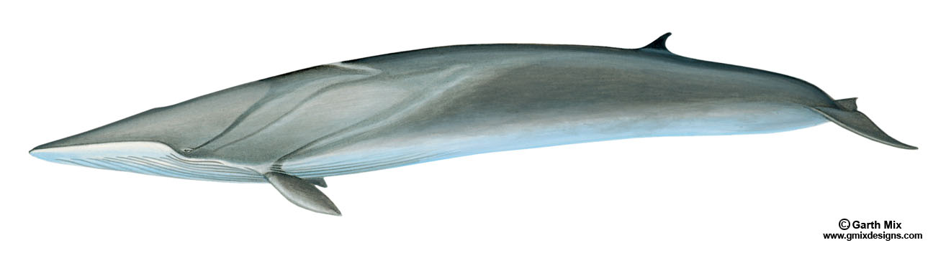
11.
This whale’s tongue is half yellow or white and half mottled black.
ANSWER: Fin whale

Slide 13
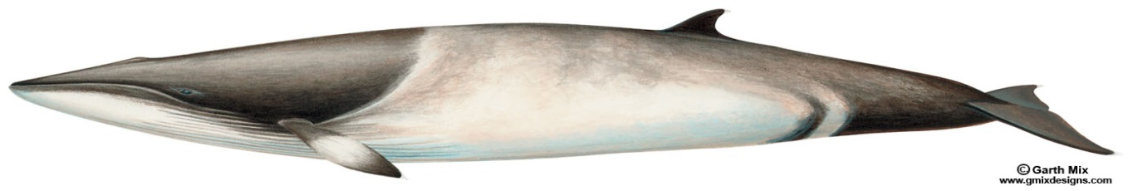
12.
These mysticetes are fast swimmers; they can swim up to 21 miles per hour!
ANSWER: Minke whale

Slide 14
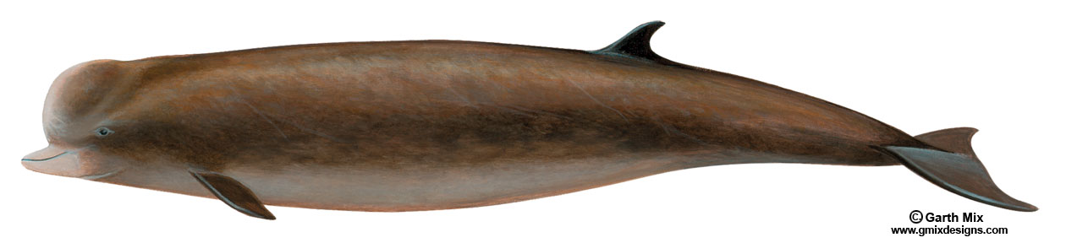
13.
Northern bottlenose whale

Slide 15
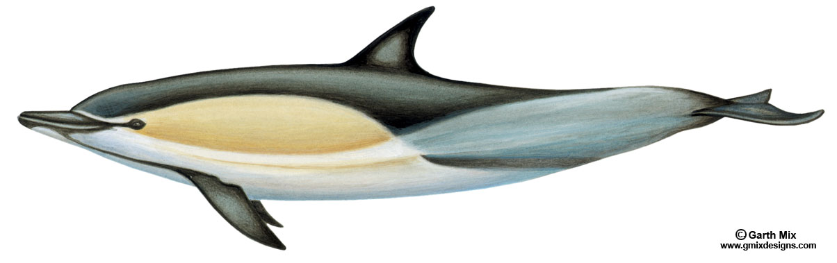
14.
Common dolphin

Slide 16
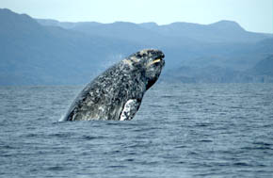
15.
These whales have white barnacles on their head, and may also have orange crab-like animals, called cyamids, on their bodies.
Photo credit: Merrill Gosho, NOAA
ANSWER: Gray whale

Slide 17
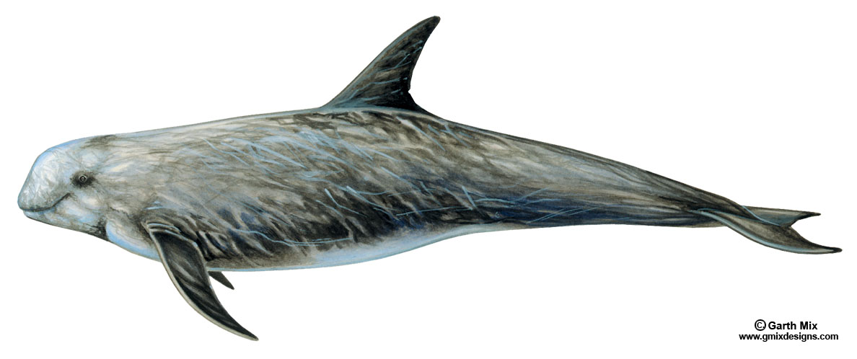
16.
Risso’s dolphin

Slide 18
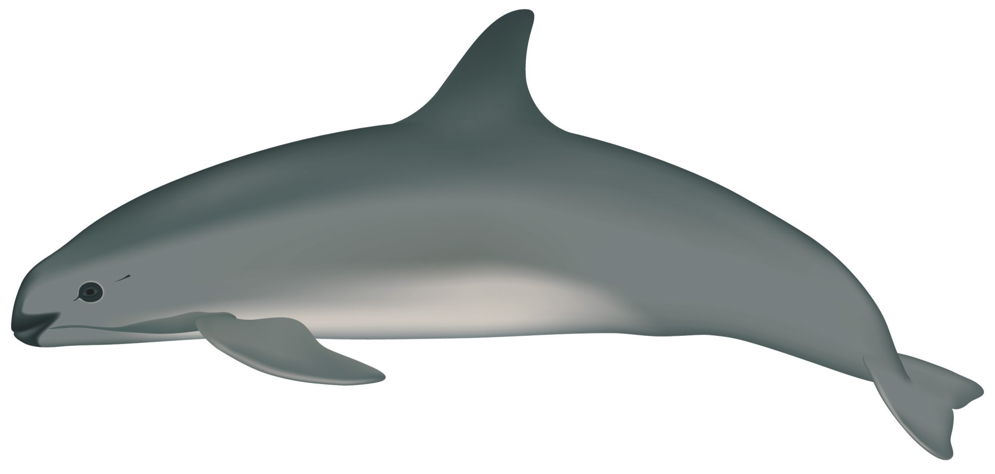
17.
Vaquita
Photo credit: Uko Gorter

Slide 19
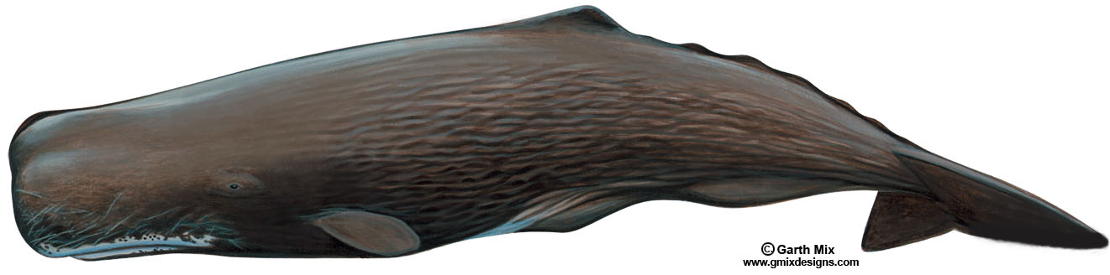
18.
This whale is the same type as the famous “Moby Dick”. Adult males have been documented occasionally striking boats for unknown reasons, causing very severe damage.
ANSWER: Sperm whale

Slide 20
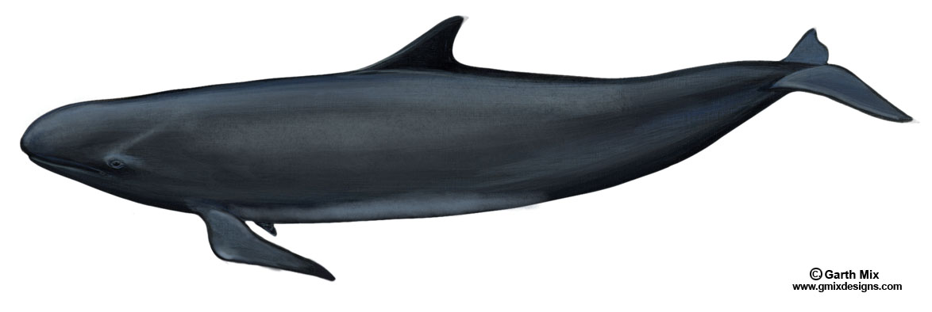
19.
False killer whale

Slide 21
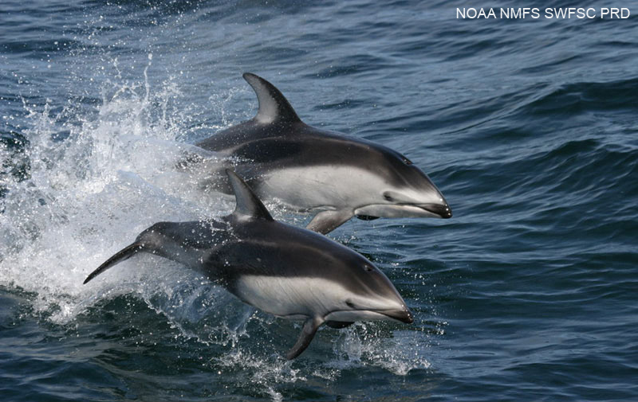
20.
Pacific white-sided dolphin

Slide 22
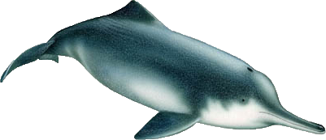
21.
Historically, this dolphin inhabited the Yangtze River in China. Sadly, it is now believed to be extinct.
ANSWER: Chinese river dolphin
Image credit:
Alessio Marrucci

Slide 23
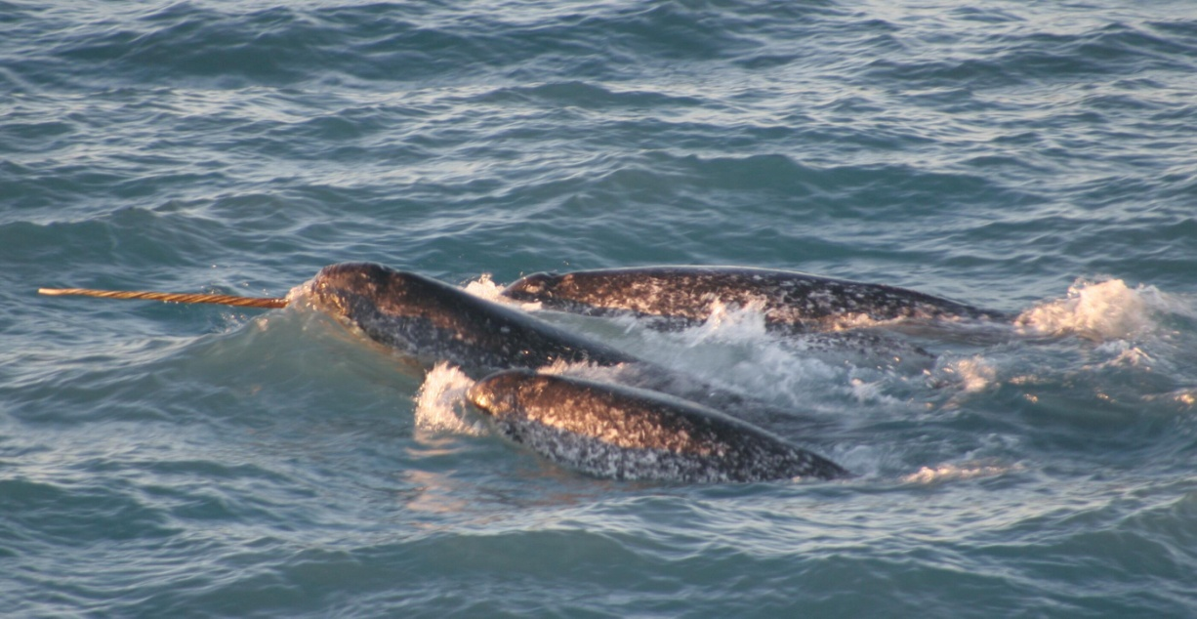
22.
This whale is severely threatened by climate change. As more Arctic ice melts, ship traffic in its home range increases. This whale is at greater risk of being hit by ships.
ANSWER: Narwhal
Photo credit: NOAA/University of Washington

Slide 24
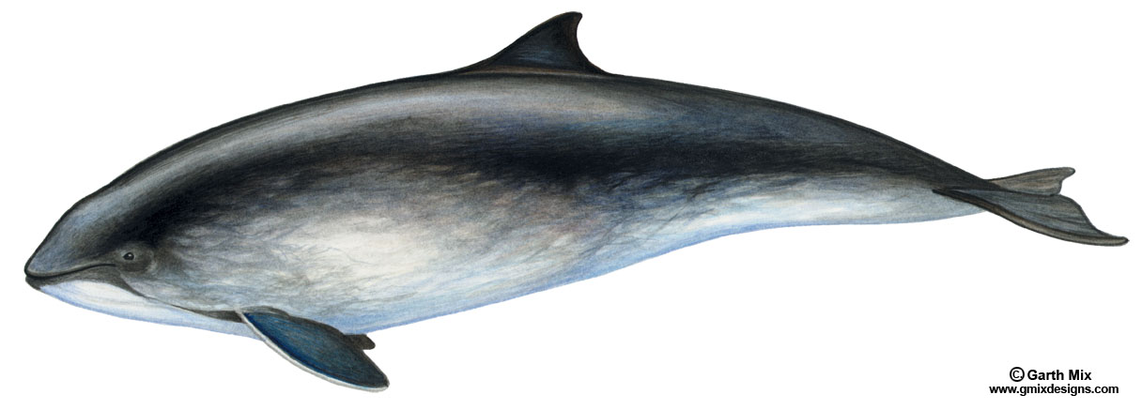
23.
Harbor porpoise

Slide 25
24.
Bowhead whale

Slide 26
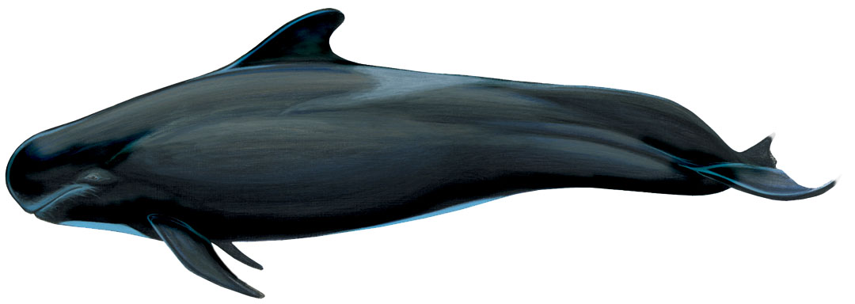
25.
This small toothed whale usually travels in large groups of 20 to 90 animals. These whales are involved in “mass stranding” events along the Florida coastline every few years. Some of these stranding events may involve more than 100 animals coming onshore at the same time.
ANSWER: Short-finned pilot whale
Image credit: Garth Mix

Slide 27
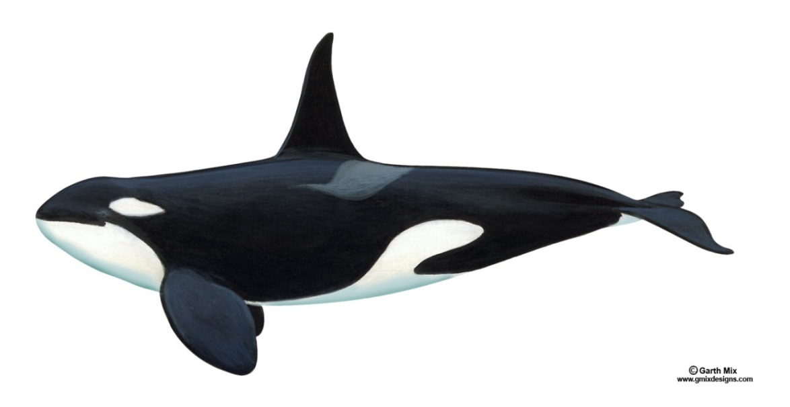
26.
A few of these whales are kept in captivity. Some of these have lived in Florida for more than 40 years.
ANSWER: Orca/killer whale

Slide 28
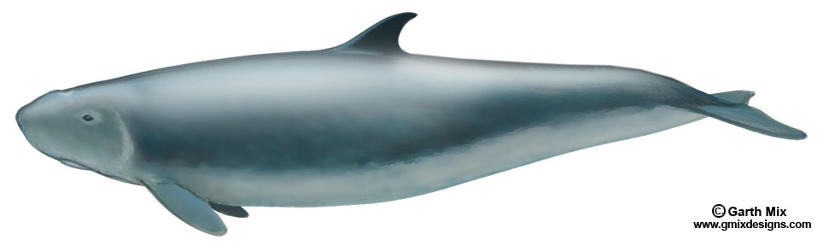
27.
Dwarf sperm whale

Slide 29
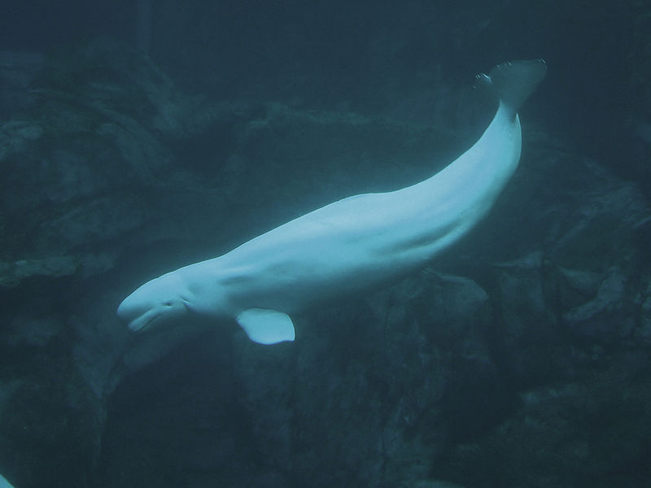
28.
This is the only whale that has a flexible neck and the ability to move its head up and down, and side to side. Scientists believe this ability helps it to hunt for prey on the bottom in shallow areas.
Photo credit: Greg Hume
ANSWER: Beluga whale

Slide 30
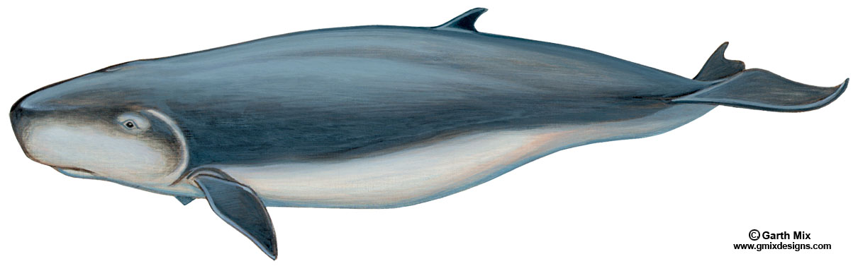
29.
When startled or frightened, this whale can release large amounts of reddish brown liquid, or “ink”, to confuse predators.
ANSWER: Pygmy sperm whale

Slide 31
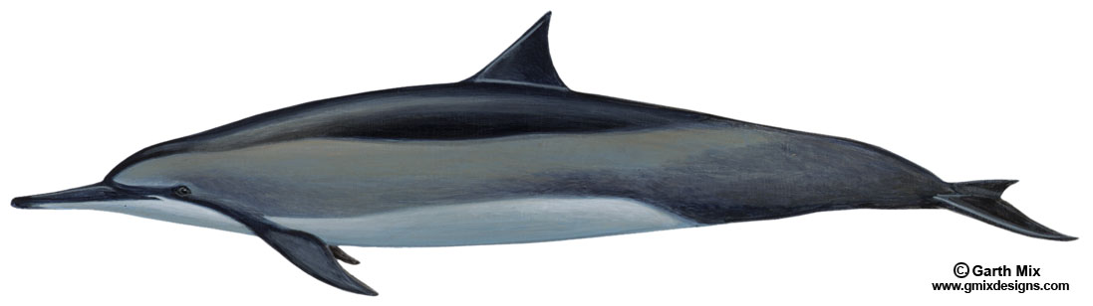
30.
These dolphins travel in very large groups, sometimes up to several thousand animals. They can be seen jumping out of the water and spinning over and over again.
ANSWER: Spinner dolphin

