Slide 1
Cetacean BINGO
Call list #1

Slide 2
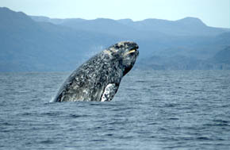
1.
This whale has one of the longest known migrations of any mammal, traveling about 10,000 miles!
Photo credit: Merrill Gosho, NOAA
ANSWER: Gray whale

Slide 3
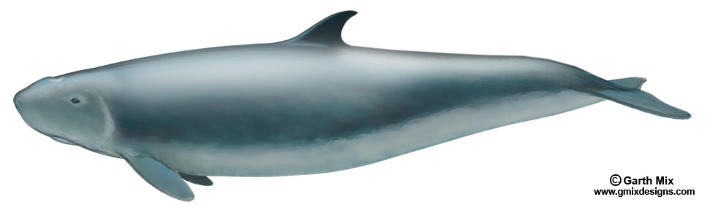
2.
Dwarf sperm whale

Slide 4
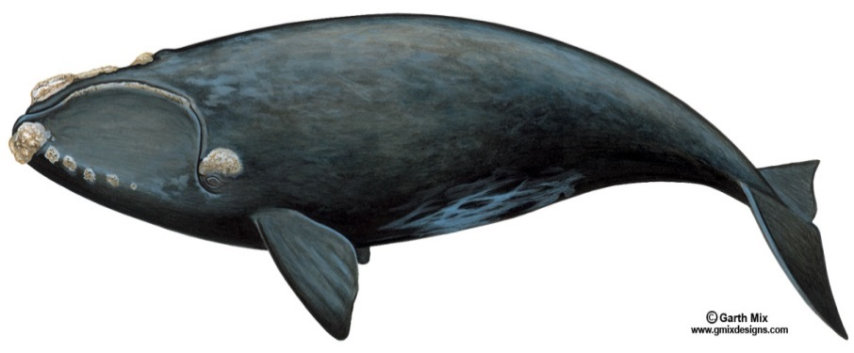
3.
This whale comes to warm Florida waters to have its babies (calves) every winter. It can sometimes be seen from the beaches of northeast Florida.
ANSWER: North Atlantic right whale

Slide 5
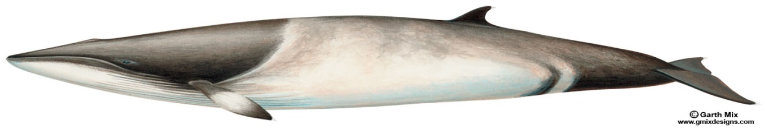
4.
This small mysticete only grows to about 30 feet long and is found in all oceans. It is not currently endangered but is protected in U.S. waters by the Marine Mammal Protection Act.
ANSWER: Minke whale

Slide 6
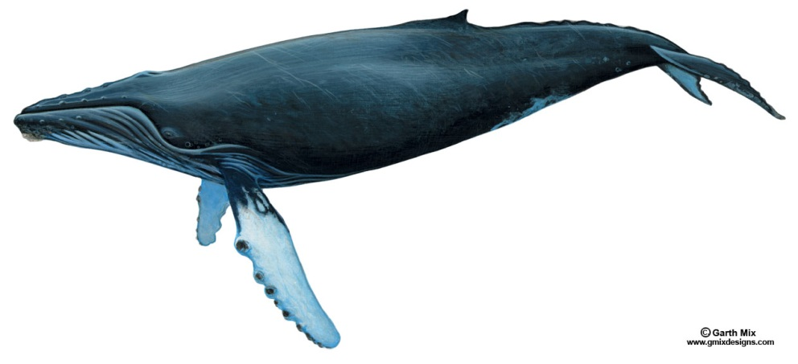
5.
Individual whales of this species can be identified by the white markings on their flippers and the underside of their tail fluke.
ANSWER:
Humpback whale

Slide 7
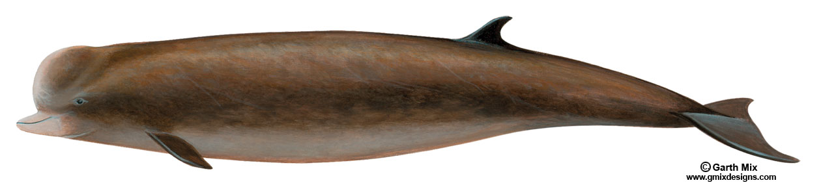
6.
Northern bottlenose whale

Slide 8
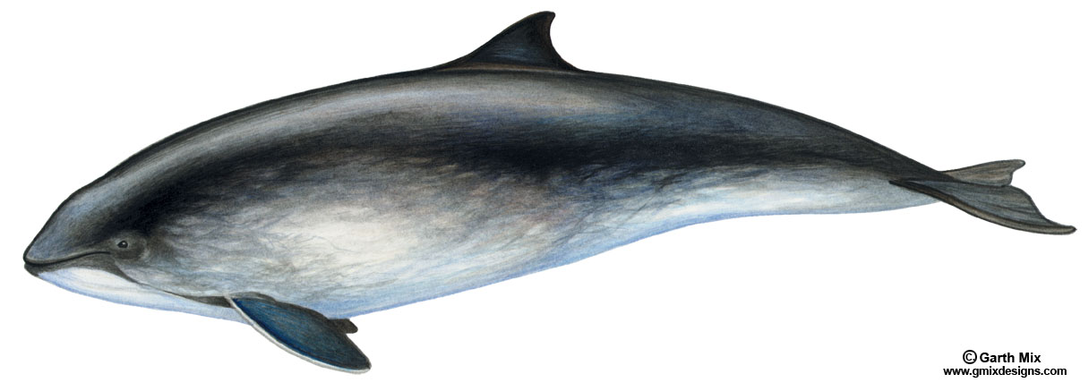
7.
Harbor porpoise

Slide 9

8.
Vaquita
Photo credit: Uko Gorter

Slide 10
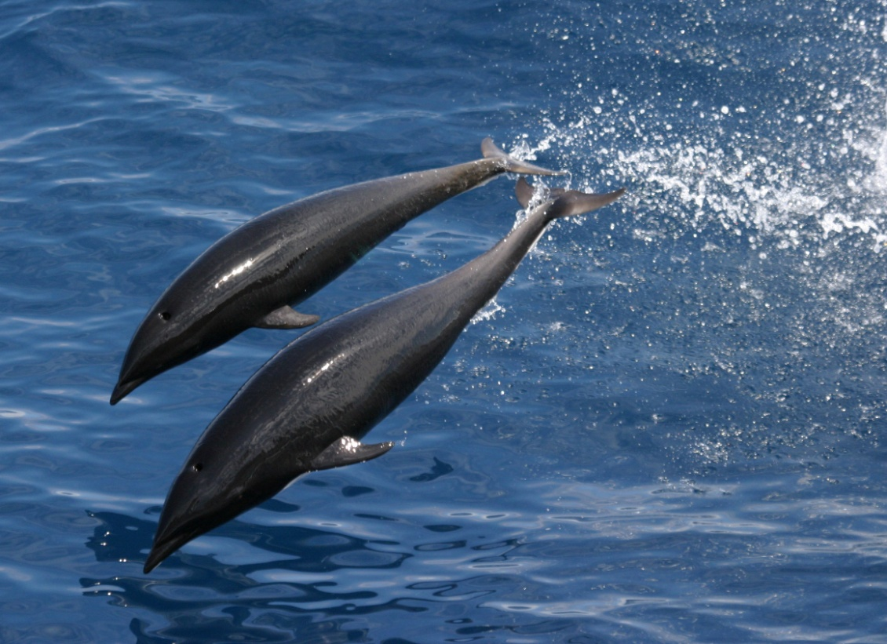
9.
Northern right whale dolphin
Photo credit: NOAA

Slide 11
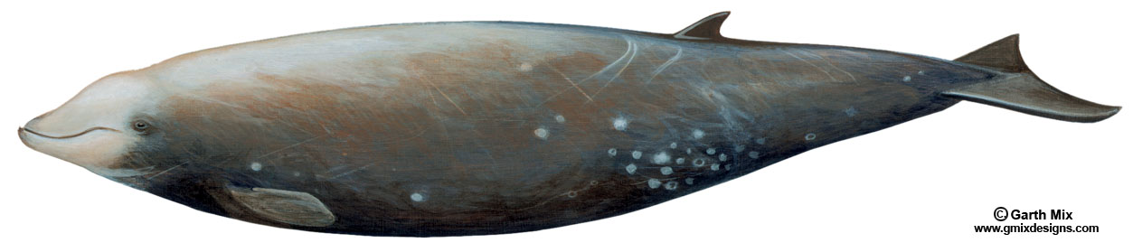
10.
This unusual odontocete hunts squid and octopus. It has grooves in its throat to help suck in prey.
ANSWER: Cuvier’s beaked whale

Slide 12
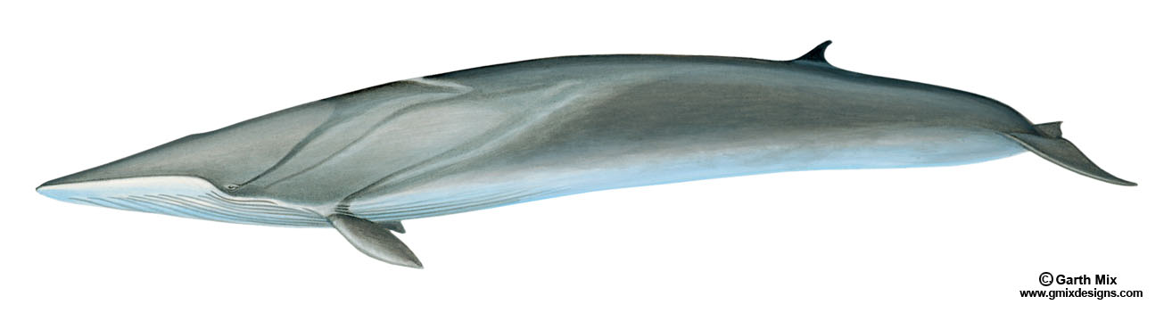
11.
Until about 1965, whalers killed up to 30,000 of these endangered mysticetes each year. These whales are now protected, but there is a small amount of tribal hunting in Greenland.
ANSWER: Fin whale

Slide 13
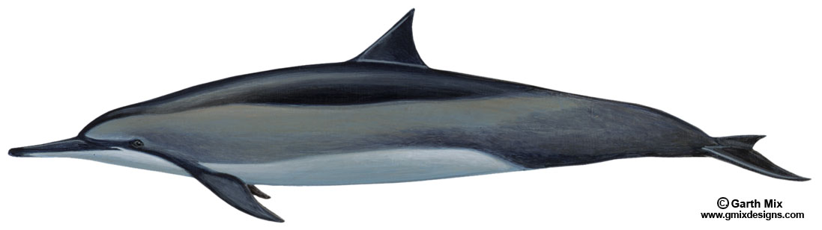
12.
These small odontocetes have long, slender snouts and easily recognized because they jump out of the water and spin their bodies around several times before re-entering the water.
ANSWER: Spinner dolphin

Slide 14
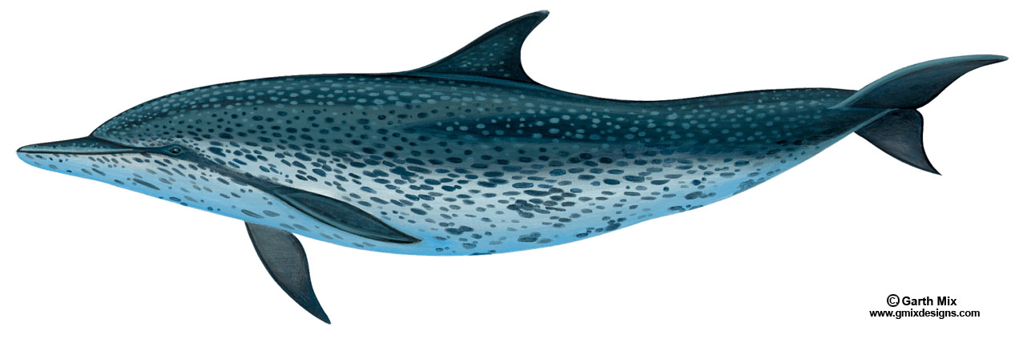
13.
Atlantic spotted dolphin

Slide 15
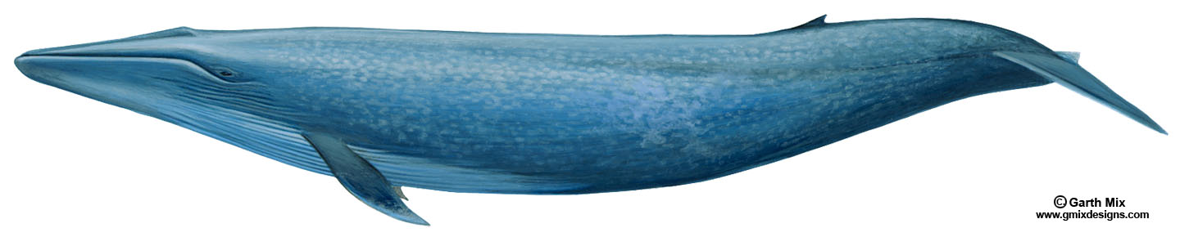
14.
This whale is the biggest animal that has ever lived. It is larger than the largest dinosaur.
ANSWER: Blue whale

Slide 16

15.
This whale is born dark gray but becomes snowy white as it matures, so it is often called “the white whale.”
Photo credit: Greg Hume
ANSWER: Beluga whale

Slide 17
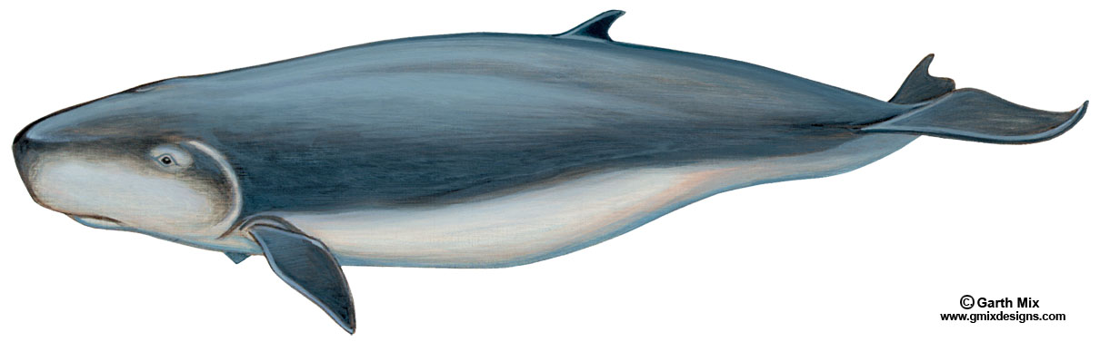
16.
This whale has a bracket-shaped marking behind its eye, which looks like the gill of a fish.
ANSWER: Pygmy sperm whale

Slide 18
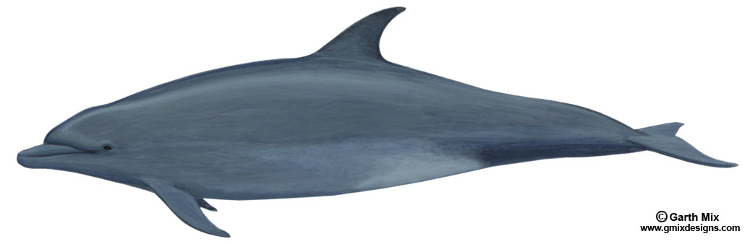
17.
This dolphin is commonly seen throughout the coastal waters of Florida. It is important to remember that feeding this dolphin can be harmful to the animal and is illegal.
ANSWER: Bottlenose dolphin

Slide 19
18.
Bowhead whale

Slide 20
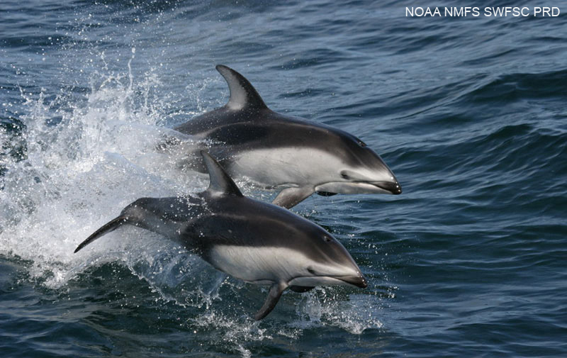
19.
Pacific white-sided dolphin

Slide 21
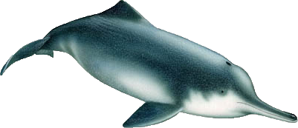
20.
This rare dolphin may be extinct. A live animal has not been seen since 2002.
ANSWER: Chinese river dolphin
Image credit:
Alessio Marrucci

Slide 22
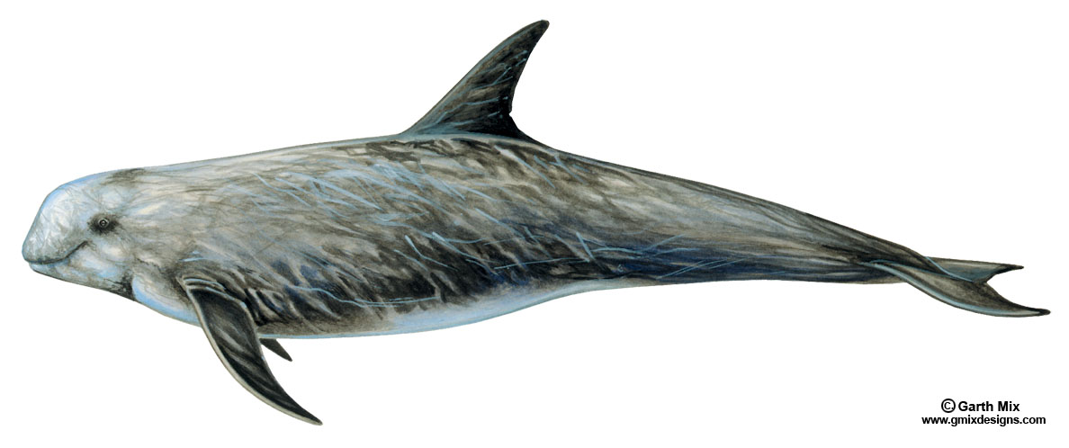
21.
Risso’s dolphin

Slide 23
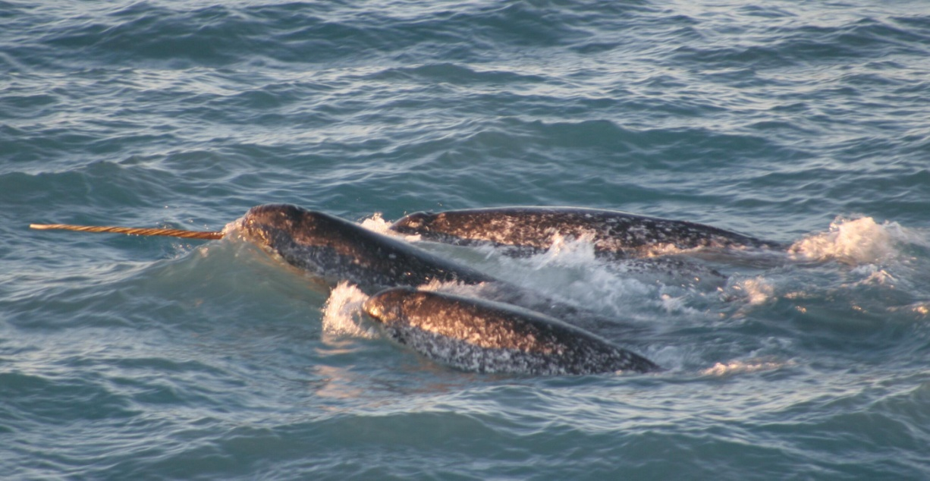
22.
Males of this species grow a single elongated tusk that may be many feet long. This structure is thought to be the basis of the mythical unicorn horn.
ANSWER: Narwhal
Photo credit: NOAA/University of Washington

Slide 24
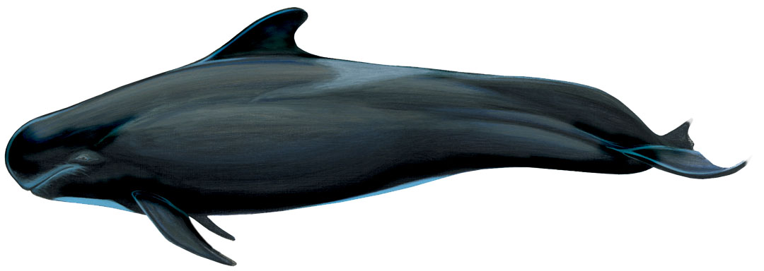
23.
This large odontocete is easily recognized by its large, bulbous, melon head. Its body is black or dark brown, and it has a large gray “saddle” behind the dorsal fin.
ANSWER: Short-finned pilot whale
Image credit: Garth Mix

Slide 25
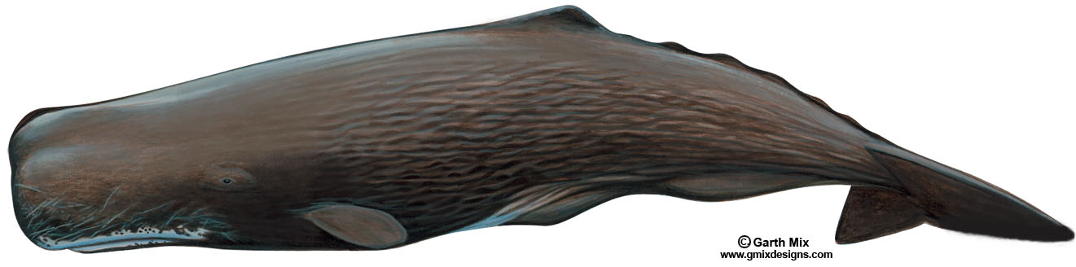
24.
This whale is the largest of the odontocetes.
ANSWER: Sperm whale

Slide 26
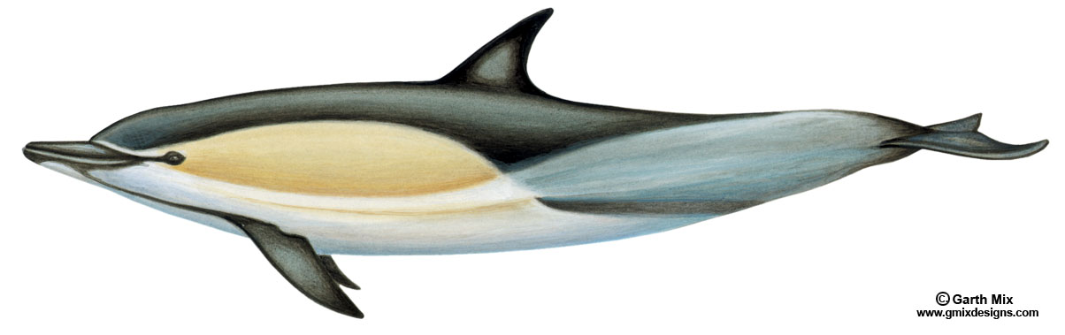
25.
Common dolphin

Slide 27
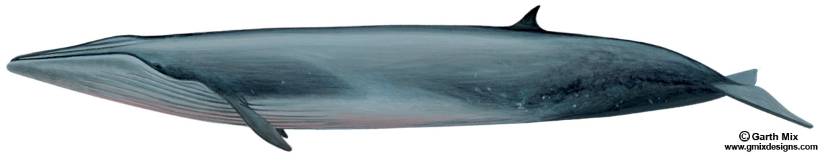
26.
Bryde’s whale

Slide 28
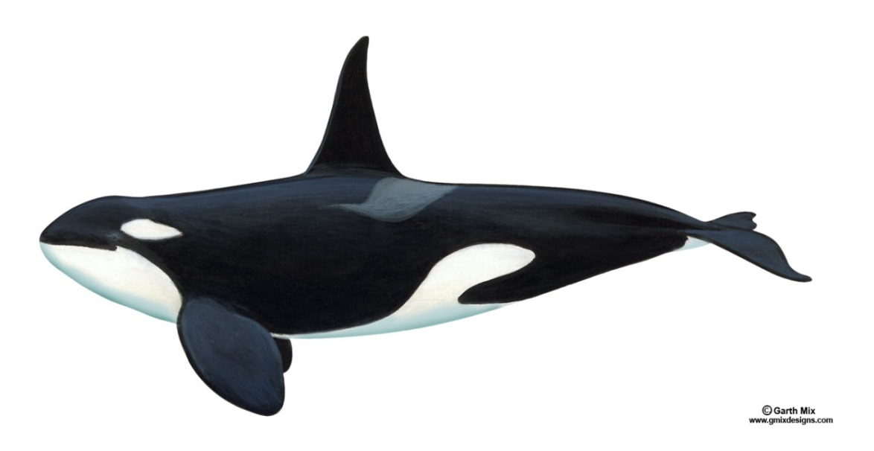
27.
This whale was given its name because it has been known to kill other whales and even great white sharks.
ANSWER: Orca/killer whale

Slide 29
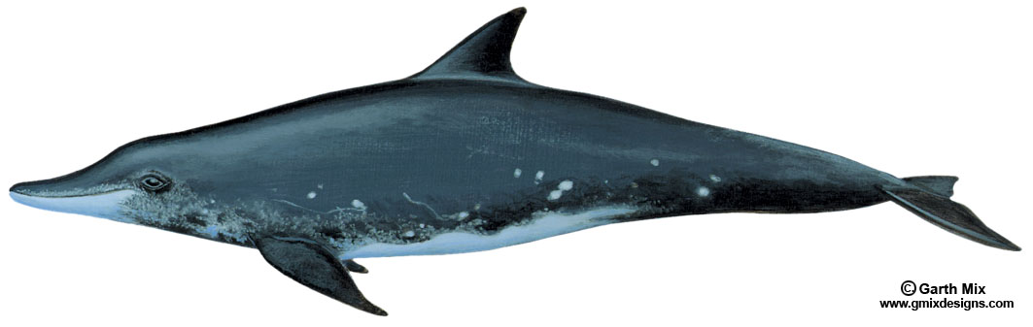
28.
Rough-toothed dolphin

Slide 30
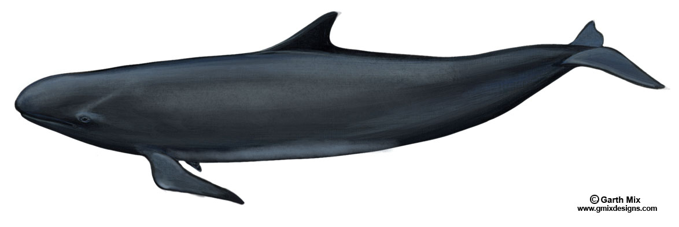
29.
False killer whale

Slide 31
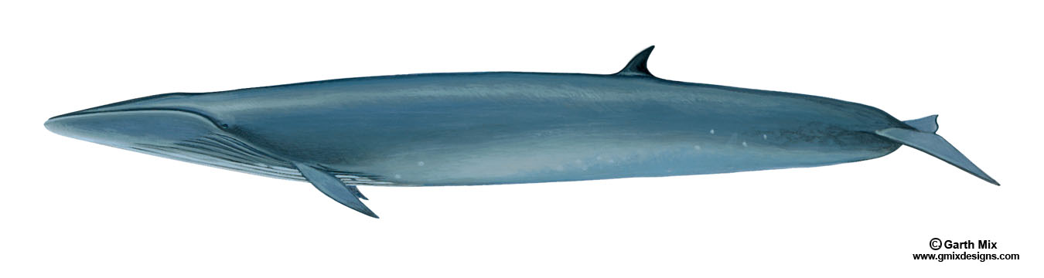
30.
Sei whale

