Slide 1
Lesson 2: What Makes A Whale A Whale?
Notes:
What Makes a Whale a Whale? Today we will learn about a group of animals called “cetaceans” [suh-TAY-shuns]—these are the whales and dolphins.

Slide 2
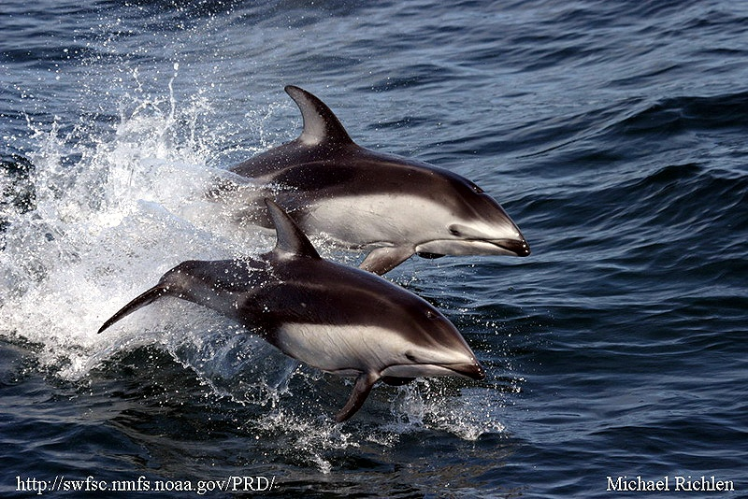
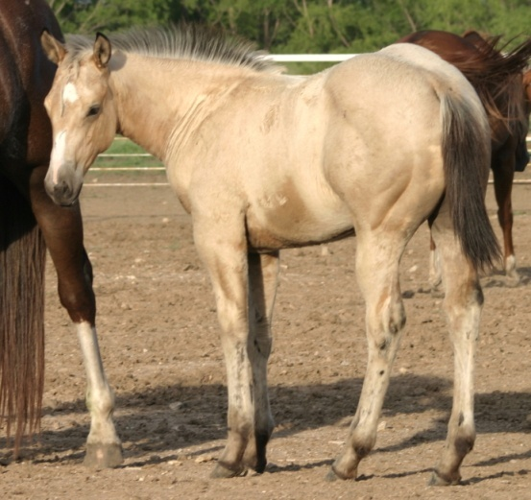
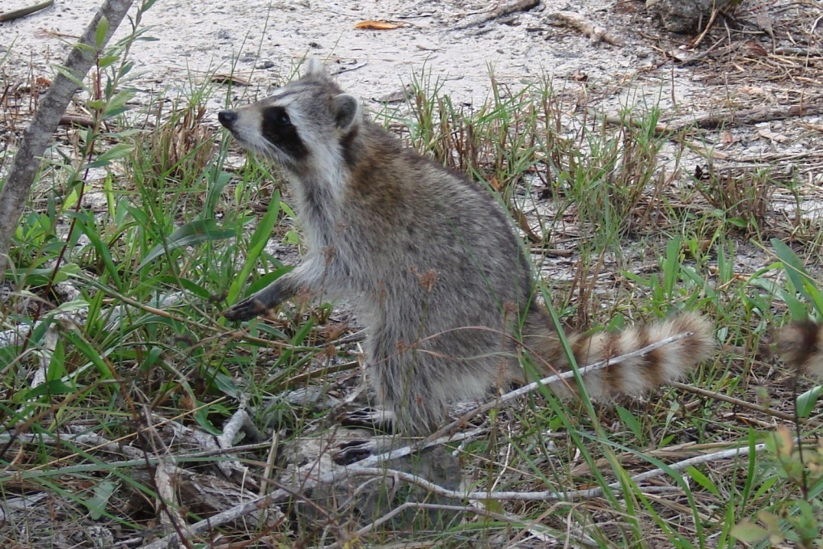
Whales are Mammals!
Photo credit: M McGuire
Photo credit: Liz Haverty
Photo credit: M McGuire
Photo credit: R Francis-Floyd
Notes:
Horses, dogs, raccoons and humans are all mammals just like whales and dolphins. There are six main characteristics of a mammal. Who can remember one of the characteristics of mammals that makes them different from other groups of animals? [Students should know characteristics of a mammal from 3rd grade!]

Slide 3
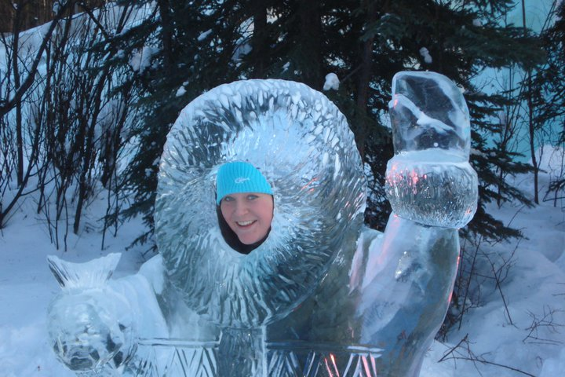
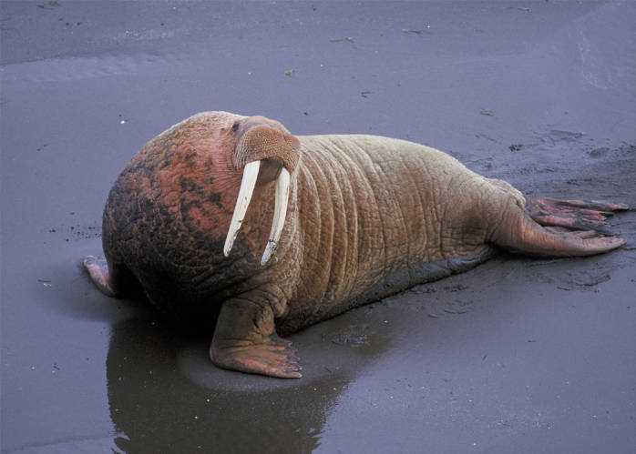
Let’s review… What Makes a Mammal a Mammal?
1. Warm-Blooded
Photo credit: S. Rump
Photo credit Bill Hickey/ USFWS
Photo credit: M. McGuire
Notes:
Mammals are all warm-blooded; most mammals keep their bodies warm with hair or fat. Many marine mammals have a thick layer of fat or blubber to protect them from the cool ocean waters.

Slide 4
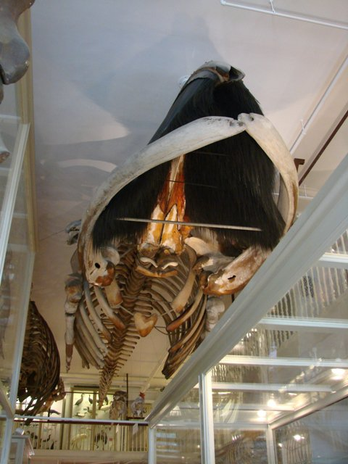
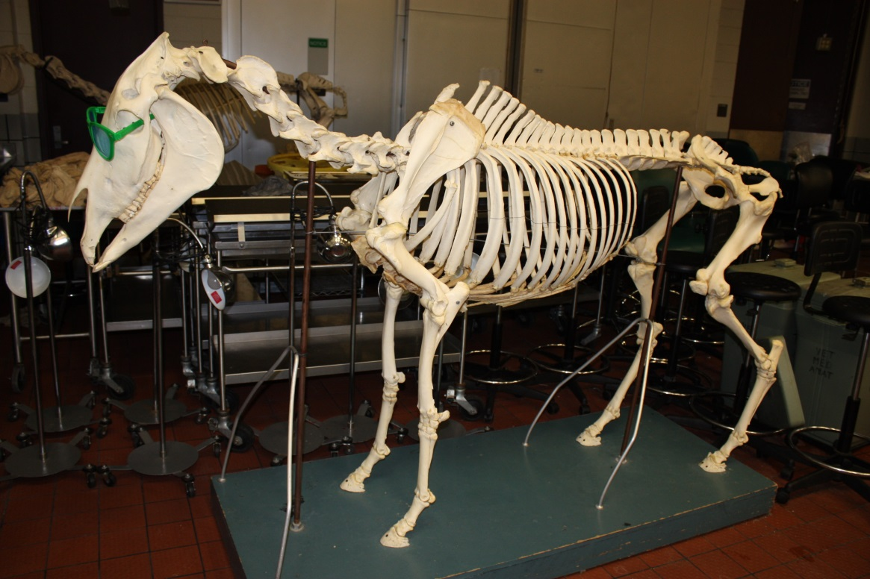
2. Backbone (vertebrae)
Photo credit: M. McGuire
Photo credit: M. McGuire
Notes:
Mammals have backbones made up of individual bones called vertebrae.

Slide 5
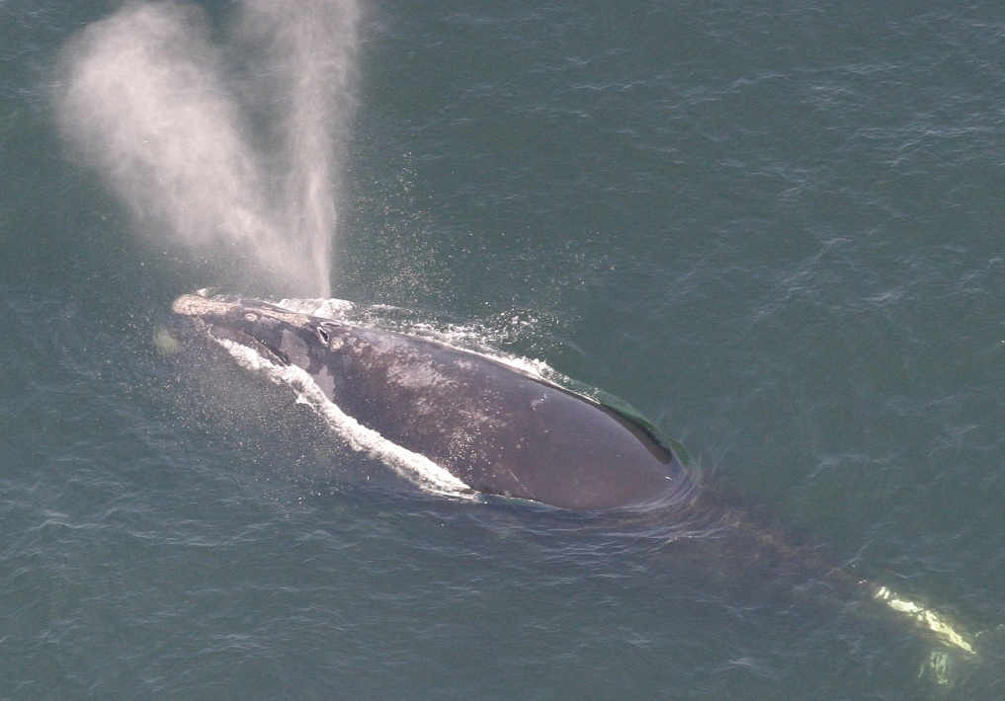
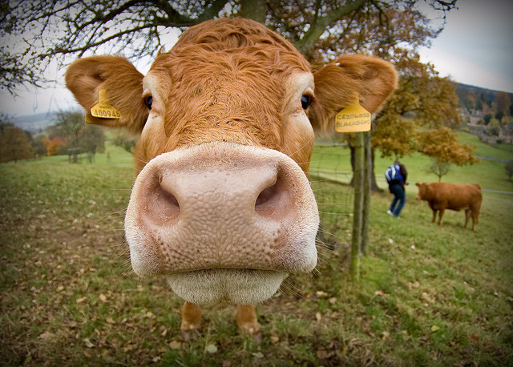
3. Air Breathing
Taken under NOAA permit
Photo credit: Dave Wild/Flickr
Notes:
Mammals breathe air. Whales and dolphins breathe air through blow holes on the tops of their head, just like cows breathe through their nose.

Slide 6
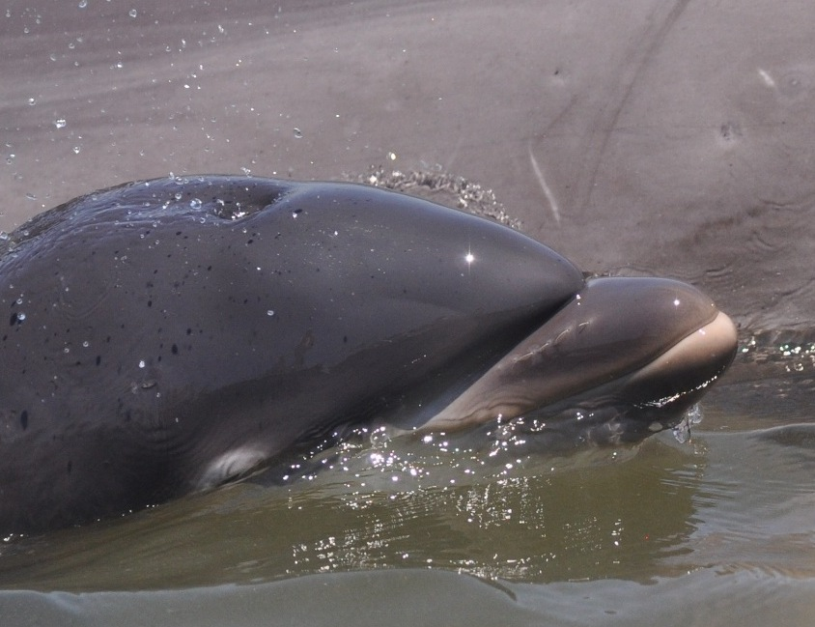
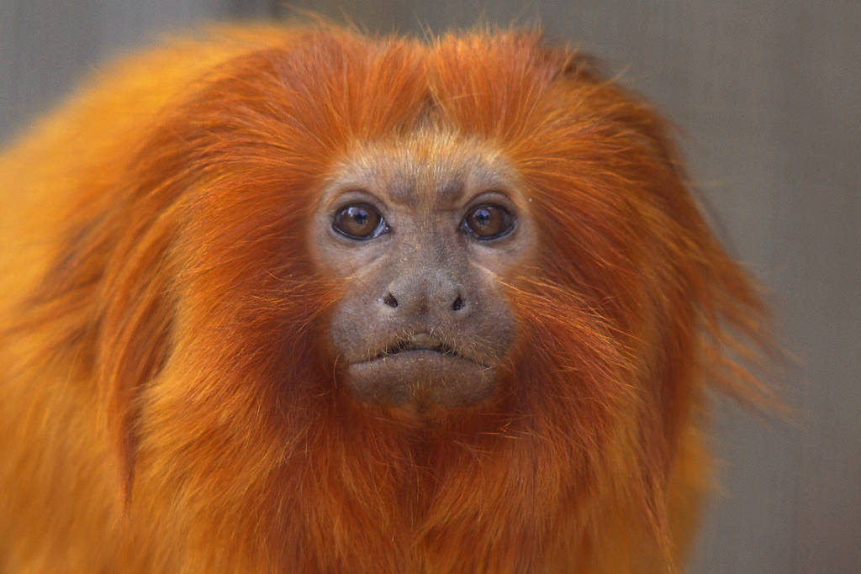
4. Have Hair
Photo credit: Robin Perrtree/ Savannah State University
Photo credit: Su Neko/Wikimedia commons
Notes:
Mammals have hair. Whales and dolphins have small areas of hair when they are born. For example, baby dolphins have a line of hair similar to a thin mustache that falls off shortly after birth. Whales, such as right whales, may have sparse hairs on the tip of the chin and upper jaw.

Slide 7
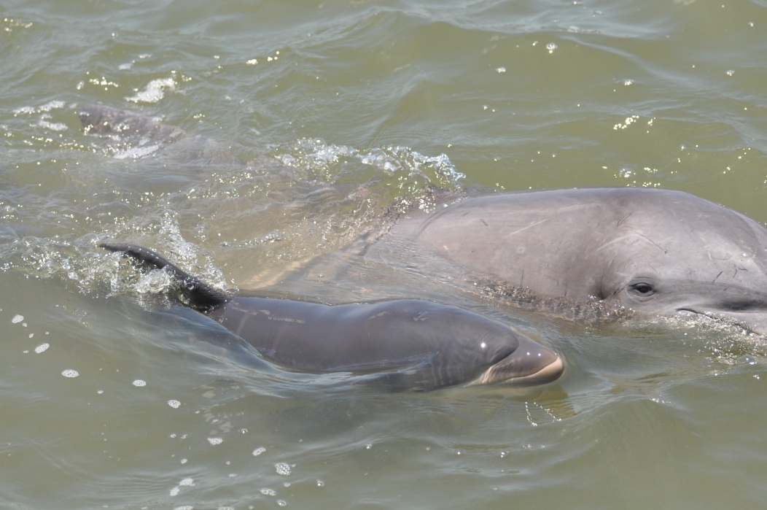
5. Give birth to live young
(don’t lay eggs)
Photo credit: Robin Perrtree/ Savannah State University
Photo credit: Ruth Francis-Floyd
Notes:
Mammals give live birth to their young. If you look really hard, you may be able to see lines on this baby dolphin (called a calf) where it was curled up inside its mother.

Slide 8
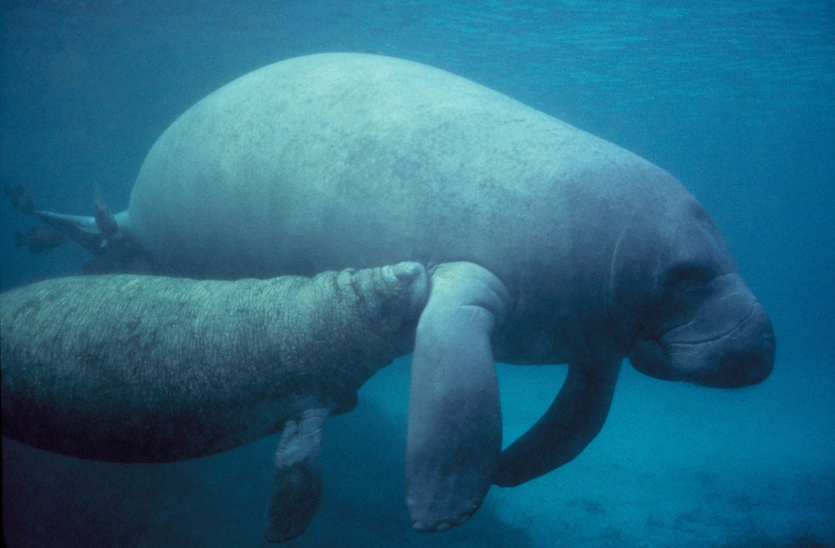
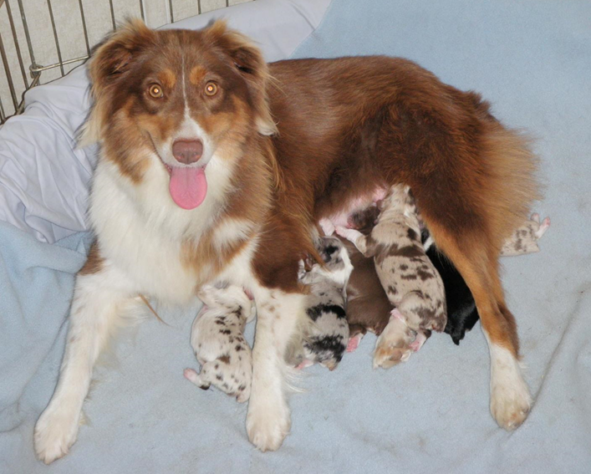
6. Nurse young by producing milk
Photo credit: USFWS
Photo credit: FWC
Photo credit: Maxine Floyd
Notes:
Mammals feed milk to their young.

Slide 9
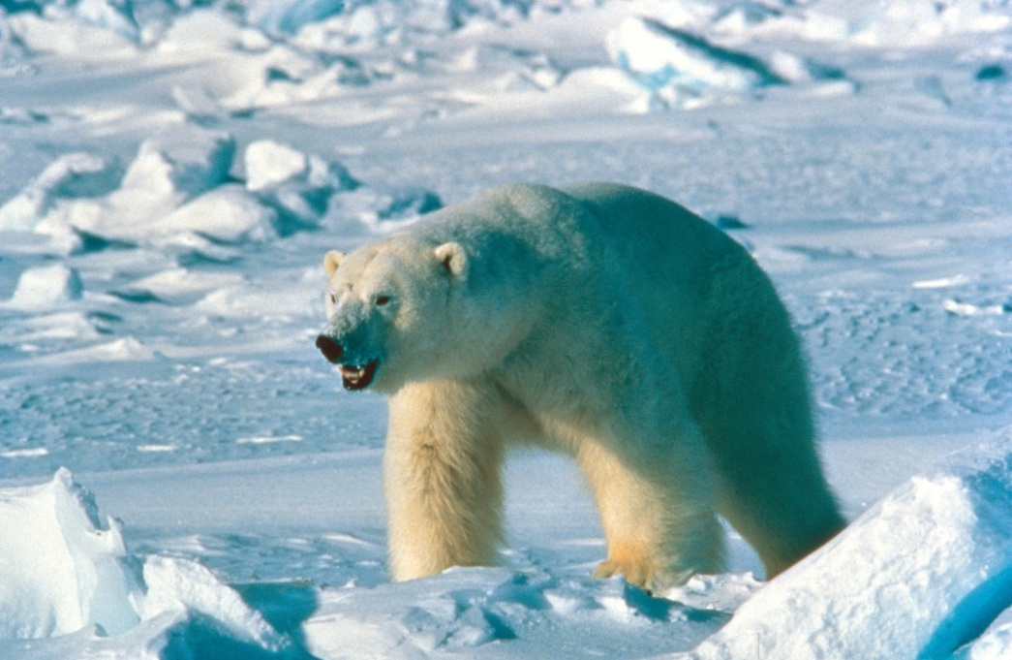
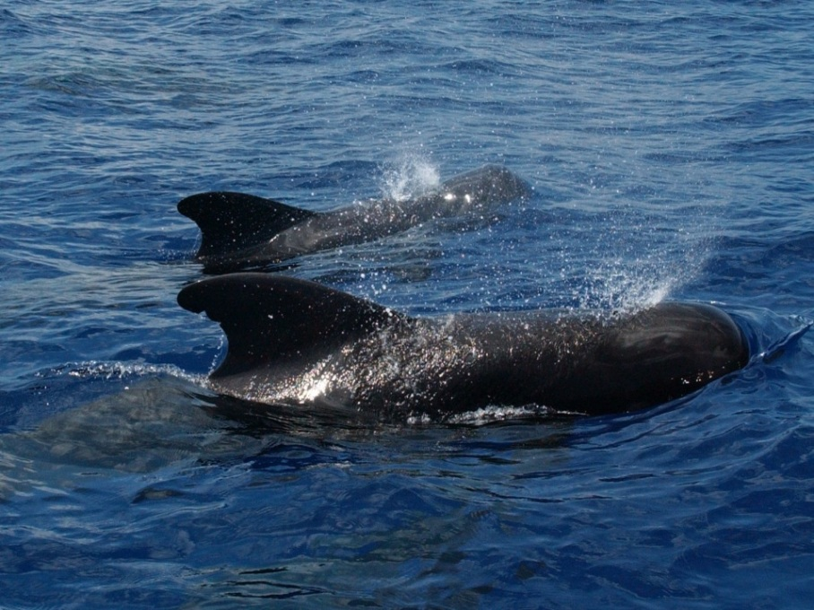
What is a Marine Mammal?
Mammals that live part of their life or all of their life in the ocean.
Photo credit: USFWS
Photo credit: NOAA
Photo credit: NOAA
Notes:
Marine mammals are those mammals that are well adapted for life in the ocean. Some marine mammals, like dolphins and whales, spend their entire life in the water. Others, like polar bears, may spend part of their life on land but depend on the ocean for food.

Slide 10
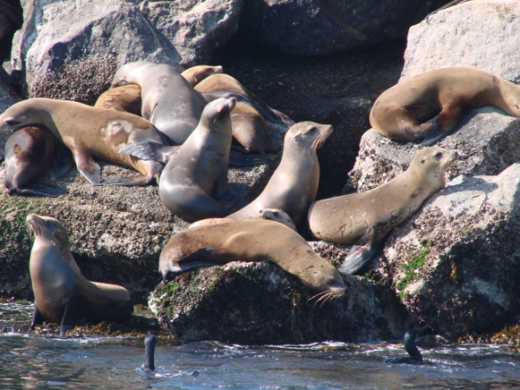
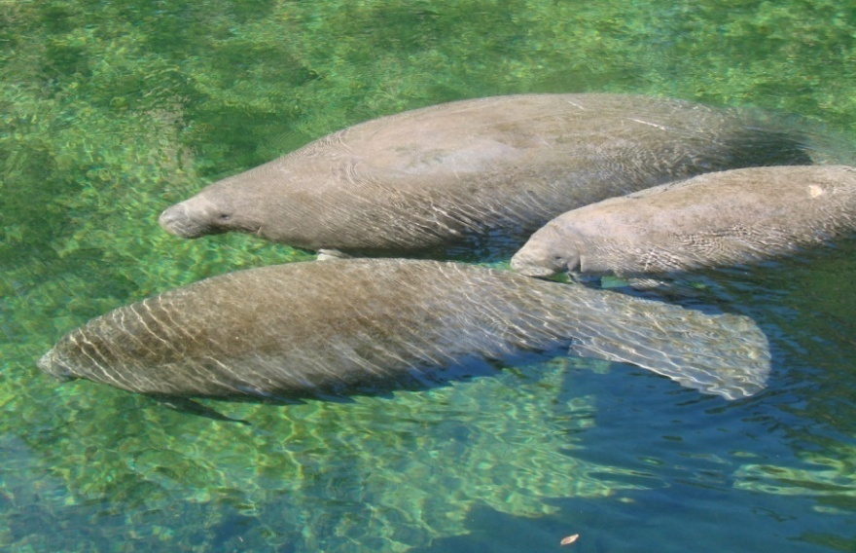
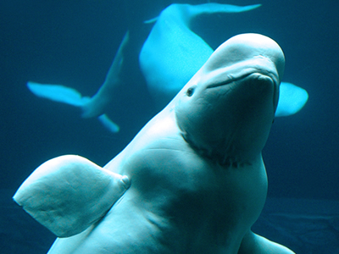
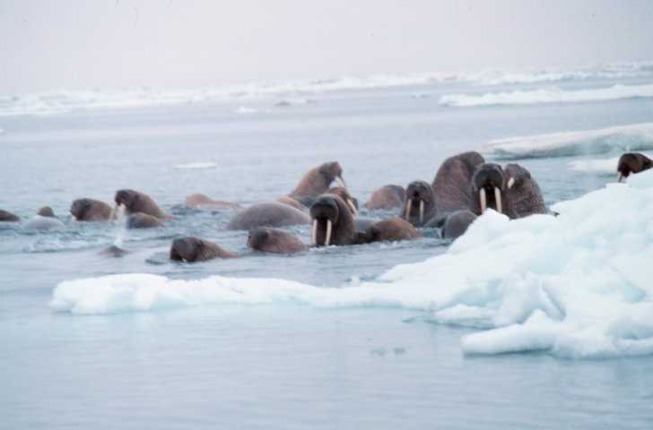
Examples of Marine Mammals!
Photo credit: M. McGuire
Photo credit: M. McGuire
Photo credit: M. McGuire
Photo credit: NOAA
Photo credit: NOAA
Photo credit: E. Green
Photo credit: NOAA
Photo credit: M. McGuire
Notes:
There are several groups of marine mammals. We will be learning more about are the cetaceans. This group includes the whales, dolphins and porpoises. Seals, sea lions and walruses are in a different group, called the pinnipeds. Manatees and their relatives are in the group called sirenians. Sea otters and polar bears are also considered marine mammals. [Top row: sea lions (pinnipeds), manatees (sirenians), and sea otter; Bottom row: humpback whale (cetacean), beluga whale (cetacean) and walrus (pinniped)]

Slide 11
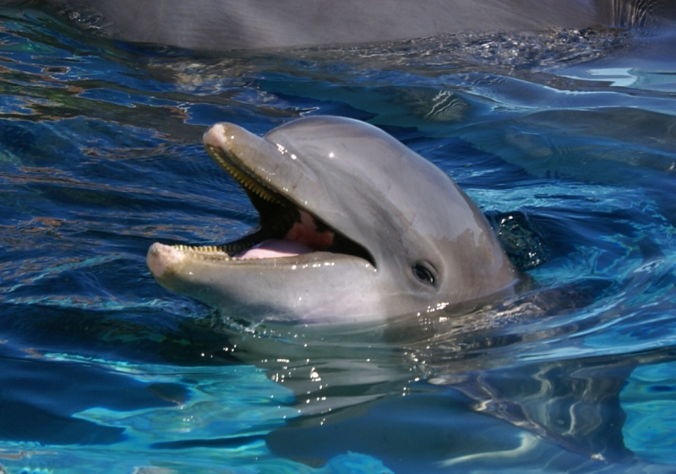
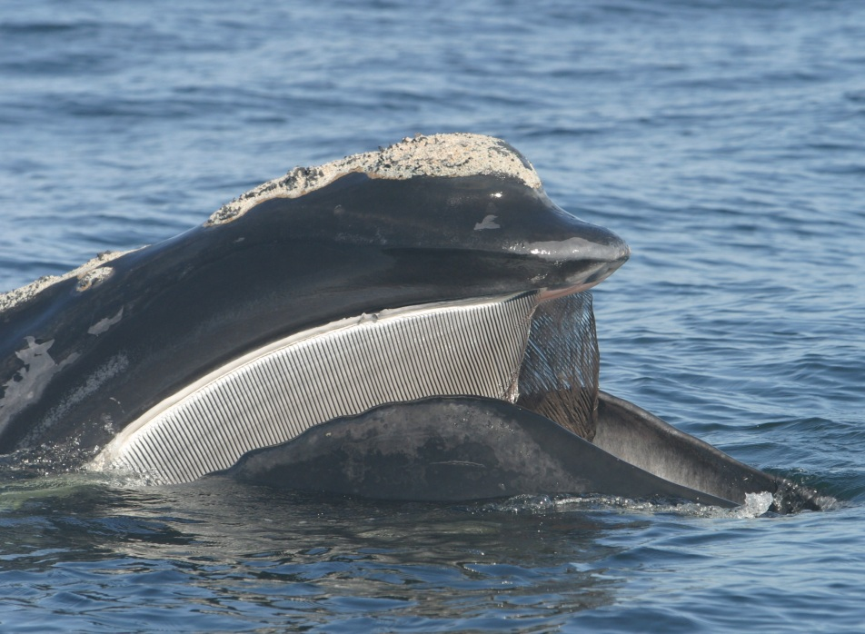
There are 2 Types of Whales
Toothed Whales, called
“ODONTOCETES”
Baleen whales, called
“MYSTICETES”
Photo credit: M. McGuire
Taken Under NOAA Permit
Notes:
Cetaceans are divided into two groups: toothed whales and baleen whales. Toothed whales, or odontocetes, have teeth. All dolphins and porpoises are included in this group. [Point out the photo of the dolphin: ] If you look carefully, you can see the dolphin’s teeth in this picture. Dolphins have up to 100 cone-shaped white teeth along their upper and lower jaws. Baleen whales, also called mysticetes, do not have teeth in their mouths. Instead, they have special fibrous plates called baleen, that hang down from the upper jaw. We will talk more about baleen in a few minutes. [Point out the photo on the right side of the slide.] This is a photo of a right whale, which is a type of baleen whale.

Slide 12
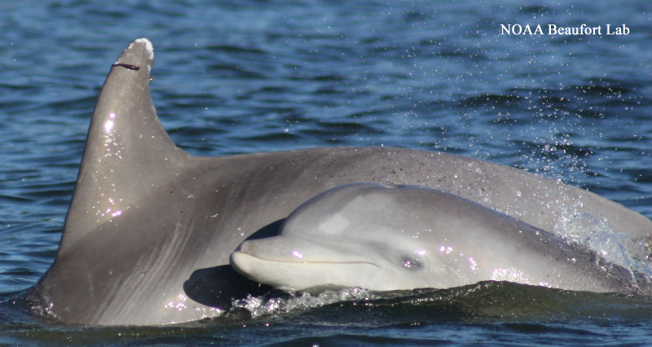
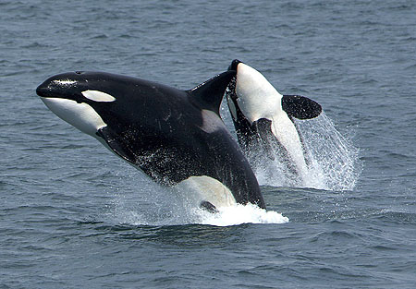
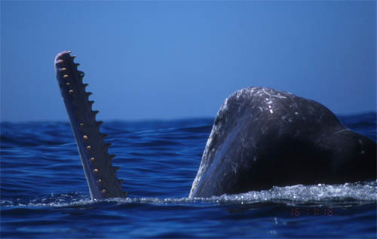
Toothed Whales (Odontocetes)
Photo credit: NOAA
Photo credit: NOAA
Photo credit: NOAA
Notes:
First, let’s talk about the toothed whales. Many of the whales that you may be familiar with, and all of the dolphins, are odontocetes. These cetaceans use their teeth to grab prey like fish, squid and even other marine mammals. [Point at top left photo.] Bottlenose dolphins are toothed whales. [Point at top right photo.] Orcas, also known as killer whales. Although we call them whales, they are actually the largest type of dolphin. [Point at bottom photo.] Other toothed whales are not dolphins. Sperm whales are very deep diving animals, hunting in 3,000 or more feet of water for their favorite food, the giant squid. There are about 70 different types of odontocetes in the world.

Slide 13
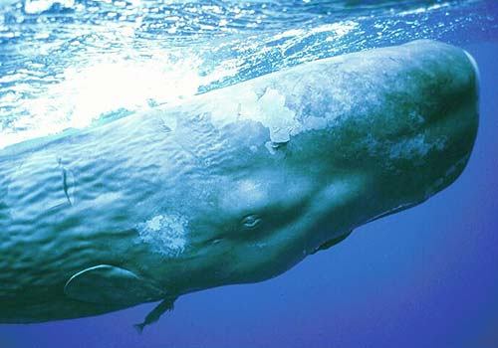
Sperm Whales…The largest Odontocetes
Photo credit: NOAA
Photo credit: Flip Nicklin/ Taken Under NOAA Permit
Notes:
The sperm whale is the largest member of the odontocete family. Male sperm whales can reach lengths near 60 ft. That’s almost as long as two school buses! Mature male sperm whales are called “bulls”. Sperm whales are able to hold their breath for more than an hour, which allows them to pursue the giant squid deep in the open ocean.

Slide 14
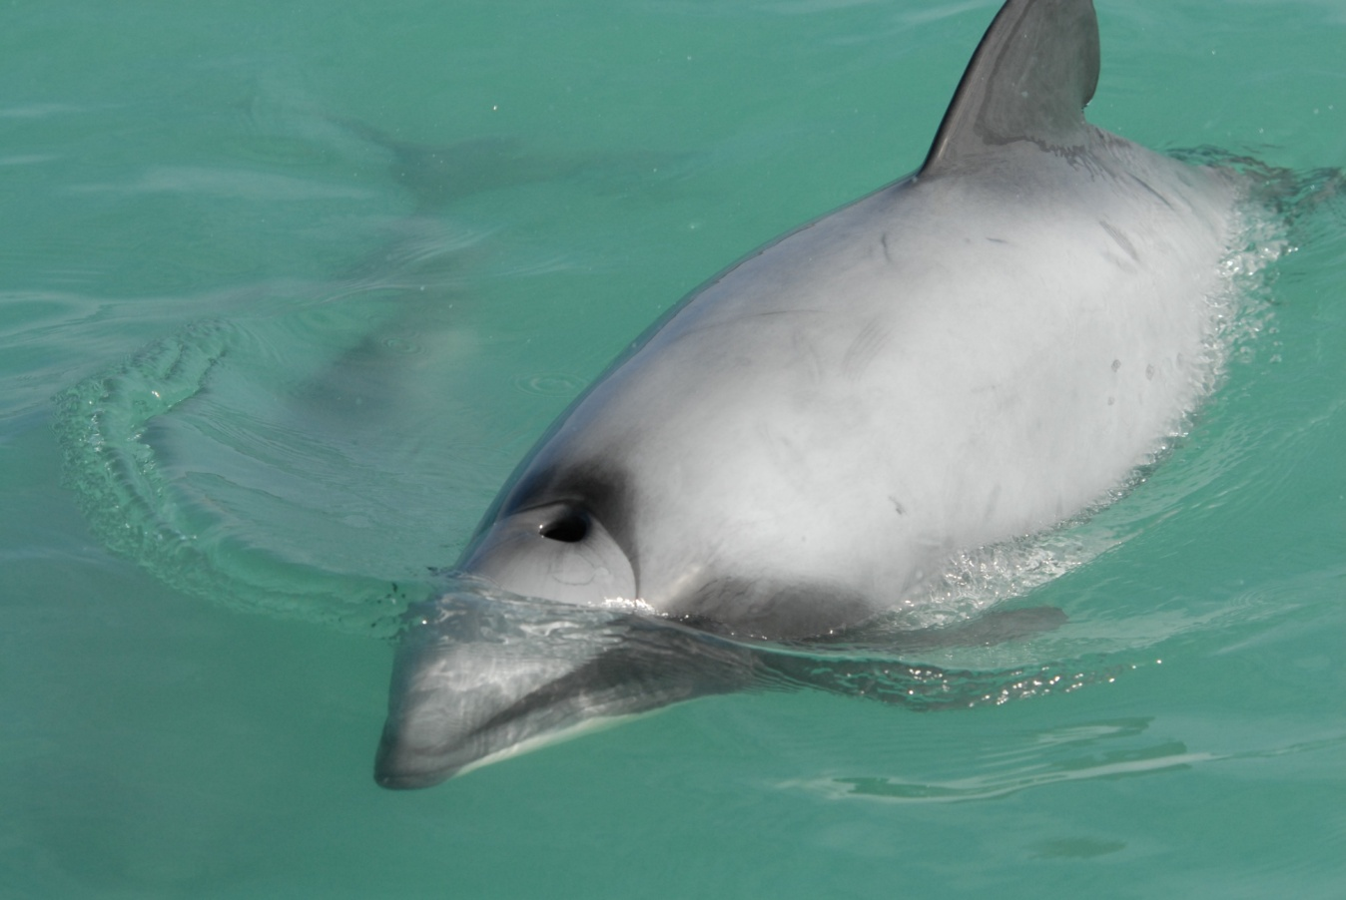
Some Odontocetes are Very Small
Hector’s Dolphin
A very small dolphin
(about 5 ft)
Found in New Zealand
Photo credit: Dr. Mridula Srinivasan/NOAA
Notes:
In contrast to the sperm whale, some odontocetes are very small. The Hector’s dolphin, shown in this photo, only gets to be about five feet long. [Suggestion--compare that to your height, or possibly the height of students in the class.]

Slide 15
Dolphin Anatomy (bottlenose dolphin)
Melon
Blowhole
Dorsal Fin
Rostrum
Eye
Fluke
Flipper
Notes:
This slide shows some of the body parts of a dolphin. The “beak” of the dolphin (and other whales) is called the “rostrum.” The forehead is called the “melon.” The blowhole, located on the top of the head, is the dolphin’s nose. The fin on the dolphin’s back is called the “dorsal fin,” the side fins are called “flippers” and the tail fin is called the “fluke.”

Slide 16
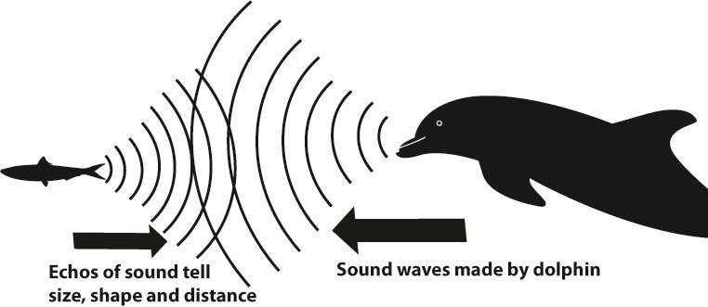
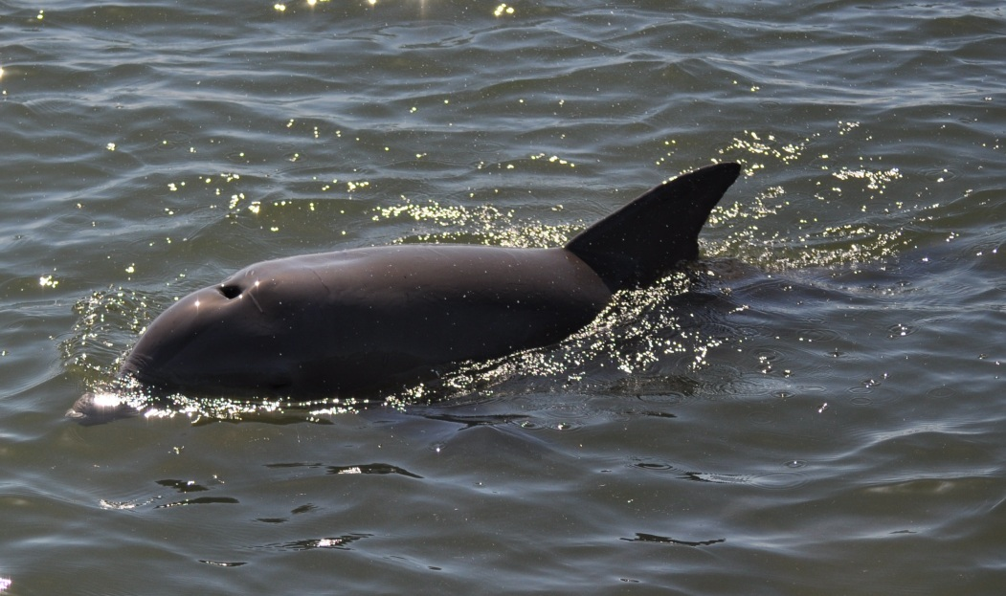
Other Special Features of Toothed Whales
Echolocation
Single blowhole
Photo credit: NOAA
Notes:
Echolocation is the ability of producing sound waves, and feel the vibration as the waves bounce off prey and other items. Odontocetes use echolocation to find food and to navigate. Odontocetes rely on echolocation when they cannot see. For example, sometimes the water they swim in is not clear, or they may be swimming in very deep water where there is little light. To echolocate, odontocetes produce sound waves from the melon and receive echoes, which they can feel through the lower jaw. Another characteristic of toothed whales is that they have a single blowhole, whereas baleen whales have paired blowholes.
Original graphic by Cheryl Bonnes (NOAA Fisheries)—used with permission

Slide 17
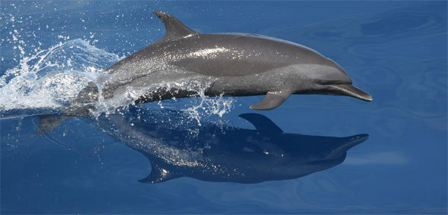
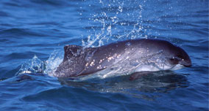
Dolphin vs. Porpoise
Photo credit: NOAA
Photo credit: NOAA
Photo credit: NOAA
They live in different climates, and have different shaped rostrum, dorsal fin and teeth.
Notes:
Dolphins and porpoises are both groups of toothed whales, but they are different from each other. Dolphins tend to have a longer rostrum and cone-shaped teeth, while porpoises have smaller rostrums, a rounded head, and flat teeth. If you look carefully at the two photographs, you may notice that the dolphin has a taller, hooked or curved dorsal fin, while the porpoise has a triangular dorsal fin. Dolphins tend to live in warmer waters, and porpoises often live in colder areas. Dolphins are more talkative than porpoises. Dolphins make whistling sounds through their blowholes to communicate with one another underwater. Scientists are pretty sure that porpoises do not do this.

Slide 18
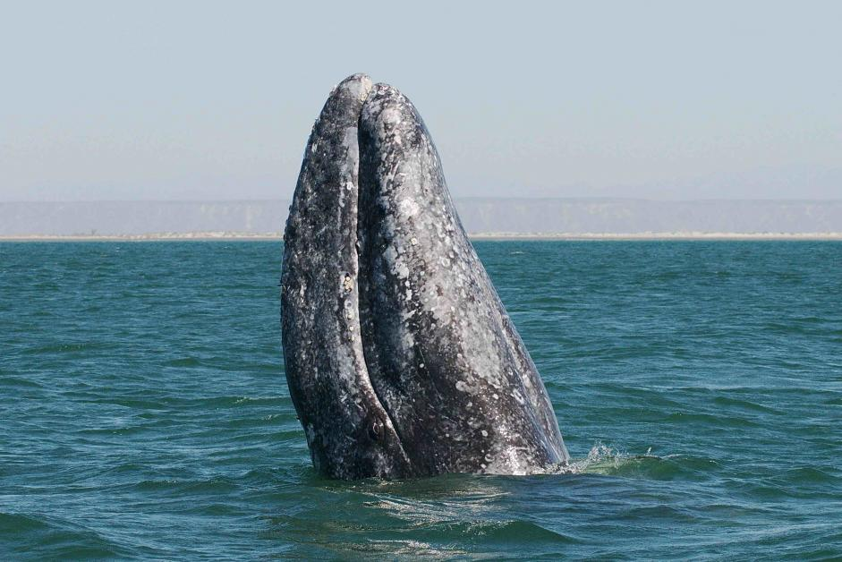
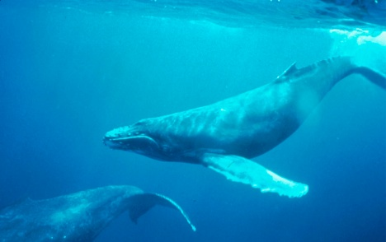
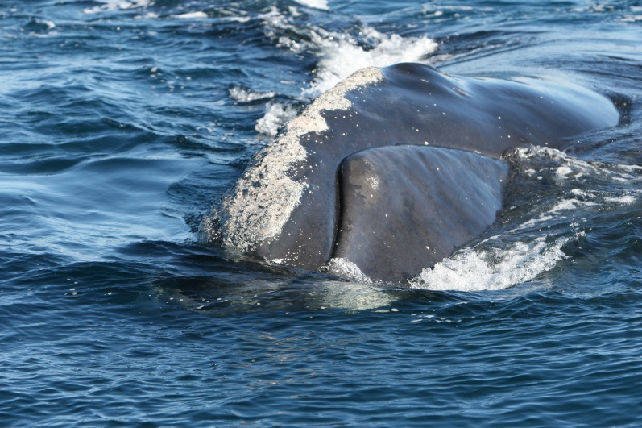
Baleen Whales (Mysticetes)
Photo credit: Dave Weller/ NMFS
Photo credit: NOAA
Taken Under NOAA Permit
Notes:
There are only about 14 species of baleen whales or mysticetes. [Top left photo] Gray whales are only found in the Pacific Ocean, so we will not see them in Florida waters. Mother gray whales go into warm lagoons on Mexico’s Pacific coast to have their calves. Then they migrate north to Alaskan waters to feed in the summer. These whales can be seen migrating along the California coast in late winter and early spring. [Top right photo] Humpback whales are sometimes seen off Florida’s coast, but these whales can also be found almost worldwide. [Bottom photo] North Atlantic right whales can sometimes be seen of the northeast coast of Florida in the winter months.

Slide 19
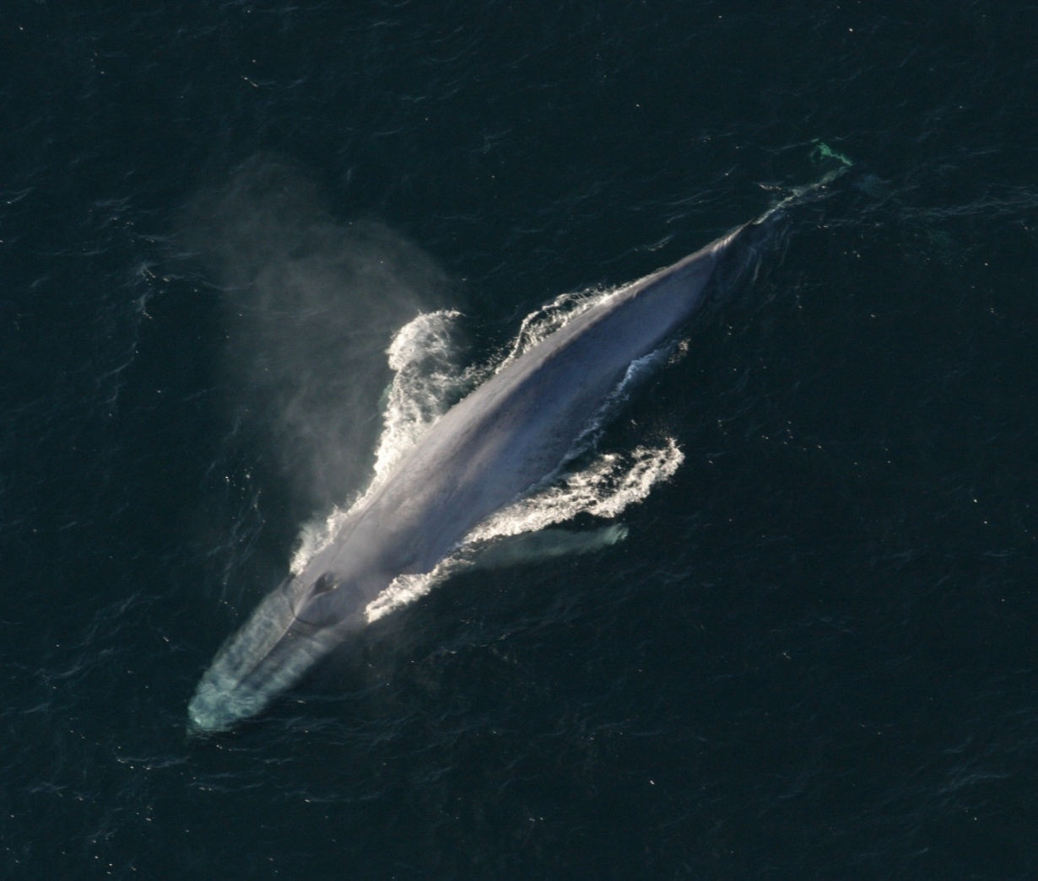
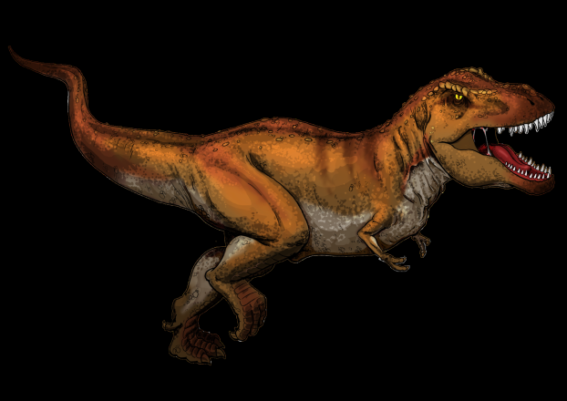
Baleen Whales are the Largest Animals on Earth!
Photo credit: NOAA
Blue whales can reach almost 100 ft. in length
Blue whales are larger than the largest dinosaur!
No way!
Image credit: myfavoritedinosaur.com
The heart of a blue whale is
the size of a small car.
Notes:
Mysticetes are very large whales. This group includes the blue whale: the largest creature ever to live on our planet. Blue whales can grow up to 100 feet, making them larger than the largest dinosaur. The heart of a blue whale is the size of a small car. Blue whales were almost hunted to extinction in the early 1900s because whale blubber was a valuable source of oil. Today we get oil from other sources. The blue whale population is slowly recovering and increasing.
T rex image: http://commons.wikimedia.org/wiki/File:Tyrannosaurus_Rex_colored.png
Thinkstock Item number: 186373415

Slide 20
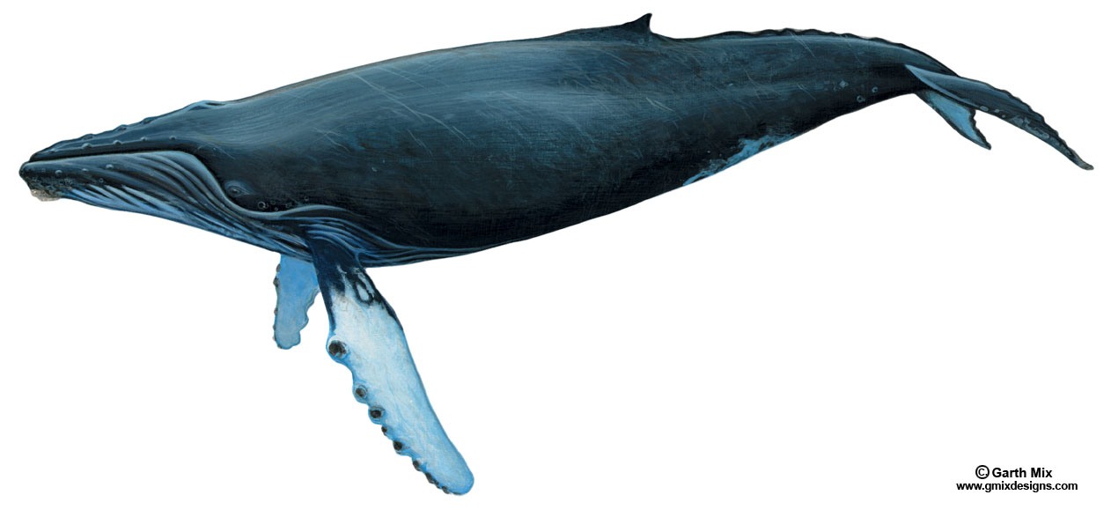
Whale Anatomy (Humpback Whale)
Blowholes
Dorsal Fin
Throat Pleats
Fluke
Eye
Flipper
Notes:
This is a humpback whale, which is a mysticete. Notice this whale has a small dorsal fin. Humpback whales have long flippers and a large tail fluke. They also have throat pleats, or skin folds, which allow them to stretch their throat open really wide when feeding. Like all mysticetes, the humpback whale has two blowholes.

Slide 21
Whale Anatomy (Right Whale)
Blowholes
No dorsal fin
(some whales have a small dorsal fin)
Eye
Fluke
Flipper
Notes:
This is a North Atlantic right whale. Unlike the humpback whale, right whales do not have a dorsal fin. Right whales have short flippers. They also have two blowholes located on the top of their heads.

Slide 22
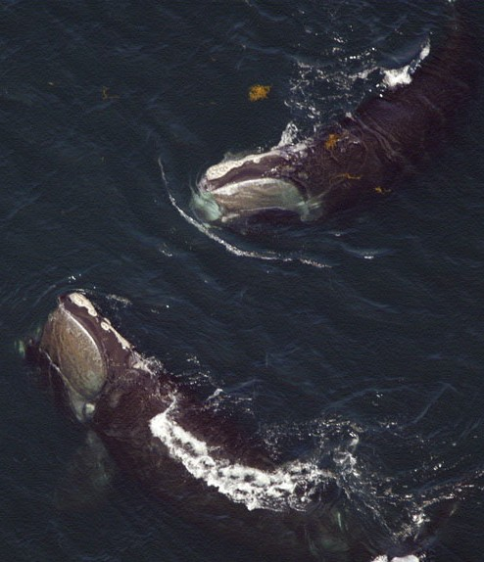
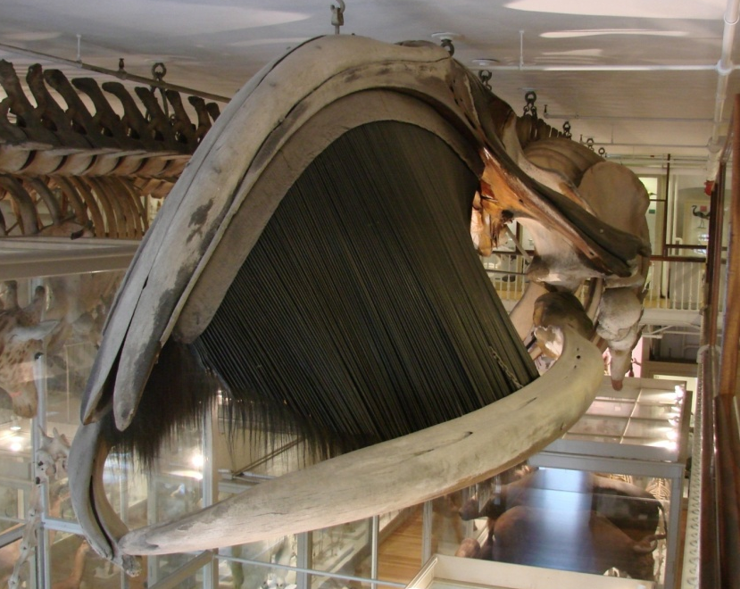
Baleen whales do NOT have Teeth
Baleen
Photo credit: M McGuire
Photo credit: Taken Under NOAA Permit
Notes:
In some ways, baleen whales are very different from toothed whales. Instead of teeth, they have large baleen plates in their mouth that hang down from their upper jaw. These baleen plates are made of the same material as our fingernails. [Top right photo] In this photograph of a right whale skeleton, you can see the dark baleen. The sheets of baleen are frayed on the inside—these hair-like strands are used to trap the tiniest of sea creatures—like zooplankton and small fish—which are then swallowed in very large numbers. [Top left photo] In this photo two right whales are feeding at the surface.

Slide 23
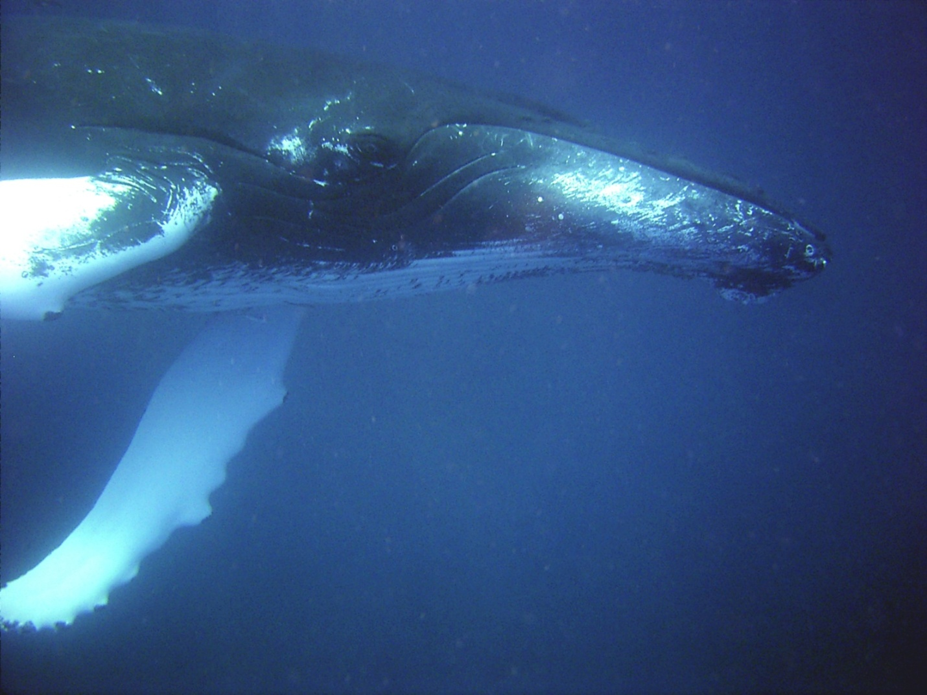
Mysticetes do NOT have Echolocation
Photo credit: NOAA
Notes:
Baleen whales do not have echolocation. Scientists are still unsure how baleen whales find the dense patches of food they are known to feed on.

Slide 24
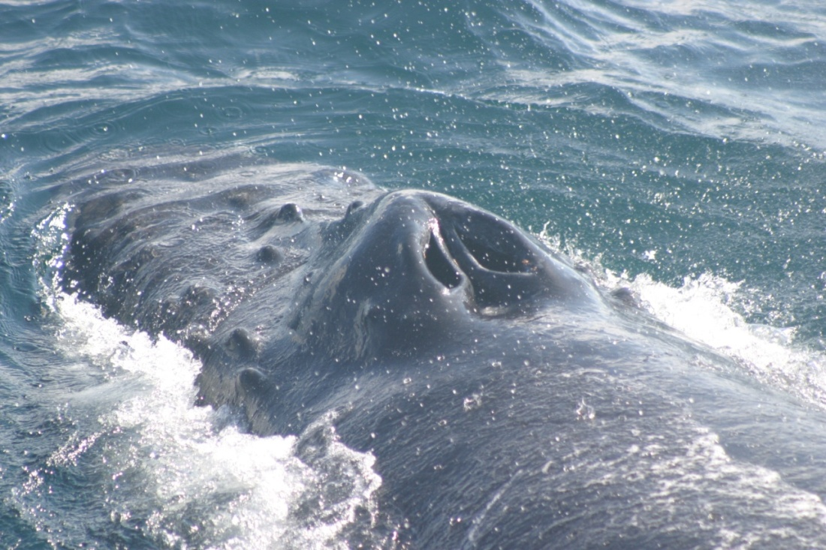
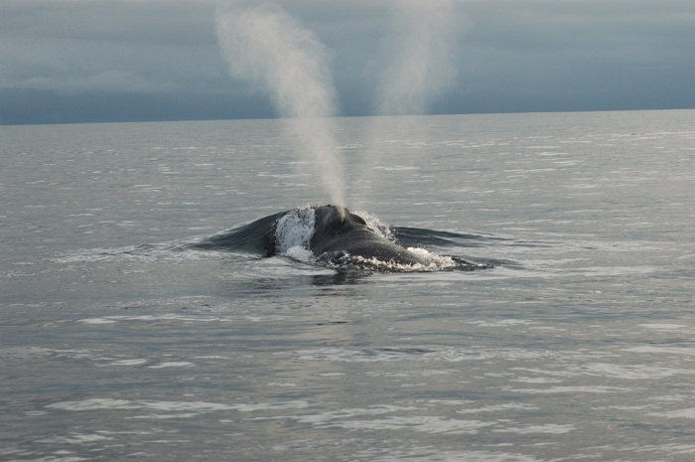
Mysticetes have TWO Blowholes!
Photo credits: Taken Under NOAA Permit
Right whales produce a v-shape blow.
Notes:
Baleen whales have two blowholes rather than the one found on toothed whale species. [Left photo] The blowhole area of a mysticete shows two distinct openings, similar to our nostrils. [Right photo] When the whale exhales, water droplets can make its breath visible. This is called the “blow”.

Slide 25
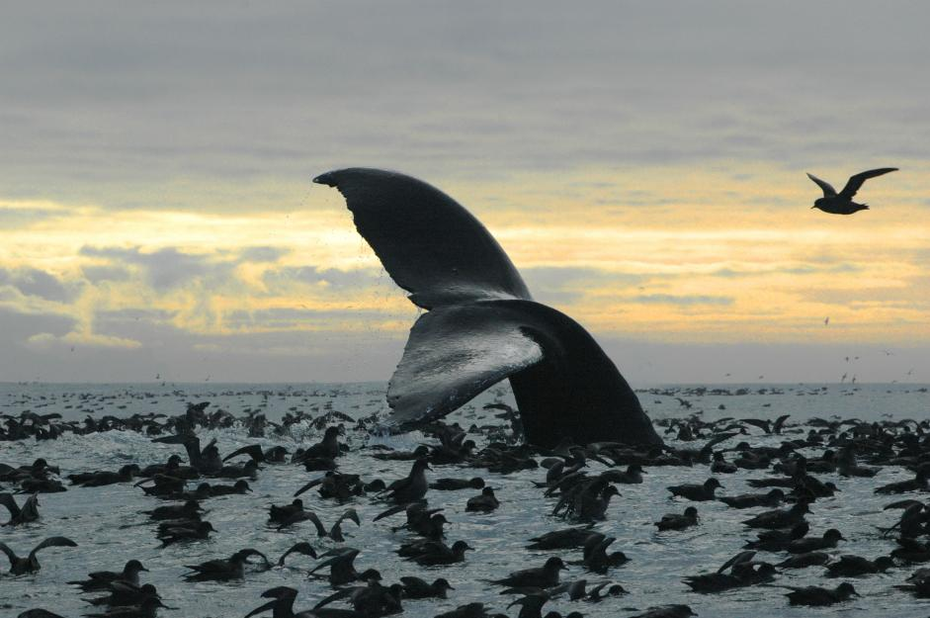
What Have You Learned?
Photo credit: NOAA
Notes:
Let’s review what we have learned today. What are the two different groups of cetaceans? [toothed (odontocetes )and baleen, (mysticetes)]. How are these two groups similar? [they are whales/mammals; they have flippers, fluke and dorsal fin, etc.] How are they different? [teeth vs baleen; one blowhole vs two; echolocation or not; eat different types of food]

