Slide 1
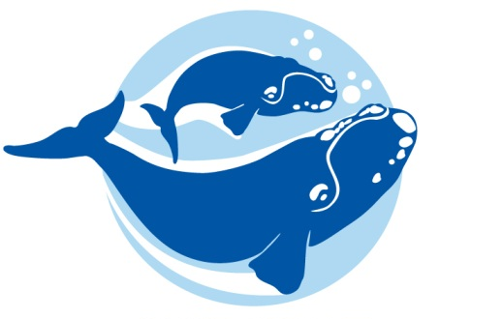
Slow Down…
Whale Crossing!
Notes:
This presentation contains background information on North Atlantic right whales and ship strikes; and the conservation methods put into place in order to decrease right whale deaths due to ship strikes.

Slide 2
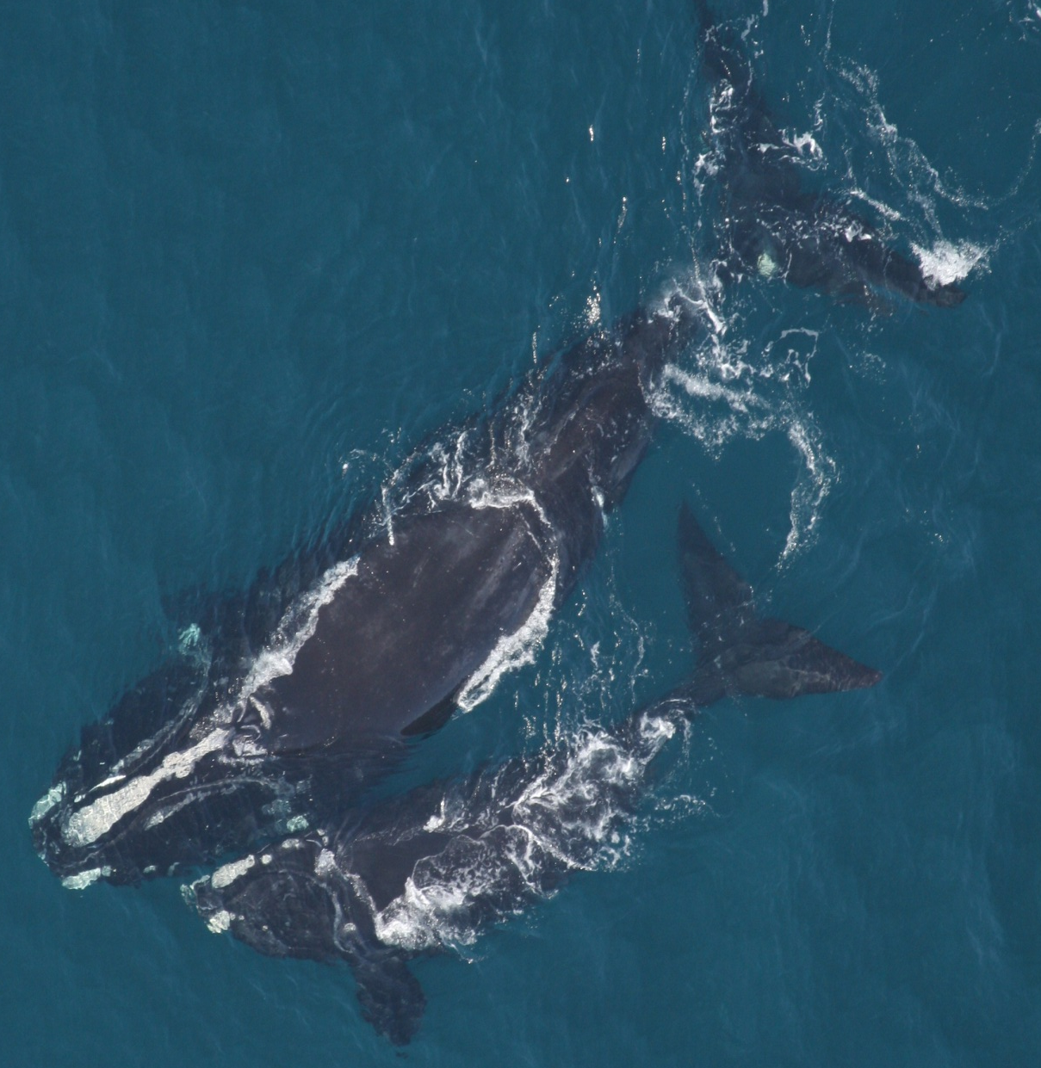
North Atlantic right whales have been protected from hunting since 1935. Scientists estimate that there were about 100 right whales at that time. Over 75 years later, as few as 450 whales exist.
Photo credit: NOAA
Taken under NOAA Permit
Why so few?
Notes:
[Read slide] Why do you think there are so few North Atlantic right whales in the ocean today compared to years ago? [Write student responses on the board. Hunting, entanglement and ship strikes are all good answers.]

Slide 3
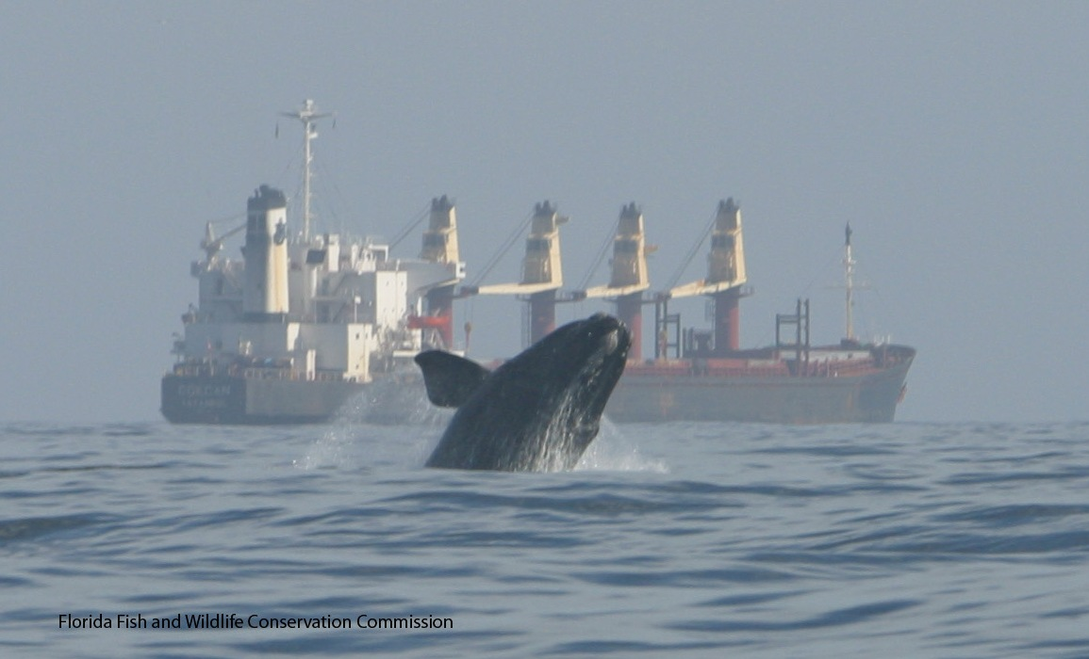
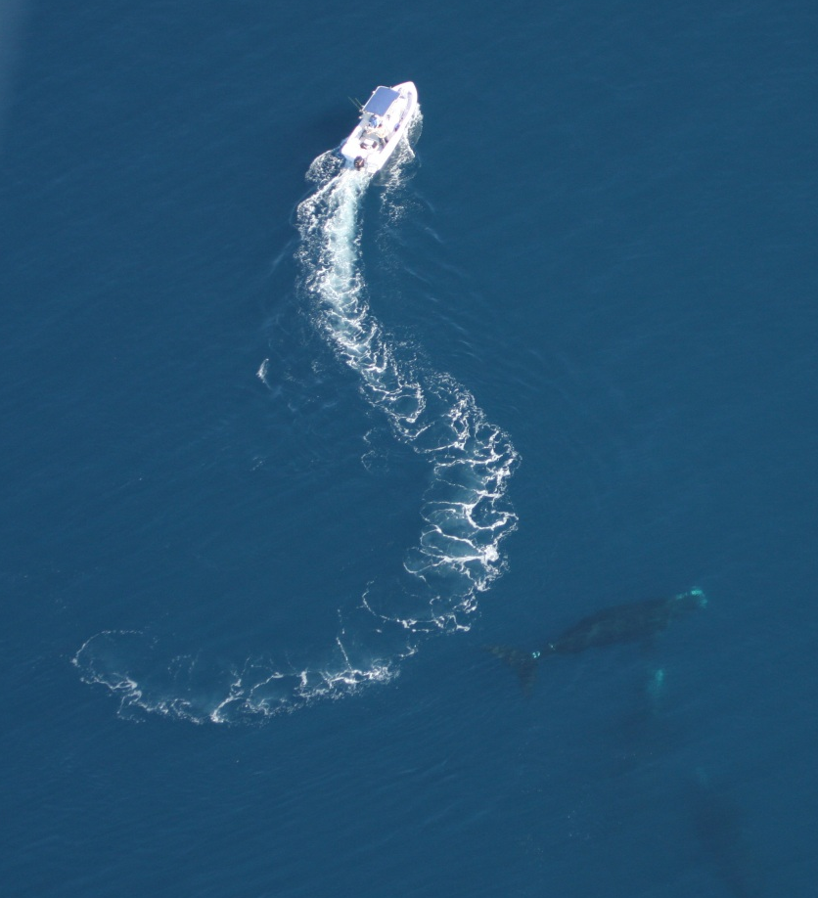
Vessel Strikes
Photo credit: FWC; taken under NOAA Permit # 665-1652
Notes:
In this lesson, we are going to focus on the threat of ships and boats (also called vessels) hitting whales.

Slide 4
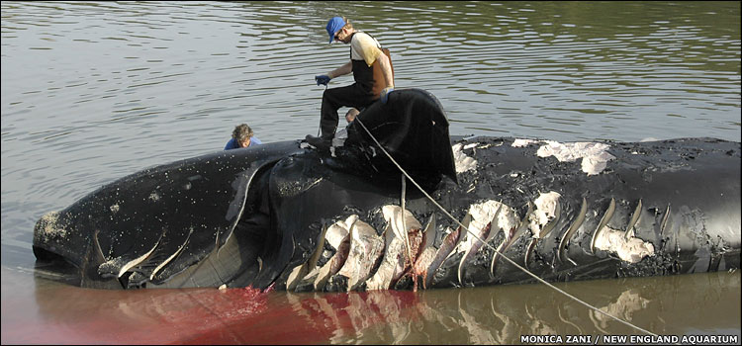
Scientists estimate that 30-40% of right whale deaths are caused by vessel strikes.
Notes:
[Read slide]. Vessel strikes are one of the greatest human threats to North Atlantic right whales. The force of the vessel’s impact and cuts from propellers can kill whales.
Whale photo permission from William F. Bennett, Ph.D. Webmaster, New England Aquarium Wed, June 27, 2012 3:20; www.news.bbc.co.uk

Slide 5
Why do so many whales get hit by ships & boats?
Notes:
The ocean is very large, and there are not very many right whales. So why do so many of these whales get hit by boats?

Slide 6

There are 3 main reasons why whales are in danger of being hit by vessels.
Whales’ appearance
Whales’ behavior
Whales’ habitat
Notes:
North Atlantic right whales are vulnerable to being hit by vessels because of where they live and migrate (their habitat), their appearance, and their behavior. We will discuss each of these separately.
Image credit: This Photo by Unknown Author is licensed under CC BY-NC-ND

Slide 7
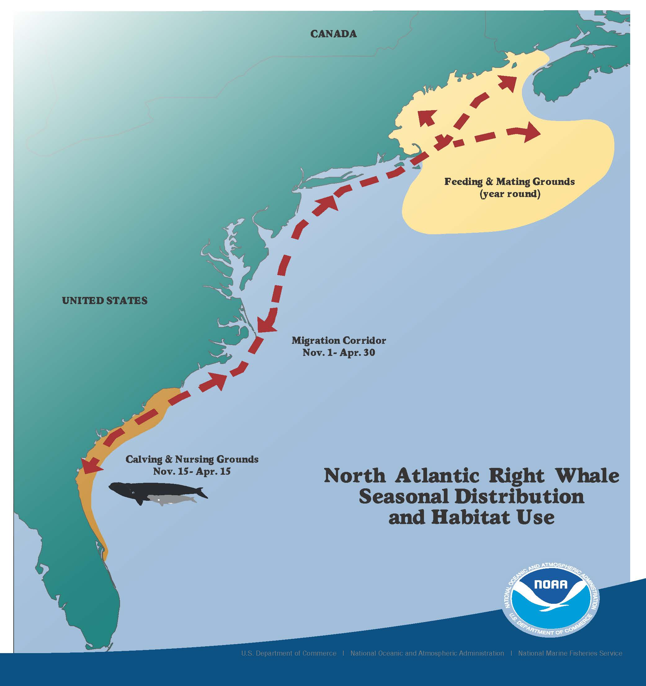
Habitat
Area is also used by many types of vessels
Notes:
As we have learned in other lessons, North Atlantic right whales migrate along the east coast of the U.S. from their northern feeding and mating ground to the southern calving area. Right whales are often found within 20 miles of shore. Many ships and boats pass through this area as they come into port or move offshore.

Slide 8
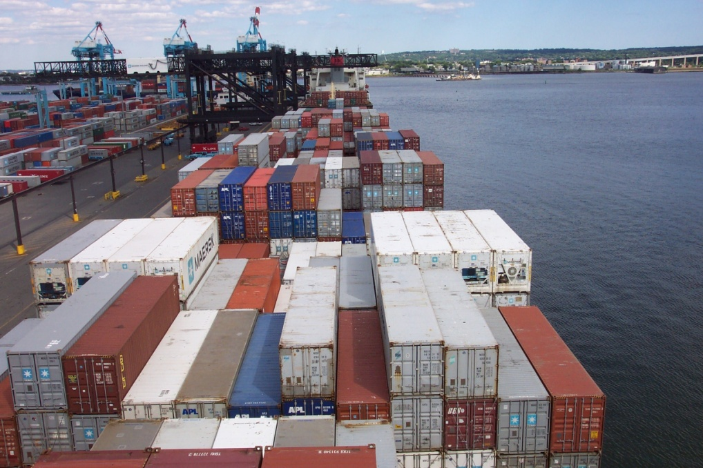
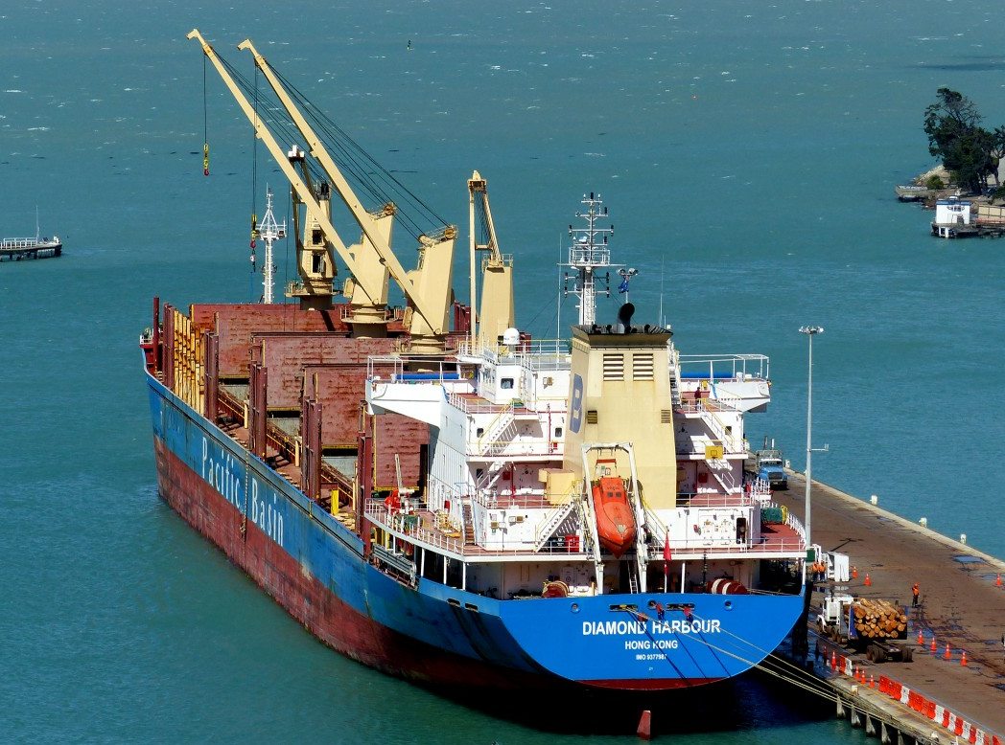
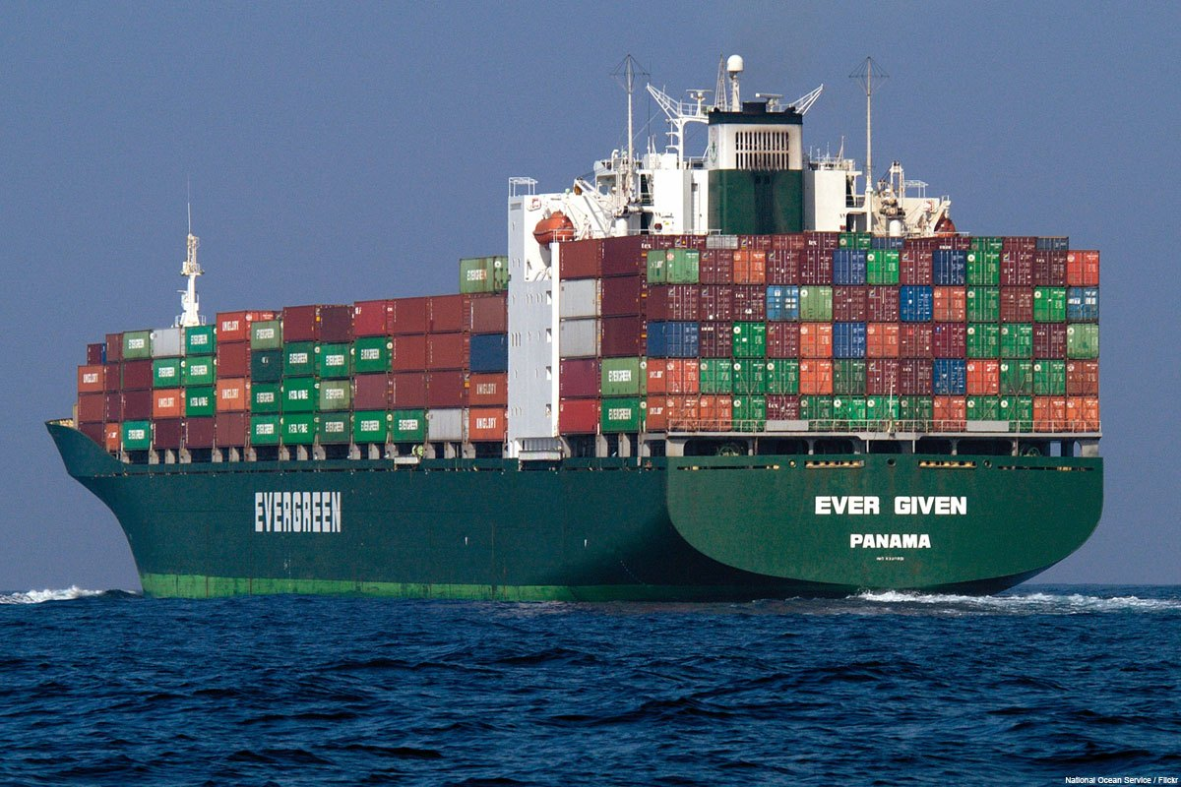
Shipping Ports
Photo credit: NOAA
The Southeast U.S. is home to some of the biggest shipping ports in the world.
Notes:
Shipping ports are places where ships and boats can dock to load and unload what they are carrying. The southeastern U.S. is home to some of the biggest shipping ports in the world. Many shipping ports, like Boston, Massachusetts and Jacksonville, Florida are near areas where right whales spend a lot of time.
Photo upper right: https://c.pxhere.com/photos/c0/63/diamondharbourship_vessel_bulkcarrier_lyttleton_shipping_port_lumixfz200_publicdomaindedicationcc0-575672.jpg!d
Photo bottom: This Photo by Unknown Author is licensed under CC BY-SA-NC

Slide 9
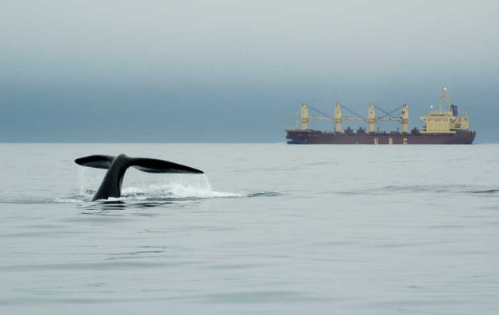
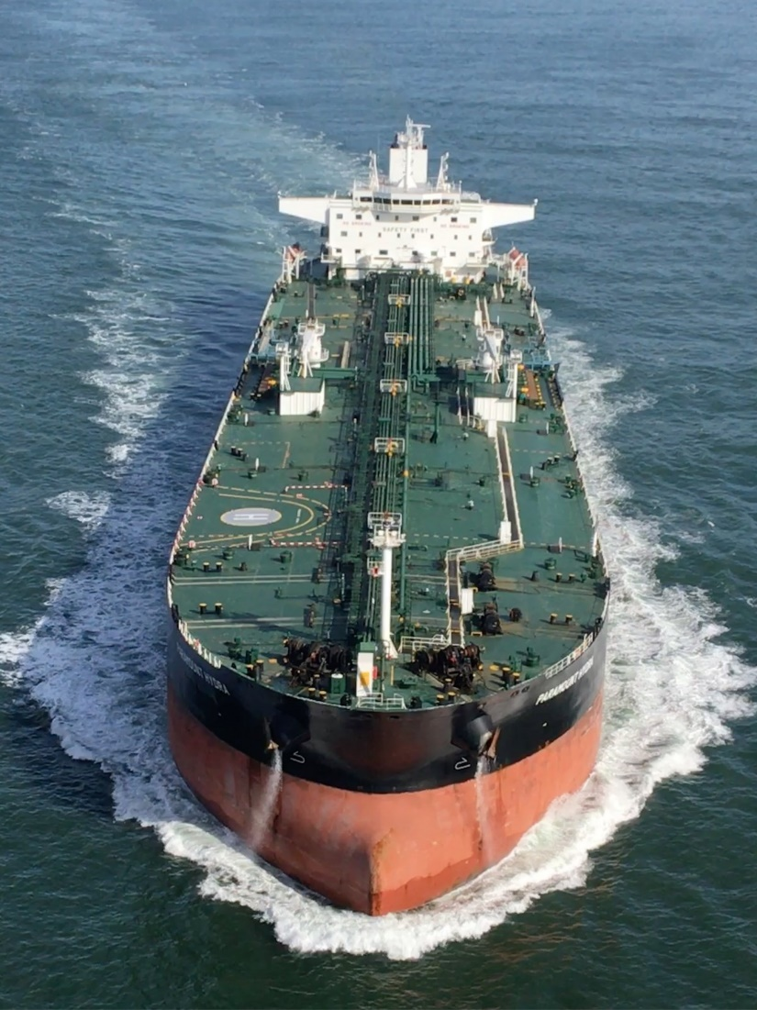
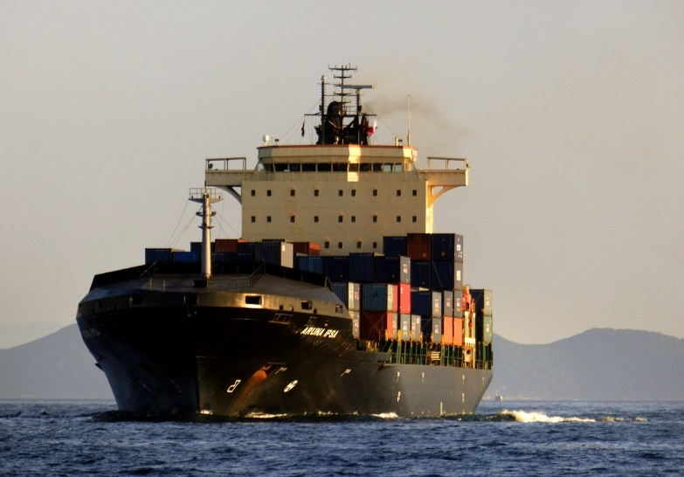
Photo Credit: NOAA
Some shipping lanes pass through whales’ habitats
Notes:
Even though we do not have roads in the ocean, ships often use specific routes to travel from one place to another—we call these routes “shipping lanes.” Ships use shipping lanes because they have deep enough water, the currents go in the right direction, and so on. Many shipping lanes are located in the North Atlantic right whale habitat.
Cargo ship on left: https://c.pxhere.com/images/72/08/68914f849a8f24b0baaab4562eaf-1423603.jpg!d
Bottom right: https://c.pxhere.com/photos/1f/8d/arunaipsa_containership_shipping_vessel_cargo_hongkong_lumixfz200_bridgecamera-431492.jpg

Slide 10
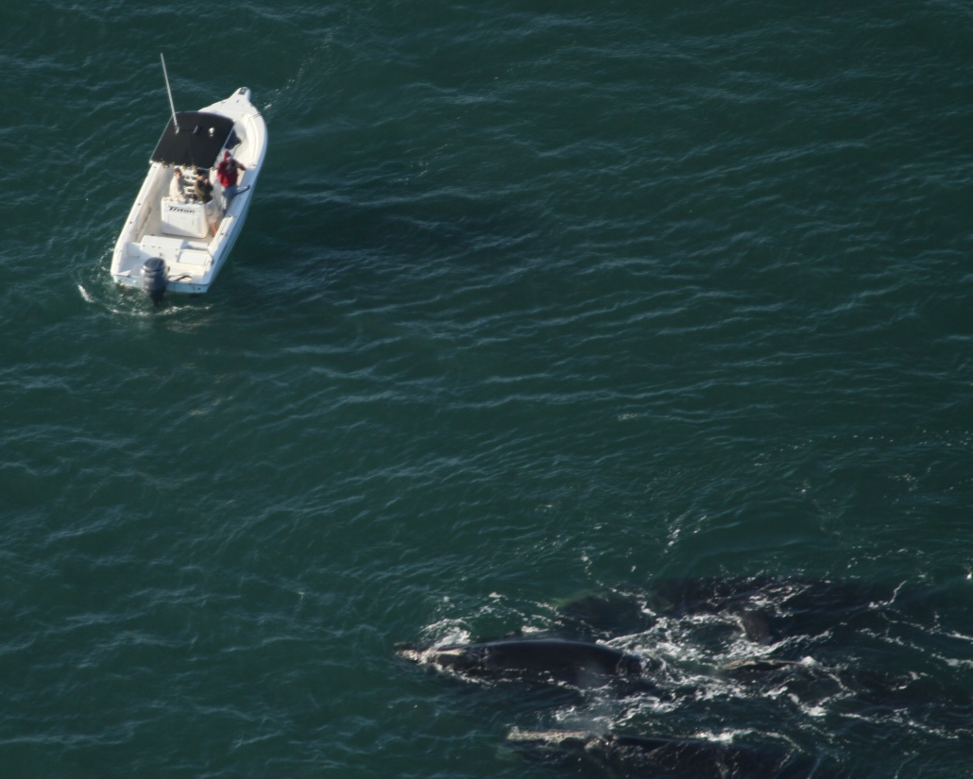
Recreational Boating
The warm weather in the Southeast U.S. attracts many recreational boats. These include yachts, fishing boats, and many other vessels.
Taken under NOAA Permit
Notes:
Large ships are not the only type of vessel that can hurt right whales. Even a collision with a small recreational boat can kill whales.

Slide 11
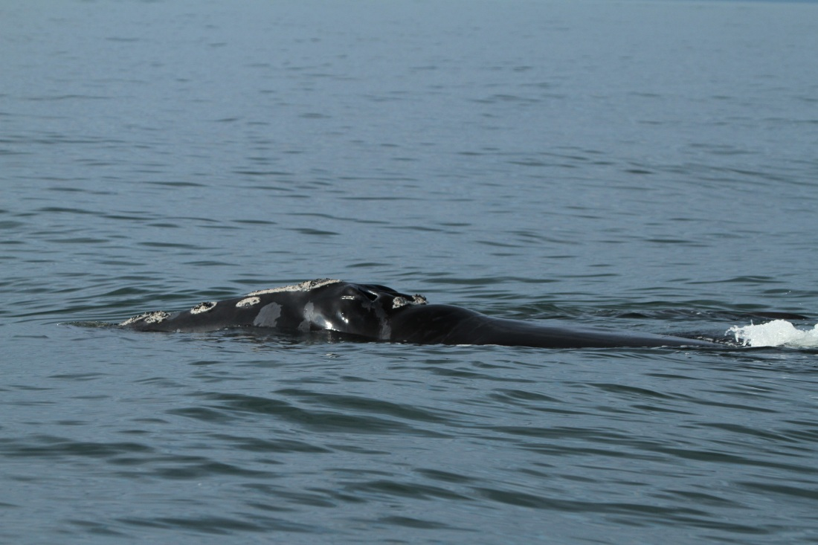
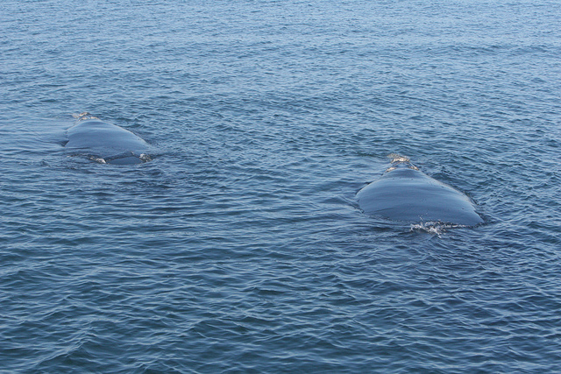
Appearance
Mariners have a hard time seeing North Atlantic right whales…
Photo credit: Barb Zoodsma, NOAA
…because they are dark in color and have no dorsal fin.
Photo credit: FWC, taken under NOAA Permit # 775-1875
Notes:
Why does the right whale’s appearance make it likely to be hit by a ship? Mariners (people in charge of seagoing vessels) have a hard time seeing the whales in the water because the whales are dark and don’t have dorsal fins.
NOAA photo permission - http://www.nmfs.noaa.gov/gallery/images/photos/html
Wed, August 8, 2012 3:40 pm - "NOAA Webmaster" webmaster@noaa.gov

Slide 12
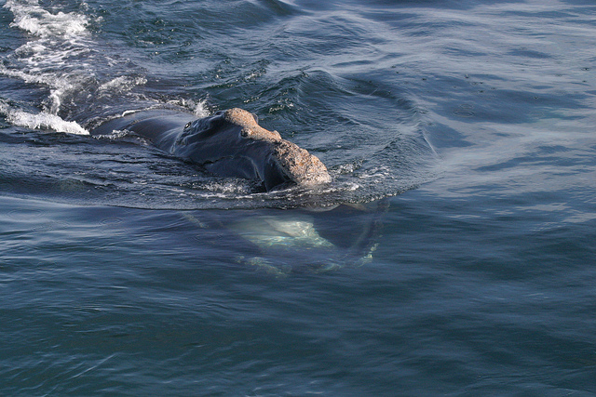
Behavior
North Atlantic right whales spend a lot of time at the surface of the water. This makes them more vulnerable to ship strikes.
Photo credit: Massachusetts Energy and Environmental Affairs; NOAA Permit # 14603
Notes:
How does a right whale’s behavior increase the risk of a ship strike? Right whales tend to stay near the surface of the ocean, and they usually only have a very small portion of their head (and sometimes back) sticking out of the water when they breathe.
http://www.flickr.com/photos/masseea/5621839007/

Slide 13
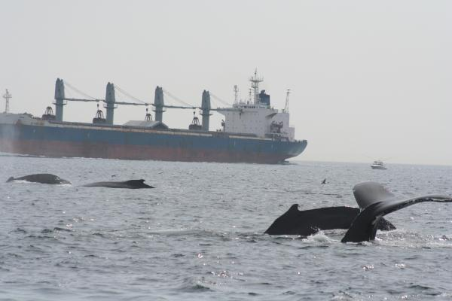
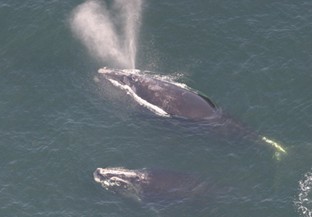
Right Whales are not good at detecting ships and are slow swimmers!
Photo credit: NOAA
Photo credit: NOAA/NEFSC Peter Duley, NOAA Permit # 775-1875
These two behaviors make it hard for them to avoid ships or swim out of the way in time to avoid danger.
Notes:
Like other marine mammals, whales do not know that boats can be dangerous to them. Have any of you ever seen a wild animal crossing a road? These animals often do not realize that cars can hurt them. Even if a whale did know that a ship was dangerous, ships often travel faster than the whales, so it would be difficult for the whale to get out of the way quickly enough.
L: http://www.nmfs.noaa.gov/gallery/images/photos/html
R: http://www.nmfs.noaa.gov/pr/species/mammals/cetaceans/rightwhale_photos.htm

Slide 14
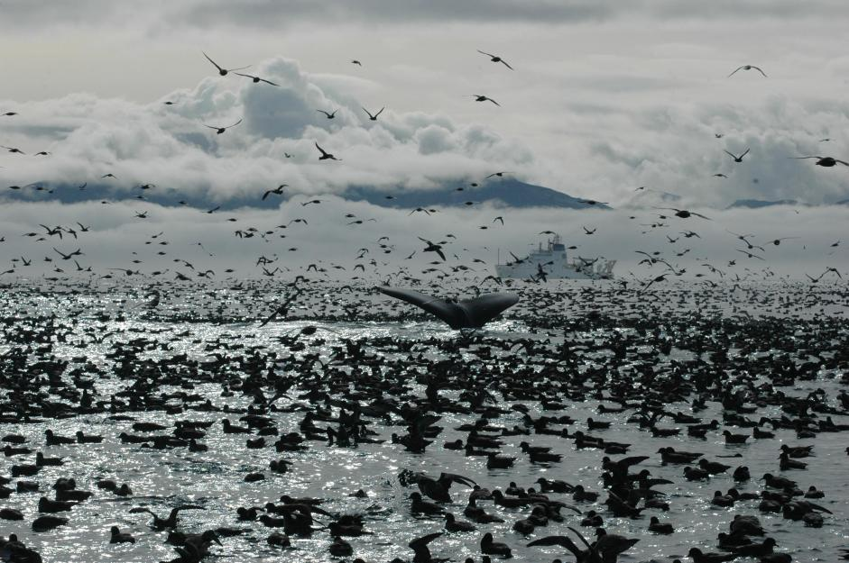
If you were the captain of this ship, do you think you would have a hard time seeing the whale?
Photo credit: NOAA
Notes:
[Read slide]
NOAA photo permission - http://www.nmfs.noaa.gov/gallery/images/photos/5575312384.html
Wed, August 8, 2012 3:40 pm - "NOAA Webmaster" webmaster@noaa.gov

Slide 15
What is being done to
protect right whales?
There have been many different conservation measures put into place to help the North Atlantic right whale population:
Early Warning System
Ship Strike Reduction Rule
No Approach Rule (500 yards)
Education & Outreach
Notes:
There are many conservation efforts to help protect North Atlantic right whales. These include the Early Warning System, laws and regulations such as the Ship Strike Reduction Rule and No Approach Rule, as well as extensive education and outreach for mariners and boaters. We are going to talk more about each of these.

Slide 16
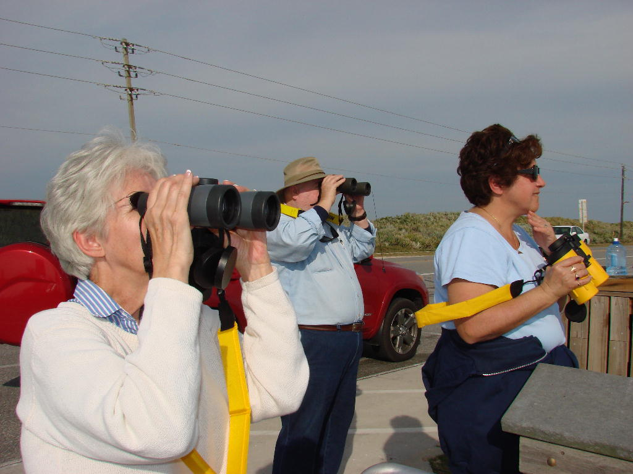
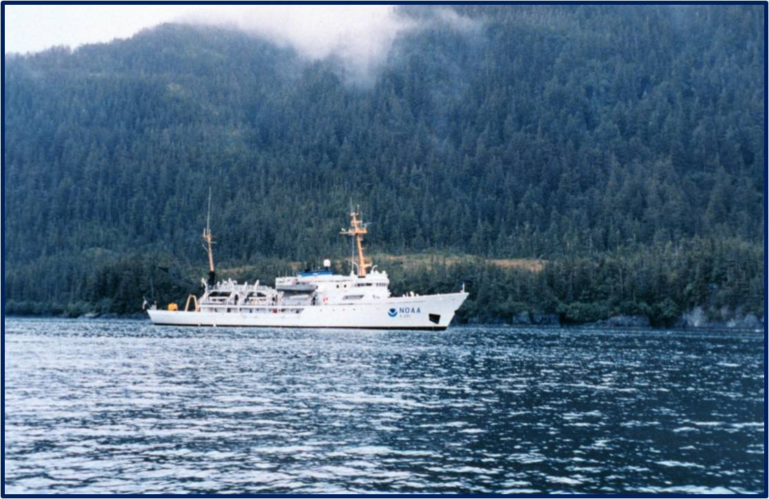
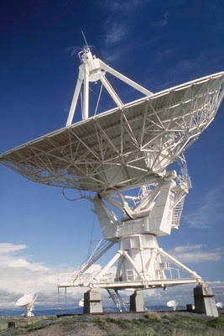
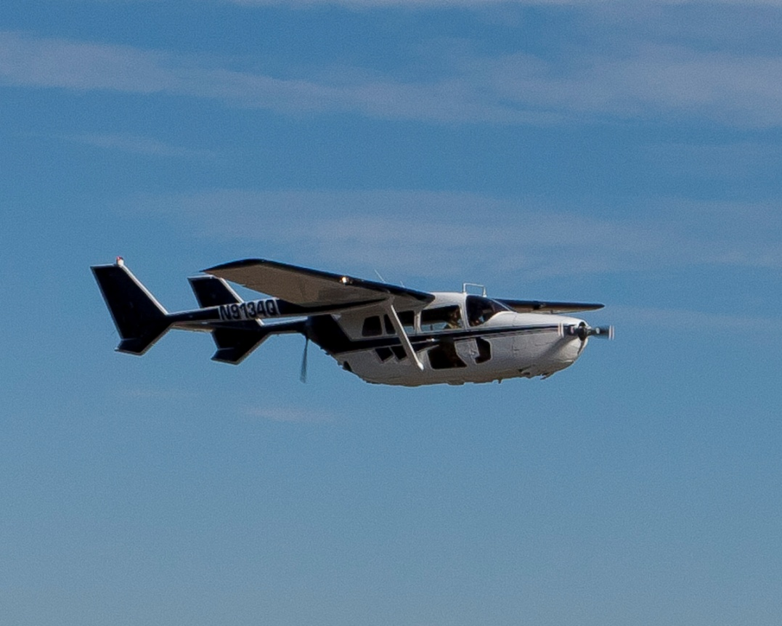

Early Warning System
Photo credit: Frank Gromling
Photo Credit: NOAA
ASSIST-U.S. Cessna 337 (O2)
Notes:
To try to help protect North Atlantic right whales, a program called the Early Warning System was started in 1993. The Early Warning System relies on planes flying over the North Atlantic right whale’s critical habitat areas to perform aerial surveys. These surveys are done in the calving area during winter months and in the feeding grounds at other times of year. People in the planes act as “spotters” and use binoculars to look for whales in the water below. If an aerial surveyor spots a right whale, they relay the GPS location of the whale to everyone in the area who should know to look out for a whale. “Everyone in the area” includes commercial mariners, US Navy, harbor pilots, Army Corps of Engineers, US Coast Guard, port authorities, and recreational boaters.
If a ship captain receives a radio notice that there is a whale nearby, they have to assign a crew member to look for the whale. They also need to communicate with other ships in the area in case one of them spots the whale. This helps everyone figure out exactly where the whale is. The ships need to avoid the whale, and should not steer in a direction that would put the ship in front of the whale. The closer a ship is to a whale, the more it needs to slow down to minimize injury in case of an accidental collision.
Plane photo – email permission given – photo credit: ASSIST-U.S. Cessna 337 (O2) by Carolyn Abbott | Mon, August 20, 2012 8:42 pm
;NOAA photo permission - http://www.nmfs.noaa.gov/gallery/images/photos/html
Wed, August 8, 2012 3:40 pm - "NOAA Webmaster" webmaster@noaa.gov
Satellite dish: This Photo by Unknown Author is licensed under CC BY-NC-ND

Slide 17
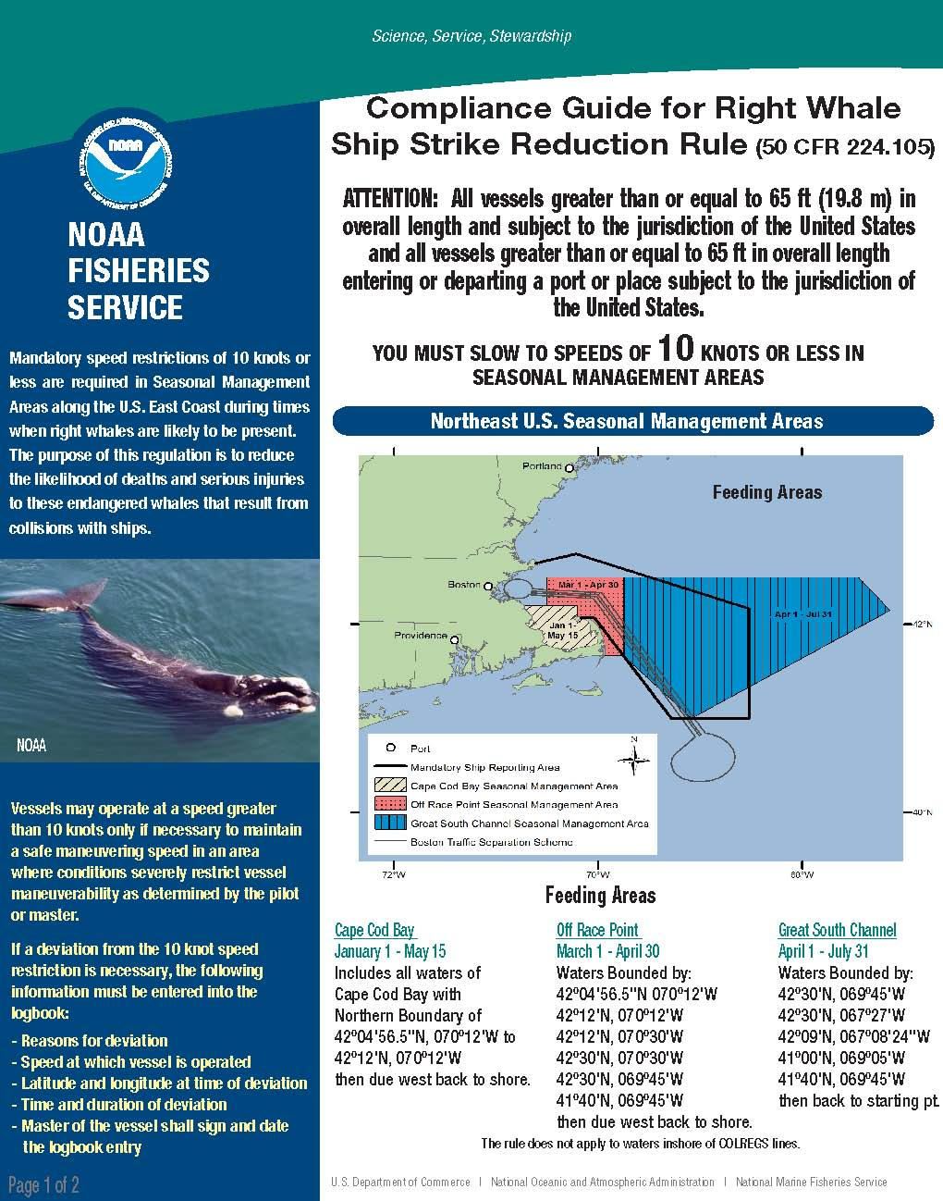
Right Whale Ship Strike Reduction Rule
All large vessels (65 ft. or greater) must slow to speeds of 10 knots or less while traveling within the seasonal management areas
Notes:
In 2008, the Right Whale Ship Strike Reduction Rule was started. This rule requires ships that are more than 65 feet long (about 10 feet longer than a right whale!) to slow down to 10 knots (about 11.5 miles/hour) in certain areas at certain times of the year.

Slide 18
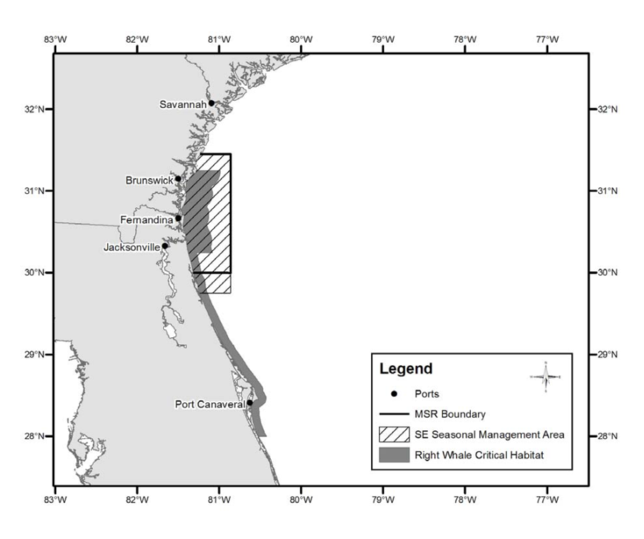
Nov 1-Apr 30 (migration route)
Nov 15-Apr 15 (calving season)
Notes:
In the next couple of slides, we will see where the Right Whale Ship Strike Reduction Rule is in effect. Off the northeast Florida and Georgia coasts, ships must go slowly during calving season. From November 1 through April 30, ships entering major ports along the east coast of the U.S. between Georgia and Massachusetts must slow down because there could be migrating right whales present.
Maps from http://www.nmfs.noaa.gov/pr/pdfs/shipstrike/map_sma.pdf

Slide 19
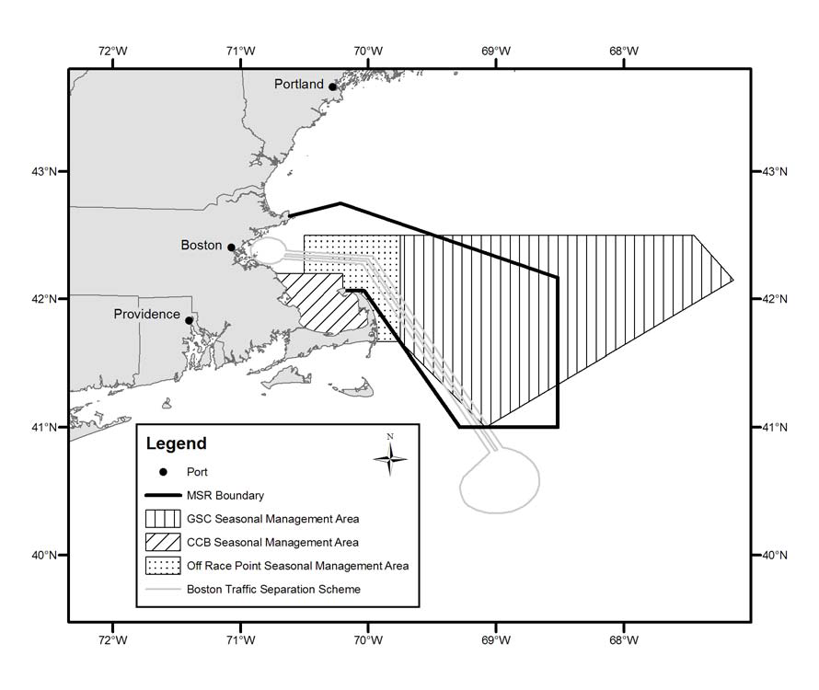
Timing of speed restrictions depends on presence of whales…
Notes:
Off Boston and Cape Cod, right whales may feed year-round. If whales are present, ships must slow down no matter what time of year it is.
Map from http://www.nmfs.noaa.gov/pr/pdfs/shipstrike/map_sma.pdf

Slide 20
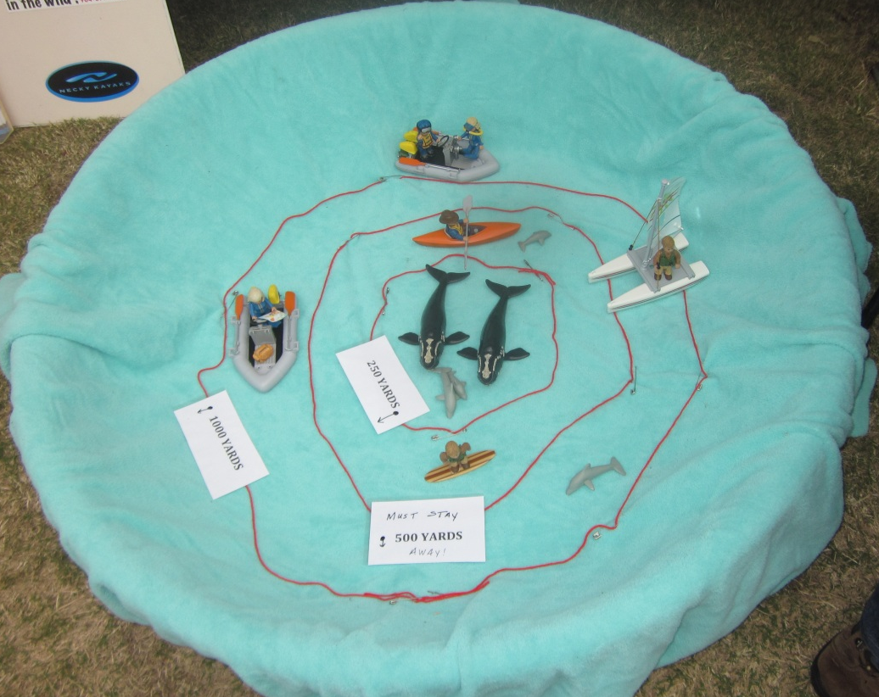
No Approach Rule (500 yards)
It is illegal to be within 500 yards of a right whale.
Photo credit: NOAA
Notes:
The No Approach Rule helps protect right whales from being disturbed by humans. This is especially important for mother whales that are pregnant or nursing newborn calves. The rule says we must not move towards or remain within 500 yards of a right whale. That’s as long as five football fields. If a mother whale is scared by a vessel, kayaker, surfer, paddleboard, Jet Ski or even a swimmer, she may swim away and leave her calf. The baby right whale cannot survive without its mother. Also, if vessels stay 500 yards away from right whales, they minimize the chance that they will hit a whale.

Slide 21
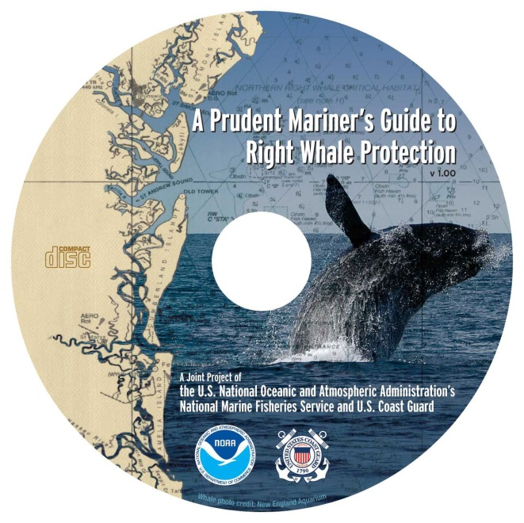
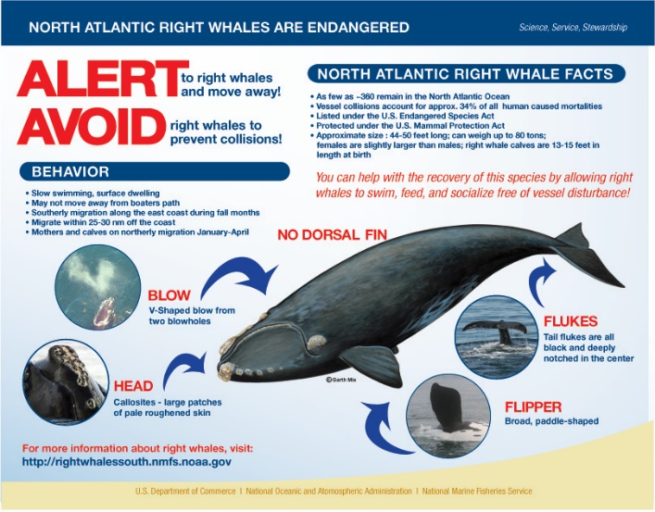
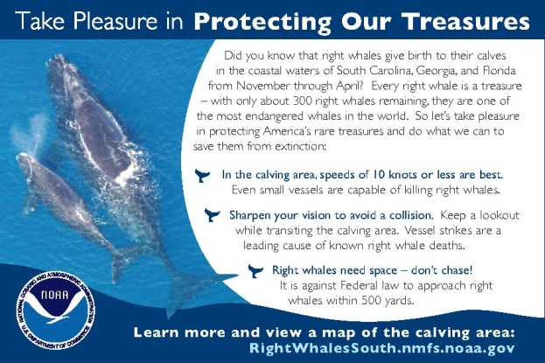
Education & Outreach
Many groups teach about the importance of protecting right whales.
Notes:
Many groups try to teach people about right whales so everyone can help protect them. People have created many types of educational brochures, flyers, coloring pages, and videos. We can all do our part to tell other people what we know.
Images provided by NOAA Fisheries

Slide 22

North Atlantic Right Whale:
Stay 500 Yards Away!
Video: NOAA Fisheries YouTube Channel https://www.youtube.com/watch?v=USVLwzmvzBc&list=UU1vLLVbthgOiXLRTwZCVG2g&index=6
Notes:
We are going to watch two videos that were created to help teach people how they should behave around North Atlantic right whales. [Click on video clip to play it (video is 60 seconds long, and has narration, so you will want to have your sound turned on.] What is the important message taught by this video? [Answer: People need to stay 500 yards away from right whales.]

Slide 23

North Atlantic Right Whale:
Slow to 10 Knots (30 sec.)
Video: NOAA Fisheries YouTube Channel https://www.youtube.com/watch?v=JG9enodDTHU&list=PLqjRqI1v493KYDkjhzeLeRSmdedipgqhA
Notes:
Let’s watch another video. [Click on video clip to play it (video is 30 seconds long)] What is the message of this one? [Answer: Boats need to slow down when whales are nearby.]

Slide 24
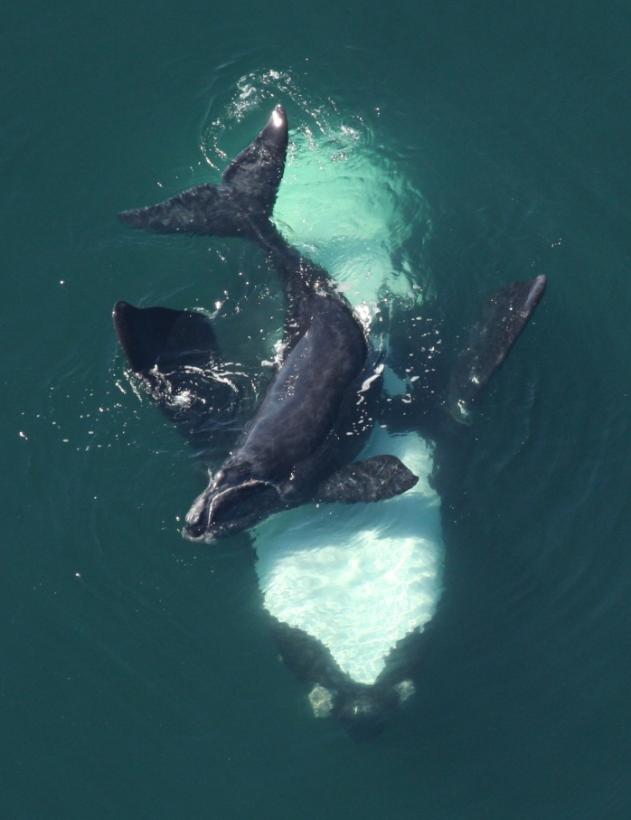
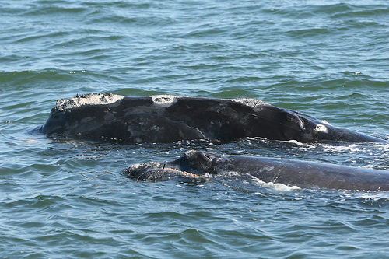
Why protect the North Atlantic
right whale population?
Photo credit: FWC. Taken under NOAA Permit # 15488
Photo credit: FWC. Taken under NOAA Permit # 665-1652
We want right whale calves to grow up and have calves of their own!
Notes:
Why do we have all of these rules in place? We want to try to help the endangered North Atlantic right whale population grow in size. If we keep the existing right whales safe, they can reproduce. This way, the population can continue to increase.

