Slide 1
Lesson 13:
Right Whale Migration
Notes:
Today we are going to learn about North Atlantic right whale migration.

Slide 2
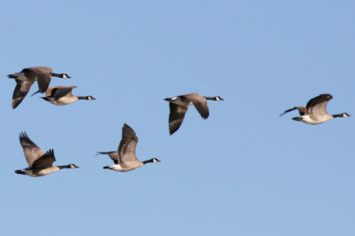
What is migration?
Migration: to pass usually periodically from one region or climate to another for feeding or breeding (Merriam Webster Dictionary)
Do you know any other animals that migrate?
Why do you think right whales migrate?
Notes:
What does “migration” mean? Many animals spend part of the year in one location, but then move to another place for part of the year—often to look for food or to breed. This movement is called migration. Can anyone name an animal that migrates? [Answers include many insects, especially monarch butterflies, many birds, fish and whales] Why do you think right whales migrate? [Write the students’ suggestions on the board. If students don’t have any ideas, prompt them to think about what whales might need in order to survive, and how that might affect where the whales go. Ideas could be to follow food, to look for warmer or colder water, to look for mates etc. Some students might know that right whales come to the Georgia/Florida area in the winter to have their babies.]
Image credit: This Photo by Unknown Author is licensed under CC BY-SA-NC

Slide 3
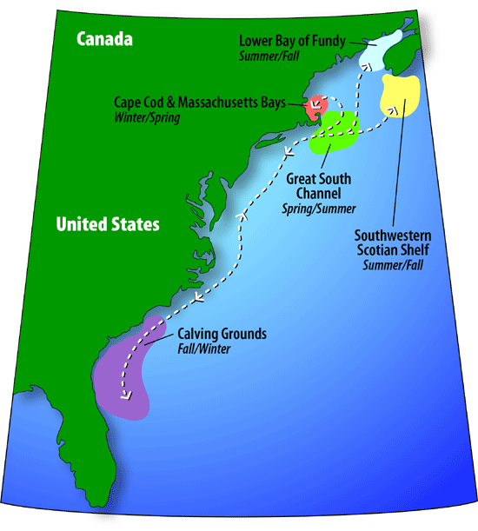
Where do right whales go?
Notes:
This map shows the western Atlantic Ocean and the East Coast of North America. [You may want to point out your location on the map]. In the spring—late February through April—most of the North Atlantic right whales can be found off the coast of New England, especially in the area of Cape Cod Bay, Massachusetts [As you mention each one, indicate the areas on the map]. By May, most of the whales gather in an area just southeast of Cape Cod, where there are large patches of copepods, the plankton that right whales like to eat. In summer and early fall, many of the right whales move into the Bay of Fundy or swim to waters off Nova Scotia where they feed. In the winter, pregnant female whales, accompanied by some juvenile whales and a few other adult whales, migrate about 1,400 miles south to the warmer waters off Georgia and northern Florida. The females give birth to their babies, called calves. Most are born between December and March. The whales do not feed much in this region because there is not a lot of plankton there for them to eat.

Slide 4
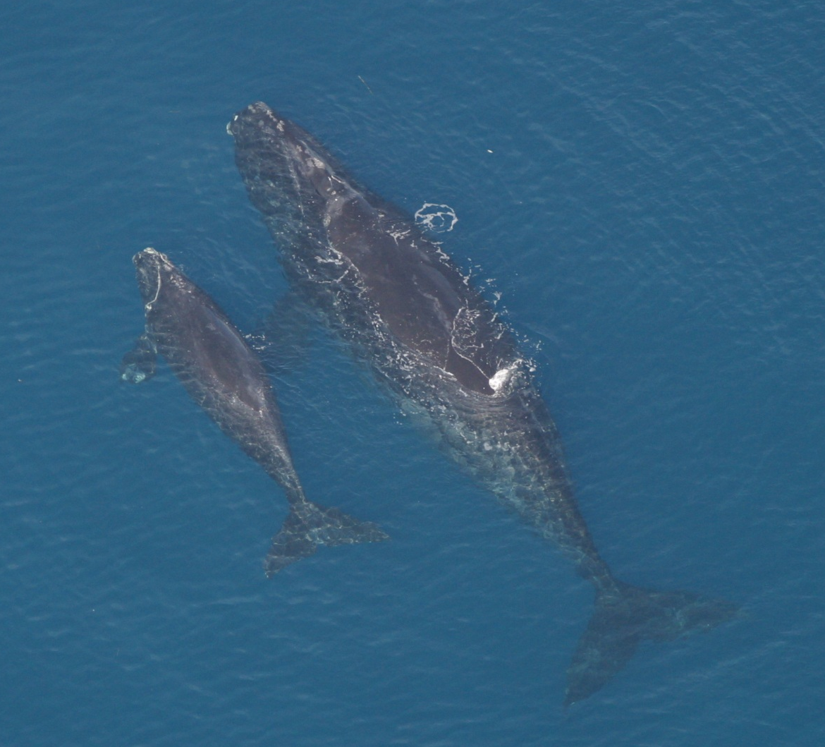
Why do pregnant right whales go south to have their calves?
Taken under NOAA permit
Notes:
Why do you think the pregnant whales come to Florida to have their calves? [As a hint, ask them what is different about Florida compared to Massachusetts in the winter. The water is warmer; baby whales may be less stressed if they are born in warmer water. In the warmer water, however, there is less food for the moms. The mothers need to feed really well before they head south because they will be nursing their calves for a couple of months without much to eat. Studies have shown that pregnant female right whales have thicker blubber than non-pregnant whales. The thicker blubber apparently provides the nutrients and energy needed for milk production.]
http://www.nmfs.noaa.gov/pr/species/mammals/cetaceans/rightwhale_photos.htm

Slide 5
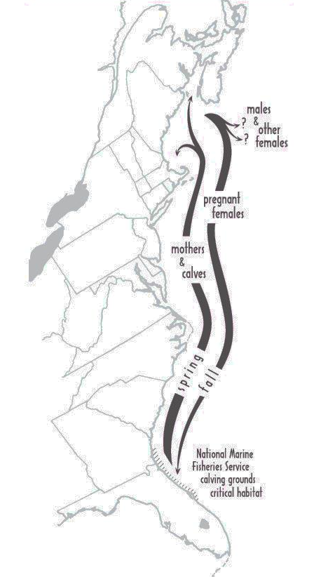
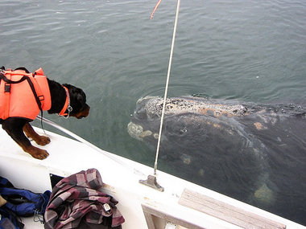
What are the other right whales doing in the winter months?
And how do we know?
Photo credit: New England Aquarium
Image credit: FWC
Notes:
Scientists still have a lot to learn about right whale migration. Where the rest of the adult whales go in the winter is a bit of a mystery, but they probably go where where there is a lot of food. Recently, researchers discovered that some of the whales may stay in the Gulf of Maine through the winter. There may be also be another calving area elsewhere. It is difficult to learn where the other whales are due to the size of the ocean. Additionally, whales can only be spotted from the air when they are near the surface of the water, so it would not be realistic to try and make survey flights covering the entire North Atlantic Ocean year-round. Scientists believe that right whales mate in the winter, as their pregnancies are thought to last for about 13 months. Presumably some of the whales go to mating areas in the winter, but we do not know where those are! Believe it or not, scientists are using whale poop to try and find whale mating areas. They can measure compounds called hormones in the poop samples and tell if the whale is a male or female, and if it is a female that is ready to become pregnant. How do they find the whale poop? By using specially trained dogs that can smell the poop and show the scientists where to look!
Photo permission granted by NEAq (Marianna Hagbloom)—image obtained from http://blog.syracuse.com/cny/2012/03/syracuse_university_professors_research_during_shipping_silence_after_911_helps_link_noise_stress_in.html

Slide 6
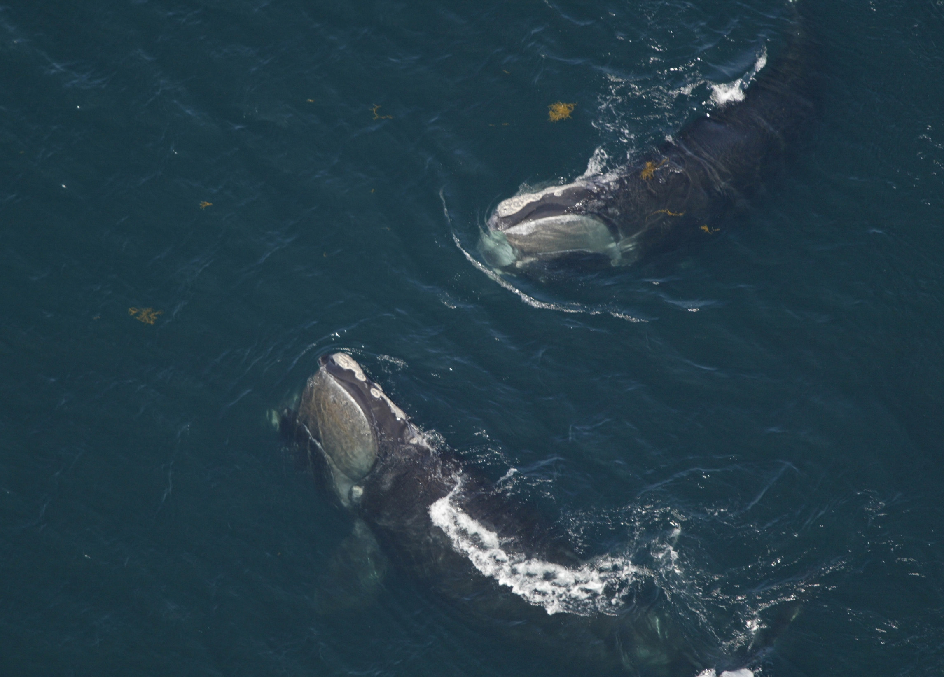
Photo credit: NOAA
Notes:
By late March, the whales that traveled to southern waters are migrating back north to the feeding grounds near Cape Cod.
http://www.nmfs.noaa.gov/pr/species/mammals/cetaceans/rightwhale_photos.htm

Slide 7
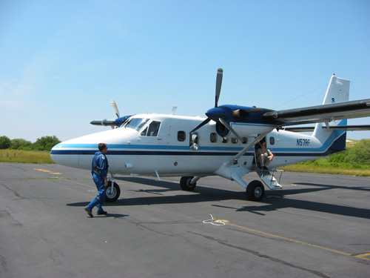
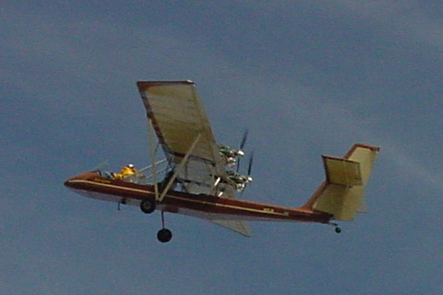
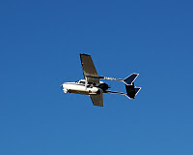
How do we study movement of right whales?
Aerial surveys
  Mostly in Cape Cod area in summer and Georgia/Florida area in winter.
Photo credit: NOAA
Photo credit: Maia McGuire
Photo credit: New England Aquarium
Notes:
We know quite a bit about the whales that come to the southeastern U.S. coast because various agencies and groups make surveys to locate and identify the individual whales. Here you can see pictures of some of the different types of airplanes used to look for whales.
Middle image used with permission from NEAq. Obtained from http://rightwhales.neaq.org/201_11_01_archive.html
NOAA image from http://www.nefsc.noaa.gov/read/protspp/RightWhale/page2.html

Slide 8
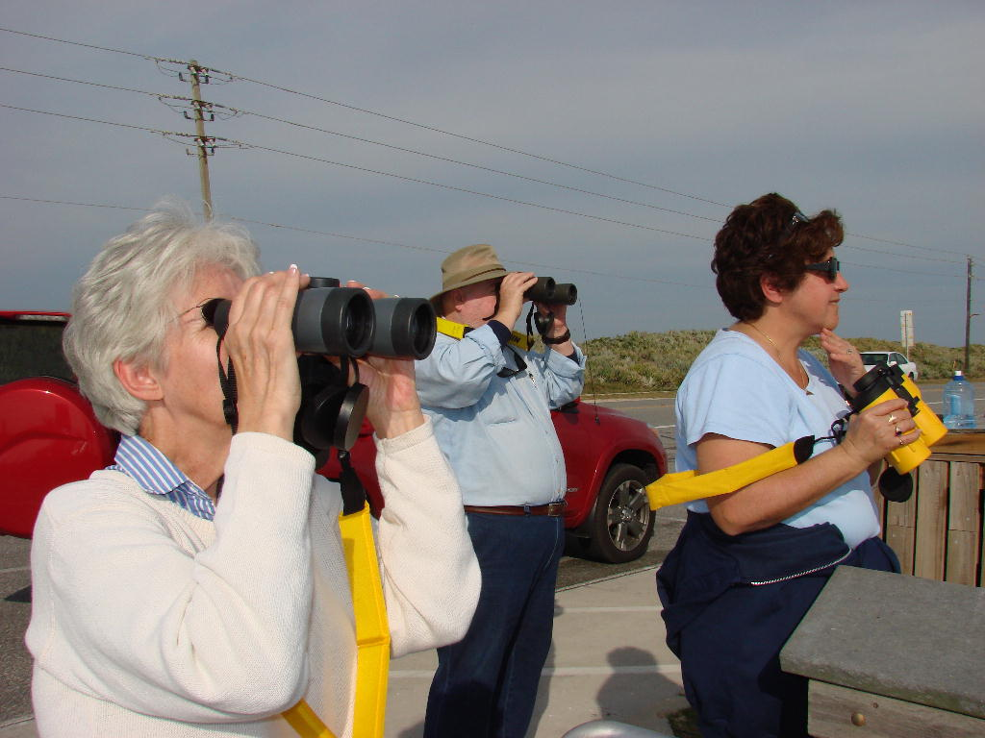
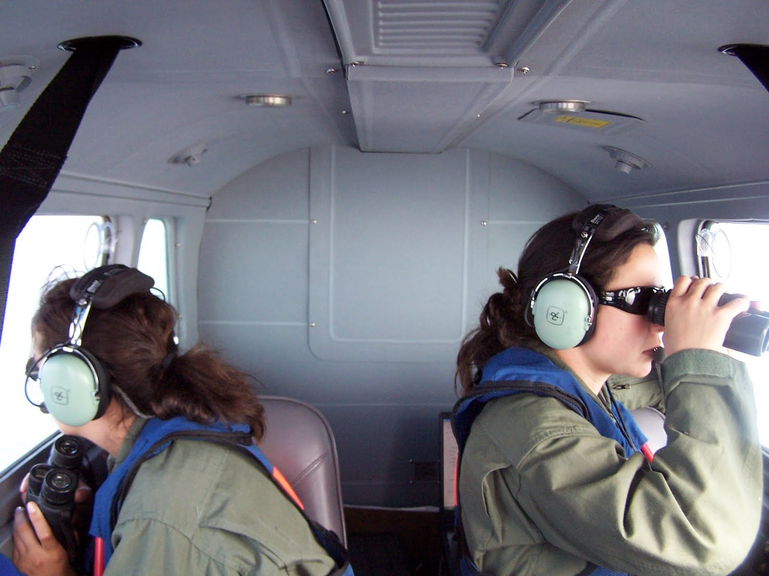
Photo credit: Frank Gromling
Photo credit: New England Aquarium
Notes:
Scientists in the airplanes and onshore observers use binoculars to locate right whales, then try to get good photographs of the whales so the animals can be identified. [If Lesson 12 from this curriculum has not been taught, you may want to include information about the way right whales are identified.]
Permission from Marianna Hagbloom at NEAq: http://ocean.si.edu/ocean-photos/right-whale-aerial-survey

Slide 9
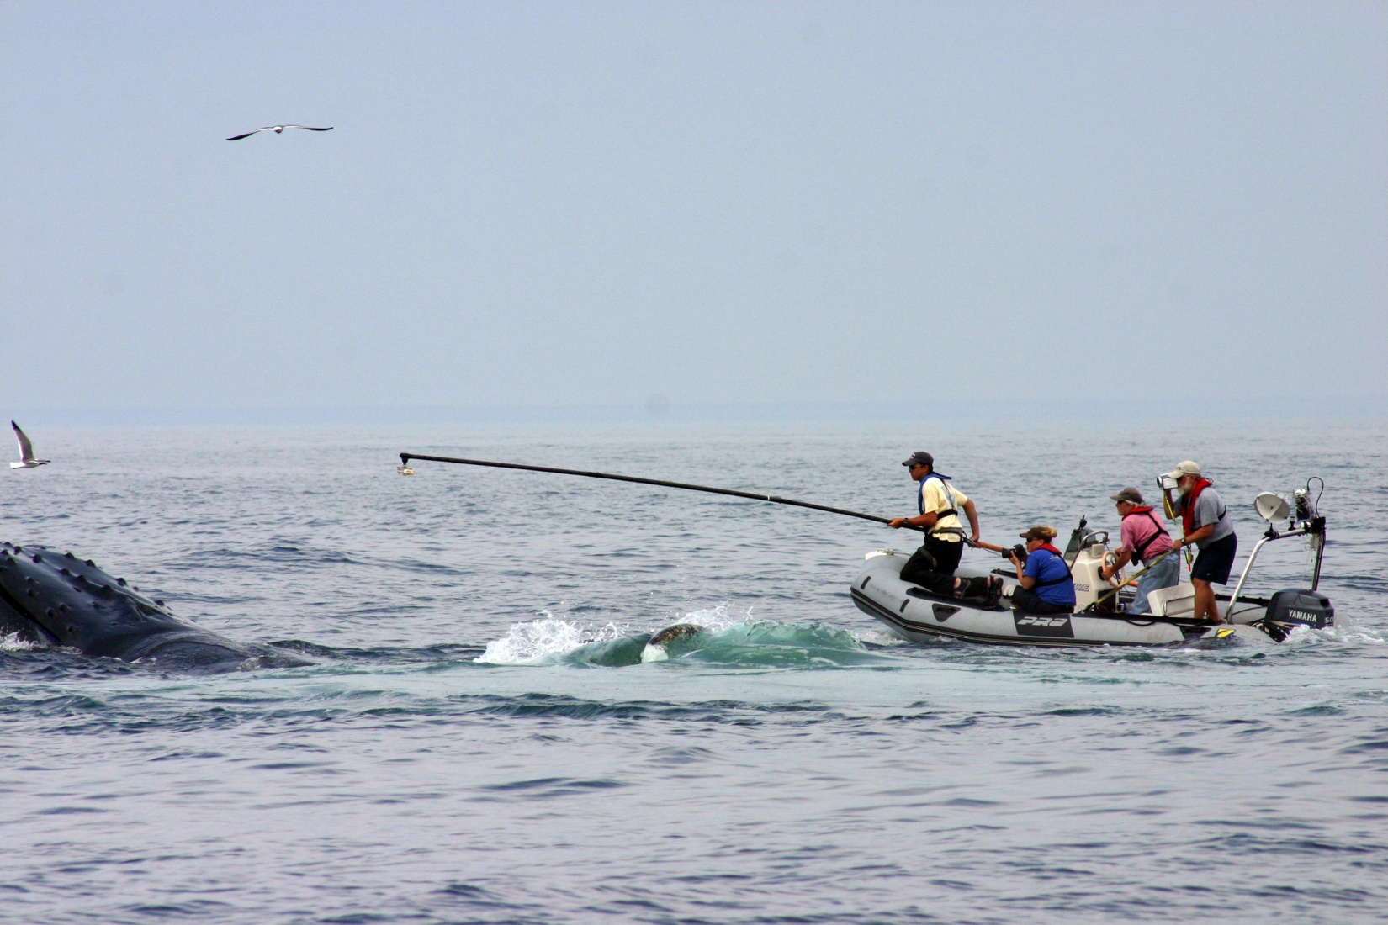
Using Technology to Track Whales
Photo credit: Stellwagen Bank National Marine Sanctuary photo by Jeremy Winn;
taken under NOAA Permit #775-1875.
Satellite tags
Whale tagging video
Notes:
Scientists are using technology to try to learn more about right whale migrations. Satellite tags are attached to the back of a whale using suction cups. When the whale comes to the surface to breathe, and the tag sticks out of the water, it sends a signal into space where the signal is picked up by a satellite. The satellite can tell where the signal came from, and transmit that information to a computer on Earth. This allows scientists to plot the whale’s location on a map. The suction cups usually stay stuck on the whales for a few days. [Click on the video link to show a 3 minute, 40 second video of scientists tagging humpback whales.]
The video link (https://oceantoday.noaa.gov/oceanasalab_whaletagging/) is a 3 minute, 40 second video showing scientists tagging humpback whales

Slide 10
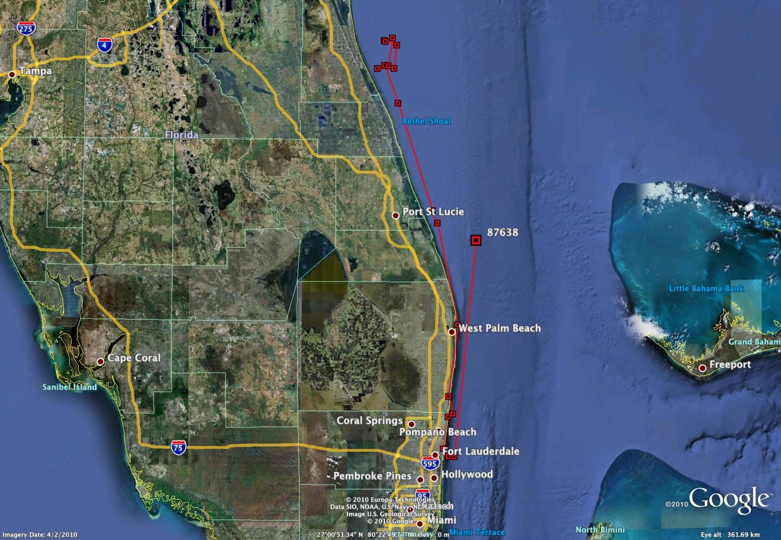
Image credit: NOAA
Notes:
As an example of satellite tracking, here is a map that shows the path of a right whale that was tracked off the coast of Florida for about a week in January, 2011. The whale had been tangled up in rope. Scientists were able to remove the rope, but they had to use sedatives on the whale. Sedatives are medicines that make the whale calm so it doesn’t swim away from the people who are trying to help it. The researchers attached a small satellite tag to the whale’s skin so they could monitor the whale and make sure it didn’t have any side effects from the sedatives.
http://www.noaa.gov/features/04_resources/rightwhale.html

Slide 11
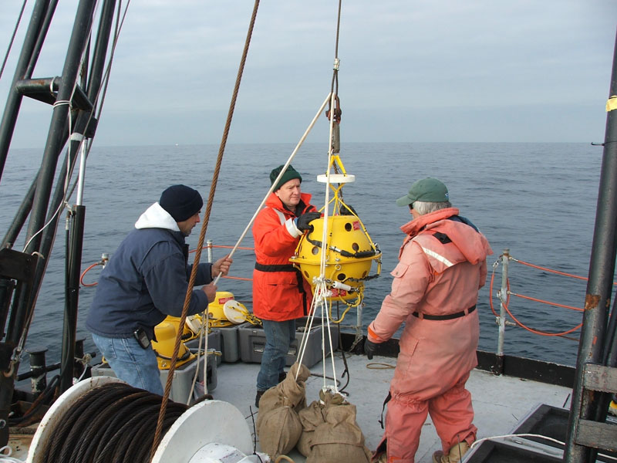
Listening for Whales
Photo credit: Michael Thompson, NOAA/Stellwagen Bank National Marine Sanctuary
Notes:
Acoustic buoys—basically underwater microphones that record noises in the ocean—have been used in areas around Cape Cod to study whale movement. The devices record whale calls along with the date and time that the whale made the sounds. The data can be collected and analyzed by scientists to help them learn how the whales are moving around. The yellow ball-like device in the middle of this picture is an acoustic buoy. The researchers are getting ready to set it in place on the sea floor.

Slide 12
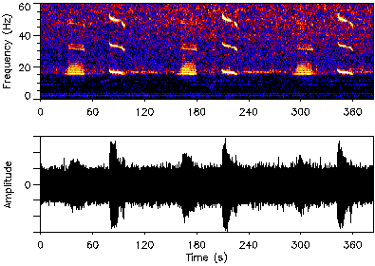
What does a right whale sound like?
https://dosits.org/galleries/audio-gallery/marine-mammals/baleen-whales/north-atlantic-right-whale/
Image credit: NOAA Ocean Explorer Program
Notes:
So what is it that the researchers are listening for? On this website [click on the link to navigate to the site], we can hear some of the different types of calls that right whales make. [one at a time, click on the buttons to hear the different types of calls. Make sure that your volume is turned all the way up!]
http://oceanexplorer.noaa.gov/explorations/sound01/background/seasounds/media/timeseries.html

Slide 13
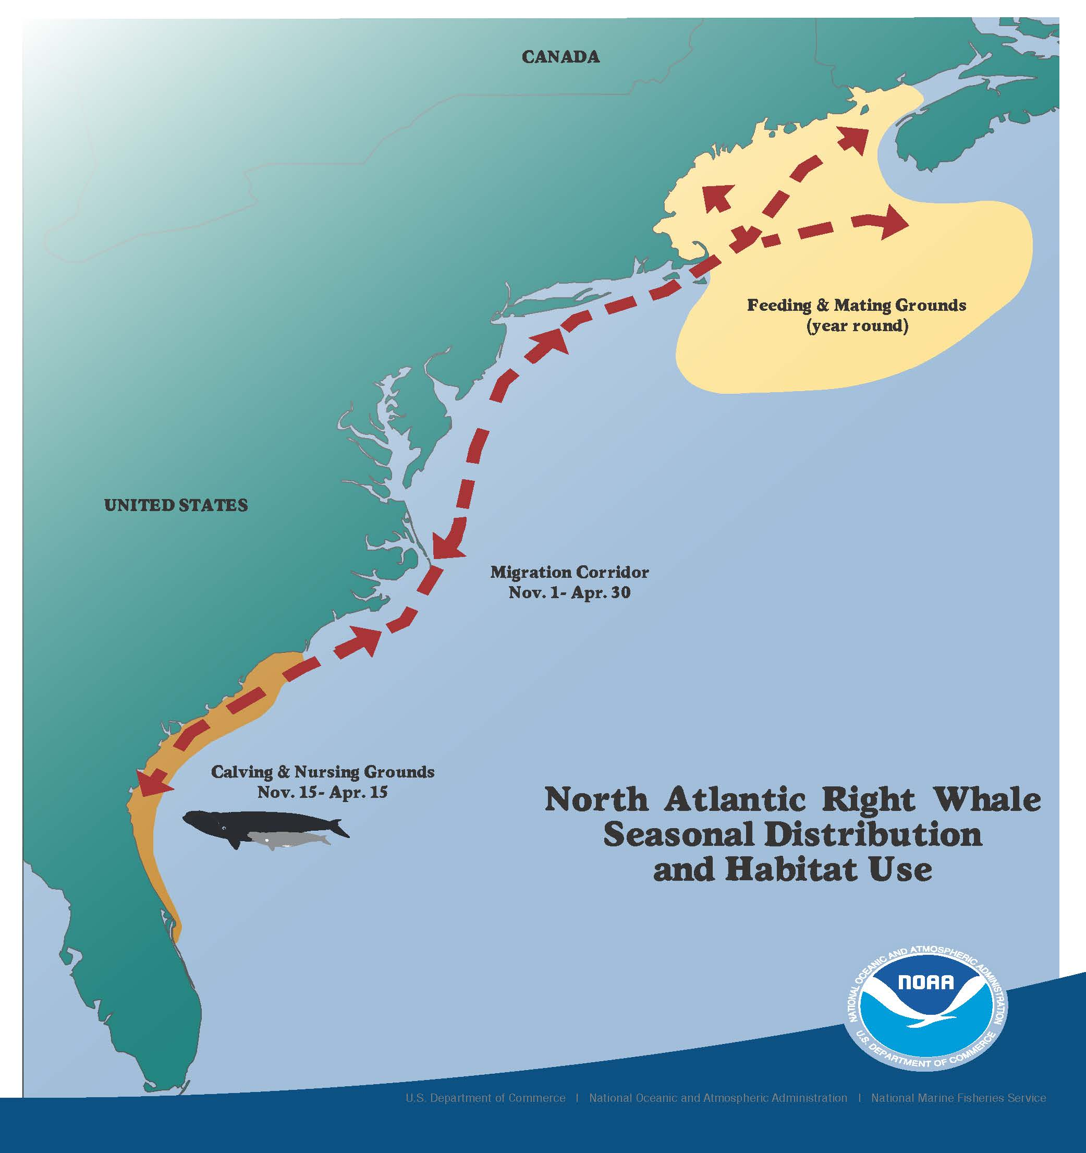
Let’s review
Notes:
Let’s review what we know about North Atlantic right whale migration.
Where are most of the North Atlantic right whales found in the spring, summer and fall? [In waters from Cape Cod, MA to Nova Scotia, Canada—the yellow area on the map.]
Why are they here? [There is a lot of plankton here for the whales to eat.]
Where do pregnant female North Atlantic right whales migrate to in the winter? [To waters off southern Georgia and northeastern Florida—shown in orange.]
Why? [To have their calves. The warmer water is less stressful for the calf.]
How long do the moms and calves stay in the warm water off Georgia and Florida? [They are there from December through March or early April.]
Where do the other whales go in the winter? [Some juvenile whales and adult females will also spend part of the winter in the warmer southern waters. We still do not know where all of the other right whales go in the winter, but new research suggests that some of them may stay in their spring and summer feeding area year-round.]

