Slide 1
North Atlantic Right Whale Matching Game
Use callosity patterns to identify an “unknown” right whale!
This game is based on the New England Aquarium’s
Right Whale Identification Game, which is accessible at http://www.neaq.org/education_and_activities/games_and_activities/online_games/right_whale_identification_games.php

Slide 2
How it works
Each slide will have a picture of the “unknown” whale and pictures of known whales from the Right Whale Catalog.
Carefully observe the callosity patterns of the “unknown” whale (it may help to sketch them) and try to match them to one of the known whales.

Slide 3
How it works (cont.)
Click on any of the small whale pictures to see them enlarged.
Click on the big (enlarged) picture to see “hints.”
When you think you have found the identity of the whale, click on the link to see if you are correct.

Slide 4
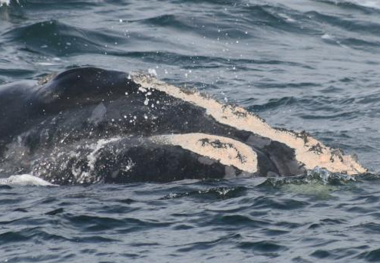
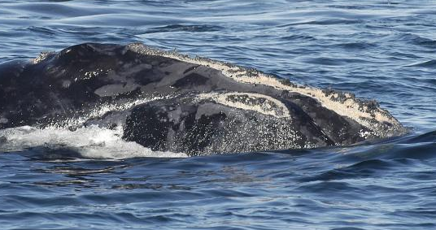
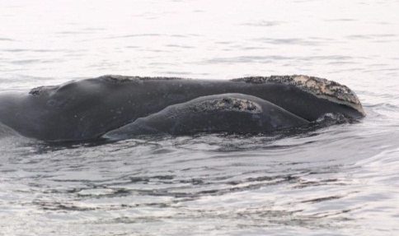
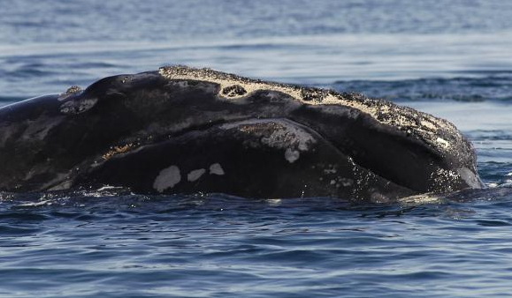
Round 1—Easy
unknown
Single peninsula
Continuous
#1152
#1706
#3192
Lip callosity
Who am I?

Slide 5

WHO AM I?
Continuous, with single peninsula
#1152
#1706
Lip callosity
Click on the picture to see hints
Click the box if you think that the unknown whale matches this one (#1152)
#3192

Slide 6

WHO AM I?
Broken
#1152
#1706
Lip callosity
Click on the picture to see hints
Click the box if you think that the unknown whale matches this one (#1706)
#3192

Slide 7
WHO AM I?
Continuous callosity with 2 peninsulas
#1152
#1706
No lip callosity (grey skin shedding)
Click on the picture to see hints
Click the box if you think the unknown whale matches this one (#3192)
#3192

Slide 8
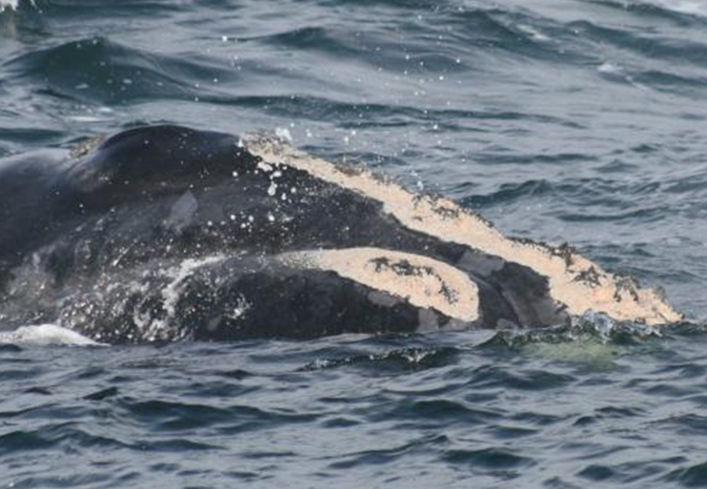
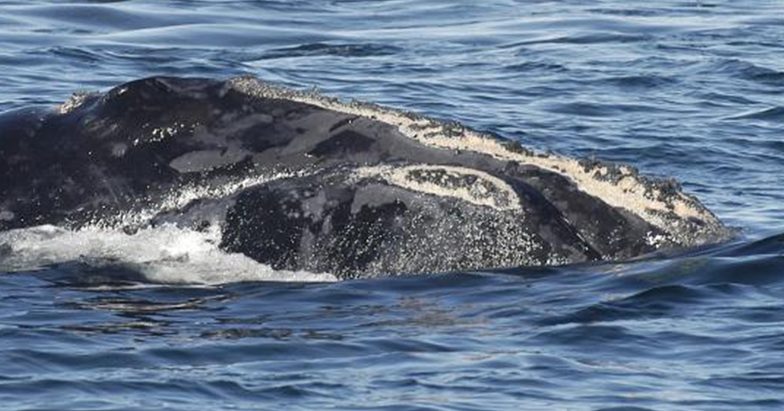
That’s correct!
Click here to try another one! This one is a bit harder…

Slide 9
Sorry…try again!
Click here to return to the game…

Slide 10
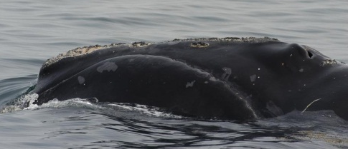
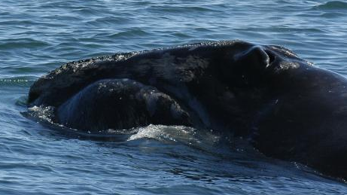
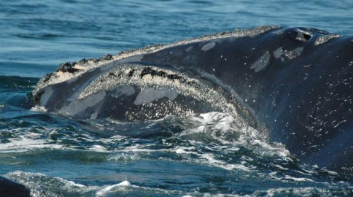
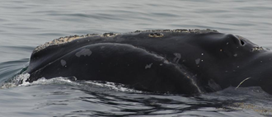
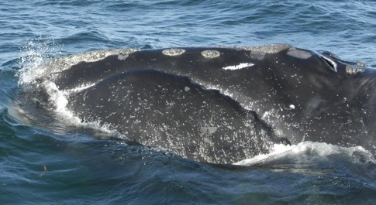
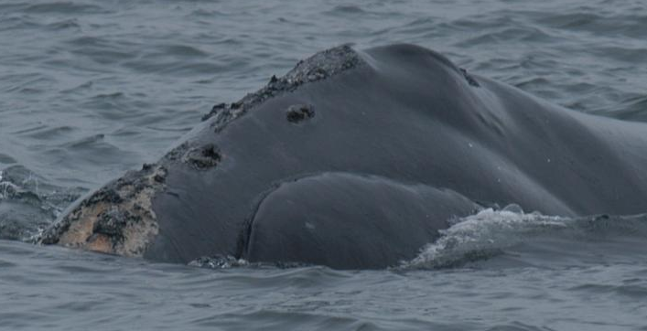
Round 2—a little harder
unknown
#1112
Islands
Long coaming
#1306
#1428
#1950
Who am I?

Slide 11
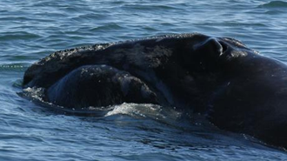

unknown
Continuous (no islands or peninsulas)
#1112
#1306
#1428
Click on the picture to see hints
Click the box if you think the unknown whale matches this one (#1112)
#1950

Slide 12
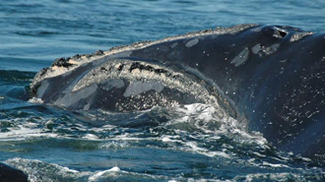
unknown
Continuous
#1112
#1306
Lip callosity
#1428
Click on the picture to see hints
Click the box if you think the unknown whale matches this one (#1306)
#1950

Slide 13
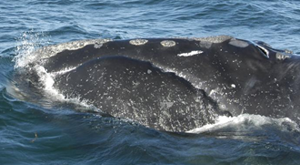
unknown
Broken, with 2 islands
#1112
#1306
Scar
#1428
Click on the picture to see hints
Click the box if you think the unknown whale matches this one (#1428)
#1950

Slide 14
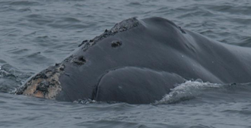
unknown
Islands
#1112
#1306
#1428
Click on the picture to see hints
Click the box if you think the unknown whale matches this one (#1950)
#1950

Slide 15

That’s correct!
Click here to try another one! This one is harder still…

Slide 16
Sorry…try again!
Click here to return to the game…

Slide 17
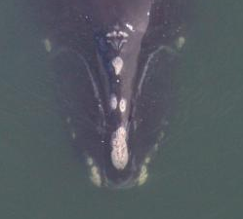
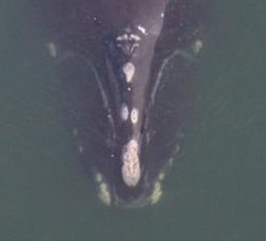
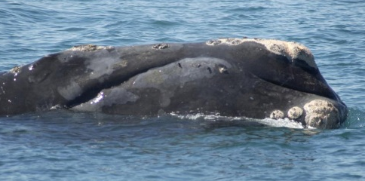
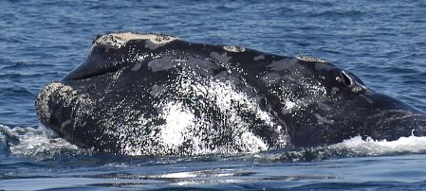
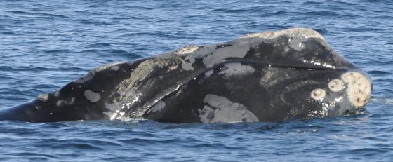
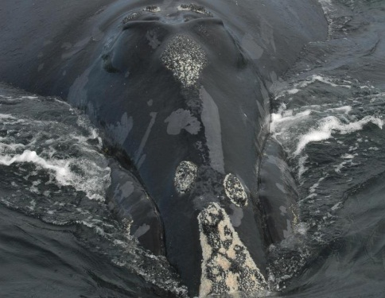
Round 3—hardest
unknown
Scars
#1123
#1239
#1701
Islands on lower jaw
#1901
Who am I?

Slide 18
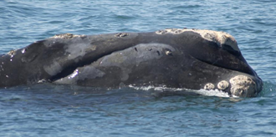

unknown
Island
Clefts/splits in bonnet
#1123
#1239
#1701
Click on the picture to see hints
Click the box if you think the unknown whale matches this one (#1123)
#1901

Slide 19
unknown
Chin callosity
Island
#1123
#1239
Lip callosity
#1701
Click on the picture to see hints
Click the box if you think the unknown whale matches this one (#1239)
#1901

Slide 20
unknown
Chin callosity with islands
Island between bonnet and coaming
#1123
#1239
#1701
Click on the picture to see hints
Click the box if you think the unknown whale matches this one (#1701)
#1901

Slide 21

unknown
Islands
#1123
#1239
#1701
Click on the picture to see hints
Click the box if you think the unknown whale matches this one (#1901)
#1901

Slide 22
That’s correct!
You are a right whale identification EXPERT!
Use the “esc” key on the keyboard to exit the game…

Slide 23
Sorry…try again!
Click here to return to the game…

Slide 24
Photo credits:
Images used in this presentation are all used with permission of the image owners. Unless otherwise credited, images were taken by New England Aquarium staff in Canadian waters. The “unknown” whale image in slides 17-22 is credited to Wildlife Trust (provided by Georgia DNR) and was taken under NMFS permit # 594-1467-00. The photo of whale #1950 in slides 10-15 is used with permission of the photographer, Susan Parks, and was taken in Canadian waters.

