Slide 1
Lesson 12:
Identifying Individual Right Whales
Notes:
Today we are going to learn more about how scientists identify individual North Atlantic right whales.

Slide 2
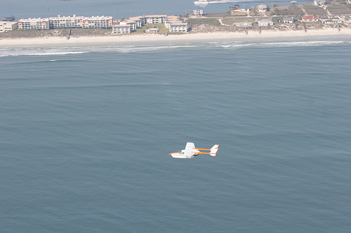
Who monitors the
North Atlantic right whales?
Photo credit: Florida Fish and Wildlife Conservation Commission
Notes:
As you may recall from earlier lessons, researchers use small airplanes to spot and photograph right whales. They may also take photographs from land using cameras with powerful zoom lenses.

Slide 3
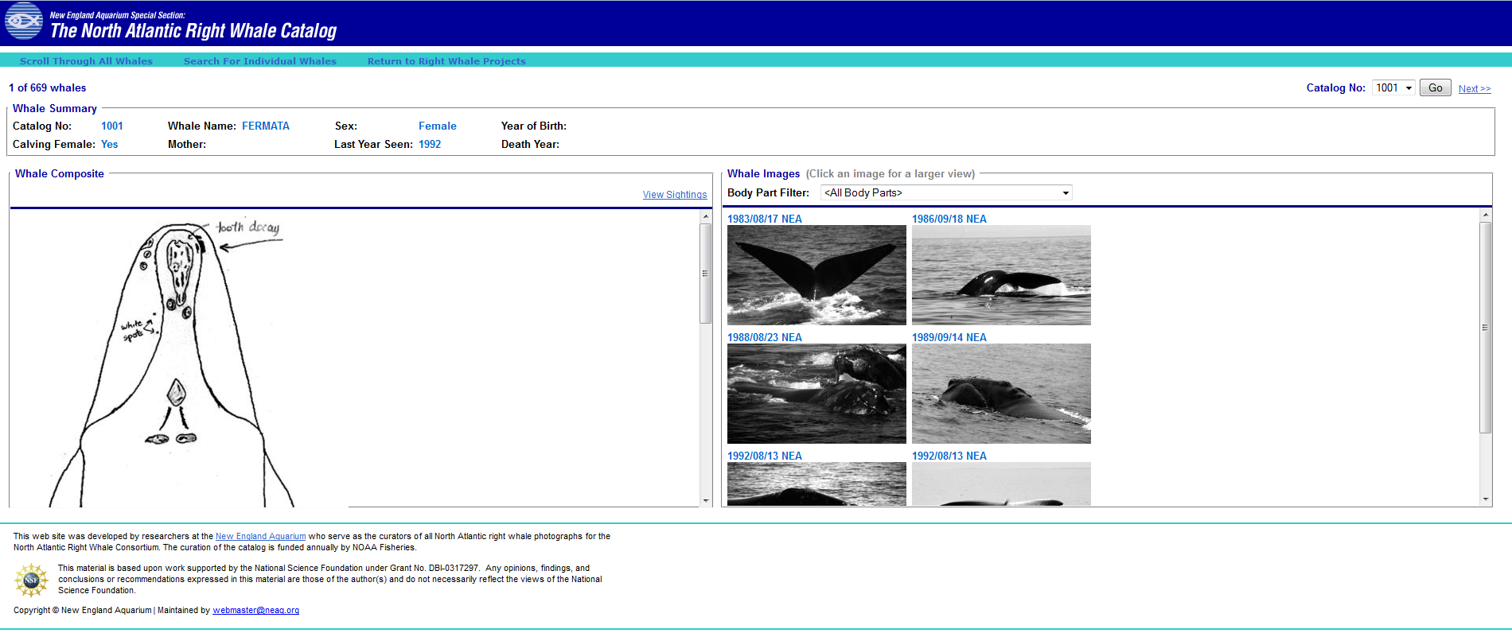
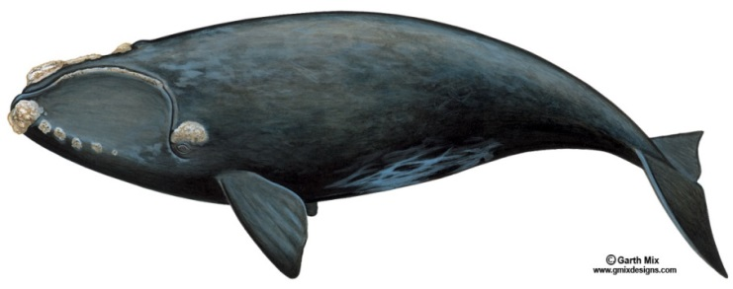
What do they do with all the photos?
The photos are put into the North Atlantic right whale database. This photo catalog is kept at the New England Aquarium.
Notes:
The photographs are all sent to the New England Aquarium, where they are added to the North Atlantic right whale catalog. This collection of photographs is viewable online at the New England Aquarium’s website. [http://rwcatalog.neaq.org/Terms.aspx]

Slide 4
Methods used to keep track of North Atlantic right whales:
Each right whale that is located has its photo taken by the aerial survey team.
The photo is then compared to the photo catalog of right whales.
The photo is then matched to a whale in the photo catalog.
The information is added to the individual sighting history.
Notes:
Scientists study the photographs very carefully and try to figure out if the whale in the picture is one that they already have in the catalog, or if it is a “new” whale (one that has not previously been reported.) If it is a new whale, they will assign it a number and will add it to the catalog. This helps scientists and managers keep track of the number of right whales remaining.
Airplane: https://www.publicdomainpictures.net/pictures/20000/velka/flying-plane-2352129280404152n.jpg
Camera: This Photo by Unknown Author is licensed under CC BY-SA
Photos: This Photo by Unknown Author is licensed under CC BY-SA-NC
Person at computer: This Photo by Unknown Author is licensed under CC BY-NC-ND

Slide 5
How can we tell individual
right whales apart?
Scars
Color patterns
Callosity Patterns
How are they going to know it’s me and not my twin?
Scott Kraus/New England Aquarium
Sascha Glinka/New England Aquarium
Notes:
Sometimes, scars and color patterns can be used to identify individual right whales. However, most right whales are identified by the callosity pattern, which is as individual as our fingerprints.

Slide 6
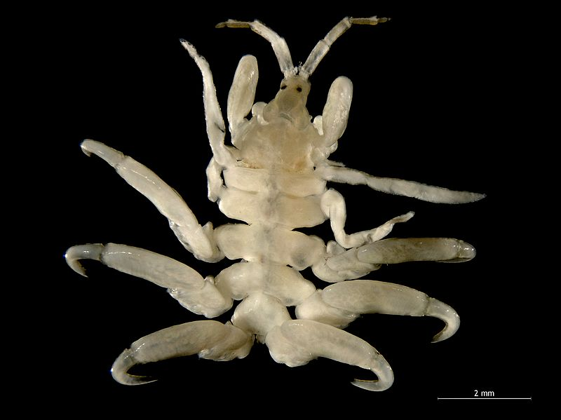
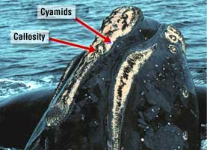
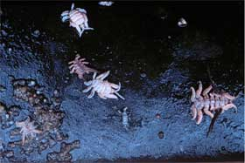
Callosity
Callosity: is tissue (same color as the whale) that becomes infested with millions of light-colored cyamids (Si-am'-ids), or “whale lice”.
Photo credit: Hans Hillewaert
Photo credit: Sascha Glinka/New England Aquarium
Photo credit: Scott Kraus, New England Aquarium
Notes:
Callosities are places where the skin on the head is thickened and rough. Each pattern is unique to only one whale. The skin itself is dark, but small, white shrimp-like animals called cyamids or whale lice move into these areas. The cyamids make the callosities look white and allow right whales to be identified from their photographs.
Whale lice pic: creative commons licensed photo by Hans Hillewaert accessed at http://en.wikipedia.org/wiki/Whale_louse

Slide 7
Callosity patterns
There are 6 areas of the head that scientists look at when describing callosity patterns on a right whale:
The “Bonnet”….which is the top of the rostrum
The chin
The lips
The “coaming”…which is the area right in front of the blowhole
The area just behind the blowhole (“post-blowhole”)
The area over the eye
Notes:
There are several different locations on the whale where callosities can be found. They are mostly on the head. Scientists look for callosities that form different patterns on different whales, allowing identification of individuals. The “Bonnet” describes callosities located on the top of the rostrum, or front part of the head, the chin, and the lips. The “coaming” refers to callosities on the area right in front of the blowhole, the area just behind the blowhole, and the area over the eye.

Slide 8
Photo credit: NOAA/NEFSC Permit # 775-1600
Bonnet
Lip
Chin
Coaming
Eye
Post-
blowhole
Notes:
Here we can see each of the different callosity types. Remember that the shapes and sizes of the callosities will vary from whale to whale. Also, not every whale has all of the different types of callosities.

Slide 9
Broken? or Continuous?
Photo credit: PCCS, taken under NMFS permit 633-1763
Photo credit: NOAA/NEFSC. Permit # 775-1600
Notes:
The bonnet and coaming are sometimes joined together. Sometimes they are separate. When they are joined together, the pattern is called “continuous”. When they are separate, they form a broken callosity pattern. Which of these two whales has a continuous callosity pattern? [Answer: the one on the right. Note that the whale on the left looks a little different because it is swimming with its mouth open—probably feeding!]

Slide 10
Islands? or Peninsulas?
Peninsula
Island
Photo credit: NOAA/NEFSC. Permit # 775-1600
Photo credit: PCCS, taken under NMFS permit 633-1763
Notes:
Whales that have continuous callosities on the head may have “peninsulas” within the callosities—these are small, round callosities that look like bulges in the callosities. Whales with a broken callosity pattern often also have these round callosities as well, but we call them “islands” because they are not attached to a larger callosity. [Point out the peninsulas and islands on the whales in the two pictures.]

Slide 11
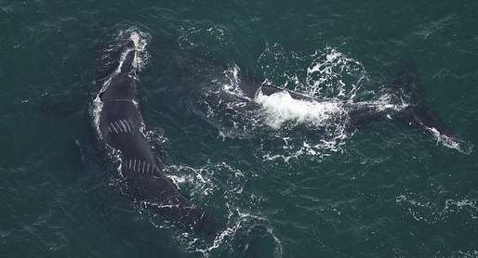
Scars
Scientists can also use scars to help
identify different right whales.
Photo credit: Florida Fish and Wildlife Conservation Commission, NOAA Research Permit # 594-1759
Florida Fish and Wildlife Conservation Commission, NOAA Research Permit # 594-1759
Notes:
Sometimes whales have scars. These scars look white. Scars usually come from ship strikes or from entanglement in rope or other fishing gear. Researchers can sometimes use scars to help identify right whales. The scars on the whale in this picture were made by the propeller of a boat. [Point out the parallel white lines on the whale on the left side of the photo.]

Slide 12
Color Patterns
Photo credit: FWC/NOAA Research Permit #665-1652-00
Florida Fish and Wildlife Conservation Commission, NOAA Research Permit # 594-1759
Notes:
Some right whales have unique color patterns that help scientists identify them. This whale has a mostly white belly. Some right whales have bellies that are completely black. If scientists can get a good look at the belly, they can sometimes use the pattern there to help identify the whale.

Slide 13
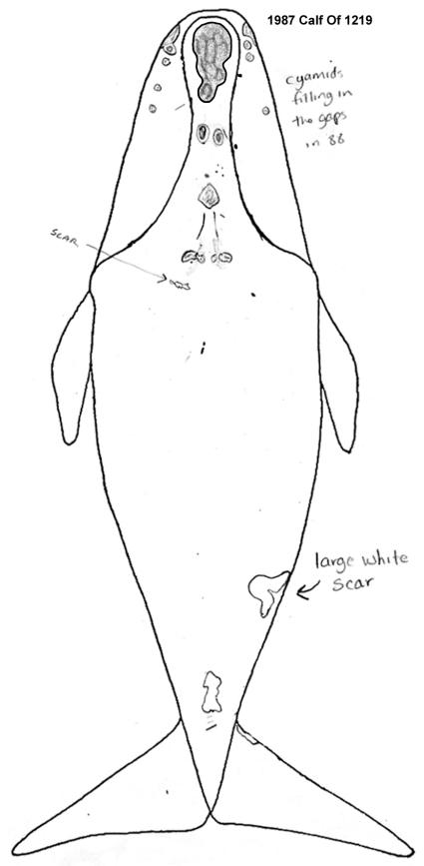
Photo credit: Georgia DNR/Wildlife Trust;
Permit # 594-1467-00
Image credit: New England Aquarium
Notes:
Researchers take the photographs of each right whale and draw the outline of all callosities and scars seen on that whale on a data sheet. This data sheet becomes part of the right whale catalog and will be used to identify the individual whales from future photographs. Researchers need to find and record all of the identifying marks. Sometimes a photograph will only show a small part of the whale’s body, so creating a complete picture can be challenging!

Slide 14
Let’s try to Identify a Whale!
Photo credit: New England Aquarium; Permit # 1014
Meet Pediddle!!
Pediddle is an adult female. She was added to the catalog in 1978. This photograph of Pediddle and her calf was taken in 2009.
Notes:
I am going to show you some pictures of a whale called Pediddle. She is one of the hundreds of North Atlantic right whales that have been identified by scientists.
Thinkstock image 488595749 (figure looking through binoculars)

Slide 15
Let’s take a closer look at Pediddle…
Step 1. Identify the different types of callosities.
1. Bonnet
2. Chin
3. Upper lip
4. Coaming
5. Blowhole
6. Eye
5
4
6
1
3
2
Notes:
Remembering what we have just learned about callosities, let’s try to identify the different types of callosities that we see on Pediddle. [As you click on the slide, the six different types of callosities will be highlighted—read the name of each one in turn.]

Slide 16
Let’s take a closer look at Pediddle…
Step 1. Identify the different types of callosities.
1. Bonnet
2. Chin
3. Upper lip
4. Coaming
5. Blowhole
6. Eye
5
4
6
1
3
2
Notes:
Here we see all of the different callosities circled.

Slide 17
Let’s try to draw Pediddle for the catalog!
Hints….
“Continuous” or “Broken” pattern?
Are there “Islands” or “Peninsulas”?
Notes:
Now it’s your turn. On your right whale identification data sheet, try and draw all of the callosities and any scars that you might see in this photograph. Some of the white marks that we see where the water touches the whale’s back are actually glare from the sunlight reflecting off the water. Sometimes the whale’s skin will be shedding, leaving grey marks on the animal that will turn black later. It is helpful to have several photos of the same whale to make sure that all of the scars and callosities are correctly recorded! [Give the students several minutes to make their sketches.]

Slide 18
So….How did you do?
This is Pediddle’s actual drawing from the Right Whale Catalog.
Image credit: New England Aquarium
Notes:
Compare your drawing to the one that the researchers have in the catalog. How did you do? What marks did you get right? Which ones were you missing?

