Slide 1
Cetacean BINGO
Call list #2

Slide 2
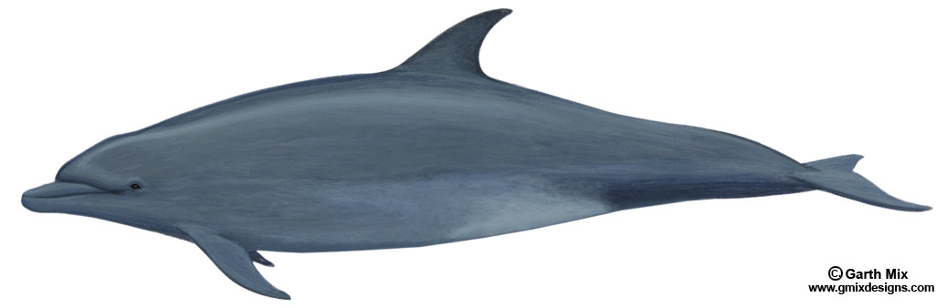
1.
These small whales can be nine feet long. They can hold their breath for 8 minutes.
ANSWER: Dolphin

Slide 3
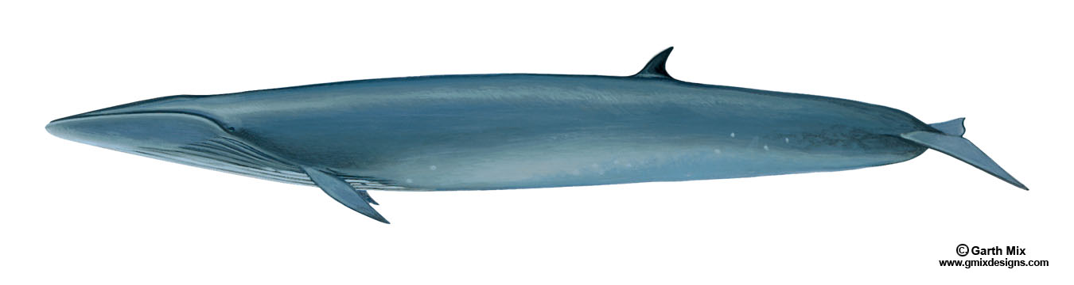
2.
This whale’s scientific name means “northern winged whale.”
ANSWER: Sei whale

Slide 4
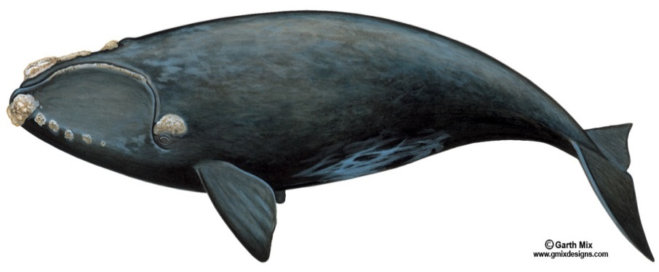
3.
These whales can be recognized by the big white growths (“callosities”) on their heads.
ANSWER: Right whale

Slide 5
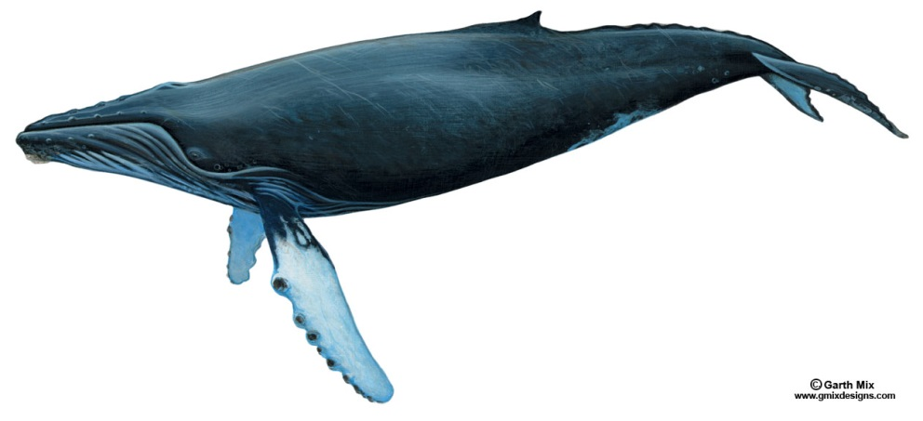
4.
These whales have long white flippers.
ANSWER:
Humpback whale

Slide 6
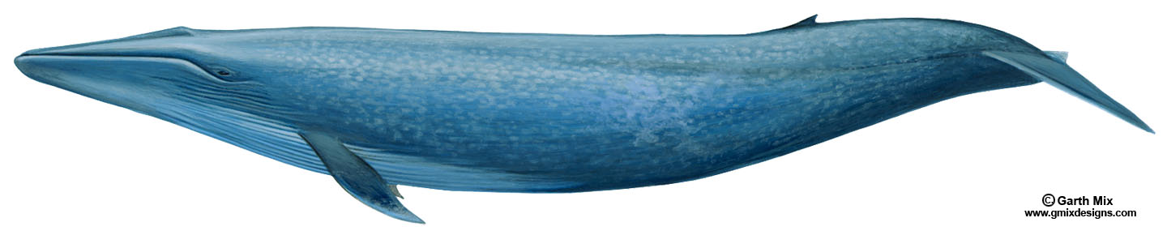
5.
Babies of this whale can grow 2 inches a day.
ANSWER: Blue whale

Slide 7
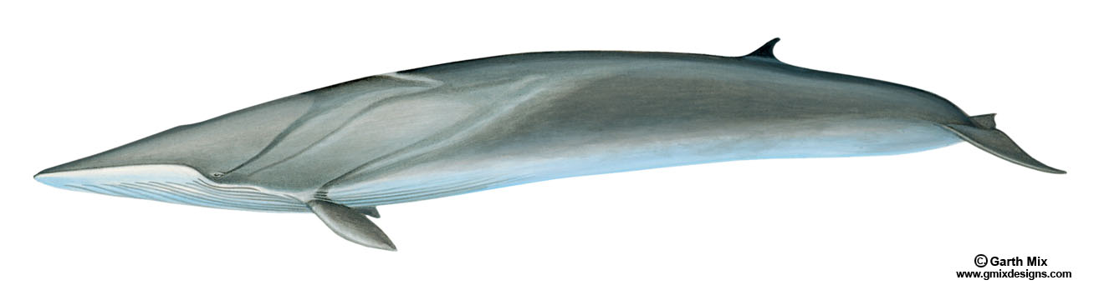
6.
This whale’s tongue is half white and half black.
ANSWER: Fin whale

Slide 8
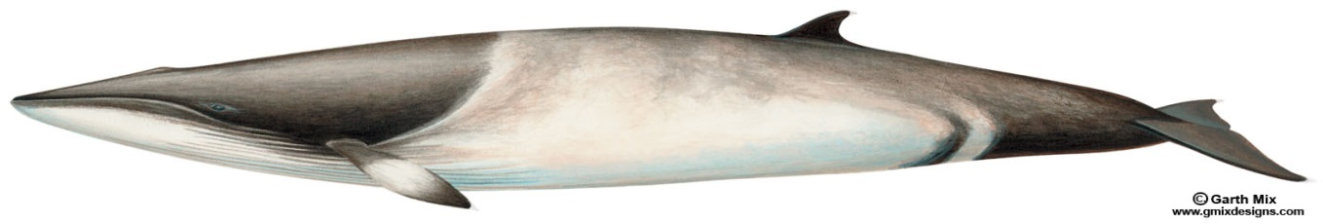
7.
These whales grow to be 33 feet long. They can hold their breath for 15 minutes.
ANSWER: Minke whale

Slide 9
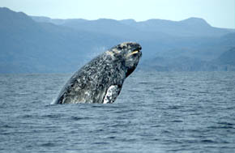
8.
Animals that look like little orange crabs live on these whales’ skin.
Photo credit: Merrill Gosho, NOAA
ANSWER: Gray whale

Slide 10
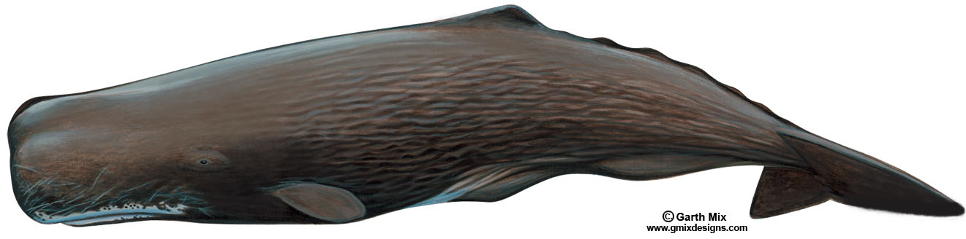
9.
This whale can hold its breath up to two hours.
ANSWER: Sperm whale

Slide 11
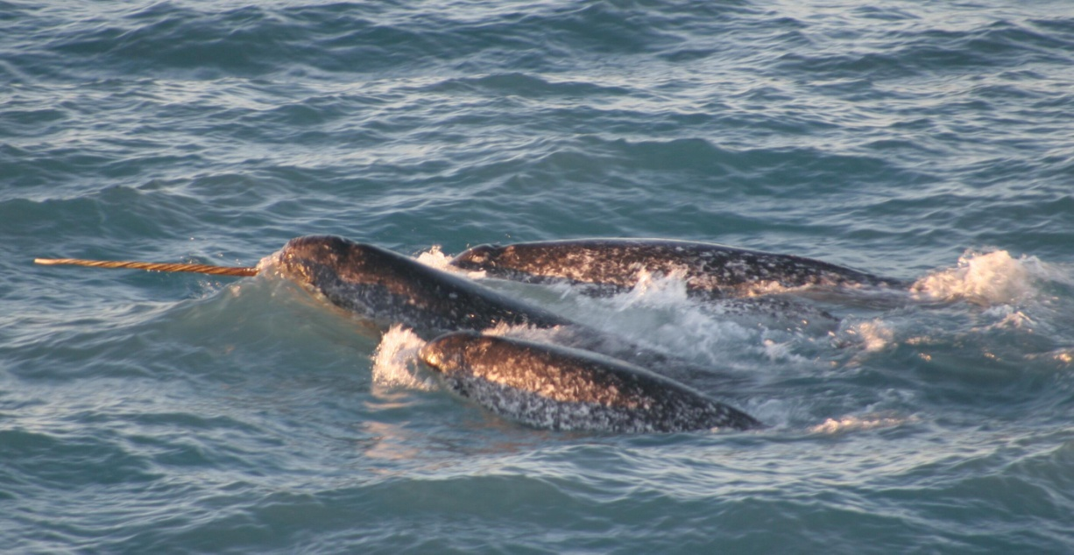
10.
These whales have thick blubber. They eat fish, squid and shrimp.
ANSWER: Narwhal
Photo credit: NOAA/University of Washington

Slide 12
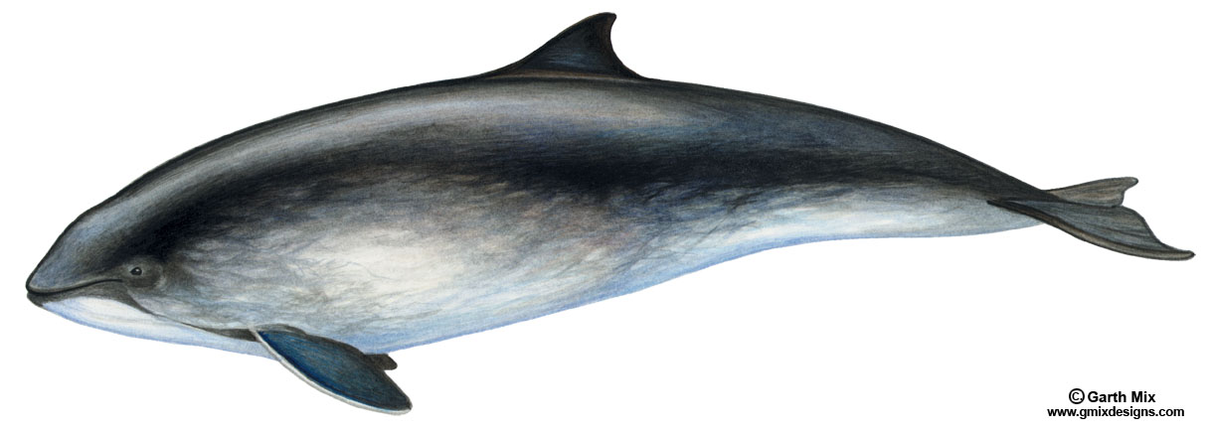
11.
These whales have rounded heads with a very short beak. They can be 5 to 8 feet long.
ANSWER: Porpoise

Slide 13
12.
These whales use their big heads to break through ice.
ANSWER: Bowhead whale

Slide 14
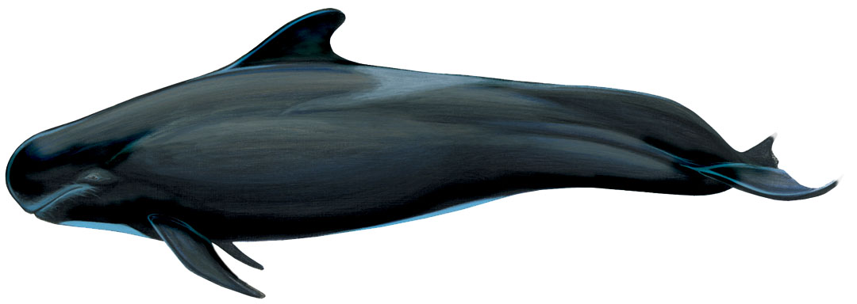
13.
This small toothed whale usually travels in large groups of up to 100 animals.
ANSWER: Pilot whale

Slide 15
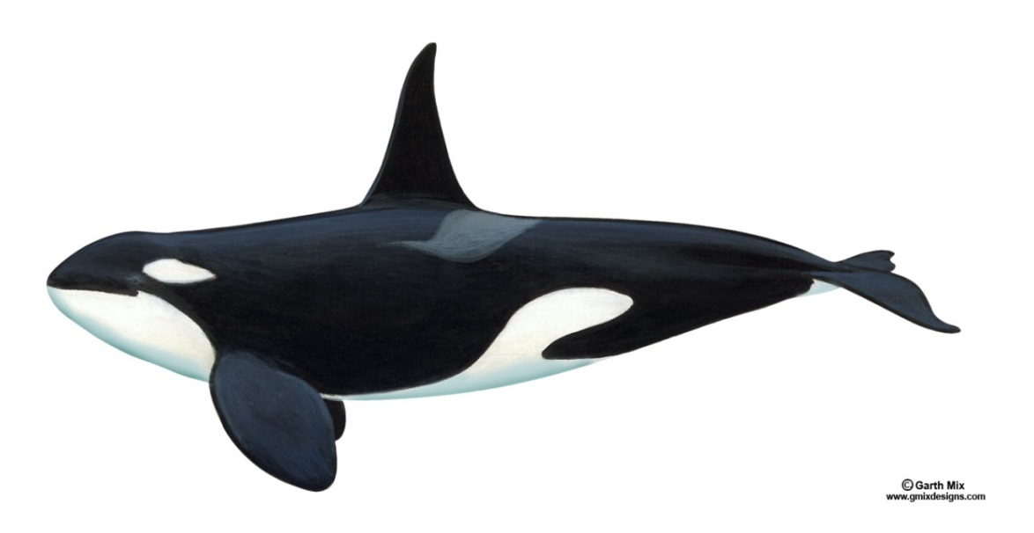
14.
These whales are sometimes called “the wolves of the sea.”
ANSWER: Orca

Slide 16
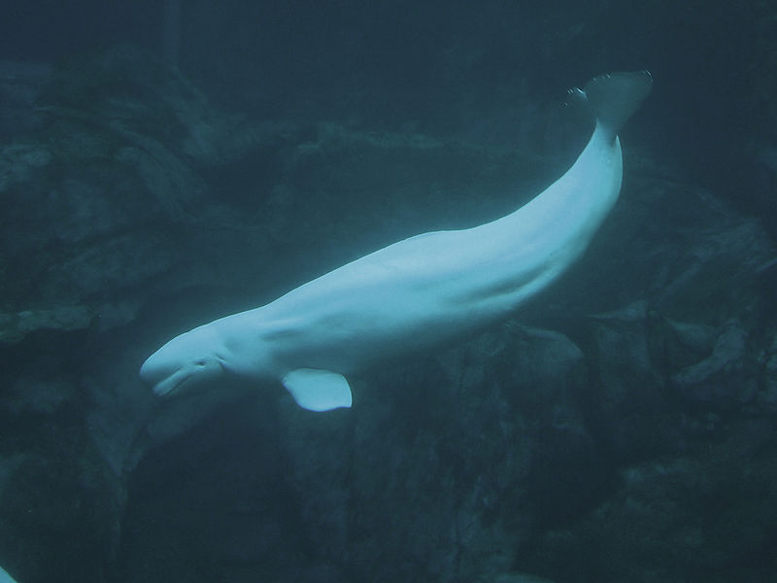
15.
This is the only whale that can move its neck. It can move its head up and down, and side to side.
Photo credit: Greg Hume
ANSWER: Beluga

