Slide 1
Slides prepared to support Seafood HACCP Alliance training courses approved by the Association of Food and Drug Officials (AFDO) which ‘require’ the accompanying training manuals:
Hazard Analysis and Critical Control Point Training Curriculum (SGR 137; Blue Book) 6th edition June 2020
FDA Fish and Fishery Products Hazards and Controls Guidance (Gold Book; SGR 129)
4th edition March 2020
1

Slide 2
Program Introduction
National Seafood HACCP Alliance for Training and Education

Slide 3
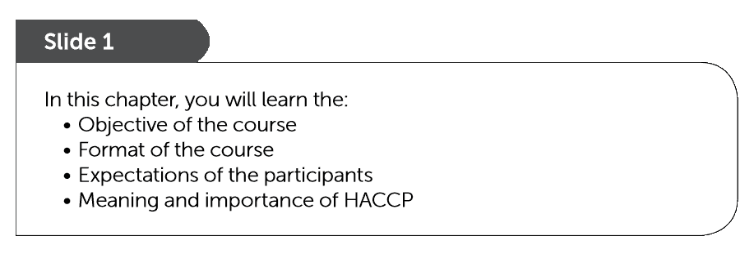
Introduction to the Alliance Course and HACCP

Slide 4
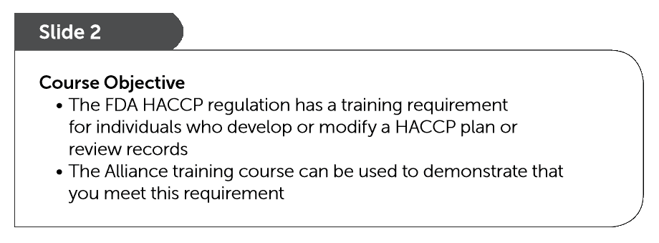

Slide 5
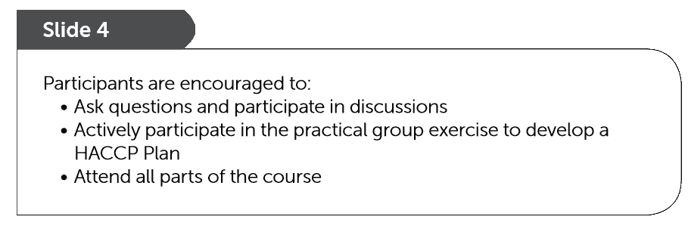
Audience Role

Slide 6
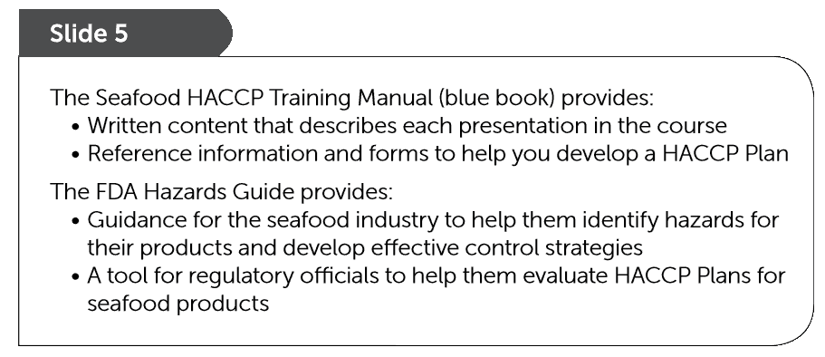
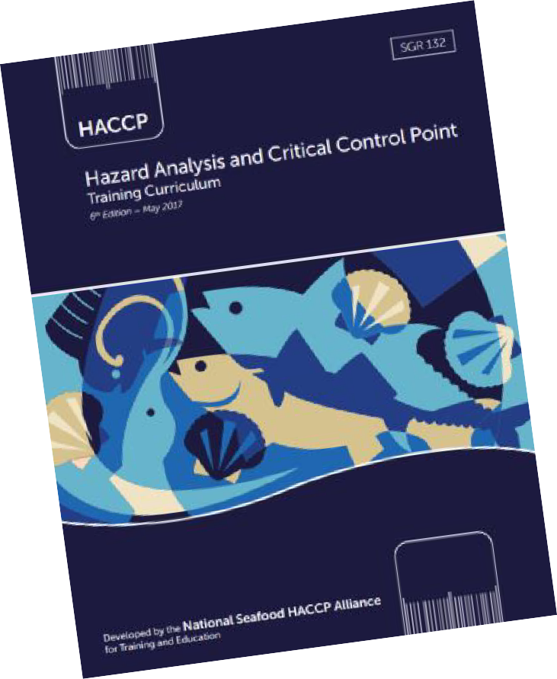
BLUE
Book
GOLD
Book

Slide 7
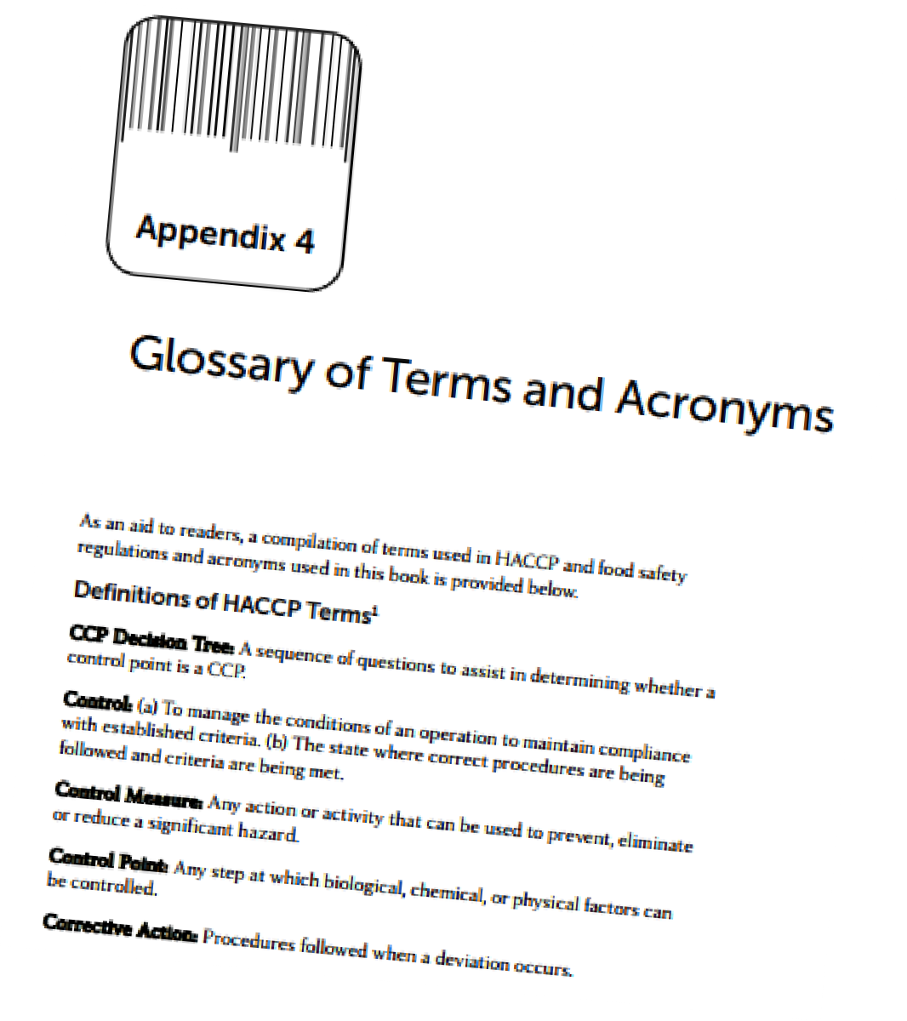
Definitions and Terms
Appendix 4
page 241

Slide 8
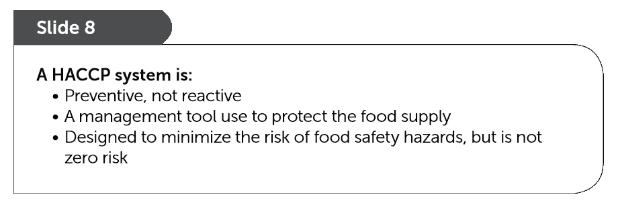

Slide 10
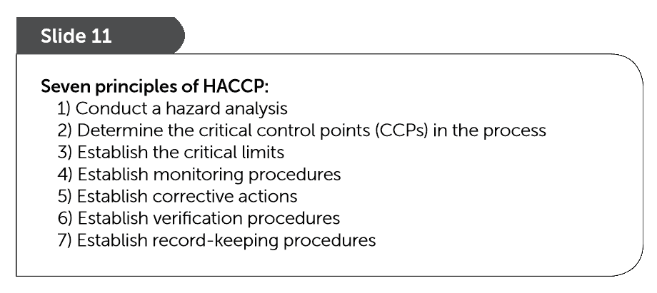
7 Principles of HACCP

Slide 11
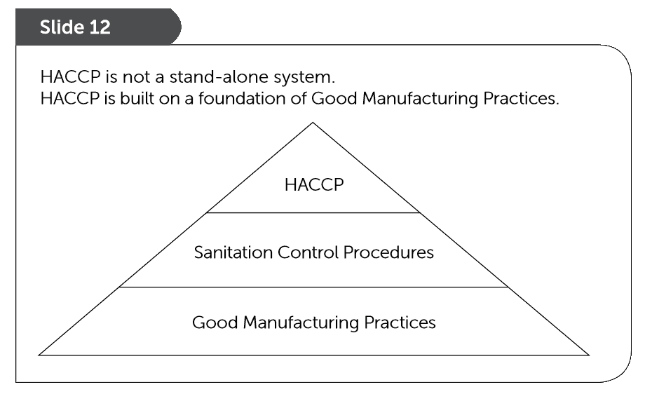
Layers of Controls

Slide 12
Prerequisite Programs and Sanitation Control Procedures

Slide 13
Prerequisites

Slide 14
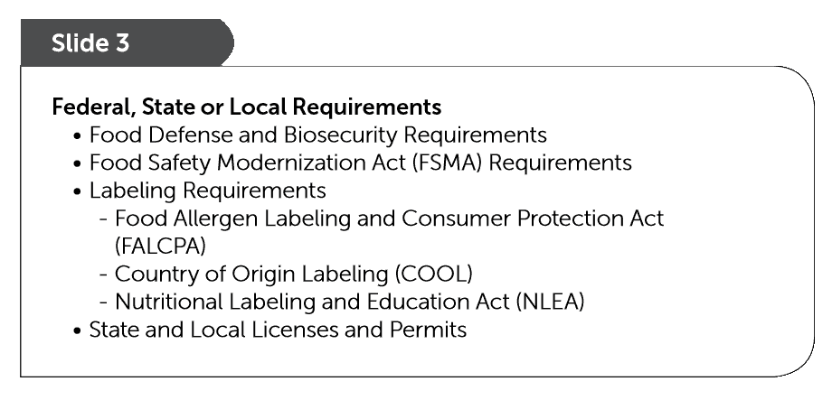

Slide 15
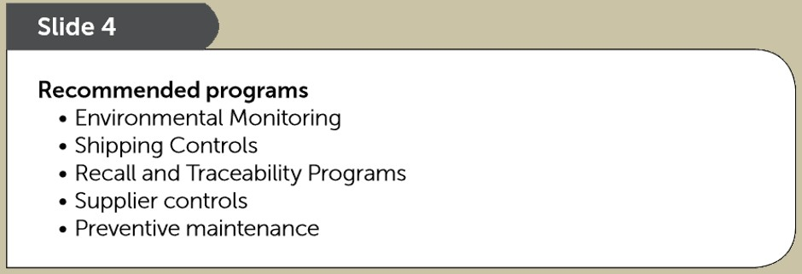

Slide 16
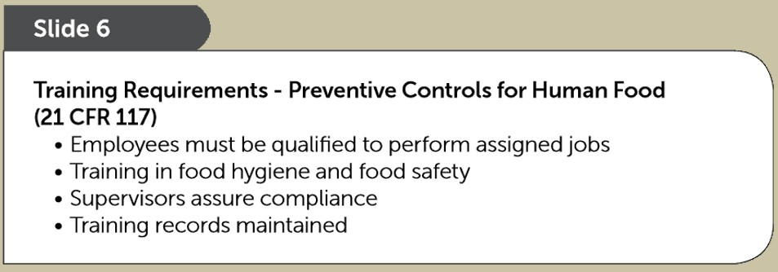
FSMA addition

Slide 17
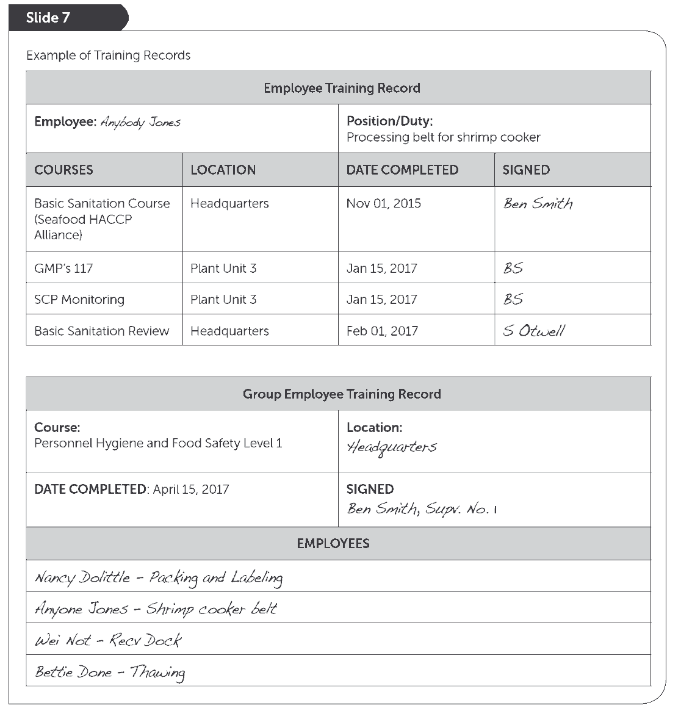
Required Training Records
Page 13

Slide 18
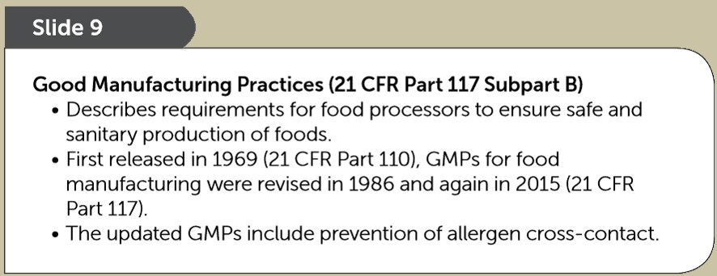
GMP’s 117

Slide 19
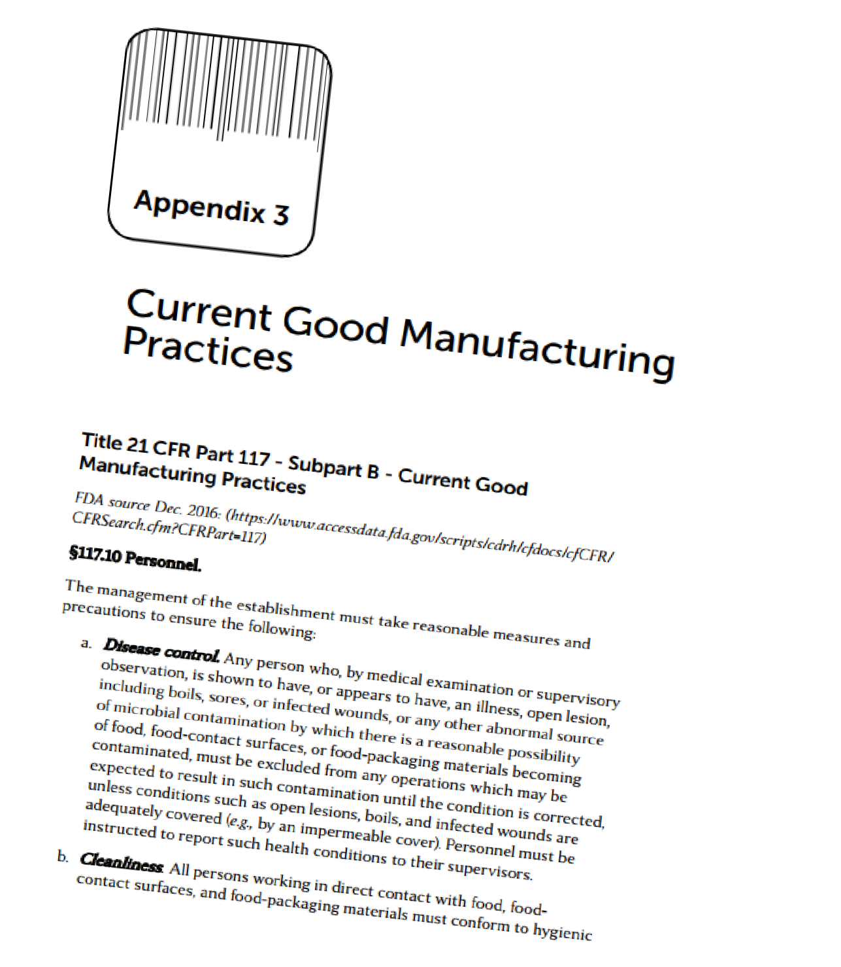
GMP’s 117
Appendix 3
page 229

Slide 20
SCP’s - Procedures

Slide 21
SSOP’s - Written Procedures

Slide 22
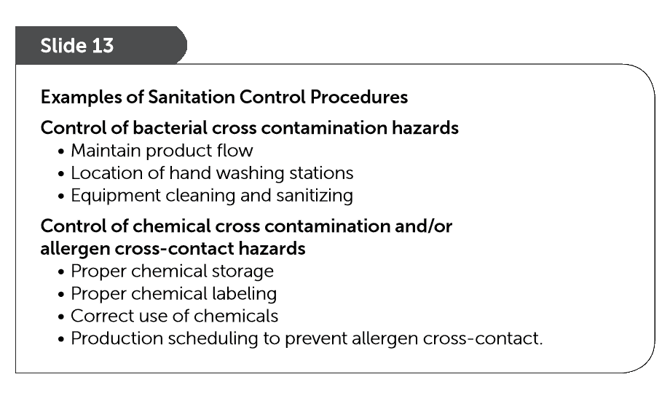

Slide 23
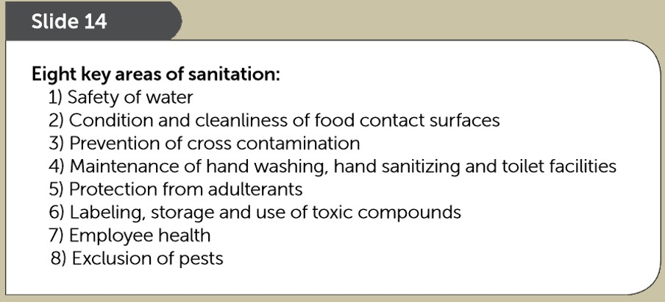
8 Key Areas of Sanitation

Slide 28
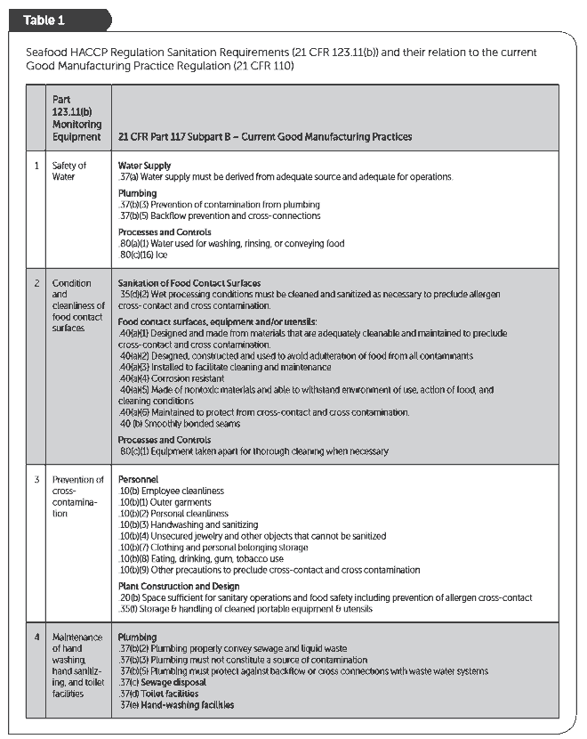
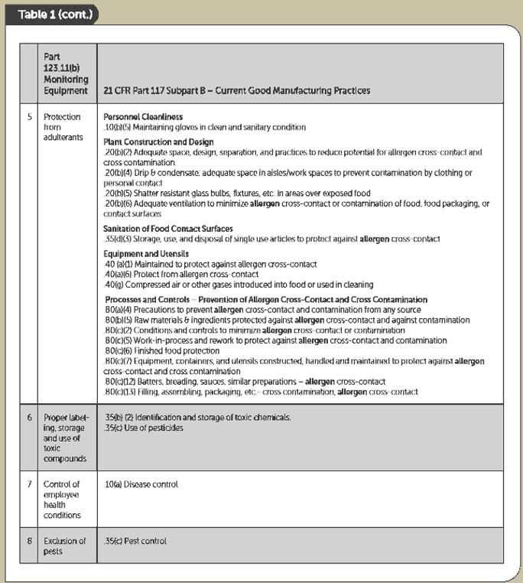
21 CFR 117
SCP’s in
GMP’s 117
Pages 21-22

Slide 29
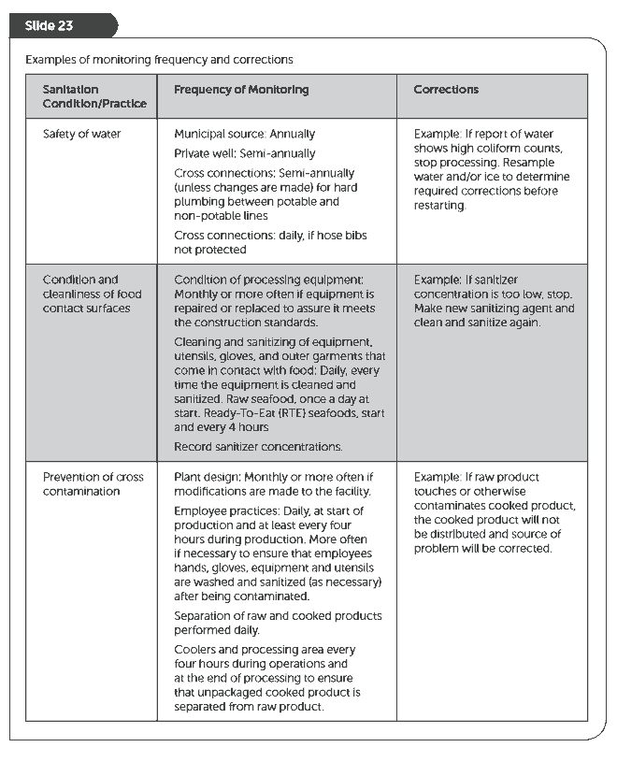
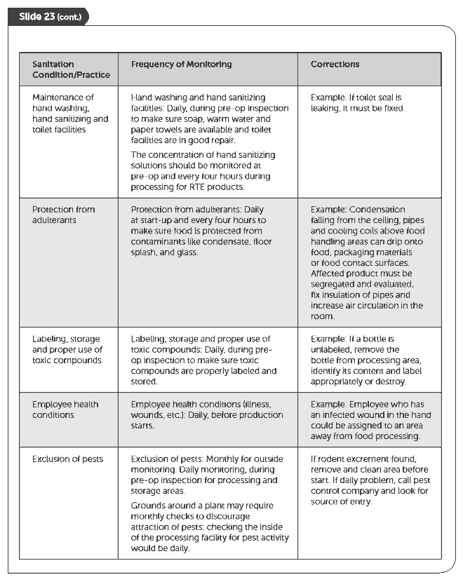
Monitoring
SCP’s
Pages 24-25

Slide 30
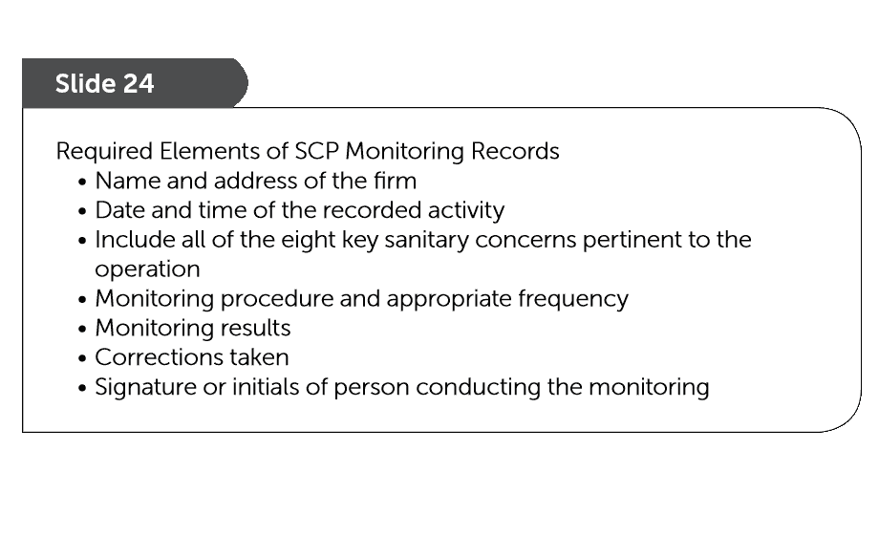
Monitoring SCP’s

Slide 31
Page 27

Slide 32
SCP Requirements

Slide 33
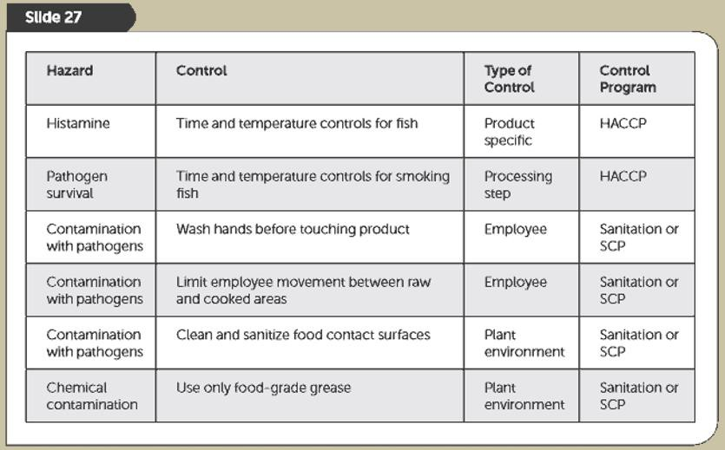
HACCP vs. SCP’s

Slide 34
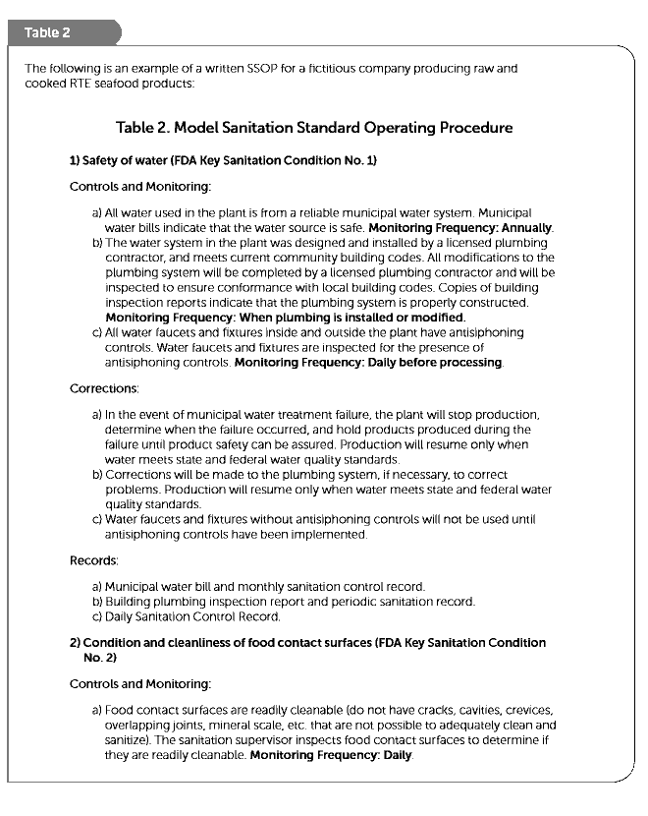
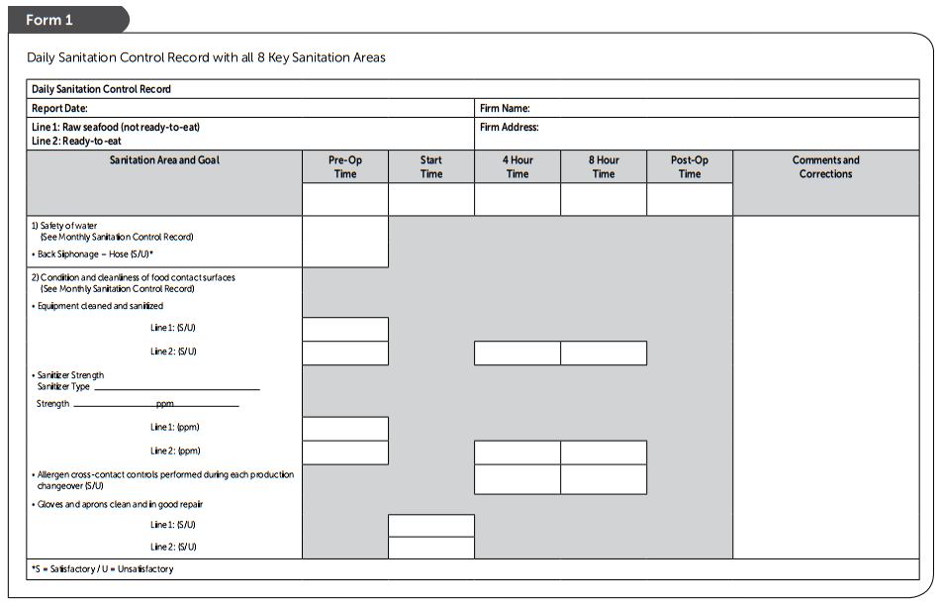
Example SSOP ‘written program’
and accompanying records
Pages 30-40

Slide 35
Seafood Safety Hazards

Slide 36
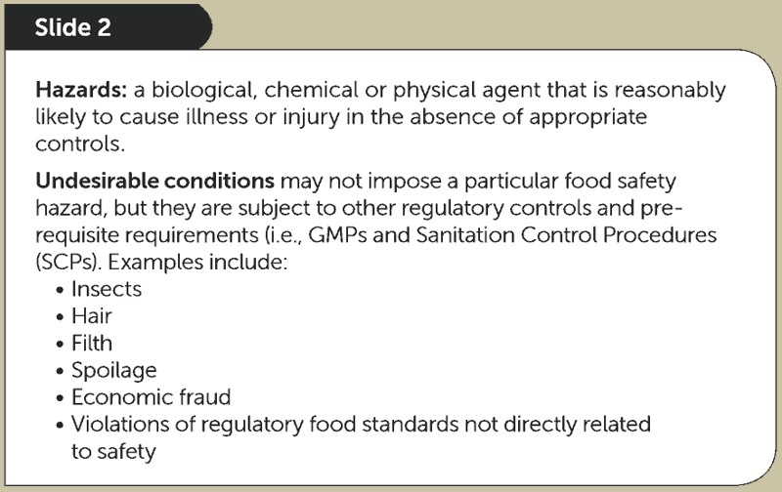

Slide 37
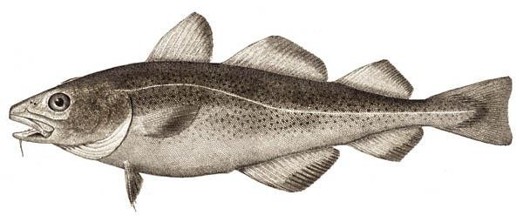
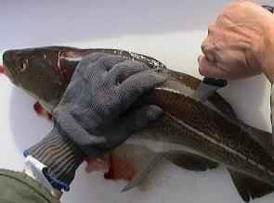

Slide 38
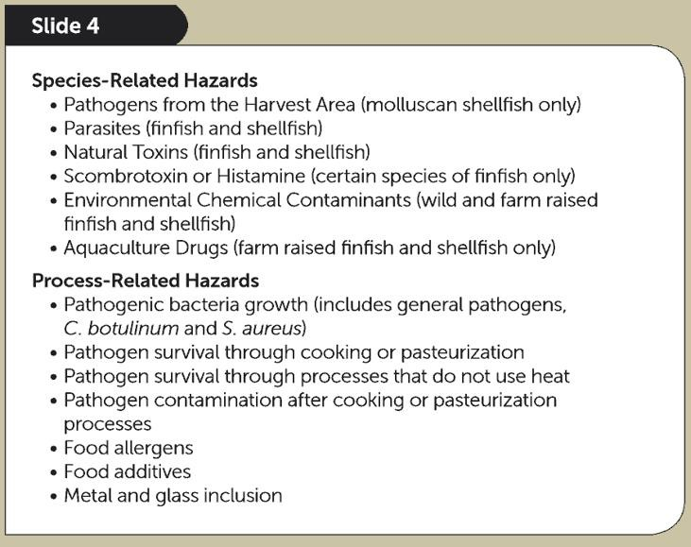

Slide 40
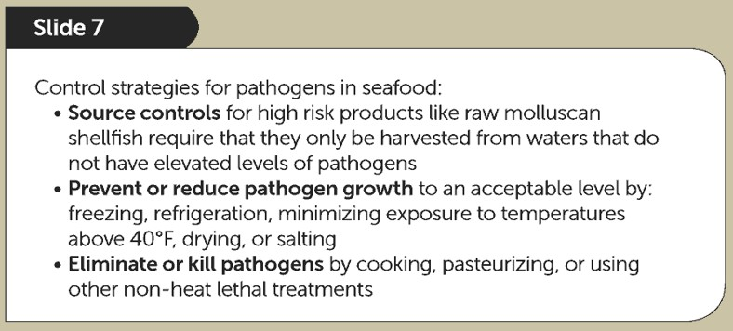
Pathogen Controls

Slide 41
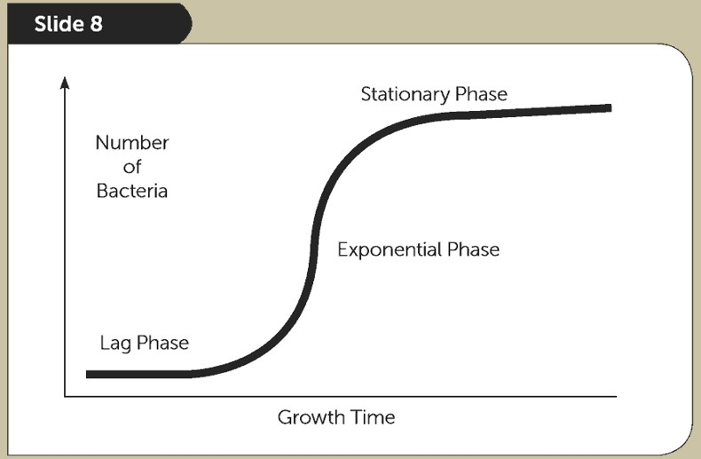
Pathogen Growth

Slide 42
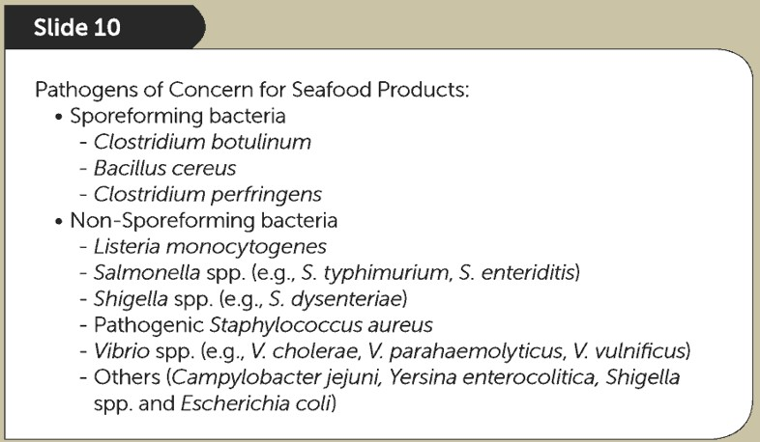
Primary Microbial Pathogens

Slide 43
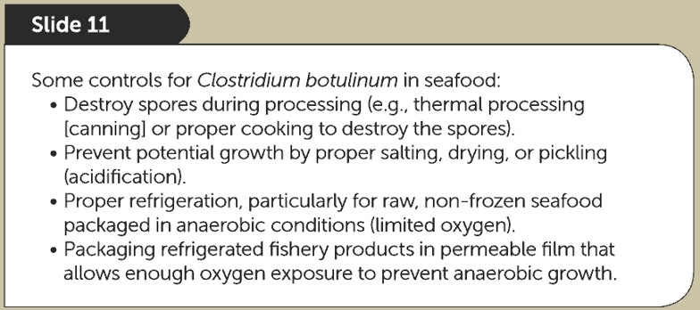
Specific Pathogen Controls

Slide 44
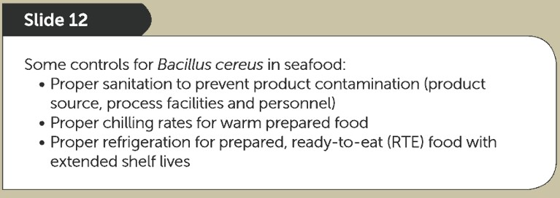
Specific Pathogen Controls

Slide 45
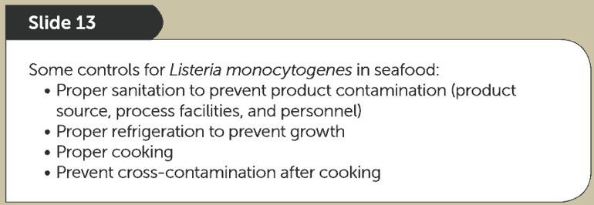
Specific Pathogen Controls

Slide 46
Specific Pathogen Controls

Slide 47
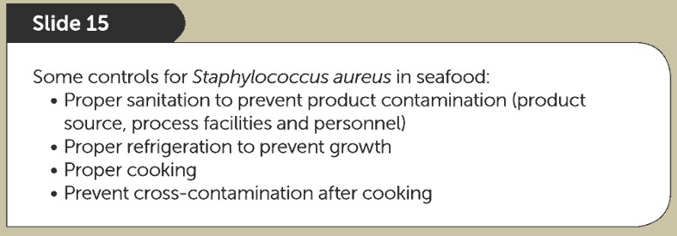
Specific Pathogen Controls

Slide 48
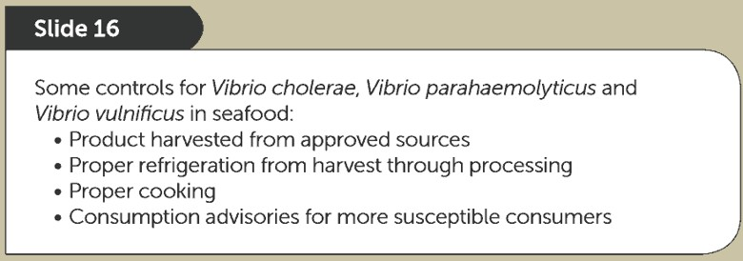
Specific Pathogen Controls

Slide 49
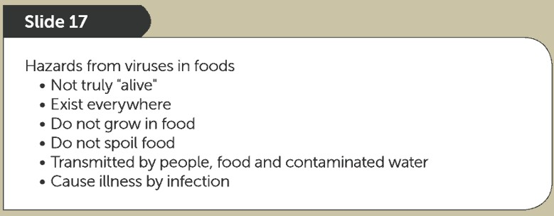
Viruses

Slide 50
Viruses

Slide 51
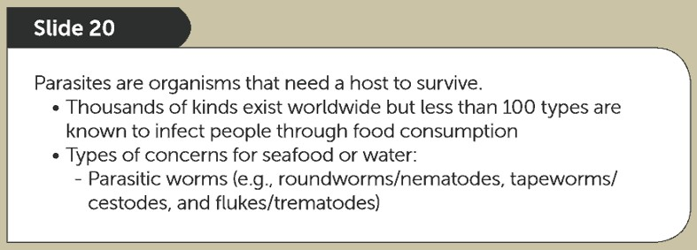
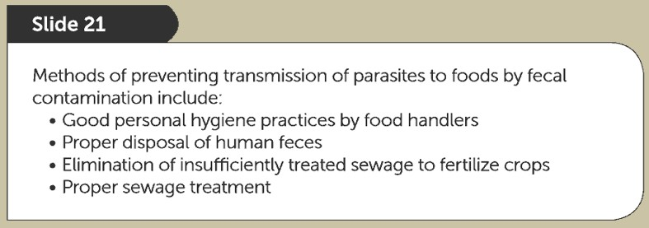
Parasites

Slide 52
Parasites

Slide 53
Species-Related Hazards from Harvest/Growing Waters

Slide 54
Natural Toxins

Slide 55
Natural Toxin Controls

Slide 56
Natural Toxin Controls

Slide 57
Environmental Chemical Contaminants

Slide 58
Aquaculture Drugs: Illegal or Improper Use

Slide 59
Scombrotoxin
(histamine poisoning)

Slide 60
Process-Related Hazards

Slide 61
Process-Related Hazards

Slide 62
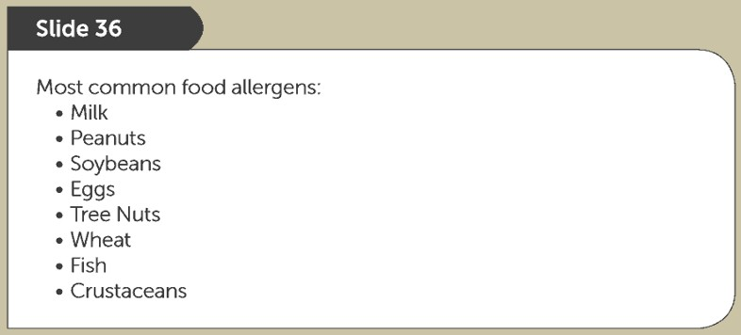
Food Allergens

Slide 63
Physical Hazards

Slide 64
Physical Hazard Controls

Slide 65
Preliminary Steps
in Developing a HACCP Plan

Slide 66
Get Ready !

Slide 67
HACCP TEAM …Who’s involved ?
Managers Sanitation
Processing

Slide 68
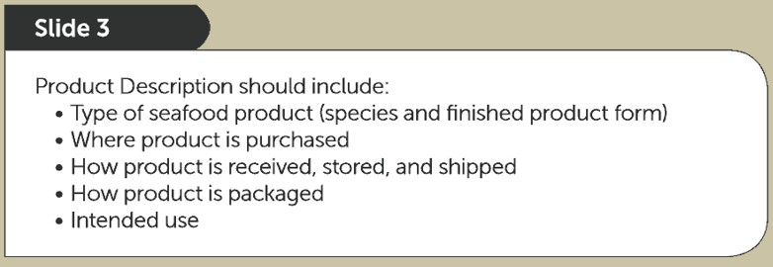
What’s involved ?

Slide 69
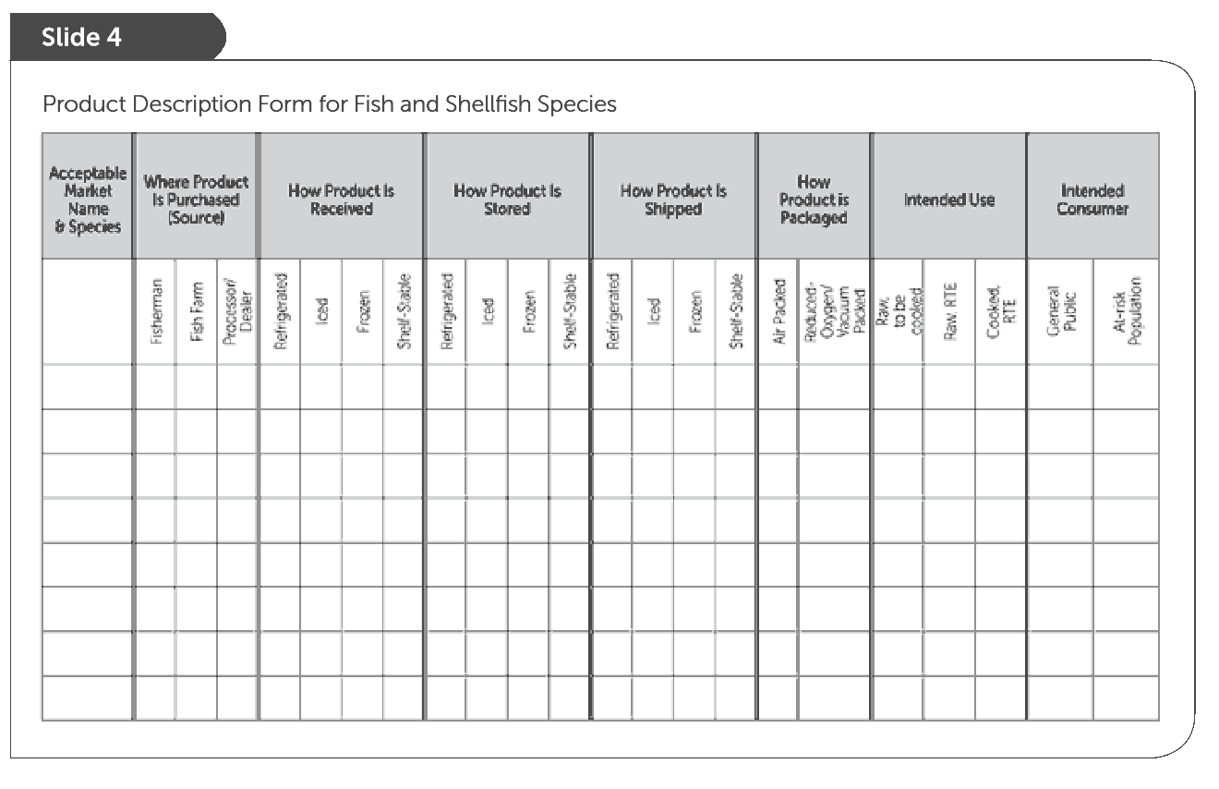
What’s involved ?
Useful Product Description Chart
Page 73

Slide 70
Processing Steps involved ?

Slide 71
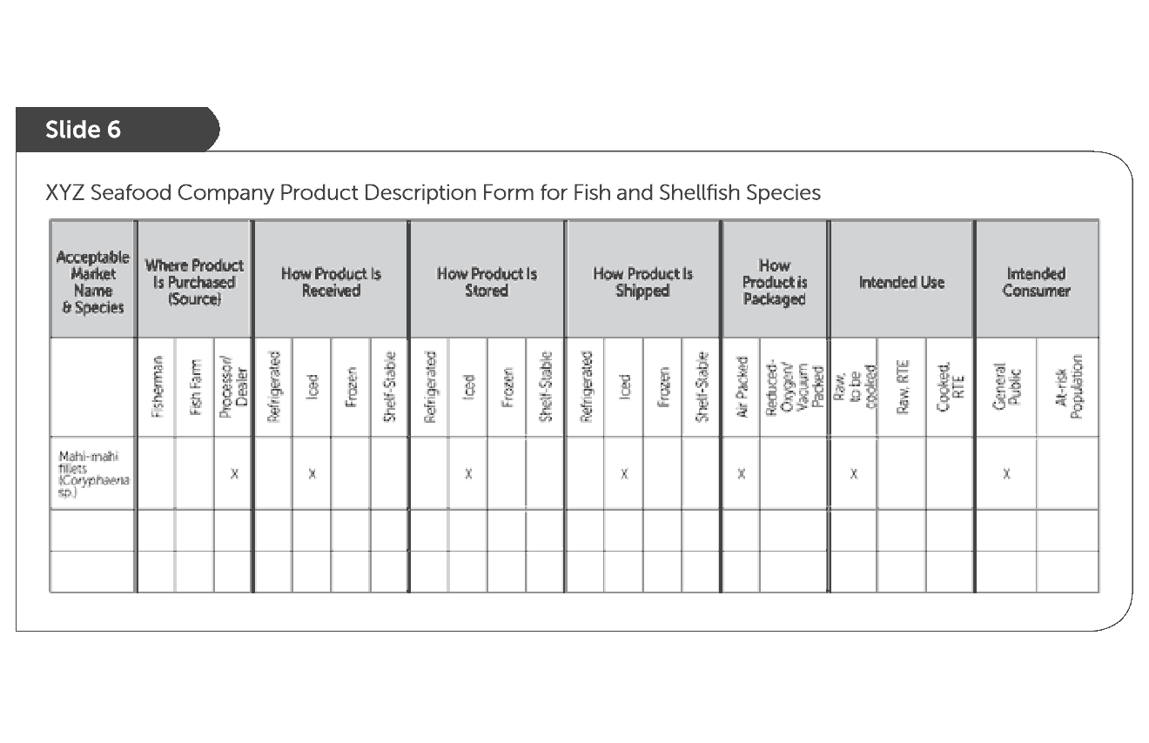
Introduce XYZ Seafood Company
(see pages 74 – 76)

Slide 72
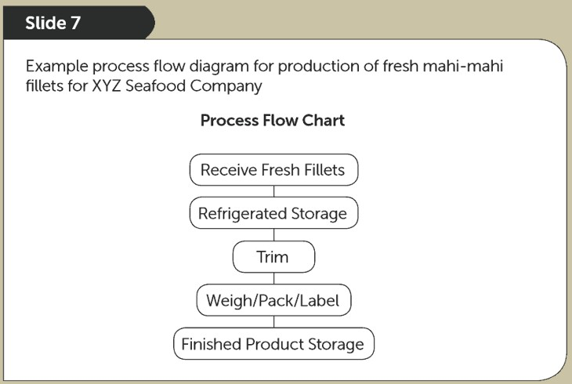
XYZ Processing Steps

Slide 73
Principle 1: HAZARD ANALYSIS

Slide 74
Key Definition
Biological
Chemical
Physical
Food Safety Hazards

Slide 75
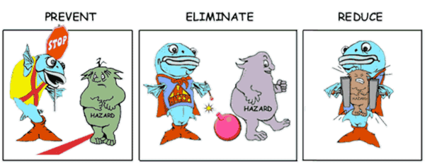
Why conduct a Hazard Analysis ?

Slide 76
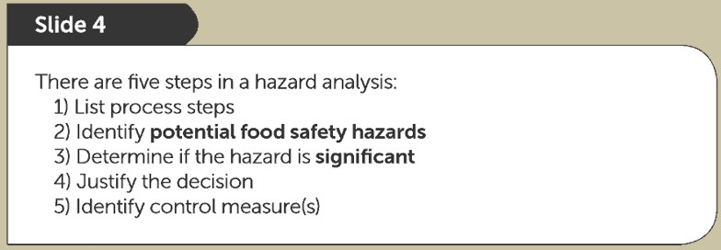
How to Conduct a Hazard Analysis
5 Steps

Slide 77
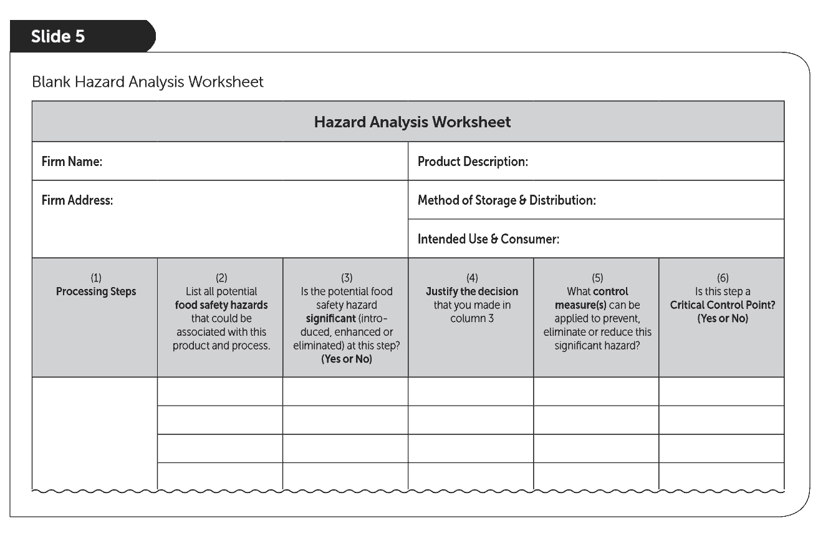
Use the Hazard Analysis Worksheet

Slide 78
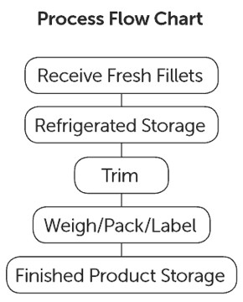
STEP 1 – Enter Processing Steps
“Fresh Mahi-mahi Fillets”
Processing Steps
Flow Diagram from
Chapter 4, Page 75

Slide 79
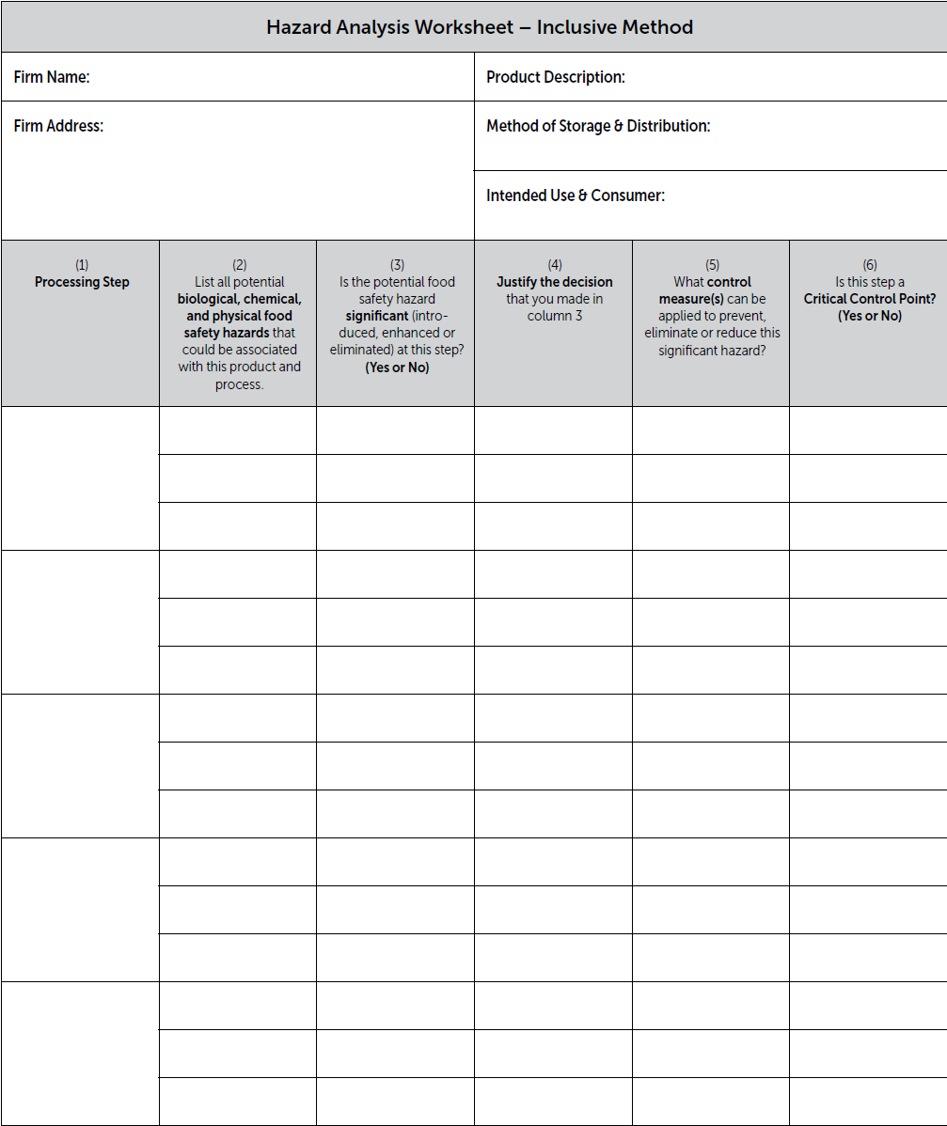
List all Processing Steps
Receiving Step
Refrigerated Storage Step
Trim Step
Weigh/Pack Label Step
Finished Product Storage
Step ₇₉₇₉
Receiving Fresh Fillets
Column 1: List all of the processing steps from the Process Flow Chart
Refrigerated Storage
Trim
Weigh/ Pack/Label
Finish Product Refrig. Storage

Slide 80
STEP 2 – List Potential Food Safety Hazards
Use the FDA Hazards Guide as a
tool to help identify potential hazards.

Slide 81
Search for the potential hazards for
the Fresh ‘Wild’ Mahi-mahi Fillets
Tables 3-2 and 3-3
Species-Related Hazards
Table 3-4
Process-Related Hazards

Slide 82
One Species-related hazard
Table 3-2

Slide 83
Four Process-related Hazards
Notice two hazards in Chapter 19
Table 3-4

Slide 84
Hazard Analysis for the XYZ Seafood Company should include 5 potential hazards:
Species-related Hazards
Table 3-2
1. Histamine formation (Chapter 7)
Process-related Hazards
Table 3-4
Pathogenic bacterial growth-temperature abuse (Chapter 12)
Allergens (Chapter 19)
Food Intolerance Substances (Chapter 19)
Metal inclusion (Chapter 20)

Slide 85
Inclusive Method
Every potential hazard considered at each processing step

Slide 86
STEPS 3 & 4 – Hazard Evaluation & Justification
Simply answer the questions in the Hazard Analysis

Slide 87
Exercise: Complete the Hazard Analysis Worksheet
Simply answer the questions in order for each listed potential hazard at each processing step
FDA Hazards Guide provides some recommendations in the respective hazard chapters

Slide 89
Justify your ‘Yes or No’ decisions
see page 88

Slide 90
BRIEF SUMMARY based on the FDA Guide that provides more recommended details
Column 2 Potential Hazards (Likely to Occur) | Columns 3 & 4 Is the hazard significant in this processing operation
Histamine | YES | Mahi is potential scombrotoxic fish species subject to temperature abuse
Pathogen Growth -Temp. Abuse | NO | Mahi intended to be cooked before consumption
Undeclared Food Allergens | YES | Fish are food allergens
Food Intolerance Substances (FIS) | NO | No FIS or food additives used or added in this processing operation
Metal Inclusion | NO | Not likely to occur in processing steps

Slide 91
STEP 5 – Identify Control Measures (Column 5)

Slide 92
Control Measures

Slide 93
Control Measures

Slide 94
BRIEF SUMMARY based on the FDA Guide that provides more recommended details
Column 2 Potential Hazards (Likely to Occur) | Columns 3 & 4 Is the hazard significant in this processing operation |  | Column 5 Necessary Controls
Histamine | YES | Mahi is potential scombrotoxic fish species subject to temperature abuse | Time and Temperature controls (Chapter 7)
Pathogen Growth -Temp. Abuse | NO | Mahi intended to be cooked before consumption | Chapter 12
Undeclared Food Allergens | YES | Fish are food allergens | Proper product labeling (Chapter 19)
Food Intolerance Substances (FIS) | NO | No FIS or food additives used or added in this processing operation
Metal Inclusion | NO | Not likely to occur in processing steps | Chapter 20 (page 386)

Slide 95
Hazard Analysis Worksheet
see pages 95 - 97
Pages 95-97
Every ‘Yes’ in column 3
requires a response in column 5 and 6

Slide 96
Hazard Analysis Worksheet
Pages 95-97
Every ‘Yes’ in column 3
requires a response in column 5 and 6

Slide 97
Be sure to identify all potential FOOD SAFETY Hazards

Slide 98
End Chapter 5: Principle 1
HAZARD ANALYSIS

Slide 99
Principle 2:
Determine Critical Control Points

Slide 100
What’s a Critical Control Point ?

Slide 101
Hazard Prevention
Control Measures Formulation Time/Temp Control Supplier Certificates
CCPs
Mixing Step
Refrigerated Storage Step Receiving Step

Slide 102
Hazard Elimination
Control Measures Cooking
Use of Metal Detection Freezing Procedures
CCPs
Cook Step
Metal Detector Step Freeze Step

Slide 103
Hazard Reduction
Control Measure Source Controls Time/Temp Control
CCP
Receiving Step Cook Step

Slide 104
More than one …

Slide 105
Product & Process Specific …

Slide 106
CCP Decision Tree
(optional tool)
Page 99

Slide 107
Completed Hazard Analysis 105 - 107
CCP
Every ‘Yes’ in column 3 requires a response in column 6
CCP

Slide 108
Completed Hazard Analysis 105 - 107
Every ‘Yes’ in column 3 requires a response in column 6
CCP
CCP

Slide 109
Conclusions from the Hazard Analysis
Histamine is a significant food safety hazard and there are three CCPs for this hazard: CCP 1. Receive fresh fish
CCP 2. Refrigerated storage, and
CCP 3. Finished product refrigerated storage
Undeclared food allergen is a significant food safety hazard and there is one CCP for this hazard:
CCP 4. Weigh/Pack/Label

Slide 110
Remember to use the recommendations in the FDA Guide
Tip
For example, ‘Likely CCPs’ for histamine formation (FDA Guide, Chapter 7)
and food allergens
(FDA Guide, Chapter 19)

Slide 111
“CCP either here or later”
Tip
Every ‘Yes’ in column 3
requires a response in column 6
Hazard here
CCP later

Slide 112
End Chapter 6: Principle 2 Determine Critical Control Points
Got it ?

Slide 113
Principle 3:
ESTABLISH CRITICAL LIMITS

Slide 114
What’s a Critical Limit ?

Slide 115
Sources & Examples …

Slide 116
Options and details …
see pages 112-115

Slide 117
Using Operating Limits

Slide 118
Using ‘Lot’
Designations
Page 109

Slide 119
Critical Limits should be specified in the written HACCP Plan

Slide 120
Optional HACCP Plan Forms
(both must contain same information)
Portrait
Landscape

Slide 121
Expected Information in all HACCP Plans

Slide 122
Building the HACCP Plan for each CCP
Hazard Analysis Worksheet
HACCP Plan form
Column 1 & 2: List all of the identified CCPs and identified hazards
122

Slide 123
Recommended Critical Limits
REMINDER: The FDA Guide contains control strategies with recommended CL’s
Processors may select alternative CL’s ‘however’ equivalent effectiveness
MUST be demonstrated and documented

Slide 124
Select a Control Strategy
Example:
CCP = Receiving Hazard = Histamine

Slide 125
Proceed through the selected Control Strategies
FDA Guide , Chapter 7
Note all listed options to suit different situations
When applicable, there can be different strategies for
primary vs. secondary processors
Note the details associated with
OR’s and AND’s

Slide 126
Select the best control to suit the situation and assure effective control for the potential hazard
TRANSIT CONTROL OPTIONS
Transit temperature records
Surrounded by ice on delivery
Use of ice; AND internal fish temperature
Frozen gel-packs; AND internal fish temperature
Transit time (< 4 hours); AND internal fish temperature
Tip
Notice ‘ORs & ANDs ’

Slide 127
HACCP Plan for XYZ Seafood Company
FDA Guide, Chapter 7

Slide 128
HACCP Plan for XYZ Seafood Company
Critical Limits based on recommendations in the FDA Hazards Guide

Slide 129
Want some more ?
End Chapter 7: Principle 3
Establish Critical Limits

Slide 130
Principle 4:
Critical Control Point Monitoring

Slide 131
What is a Monitoring ?

Slide 132
When ? (frequency)
How ?
What ?
4 required parts for proper MONITORING
Who ?

Slide 133
What ?

Slide 134
How ?

Slide 135
When ? (frequency)

Slide 136
Who ?

Slide 137
Monitoring requires training

Slide 139
Monitoring for XYZ Seafood Company

Slide 140
End Chapter 8: Principle 4
MONITORING

Slide 141
Principle 5: Corrective Actions

Slide 142
What are Corrective Actions ?

Slide 143
Identify involved product
Assess safety and product disposition
Correct the problem
Restore control

Slide 144
Is the involved product safe ?
Helpful Sources:
FDA Guide-Appendix 4

Slide 145
Is the involved product safe ?

Slide 146
Using the FDA Guide for CA’s
Optional CA’s
FDA Guide Example
Chapter7, page 143
In some cases, the final option to reject or destroy product is more logical than trying to produce evidence for other options

Slide 147
Information for documenting Corrective Actions
Page 127

Slide 148
Example Corrective Actions
see pages 128 -129

Slide 149
Corrective Actions for XYZ Seafood Company
see page 138-139

Slide 150
Corrective Actions for XYZ Seafood Company
see page 138-139

Slide 151
End Chapter 9: Principle 5
CORRECTIVE ACTIONS

Slide 152
Principle 6:
Establish Verification Procedures

Slide 153
What is Verifications ?

Slide 154
Various types of Verifications

Slide 155
Validation ‘before’ operations
‘Will it work’

Slide 156
Before operations…‘Validate the HACCP controls and plan will work’

Slide 157
When to Validate

Slide 158
Verification ‘during’ operations
‘Is it working’

Slide 159
‘Is it working’ … see page 140

Slide 160
Record Accuracy and Calibration

Slide 161
Verify through periodic testing

Slide 162
Must Review Monitoring and Corrective Action Records

Slide 163
Total HACCP Program Verification
Requires a signature

Slide 164
Total HACCP Program Verification

Slide 165
Ultimate Verification

Slide 166
Verification Summary …
Pages 146-147

Slide 167
Verifications for XYZ Seafood Company

Slide 168
Verifications for XYZ Seafood Company

Slide 169
End Chapter 10: Principle 6
VERIFICATIONS

Slide 170
Principle 7:
Record-Keeping Procedures

Slide 171
Records support the HACCP Program
Required Records

Slide 172
Recommended and Required Records
HACCP Plan
REQUIRED

Slide 173
Additional Record support for HACCP

Slide 174
Required information on required records

Slide 175
Example Monitoring Records

Slide 176
Example Monitoring Records …
Pages 161-163

Slide 177
Information for CA records
…
Pages 163-164

Slide 179
Additional Record Examples … ^{Pages 161-163}

Slide 180
Do Not Forget Records for required SCP monitoring
Remember SCP records for the 8 Key Sanitation Conditions

Slide 181
Do Not Forget Employee Training Records in GMP’s 117
Page 171

Slide 182
Computer Recordkeeping
allowed …
IF

Slide 183
Records for XYZ Seafood Company
see pages 179 -180

Slide 184
Records for XYZ Seafood Company
see pages 179 -180

Slide 185
SPECIAL NOTE
The HACCP Plan form can be used in portrait format which can be more convenient
XYZ Seafood Company
Pages 181-184
Blank forms are in Appendix 2

Slide 186
End Chapter11: Principle 7
Record-Keeping
Are ya done !

Slide 187
The Seafood HACCP Regulation

Slide 188
Copies of the Official Published Regulation
21 CFR Part 123 Seafood HACCP Regulation
SHA Training Manual
Appendix 1 (p. 205)
FDA Guide
Appendix 8
Stay aware for periodic additions
Tip

Slide 189
Regulation Outlined in Parts

Slide 190
Key Definitions in the Regulation

Slide 191
Key Definitions in the Regulation

Slide 192
Who must comply ?

Slide 193
Define Processing

Slide 194
Regulation does not apply to:

Slide 195
Foundation for the Regulation
Copy of the current GMP’s Part 117
Appendix 3, Page 235

Slide 196
Determine hazards likely to occur…

Slide 197
Written HACCP plans …

Slide 198
HACCP plans ‘shall’ contain …

Slide 199
HACCP plans ‘shall’ be signed and dated …

Slide 200
Special considerations
for seafood canning operations …

Slide 201
Sanitation or HACCP Controls ?

Slide 203
Processors ‘shall’ take ‘corrective actions’

Slide 204
Verifications are required …

Slide 205
Required records …

Slide 206
Information required on each record …

Slide 207
Record Reviews and Retention …

Slide 208
HACCP training to …
Trained

Slide 209
SCP’s – Sanitation Control Procedures

Slide 210
8 Key Sanitation Control Areas

Slide 211
HACCP with Imported Seafood

Slide 212
HACCP with Imported Seafood

Slide 213
HACCP with Smoked Seafood

Slide 214
HACCP with Raw Molluscan Shellfish

Slide 215
HACCP with Raw Molluscan Shellfish

Slide 218
Resources for Preparing Seafood HACCP Plans
Recommended websites:
FDA Seafood HACCP Regulations
AFDO Seafood HACCP Alliance (Association of Food and Drug Officials)
Numerous State based Sea Grant Programs via Seafood
Safety and HACCP
USDC/National Marine Fisheries Services via Seafood HACCP
USDA Catfish HACCP

