Slide 1

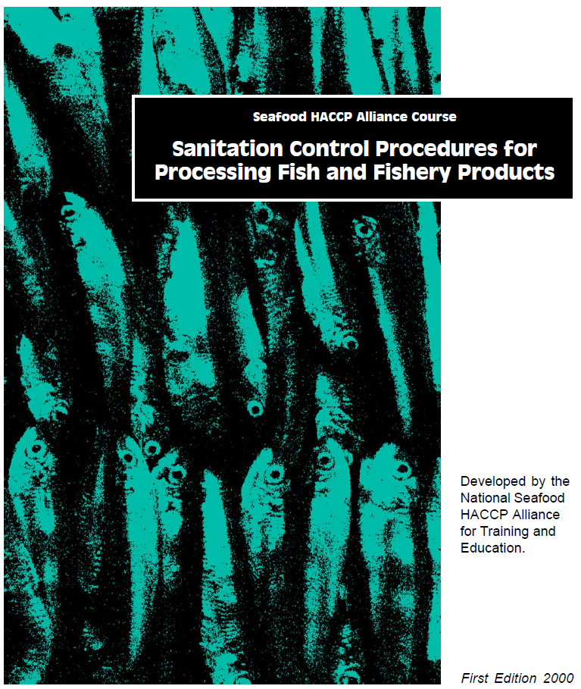
Sanitation Control Procedures
Course No. <assign course number>
< course location >
< training date >
< Instructors >
Place for credits and logos

Slide 2
Sanitation Control Procedures
Why is training necessary ?
… evidence through inspections has shown a need to develop a culture throughout the seafood industry in which processors assume a more operative role in controlling sanitation in their plants

Slide 3
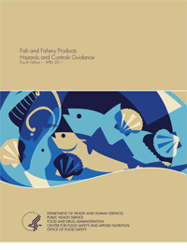
Sanitation Control Procedures
Purpose for SCP training
Assist industry in developing and implementing SCPs as mandated by the FDA “Seafood HACCP Regulation (21 CFR, Part 123)

Slide 4
Sanitation Control Procedures
SCPs are required in prevailing HACCP regulations
Processors ‘should’ implement written SSOP plans
Processors ‘shall’ monitor the sanitary conditions and practices
Processors ‘shall’ correct insanitary conditions and practices in a ‘timely manner’, and
Processors ‘shall’ maintain sanitation control records

Slide 5
Sanitation Control Procedures
SCPs Records are required
SCP monitoring ‘shall’ be recorded at the time it is observed
SCP Records ‘shall’ include:
  Name and location of the processor
  Date and time of the activity recorded
  Signature or initials of the person performing the monitoring operation

Slide 6

Sanitation Control Procedures
SCPs Records ‘shall’ be retained for:
At least 1 year for refrigerated products
At least 2 years for frozen, preserved or
shelf-stable products

Slide 7
Sanitation Control Procedures
More Recent Regulations were introduced in 2016
HACCP and SCP’s are based on the current Good Manufacturing Procedures, GMP’s
New GMP’s were introduced by
the Food Safety Modernization Act
(FSMA)
HACCP
SCP’s
GMP’s 117

Slide 8
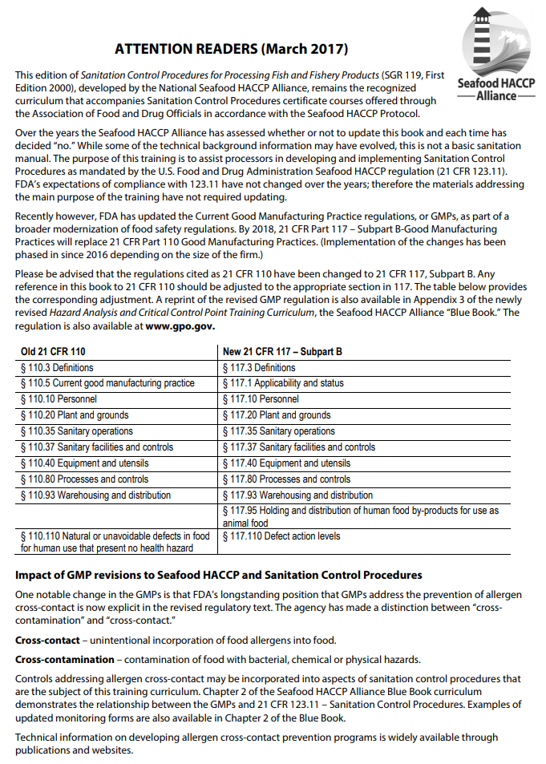
Sanitation Control Procedures
As of 2016, the new GMP’s Part 117 replaced the previous versions Part 110
The SCP Training manual (SGR 119) includes a yellow insert to explain the changes
HACCP
SCP’s
GMP’s 117

Slide 9
Sanitation Control Procedures
Basically under new changes introduces by the Food Safety Modernization Act (FSMA):
HACCP requirements still prevail for seafood processing
SCP monitoring must account for potential ‘cross-contact’ with food allergens
Basic SCP related training is ‘required for qualified persons’ in processing operations

Slide 10
Sanitation Control Procedures
REQUIRED TRAINING
Training is required for all individuals who manufacture, process, pack or hold food
The training MUST be documented with records
There are no prescribed training courses, but
the SCP course can be one source

Slide 11
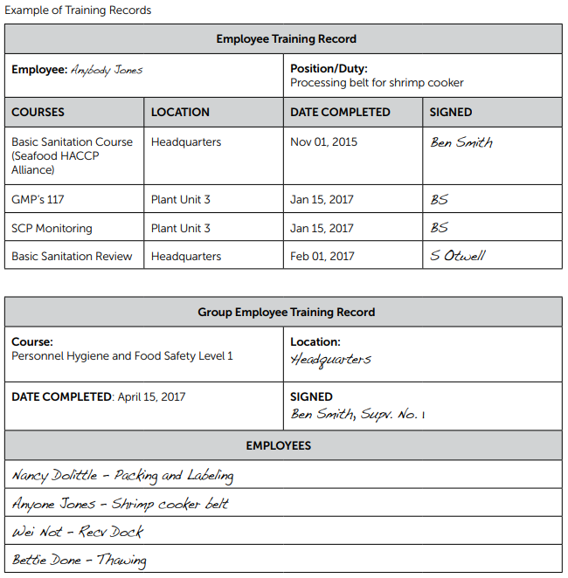
Sanitation Control Procedures
EXAMPLE
REQUIRED Training Records simply document:
Who was trained
When training occurred
Where training occurred
Type or nature of the training course or event
Responsible signature

Slide 12
8 Key SCP Conditions
Require Records for monitoring and corrections
Safety of the water (including ice)
Condition and cleanliness of food contact surfaces
Prevention of cross contamination (and cross-contact)
Maintenance of handwashing, hand sanitizing and toilet facilities
Protection from adulterants
Labeling, storage and use of toxic compounds
Employee health
Exclusion of pests

Slide 13
Sanitation Control Procedures
Monitoring for Cross-Contact
The new requirements for assessing and monitoring the processing operations for ‘cross-contacts’ for potential food allergens can be simply incorporated as part of the routine SCP’s as taught in this course
Eight Common Food Allergens:
Milk, Eggs, Fish, Crustaceans, Tree nuts,
Peanuts, Wheat, and Soybeans

Slide 14
Sanitation Control Procedures
Now that you understand WHY processors must maintain SCP’s
Do you know HOW?
There is no one way!
TIP

Slide 15
Sanitation Control Procedures
SCP Course Approach
The SCP training is not intended to be a basic stand-alone sanitation course
The SCP course intends to train – 3 Parts
  How to develop Sanitation Standard Operation Procedures (SSOP’s);
  How to conduct and record SCP monitoring; and
  Provides background information about the
  8 key SCP conditions

Slide 16
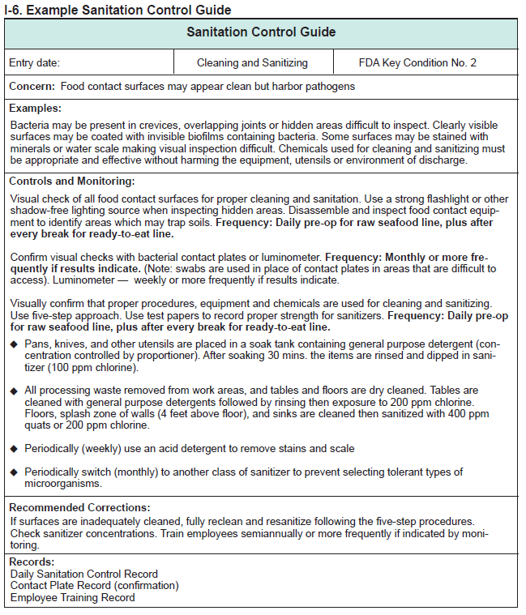
1. How to develop SSOP’s
SCP training provides an example SSOP plan
Although the prevailing Seafood HACCP Regulation does not require a ‘written’ SSOP plan, the SCP training strongly recommends written plans

Slide 17
Good Reason to Recommend ‘Written SSOP plans:
Describe the sanitation procedures to be used in the plant;
Provide a schedule of these sanitation procedures;
Provide a foundation to support a routine monitoring program;
Encourage prior planning to ensure that corrections are taken
when necessary;
Identify trends and prevent recurrent problems;
Ensure that everyone, from management to production workers,
understands sanitation;
Provide a consistent training tool for employees; and
Demonstrate commitment to buyers and inspectors.

Slide 18
1. How to develop SSOP’s
SCP training progressively builds a SSOP plan through eight Chapters, one for each key SCP condition
Features in SSOP Plans
Reasons for the controls and monitoring
Frequency (when) to conduct actions and monitoring
Details for sanitary practices
Recommendad corrections
1
2
3
4

Slide 19
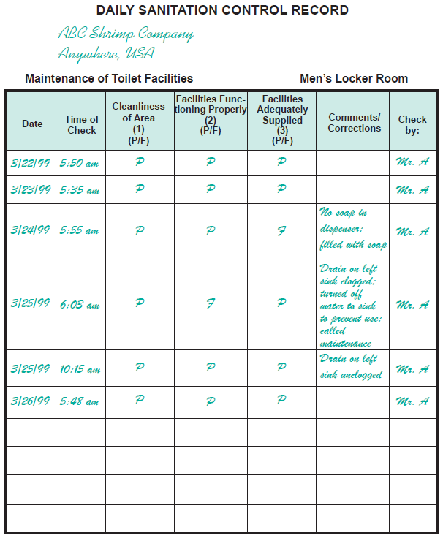
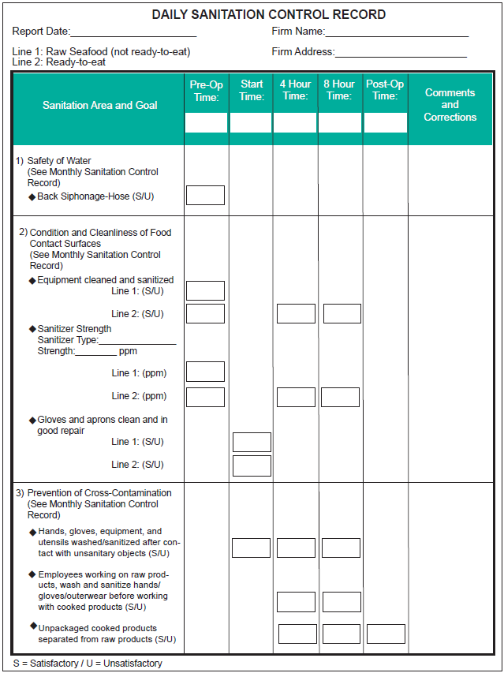
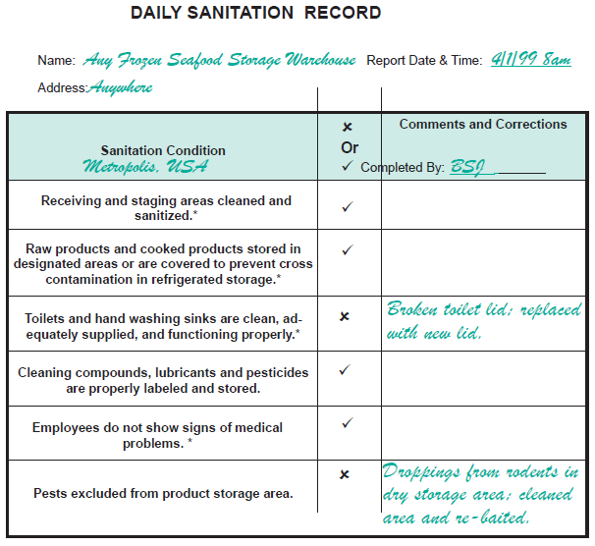
2. How to conduct and record SCP monitoring
Provides Example SSOP Monitoring and Record forms

Slide 20
2. How to conduct and record SCP monitoring
1
Features in Record forms
Required signatures and dates
Each ‘key’ sanitation condition
Frequency for monitoring
How to monitor the sanitary procedure
Details for sanitary procedures
Space to record corrections
3
2
4
5
6
4

Slide 21

2. How to conduct and record SCP monitoring
Required to record ?
According to the Seafood HACCP Regulation,
the SCP records MUST include:
Name and location of the processing
Date and time of activity recorded, and
Signature or initials of the person performing
the monitoring operation.(21 CFR, Part 123.9(a)

Slide 22
2. How to conduct and record SCP monitoring
When to record ?
SHALL !
The Seafood HACCP Regulation, calls for “each processor ‘shall’ monitor the conditions and practices during processing with sufficient frequency to ensure, at a minimum, conformance with these conditions and practices specified in the [GMPs] that ae appropriate to the plant and food being processed”
(21 CFR, Part 123.11(b)

Slide 23
2. How to conduct and record SCP monitoring
Sufficient Frequency ?
Frequency for monitoring sanitary practices and conditions are not specified in the FDA Seafood HACCP Regulation, but are recommended in this Seafood HACCP Alliance course as an optional guideline to help ensure conformance with the prevailing GMPs that should be appropriate to the plant and food being processed.

Slide 24
Both are important and required
for seafood safety, but
When to monitor as CCP or SCP ?
CCP: A processing step at which control can be applied to prevent or eliminate a food safety hazard or reduce it to an acceptable level
SCP: Procedure to maintain sanitary conditions usually related to the entire processing facility or an area, not just limited to a specific processing step or CCP.

Slide 25
When to monitor as CCP or SCP ?
General guideline to distinguish:
CCPs are associated with preventative controls applied at a discrete processing step
SCPs are controls for potential hazards associated with the processing environments or personnel

Slide 26
When to monitor as CCP or SCP ?
EXAMPLES for comparison
Hazard | Control |  | Record
Histamine | Time & temperature of scrombroid fish | Product specific | CCP
Pathogen Survival | Time & temperature for smoking fish | Processing step | CCP
Contamination with pathogens | Wash hands before touching product | Personnel | Sanitation
Contamination with pathogens | Limit employee movement between raw and cooked areas | Personnel | Sanitation
Contamination with pathogens | Clean and sanitize food contact surfaces | Plant environment | Sanitation
Chemical contamination | Use only food-grade grease | Plant environment | Sanitation

Slide 27
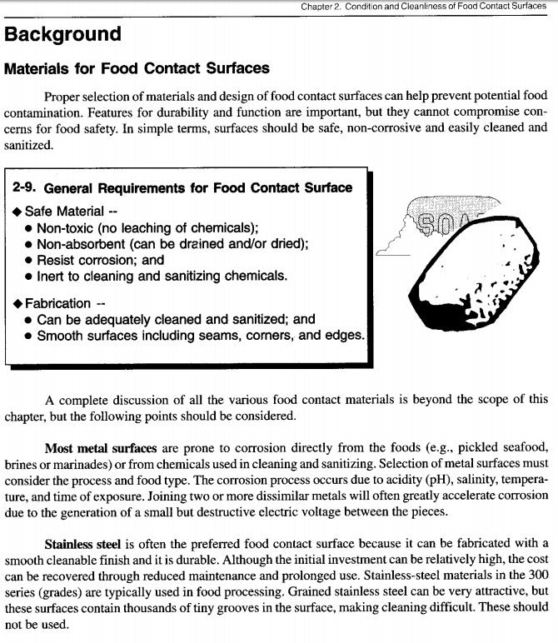
3. Provides Background Information for
each of the 8 Key Sanitation Conditions
The SCP training manual has a chapter for each of the 8 key sanitary conditions
Each chapter contains background information about the key sanitary conditions

Slide 28
Sanitation Control Procedures
Now that you understand WHY
SCP training is important,
and you anticipate the training
approach by the Seafood HACCP Alliance
Let the course begin !

Slide 29

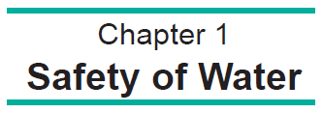
Sanitation Control Procedures

Slide 30

1-1. Key Sanitation condition No. 1:
◆ Safe supply for water that contacts food and food contact surfaces;
◆ Safe water supply for production of ice; and
◆ No cross-connections between potable and
non-potable water

Slide 31

1-2. Water is one of the most important
components of a seafood establishment
since it is used:
◆ As an ingredient;
◆ To convey or transport products;
◆ To wash foods;
◆ To make ice and glazed products;
◆ To clean and sanitize facilities, utensils, containers and equipment; and
◆ For drinking

Slide 32
1-3. Common sources for water use in
seafood processing:
◆ Municipal;
◆ Private wells; and
◆ Seawater

Slide 33
1-5. Private water monitoring
Private water monitoring should be conducted
before any new service is used for processing operations and then at least on a semi-annual basis or more frequently for suspect sources in accordance with state requirements.

Slide 34

1-6. Sea water monitoring
Monitoring for seawater safety in processing should be conducted more frequently than for land-based municipal or private sources. The guidelines should be in accordance with state requirements and locally approved testing labs.

Slide 35
1-8. EPA National Drinking Water Regulations for
Microorganisms
MCL Goal MCL*
Total coliforms (including zero 5%**
fecal coliforms & E. coli)
viruses (enteric) zero 99.99% killed or inactivated
Giardia lamblia zero 99.99% killed or inactivated
* See footnotes ____________

Slide 36

1-9. Most common water source
obtained from municipalities have:
◆ High chemical and microbiological standards;
◆ Been purified or treated; and
◆ Been tested on a pre-determined schedule.

Slide 37
1-10. Chemical and microbiological contamination
of well water can occur due to:
◆ Flood or heavy rains;
◆ Location too close to cesspools, septic tanks,
agricultural sites, or associated drainage field;
or
◆ Cracked or improperly sealed well
casing or liners.

Slide 38
1-11. World Health Organization’s
recommendations:
(WHO) defines ‘clean sea water’ as seawater which meets the same microbiological standards as potable water and is free from objectionable substances.

Slide 39
1-12. Passenger Vessel Sanitation Program
Guidelines for Potable Water Use
Source: Potable according to EPA’s National Primary Drinking Water Regulations
Treatment: Halogen level (e.g., free chlorine content) greater than 0.2 mg/liter (ppm) and less than 5.0 ppm.
Monitoring: Minimum of four samples per month to assure zero E. coli.
Storage: Tanks do not share common wall with the vessel hull or with tanks containing non- potable water or other liquids; interior tank coatings approved for potable water contact (non-corrosive); tank vents and overflows protected from contamination; and device used to check tank water depth will not contaminate.
Piping: Must be colored (blue) and labeled for potable water use; no potable water piping to pass under or through sewage or other tanks holding non-potable liquids; no non-potable piping passing through or under tanks holding potable water.
Hoses: Colored and labeled for potable water use only; unique hose fillings from all other hose fittings, flush before use and drain after use.
______________________________________________
Source: Vessel Sanitation Program Operations Manual, 1999.
Centers for Disease Control and Prevention - VSP, Atlanta, GA

Slide 40
1-13. Causes of In-Plant Water Contamination
◆ Cross-Connections
◆ Backflow
● back pressure
● back siphonage
1-14. Backpressure can be a source of contamination
A potable water system is connected to a system
operating under a higher pressure by means of a
pump, boiler, elevation difference, or air or steam
pressure.

Slide 41
1-15. Backflow control:
◆ Air gap
◆ Vacuum breaker
◆ Check valve

Slide 42
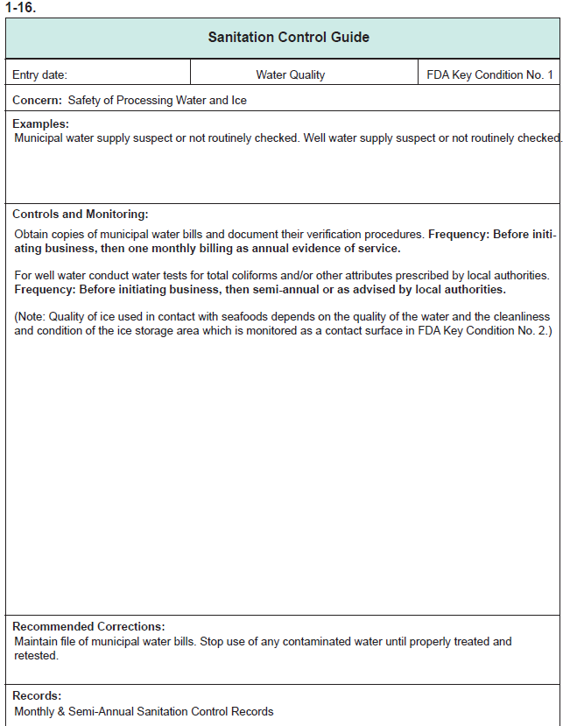
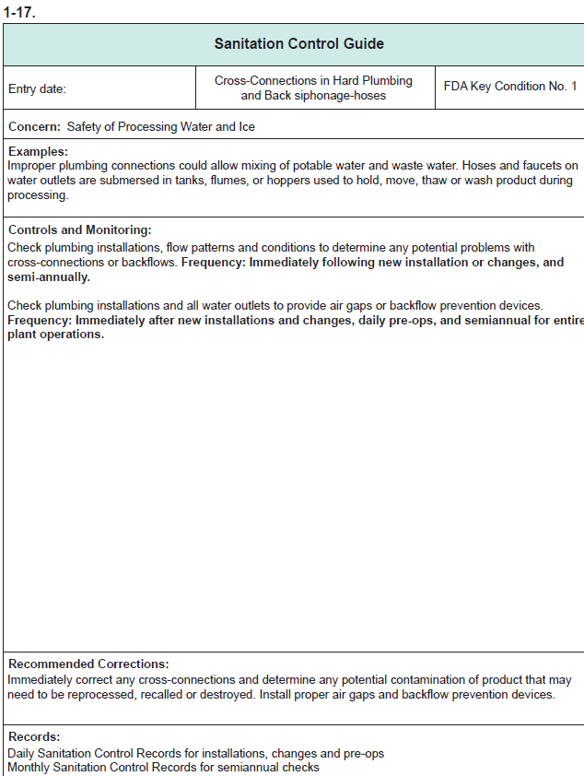
Sanitation Control Guide
pages 1-14 thru 1-15

Slide 43
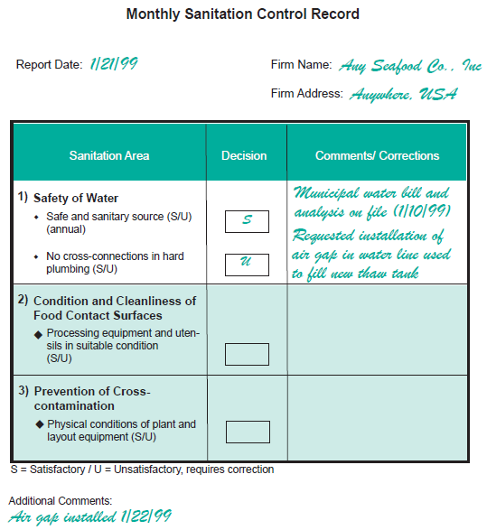

page 1-3

Slide 45
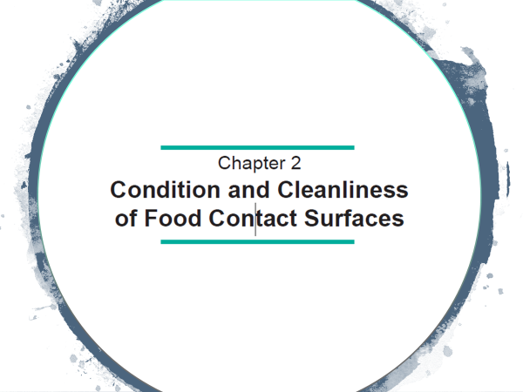

Slide 46
2-1. Key Sanitation Condition No. 2
Condition and cleanliness of food contact surfaces

Slide 47
2-2. Food Contact Surface:
“Those surfaces that contact human food and those surfaces from which drainage, or other transfer, onto the food or onto surfaces that contact the food ordinarily occurs during the normal course of operations” (GMP, 21 CFR 117.3). Food contact
surfaces include utensils, knives, tables, cutting boards,
conveyor belts, ice makers, ice storage bids, gloves, aprons, etc.”

Slide 48
2-3. Goal:
Monitoring should provide assurance that food contact surfaces including gloves and outer garments are properly designed, constructed and maintained to facilitate sanitation, and that they are adequately and routinely cleaned and
sanitized.

Slide 49

2-4. What to Monitor:
◆ Condition of the food contact surfaces;
◆ Cleanliness and sanitation of food contact
surfaces;
◆ Type and concentration of sanitizers(s) used;
and
◆ Gloves and outer garments which might contact food are clean and in good condition.

Slide 50
2-5. How to Monitor:
◆ Visual Inspection --
● Surfaces in good condition;
● Surfaces cleaned and sanitized; and
● Gloves and outer garments clean and in
good repair.
◆ Chemical Testing --
● Sanitizer concentration (test strips or kits).
◆ Verification Checks --
● Microbial tests of surfaces (optional).

Slide 51
2-6. Typical Corrections:
◆ Observation: Sanitizer concentration from
dispenser varies day to day.
Correction: Repair or replace chemical
proportioning equipment and train
cleaning crew in its proper use.
◆ Observation: Juncture of two tables tops trap
food debris
Correction: Separate tables to allow access
for cleaning.

Slide 52
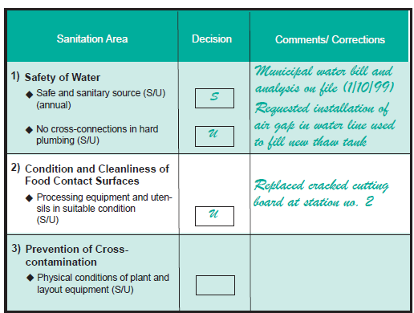
Explain: MONTHLY Sanitation Control Records
Page 2-5

Slide 53
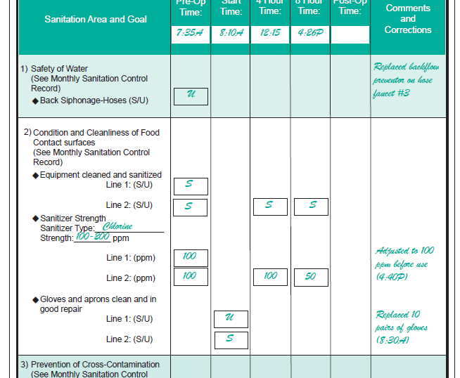
Explain: DAILY Sanitation Control Records
Page 2-6

Slide 54
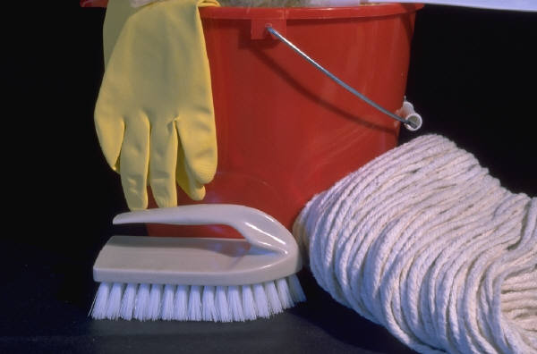
2-9. General Requirements for Food Contact Surface
◆ Safe Material --
● Non-toxic (no leaching of chemicals);
● Non-absorbent (can be drained and/or dried);
● Resist corrosion; and
● Inert to cleaning and sanitizing chemicals.
◆ Fabrication --
● Can be adequately cleaned and sanitized; and
● Smooth surfaces including seams, corners, and
edges.

Slide 55
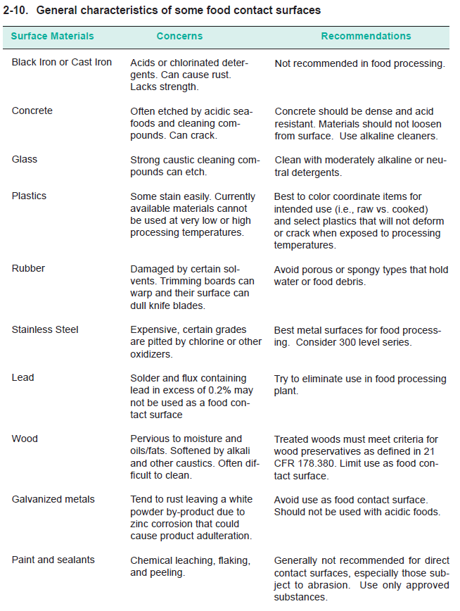
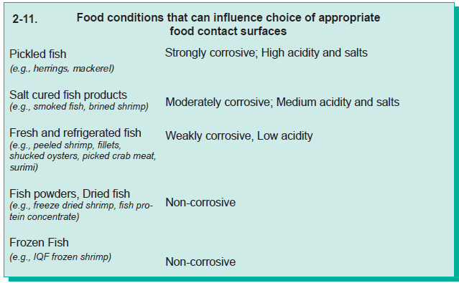
Explain:
General characteristic of some food contact surfaces and food conditions (pages 2-8 thru 2-9)

Slide 56
AVOID !
2-12. Food contact surface materials which
normally should be avoided if feasible:
Wood (microbial concerns);
Ferrous metals (corrosion concerns);
◆ Brass (variable corrosion resistance and product quality
concerns); and
◆ Galvanized metal (corrosion and chemical leaching
concerns).
Note: Certain state regulations may prohibit use of these
materials as food contact surfaces in processing operations.

Slide 57
2-13. Storage of Clothing and Gloves:
◆ Store clothing and gloves in clean and dry
locations;
◆ Ensure that clothing and gloves are not exposed
to splash, dust or other contaminants; and
◆ Store clean garments separately from soiled
garments and gloves.

Slide 58
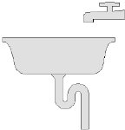
2-14. Design and Install Food Contact
Equipment to:
◆ Drain and not entrap soils;
◆ Provide access for cleaning and inspection; and
◆ Withstand plant environment.

Slide 59
5 Steps!
2-15. Five Steps of Cleaning and Sanitizing:
1. Dry-clean;
2. Pre-rinse;
3. Detergent application, then;
4. Post-rinse; and
5. Sanitizing.

Slide 60
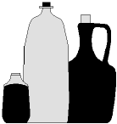
2-16. Types of Detergents:
◆ General Purpose (GP);
◆ Alkaline;
◆ Chlorinated (chlorinated alkaline);
◆ Acid; and
◆ Enzyme

Slide 61
2-17. A detergent’s effectiveness varies with:
◆ Contact time;
◆ Temperature;
◆ Physical disruption (scrubbing); and
◆ Water chemistry.

Slide 62
2-18. Detergent application methods:
◆ Soak tanks;
◆ Foam;
◆ Automated systems;
CIP (clean-in-place); and
parts washers
◆ Manual (pails).

Slide 63
2-19. Example Cleaning Procedures:
A processor applies an alkaline foam detergent to equipment every day. The detergent is allowed to stand and then is rinsed without scrubbing. Actual scrubbing with brushes or pads takes place only once
each week.

Slide 64
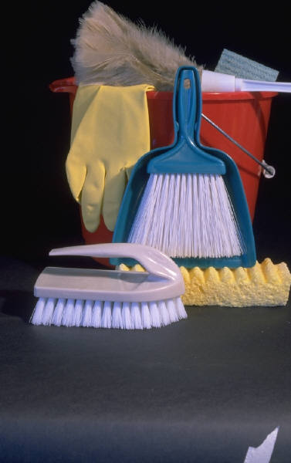
2-20. Physically removing soils:
◆ Brushes -- proper stiffness;
◆ Pads -- proper cutting properties; and
◆ Pressure spray -- moderate pressure.

Slide 65
2-21. Pads, brushes and brooms should be
dedicated to tasks for which they are
designed:
◆ Optimizes cleaning effectiveness; and
◆ Minimizes cross-contamination between areas
of the plant.

Slide 66
2-22. Cleaning aids which retain water, such
as sponges, wiping cloths and mops
should not be used for routine cleaning in
processing plants.

Slide 67
5 Steps!
2-15. Five Steps of Cleaning and Sanitizing:
1. Dry-clean;
2. Pre-rinse;
3. Detergent application, then;
4. Post-rinse; and
5. Sanitizing.
https://www.youtube.com/watch?v=YRwxG7LY5vM

Slide 68
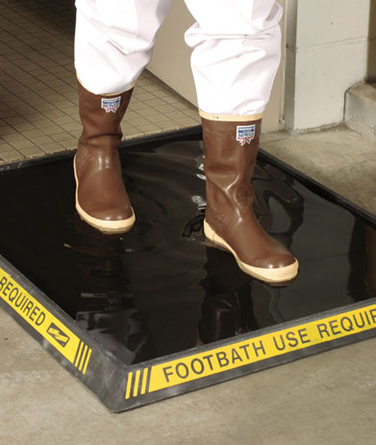
2-24. Sanitizer Mixing and Application:
In-line proportioners/applicators;
Station proportioners/applicators;
● Hand and footbath sanitizers;
Foamers;
Tank sprayers (low pressure); and
◆ Dips.

Slide 69
2-25. Sanitizer Concentrations Used in Food Plants
Sanitizer | Food Contact Surface | Non-Food Contact Surfaces | Plant Water
Chlorine | 100-200* ppm | 400 ppm | 3-10 ppm
Iodine | 25 * ppm | 25 ppm
Quats | 200* ppm | 400-800 ppm
Chlorine dioxide | 100-200*† ppm | 100-200† ppm | 1-3† ppm
Peroxyacetic acid | 200-315* ppm | 200-315 ppm
The higher end of the listed range indicates the maximum concentration permitted without a required rinse (surfaces must drain) † Includes mix of oxychloro compounds Source: 21 CFR 178.1010

Slide 70
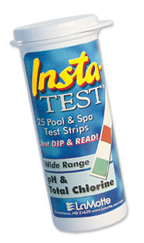
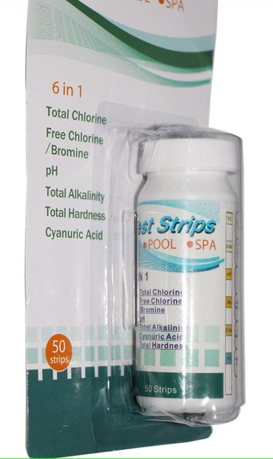
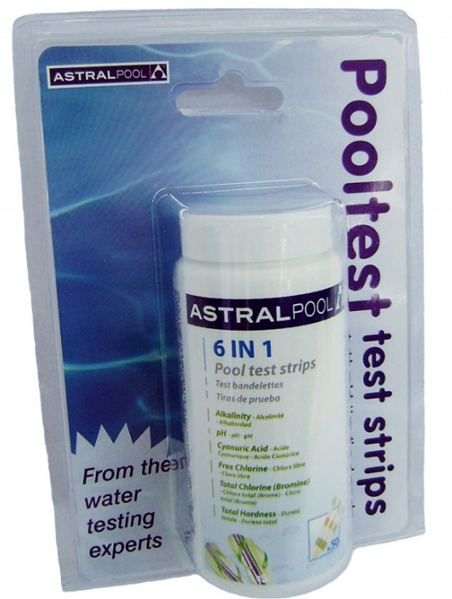
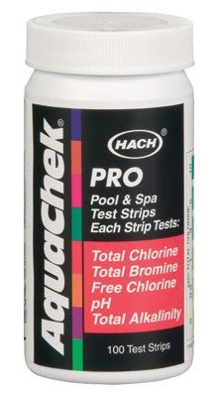
pH and Chlorine Test Strips

Slide 71
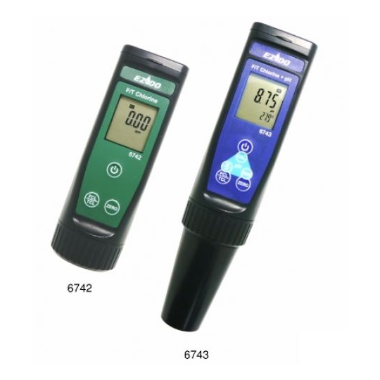
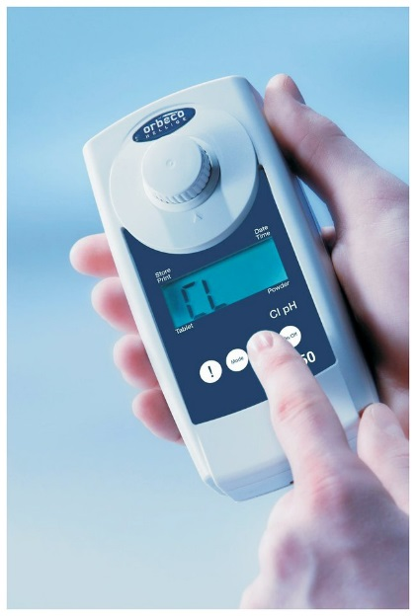
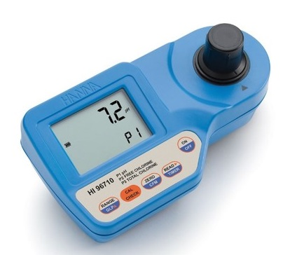
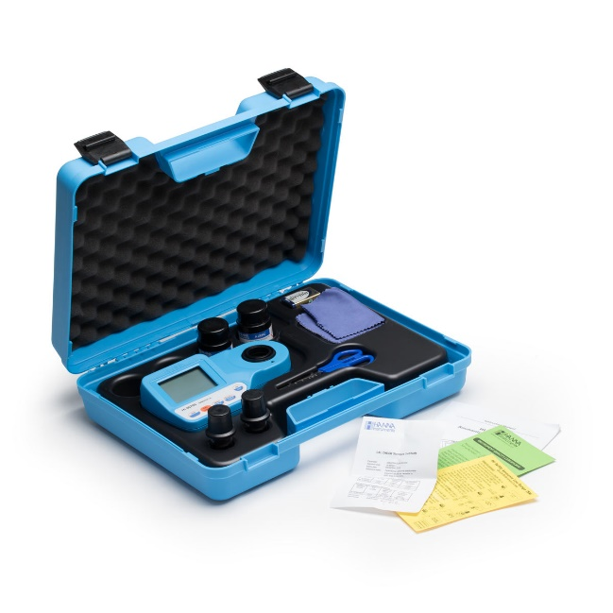
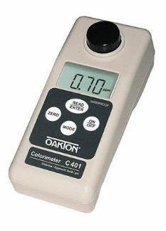
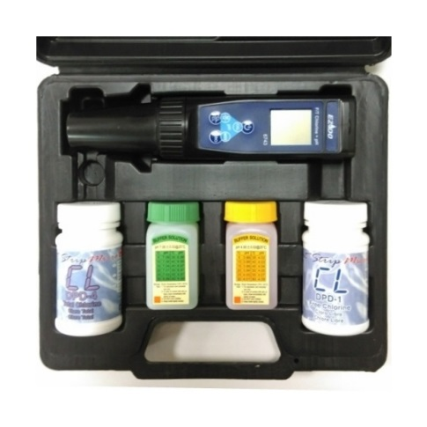
pH, Free Chlorine, and Total Chlorine

Slide 72
Explain:
Common types of Sanitizers (pages 2-22 thru 2-23)

Slide 73
2-27. Periodic Confirmations for Sanitization:
◆ Microbiological Enumeration;
● Contact plates
● Swabs; and
◆ Luminometry.

Slide 74
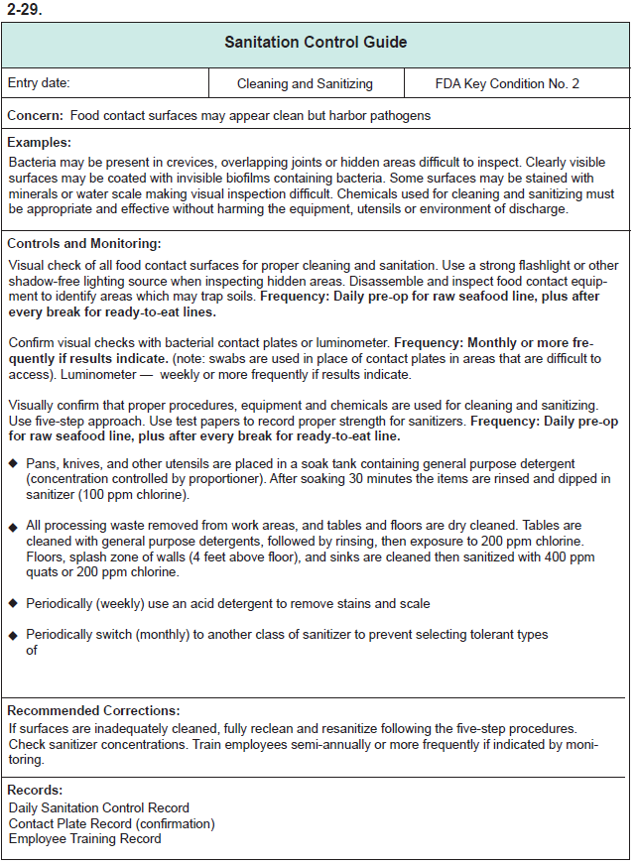
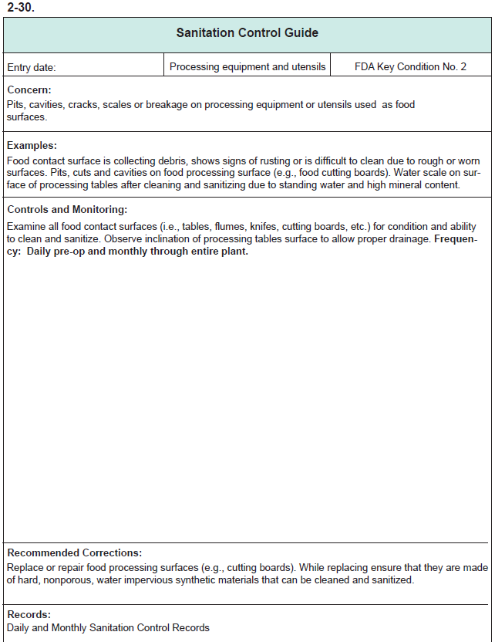
Explain: Sanitation Control Guide
pages 2-29 thru 2-30

Slide 75
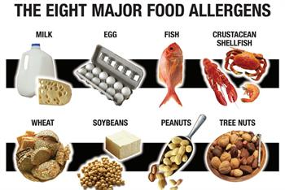
New requirement 21 CFR Part 117
Discuss related concerns and controls for cross-contact with potential food allergens

Slide 76

What is Cross-Contact?
Associated with allergens
Cross-contact is the inadvertent introduction of an allergen into a product.
It is generally the result of environmental exposure during processing or handling, which may occur when multiple foods are produced in the same facility.
It may occur due to use of the same processing line, through the misuse of rework, as the result of ineffective cleaning, or from the generation of dust or aerosols containing an allergen.

Slide 77
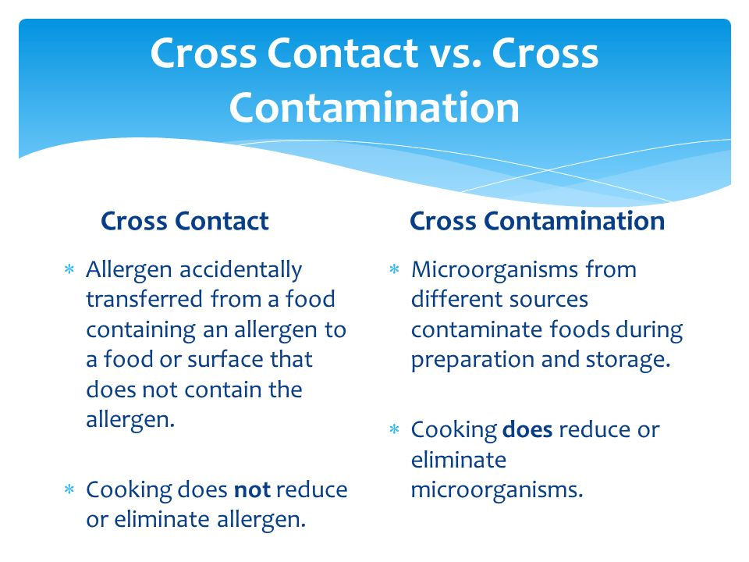

Slide 78
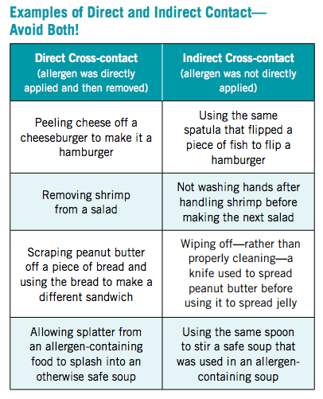

Slide 79
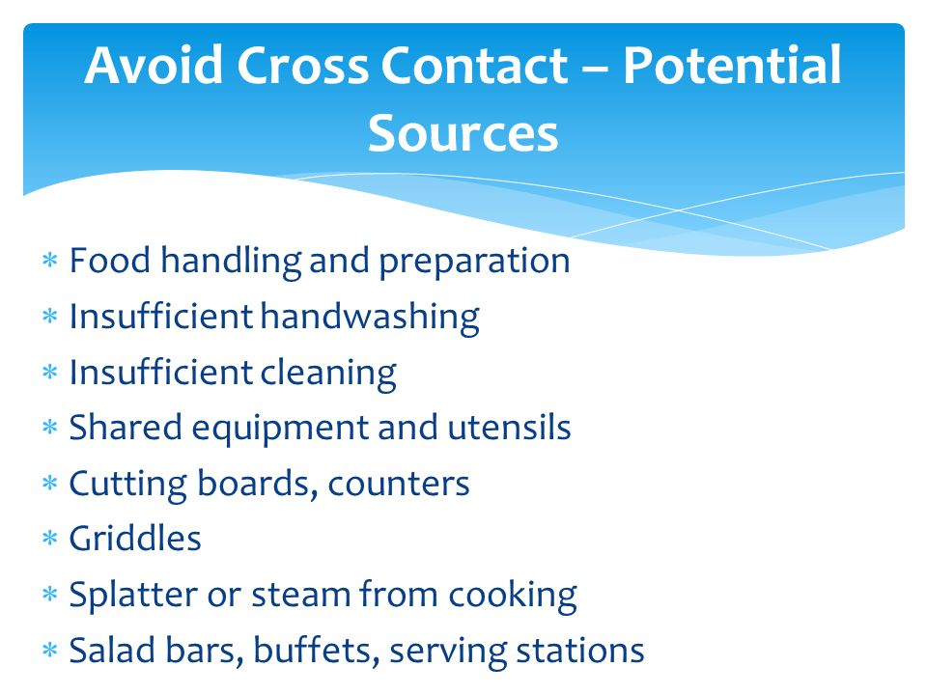

Slide 81

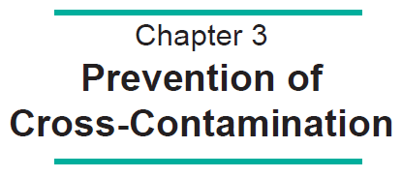

Slide 82
3-1. Key Sanitation Condition No. 3:
◆ Employee ‘practices’ to prevent
cross-contamination;
Separation of raw and ready-to-eat foods; and
◆ Plant design to prevent cross-contamination.

Slide 83
3-2. Cross-Contamination:
Cross-contamination is the transfer of biological or chemical contaminants to food products from raw foods, food handlers, or
the food handling environment. The type of cross-contamination most frequently implicated in foodborne illness occurs when pathogenic bacteria or viruses are transferred to ready-to-eat foods.

Slide 84
3-3. Goal:
To prevent cross-contamination from insanitary objects to food, food-packing materials and other food-contact surfaces, including utensils, gloves and outer garments, and raw product to cooked product or ready-to-eat products.

Slide 85
3-4. Common Daily Sanitation Practices
to Prevent Cross-Contamination
Adequate separation of raw and cooked or ready-to-eat product handling or processing activities;
Adequate separation or protection of products in storage;
Food handling or processing areas and equipment adequately cleaned and sanitized;
Employee hygiene, dress and hand washing practices;
Employee food handling practices and utensils; and
Employee traffic or movement about the plant.

Slide 86
3-5. Examples of Poor Employee Practices:
Handling raw product, then handling cooked product;
Working near or on the floor, then handling product;
Returning from restrooms without washing hands;
Shovel used to handle floor waste, also used to handle product;
Scratching face, then handling product; and
Touching unclean cooler door handle, then handling product.

Slide 87


3-6. Corrections for Cross-contamination:
Stop activities, if necessary, until the situation is corrected;
Take steps to prevent contamination from re-occurring;
Evaluate product safety and, if necessary, divert,
reprocess or discard affected products; and
Document what corrections were taken.

Slide 88

3-7. Continuous monitoring for
Cross-contamination:
Although the recording from may list designated periods for checks (e.g., morning and afternoon shift),concerns
for cross-contamination should extend through the entire work day.

Slide 89
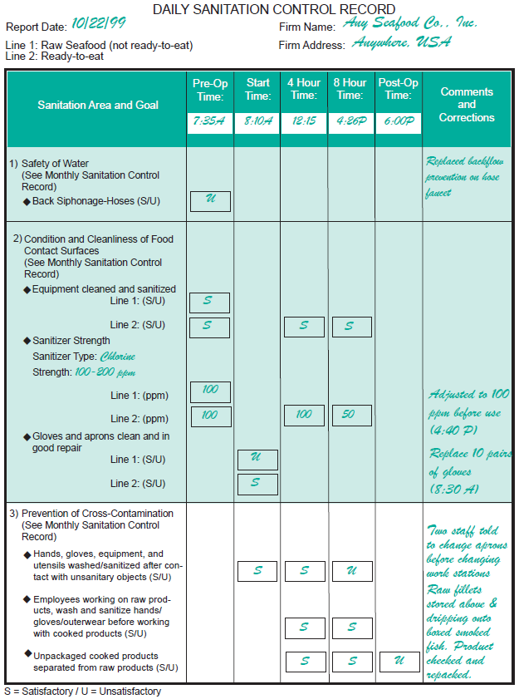
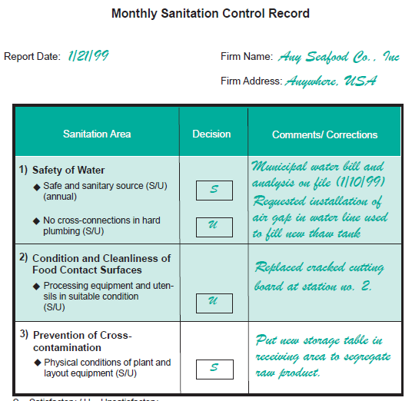
Explain:
Daily and Monthly Sanitation Control Records
(pages 3-6 thru 3-7)

Slide 90
3-10. Typical raw or ready-to-eat seafood that
will not be cooked before they are eaten:
Cooked shrimp and other cooked shellfish
Smoked fish or shellfish;
Dried, pickled or cured fish or shellfish;
Surimi products;
Seafood salads;
Heat and serve entrees;
Molluscan shellfish to be eaten raw; and
Finfish to be eaten raw (sashimi or sushi).

Slide 91
3-11. Sources of pathogens that could
cross-contaminate finished products:
Seafood handlers and other plant personnel;
Raw seafood;
Equipment or utensils; and
Processing plant environment.

Slide 92
3-12. Goal:
To ensure that product handling and/or
processing procedures prevent the
cross-contamination of seafood products
by raw materials, ingredients or
processing operations.

Slide 93
3-13. Separate raw and ready-to-eat products:
When receiving products or ingredients;
During processing of handling operations;
During storage; and
During shipping.

Slide 94
3-14. Prevent cross-contamination during
processing by:
◆ Designating separate areas for handling
raw and ready-to-eat products;
Controlling the movement of equipment
from one area to another; and
Controlling the movement of employees
from one area to another.

Slide 95
3-15. Goal:
Prevent cross-contamination of seafood products by ensuring that employees follow proper personal hygiene and hand washing practices.
3-16. Employee hygiene practices:
◆ Hand washing;  Jewelry;
◆ Hair/beards;  Footwear;
◆ Eating, drinking, smoking, etc.; and
◆ Other – perspiration, cosmetics, medicine.

Slide 96

3-17. Reason for a Hand Washing Program:
Many employees do not routinely wash their hands;
Hand washing is not conducted properly; and
Many employees do not understand the importance
of hand washing.

Slide 97
3-18. How to wash hands:
Remove jewelry;
Wet hands with warm water (110º F);
Lather and rub using warm water;
Rinse;
Dry with disposable paper towels; and
Avoid recontamination.

Slide 98
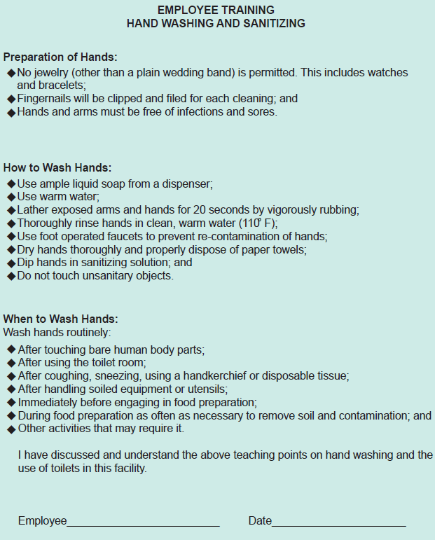
Explain:
Employee orientation for hand washing and sanitizing requirement (page 3-16)

Slide 99
3-19. When to wash arms and hands:
After touching bare human body parts other than clean
hands and clean exposed portions of arms;
After using the toilet room;
After coughing, sneezing, using a handkerchief or disposable tissue, using tobacco, eating, or drinking;
After handling soiled equipment or utensils; and;
During food preparation, as often as necessary to remove soil and contamination and to prevent cross-contamination when changing tasks.

Slide 100
3-19. Management’s role:
Set policies that outline personal hygiene expectation;
Set policies for employees with an illness (Chapter 7);
Training;
Monitoring and enforcement; and
Provide adequate employee facilities.

Slide 101
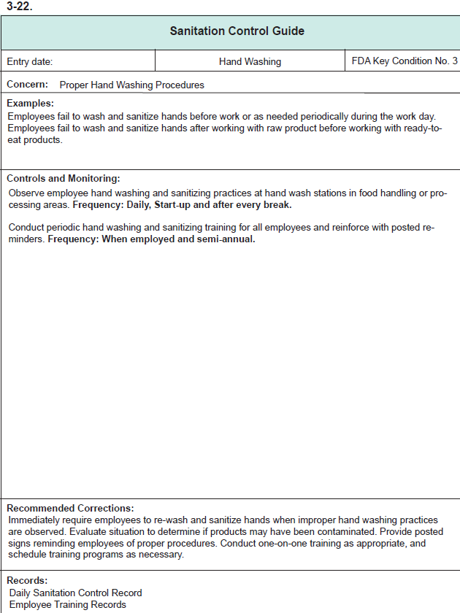
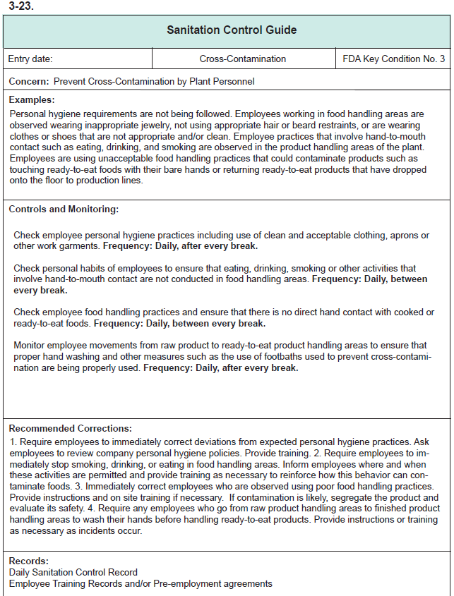
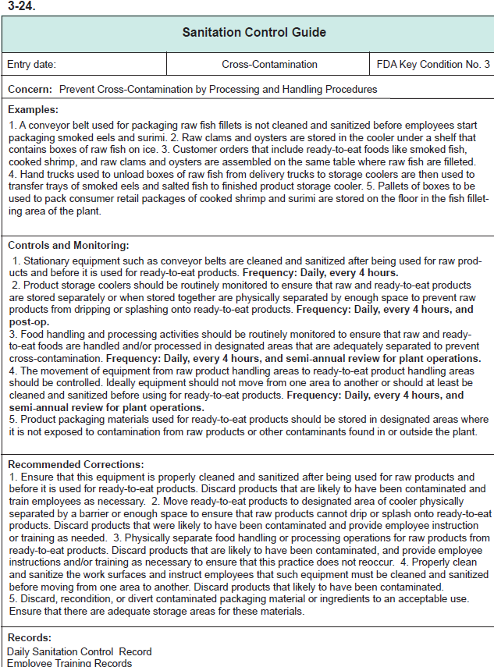
Explain: Sanitation Control Guide
pages 3-18 thru 3-20 thru 2-30

Slide 102
New requirement 21 CFR Part 117
Discuss related concerns and controls for cross-contact with potential food allergens
What is cross-contact?
The inadvertent introduction of an allergen into a product.
How does cross-contact occur?
  It is generally the result of environmental exposure during processing or handling, which may occur when multiple foods are produced in the same facility.
  It may occur due to use of the same processing line, through the misuse of rework, as the result of ineffective cleaning, or from the generation of dust or aerosols containing an allergen.

Slide 103
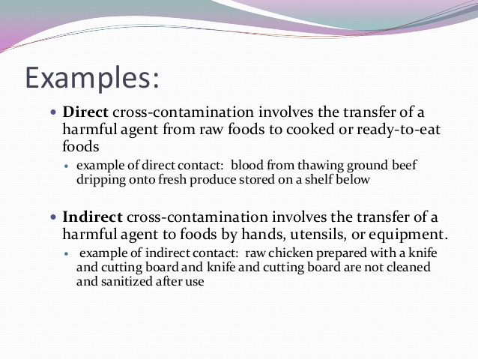

Slide 105
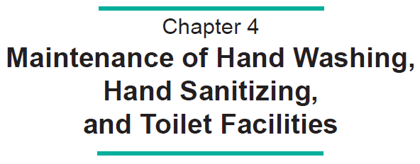

Slide 106
4-1. Key Sanitation Condition No. 4:
◆ Condition of hand washing facilities;
◆ Condition of hand sanitizing facilities; and
Condition of toilet facilities.
4-2. Goal:
To support a necessary hand washing program to prevent the spread of filth and potential pathogenic organisms about the processing area or to foods.

Slide 107

4-3. Recommended monitoring for hand
washing, hand sanitizing and
toilet facilities:
◆ Condition of hand washing facilities;
◆ Condition of hand sanitizing facilities; and
Condition of toilet facilities.

Slide 108
4-4. Corrections:
◆ Fix or replenish supplies in toilets and hand wash stations;
Discard and make up new hand sanitizer solutions if concentration is incorrect;
Record observations of corrections taken when unsatisfactory conditions are observed; and
◆ Repair improperly working toilets.

Slide 109
4-5. Records for the condition of facilities
to clean and sanitize hands, and for
toilets:
Condition and location of hand washing stations or sinks, and toilet facilities;
Condition and availability of hand sanitizer stations, sinks or dips;
Concentration of hand sanitizers; and
Corrections taken when unsatisfactory conditions are observed.

Slide 110
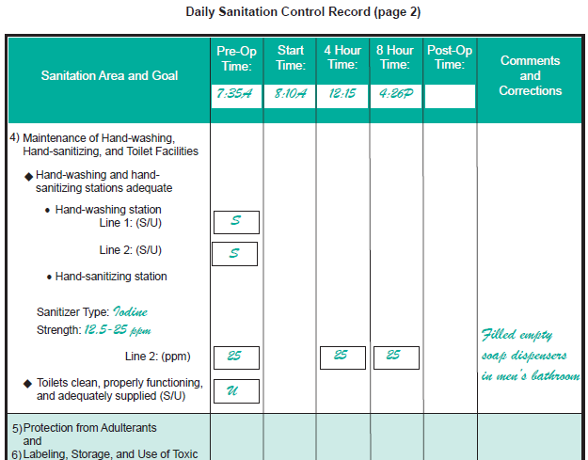
Explain:
Daily Sanitation Control Records (page 4-5)

Slide 111
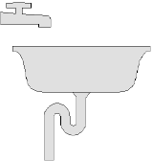
4-7. Recommendations for Hand Washing
Facility:
◆ Clean at all times;
Strategically located as per regulations, near
bathrooms and entrances to the processing area;
Dedicated to hand washing only;
Liquid soap in dispenser;
Hot water (43º C or 110º F);
Use of disposable paper towels or air blowers; and
Adjacent hand sanitizing facilities.

Slide 112

4-8. Hand Sanitizing Facilities:
Proper sanitizer concentrations with strengths of 100 - 200 ppm chlorine, or 12.5-25 ppm iodine;
Frequent monitoring and changes to maintain proper concentrations; and
Conveniently located to encourage employee use but to avoid contact with foods.

Slide 113

Explain: Sanitation Controls Guide (page 4-9)

Slide 115


Slide 116
5-1. Key Sanitation Concern No. 5:
To ensure that the food, food-packaging material and food contact surfaces are protected from various microbiological, chemical and physical contaminants, such as lubricants, fuel, pesticides, cleaning compounds, sanitizing agents, condensate and floor splash.

Slide 117
5-2. Definition: Adulterated Food:
◆ If it (food) bears or contains any poisonous or deleterious substance which may render it injurious to health; . . .
If it (food) has been prepared, packed, or held under insanitary conditions whereby it may have become contaminated with filth, or whereby it may have been rendered injurious to health;
Source: Section 402 of the Food, Drug and
Cosmetic Act, items (a) 1and (a) 4

Slide 118
Types of Adulterants
Microbial, Chemical and Physical Contaminants
Condensates
Pooled or standing water
Chipping paint
Rust
Glass
Cleaning and sanitizing compounds
Lubricants, grease
Fuel
Pesticides

Slide 119
5-3. Goal:
To ensure that the food, food-packaging material and food contact surfaces are protected from various microbiological,chemical and physical contaminants.

Slide 120
5-4. What to Monitor:
Any possible adulterant that could contaminate
the food or food contact surfaces including:
Potential toxic compounds; and
Insanitary water (e.g., condensate forming on insanitary surfaces and standing pools of water).

Slide 121
5-5. When to Monitor:
With sufficient frequency to ensure conformance;
Recommend at start-up and every four hours during
work hours; and
◆ Observe conditions and activities throughout the day.

Slide 122
5-6. Possible Corrections:
Remove condensate from insanitary surfaces;
Correct air flow and room temperatures to reduce condensation;
Install covers to prevent condensation from falling on food, packaging materials or food contact surfaces;
“Squeegee” floor to remove standing water;
Direct foot or vehicle traffic around pools of standing water;
Wash food contact surfaces inadvertently exposed to chemical adulterants;
Erect screens to protect product when working with a toxic compound in a non-product area;
Evaluate impact of improper use of toxic compounds to assess whether or not food has been contaminated;
Reinforce training of employees to correct inappropriate activities; and
Discard unlabeled chemicals.

Slide 123

Examples of problems
Where are the problems?
What to monitor?
How to correct deficiencies; and
Document

Slide 124
Monitoring and Correction Records
  Monitoring and corrections to sanitation deficiencies must be documented.
  Records available for State/Federal Inspection
  Name, location, date and time of activity, signature of
  the person performing the monitoring , other information

Slide 125

If condensation is observed
Possible Corrections ?

Slide 126

5-8 Sanitation Control Guide
Monitoring
What
How
Frequency
Recommended Corrections

Slide 127



5-7 Daily Sanitation Control Record
  Monitoring of sanitation observations
  Frequencies
  Corrections taken
  Satisfactory
  S, Pass, Yes,
  Unsatisfactory
    U, Fail, No,
      Must have a correction written on the records

Slide 128

Remove condensate from affected area and then remove affected product
Remove condensate from affected area and record the results in monitoring record
Remove product; Remove condensate from affected area; evaluate affected product; and record results in monitoring record;
Condensation is found above the area where food is being processed. You should do the following:

Slide 130


Slide 131

6-1. Key Sanitation Condition No. 6:
Proper labeling, storage and use
of potential toxic compounds.
6-2. Goal:
To ensure that the labeling, storage
and use of toxic compounds are
adequate to protect food from contamination.

Slide 132
6-3. ‘What’ to Monitor:
Are toxic compounds:
properly labeled?
properly stored?
properly used?

Slide 133


Types of Toxic Compounds
Cleaners
  Hand soaps, Acid cleaners, floor, wall cleaners
Sanitizers
Machine Lubricants
Degreasers
Pesticides
Non-food grade chemicals

Slide 134


6-4. Proper Labeling of Containers:
Original container labels should show:
-Name of compound or solution in
container;
-Name and address of manufacturers
or “Manufactured for” or “Packed for”
or “distributed by” and appropriate
approvals; and
-Instructions for proper use.
Working container labels must show:
-Name of compound or solution in the
container; and
-Instructions for proper use.

Slide 135

6-5. Proper Storage of Toxic Compounds:
room with limited access;
segregate food grade from non-food grade; and
keep away from food equipment, utensils and
other food contact items

Slide 136
6-6.
Containers used to hold cleaners
and sanitizers must not be food
containers that could inadvertently
be used to pack a food product.
NEVER !

Slide 137

6-7. Proper Use of Compounds:
◆ According to manufacturer’s Instructions;
and
Procedure will not result in adulteration of products.
Manufacturer’s
Instructions

Slide 138
6-8. ‘When’ to Monitor:
◆ with sufficient frequency to ensure conformance;
recommend at least once per working day; and
observe conditions and activities throughout the day.

Slide 139
6-9. Possible Corrections
◆ move incorrectly stored toxic compounds;
return to supplier if inadequately labeled;
correct labeling;
destroy damaged containers;
assess safety of food; and
reinforce training of employees.

Slide 140
Monitoring and Correction Records
  Monitoring and corrections to sanitation deficiencies must be documented.
  Records available for State/Federal Inspection

Slide 141

Explain: Daily Sanitation Records (page 6-8)

Slide 142


Explain: Sanitation Control Guide (page 6-12)
Monitoring
What
How
Frequency
Recommended Corrections

Slide 143
Labeling of cleaning compounds should have the following information:
Name of the compound and instructions
for use
Name and address of manufacturer.
All of the above

Slide 144


Any Problems with this product?

Slide 146


Slide 147

7-1. Key Sanitation Condition No. 7:
Manage persons who are diagnosed with or have symptoms of an illness, wounds or other afflictions that could be a source of microbial contamination.

Slide 148
7-2. Goal:
The primary goal of monitoring employee health is to control conditions that could result in the microbiological contamination of food, food packaging materials, and food contact surfaces.
7-3. Common Symptoms and Conditions to be
Aware of in Processing Plant Employees:
◆ diarrhea  sore throat with fever
◆ fever  open skin sores or cuts;
◆ vomiting  boils ♦ dark urine
◆ jaundice (yellow skin or eyes);

Slide 149


Slide 150
Reportable Symptoms
Diarrhea
Vomiting
Jaundice
Sore throat with fever
Infected cuts or wounds on
exposed body part

Slide 151
7-7. Management responsibilities concerning
employee health:
Set company policy – when to restrict or exclude an ill employee and when to allow such an employee to return to work;
Set company policy – health and personal hygiene;
Provide a good example;
Monitor employees;
Provide proper design and
maintenance of facilities, and
Provide training.

Slide 152
Exclude vs. Restrict
Include in your company policy
Exclude-- prevent a person from working in a food establishment
Restrict-- limit activities of employee--does not work with exposed food or FCS

Slide 153
7-8. Personnel Responsibilities:
Maintain good health;
Report illness;
Wash hands after sneezing, coughing, scratching, etc.; and
Be aware of conditions that might cause contamination.

Slide 154

Explain: Daily Sanitation Control Records
(page 7-4)

Slide 156


Slide 157
8-1. Key Sanitation Condition No. 8:
No pests in the food processing plant.
8-2. Foodborne illnesses that may be
passed on by pests are numerous:
♦ Flies and cockroaches may transmit Salmonella, Staphylococcus, C. perfringens, C. botulinum, Shigella, Streptococcus, and others;
Rodents are sources for Salmonella and parasites; and
Birds are hosts for pathogens such as Salmonella and Listeria

Slide 158



8-3. Goal:
Monitoring must confirm that pests are excluded
from relevant areas of the plant to the extent
possible and should also confirm that procedures
are followed to prevent infestation.

Slide 159
8-4. Monitoring for exclusion of pests:
Visually inspect for presence of pests in processing areas;
Use flashlight to expose potential hiding places and to check traps; and
Maintain good housekeeping to facilitate inspections.

Slide 160
8-5. Corrections
Example
Observation: After pesticide and trap use, flies
re-enter processing areas
Correction: Add air curtain above outside door
and move waste storage container
away from door

Slide 161
8-7. Three phase pest control program:
1. Elimination of shelter and attractants;
2. Exclusion of pests from the food plant; and
3. Extermination of those pests that gain entry.

Slide 162
8-8. Complete Pest Exclusion Program:
Required Monitoring
Presence / Absence of Pests.
Related Conditions
Plant and Grounds;
Structure and Layout;
Plant Machinery, Equipment and Utensils;
Housekeeping;
Waste Disposal; and
Use of Pesticides and other Control Measure.

Slide 163


8-9. Example Pest Control Checklist (not required):
Plant and Grounds
Are the grounds clear of weeds, tall grass, brush, and debris to minimize cover for pests to approach and enter the facility?
Is there standing water on the grounds which may attract pests?
Are traps sufficient in number, well maintained and in good repair?
Are there signs of the presence of domestic animals or large feral animals (including but not limited to dogs, cats or raccoons)?
Grounds clear of weeds, tall grass, brush, and debris to minimize cover for pests to approach and enter the facility

Slide 164

8-10. Example Pest Control Checklist
Building / Facility
Do windows and doors seal tightly to prevent entry of pests or contaminants?
Do windows have screens in good repair to keep out insects?
Are there openings of 1/4-inch or greater that will allow entry of rodents and insects?
Are drains properly cleaned and free of buildup that may act as an attractant to rodents and other pests?
Is there sufficient clearance space (six-inch minimum between walls and equipment) to inhibit rodent activity?
Are drain covers in good repair and properly fitted?

Slide 165
8-11. Example Pest Control Checklist
Plant Machinery, Equipment and Utensils
Are machinery, equipment and utensils properly cleaned and sanitized to eliminate the build-up of food or other static materials that may act as an attractant to pests?
Is there sufficient space along the process line to allow for proper cleaning and sanitizing?
Are there any “dead spaces” which may allow for the build-up or collection of food and other debris acting as attractant or harborage of insects and bacteria?
Are blacklight units maintaining the proper light intensity levels to attract flying insects?
Are blacklight electrocution devices properly set up?
Are the blacklight electrocution device catch basins cleaned out regularly?

Slide 166
8-12. Example Pest Control Checklist
Housekeeping
Is trash, debris and clutter picked up eliminating cover for pests?
Are personnel locker rooms and break rooms cleaned and sanitized to inhibit the attractions of rodents and other pests?
Are there signs of rodent, insect, or bird habitation, e.g., droppings, hair, feathers, gnaw marks, grease runs from rodent activity along walls, urine/ammonia odors?
Have previously noted indicators of pest habitation been cleaned up in order to note any new or continued activity?

Slide 167

8-13. Example Pest Control Checklist
Waste Disposal
Is waste material properly collected, stored and disposed of in order to inhibit the attraction of rodents and other pests?
Are waste bins, tubs and/or dumpsters properly cleaned and sanitized in order to inhibit the attraction of rodents other pests?

Slide 168
8-14. Categories of Pesticide Use:
1. General use insecticides; and
2. Restricted use insecticides.
8-15. Certification of Applicators:
1. Private applicator; and
2. Commercial applicator.

Slide 169
8-16. General Standards for Applicator Certification:
Label and labeling comprehension;
Safety;
Environmental factors and the consequence of use
and misuse of the pesticide;
Knowledge of pests; and
Knowledge of pesticides and types of
formulations, including the hazards associated
with residues.

Slide 170


Pest Control Monitoring
Equipment and Utensils
Blacklight units at the proper light intensity levels
Cleaned out regularly, and Properly set up

Slide 171


Pest Control Monitoring
Plant and Grounds
Problem: standing water, drain plugged
Correction: Provide maintenance; clean drain

Slide 172

Pest Control Monitoring
Buildings and Facilities
  Problem: holes could allow the entry of insects, rodents and other animals into the processing plant.
  Correction: repair holes

Slide 173


Pest Control Monitoring
Housekeeping
Problem: signs of rodent droppings, gnaw marks, etc.
Correction: dispose of residue, provide traps, call pest company

Slide 174
Monitoring and Correction Records
  Monitoring and corrections to sanitation deficiencies must be documented.
  Records available for State/Federal Inspection

Slide 175

8-17 Sanitation Control Guide
Monitoring
What
How
Frequency
Page 8-13
Recommended Corrections

Slide 176


Explain: Daily Sanitation Record (page 8-5)

Slide 177
Pests that should be monitored in the plant includes not only flies and roaches but also:
Dogs , cats, raccoons
Rodents
Birds
All of the above

Slide 178
The monitoring of pests includes:
    The conditions inside the plant (walls, doors, ceilings)
    The conditions outside the plant (trash, debris, pooled water)
    Conditions inside and outside of the plant and the
    results of the private pest control service
    A and B

Slide 179
Monitoring for pests in the processing plant is done by …
A commercial service. They will leave you a
record of their findings.
B. The plant is responsible for the monitoring.
C. All of the above

Slide 180

Example: SSOP Plan and
Sanitation Control Procedures
NEW EXAMPLES
Refer to the ‘Blue Book’
Chapter 2, Table 2…pages 30-40

Slide 181




Chapter 2 in the new edition of the Basic Seafood HACCP Training manual contains a new Example
SCP Plan and SSOP monitoring forms

